Slide 1
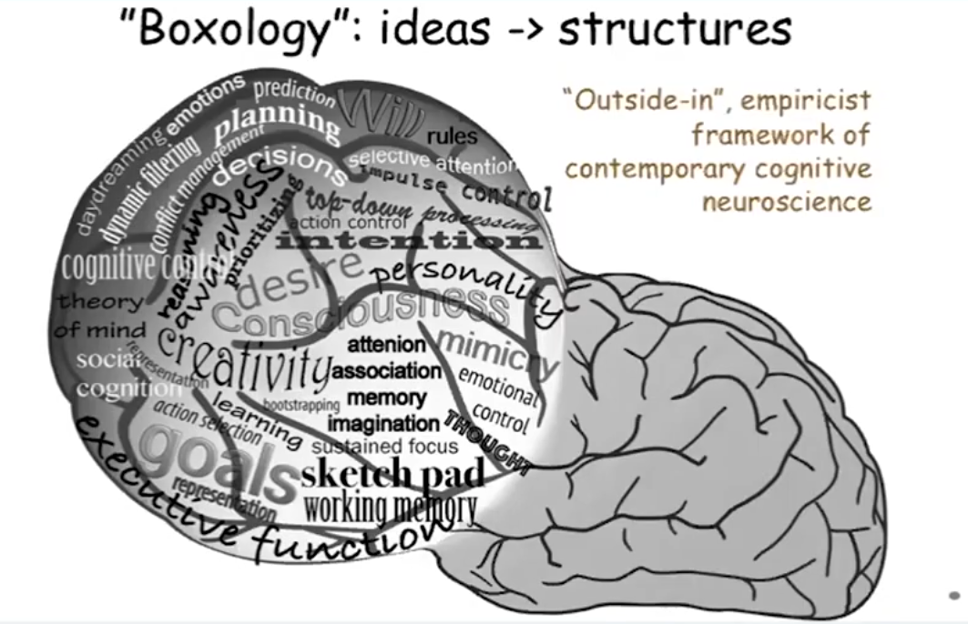
Notes:
Too many ideas!

Slide 2
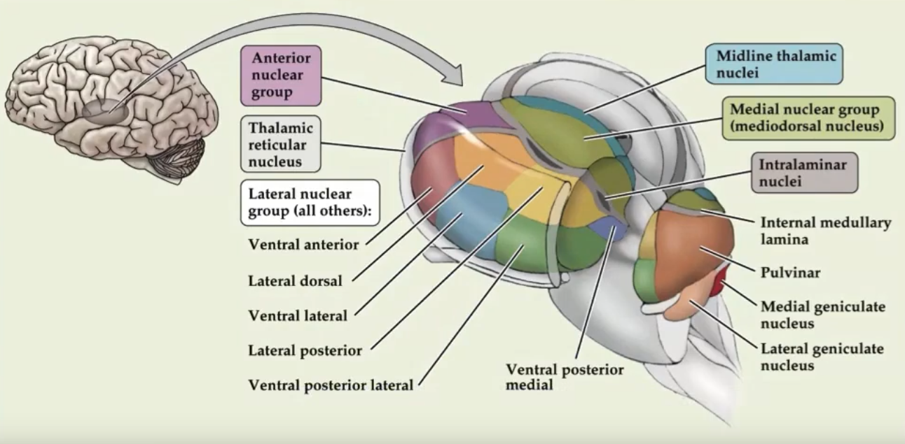

Slide 3
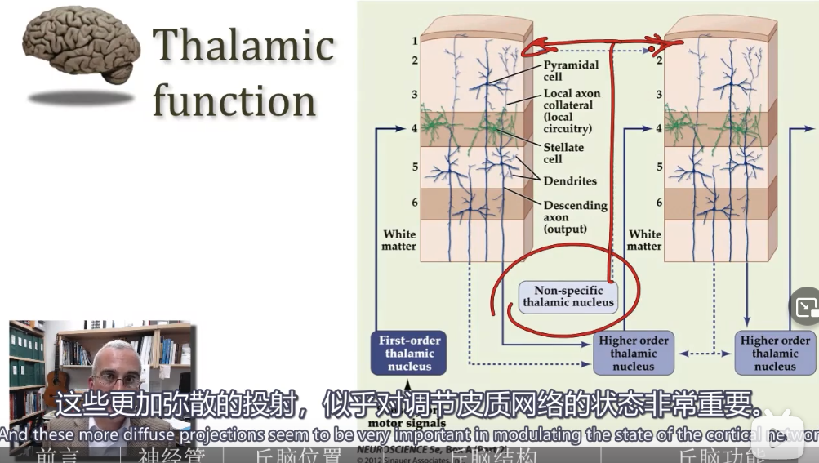
https://www.brainfacts.org/thinking-sensing-and-behaving/thinking-and-awareness/2021/psychedelics-open-a-new-window-on-the-mechanisms-of-perception-070821
Notes:
到处充满了这种奇怪的直接映射

Slide 4
the brain is a self- organized system with preexisting connectivity and dynamics whose main job is to generate actions and to examine and predict the consequences of those actions.

