Slide 1














Slide 2










Slide 3













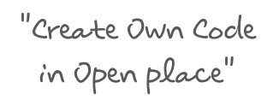





Slide 4



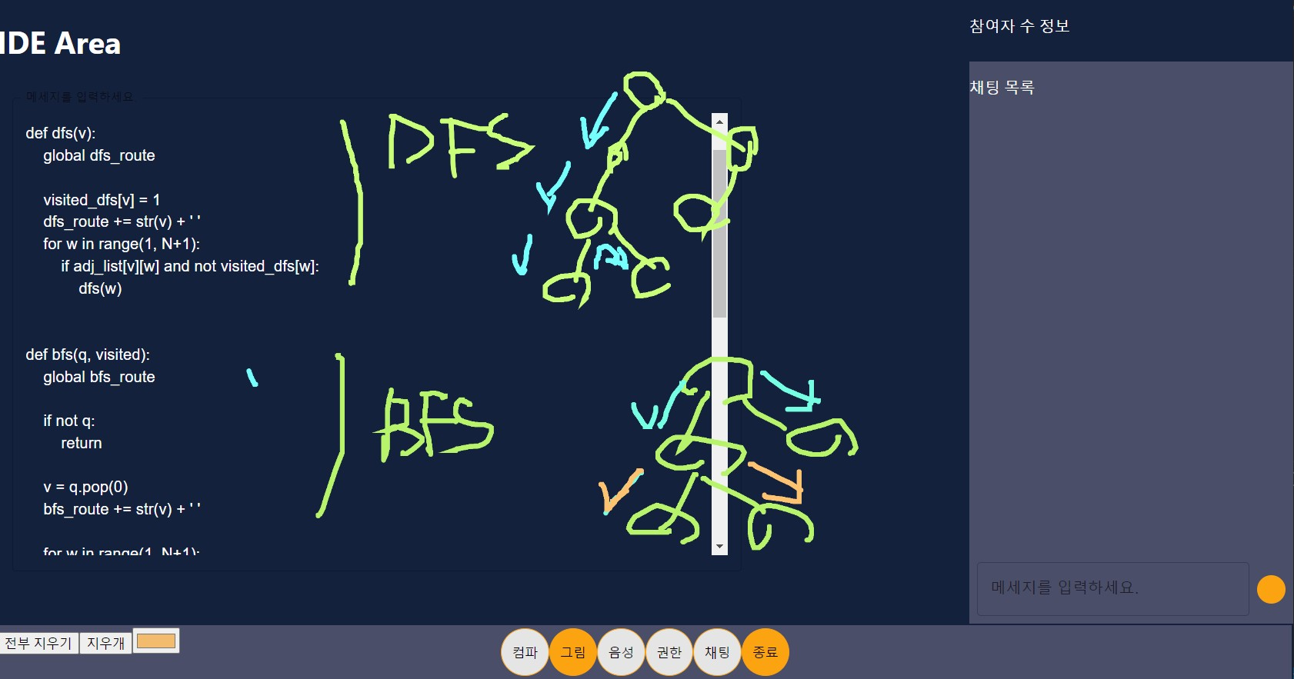






Slide 6










Slide 7










Slide 8
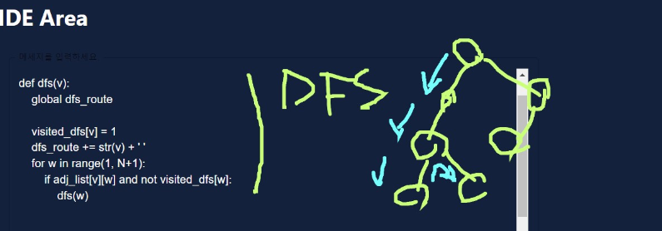
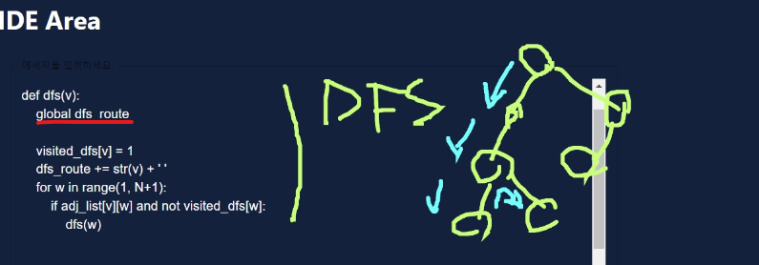



Client 1
Client 1
Client 1
MouseDown
MouseUp
MouseMove
(x,y)
(x,y)
Client etc
Client etc

Slide 10


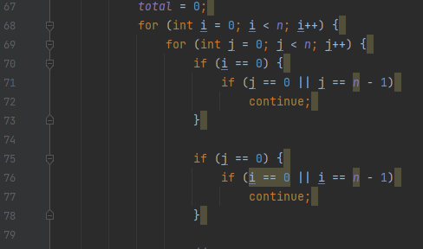



-code
-input
-expectedOutput
-isVisualization
Optional
-variable
-line
-iterationVector
-userId
1.output
String output
2.Images

Slide 11












