Slide 1
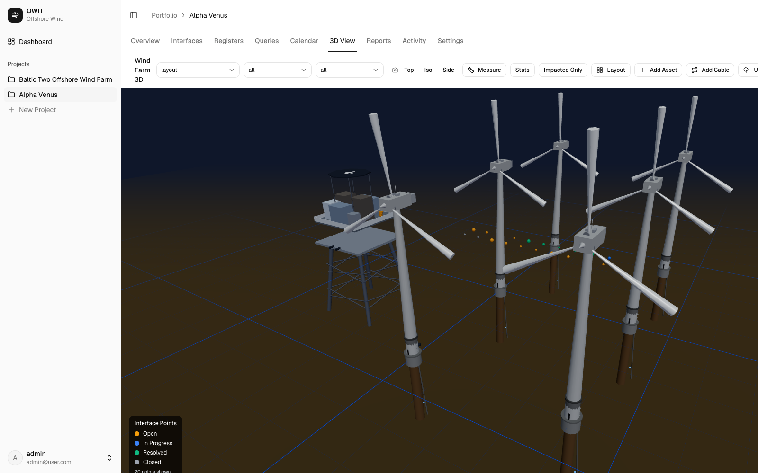
Interface Management Tool
Visibility Deck | Offshore Wind Project Execution
Current product state | Real application screenshots | April 2026

Slide 2
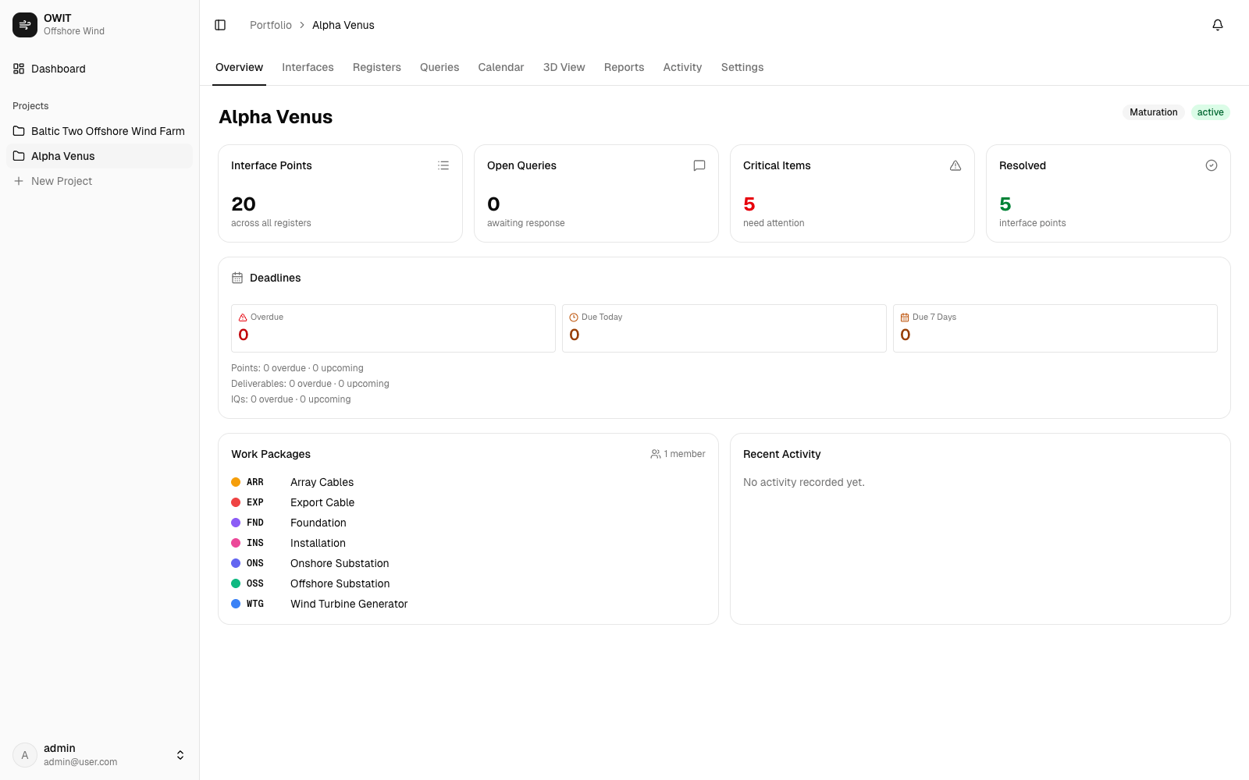
Project-level control is visible immediately from the overview cockpit

Slide 3
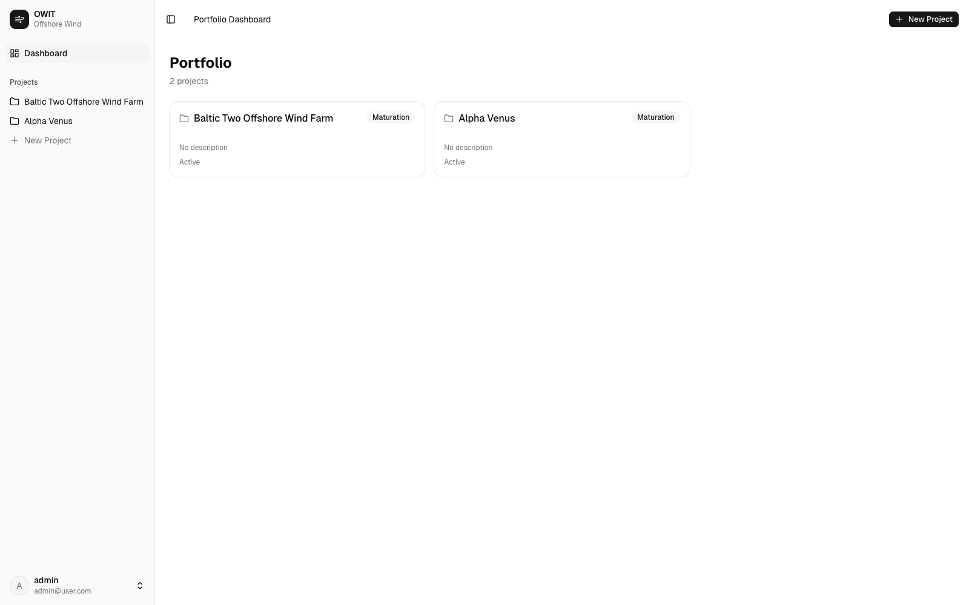
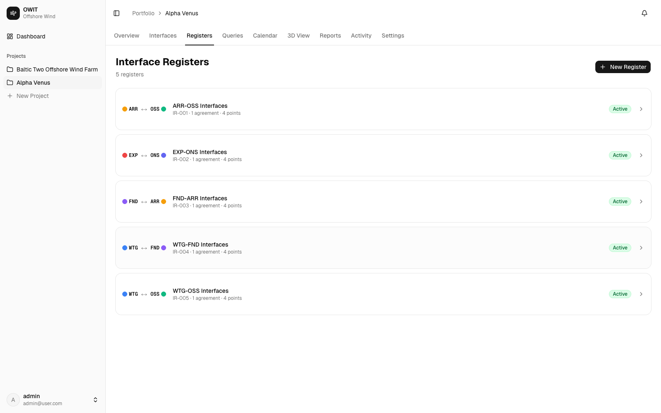
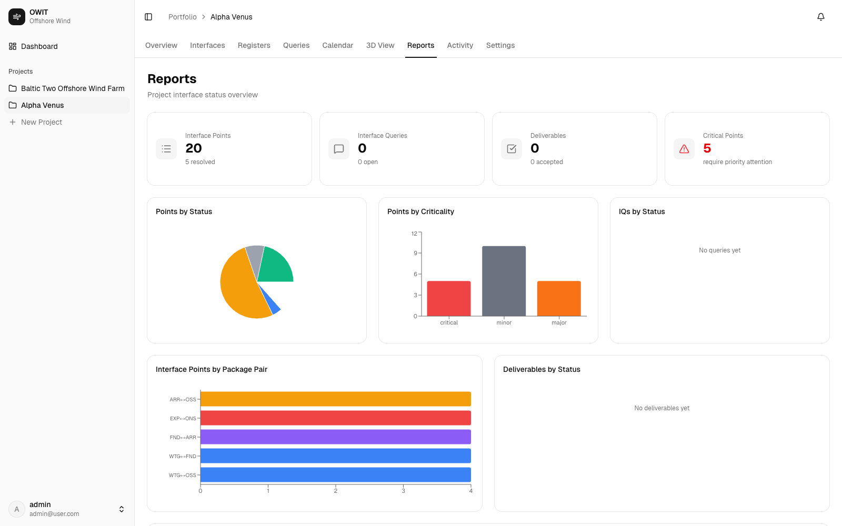
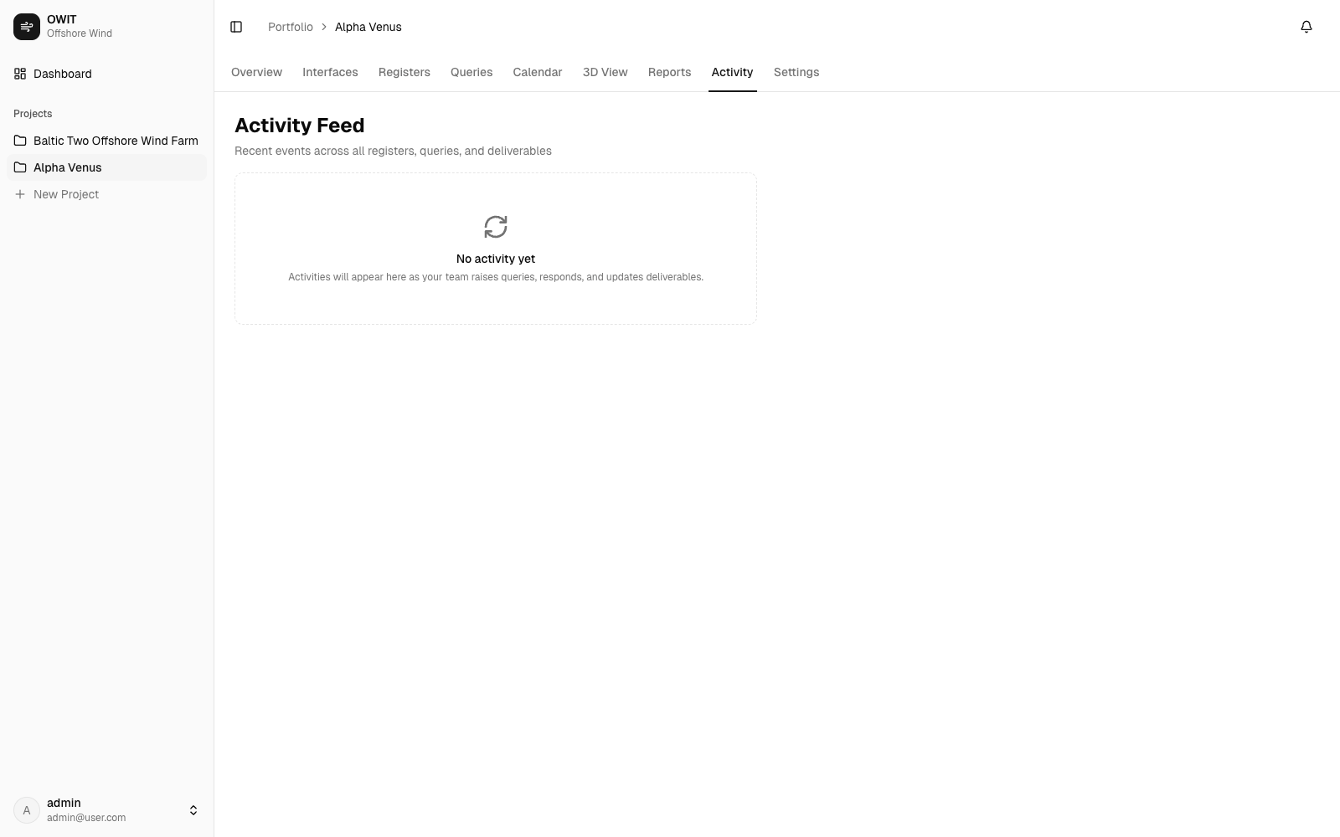
The tool provides broad operational coverage across the interface lifecycle

Slide 4
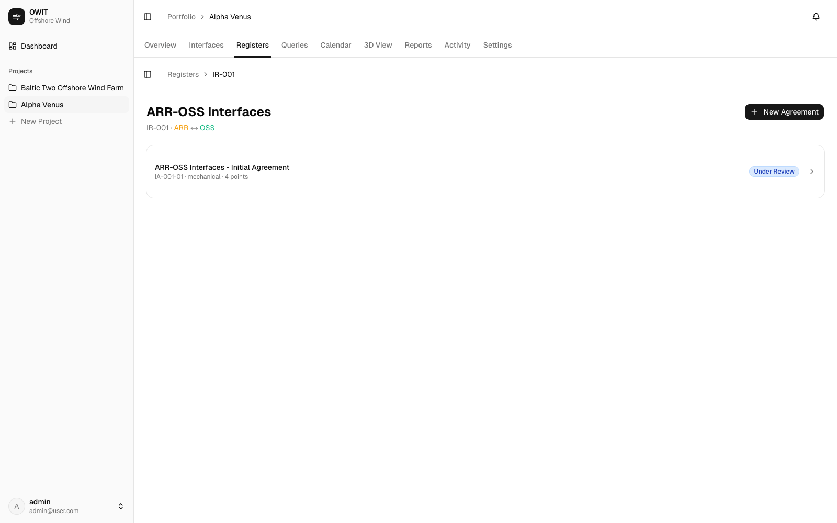
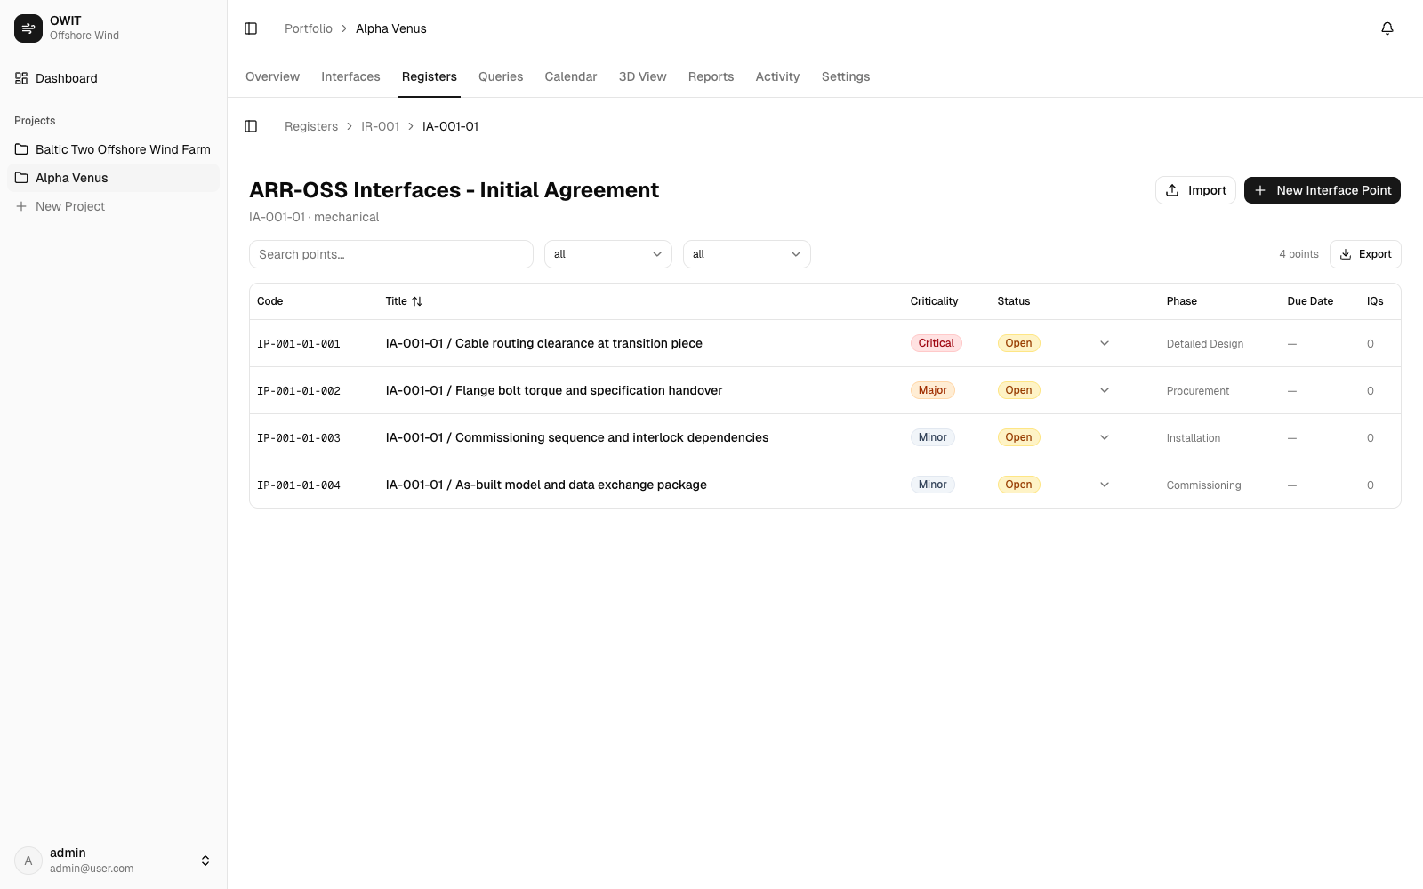
Register governance and agreement structure anchor interface accountability

Slide 5
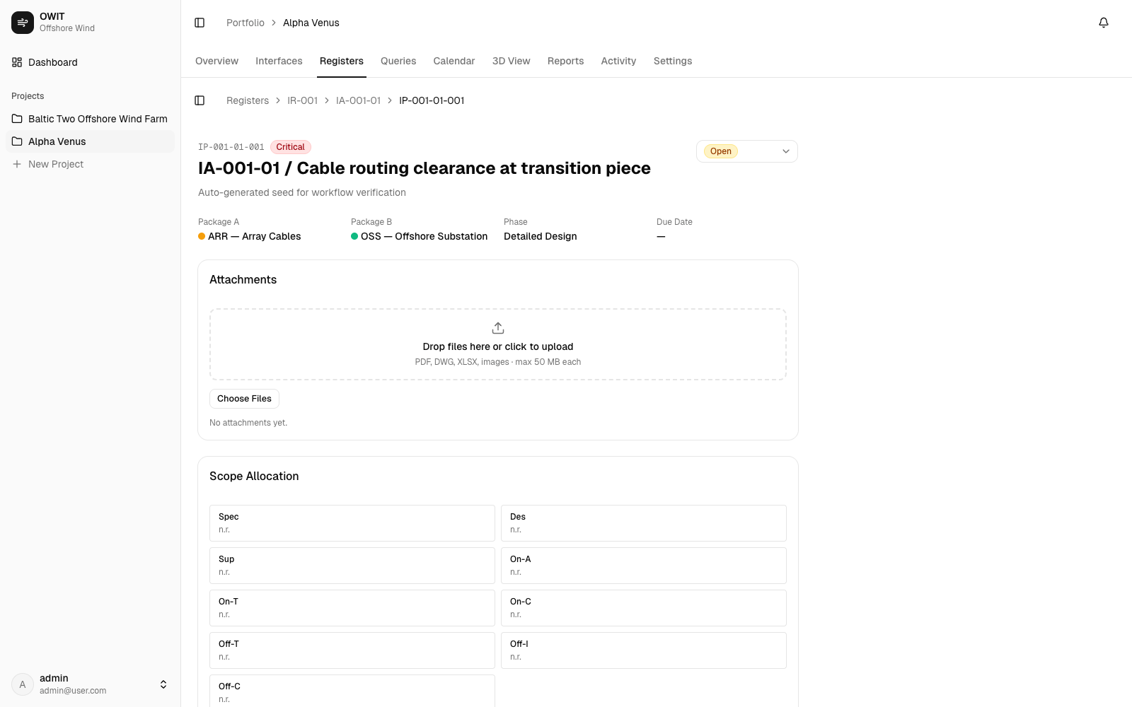
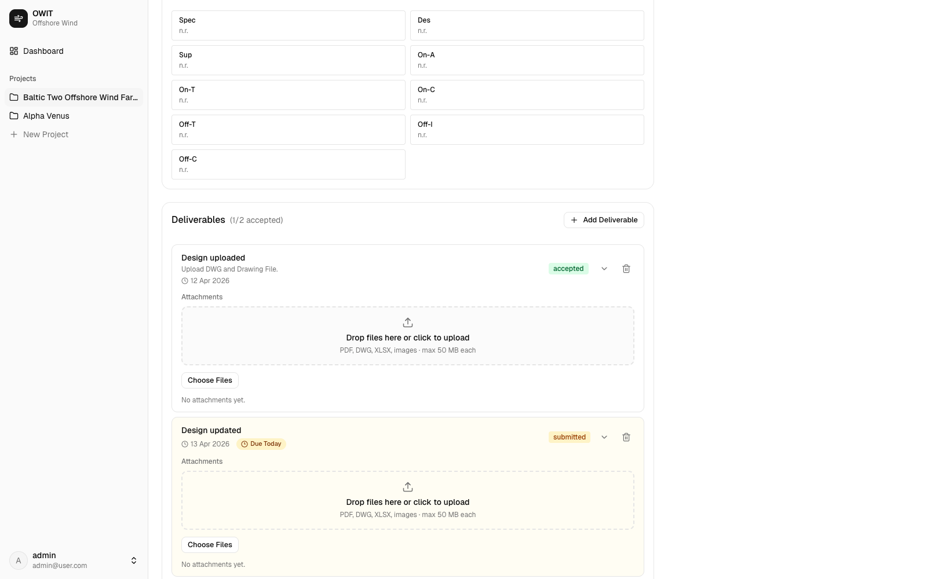
Point-level workspace links obligations, deliverables, and technical clarification

Slide 6
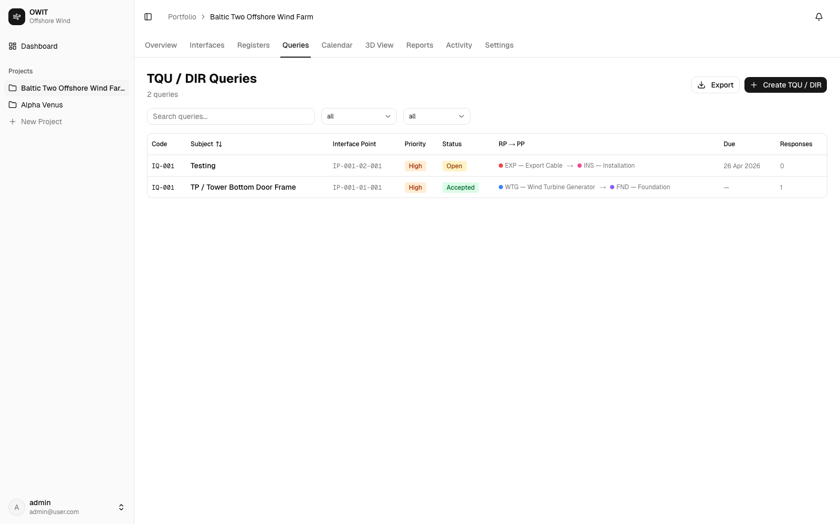
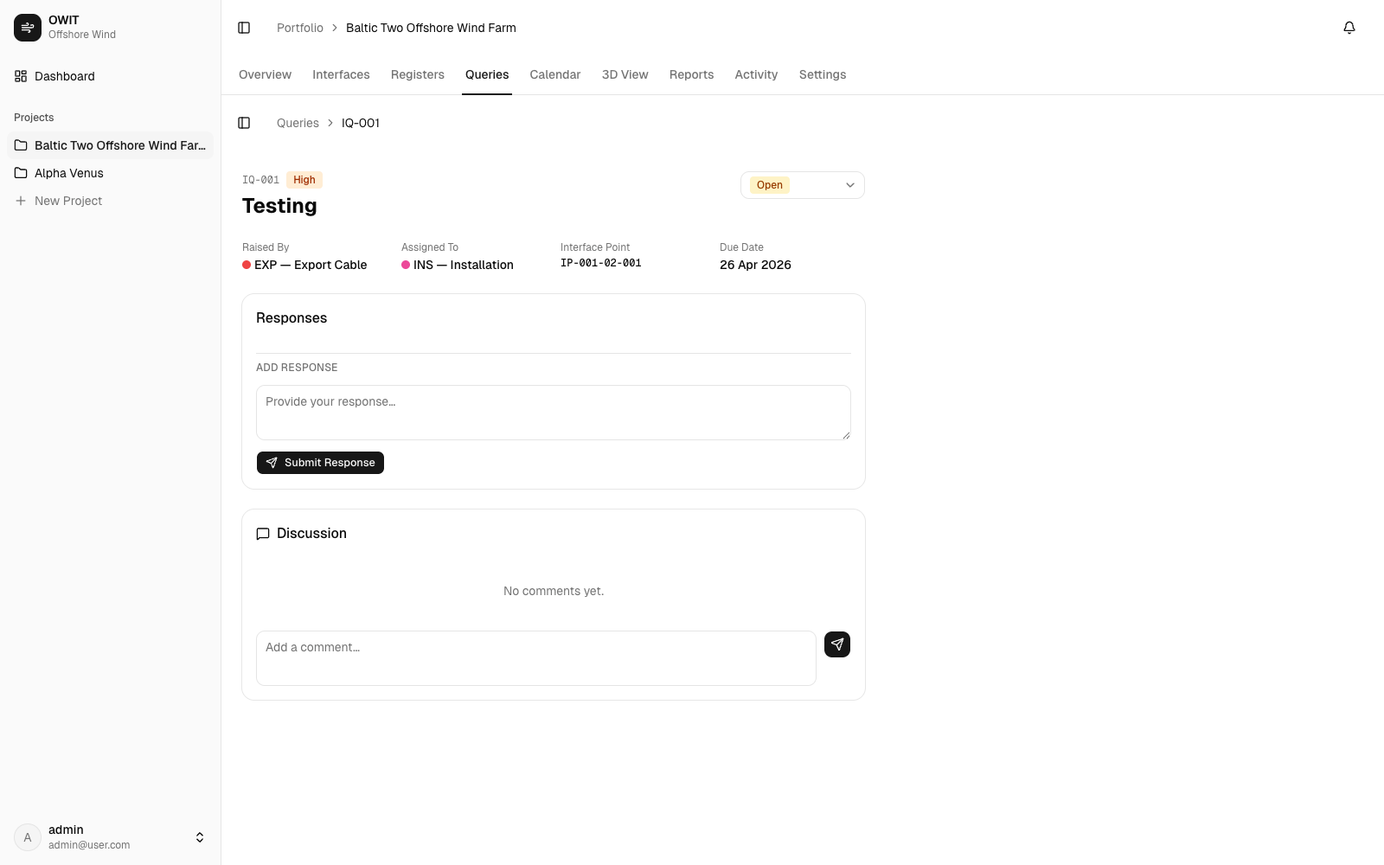
TQU/DIR management supports both queue-level triage and record-level actions

Slide 7
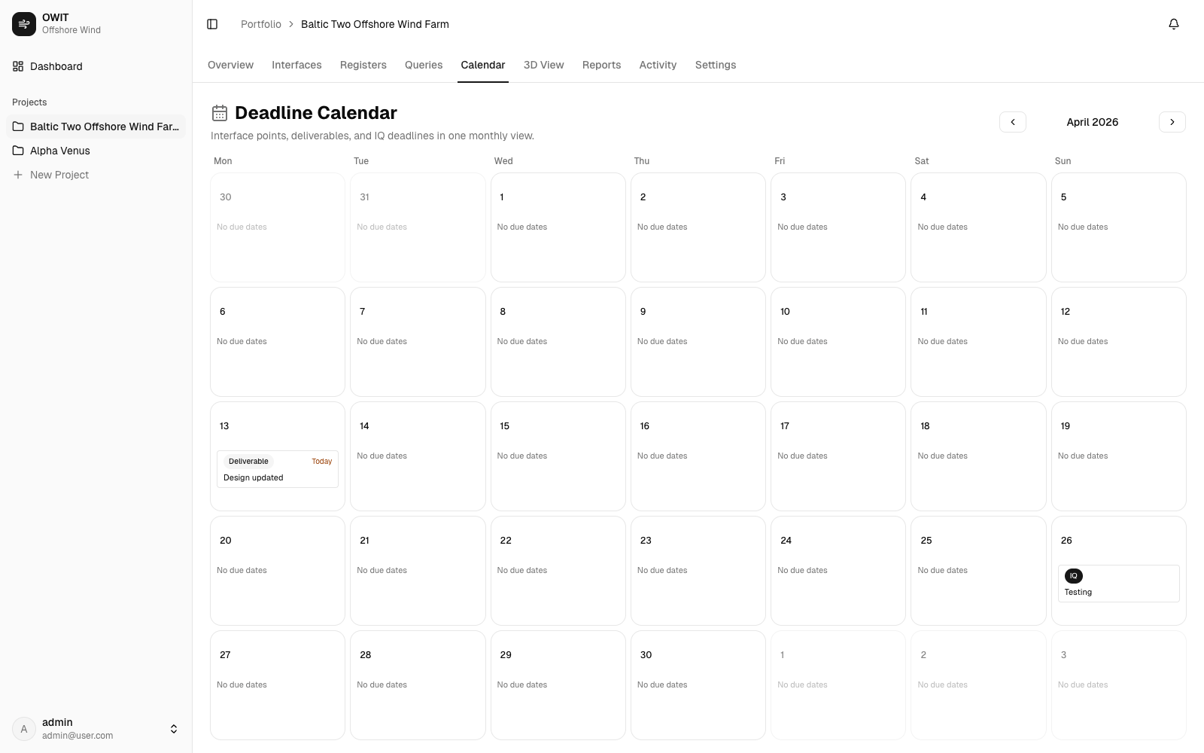
Deadline calendar surfaces due-now and upcoming obligations in one operational view

Slide 8
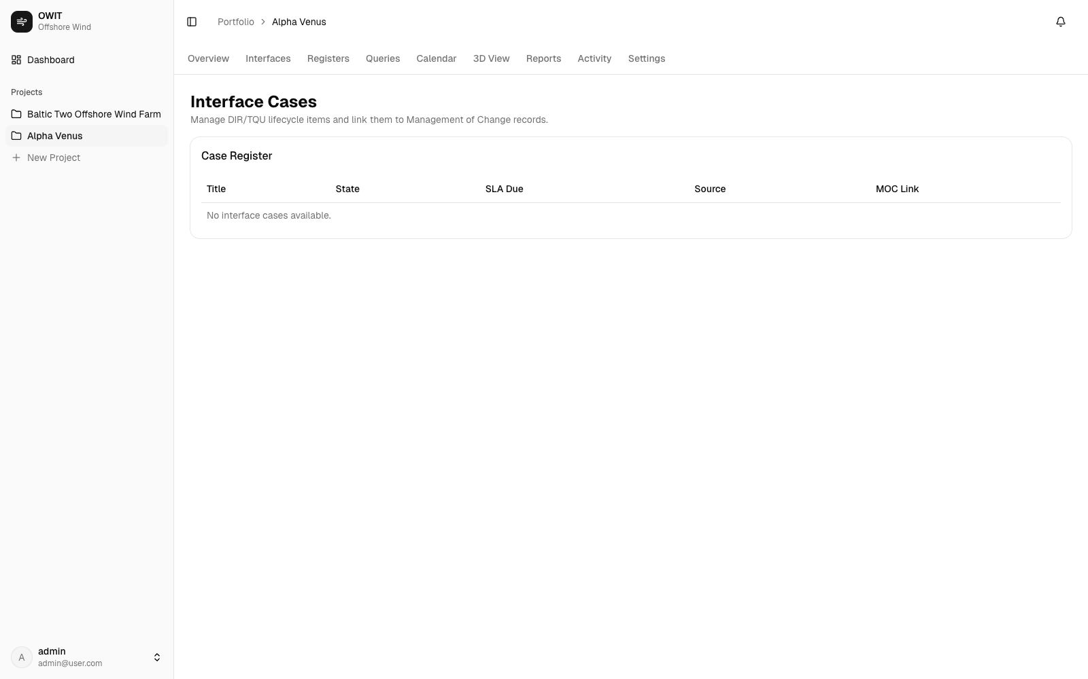
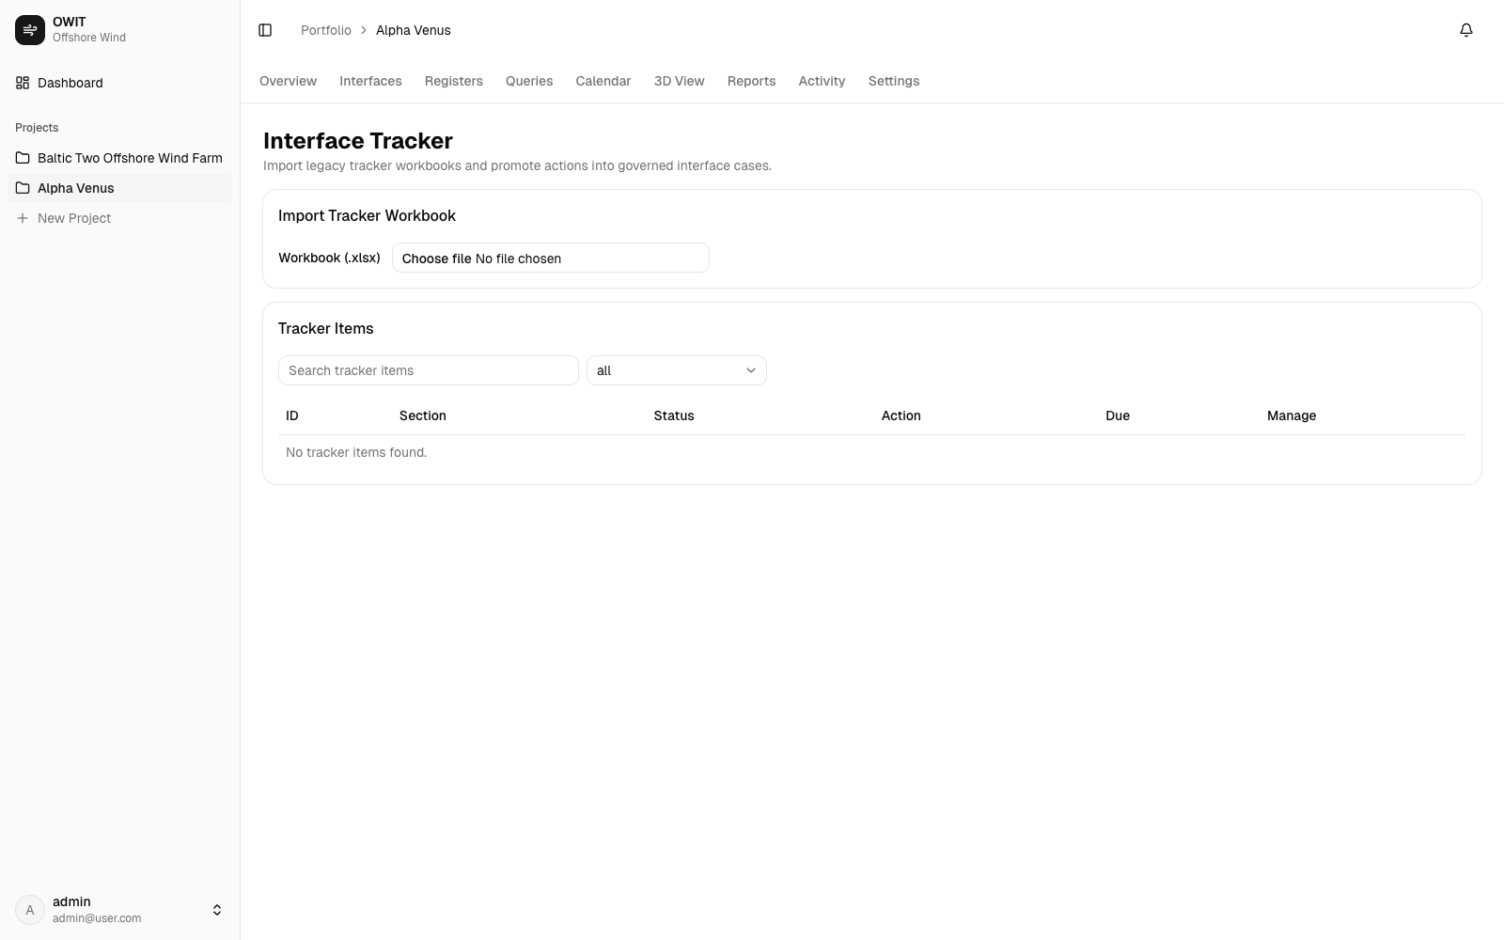
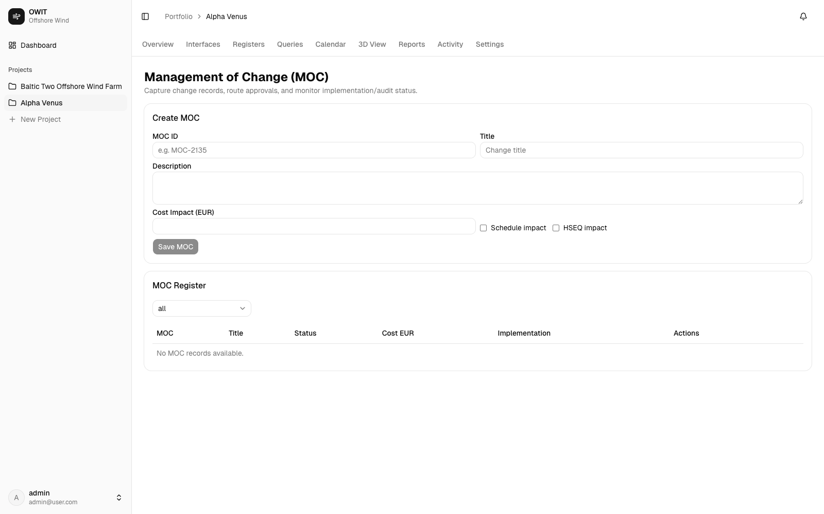
Governance modules are available for cases, tracker, and MOC controls

Slide 9
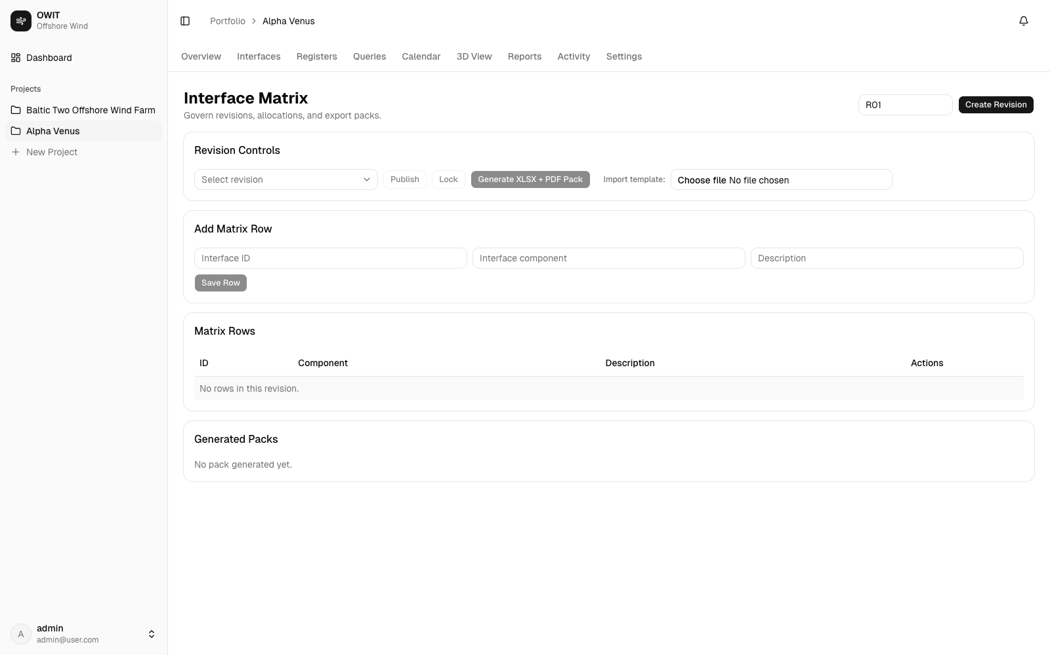
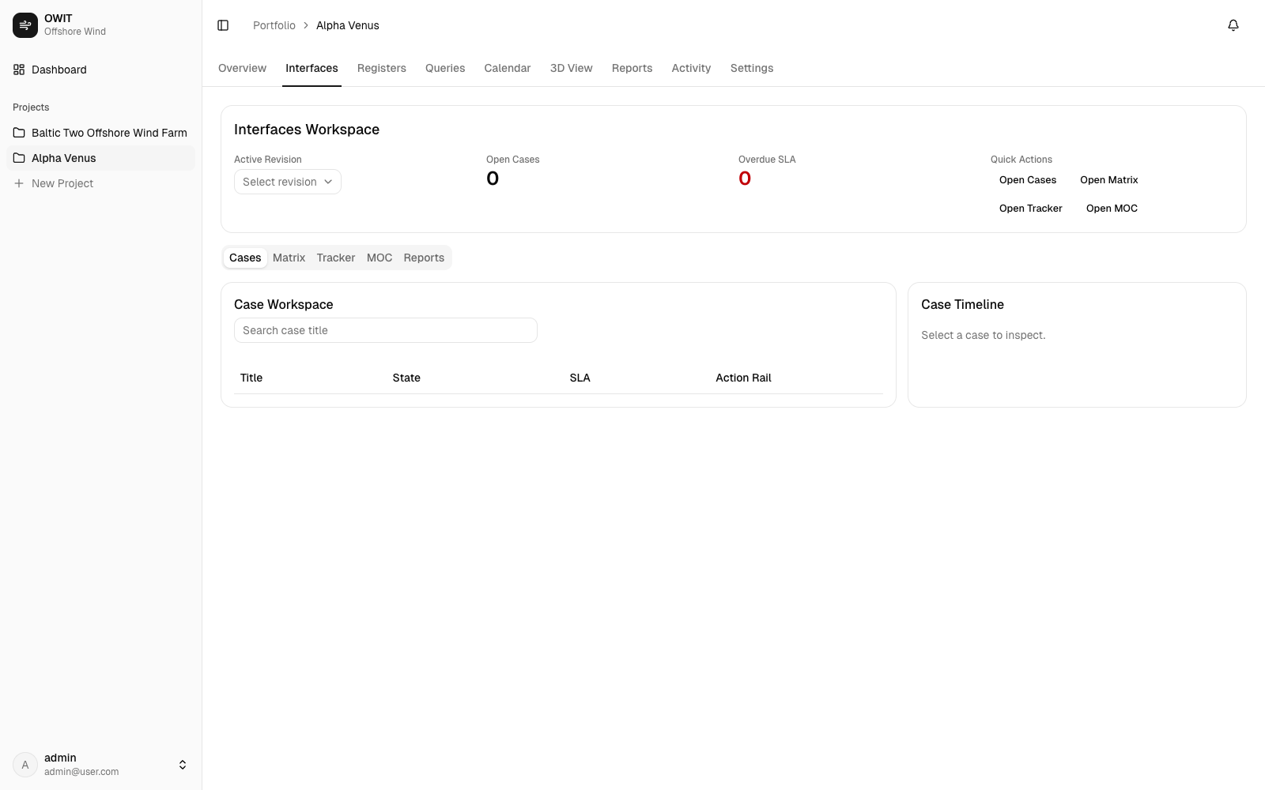
Matrix governance and interfaces workspace extend compliance-oriented operations

Slide 10
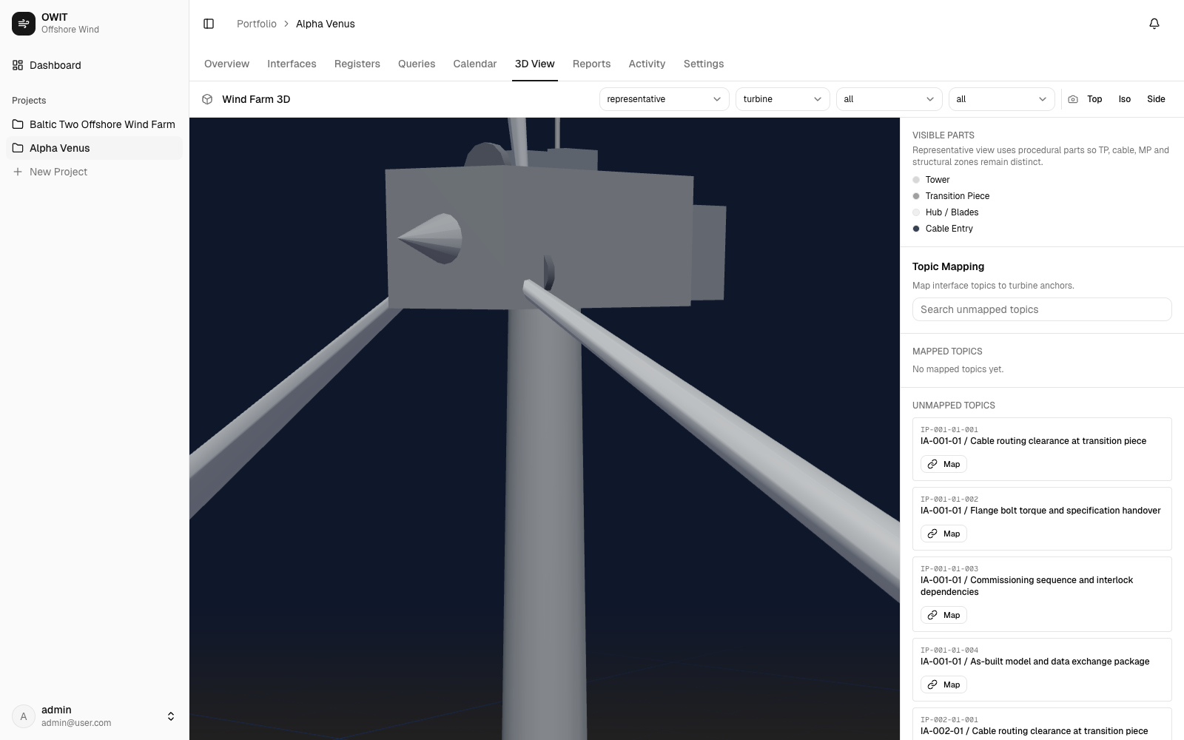
Representative 3D mode enables focused topic mapping on key assets

Slide 11
Full layout 3D mode connects the farm context with interface point markers

Slide 12
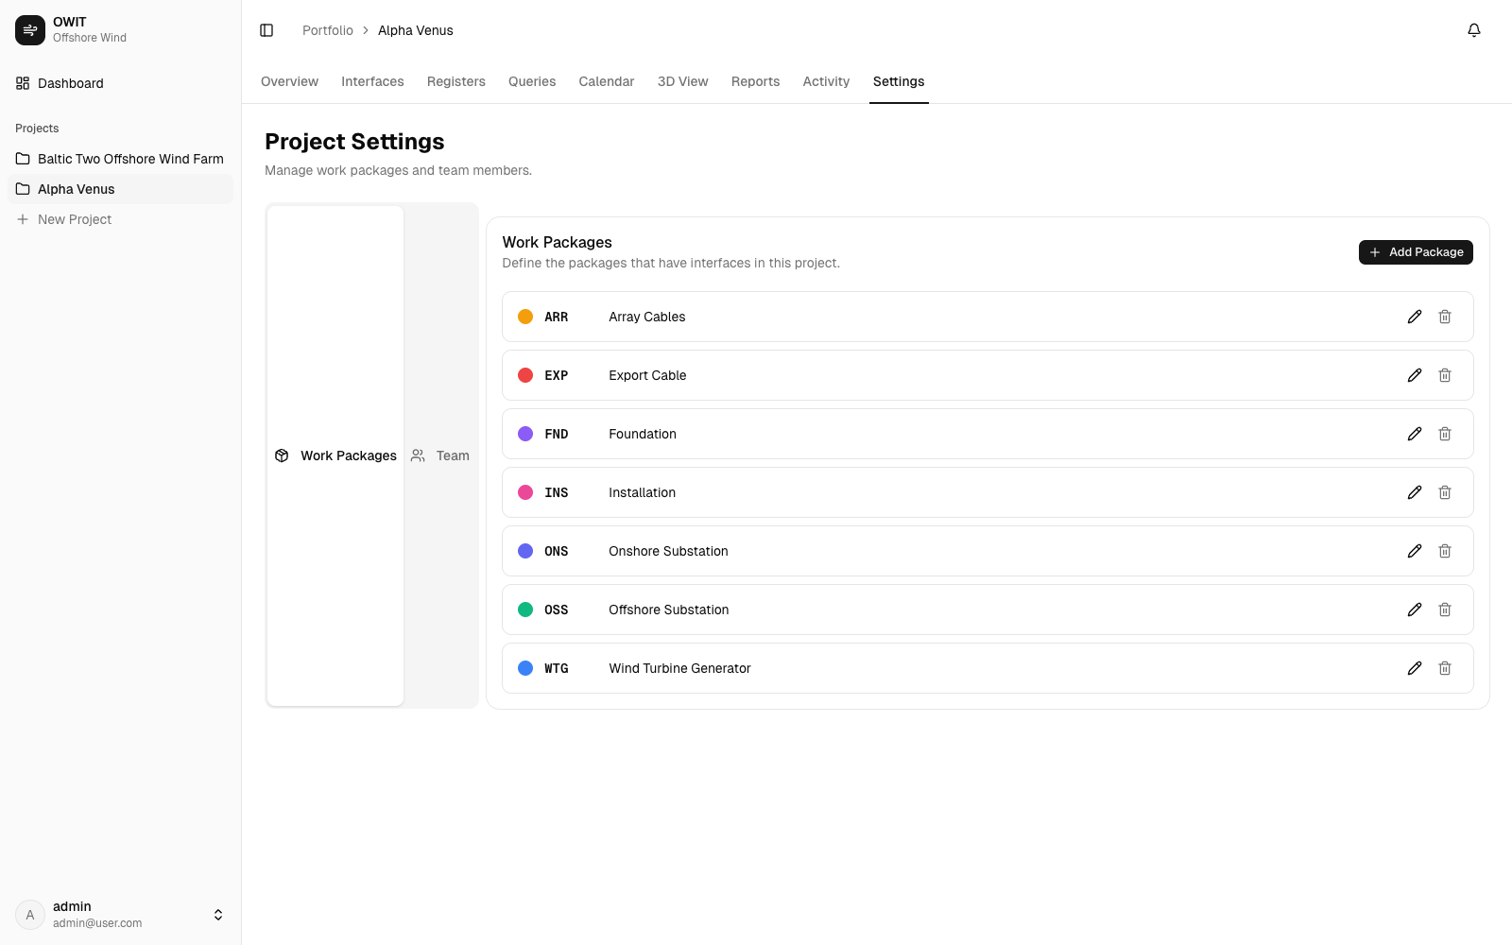
Team settings and analytics keep ownership, package structure, and KPI visibility aligned

Slide 13
Execution visibility is now live across interface governance, delivery, and 3D context
Positioning: practical risk-control layer between project teams and management oversight

