Slide 1

Lecture 1
Introduction
1.<number>
Copyright © The McGraw-Hill Companies, Inc. Permission required for reproduction or display.
Notes:
1.#

Slide 2
Lecture 1
Objectives
To define three security goals
To define security attacks that threaten security
goals
To define security services and how they are
related to the three security goals
To define security mechanisms to provide security
services
To introduce two techniques, cryptography and
steganography, to implement security mechanisms.
1.<number>
Notes:
1.#

Slide 3
1-1 SECURITY GOALS
This section defines three security goals.
Topics discussed in this section:
1.1.1 Confidentiality
1.1.2 Integrity
1.1.3 Security
1.<number>
Notes:
1.#

Slide 4
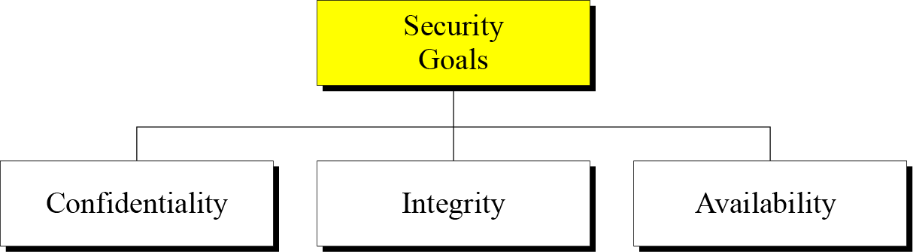
1.1 Continued
Figure 1.1 Taxonomy of security goals
1.<number>
Notes:
1.#

Slide 5
1.1.1 Confidentiality
Confidentiality is probably the most common aspect of information security.
We need to protect our confidential information.
An organization needs to guard against those malicious actions that endanger the confidentiality of its information.
1.<number>
Notes:
1.#

Slide 6
1.1.2 Integrity
Information needs to be changed constantly.
Integrity means that changes need to be done only by authorized entities and through authorized mechanisms.
1.<number>
Notes:
1.#

Slide 7
1.1.3 Availability
The information created and stored by an organization needs to be available to authorized entities.
Information needs to be constantly changed, which means it must be accessible to authorized entities.
1.<number>
Notes:
1.#

Slide 8
Strong Protection
The information created and stored by an organization needs to be available to authorized entities.
Information needs to be constantly changed, which means it must be accessible to authorized entities.
1.<number>
Notes:
1.#

Slide 9
1-2 ATTACKS
The three goals of security⎯confidentiality, integrity, and availability⎯can be threatened by security attacks.
Topics discussed in this section:
1.2.1 Attacks Threatening Confidentiality
1.2.2 Attacks Threatening Integrity
1.2.3 Attacks Threatening Availability
1.2.4 Passive versus Active Attacks
1.<number>
Notes:
1.#

Slide 10
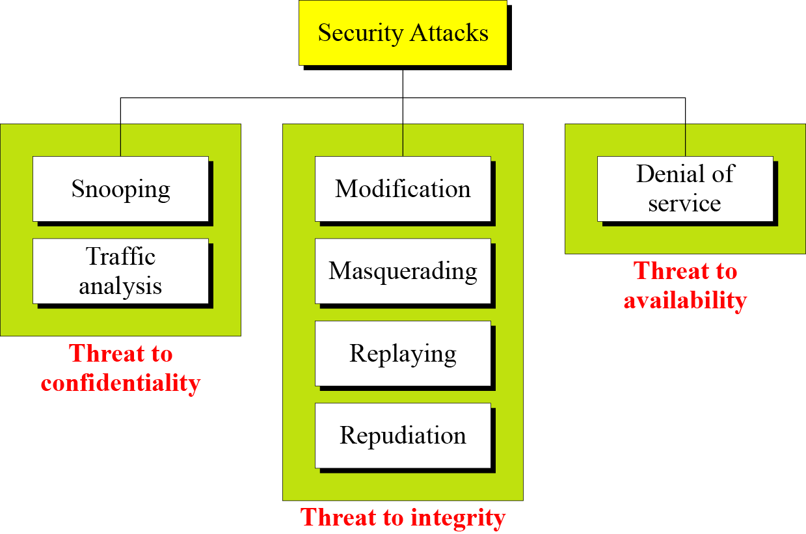
1.2 Continued
Figure 1.2 Taxonomy of attacks with relation to security goals
1.<number>
Notes:
1.#

Slide 11
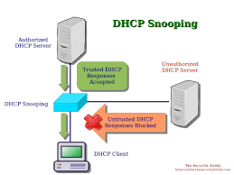
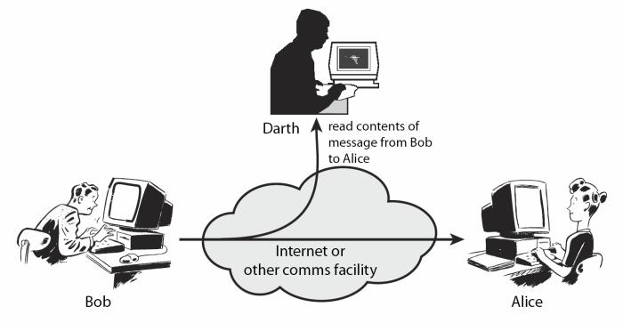
1.2.1 Attacks Threatening Confidentiality
Snooping refers to unauthorized access to or interception of data. Access your network and read confidential data
Traffic analysis refers to obtaining some other type of information by monitoring online traffic.
1.<number>
Notes:
1.#

Slide 12
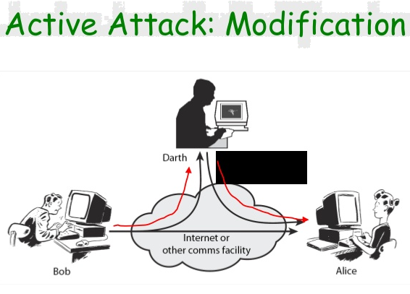
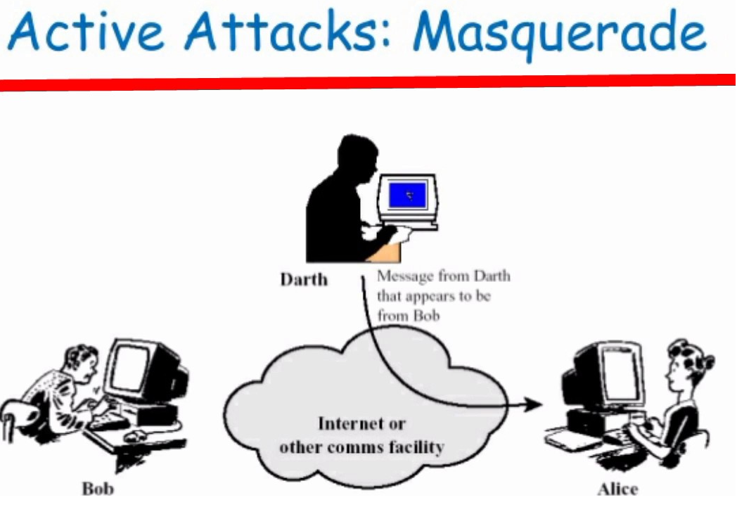
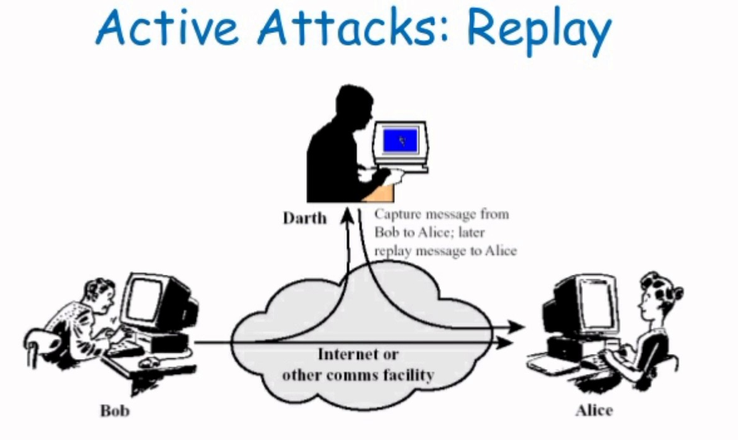
1.2.2 Attacks Threatening Integrity
Modification means that the attacker intercepts the message and changes it.
Masquerading or spoofing happens when the attacker impersonates somebody else.
Replaying means the attacker obtains a copy
of a message sent by a user and later tries to replay it.
1.<number>
Notes:
1.#

Slide 13
1.2.3 Attacks Threatening Availability
Repudiation means that sender of the message might later deny that she has sent the message; the receiver of the message might later deny that he has received the message.
Denial of service (DoS) is a very common attack. It may slow down or totally interrupt the service of a system.
1.<number>
Notes:
1.#

Slide 14
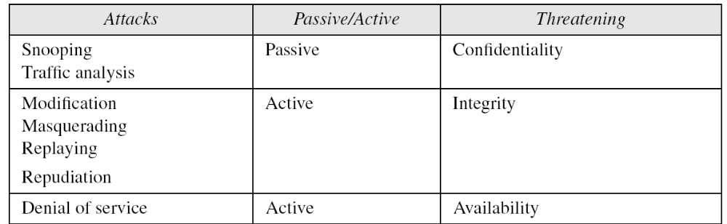
1.2.4 Passive Versus Active Attacks
Table 1.1 Categorization of passive and active attacks
1.<number>
Notes:
1.#

Slide 15
1-3 SERVICES AND MECHANISMS
ITU-T provides some security services and some mechanisms to implement those services. Security services and mechanisms are closely related because a
mechanism or combination of mechanisms are used to provide a service..
Topics discussed in this section:
1.3.1 Security Services
1.3.2 Security Mechanism
1.3.3 Relation between Services and Mechanisms
1.<number>
Notes:
1.#

Slide 16
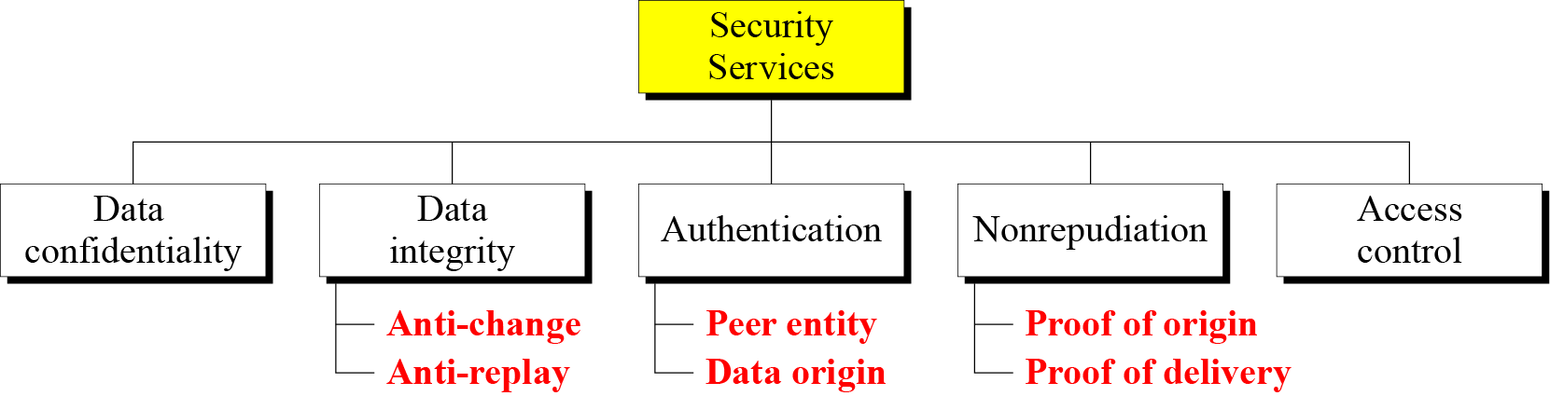
1.3.1 Security Services
Figure 1.3 Security services
1.<number>
Notes:
1.#

Slide 17
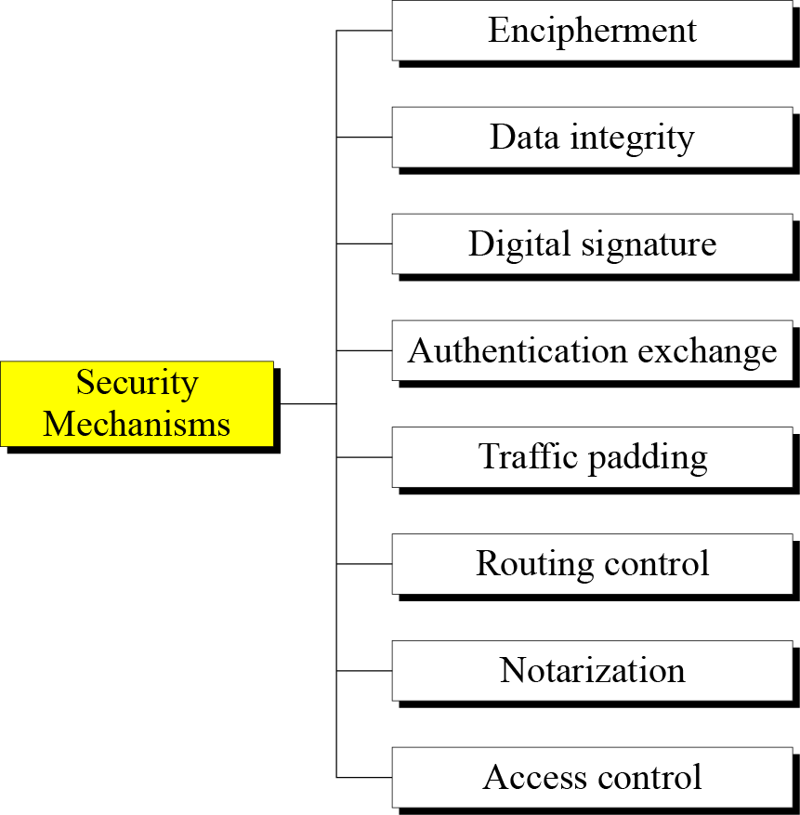
1.3.2 Security Mechanism
Figure 1.4 Security mechanisms
1.<number>
Notes:
1.#

Slide 18
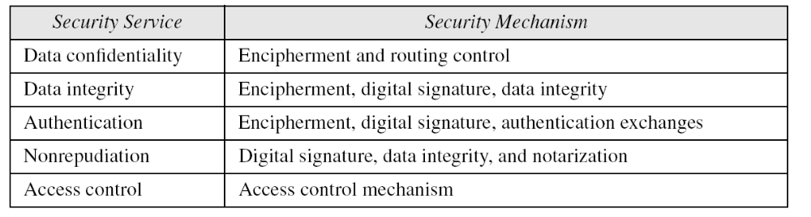
1.3.3 Relation between Services and Mechanisms
Table 1.2 Relation between security services and mechanisms
1.<number>
Notes:
1.#

Slide 19
1-4 TECHNIQUES
Mechanisms discussed in the previous sections are only theoretical recipes to implement security. The actual implementation of security goals needs some techniques. Two techniques are prevalent today: cryptography and steganography.
Topics discussed in this section:
1.4.1 Cryptography
1.4.2 Steganography
1.<number>
Notes:
1.#

Slide 20
1.4.1 Cryptography
Cryptography, a word with Greek origins, means “secret writing.” However, we use the term to refer to the science and art of transforming messages to make them secure and immune to attacks.
1.<number>
Notes:
1.#

Slide 21
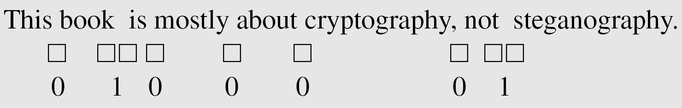
1.4.2 Steganography
The word steganography, with origin in Greek, means “covered writing,” in contrast with cryptography, which means “secret writing.”
Example: covering data with text
1.<number>
Notes:
1.#

Slide 22
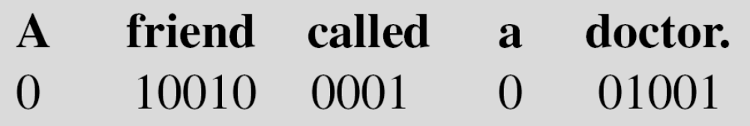
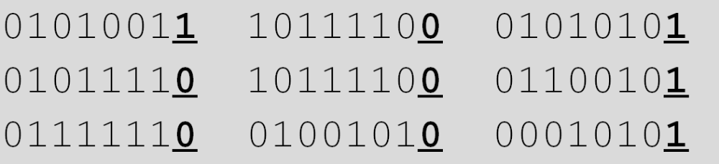
1.4.2 Continued
Example: using dictionary
Example: covering data under color image
1.<number>
Notes:
1.#

Slide 23
1-5 THE REST OF THE BOOK
The rest of this book is divided into four parts.
Part One: Symmetric-Key Enciphermen
Part Two: Asymmetric-Key Encipherment
Part Three: Integrity, Authentication, and Key Management
Part Four: Network Security
1.<number>
Notes:
1.#

