Slide 1

Chapter 16
Security at the Application Layer:
PGP and S/MIME
Copyright © The McGraw-Hill Companies, Inc. Permission required for reproduction or display.

Slide 2
Chapter 16
Objectives
To explain the general structure of an e-mail
application program
To discuss how PGP can provide security services
for e-mail
To discuss how S/MIME can provide security
services for e-mail
To define trust mechanism in both PGP and
S/MIME
To show the structure of messages exchanged in
PGP and S/MIME

Slide 3
16-1 E-MAIL
Let us first discuss the electronic mail (e-mail) system in general.
Topics discussed in this section:
16.1.1 E-mail Architecture
16.1.2 E-mail Security

Slide 4
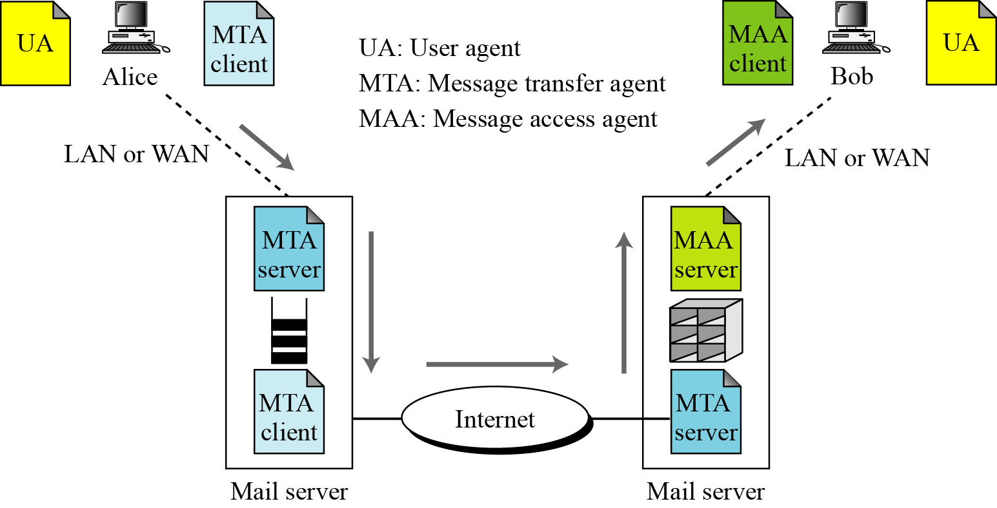
16.1.1 E-mail Architecture
Figure 16.1 E-mail architecture

Slide 5

16.1.2 E-mail Security
Cryptographic Algorithms
Note
In e-mail security, the sender of the message needs to include the name or identifiers
of the algorithms used in the message.
Certificates
It is obvious that some public-key algorithms must be used for e-mail security.

Slide 6
16.1.2 Continued
Cryptographic Secrets
Note
In e-mail security, the encryption/decryption is done using a symmetric-key algorithm,
but the secret key to decrypt the message is encrypted with the public key of the
receiver and is sent with the message.

Slide 7
16-2 PGP
Pretty Good Privacy (PGP) can be used to create a secure e-mail message or to store a file securely for future retrieval.
Topics discussed in this section:
16.2.1 Scenarios
16.2.2 Key Rings
16.2.3 PGP Certificates
16.2.4 Key Revocation
16.2.5 Extracting Information from Rings
16.2.6 PGP Packets
16.2.7 PGP Messages

Slide 8
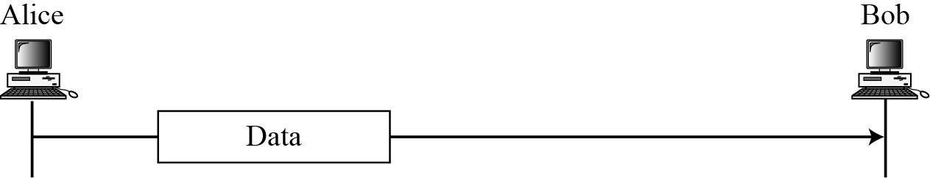
16.2.1 Scenarios
Plaintext
Figure 16.2 A plaintext message

Slide 9
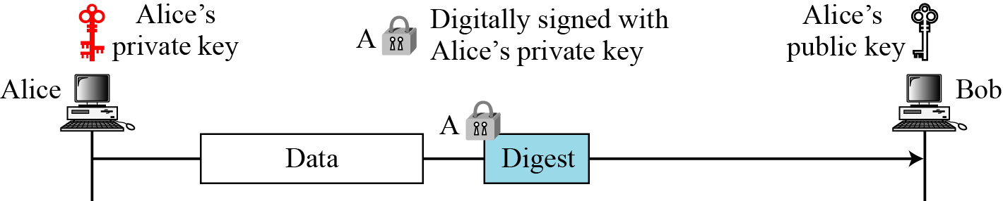
16.2.1 Continued
Message Integrity
Figure 16.3 An authenticated message

Slide 10
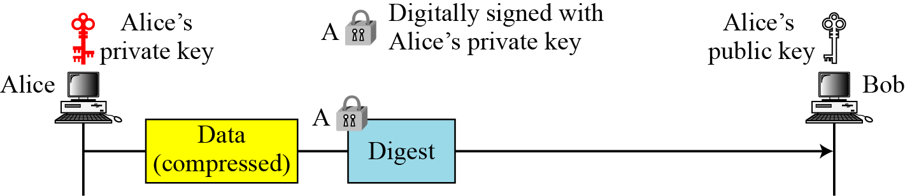
16.2.1 Continued
Compression
Figure 16.4 A compressed message

Slide 11
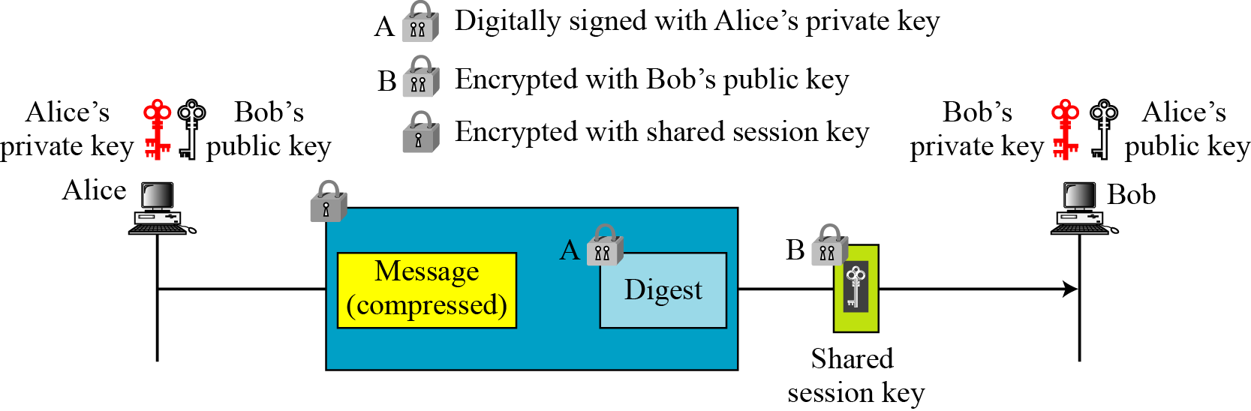
16.2.1 Continued
Confidentiality with One-Time Session Key
Figure 16.5 A confidential message

Slide 12
16.2.1 Continued
Code Conversion
Another service provided by PGP is code conversion. PGP uses Radix-64 conversion.
Segmentation
PGP allows segmentation of the message.

Slide 13
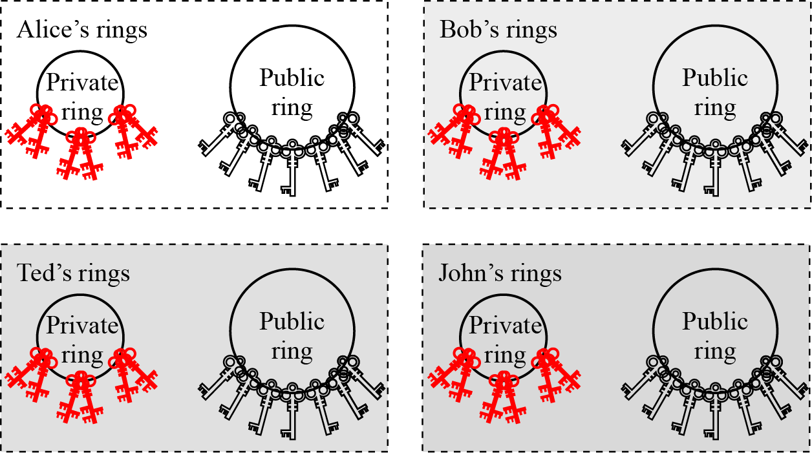
16.2.2 Key Rings
Figure 16.6 Key rings in PGP

Slide 14
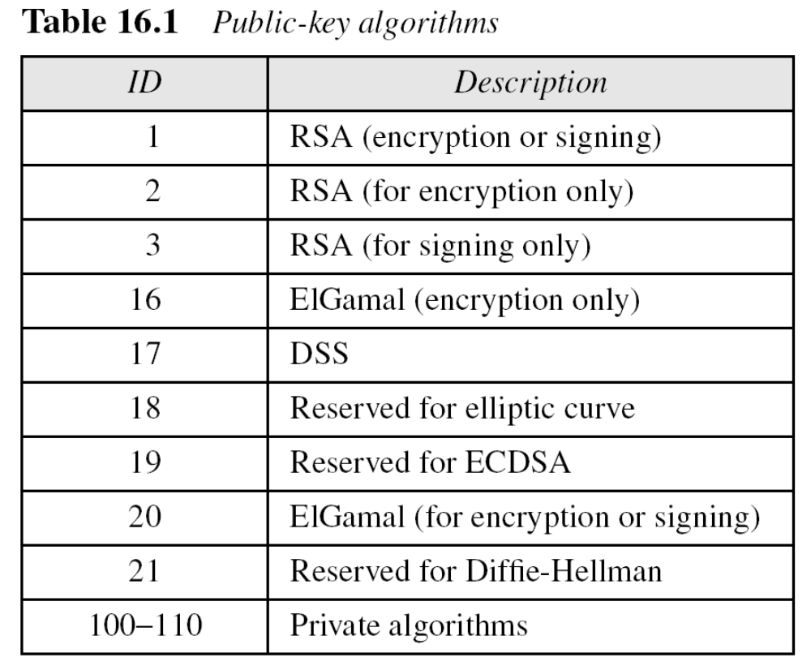
16.2.2 Continued
PGP Algorithms

Slide 15
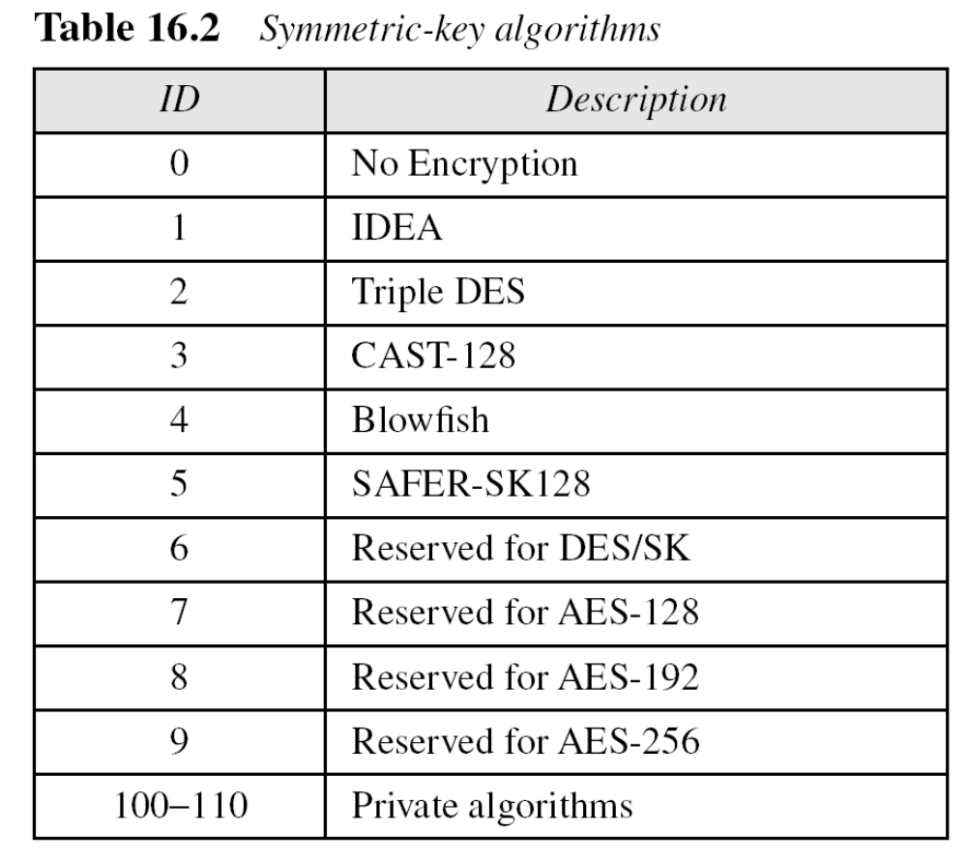
16.2.2 Continued

Slide 16
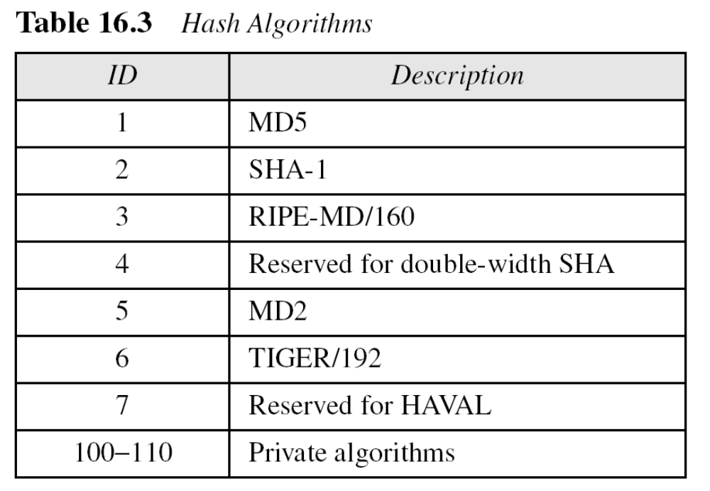
16.2.2 Continued

Slide 17
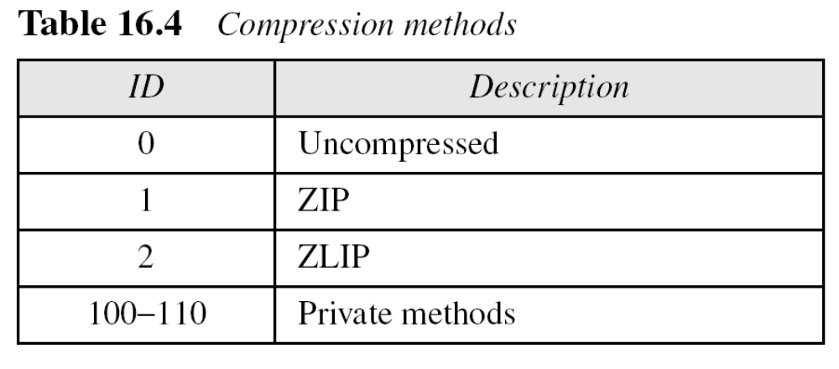
16.2.2 Continued

Slide 18
16.2.3 PGP Certificates
X.509 Certificates
Protocols that use X.509 certificates depend on the hierarchical structure of the trust.
Note
In X.509, there is a single path from the fully trusted authority to any certificate.

Slide 19
16.2.3 Continued
PGP Certificates
In PGP, there is no need for CAs; anyone in the ring can sign a certificate for anyone else in the ring.
Note
In PGP, there can be multiple paths from fully or partially trusted authorities to any subject.
Trusts and Legitimacy
The entire operation of PGP is based on introducer trust, the certificate trust, and the legitimacy of the public keys.

Slide 20
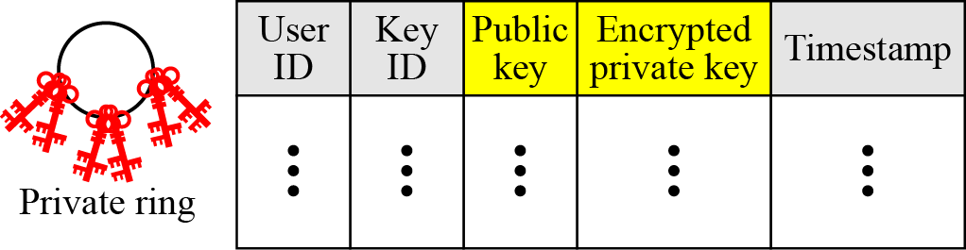
16.2.3 Continued
Figure 16.7 Format of private key ring table

Slide 21
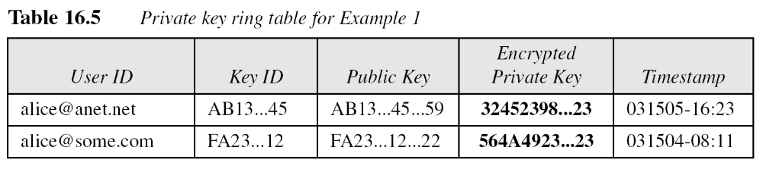
16.2.3 Continued
Example 16.1
Let us show a private key ring table for Alice. We assume that Alice has only two user IDs, alice@some.com and alice@anet.net. We also assume that Alice has two sets of private/public keys, one for each user ID.

Slide 22
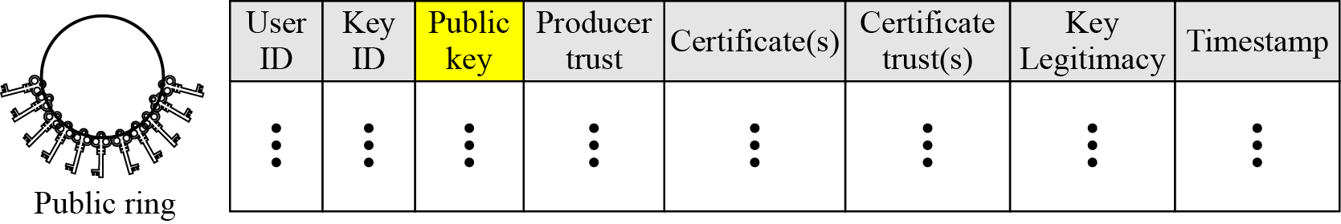
16.2.3 Continued
Figure 16.8 Format of a public key ring table

Slide 23
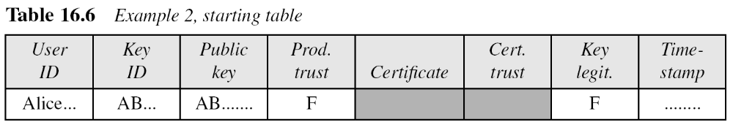
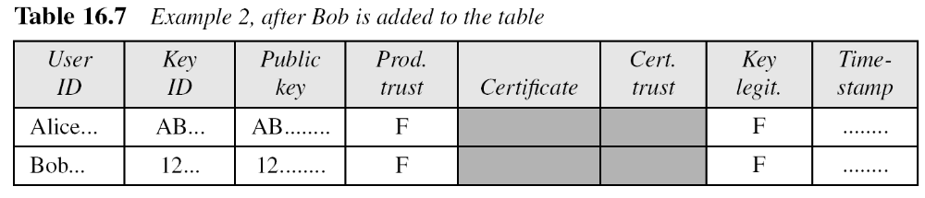
16.2.3 Continued
Example 16.2
A series of steps will show how a public key ring table is formed for Alice.

Slide 24
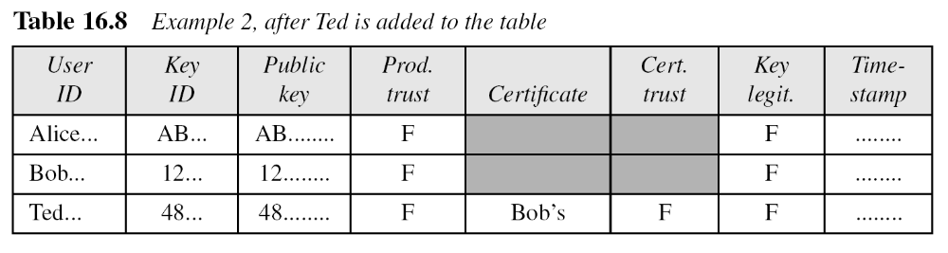
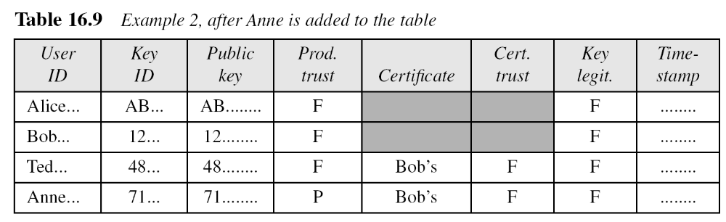
16.2.3 Continued
Example 16.2
Continued

Slide 25
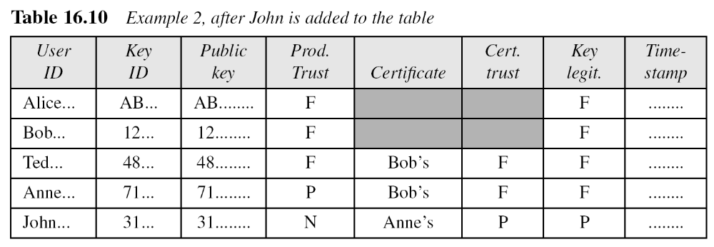
16.2.3 Continued
Example 16.2
Continued

Slide 26
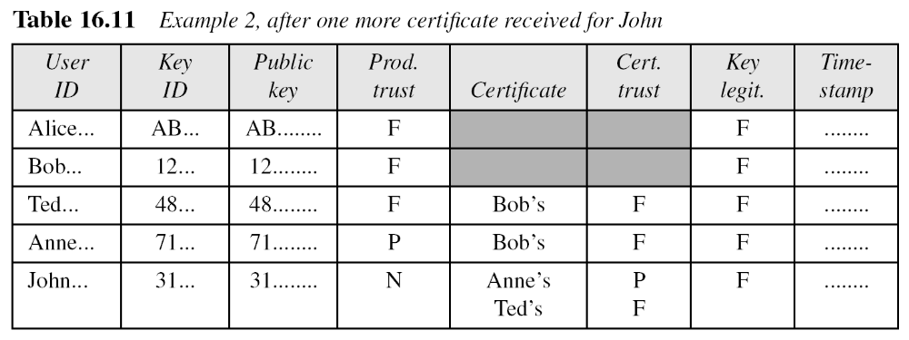
16.2.3 Continued
Example 16.2
Continued

Slide 27
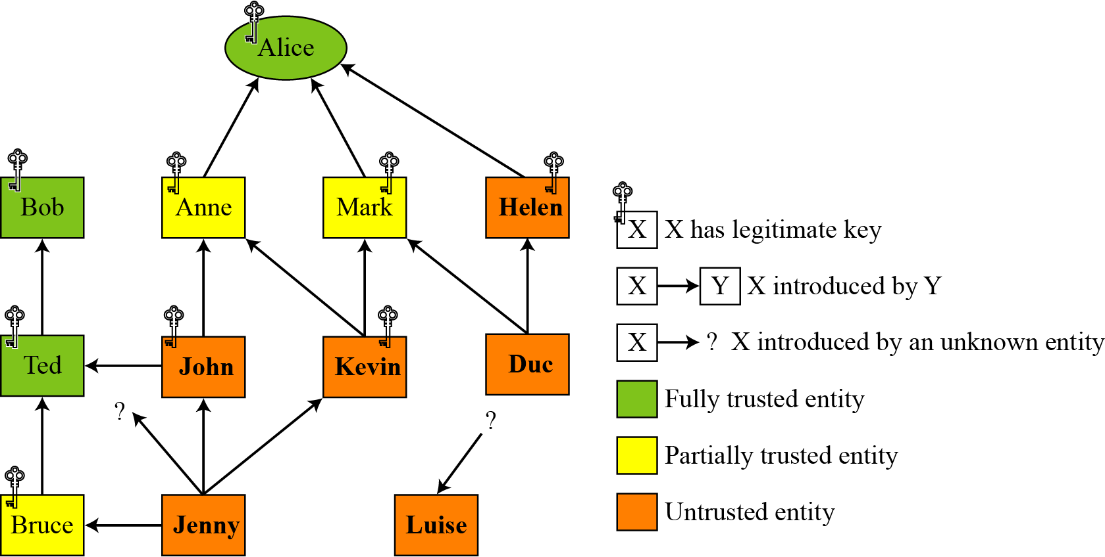
16.2.3 Continued
Trust Model in PGP
Figure 16.9 Trust model

Slide 28
16.2.4 Key Revocation
It may become necessary for an entity to revoke his or her public key from the ring. This may happen if the owner of the key feels that the key is compromised (stolen, for example) or just too old to be safe.

Slide 29
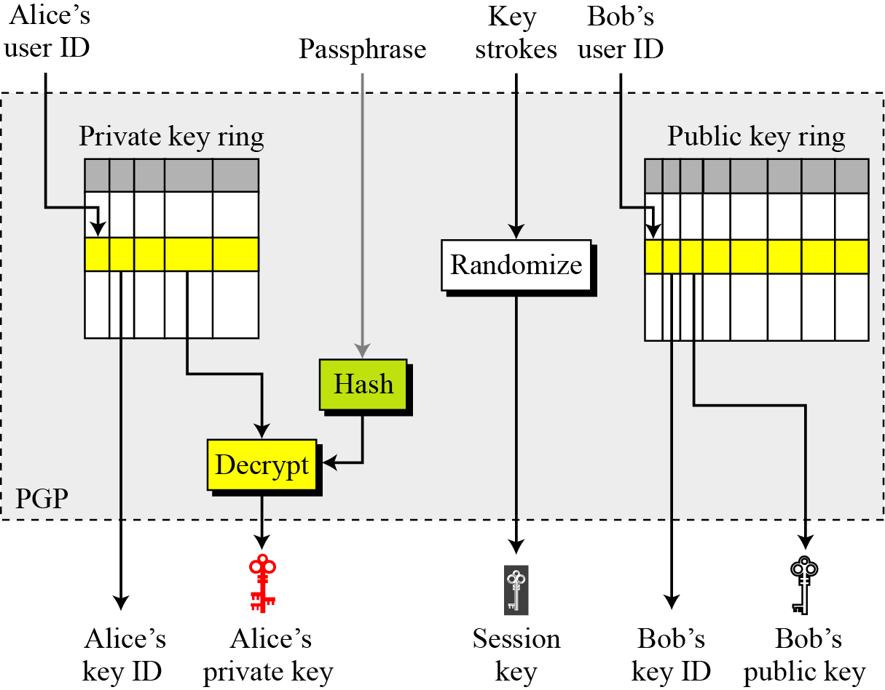
16.2.5 Extracting Information from Rings
Figure 16.10 Extracting information at the sender site

Slide 30
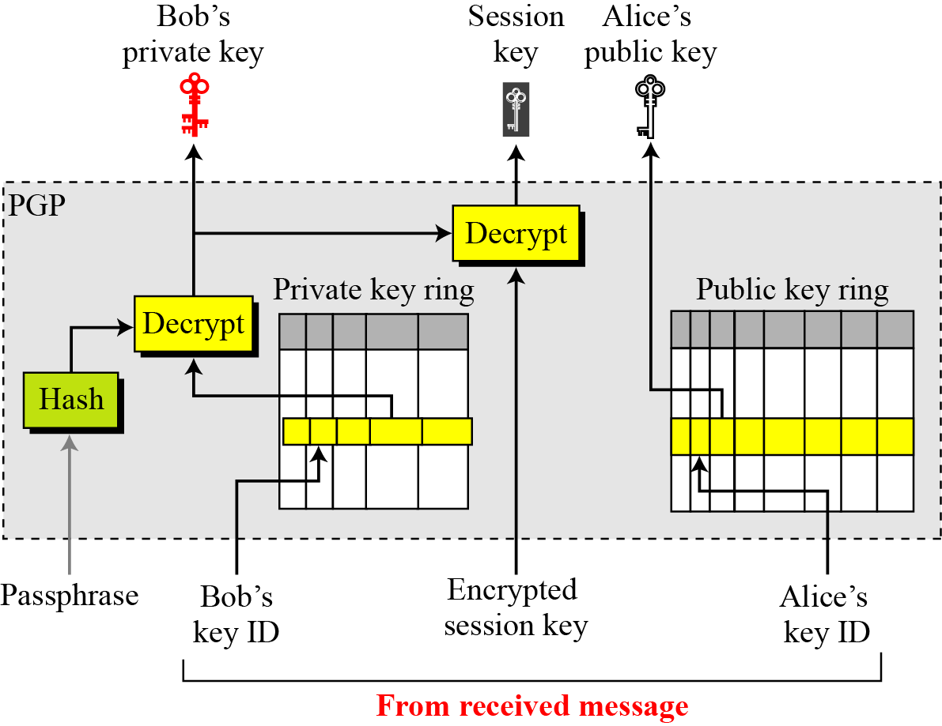
16.2.5 Continued
Figure 16.11 Extracting information at the receiver site

Slide 31
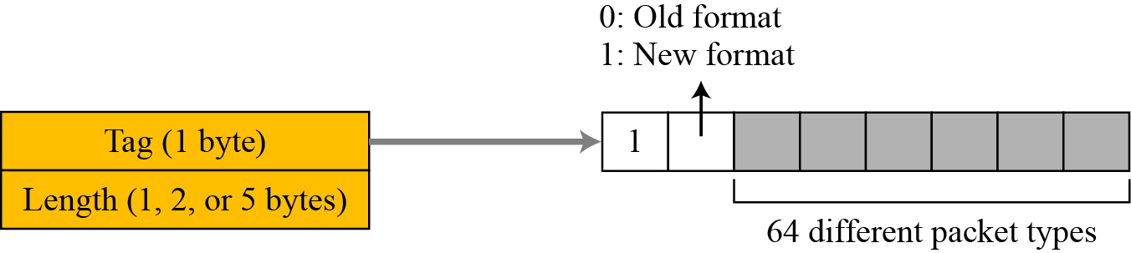
16.2.6 PGP Packets
Figure 16.12 Format of packet header

Slide 32
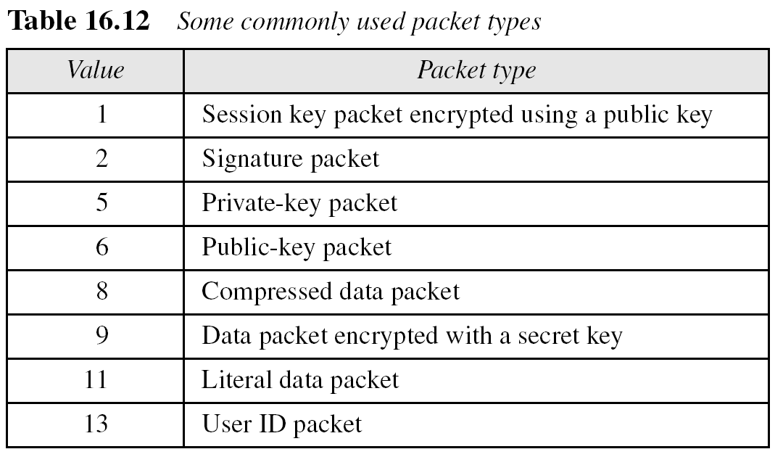
16.2.6 Continued

Slide 33
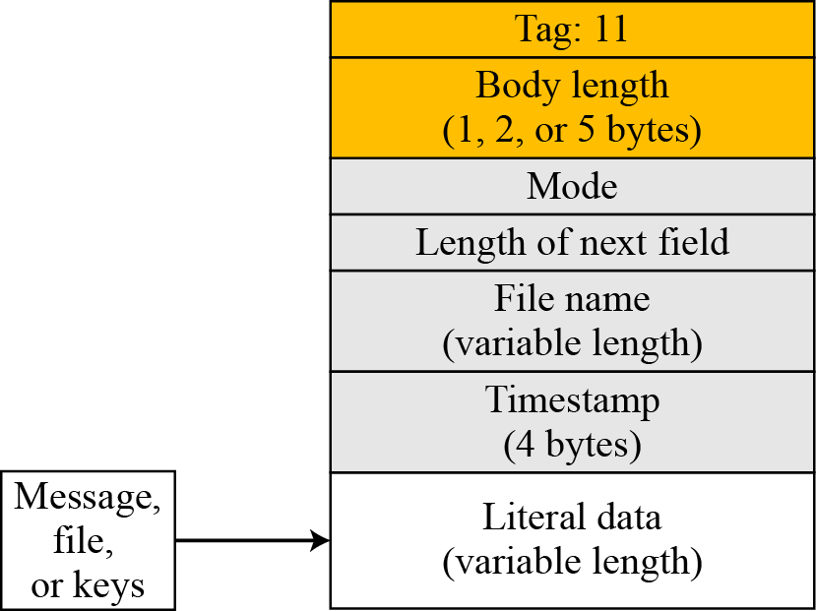
16.2.6 Continued
Figure 16.13 Literal data packet

Slide 34
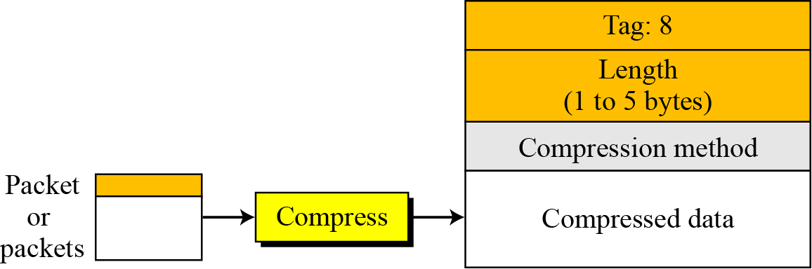
16.2.6 Continued
Figure 16.14 Compressed data packet

Slide 35
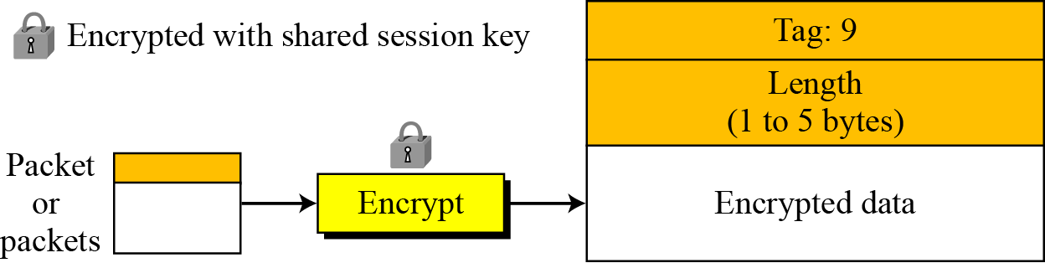
16.2.6 Continued
Figure 16.15 Encrypted data packet

Slide 36
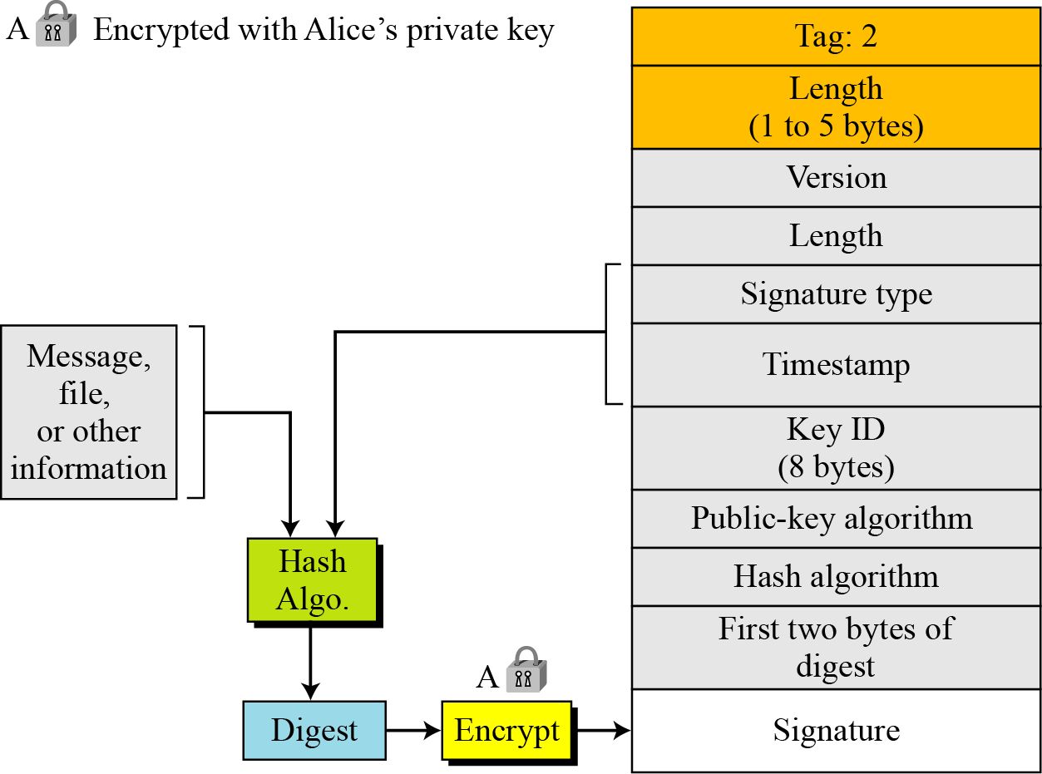
16.2.6 Continued
Figure 16.16 Signature packet

Slide 37
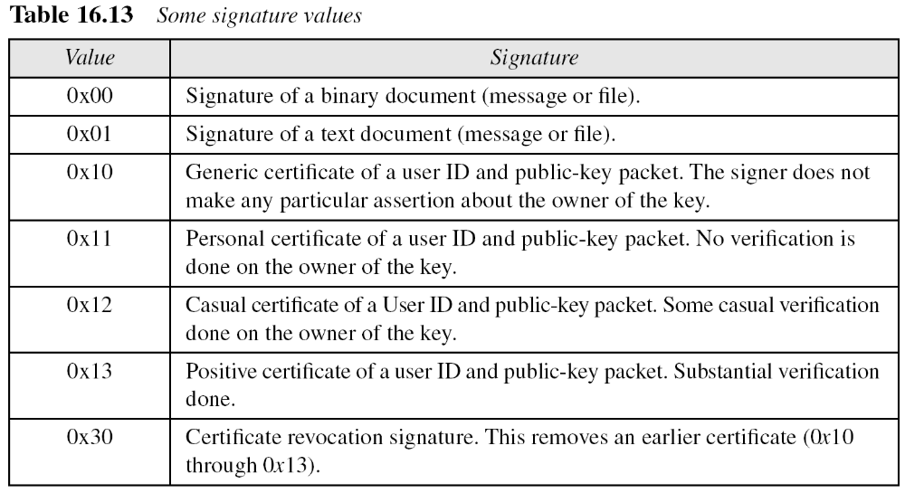
16.2.6 Continued

Slide 38
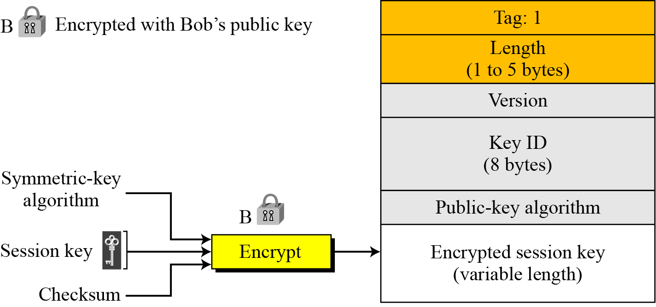
16.2.6 Continued
Figure 16.17 Session-key packet

Slide 39
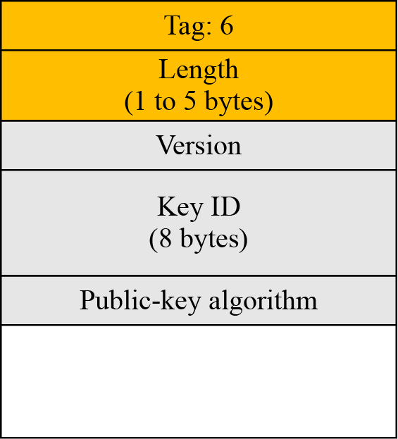
16.2.6 Continued
Figure 16.18 Public-key packet
Public Key

Slide 40
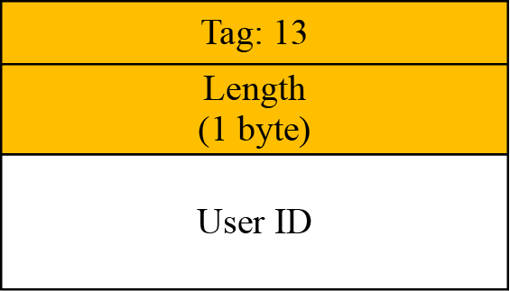
16.2.6 Continued
Figure 16.19 User ID packet

Slide 41
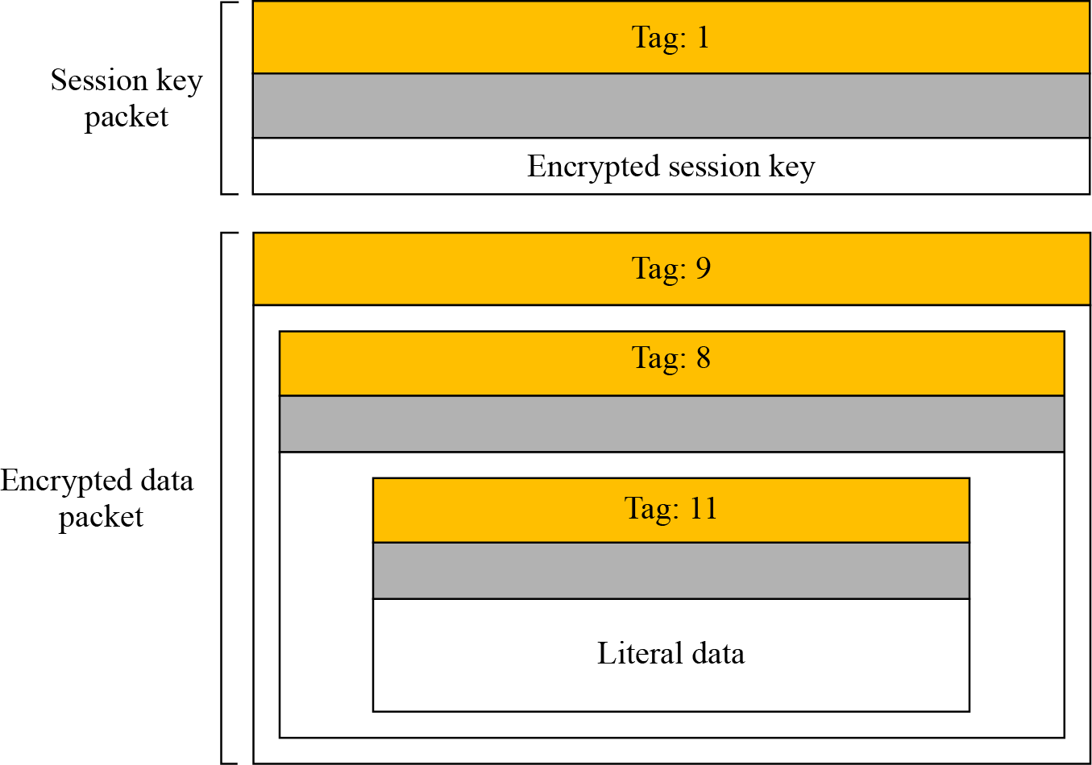
16.2.7 PGP Messages
Figure 16.20 Encrypted message

Slide 42
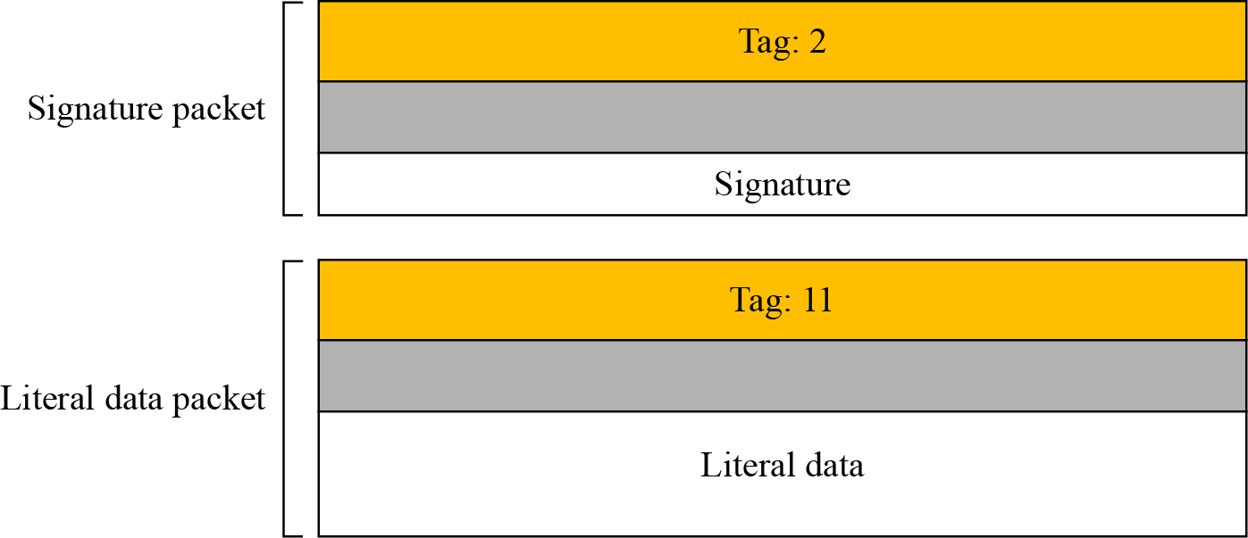
16.2.7 Continued
Figure 16.21 Signed message

Slide 43
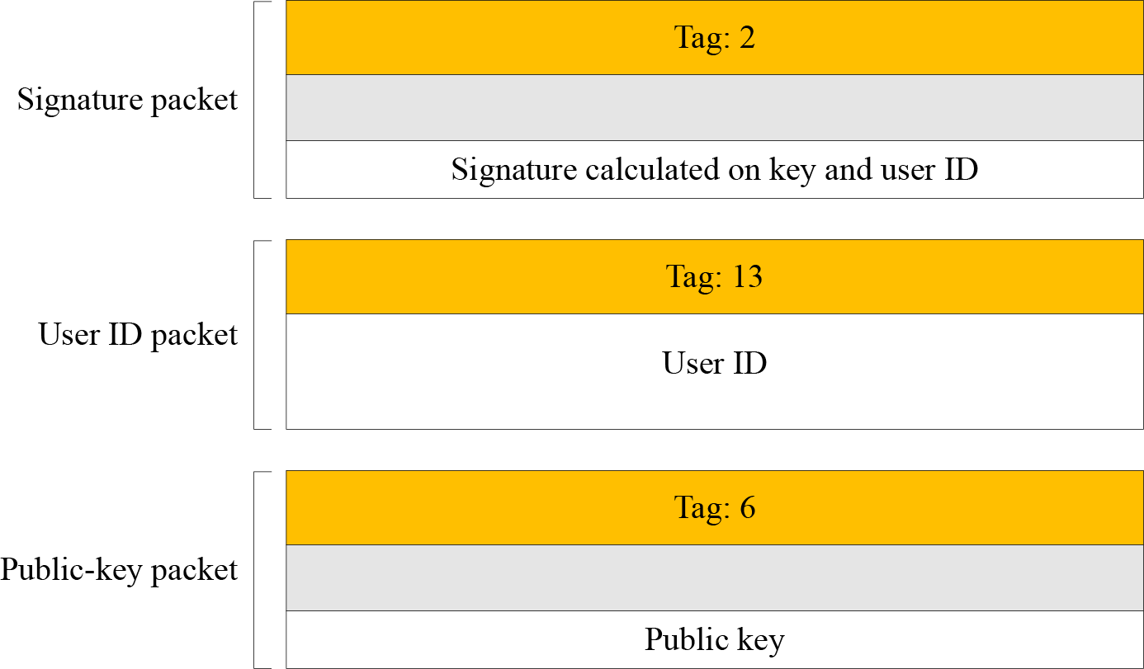
16.2.7 Continued
Figure 16.22 Certificate message

Slide 44
16-3 S/MIME
Another security service designed for electronic mail is Secure/Multipurpose Internet Mail Extension (S/MIME). The protocol is an enhancement of the Multipurpose Internet Mail Extension (MIME) protocol.
Topics discussed in this section:
16.3.1 MIME
16.3.2 S/MIME
16.3.3 Applications of S/MIME

Slide 45
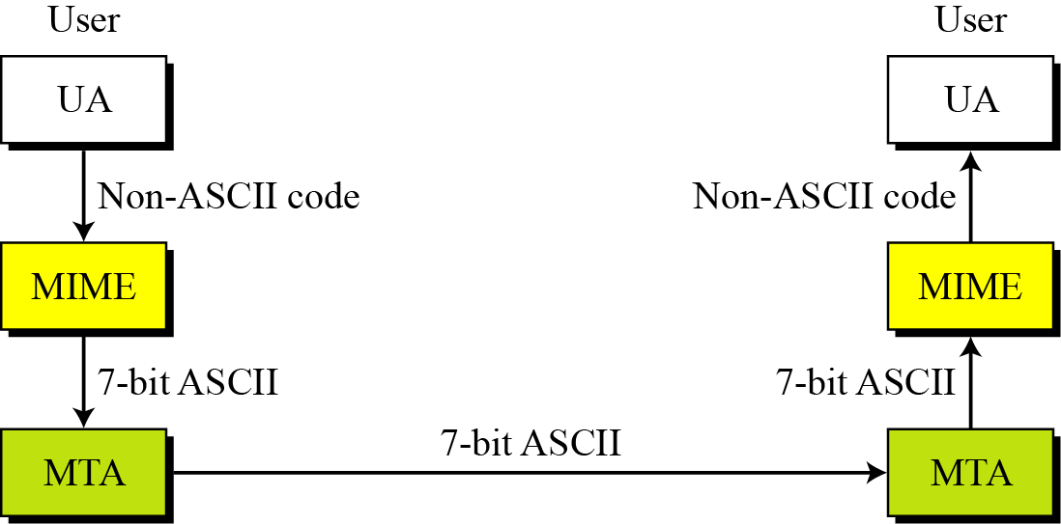
16.3.1 Continued
Figure 16.23 MIME

Slide 46
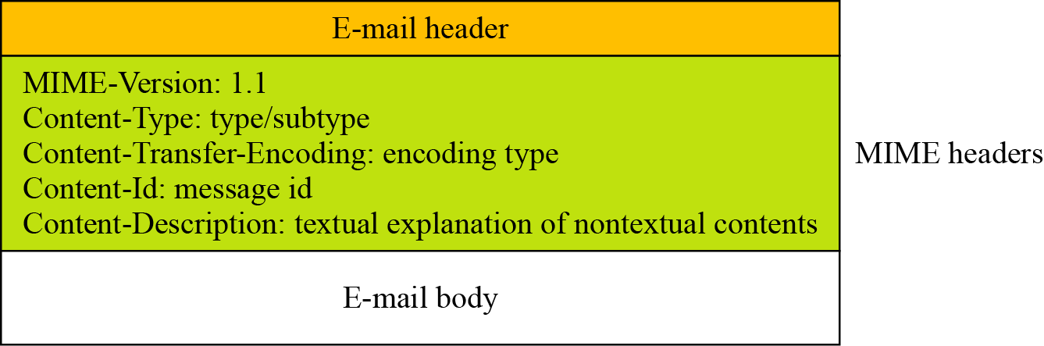
16.3.1 Continued
Figure 16.24 Teledesic

Slide 47
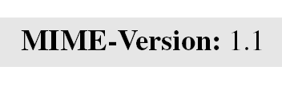
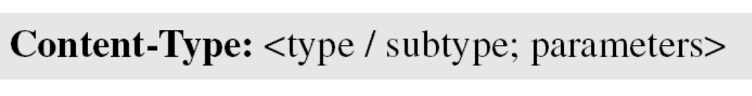
16.3.1 Continued
MIME-Version
This header defines the version of MIME used. The current version is 1.1.
Content-Type
The content type and the content subtype are separated by a slash. Depending on the subtype, the header may contain other parameters.

Slide 48
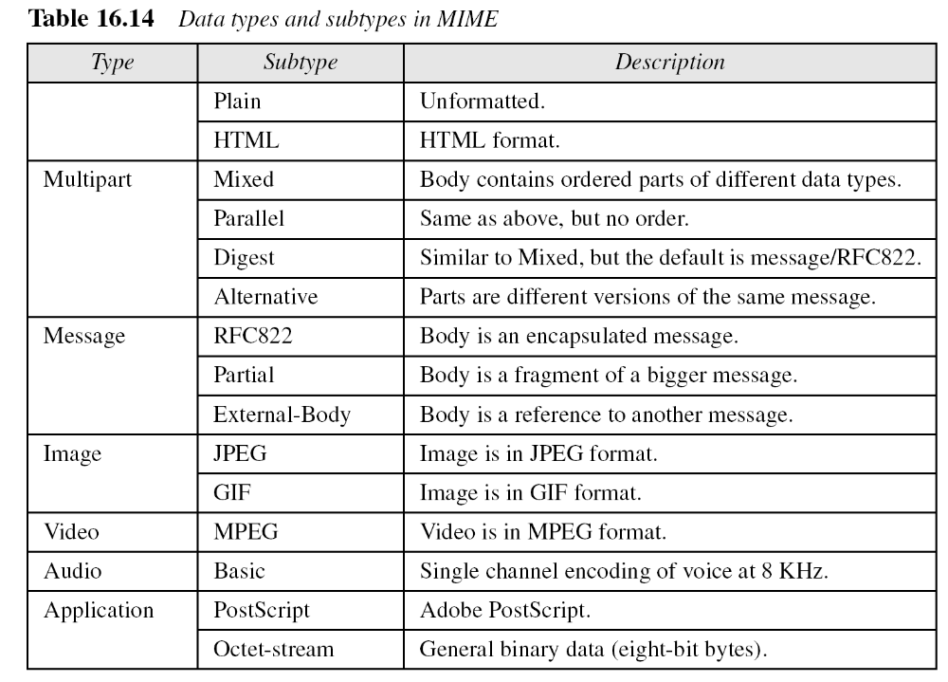
16.3.1 Continued

Slide 49
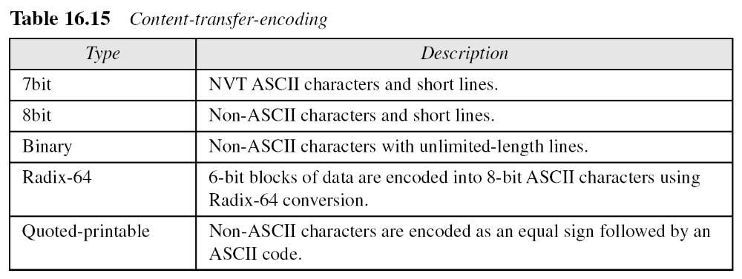
16.3.1 Continued

Slide 50
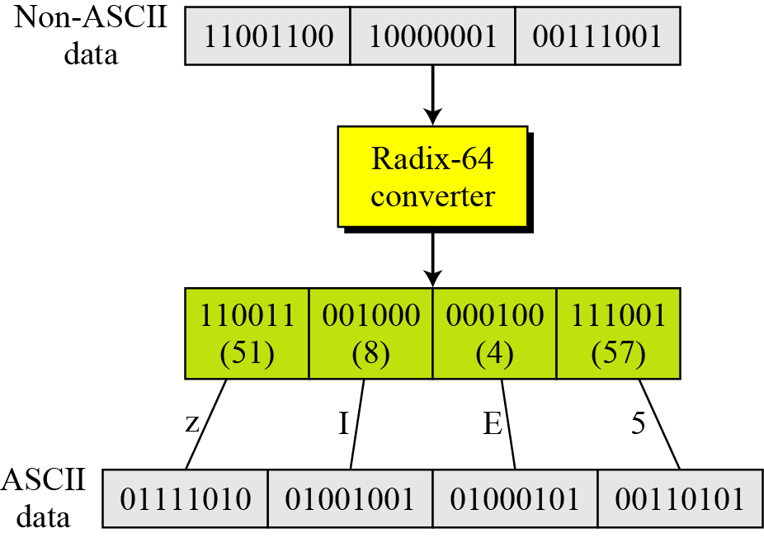
16.3.1 Continued
Figure 16.25 Radix-64 conversion

Slide 51
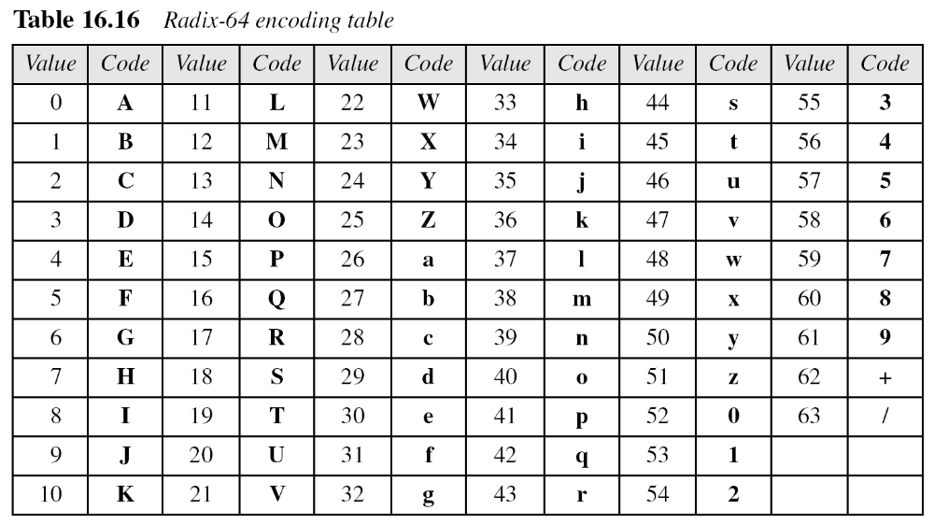
16.3.1 Continued

Slide 52
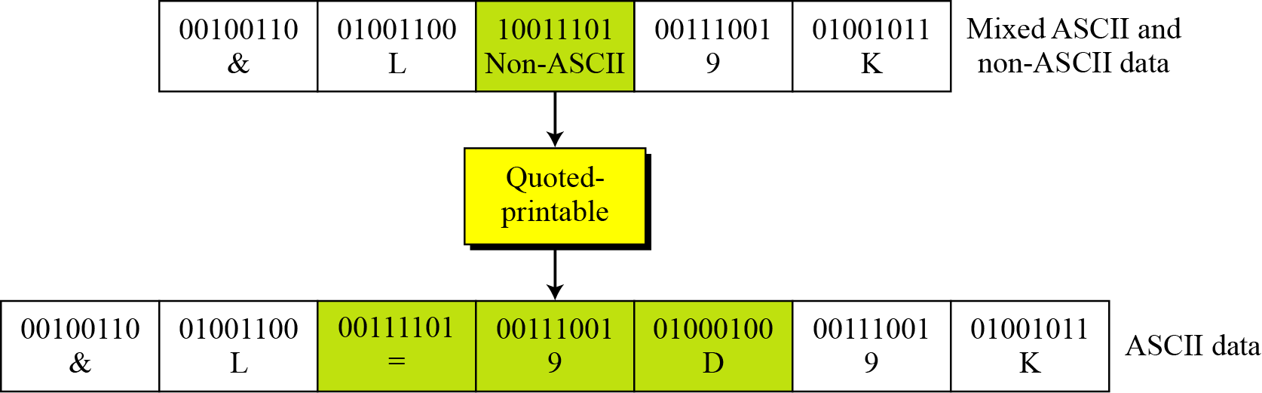
16.3.1 Continued
Figure 16.26 Quoted-printable

Slide 53
16.3.2 S/MIME
S/MIME adds some new content types to include security services to the MIME. All of these new types include the parameter “application/pkcs7-mime,” in which “pkcs” defines “Public Key Cryptography Specification.”
Cryptographic Message Syntax (CMS)
To define how security services, such as confidentiality or integrity, can be added to MIME content types, S/MIME has defined Cryptographic Message Syntax (CMS). The syntax in each case defines the exact encoding scheme for each content type. For details, the reader is referred to RFC 3369 and 3370.

Slide 54
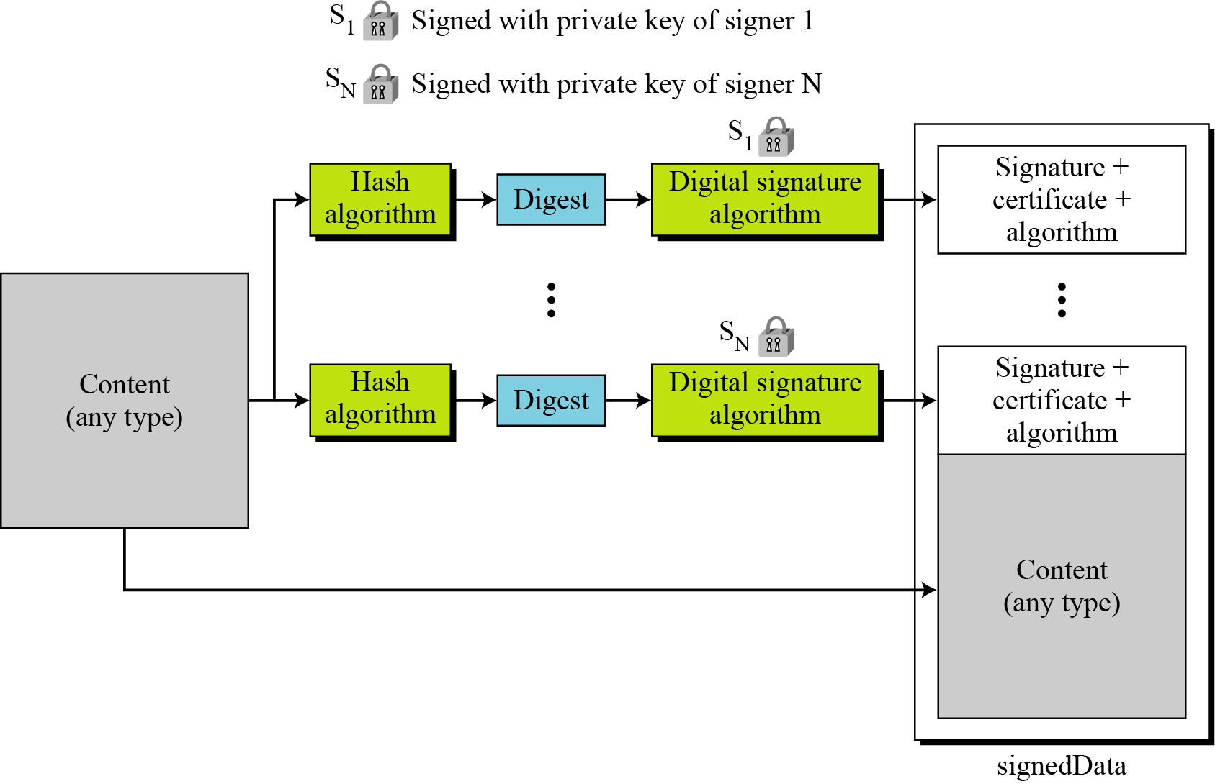
16.3.2 Continued
Figure 16.27 Signed-data content type

Slide 55
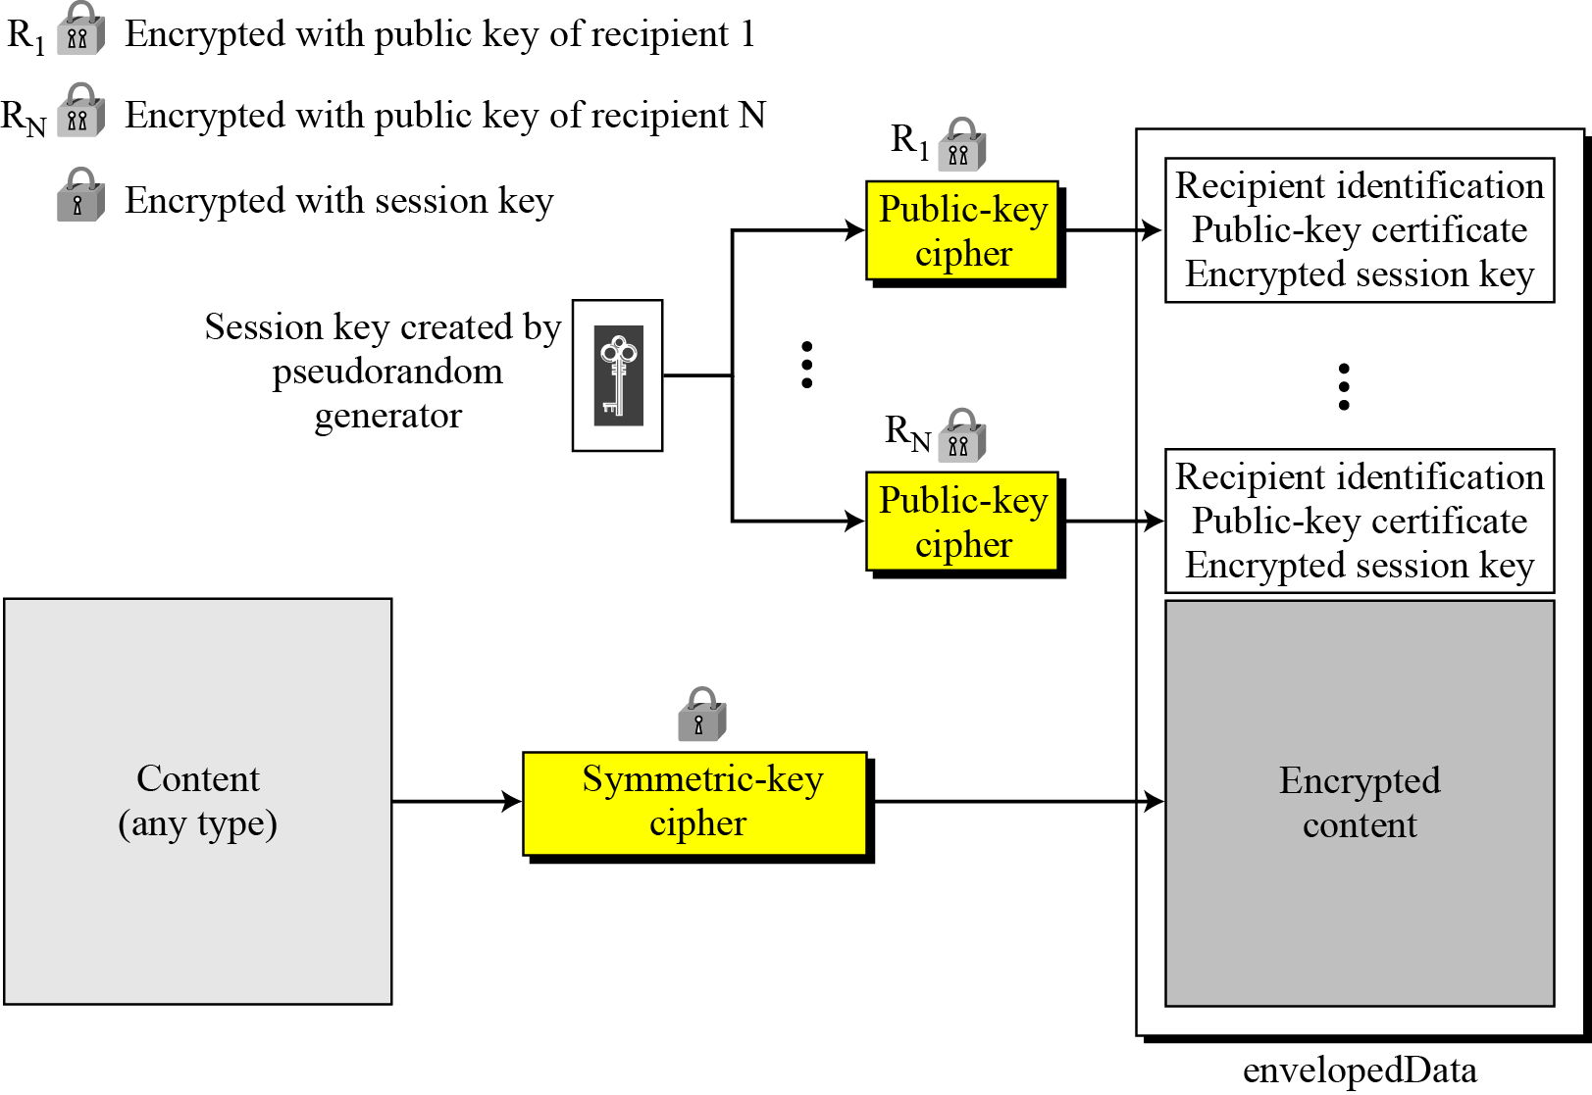
16.3.2 Continued
Figure 16.28 Enveloped-data content type

Slide 56
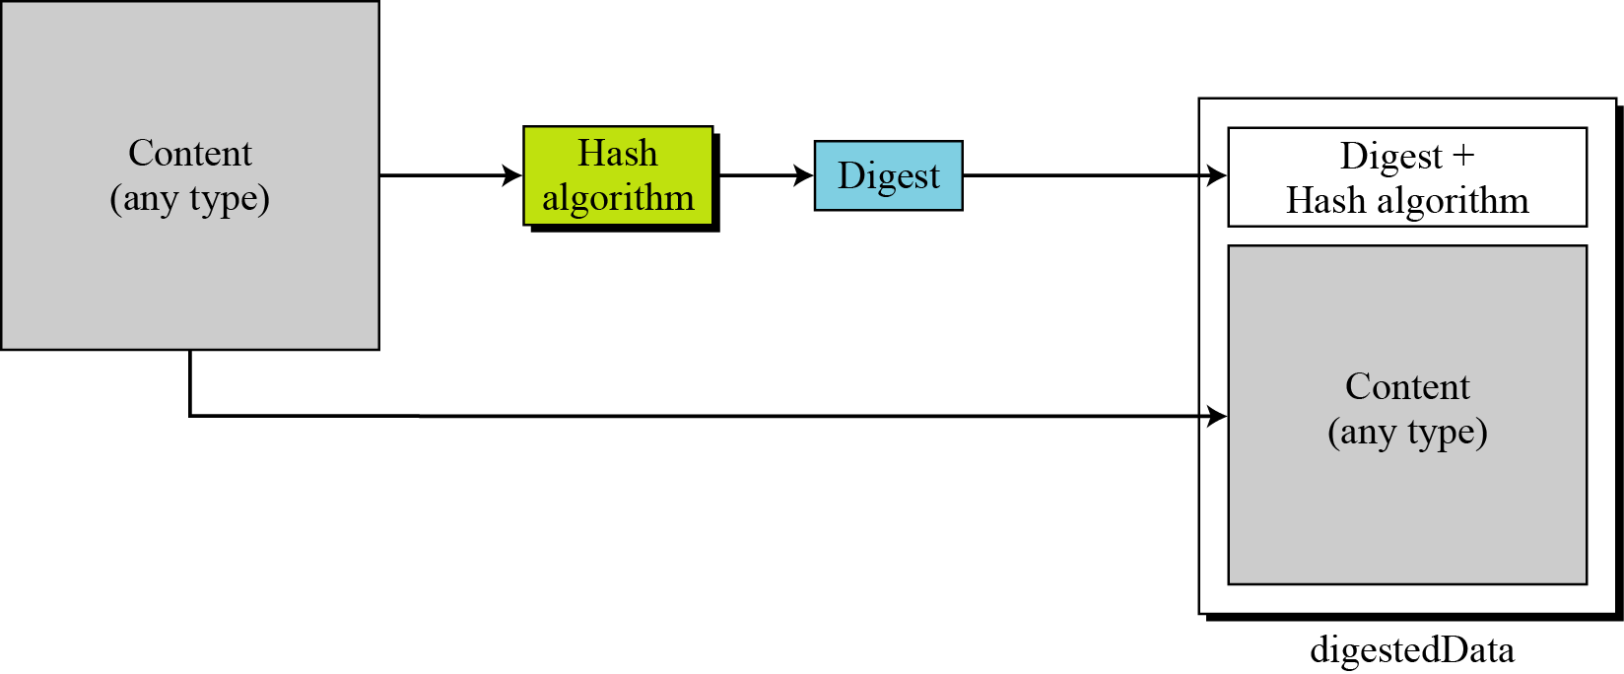
16.3.2 Continued
Figure 16.29 Digest-data content type

Slide 57
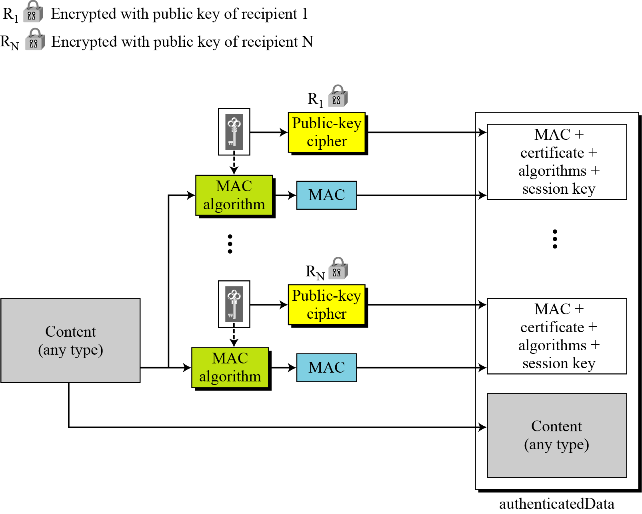
16.3.2 Continued
Figure 16.30 Authenticated-data content type

Slide 58
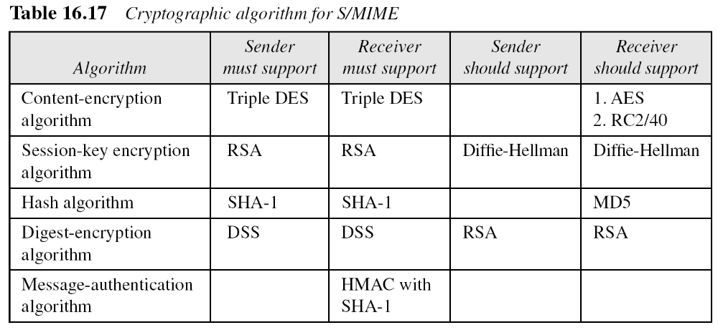
16.3.2 Continued
Cryptographic Algorithms
S/MIME defines several cryptographic algorithms. The term “must” means an absolute requirement; the term “should” means recommendation.

Slide 59
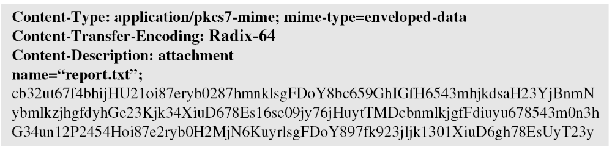
16.3.2 Continued
Example 16.3
The following shows an example of an enveloped-data in which a small message is encrypted using triple DES.

