Slide 1
PRESENTATION
SCHOOL REPORTING AND INFORMATION SYSTEM
PREPARED BY:MUCYO TUYISENGE Rene
SUPERVISED BY: Patrick NDIZEYE

Slide 2
PROJECT SUMMARY
School reporting and information system is the system developed so as to make good and convenience reporting process
Administrator will sign in the will be able to register students, teacher, and other resources like years, term, class, department, and will be able to the reports of all students.
Then other user called a teacher will sign in into the system then able to register the student’s marks
The students will sign in into the system and will be able to view their reports.

Slide 3
PROBLEM STATEMENT
In Rwanda reporting system still have the following difficulties:
Recording information like marks on paper
Calculation operation of the recorded information
Storing papers that contain some the recorded marks which can easily be damaged or lost mostly. That led bad management of some schools.
Rewriting the information recorded on paper into computer which is sometimes not accurate(errors can occur while writing)

Slide 4
OBJECTIVE OF THE PROJECT
Objective of this project is to develop reliable system that will be more useful and more accurate compared to the existing paper based system. such a way that both the dean of studies and teachers and the parents and as well as the students will be easily facilitated by this system.

Slide 5
SCOPE AND LIMITATION
This SCHOOL REPORTING AND INFORMATION SYSTEM is unlimited to be implemented into all schools that provide three term school report and also focus on every department of the school.

Slide 6
TOOLS AND TERMINOLOGY
Computer with(at least 2GHz, and 1GB of RAM)
Incremental model
Browsers (Mozilla, Internet explorer)
Software (XAMPP)

Slide 7
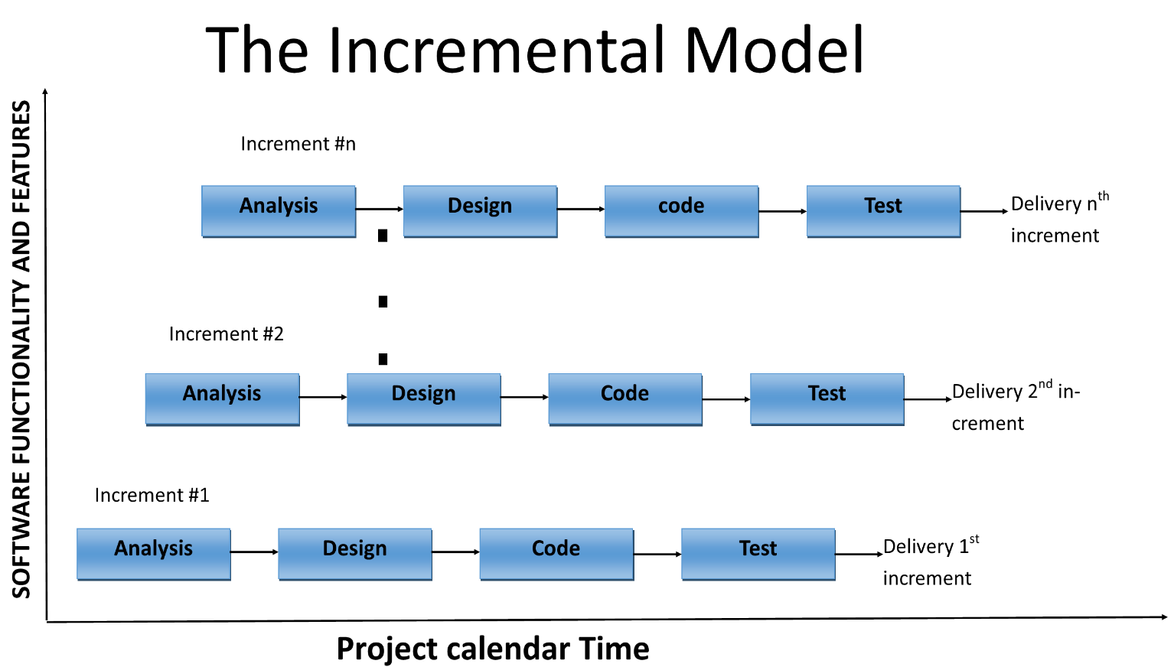
Software development model

Slide 8
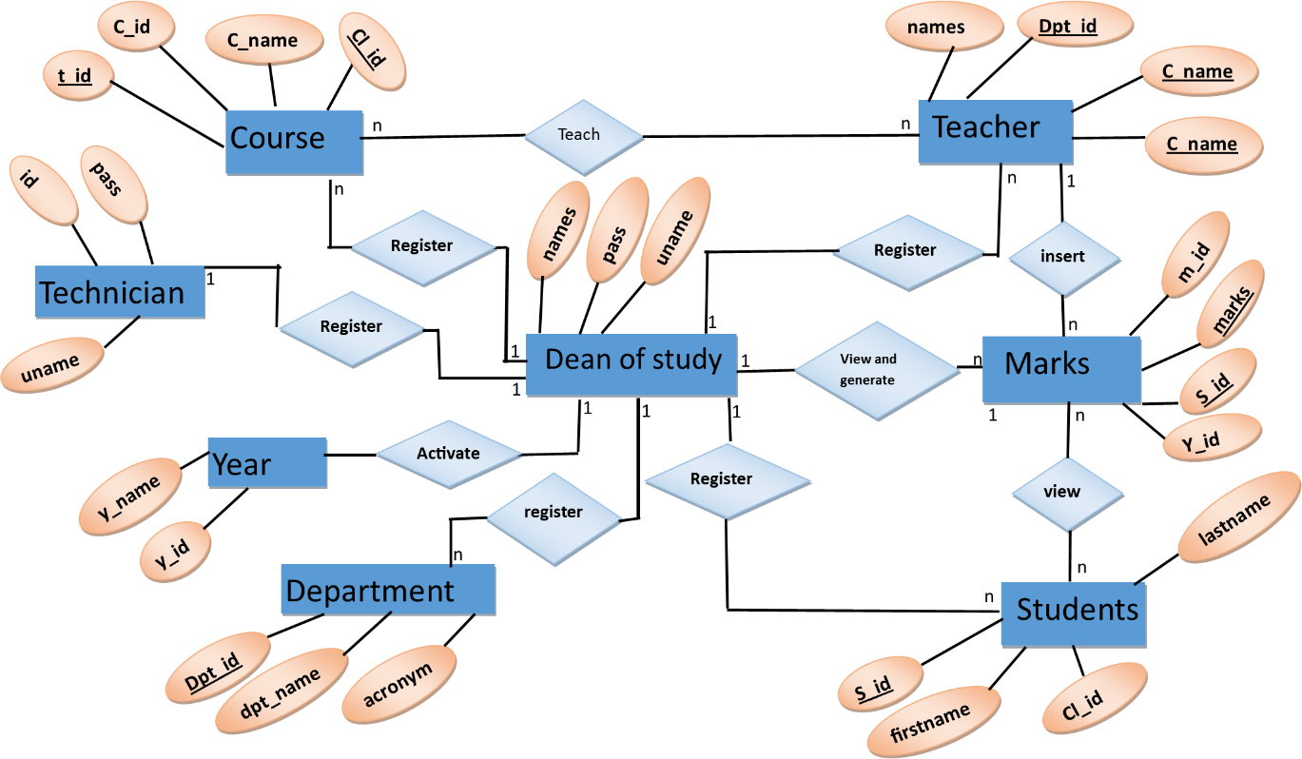
ENTITY RELATIONSHIP DIAGRAM

Slide 9
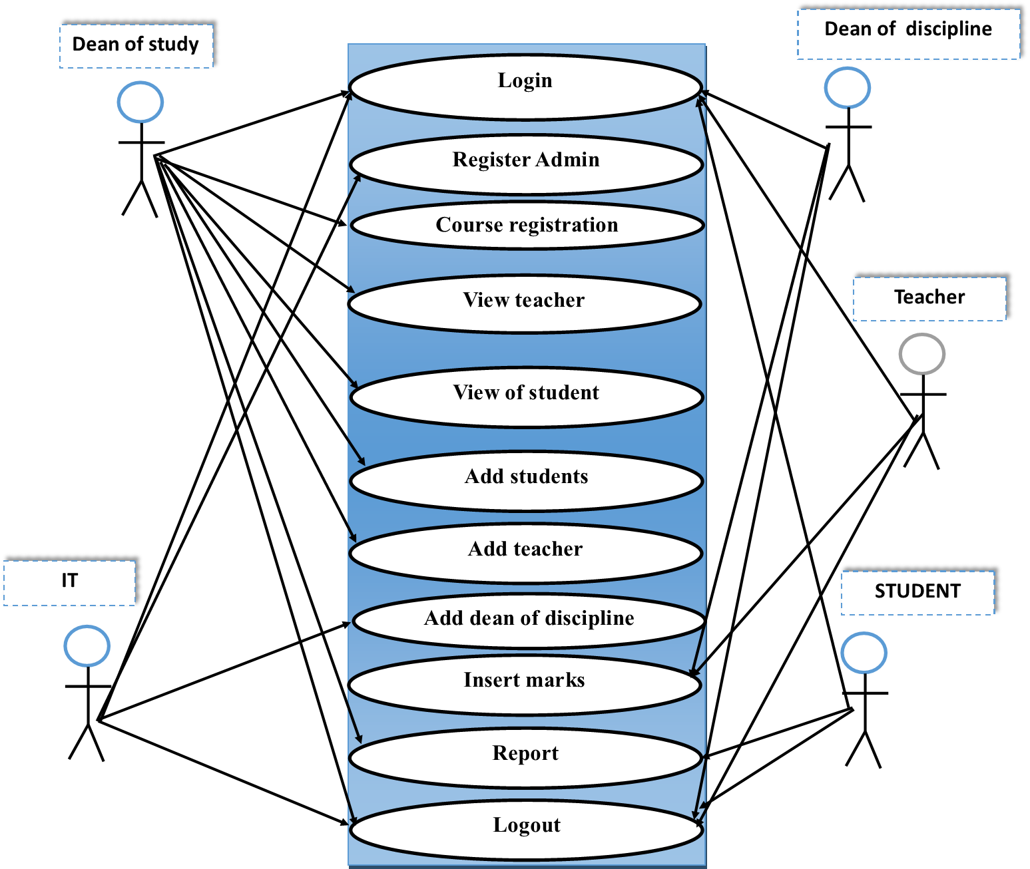
USED CASE DIAGRAM

Slide 10
PRACTICAL PART

Slide 11
CONCLUSION
This project is run successfully and it is able to be implemented at schools in Rwanda also strict adherence was made on proven application engineering principles and practices.
It is hoped that effective implementation of this application product would eliminate many problems discovered during legacy system investigation and large system that have school reporting.

Slide 12
RECOMMENDATION
As we know the end of this dissertation, we met the obstacles like:
I would like to recommend Ecole Technique saint KIZITO to provide laboratory to senior four and five student without difficulties.
I recommend my young brother to explore this system and find the problems and develop report in PDF format.
I recommend schools to implement this reporting systems into their schools.

