Slide 1
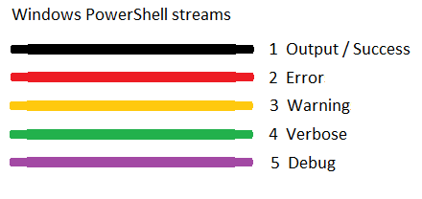
https://blogs.technet.microsoft.com/heyscriptingguy/2014/03/30/understanding-streams-redirection-and-write-host-in-powershell/

Slide 2
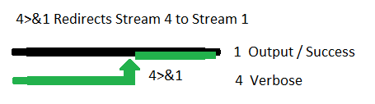
https://blogs.technet.microsoft.com/heyscriptingguy/2014/03/30/understanding-streams-redirection-and-write-host-in-powershell/

Slide 3
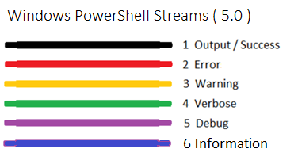
https://blogs.technet.microsoft.com/heyscriptingguy/2015/07/04/weekend-scripter-welcome-to-the-powershell-information-stream/

Slide 4
Identifier | Numeric value | Description
SilentlyContinue | 0 | When this action preference is set, the error message isn’t written to the output pipe before continuing execution. Note that it’s still added to $error, and $? is still set to false. Again, execution continues at the next line.
Stop | 1 | This error action preference changes an error from a nonterminating error to a terminating error. The error object is thrown as an exception instead of being written to the output pipe. $error and $? are still updated. Execution does not continue.
Continue | 2 | This is the default preference setting. The error object is written to the output pipe and added to $error, and $? is set to false. Execution then continues at the next script line.
Inquire | 3 | Prompts the user requesting confirmation before continuing on with the operation. At the prompt, the user can choose to continue, stop, or suspend the operation.
Ignore | 4 | Ignore the error completely (not even logging it).
Suspend | 5 | Suspend the command for further diagnosis. Supported only for workflows.
https://blogs.technet.microsoft.com/heyscriptingguy/2014/07/09/handling-errors-the-powershell-way/

