Slide 1
LAB WATCHER
Supervised By: Mr. Umer Rashid
Developed By: Muhammad Mudassar Tufail

Slide 2
Presentation Outline
Problem Definition and Related Work
Introduction
Scope
Functional Requirements
Non-Functional Requirements
Use Case Diagram
Software Architecture
Class Diagram
Tools and Programming Languages
Future enhancements

Slide 3
Problem Definition and Related Work

Slide 4
Problem Definition
Computer Labs are usually equipped with interconnected Personal Computers (PCs).
The heavy and improper utilization of the PCs in the Lab setting makes them more vulnerable to the hardware as well as the software based errors.
The technical staff usually monitors PCs, and diagnose errors in Lab settings on the regular basis or on user complaints.
The continuous monitoring of the PCs in Lab setting, the diagnosis of errors and their reporting is a frustrating and tedious task for the technical staff.
Therefore a tool required which would ease the duties of technical staff for monitoring each and every PC for errors and to maintain their information.

Slide 5
Related Work
Nagios (Monitoring Windows Machines) it is an open source powerful monitoring system.
It monitors entire IT infrastructure of the organization to ensure systems, applications, services are functioning properly in case of a problem or failure it can alert the technical staff about the issue and allowing them to fix it.
It monitors only specific attributes of the windows machines such as: Memory Usage, CPU Load, Disk Usage, Service States, running processes etc.
Windows Event log viewer is also a useful tool which shows error logs entries occurs in system during its working.
Windows applications write entry in log when information, warning, or error event occurs which is sometime very useful to diagnose and troubleshoot problems from the system.

Slide 6
What are their defects and What’s new?

Slide 7
Nagios Installation and configuration is difficult because we need to do extra work of configuration and mostly things are done manually.
Secondly it requires special Nagios Monitoring server and its has to be configured to communicate with agent running on window machine so it requires extra technical skills of the staff.
Windows Event log viewer only log error entries on local machine and administrators of the machine are responsible for checking and diagnosing the problem.
Secondly it only monitors system and application events not the resource utilization and performance of the systems, which is very crucial for computer labs.
LAB WATCHER is a useful tool which not only do the work of Nagios but also Windows event log viewer, it monitors system resources, hardware and software based errors and warnings as well.

Slide 8
INTRODUCTION

Slide 9
Introduction
LAB WATCHER is a windows based errors, warnings as well as system resource monitoring system.
It actively monitors hardware and software errors, warnings and their statuses, and actively reporting them to technical staff.
When error occurs it send error description to server side web application where technical staff is responsible for troubleshooting problem from computer.
Also System is easily manageable and easy to operate, which will provide ease to technical staff.
It mainly consist of two modules PC Monitoring Service (Client Side) and Online Web Application (Server Side)

Slide 10
Scope

Slide 11
Scope
System will provide ease to technical staff and will actively monitor PCs for hardware and software based errors.
System will report error and warning events.
System will report hardware and computer status.
System will provide facility to manage these errors and hardware reports.
System will provide facility to administrator to manage lab technical staff.

Slide 12
Functional Requirements

Slide 13
Functional Requirements
System should provide a login/logout option to users (administrator and technical staff).
System should provide a setup wizard to users (administrator and technical staff) to install or uninstall the PC Monitoring Service.
System should provide staff management facility to administrator so that administrator can add, view, edit and delete technical staff.
System should provide view and management of Error reports so that users (administrator and technical staff) can view and delete error reports.
System should provide generate report facility to users (administrator and technical staff) so that they can view specific error reports and computers information.
System should provide update profile feature to users (administrator and technical staff).

Slide 14
Non-Functional Requirements

Slide 15
Non-Functional Requirements
Availability
Security
Maintainability

Slide 16
Use Case Diagram

Slide 17
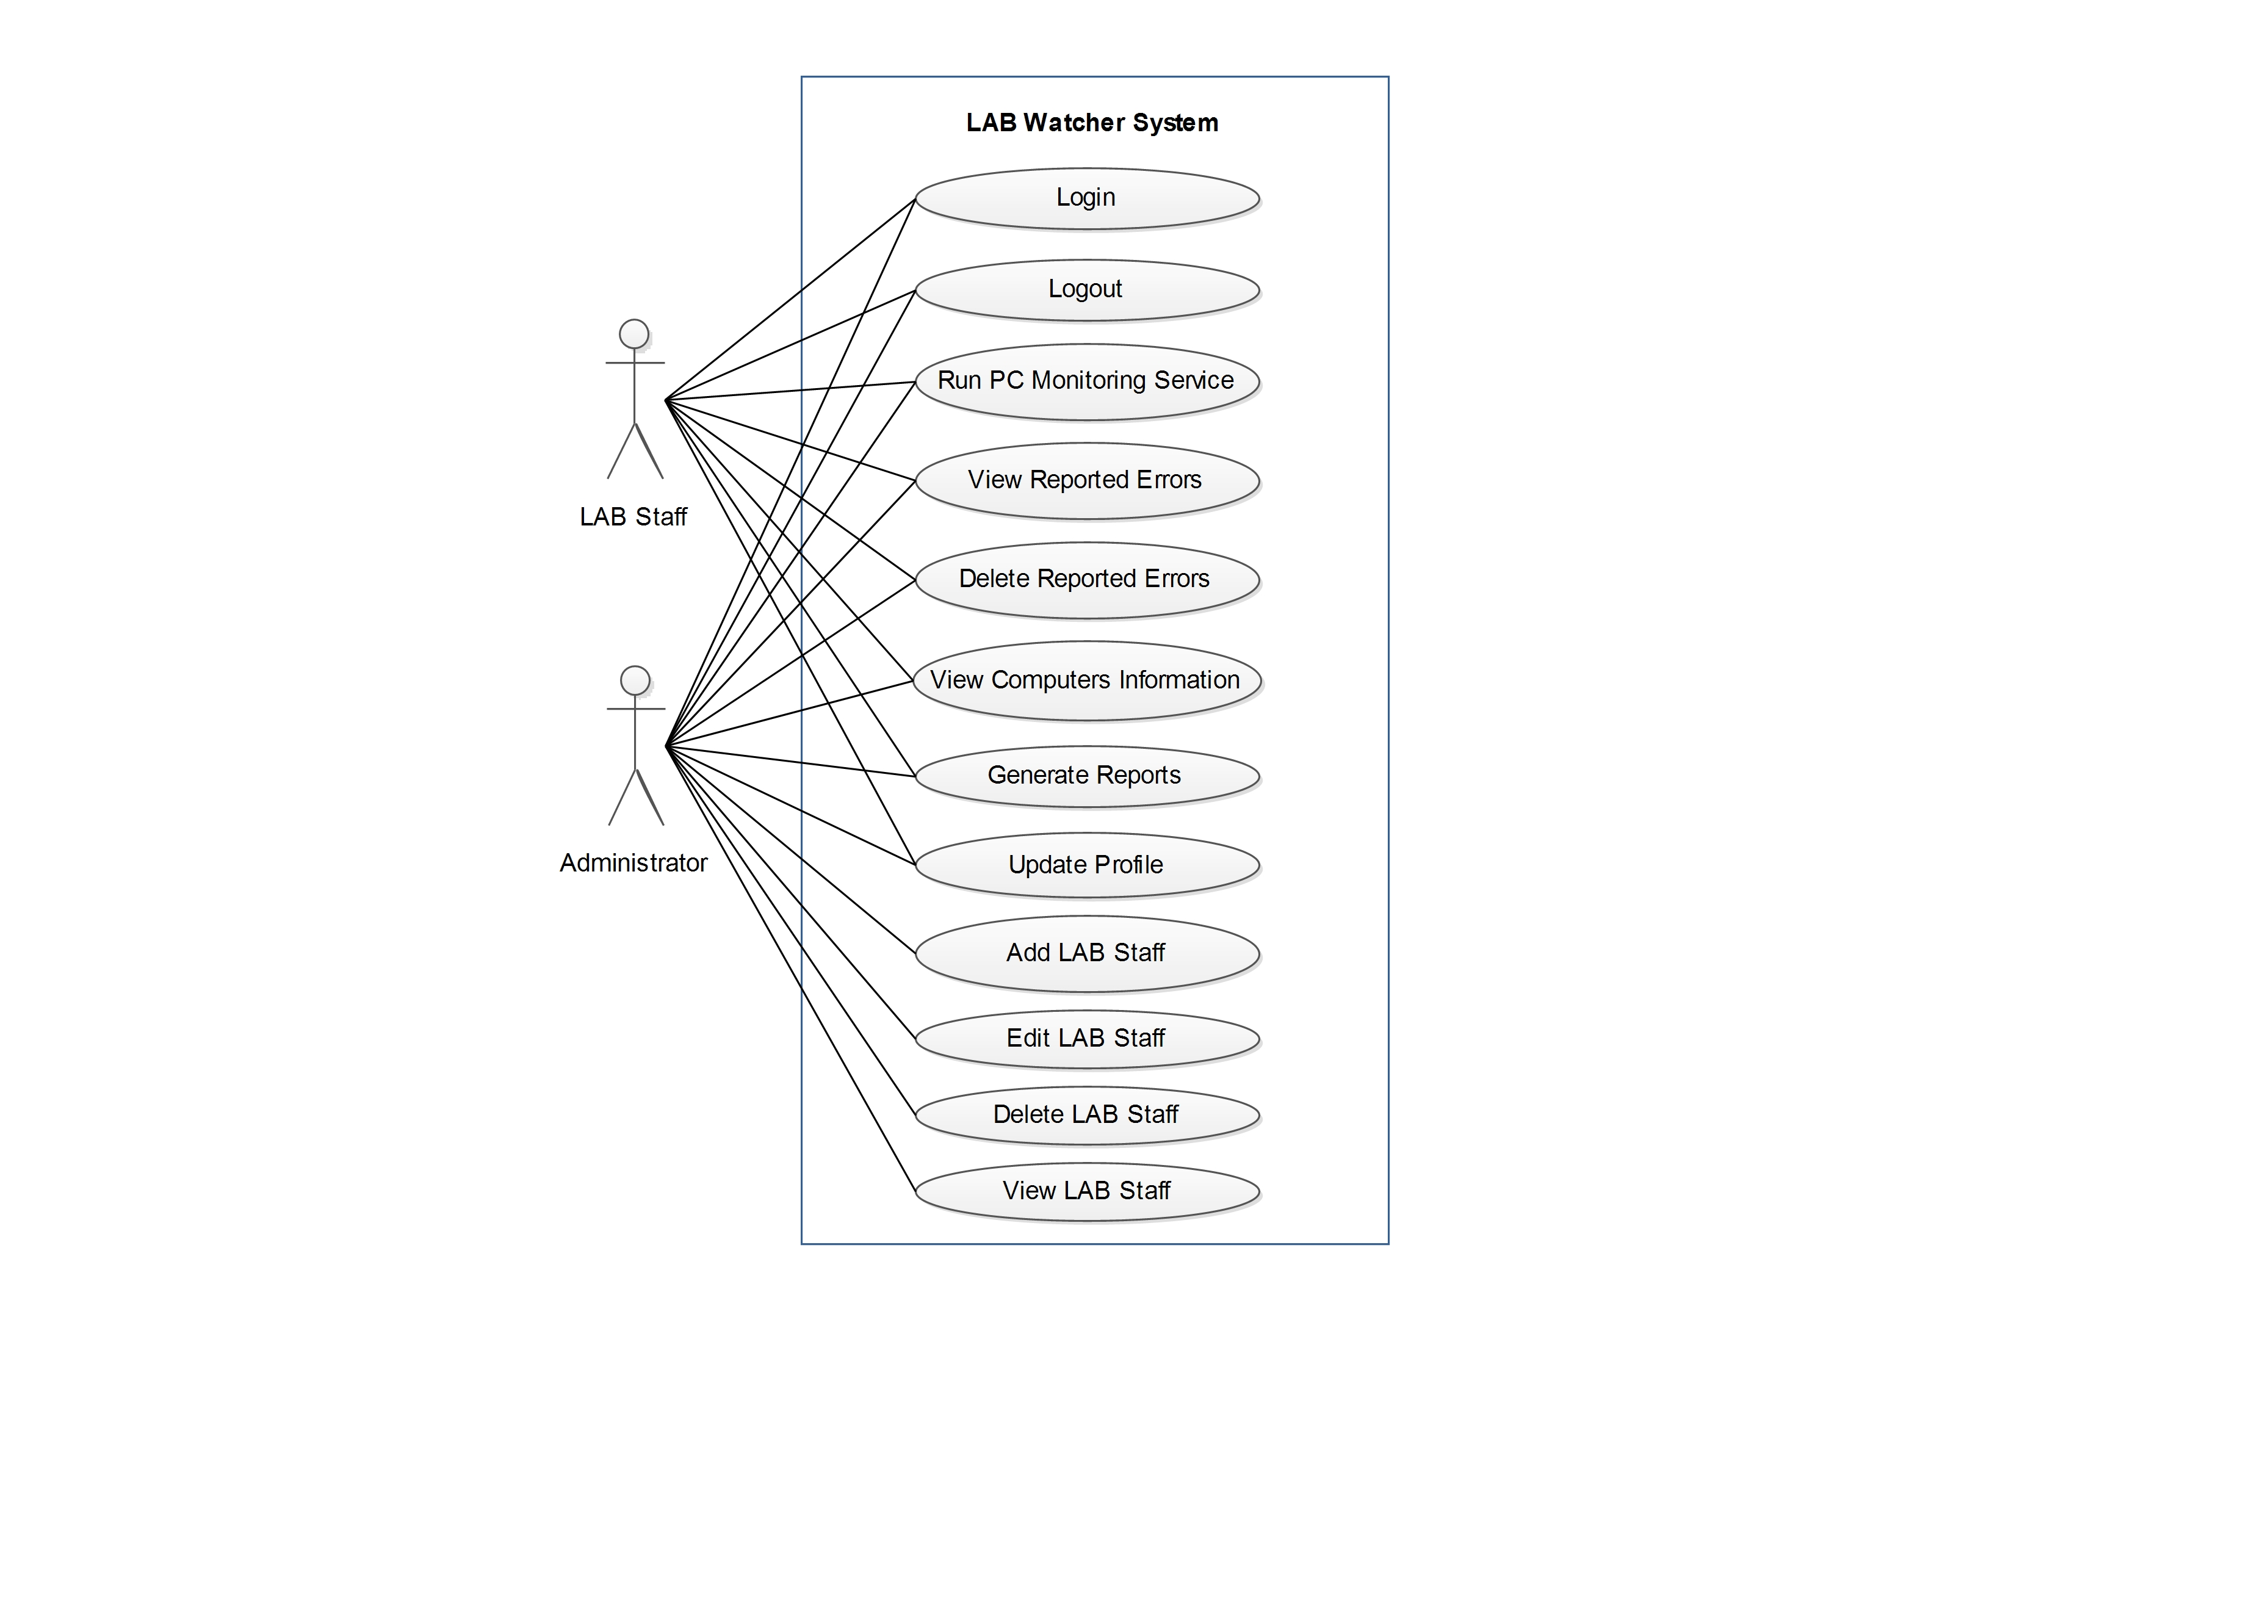
Use case diagram
Figure 1. Use Case Diagram

Slide 18
Software Architecture

Slide 19
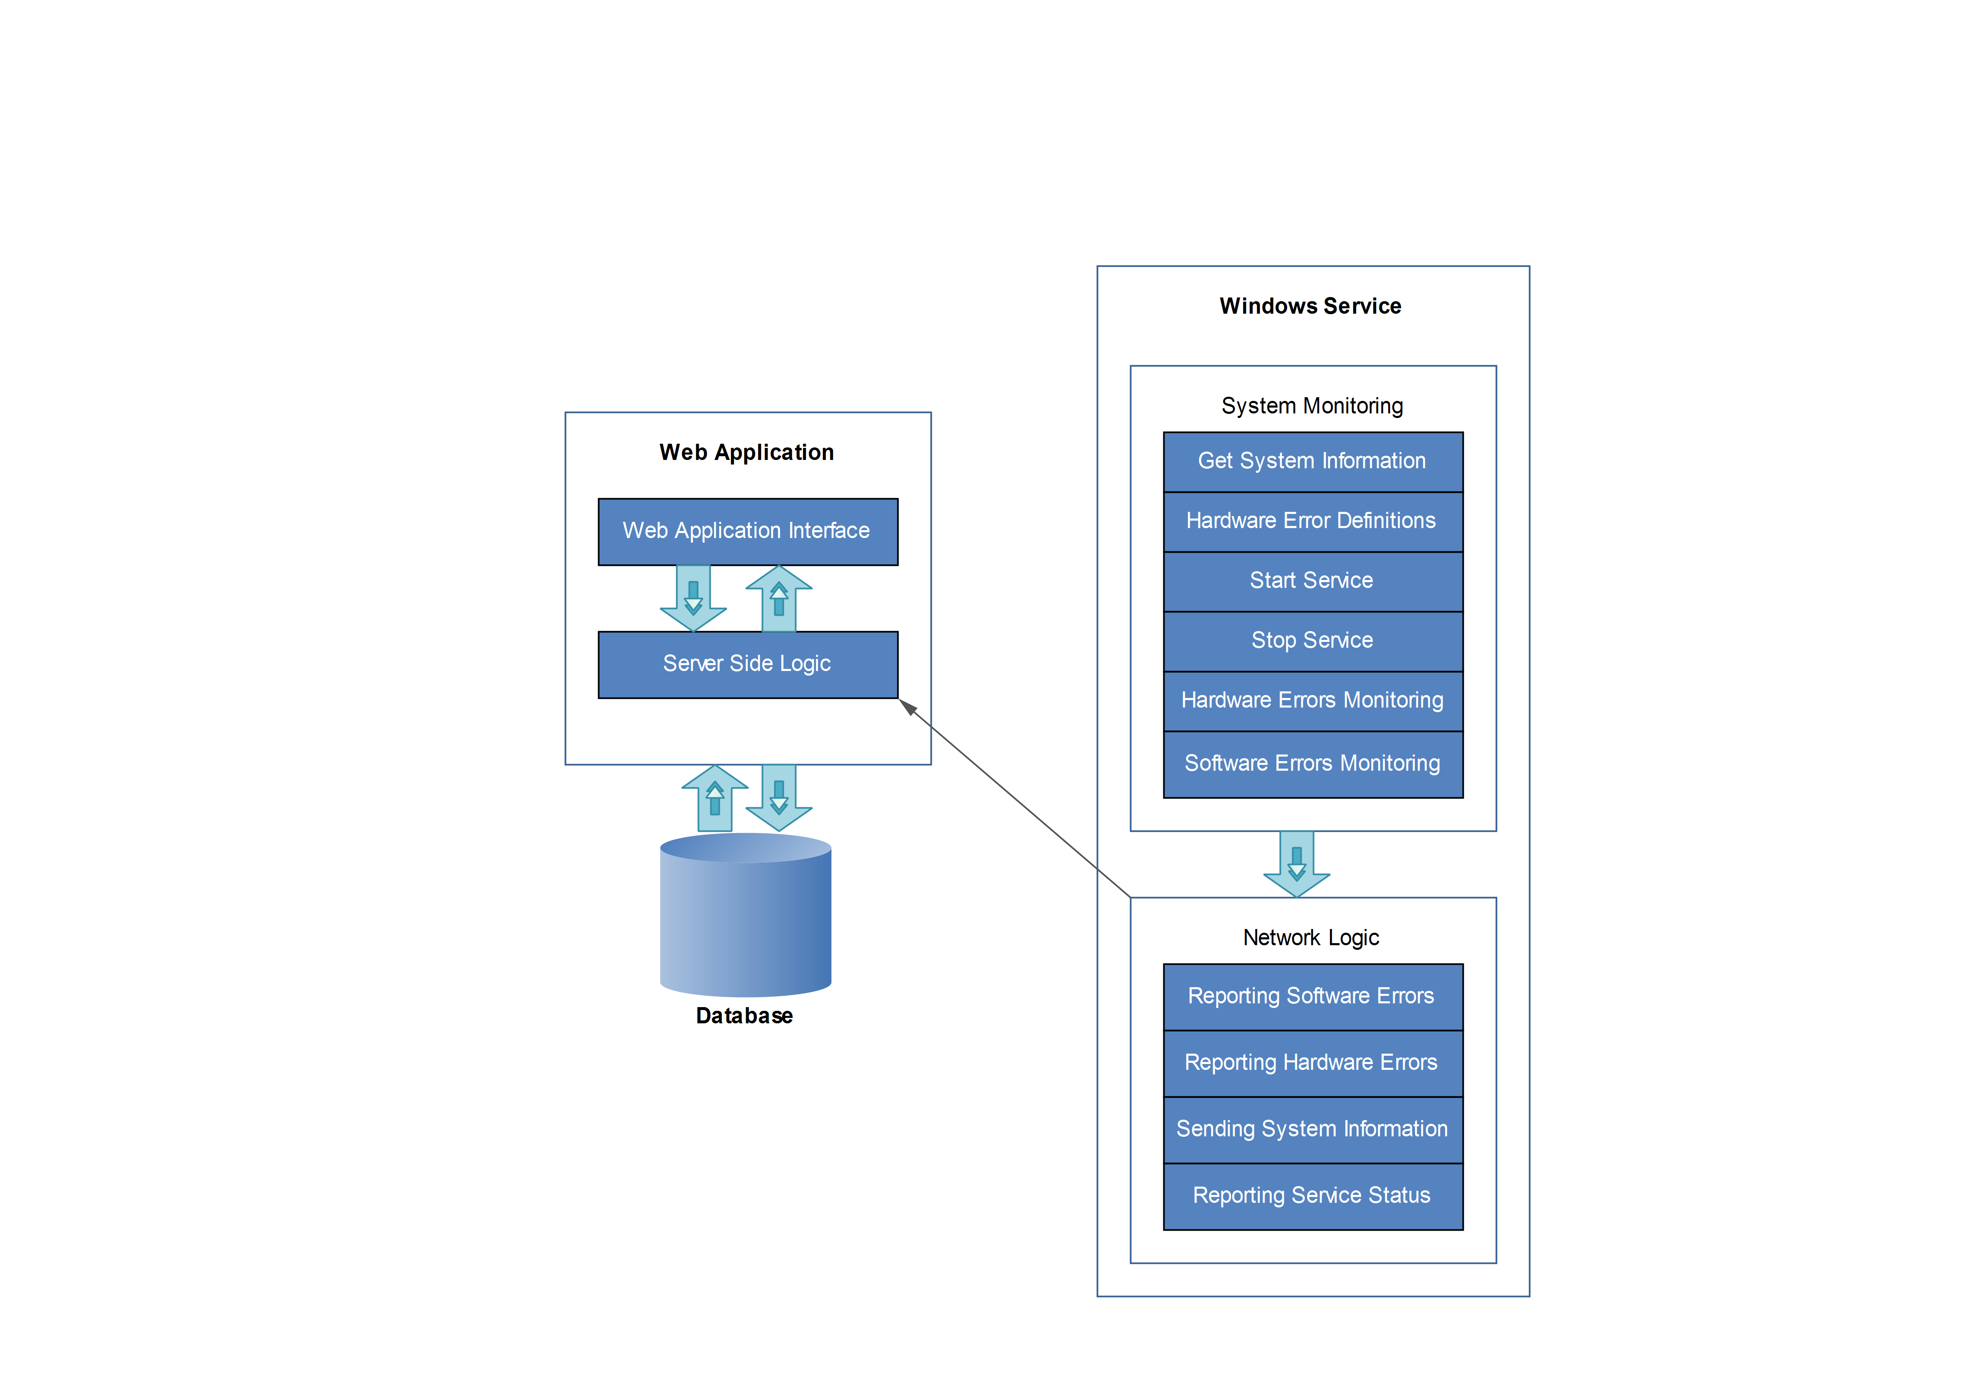
Figure 2. Software Architecture (Client/Server Style)
Client
Network
Server

Slide 20
Class Diagram

Slide 21
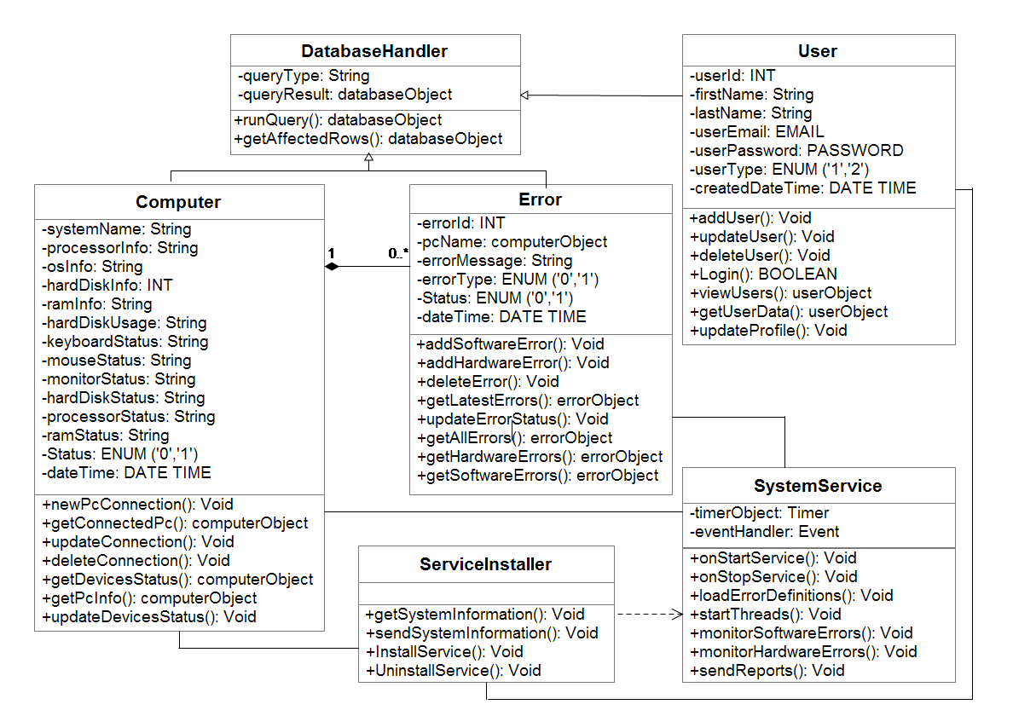
Figure 3. Class Diagram

Slide 22
Tools and Programming Languages

Slide 23
Tools and Programming Languages
Following tools and programming languages are used in the development:
C#.NET (PC Monitoring Service)
Core PHP (Online Web Application)
MySQL (Database)

Slide 24
Future Enhancements

Slide 25
Future Enhancements
This system can be enhanced further in lots of ways.
Presently its main focus is common hardware and software errors monitoring and some basic resource monitoring.
Remote PC administration facility can be added to monitor computer labs effectively.

Slide 26
Any Questions?

Slide 27
Thank You !!!

