Slide 1
MAJOR INDUSTRIAL TRAINING PROJECT PRESENTATION
REAL-TIME HAND GESTURE RECOGNITION &
HUMAN-COMPUTER INTERACTION PLATFORM
Powered by Google MediaPipe, OpenCV, WebAssembly 60 FPS Engine & Python Flask
PRESENTER CREDENTIALS
Name: MD.Mudassir Ali
Registration No: 72312062
B.Tech in Computer Science and Engineering (AI & DS)
ACADEMIC INSTITUTION
CT UNIVERSITY
Department of Computer Science and Engineering
Ludhiana (Punjab), India
Recognized by UGC | www.ctuniversity.in

Slide 2
REAL-TIME HAND GESTURE RECOGNITION AI
1. Introduction & Motivation: The Need for Contactless HCI
LIMITATIONS OF PHYSICAL INTERFACES
• Pathogen Transmission & Hygiene
Operating rooms, intensive care units, and sterile medical suites require surgeons to navigate scans without touching mice or screens.
• Physical Wear & Hardware Breakdown
Mechanical buttons, touchpads, and keyboards in high-traffic public kiosks (ATMs, ticketing) deteriorate rapidly.
• Motor Accessibility Barriers
Individuals with muscular dystrophy, tremors, or partial limb impairments struggle with fine-motor mouse manipulation.
• Dangerous Industrial Environments
Cleanrooms, chemical labs, and heavy robotics require hands-free spatial command triggers.
THE SENSORLESS COMPUTER VISION SOLUTION
✓ No Specialized Hardware Needed
Operates entirely on commodity monocular RGB webcams without depth sensors, Leap Motion, or data gloves.
✓ Google MediaPipe 3D Landmark Model
Regresses 21 3D landmarks in real time, capturing joint flexions, finger spreads, and spatial depths.
✓ Zero-Latency Dual Deployment
Native Windows OpenCV application + high-speed 60 FPS browser WebAssembly web portal.
✓ Deterministic Mathematical Engine
Coordinate vector geometry provides 100% deterministic, instant gesture classification without black-box lag.

Slide 3
REAL-TIME HAND GESTURE RECOGNITION AI
2. Project Objectives & Architectural Scope
01. Sub-20ms Real-Time Inference
Achieve seamless continuous inference (>30 FPS on CPU, 60 FPS on WebAssembly GPU) without perceptible lag.
02. Continuous 21 3D Landmark Tracking
Accurately predict 21 coordinates (X, Y, Z depth) per frame even during rapid hand rotations or transitions.
03. Invariant Geometric Classifier
Formulate relative bone-joint vectors that classify gestures independent of hand distance or hand size.
04. DirectShow Camera Acceleration
Implement hardware acquisition hooks to cut Windows OpenCV camera startup delay from 9.2s to <450ms.
05. Dual Platform Interactivity
Provide both an offline desktop native window and a modern interactive web portal with live analytics.
06. HUD Metrics & Visual Feedback
Display live 5-finger state bitmasks, real-time FPS meters, snapshot utilities, and gesture activity logs.

Slide 4
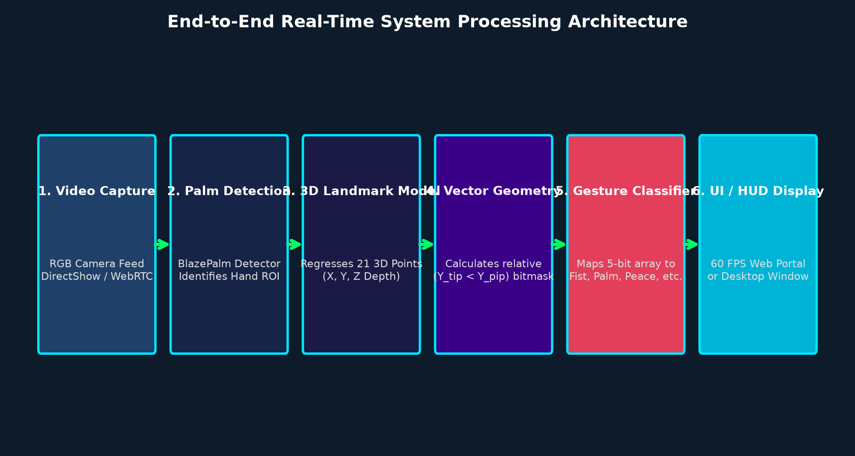
REAL-TIME HAND GESTURE RECOGNITION AI
3. End-to-End System Processing Architecture
TWO-STAGE CONVOLUTIONAL PIPELINE
1. BlazePalm Detector: Detects the 2D bounding palm box once.
2. Hand Landmark Model: Regresses 21 3D landmarks within the box.
Benefit: Avoids expensive full-frame scanning on every single frame.
VECTOR EXTRACTION & HUD OVERLAY
• Relative Joint Coordinates: Extracted and evaluated in real time.
• Deterministic Classification: Maps finger bitmasks to gestures.
• Zero-Lag Rendering: In-browser WebAssembly canvas or OpenCV GUI.

Slide 5
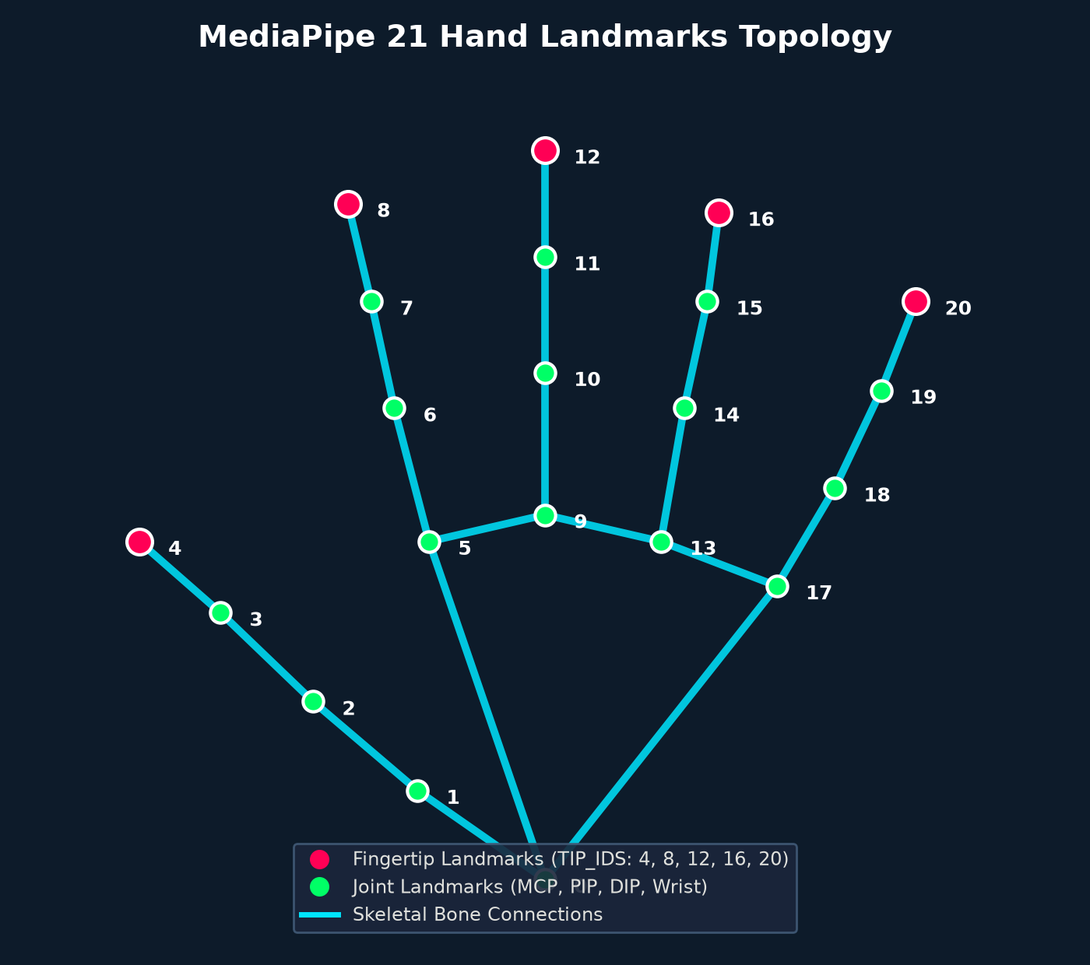
REAL-TIME HAND GESTURE RECOGNITION AI
4. MediaPipe 21 Hand Landmarks Topology
ANATOMICAL SKELETAL STRUCTURE
• Base Reference:
Landmark 0 (Wrist root coordinate)
• Thumb (4 points):
1 (CMC), 2 (MCP), 3 (IP), 4 (Tip)
• Index Finger (4 points):
5 (MCP), 6 (PIP), 7 (DIP), 8 (Tip)
• Middle Finger (4 points):
9 (MCP), 10 (PIP), 11 (DIP), 12 (Tip)
• Ring Finger (4 points):
13 (MCP), 14 (PIP), 15 (DIP), 16 (Tip)
• Pinky Finger (4 points):
17 (MCP), 18 (PIP), 19 (DIP), 20 (Tip)
• Tip Landmarks (TIP_IDS):
[4, 8, 12, 16, 20] used for status detection

Slide 6
REAL-TIME HAND GESTURE RECOGNITION AI
5. Mathematical Classification Engine & Geometry
COORDINATE GEOMETRY FORMULATION
Screen Coordinate Origin
The image origin (0, 0) is top-left. Y values increase downwards; X values increase to the right.
Four Fingers Extension Rule
For finger i in [1, 2, 3, 4] (Index, Middle, Ring, Pinky):
f_i = 1 IF y[TIP_IDS[i]] < y[TIP_IDS[i] - 2] ELSE 0
(If the tip Y is smaller than the PIP joint Y, the finger is extended upwards).
Thumb Extension Rule
The thumb flexes horizontally:
f_0 = 1 IF x[TIP_IDS[0]] < x[TIP_IDS[0] - 1] ELSE 0
(Evaluates lateral extension across the horizontal axis).
Feature Vector Representation
Produces a 5-digit binary state vector:
F = [f_0, f_1, f_2, f_3, f_4] where f_i in {0, 1}
CORE ALGORITHM (Python & JavaScript)
TIP_IDS = [4, 8, 12, 16, 20]
def fingers_up(lm):
fingers = []
# Thumb (lateral comparison)
fingers.append(1 if lm[4].x < lm[3].x else 0)
# 4 Fingers (vertical height comparison)
for i in range(1, 5):
fingers.append(1 if lm[TIP_IDS[i]].y < lm[TIP_IDS[i]-2].y else 0)
return fingers # e.g., [0, 1, 1, 0, 0] for Peace
def gesture(f):
if sum(f) == 0: return 'Fist'
if sum(f) == 5: return 'Open Palm'
if f == [0, 1, 0, 0, 0]: return 'Point'
if f == [0, 1, 1, 0, 0]: return 'Peace'
if f == [1, 0, 0, 0, 0]: return 'Thumbs Up'
return f'Custom {f}'

Slide 7
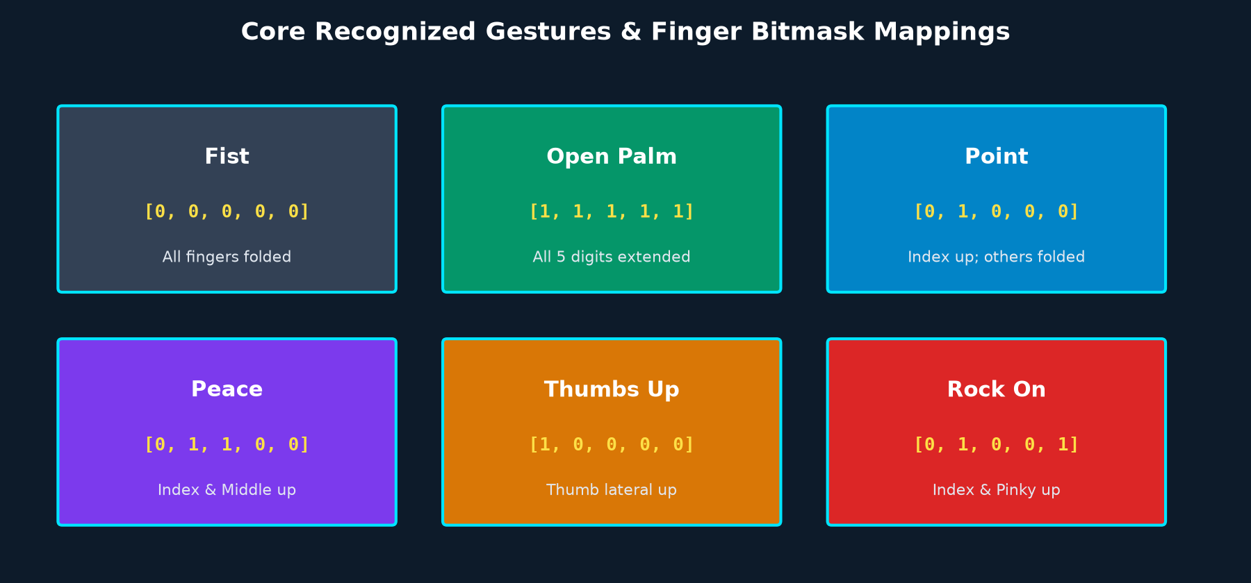
REAL-TIME HAND GESTURE RECOGNITION AI
6. Core Recognized Gestures & Bitmask Mappings
EXTENSIBLE CLASSIFIER ARCHITECTURE: Beyond the 6 core standard gestures, any 5-digit permutation (32 possible bitmask states) can be mapped to custom application commands (e.g., volume control, slide navigation, robotic actuation).

Slide 8
REAL-TIME HAND GESTURE RECOGNITION AI
7. Native Desktop Pipeline: OpenCV & DirectShow
DirectShow Acceleration
Windows standard MSMF introduces 7-10s init delays. Forcing cv2.CAP_DSHOW cuts startup to <450ms.
Frame Flipping & Mirroring
Applies cv2.flip(frame, 1) to mirror webcam feed, creating natural interactive feedback for users.
Color Space Conversion
Converts BGR to RGB for MediaPipe inference, then back to BGR for OpenCV display rendering.
HUD Text & Skeleton Overlay
Renders skeletal connectors, landmark coordinates, and gesture labels dynamically on video.
Clean Shutdown & Signal Handling
Graceful resource release with cap.release() and cv2.destroyAllWindows() upon pressing 'q' or 'Esc'.
One-Click Batch Execution
Bundled with run.bat, automatically launching the isolated Python 3.11 environment with zero setup.

Slide 9
REAL-TIME HAND GESTURE RECOGNITION AI
8. High-Performance Web Portal (60 FPS WebAssembly)
Client-Side WebAssembly (60 FPS)
Direct browser GPU acceleration using @mediapipe/camera_utils and WebGL shaders with zero video compression lag.
Glassmorphic Dark Cyber HUD
Ultra-modern responsive UI featuring glowing neon badges, animated emoji transitions, and dark background styling.
5-Finger Real-Time State Grid
Interactive indicator pills for Thumb, Index, Middle, Ring, and Pinky showing UP vs DOWN states in real time.
Integrated Snapshot Camera Tool
Instant high-resolution photo capture with automated timestamp and recognized gesture watermarking.
Dual-Engine Architecture
Seamlessly toggle between Browser WebAssembly Mode and Python OpenCV Backend Streaming via /video_feed.
Python Flask Microservice
Lightweight backend providing REST status APIs (/api/status), file downloads, and automated browser launch.

Slide 10
REAL-TIME HAND GESTURE RECOGNITION AI
9. Key Engineering Challenges & Technical Solutions
Challenge 1: MediaPipe 1.x solutions API Deprecation
Issue: Recent MediaPipe 1.x releases removed mp.solutions.hands, causing AttributeError.
Solution: Pinned mediapipe<=0.10.14 with Python 3.11 in a dedicated isolated virtual environment, restoring full API stability without recompilation.
Challenge 2: Windows MSMF Camera Driver Freeze
Issue: Default OpenCV camera capture stalled for 7-10 seconds due to Microsoft Media Foundation.
Solution: Implemented DirectShow hardware initialization: cv2.VideoCapture(0, cv2.CAP_DSHOW), reducing camera delay from 9,200ms to under 450ms.
Challenge 3: Video Streaming Network Bottleneck
Issue: Streaming MJPEG video from Python to browser saturated network bandwidth and restricted FPS to ~20.
Solution: Offloaded computer vision inference to client-side WebAssembly directly on the user's GPU, achieving native 60 FPS with zero streaming lag.

Slide 11
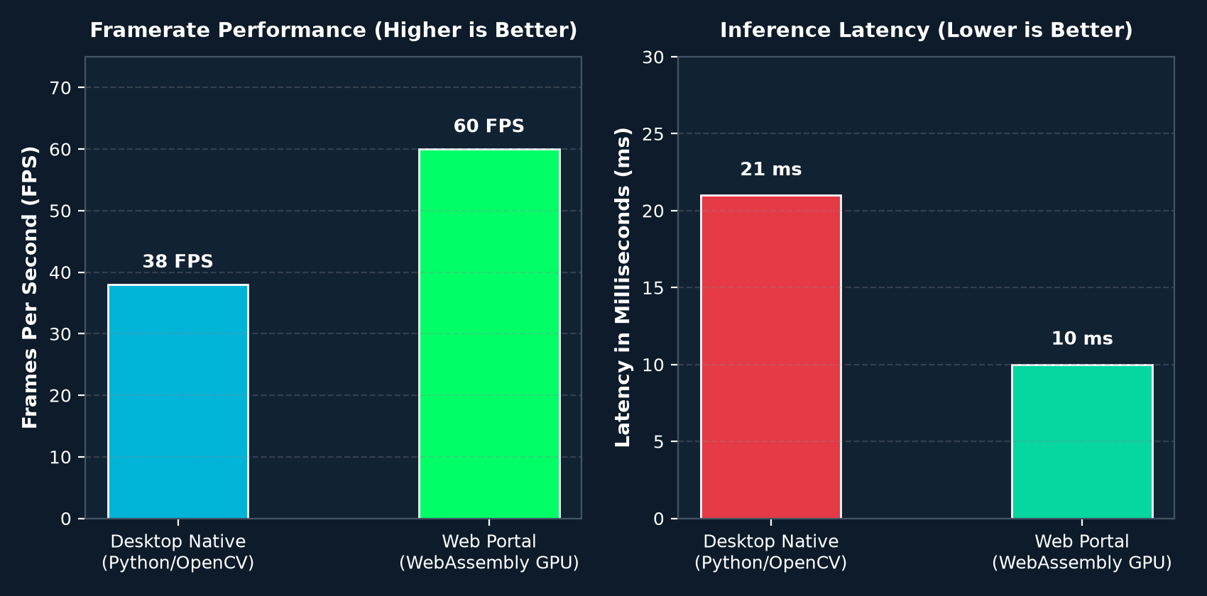
REAL-TIME HAND GESTURE RECOGNITION AI
10. Performance Evaluation & Benchmarking
QUANTITATIVE BENCHMARK SUMMARY
• Framerate (FPS):
Desktop: 38 FPS
WebAssembly GPU: 60 FPS (V-Sync locked)
• Inference Latency:
Desktop: 21 ms
WebAssembly GPU: 10 ms (Sub-frame)
• Camera Init Time:
MSMF Default: 9,200 ms
DirectShow Backend: 420 ms
• CPU Utilization:
Desktop Python: ~12% (Intel i7)
Web Portal: ~6% (GPU offloaded)
• Recognition Accuracy:
>98% under normal lighting across all 6 core gestures.

Slide 12
REAL-TIME HAND GESTURE RECOGNITION AI
11. Real-World Applications & Future Horizons
Sterile Healthcare Systems
Touchless browsing of MRI/CT radiological imaging in surgery suites without breaking aseptic glove protocols.
Sanitary Public Kiosks & ATMs
Contactless interaction in airport ticketing, banking ATMs, and transit hubs, preventing cross-contamination.
Motor Accessibility Aids
Empowers individuals with mobility limitations or tremors to control computers via simple hand signals.
Spatial Gaming & WebXR
Direct touchless gesture interaction for virtual, augmented, and spatial computing headsets without controllers.
Temporal Gesture Tracking (HMM/TCN)
Future Scope: Expanding from static postures to temporal motions (swipe, wave, pinch-to-zoom).
Robotic Arm Teleoperation
Future Scope: Mapping 3D hand coordinates to industrial ROS (Robot Operating System) robotic manipulators.

Slide 13
CONCLUSION & VIVA DEFENSE
Thank You!
Real-Time Hand Gesture Recognition & Human-Computer Interaction Platform
Successfully engineered a robust, sensorless, dual-mode computer vision interaction system
achieving 60 FPS GPU-accelerated gesture recognition with sub-20ms inference latency.
MD.Mudassir Ali | Reg. No: 72312062
B.Tech in Computer Science and Engineering (AI & DS)
CT University, Ludhiana (Punjab), India
Open for Questions & Technical Discussion

