Slide 1
Olist E-Commerce Analytics: Scaling Dynamics, Logistics Friction & Growth Strategy
Executive Data Analysis & Marketplace Optimization Roadmap
🌐 Live Interactive Dashboard
💻 GitHub Project Repository
Real-time metrics and KPI monitoring across all marketplace dimensions
Link: https://data-analysis-hackathon-vyzvs4jxmbtd4yvzzwbafe.streamlit.app/
Full analytical codebase, data pipeline, and methodology documentation
Link: https://github.com/mudassirkhan1249/Data-Analysis-Hackathon
Developed by Mudassir Khan

Slide 2
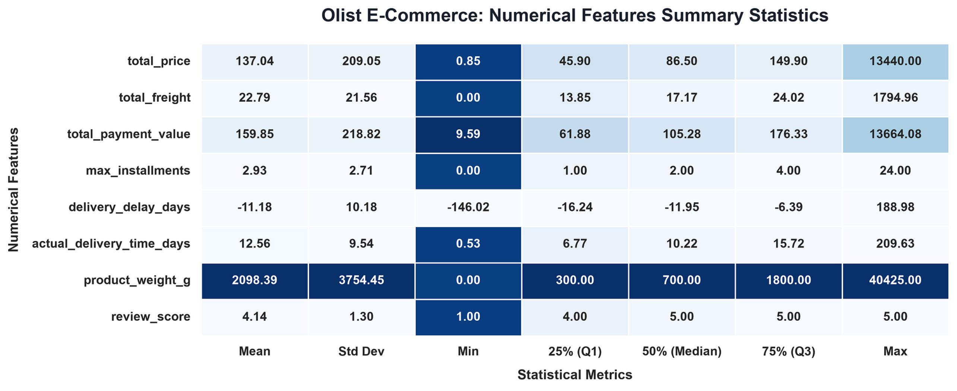
Dataset Architecture & Statistical Baseline
The Olist dataset provides a comprehensive multi-dimensional view of Brazilian e-commerce operations. The following descriptive statistics establish the analytical foundation for all subsequent strategic findings.
Order Pricing
Logistics Performance
Customer Feedback
Mean item price 137.04 BRL (Median: 86.50 BRL). Right-skewed distribution driven by high-value outliers reaching up to 13,440 BRL — indicating a long tail of premium SKUs.
Average delivery time of 12.56 days. Actual delivery arrives 11.18 days ahead of estimated dates on average — a structural buffer that masks true delay risk in tail segments.
Overall satisfaction maintains a strong mean rating of 4.14 / 5.0 — a healthy baseline that conceals significant variance across delivery cohorts and product categories.

Slide 3
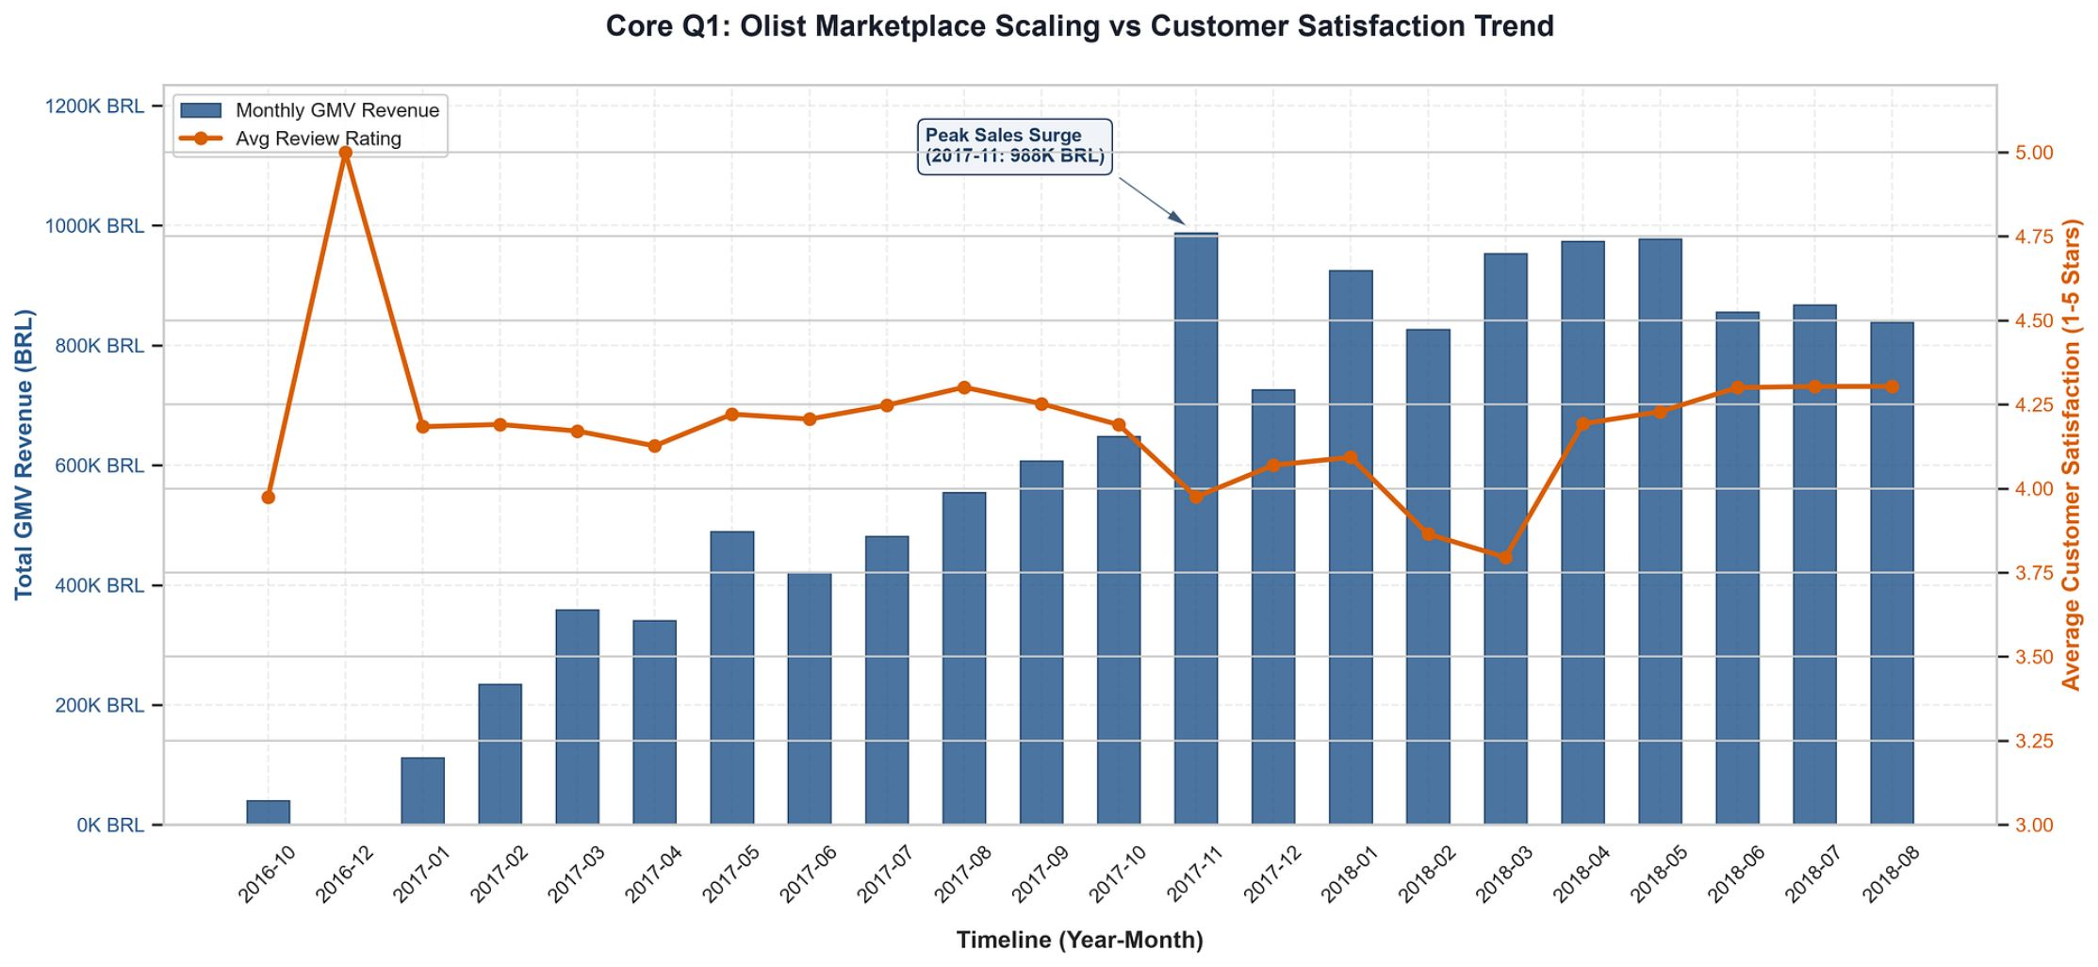

Marketplace Growth vs. Quality Trade-Off
Rapid GMV scaling during 2017–2018 exposed a critical operational tension: volume growth outpaced fulfillment capacity, temporarily eroding the customer experience that sustains long-term retention.
Revenue Scaling
Satisfaction Impact & Recovery
Monthly GMV surged dramatically, hitting a peak of 988K BRL in November 2017 — driven by Black Friday demand concentration. This single-event spike represents a structural stress test on logistics infrastructure.
Rapid order volume scaling temporarily eroded customer ratings, dropping satisfaction from >4.5 down to a trough of 3.75 in early 2018. Rating trajectory subsequently stabilized back around 4.25 as operational capacity adjusted — confirming that quality degradation was transient but operationally significant.
The growth-quality trade-off is a leading indicator of churn risk. Every 0.1-point drop in average rating correlates with measurable increases in one-time purchase rates and reduced repeat conversion.

Slide 4
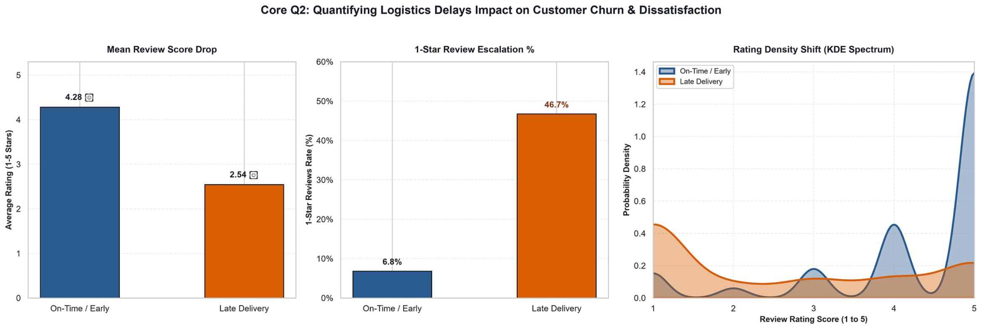
Quantifying Delays Impact on Customer Ratings
Delivery timing is the single most powerful lever on customer satisfaction in the Olist marketplace. The data reveals a stark, non-linear penalty structure that demands immediate logistics prioritization.
4.28
2.54
46.7%
On-Time Stars
Late Delivery Stars
1-Star Rate (Late)
Average rating for on-time or early deliveries
Average rating when delivery is late — a 1.74-star penalty
1-star reviews skyrocket from 6.8% on-time to 46.7% when delayed
On-time orders heavily skew toward 5-star ratings, while delayed orders shift the entire review density to 1 star. This bimodal distribution confirms that delivery reliability is a binary satisfaction driver — not a gradual one.

Slide 5
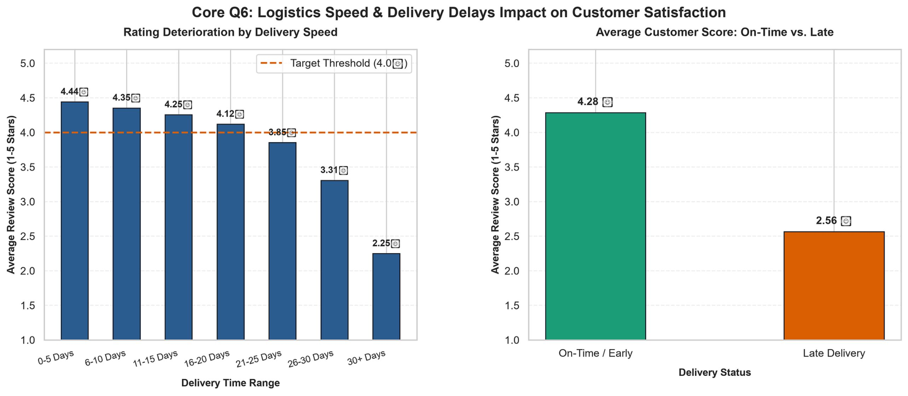

Customer Tolerance & Delivery Windows
Understanding where satisfaction thresholds break down allows Olist to set evidence-based SLA targets and prioritize logistics investment at the most impactful delivery windows.
Optimal Window: 0–15 Days
Critical Threshold: 20 Days
Severe Deterioration: 30+ Days
Ratings remain strong, ranging from 4.44 stars (0–5 days) to 4.25 stars (11–15 days). This is the target SLA band for all high-demand SKUs and priority regions.
Customer satisfaction breaches the 4.0 benchmark once delivery times cross 20 days, dropping to 3.85 stars. This is the operational red line for SLA management and carrier escalation protocols.
Orders taking 30 or more days drop to a critical rating of 2.25 stars — entering territory that triggers negative word-of-mouth, refund requests, and permanent churn. Immediate intervention required at this cohort.

Slide 6
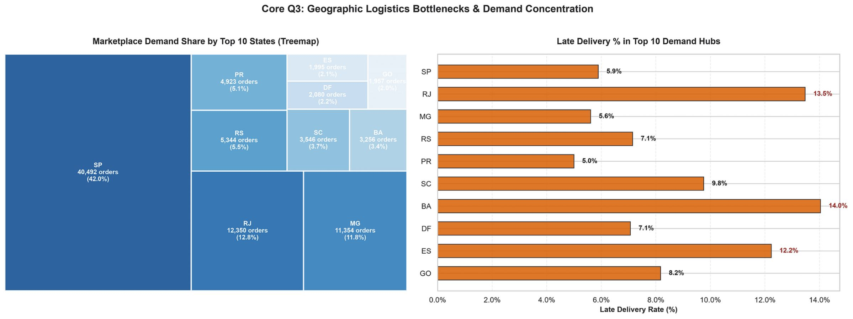
Demand Concentration vs. Regional Delay Rates
Geographic demand is heavily concentrated in Southeast Brazil, but logistics performance varies dramatically by state — creating a misalignment between where volume is highest and where delay risk is most acute.
Demand Hubs
Regional Logistics Bottlenecks
São Paulo (SP) dominates with 40,492 orders (42.0%) of total volume. Rio de Janeiro (RJ) follows at 12.8% and Minas Gerais (MG) at 11.8%. These three states collectively represent over 66% of all marketplace orders.
SP Hub: Efficient operations with only 5.9% late rate — a benchmark for other regions.
High-Risk Zones:
Bahia (BA): Leads late deliveries at 14.0%
Rio de Janeiro (RJ): 13.5% late rate despite high volume
Espírito Santo (ES): 12.2% late rate
The RJ paradox — high demand paired with high delay rates — represents the most urgent logistics investment case.

Slide 7
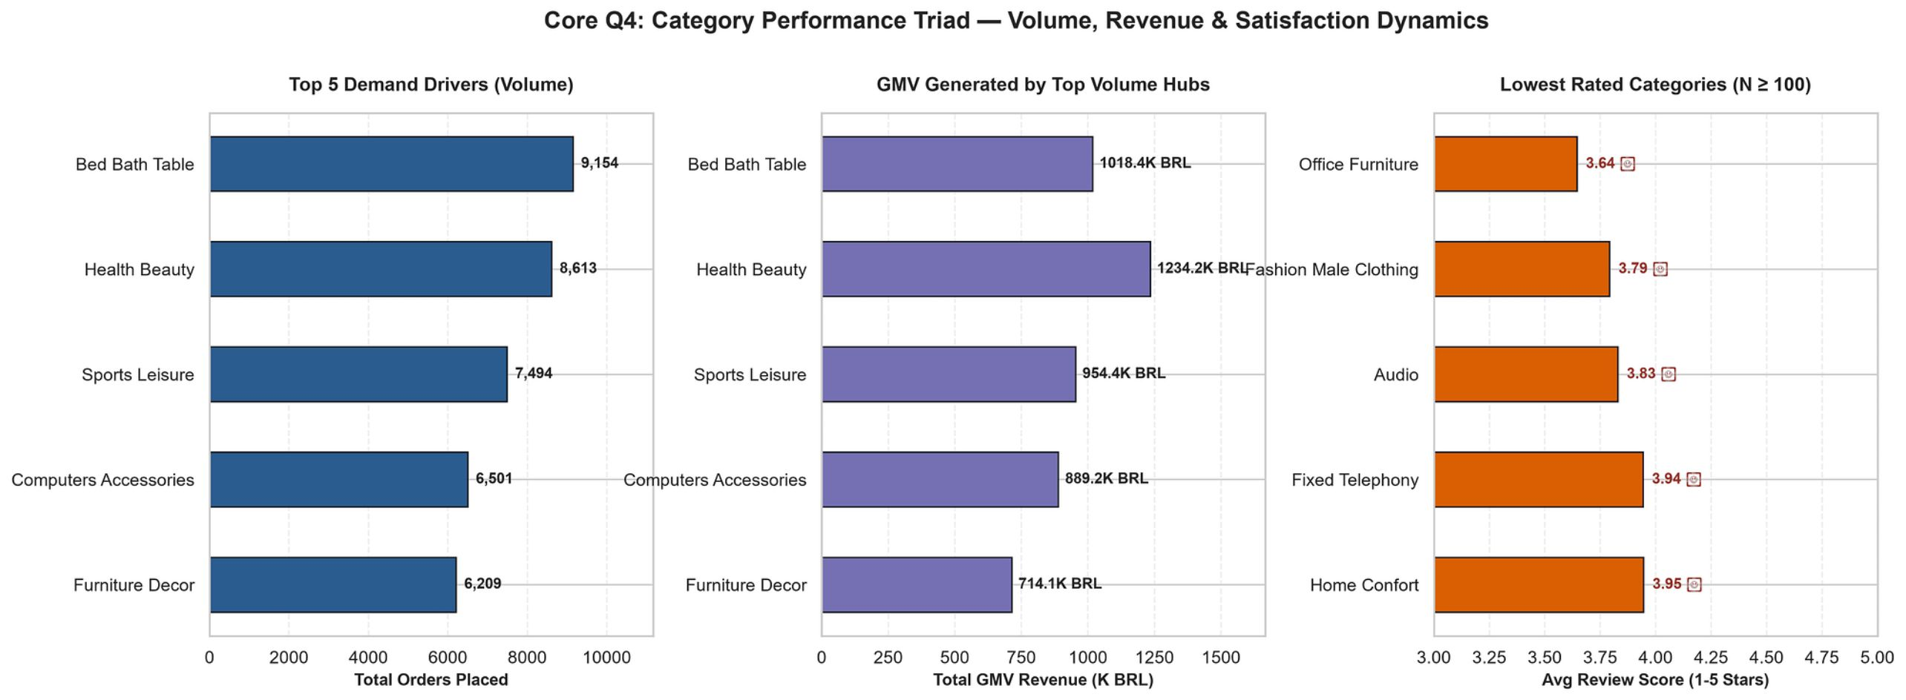
Volume Drivers, Revenue Hubs & Quality Red Flags
Category-level analysis reveals a three-way tension between order volume, revenue generation, and customer satisfaction — requiring differentiated strategies across the product portfolio.
Top Volume Driver
Top Revenue Generator
Quality Red Flags
Bed Bath Table leads volume with 9,154 orders and 1,019.4K BRL GMV. High transaction frequency makes this category a logistics throughput priority and a key lever for fulfillment efficiency gains.
Health Beauty generates the highest revenue at 1,234.2K BRL GMV across 6,613 orders. Higher average order value and strong repeat purchase potential make this the primary category for loyalty program investment.
Lowest-rated categories requiring immediate quality intervention:
Office Furniture: 3.64 stars
Fashion Male Clothing: 3.79 stars
Audio: 3.83 stars

Slide 8
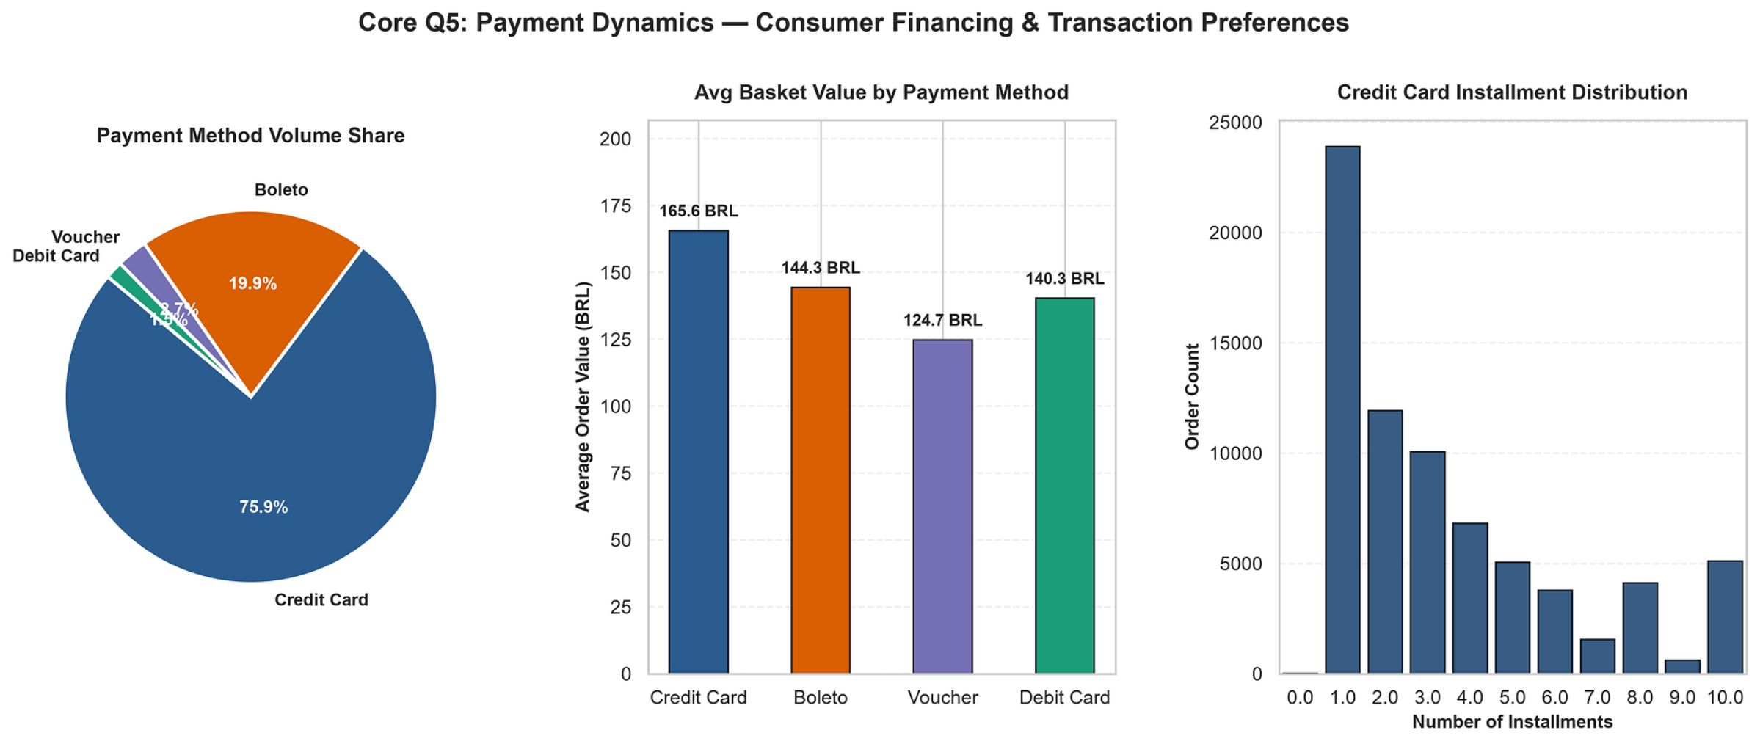
Consumer Financing & Payment Methods
Payment behavior analysis reveals both the dominance of credit infrastructure and the strategic importance of installment financing in driving basket size — with direct implications for checkout optimization and revenue per transaction.
Payment Volume Share
Basket Value & Installment Behavior
Credit Card: 75.9% of all transactions
Boleto: 19.9% — critical for unbanked segments
Voucher: 3.7%
Debit Card: 1.5%
Credit Cards drive the highest Average Order Value at 165.6 BRL, compared to Boleto at 144.3 BRL — a 14.8% AOV premium for credit-enabled customers.
Installment analysis reveals a bimodal demand pattern: 1-installment transactions peak at ~24K orders, but long-term financing at 8–10 installments represents a significant secondary demand spike — indicating a meaningful segment of high-value, credit-dependent consumers financing larger purchases.
Credit card dominance reflects Brazil's growing fintech penetration, but Boleto's 19.9% share signals a substantial unbanked consumer base that must not be deprioritized.

Slide 9
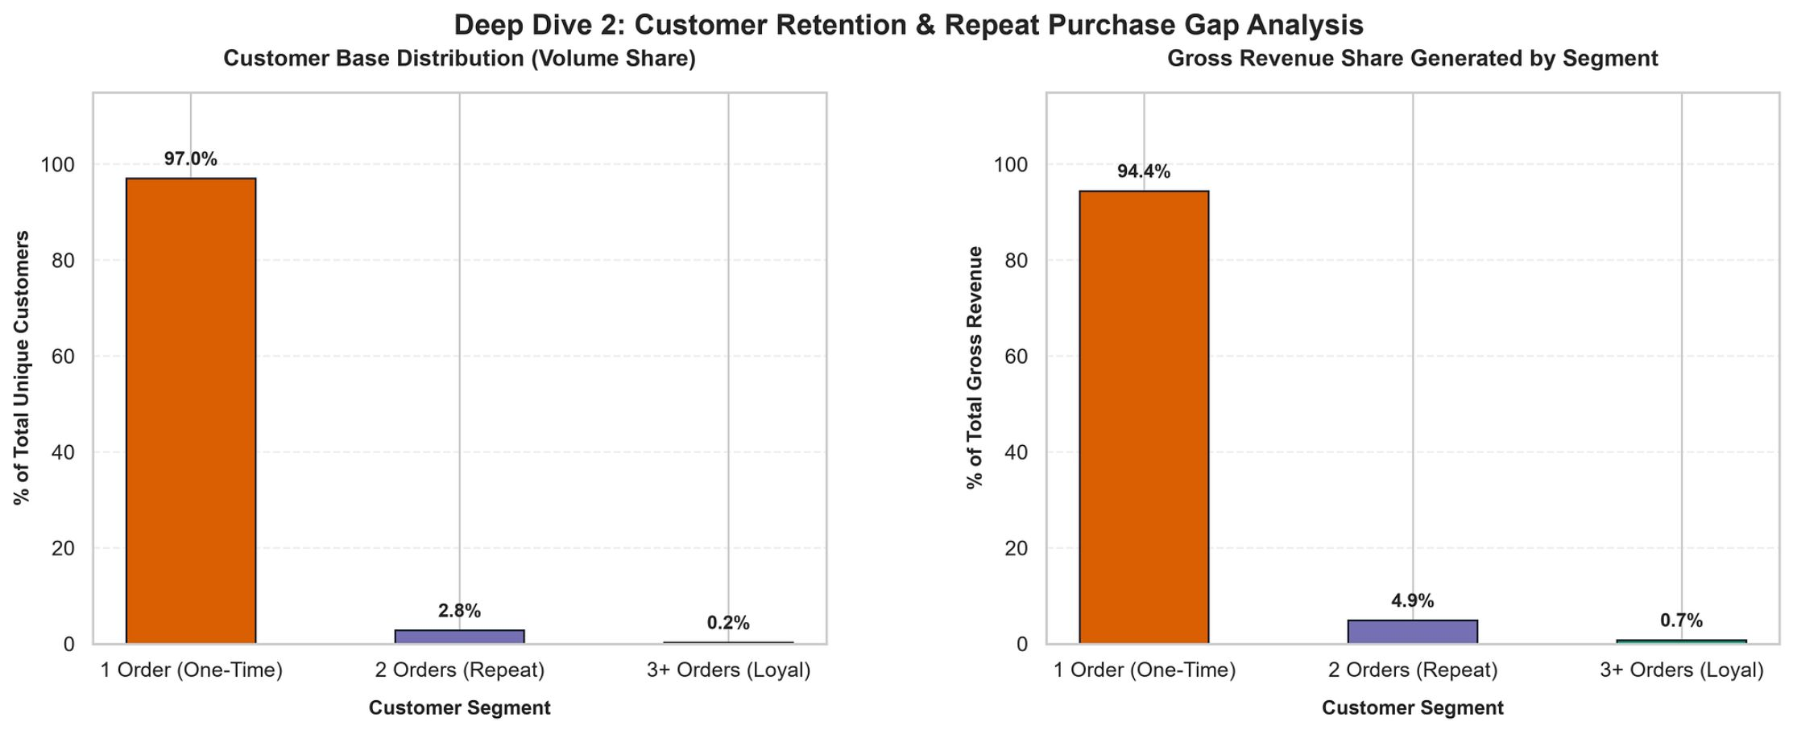

Severe One-Time Purchase Dependency
The most structurally critical finding in the dataset: Olist's revenue base is almost entirely dependent on first-time buyers, creating extreme fragility in Customer Lifetime Value and long-term platform sustainability.
97.0%
94.4%
2.8%
One-Time Buyers
Revenue from Single Orders
Repeat Buyers (2 Orders)
Customers who place only a single order — the dominant behavioral cohort
Gross revenue contribution from one-time buyers — a critical concentration risk
Only 2.8% of customers return for a second purchase; 3+ orders represent just 0.2%
Urgent strategic imperative: Deploy loyalty programs, post-purchase engagement sequences, and subscription incentives to lift Customer Lifetime Value (LTV). A 5-percentage-point shift in repeat purchase rate would represent a transformational revenue impact at current GMV scale.

Slide 10
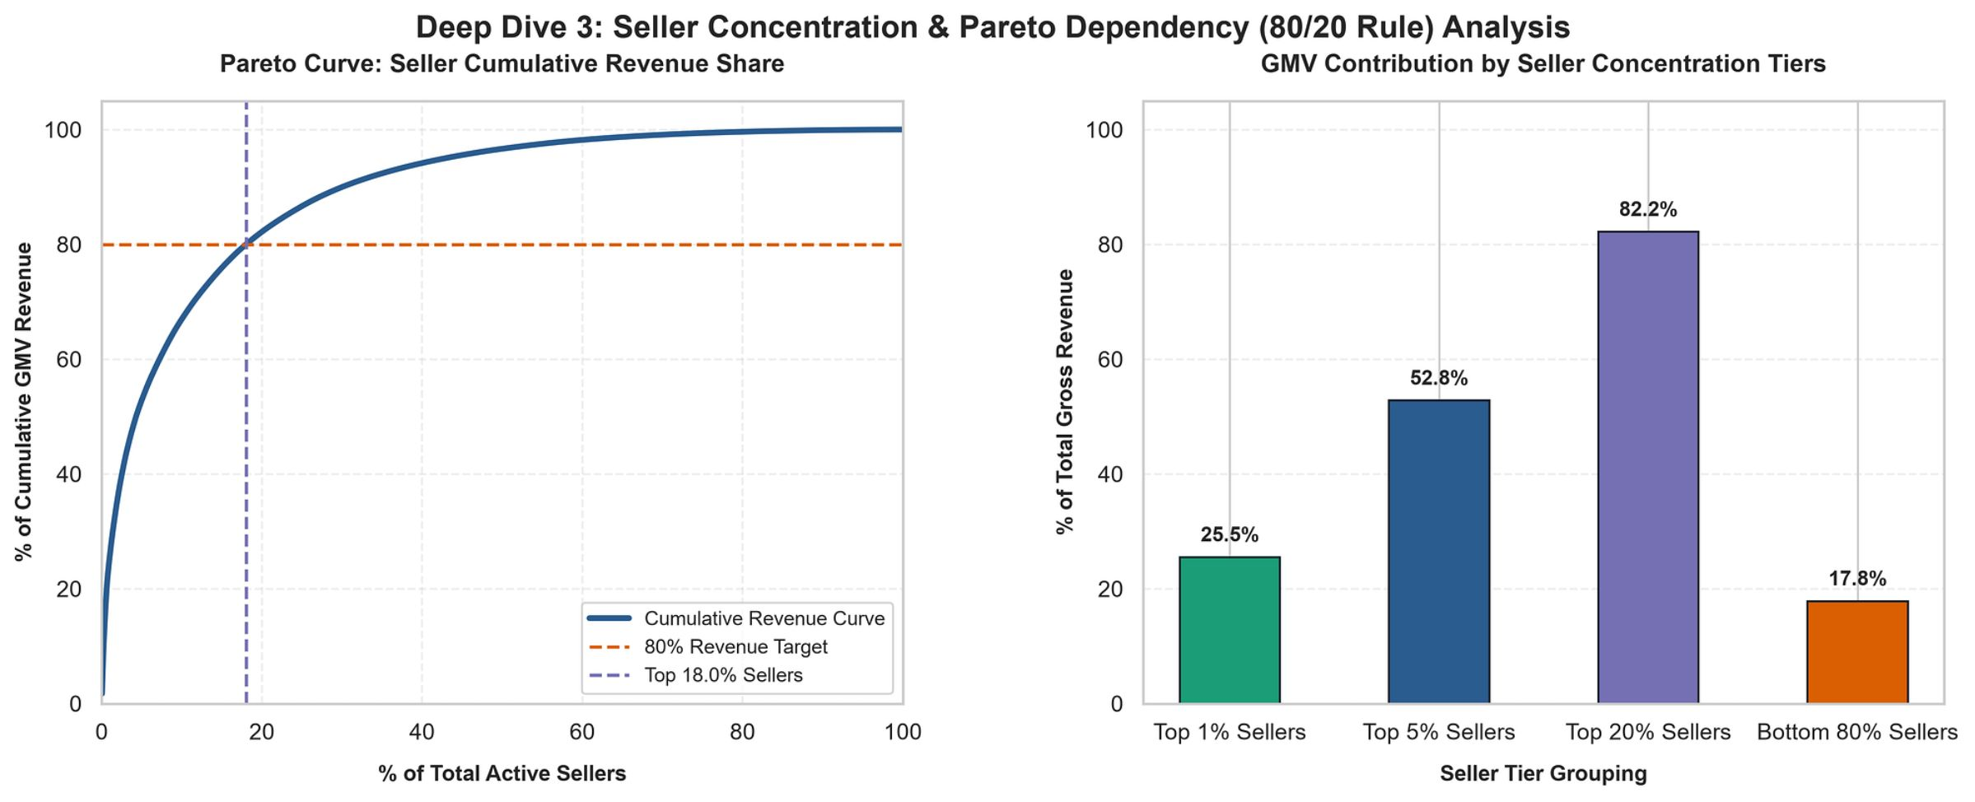
Pareto Dependency & Seller Risk Analysis
Seller concentration analysis confirms a classic Pareto structure — with extreme revenue dependency on a small cohort of top performers. This concentration creates significant platform risk and demands a differentiated key-account strategy.
Seller Tier Breakdown
Strategic Risk & Recommendations
Top 1% Sellers: Drive 25.5% of gross revenue
Top 5% Sellers: Drive 52.8% of gross revenue
Top 20% Sellers: Account for 82.2% of gross revenue
Bottom 80% Sellers: Generate only 17.8% combined GMV
High platform dependency on top sellers creates three categories of structural risk:
Churn Risk: Loss of a single top-1% seller removes ~25% of GMV — requiring dedicated key-account retention programs with SLA guarantees and preferential fee structures.
Negotiation Leverage: Concentrated sellers hold disproportionate bargaining power on commission rates and promotional terms.
Growth Ceiling: Bottom-80% seller underperformance signals a need for seller enablement programs — onboarding support, analytics tooling, and fulfillment subsidies — to broaden the revenue base.
Top 18.0% of active sellers generate 80% of total GMV — a concentration ratio that exceeds even the classic Pareto benchmark.

