Slide 1
Chapter 8
Engineers as Employees
ECC429
ENGINEERING ETHICS

Slide 2
In this chapter
We will:
look at what the codes say about employer employee relationship.
consider the changing legal status of employee rights.
state some criteria for deciding when decisions should be made by managers and when decisions should be made by engineers.
talk about organizational loyalty.

Slide 3
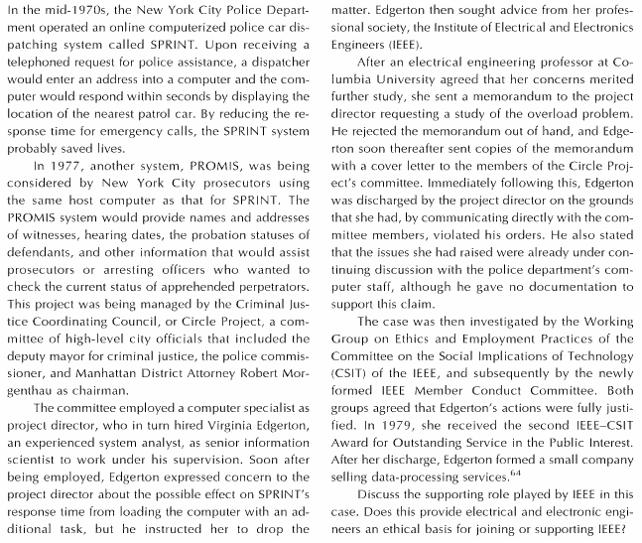

Slide 4
The Codes of Employer-Employee relationship
Its quite clear that engineering codes usually provide guidelines for this relationship but also show that there are many possibilities of conflict and line drawing issues in this area
Lets see what the codes of the National Society for Professional Engineers (NSPE) say.

Slide 5
From the NSPE code of ethics
Canon 4: “engineers shall act in professional matters for each employer or client as faithful agents or trustees”
(here we see loyalty to employer )
Canon 1: “hold paramount the safety, health and welfare of the public in the performance of professional duties”
(this in some cases can conflict with canon4)
Furthermore conceptual issues are produced.

Slide 6
I. Fundamental Canons
Engineers, in the fulfillment of their professional duties, shall:
Hold paramount the safety, health and welfare of the public.
Perform services only in areas of their competence.
Issue public statements only in an objective and truthful manner.
Act for each employer or client as faithful agents or trustees.

Slide 7
Part III. Professional Obligations
Engineers shall not disclose, without consent, confidential information concerning the business affairs or technical processes of any present or former client or employer, or public body on which they serve.
(employers sometimes ask engineers to work on projects when information gained from previous employment can be used)

Slide 8
Conceptual issues are caused by codes
Codes say: protect public.. But does not say who counts as public!
or what is the definition of “faithful agents or trustees”
**We can say that the codes do not provide clear and easy answers to all of the issues that professional engineers face in relating to their employers. (they do provide clear answers to many other questions).

Slide 9
Changing legal status of employee rights
Public policy exception to employment at will. Employees refusing to break a law, performing an important public obligation, acting to protect the public from a clear threat to health or safety is covered in court by public-policy exception. (four limitations pp184-185/178)
  No clear distinction b/w public policy violation and “private” interests of employees (when to go to public/court about the violation of the company),
  Courts usually decline to give the employee protection where there is a little difference in judgement b/w employer and employee,
  Courts have distinguished b/w codes informed by private organizations (professional bodies) and administrative and judicial bodies,
  Courts have appealed to the need to “balance” the interests of the public against those to the employer.
Statutory protection: changes to protect whistle-blowers. (dissenting employees)

Slide 10
Manager Engineer Relationship
Areas of conflict between engineers and
managers:
Although engineers want to be loyal to employers they have to insist on high standards of quality and safety (canon 1)
Managers are not engineers and so do not have engineering expertise this makes communication difficult.
Even if they are engineers superior becomes to take a managerial rather than engineering perspective.

Slide 11
Two studies to
Manager Engineer Relationship
Robert Jackall: finds the engineering-manager relationship fundamentally adversarial (opposing sides).
  Organizational considerations does not allow the managers to include moral commitments in decisions
  Loyalty to peers and superiors is the primary virtue for managers
  Lines of responsibility are deliberately blurred to protect oneself, his peers, and superiors.
Hitachi Corporation: come up with different conclusions.
  The distinction b/w engineers and managers is not always clear in large organizations
  No difference in perspective b/w engineers and managers
  Engineering considerations (of managers and engineers) should have priority in matters of safety, and quality
Page 188-189, 180-183
Result: separate engineering and management decisions!!

Slide 12
Functions of engineers and managers
Engineers:
The primary function of engineers within an organization is to use their technical knowledge and training to create products and processes that are of value to the organization and customers.
Engineers have dual loyalty:
Loyalty to the organization
Loyalty to their profession.

Slide 13
Functions of engineers and managers
Managers:
Their function is to direct the activities of the organization, including the activities of engineers.
Managers are primarily concerned with the organizations present and future well-being.
Well-being is mostly measured in economic term. But includes public image and employee moral.

Slide 14
PED and PMD
PED-Proper Engineering Decision:
  a decision that should be made by engineers or from the engineer perspective.
PMD-Proper Manager Decision:
  a decision that should be made by managers or from the management perspective.

Slide 15
PED and PMD
PED: a decision that should be made by engineers or at least governed by professional engineering practice because it either:
Involves technical matters that require engineering expertise or
Falls within the ethical standards embodied in the engineering codes, especially those requiring engineers to protect the health and safety of the public

Slide 16
PED and PMD
PMD: a decision that should be made by managers or at least governed by management considerations, because
It involves factors related to the well-being of the organization such as cost, scheduling, marketing, employee morale or welfare and
The decision does not force engineers (or other professionals) to make acceptable compromises with their own technical practices or ethical standards.

Slide 17
Read paradigmatic and non paradigmatic examples at home! Take a look at each line drawing carefully.
Page 192-193, 185-187

Slide 18
Loyalty: Uncritical and Critical
Uncritical Loyalty to an employer: placing the interest of the employer, as the employer defines those interests, above any other consideration.
Critical Loyalty to an employer: giving due regard to the interests of the employer, insofar as this is possible within the constraints of the employee’s personal and professional ethics.

Slide 19
Loyalty: Uncritical and Critical
Critical loyalty is a creative middle way that seeks to honor both requirements:
Engineers should be loyal employees, but only as long as this does not conflict with fundamental personal or professional obligations.

Slide 20
Responsible Organizational Disobedience
Disobedience by Contrary Action: activities contrary to the interest of the company, as perceived by management.
Disobedience by Non-participation: refusing to carry out an assignment because of moral or professional objections.
Disobedience by Protest: protesting a policy or action of the company. (whistle-blowing)

Slide 21
DeGeorge believes that whistle-blowing is morally permissible if:
the harm that will be done to the public is serious and considerable
the employees report their concern to their superiors
“getting no satisfaction from their immediate superiors, they exhaust the channels available” within the organization.

Slide 22
DeGeorge believes that whistle-blowing is morally obligatory if:
4. the employee has “documented evidence that would convince a responsible, impartial observer that his view of the situation is correct and the company policy is wrong”
5. the employee has “strong evidence that making the information public will in fact prevent the threatened serious harm”.
(for unsafe products) criticism page 205/198

Slide 23
Implementing Professional Employee Rights
Organizations must take actions to avoid the need for whistle blowing by:
methods improving communication between employer and employees and
providing avenues within the organization through which employees can register concerns.

Slide 24
These methods include:
“Open Door Policy”
  Managers can make themselves available for hearing the complaints on a regular basis and without prejudice to the complaints.
Mechanism to register “differing professional opinions”
  An impartial, competent commission might be used to review employee’s concise written statement whcih was submitted to his/her supervisor and had no accomodation.
“Ombudsman system”
  After registering employee complaints in a confidential and anonymous way, the ombudsman (advocate) can facilitate a meditaion between a professional and a a manager.
“An office for ethical issues with an ethics hotline”
  The office’s concern is ethics and social responsibility. Its duty is proper disposition of employee complaints.
  Hotline is useful to employees who want to make inquiries about corporate ethics policirs or to get advice on how to handle troublesome situations.

