Slide 1
How a Neural Network Learns to Classify
EDUCATIONAL DEMO
An interactive neural network demo built from scratch
Neural Network from Scratch: Interactive Binary Classification Demo
Notes:
Welcome everyone. Today we look at a tiny neural network that I built from scratch. It is an educational demo: it shows how a network learns, step by step, using just four toy examples. The picture on the right is a simple network: inputs on the left, hidden neurons in the middle, and one output.

Slide 2
The problem: binary classification
Input: two numbers
Output: a label, Class 0 or Class 1
The network learns the pattern from labeled examples
Example 1
Example 2
(-2, -1)
(25, 6)
Class 1
Class 0
Example 3
Example 4
(17, 4)
(-15, -6)
Sample labels only
They do not represent real-world categories.
Class 0
Class 1
Notes:
Binary classification just means: take two numbers in, and decide between two labels, Class 0 or Class 1. Here are our four training examples. Please note these labels are just sample labels made up for the demo. They do not stand for anything in the real world. The point is to watch the learning process.

Slide 3
How the neural network works
2 input values
2 hidden neurons
1 output
x1
h1
0 to 1
after sigmoid
out
x2
h2
Each line carries a weight, a number the network adjusts
Weights
Hidden neurons
Sigmoid
Numbers that training adjusts to reduce error.
Small units that combine the inputs.
Turns the output into a value from 0 to 1.
Notes:
Our network is very small: two input numbers go into two hidden neurons, which feed one output neuron. Every connection has a weight, which is just a number. Training means nudging those weights so predictions get closer to the correct labels. At the end, a function called sigmoid squeezes the output into a value between 0 and 1, which we can read as the chance of Class 1.

Slide 4
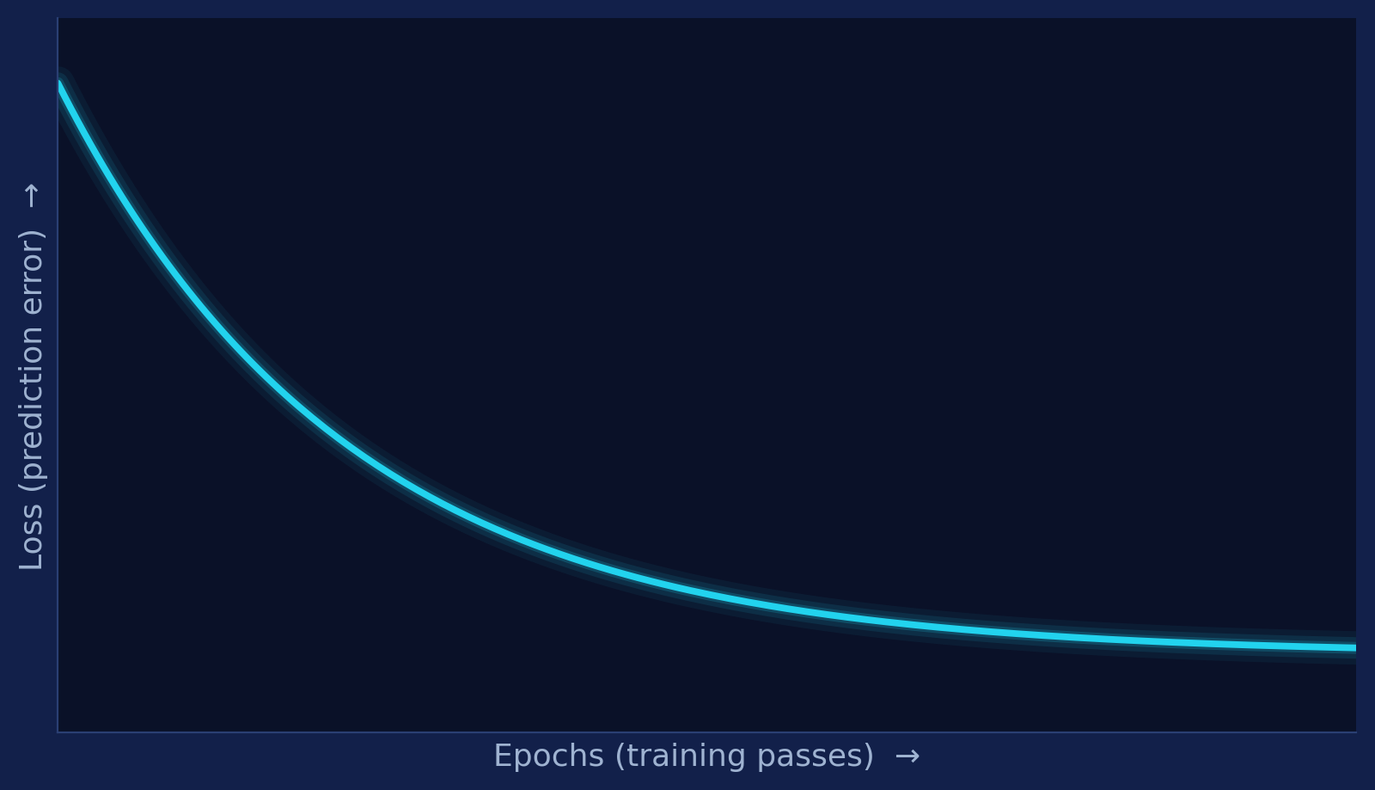

Training and loss
Epoch
One full pass through the training examples.
Loss
A number that measures prediction error.
Lower loss generally means the model fits these examples better.
Schematic of the live loss chart (not real results)
A downward curve means the loss is shrinking as training goes on.
Notes:
An epoch is one full pass through all four training examples. Loss is a score for how wrong the predictions are: lower is better. The demo draws a live loss chart while it trains. If the line slopes downward, the network is making smaller mistakes as it learns. The chart on the slide is only a sketch of that shape, not real results.

Slide 5
Understanding the prediction
Enter two numbers
Network computes
Probability of Class 1
Type your own input values
Passes them through the weights
A value between 0% and 100%
Probability of Class 1
50% cutoff
Below 50%: Class 0
Above 50%: Class 1
0%
100%
Results can vary. The network starts with random weights, so different runs can give different predictions.
Notes:
In the demo you type two numbers and the network predicts Class 0 or Class 1. It also shows the probability of Class 1. If that probability is above 50 percent, the model picks Class 1; below 50 percent, it picks Class 0. Because the network starts with random weights, two training runs can end up with different answers. That is normal.

Slide 6
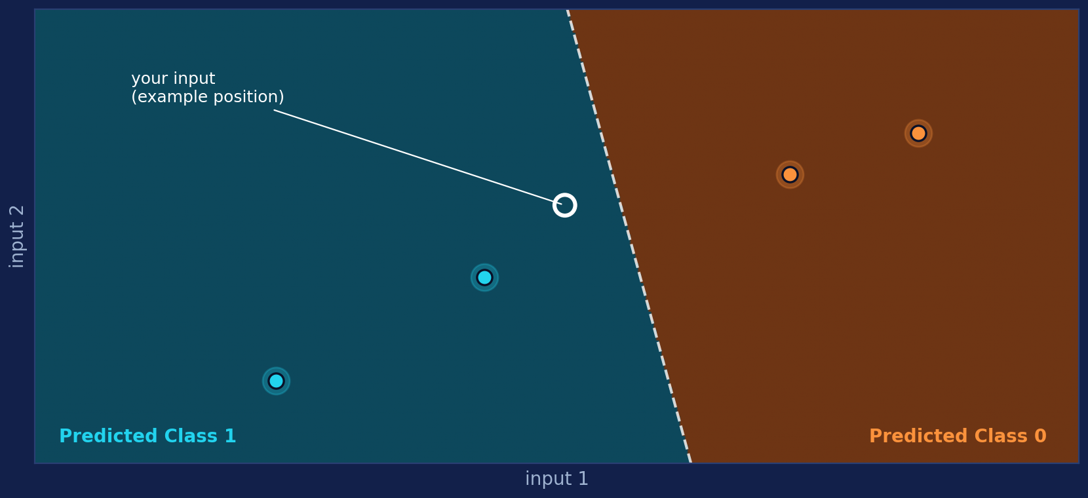
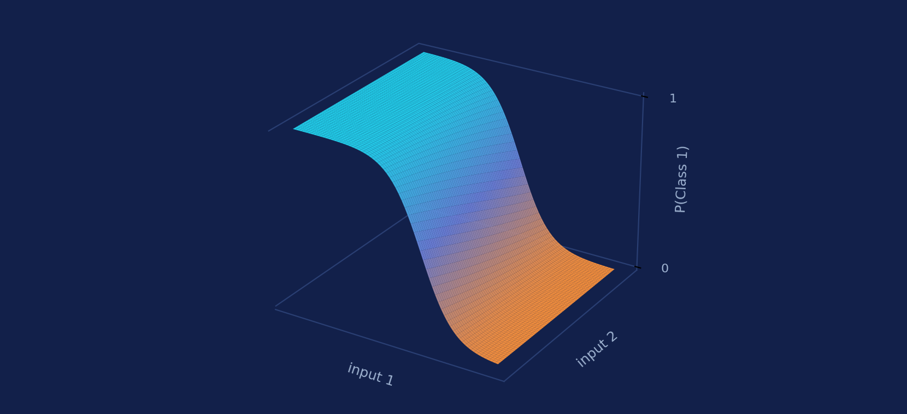
The visualizations
Decision boundary
3D probability surface
Background color = predicted class
Dots = the four sample points
Outlined dot = your input
Height and color = probability
Drag to rotate, or use arrow keys
Low = Class 0 side, high = Class 1 side
Illustrations only, not output from the real model
Notes:
The demo draws two pictures. The decision boundary chart colors the background by the class the model would predict at each spot. The four sample points are plotted on top, and your own input is the outlined point. The 3D surface shows the probability of Class 1 as height and color; you can drag it to rotate or use the arrow keys. The pictures here are illustrations of the idea, not real output.

Slide 7



Training settings
Learning rate
How strongly the weights change at each update.
Epochs
How many training passes to perform.
Batch size
How many samples are used in one update.
SGD, Momentum, Adam
Different methods for adjusting weights.
Try it: change the settings, then compare how the loss and predictions change.
Notes:
Students can change four kinds of settings. Learning rate is how big each weight change is. Epochs is how many passes to train. Batch size is how many samples are used for each update. SGD, Momentum and Adam are different recipes for updating weights. Try changing one setting at a time and watch how the loss chart and the predictions respond.

Slide 8
Conclusion and limitations
What it shows
Limitations
How a small network is trained
Binary classification: Class 0 or Class 1
Loss, boundary, and probability visuals
Uses only four toy examples
Made for learning and visualization
Not reliable for real-world prediction
KEY TAKEAWAY
A neural network learns patterns from labeled examples by adjusting its weights to reduce error.
Notes:
To wrap up: this project shows the basic process of training a small neural network for binary classification. Remember its limits: only four toy examples, so it is for learning and visualization, not for dependable real-world predictions. The key idea to take away: a neural network learns patterns from labeled examples by adjusting its weights to reduce error.

