Slide 1
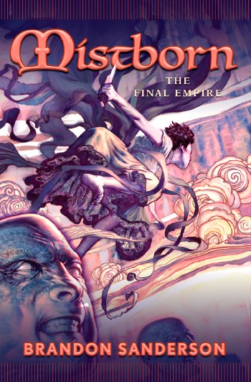
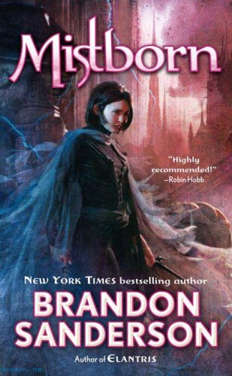
Mistborn

Slide 2
About
Title: Mistborn
Author: Brandon Sanderson
Publisher: Tor Books
Copyright Date:
2006
Ar Points: 33.0 Ar Book level: 5.5

Slide 3
Why I chose this book
I chose this book because I really enjoy the author and my dad recommended it.

Slide 4
Summary
The story mistborn is about the main character Vin finding out she mistborn and helping to bring down the final empire. Mistborn is the term for a human who has the ability to burn metals in their body to gain powers. The main allomantic metals are Steel (pushes nearby metals) , Iron (pulls nearby metals) , Pewter (increases physical abilities) , Tin (increases senses) , Zinc ( Riots emotions) , Brass ( Dampens emotions) , Copper ( Hides allomancy) , Bronze ( can hear allomantic pulses). To learn more read the book.

Slide 5
Setting
Where did it happen?
This book took place in an empire called “The Final Empire”. This empire is ruled by the lord ruler an all powerful god. The main characters goals are to kill this god and stop his oppression. The final empire is a hard place to live in where nobility are the strong ones.

Slide 6
Conflict
The main problem in the story is that the Nobility have forced the skaa race into slavery. Think of this problem as what happened in our history for slavery. The skaa are treated horribly. The main characters of the book wish to take down the nobility and free the skaa.

Slide 7
Main Characters
Vin: A young mistborn skaa rescued by Kelsior.
Kelsior: The crew leader also a mistborn
Breeze: A soother misting part of kelsior’s crew
Ham: The thug of the group
Dockson: Kelsior”s right hand man handles all money
Clubs: Owns the hideout and is a smoker
Spook: The tineye lookout

