Slide 1
Python MySQL Database Helper
Connecting Python to MySQL with mysql.connector
Name:Muddada Anitha
Student ID:AF04957415

Slide 2
Project Overview:
Object-Oriented Database Helper: The code defines a DBHelper class in Python to encapsulate all logic for connecting to and interacting with a MySQL database.
Core Functionality (CRUD): The class provides methods for Create (insert\_user), Read (fetch\_all\_users), Update (update\_user), and Delete (delete\_user) operations on a simple user table.
Setup and Initialization: The constructor establishes the mysql.connector connection, creates a database cursor, and automatically ensures the necessary user table exists.
Security and Integrity: It employs parameterized queries for security against SQL injection and utilizes commit() and rollback() to manage database transactions and maintain data integrity.
Interactive Interface: A main() function creates an interactive command-line menu for users to easily test and execute the various database operations implemented in the DBHelper class.

Slide 3
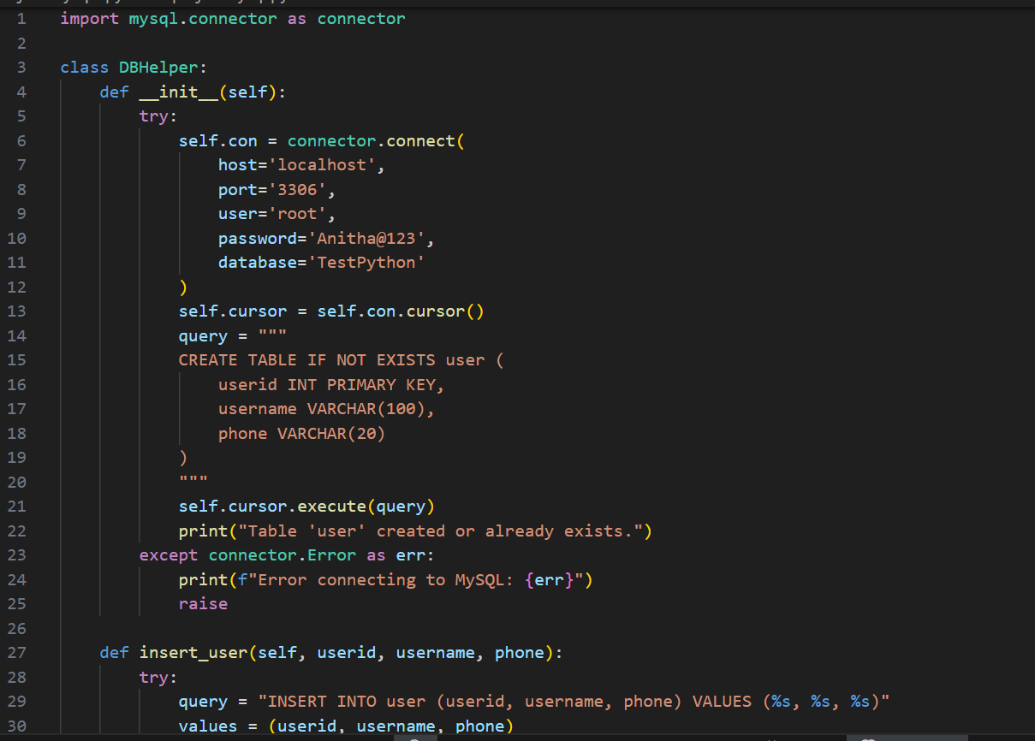
Source code:

Slide 4
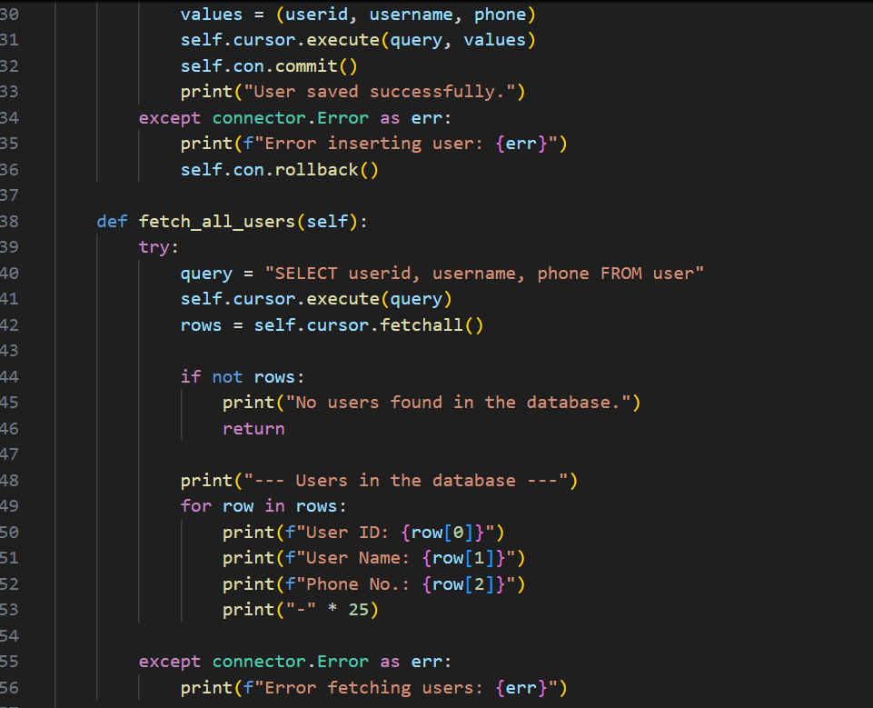

Slide 5
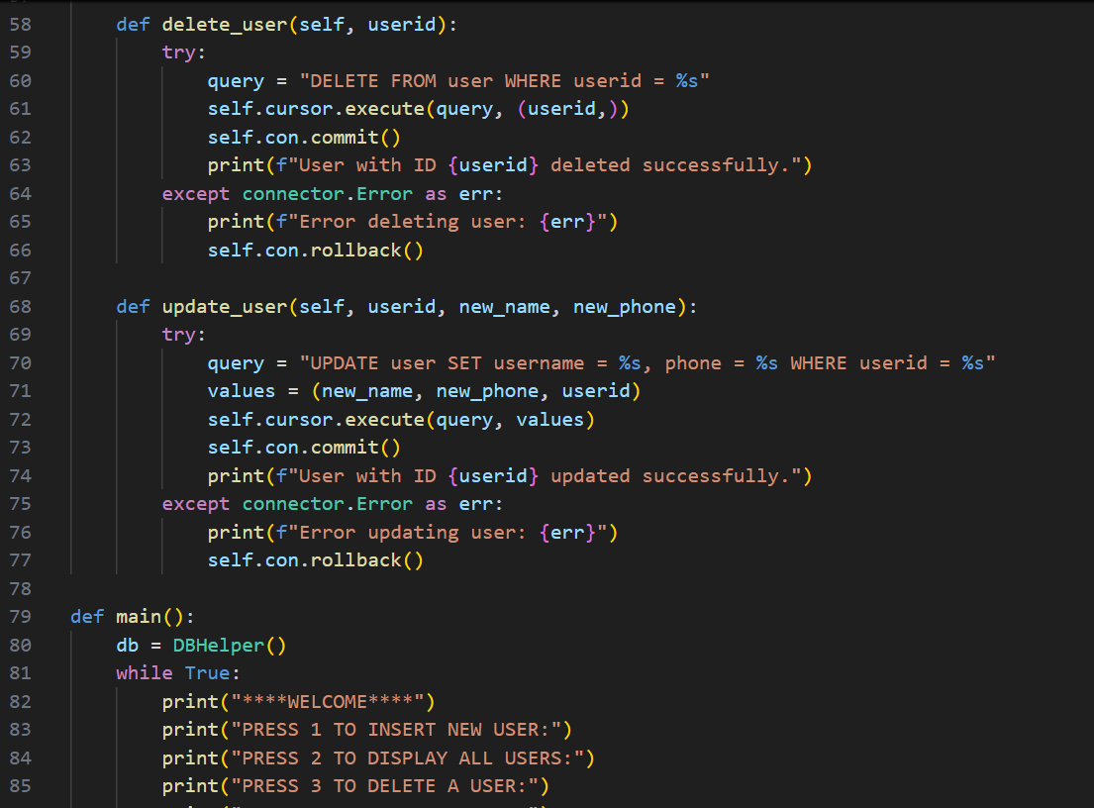

Slide 6
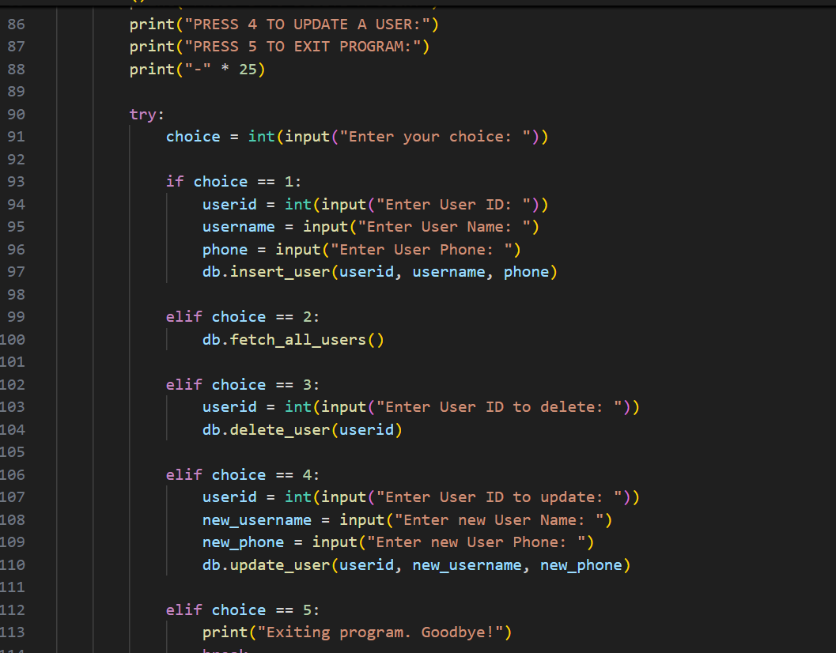

Slide 7
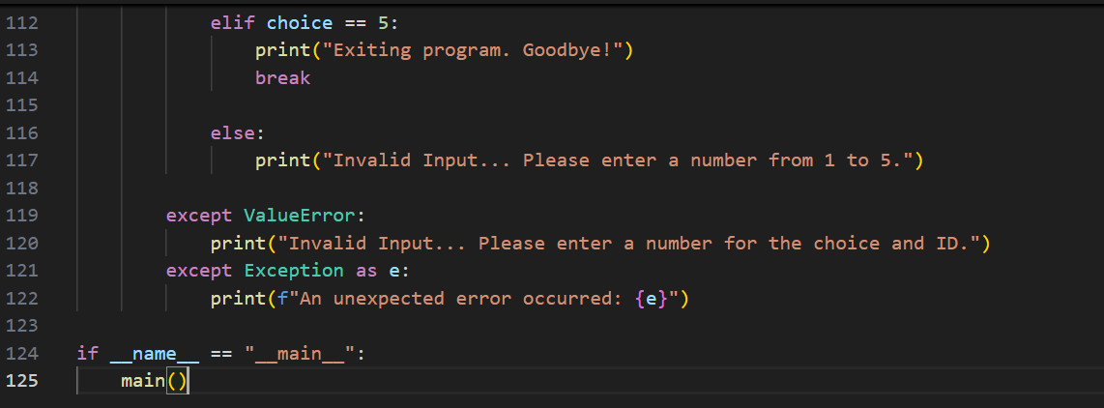

Slide 8
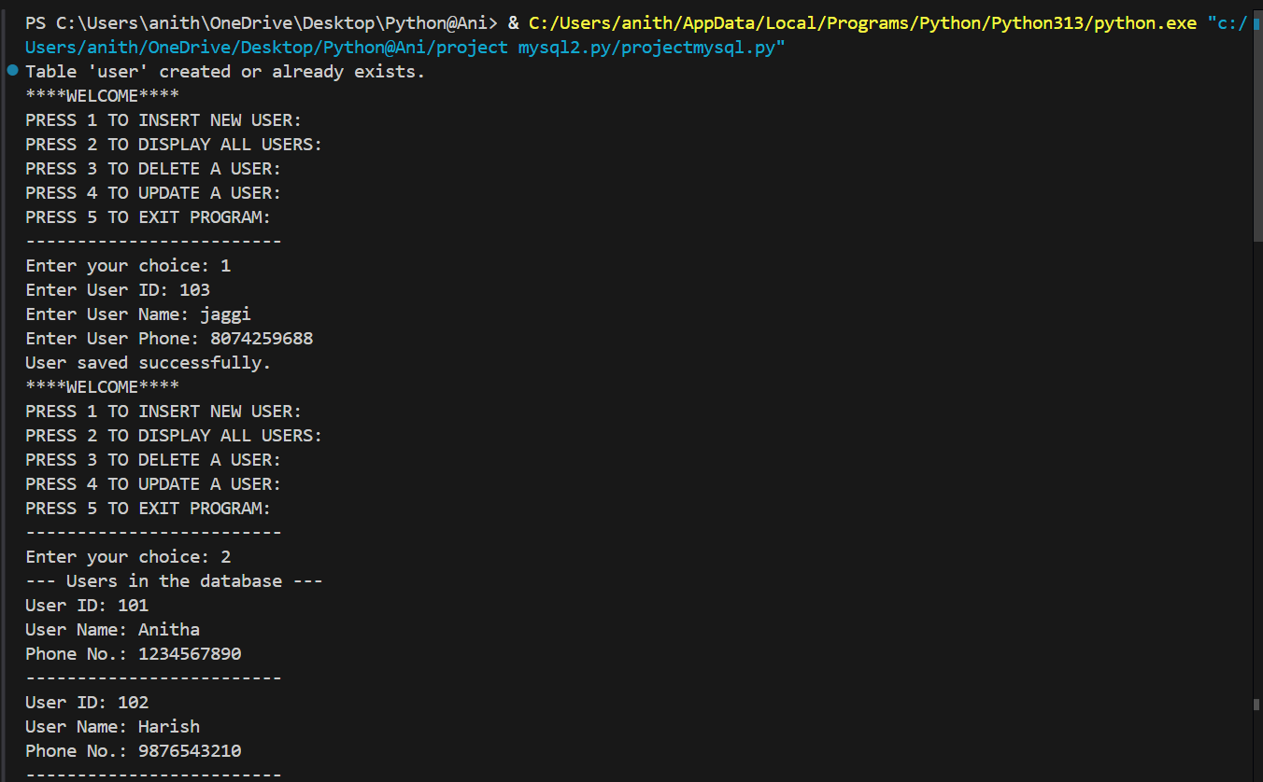
Output:

Slide 9
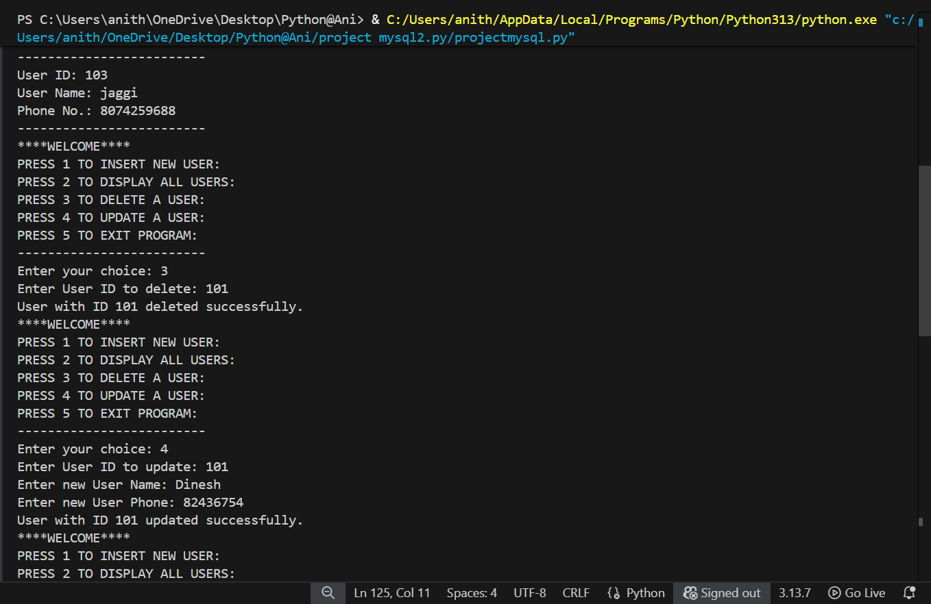

Slide 10
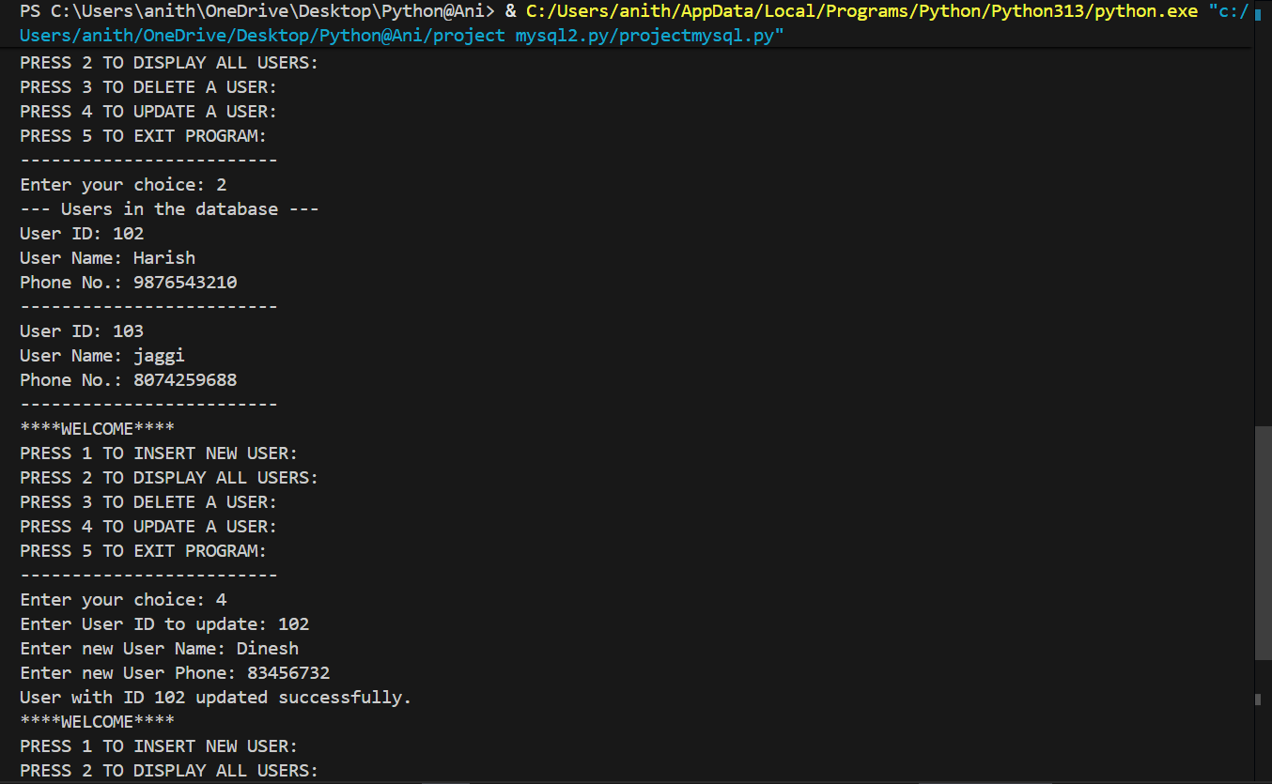

Slide 11
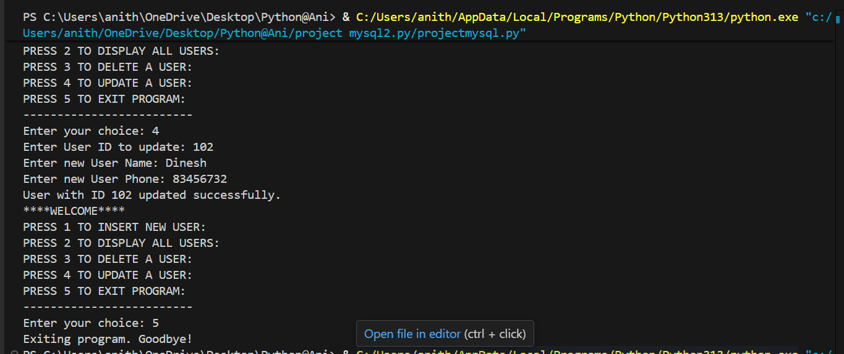

Slide 12
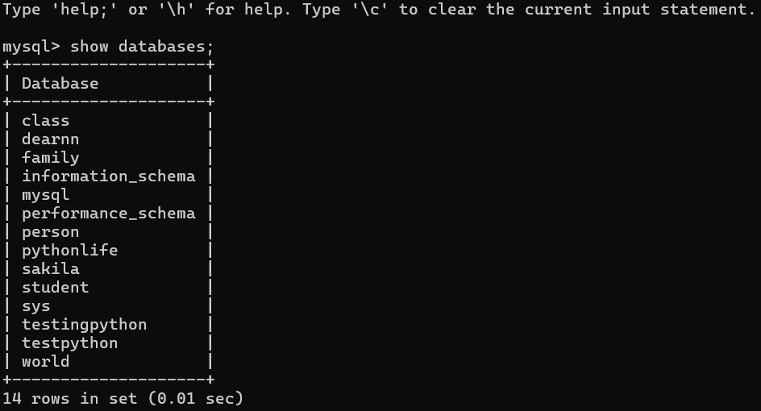
MYSQL QUERIES:

Slide 13
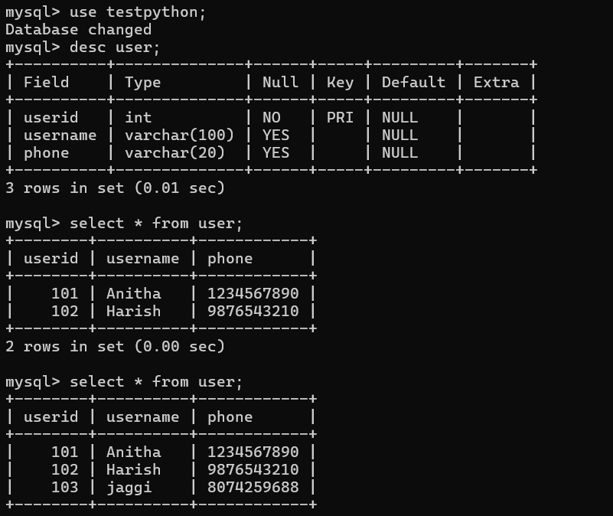

Slide 14
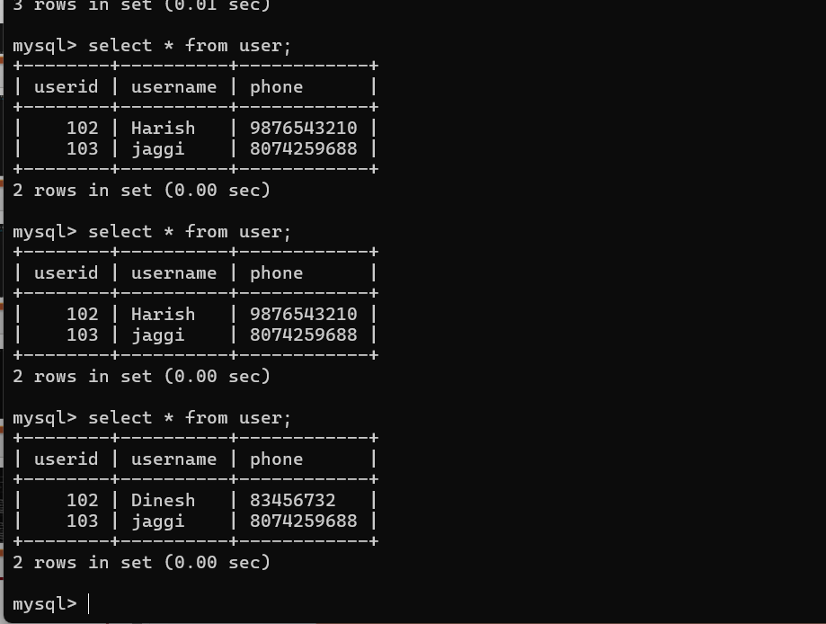

Slide 15
CONCLUSION:
Successful Encapsulation: The DBHelper class successfully encapsulates all database interaction logic, providing a clean, reusable set of methods (CRUD) for managing user data, thereby separating the data layer from the application logic.
Robustness and Security: The project prioritizes data integrity and security through the use of parameterized queries to prevent SQL injection and implements transaction control (commit()/rollback()) and error handling to ensure reliable database operations.
Foundation for Expansion: This structure serves as an excellent foundation, easily expandable for complex applications while demonstrating core skills in Python object-oriented programming and interfacing with a relational database (MySQL).

Slide 16
Thankyou

