Slide 1
RANDOM FOREST(CLASSIFICATION)
What is Random Forest ?
Random Forest is a machine learning algorithm based on Supervised learning, that can be used for both Classification and Regression problems.
It is a collection of multiple random decision trees , which is called forest.
Random Forest or Random Decision Forest is a method that operates by constructing multiple Decision Trees during training phase.
The Decision of the majority of the trees is chosen by the random forest as the final decision.

Slide 2
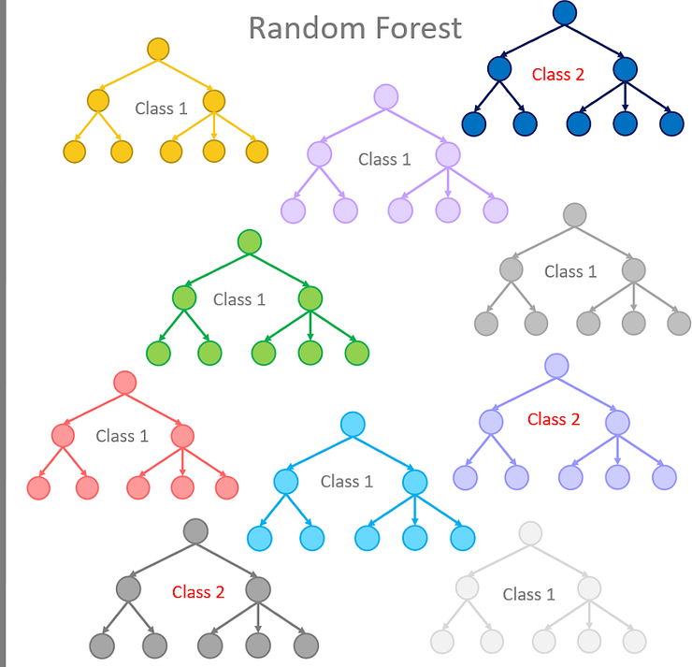
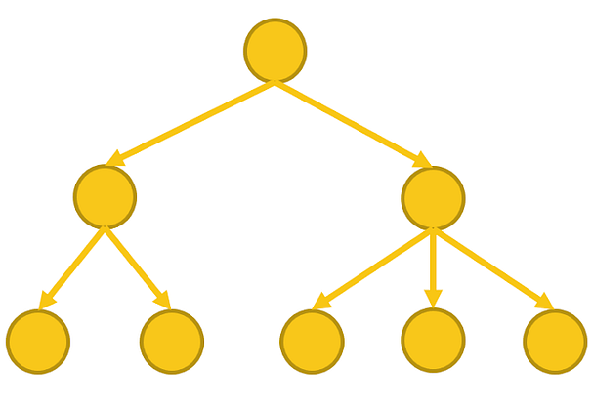

Slide 3
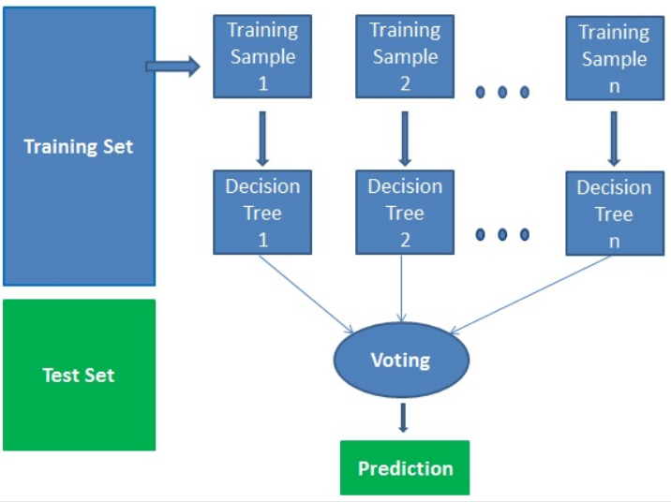
Random Forest is an ensemble learning(Bagging) technique.
Random Forest builds multiple decision trees and merge them together to get a more accurate and the stable predictions.
Then it gets predictions from each tree and by means of majority voting , it selects the decision which gets the majority vote.

Slide 4
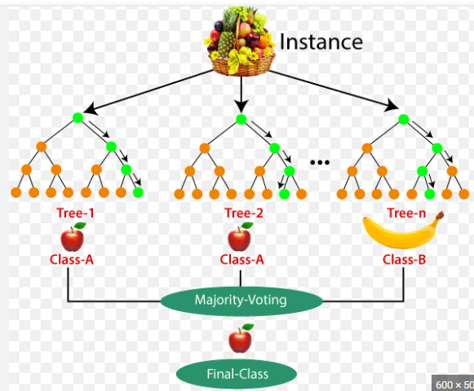
Example : Fruit Basket
Suppose there is a dataset that contains multiple
fruit images. So , This dataset is given to the Random
Forest classifier. The dataset is divided into subsets and
Given to each decision tree. During the training phase,
Each decision tree produces a prediction result, and
When a new data point occurs , then based on the
majority of results , the Random Forest classifier
Predicts the final decision.

Slide 5
Why should we use Random Forest?
1.No Overfitting:
Use of multiple trees to reduce the risk of overfitting.
Training time is less.
2.High Accuracy:
Runs efficiently on large databases.
For large data , it produces highly accurate predictions.
3.Estimates missing data:
Random Forest can maintain accuracy when a large proportion of data is missing.

Slide 6
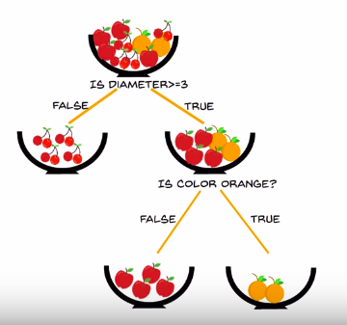
Now What is Decision Tree ?
Decision Tree is a tree shaped diagram used to determine a course of action . Each branch of the tree represents a possible decision , occurrence or reaction.
Important terms in Decision Tree:
1.Entropy:Entropy is the measure of randomness or unpredictability in the
dataset.
2.Information Gain: It is the measure of decrease in entropy after the
dataset is split.
3.Leaf Node: Leaf Node carries the classification or the decision.
4.Decision Node : Decision Node has two or more branches.

Slide 7
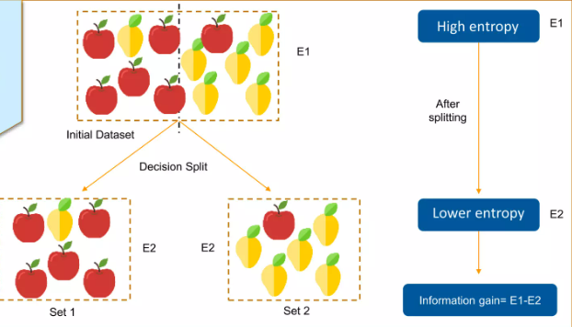
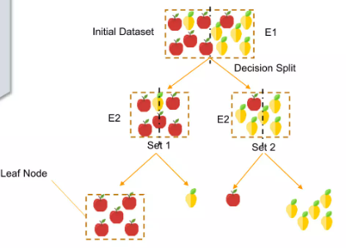
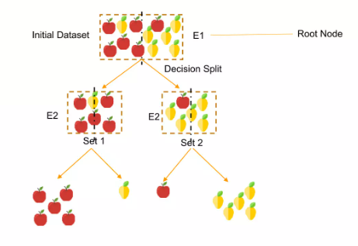
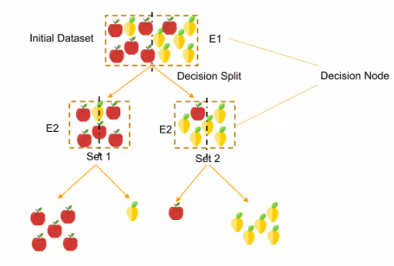
5.Root Node : The top most Decision Node is known as Root Node.

Slide 8
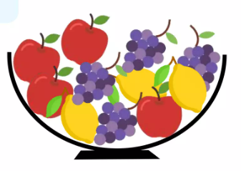
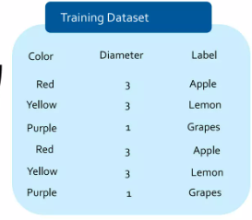
How Decision Tree works?
Problem Statement: To Classify the different types of fruits
in the bowl based on the different features.
The dataset(bowl)looking quite messy and the entropy is high in this
case.
We have to frame the conditions that split the data in such a way that the
Information Gain is highest.
NOTE: Gain is the measure of decrease in entropy after splitting.
Now we will try to choose a condition that gives us the highest Gain.
We will do that by splitting the data using the each condition and checking the Gain that we get out them.
The condition that gives us the highest Gain will be used to make the first split.

Slide 9
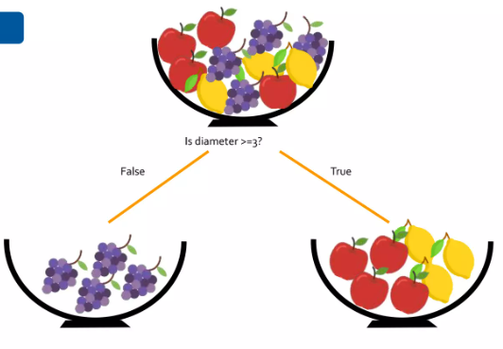
Conditions:
Let’s say the Diameter=3 has maximum Gain.
We split the data
The entropy after splitting has decreased considerably.
This node has already attained as jsjddhb However , this node
an entropy value as zero. As still requires a split to
you can see there is only one decrease the entropy
kind of label is left for this further.
branch. So, no further splitting
is required for this node.

Slide 10
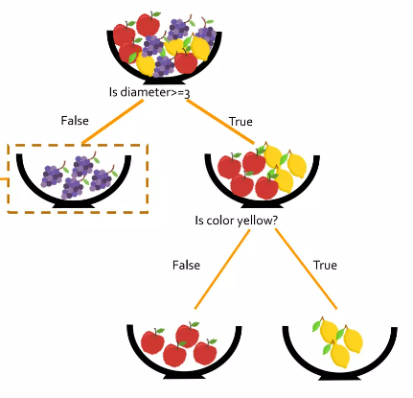
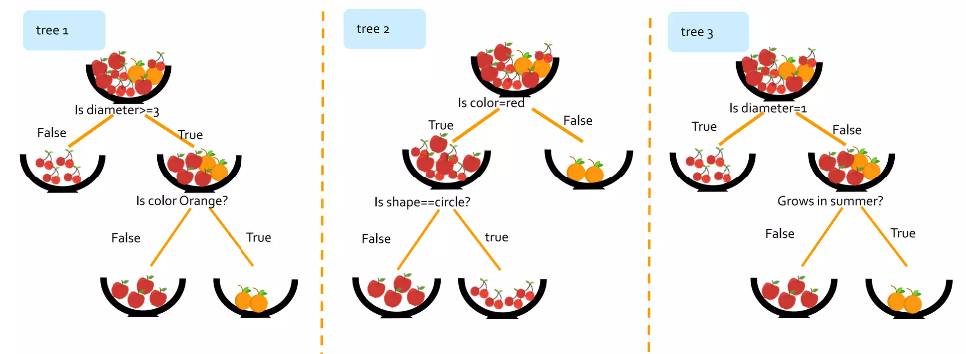

Slide 11

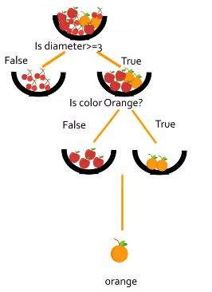
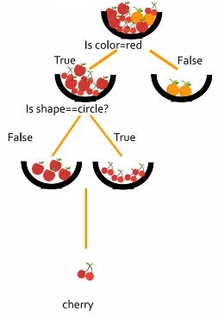
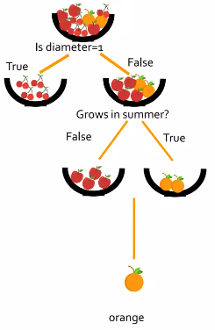
How does Random Forest Work?
Now let’s classify this fruit? Diameter=3,Color = Orange, Shape=Circle, Summer=Yes
Tree1 classifies it as an orange Tree2 classifies it as cherries Tree3 classifies it as an orange

Slide 12

Majority classified as an Orange . So our fruit is classified as Orange.
As I mentioned in Slide 3 Random Forest is an ensemble learning technique which is a Bagging technique.
What is Ensemble Learning Technique??
Ensemble learning Technique (or) Ensemble methods is a machine learning technique that contains several base models in order to produce one optimal predictive model.
Base models can be multiple algorithms (or) one algorithm can we use multiple times(Decision Tree).

Slide 13
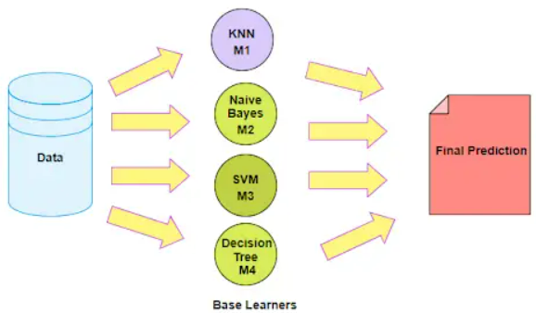
Another way of understanding Ensemble Method is a technique that combines the predictions from multiple machine learning algorithms together to make more accurate predictions than any individual model . A model comprised of many models is called an Ensemble Model.

Slide 14
Types of Ensemble Techniques:
There are 3 types of Ensemble Techniques: 1.Bagging(Bootstrap Aggregation)
2.Boosting
3.Stacking
Random Forest is a Bagging Technique.
What is Bagging Technique??
It is general procedure that can be used to reduce the variance for that algorithm that has high variance , typically decision trees .Bagging makes each model run independently and then aggregates the output at the end without preference to any model.
In Bagging we take different subsets of dataset randomly and combine them with the help of the Bootstrap Sampling.

Slide 15
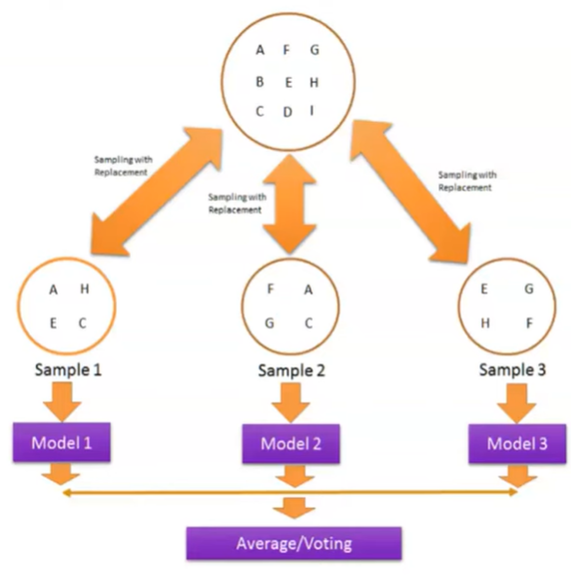
In detail, given a training dataset containing the ‘n’ number of training examples , a sample of ‘m’ training examples will be generated by sampling with replacement .
In Bagging we used the most popular strategies for aggregating the outputs of base learners, that is , find out the majority vote in Classification task.
In Bagging we actually combine several strong
learners in which all the base models are overfitted
models they are having a very high variance and at
the time of aggregating we simply try to reduce that
variance without affecting the bias with which the
accuracy may improve.

Slide 16
Advantages of Random Forest:
Random Forest is very stable.
Random Forest is not biased.
The Random Forest algorithm works well when you have both categorical and numerical features.
The Random Forest algorithm also works well when data has missing values or it has not been scaled well.
Overcomes overfitting.
Works well for large dataset.
High Accuracy.

Slide 17
Disadvantages of Random Forest:
Complexity
Time Consuming
Applications in real time scenario:
1.Banking:Banking sector mostly uses this algorithm for the identification of loan risk.
2.Marketing:Marketing trends can be identified using this algorithm.
3.Medicine:With the help of this algorithm , disease trends and risks of the disease can be identified.
4.Land Use : We can identify the areas of similar land by using this algorithm.

