Slide 1

Project Title -
[Student Name – Muddasani Aditi
College Name- Sridevi Women’s Enginerring College ]
AICTE STU ID : (STU6809bfaed21f31745469358)

Slide 2

PROBLEM STATEMENT
To analyze agricultural performance across seasons, crops, regions, environmental conditions, and farming practices, identify meaningful patterns and variations in yield, resource utilization, and profitability, and generate data-driven insights to support effective agricultural planning and decision-making.

Slide 3
Project Description
Seasonal Agriculture Performance Analysis is a data analytics project that explores agricultural performance across seasons, crops, regions, environmental conditions, and farming practices. Using data preprocessing, statistical analysis, correlation analysis, and visualization techniques, the project identifies patterns in crop yield, production, resource efficiency, revenue, and profitability. The insights generated can support data-driven agricultural planning and informed decision-making.

Slide 4

WHO ARE THE END USERS?
Farmers
Agricultural Planners
Government & Agricultural Departments
Agricultural Researchers
Data Analysts
Resource Management Organizations

Slide 5

Technology Used
Python – Core programming language for data analysis
Google Colab / Jupyter Notebook – Development and analysis environment
Pandas – Data loading, cleaning, transformation, and aggregation
NumPy- Numerical and statistical computations
Matplotliby – Data visualization and charts
SciPy – Statistical analysis, including ANOVA
CSV Dataset – Source format for agricultural data
  “Python-based data analytics tools were used for data preprocessing, exploratory analysis, statistical testing, visualization, and interpretation of seasonal agricultural performance.”

Slide 6
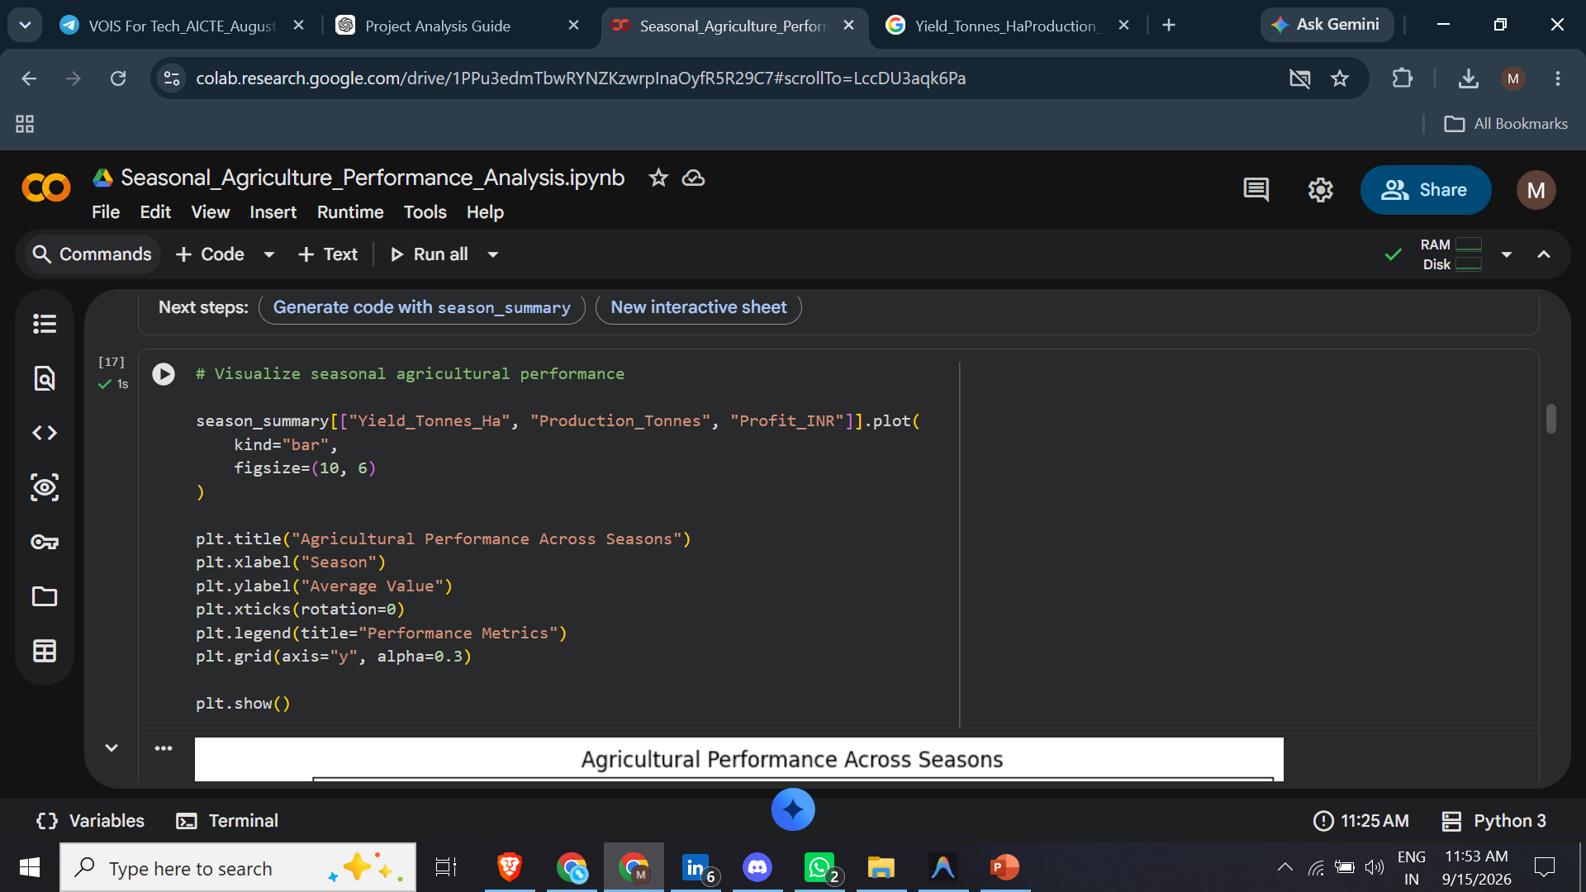
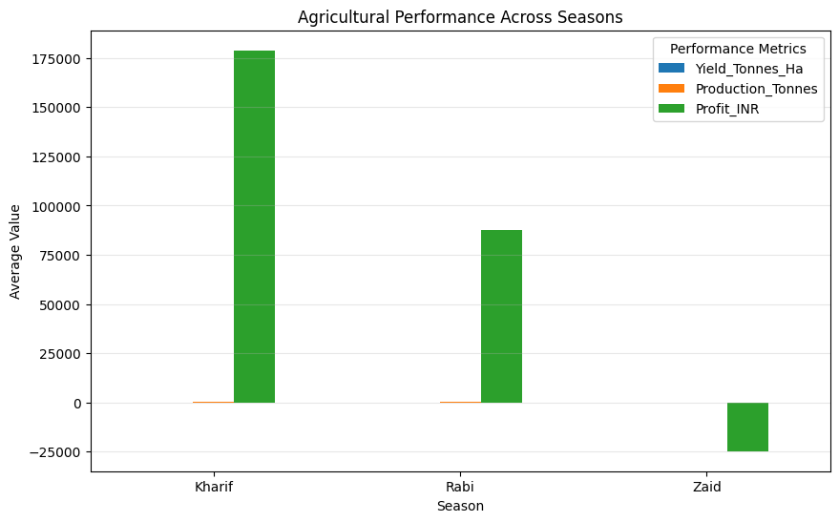
RESULTS

Slide 7
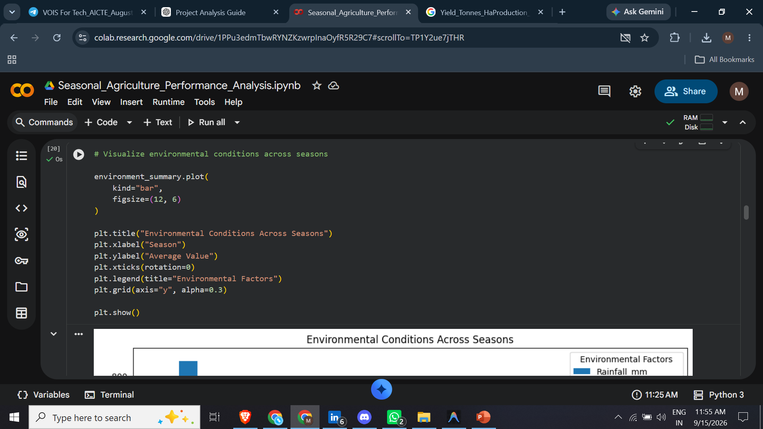
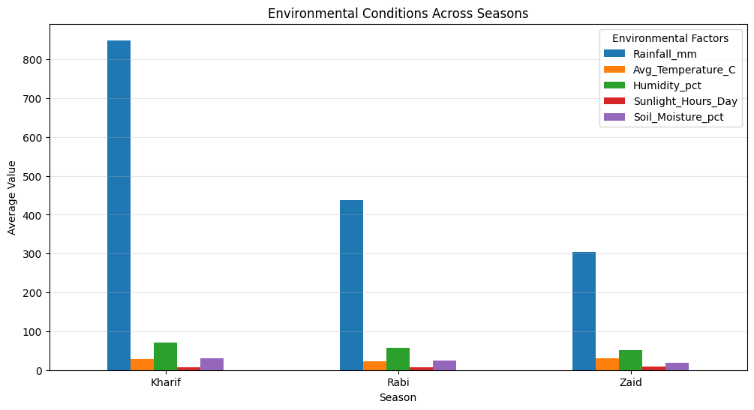
RESULTS

Slide 8
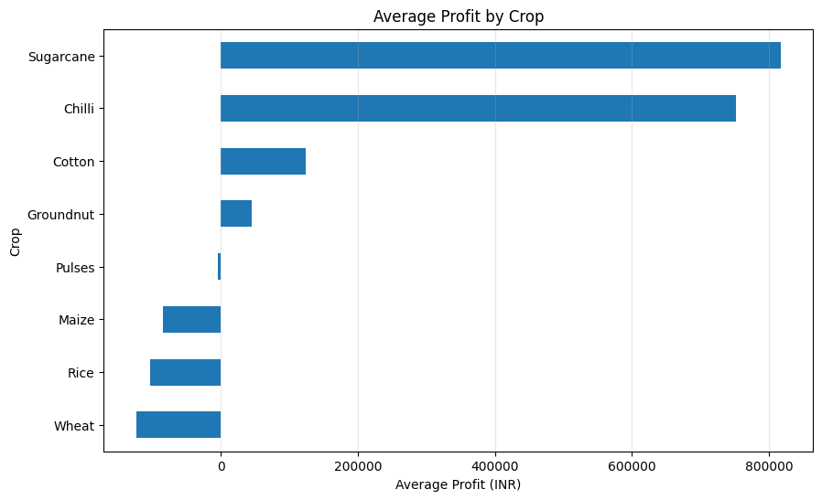
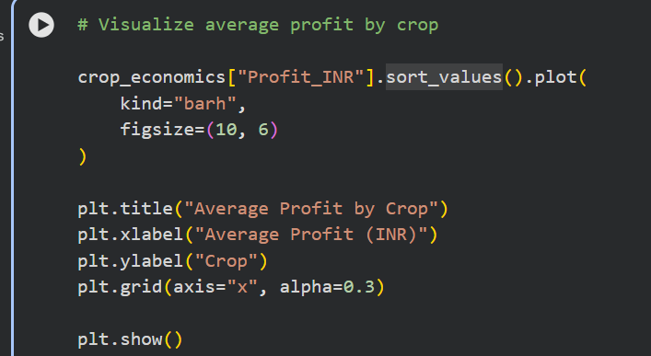
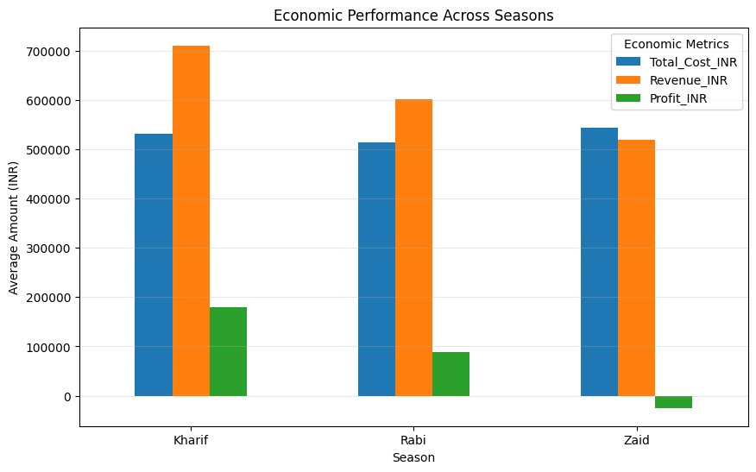
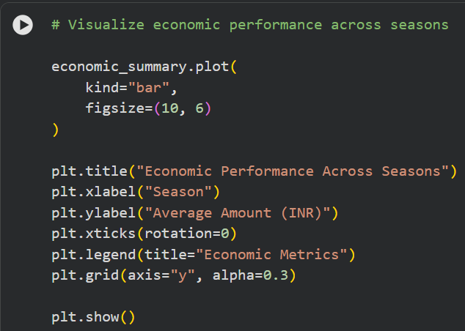
RESULTS

Slide 9
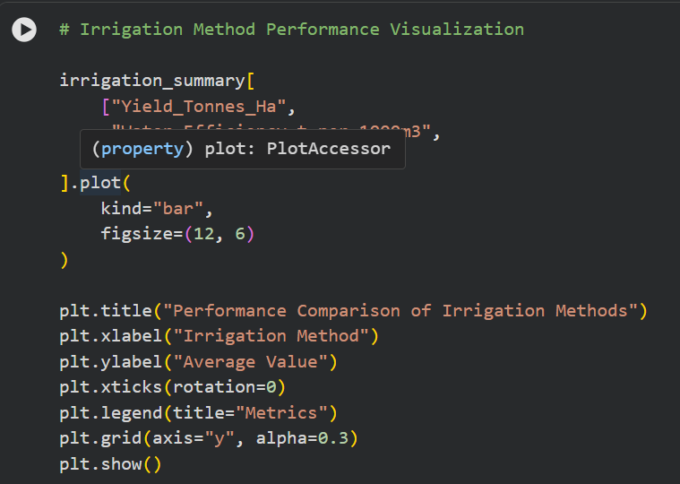
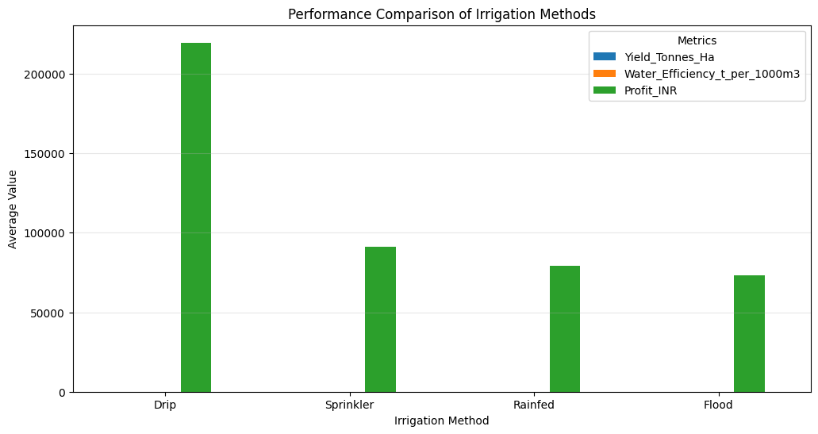
RESULTS

Slide 10
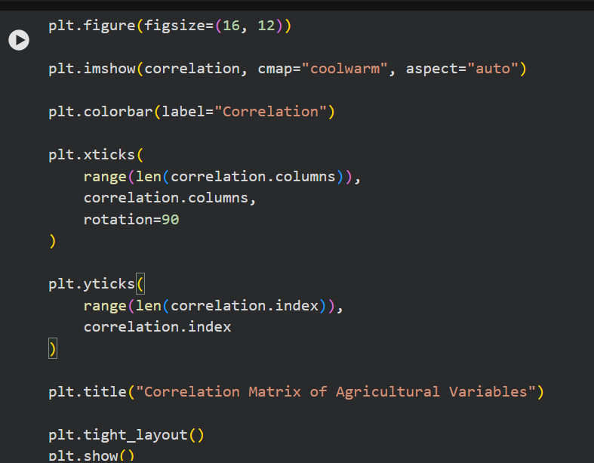
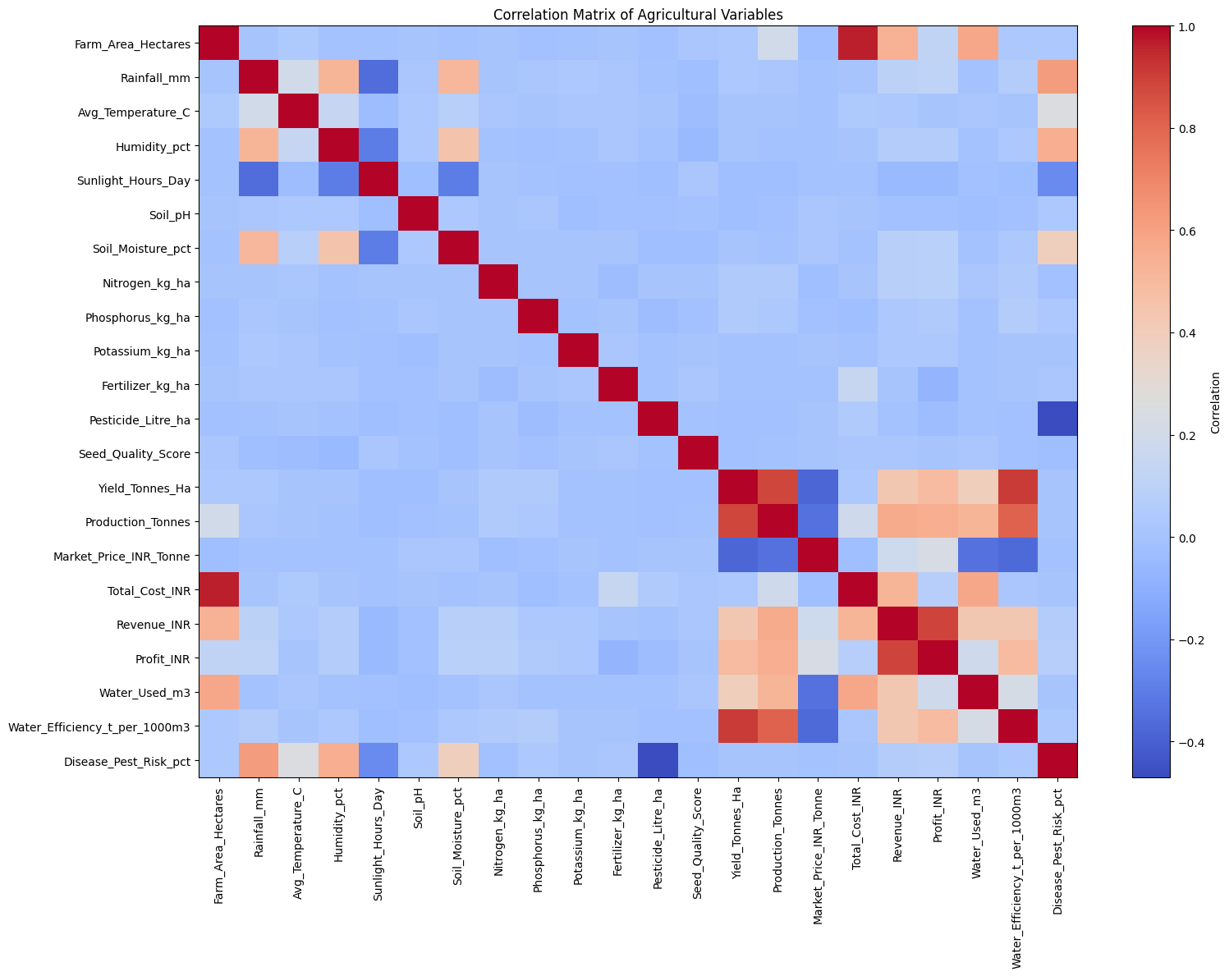
RESULTS

Slide 11
Future scope
• Predictive yield analysis
• Smart crop recommendation
• Real-time environmental monitoring
• Resource optimization
• Interactive agricultural dashboard
• Early risk detection

Slide 12
GitHub Link
https://github.com/muddasaniaditi511/Seasonal-Agriculture-Performance-Analysis

Slide 13
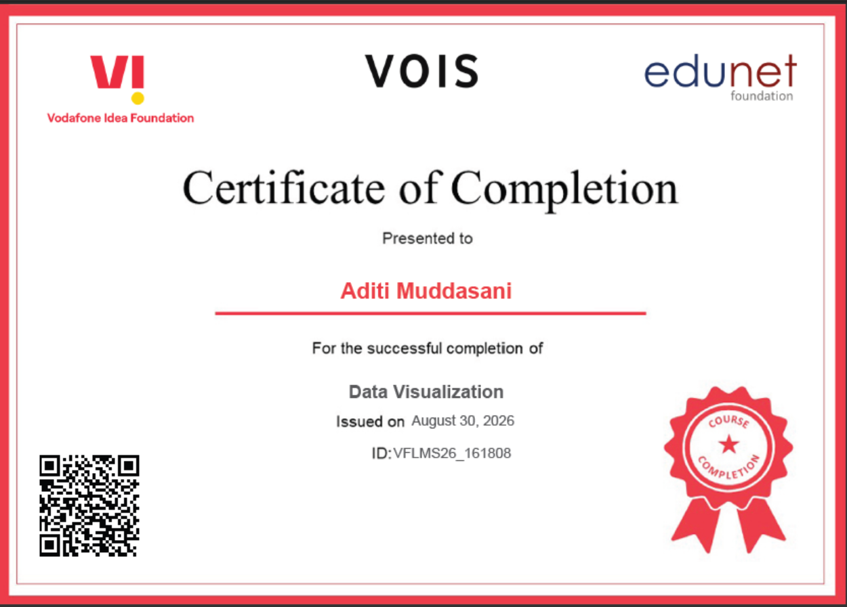
VOIS Course completion certificate -
Course name- Data Visualization

Slide 14
Thank you
.
.

