Slide 1
Throw and Block
Mohammed Muddasser, Raphael Brösamle
Practical Course Robotics | 16.07.2020

Slide 2
What is the project about?
Implementation of a thrower and a goalie
The balls are shot periodically from different positions
Trajectory estimation for the ball intersection position
The current ball position directly queried
Thrower:
180° field of view
Ball thrown towards the desired goal direction
Works also for multiple throwers

Slide 3
Throw and Block
Trajectory based estimation:
Line intersection between the goal direction and the axis of the goal to get x and y co-ordinates of the intersection point.
1D projectile motion to estimate the height of intersection(z).
Approximate estimation:
Line intersection between the goal direction and the axis of the goal to get x and y co-ordinates of the intersection point.
Track the height of the ball at every time step to get the height(z).

Slide 4
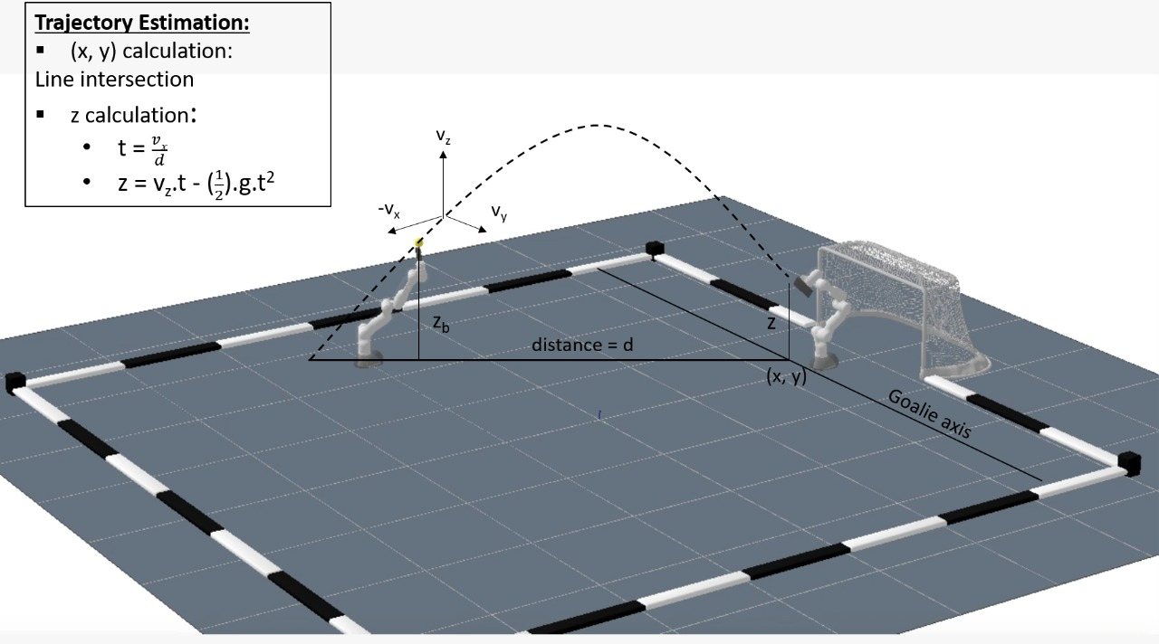

Slide 5
Challenges
Tried various throw paths
Circular motion
Pushing
Predefined throw path gave the best results with respect to velocity of the throw
No restriction of degrees of freedom even with the predefined throw path
Even curved trajectories can be estimated

Slide 6
Limitations
No control on the velocity of the throw
Higher computational complexity with more number of throwers
Disregarding air resistance
Glitch in the simulation (goalie paddle)
More physical disturbances and limitations in the real world
Self goal can not be prevented

Slide 7
Conclusion
Simulation results:
Algorithm 1 - 37/40 Blocked, 3/40 Went over the goal
Algorithm 2 - 36/40 Blocked, 3/40 Went over the goal, 1/40 Self goal

