Slide 1


Python Quiz
Group-13

Slide 2
Introduction
Name of team members- Naman Arora –Roll no.-2210991953
Muddit Pahwa – Roll no.-2210991942
Nandini Kaushik – Roll no.-2210991958
Course- BE CSE
Group—11 ,K
Mentor Name-Ms Ridhima Rani
Institute Name- Chitkara University

Slide 3
Contents
Acknowledgement
Project Overview
Topics Covered
Test Cases
Advantages
Bibliography
C

Slide 4
..Acknowledgement..
We would like to express our special thanks of gratitude to our respected mentor "Ms. Ridhima Rani" and our respected dean sir "Dr. Monit Kapoor“ for giving us this opportunity to do this project which helped us in learning new concepts and taught us the value of team work.

Slide 5
Project Overview
We’ll start by creating a basic Python quiz application that’s only capable of asking question’s, collecting answer’s, and checking whether the answer is correct. We’ll add more and more features in order to make our project more interesting, user-friendly, and fun.

Slide 6
Topic’s Covered
Data Types(Strings,Integers,Float)
Operations
Conditions(use of if,else,elif)
Loops
Functions
Lists

Slide 7
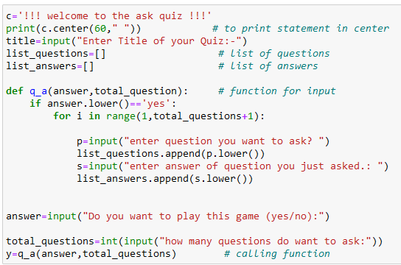
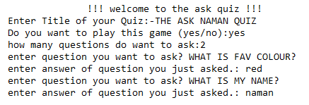
Test Case-1
Code:-
Output:

Slide 8
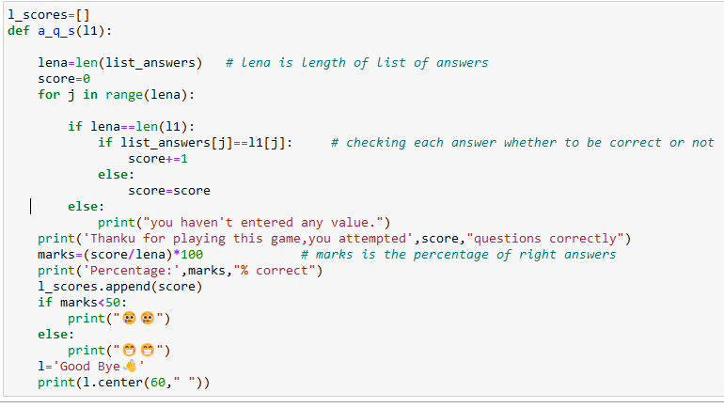
Test Case-2
Code:
Output:
Function created to be used in upcoming user case.

Slide 9
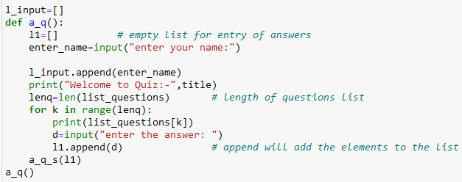
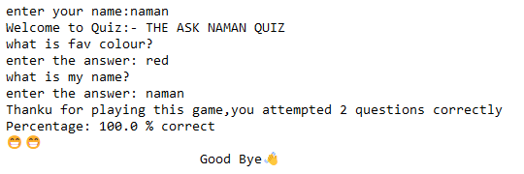
Test Case-3
Code:
Output:

Slide 10
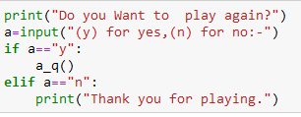
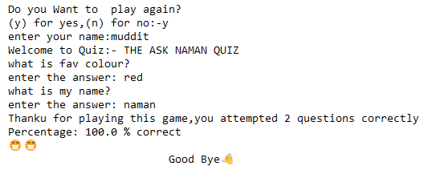
Test Case-4
Code:
Output:

Slide 11


Test Case-5
Code:
Output:

Slide 12
Advantages
This is a fun game that relax users mind and gives temporary escape from their stressful schedule.
It provide interactive way of playing quiz.
It is helpful in online quiz that held in schools and colleges.

Slide 13
BiblioGraphy
Python.org
Codecademy
Learnpython.org
CodingNinja

Slide 14
Thank you
“Good questions inform , great questions transform”

