Slide 1


CV5100: Modelling, Uncertainty and Data for Engineers
MODULE 2: TIME SERIES ANALYSIS, lecture 2: Modeling and estimation

Slide 2
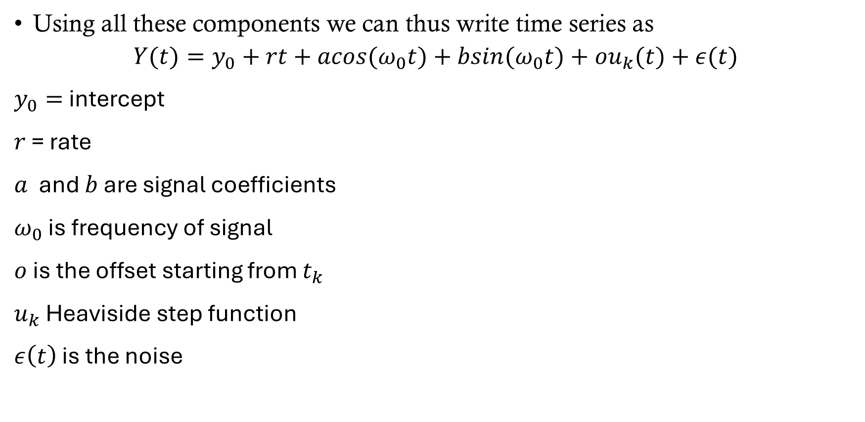
Time series expression
Using all these components we can thus write time series as
$$Y(t)=y_{0}+rt+acos(ω_{0}t)+bsin(ω_{0}t)+ou_{k}(t)+ε(t)$$
$y_{0}=$ intercept
$r$ = rate
$a$ and $b$ are signal coefficients
$ω_{0}$ is frequency of signal
$o$ is the offset starting from $t_{k}$
$u_{k}$ Heaviside step function
$ε\left(t\right)$ is the noise

Slide 3
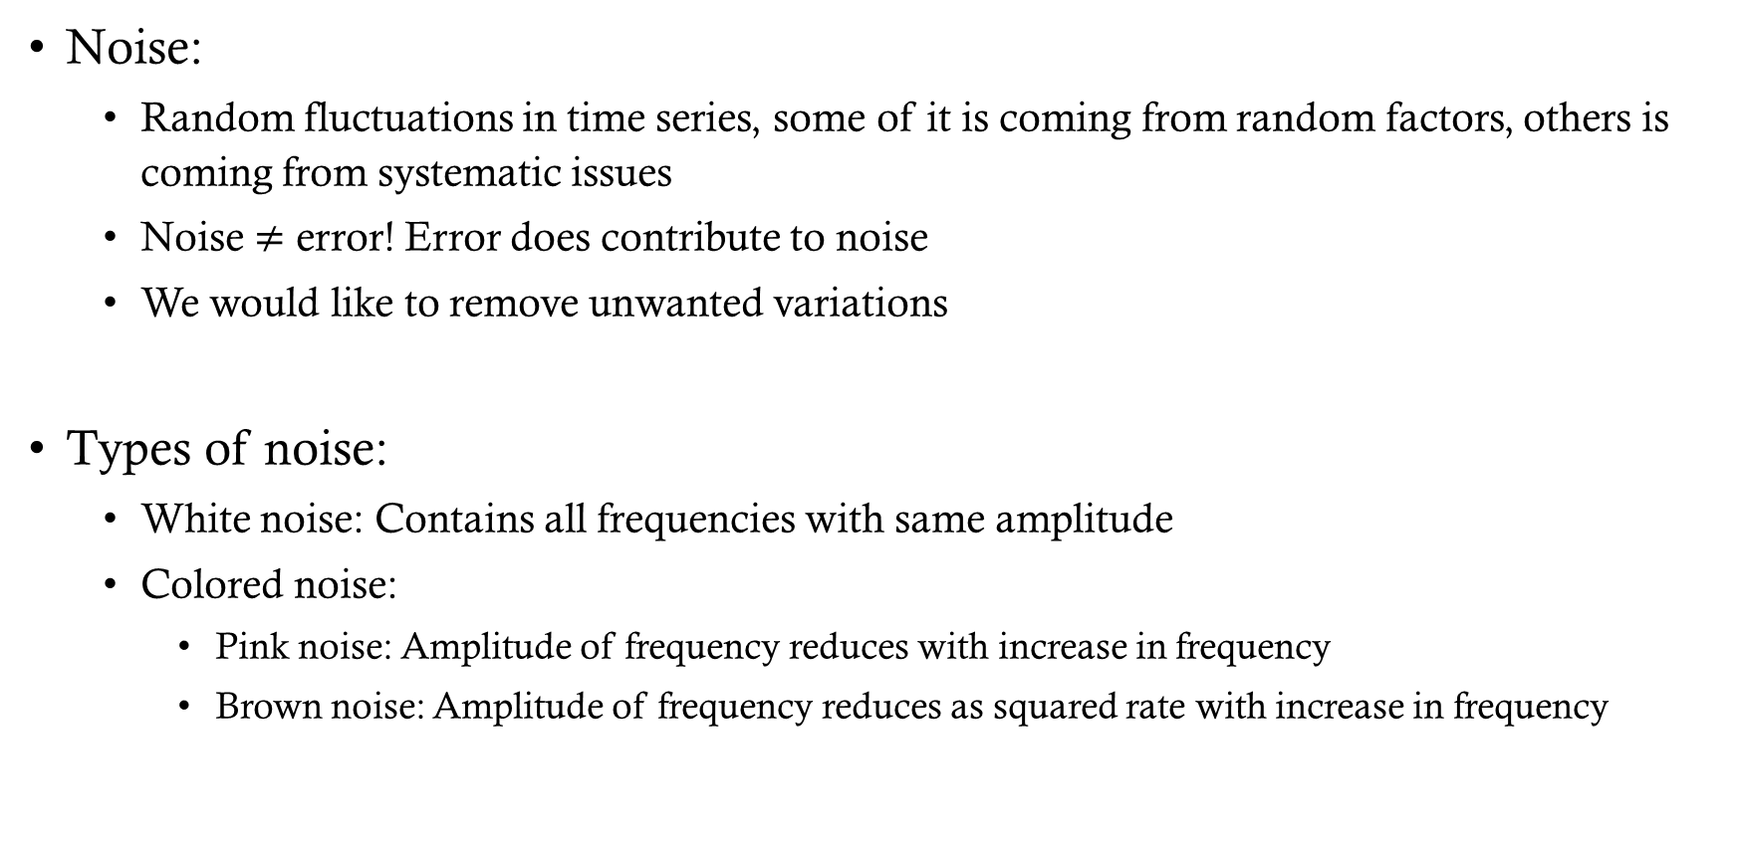
components
Noise:
  Random fluctuations in time series, some of it is coming from random factors, others is coming from systematic issues
  Noise $≠$ error! Error does contribute to noise
  We would like to remove unwanted variations
Types of noise:
  White noise: Contains all frequencies with same amplitude
  Colored noise:
    Pink noise: Amplitude of frequency reduces with increase in frequency
    Brown noise: Amplitude of frequency reduces as squared rate with increase in frequency

Slide 4
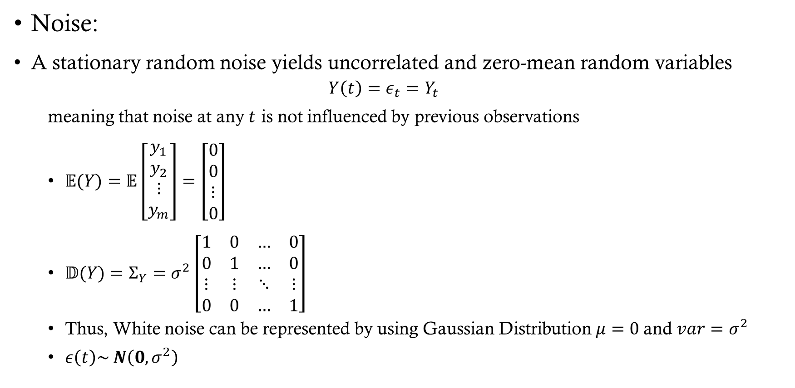
components model
Noise:
A stationary random noise yields uncorrelated and zero-mean random variables
  $$Y\left(t\right)=ε_{t}=Y_{t}$$
  meaning that noise at any $t$ is not influenced by previous observations
  $\begin{aligned}𝔼(Y)=𝔼\left[\begin{aligned}y_{1} \\ y_{2} \\ ⋮ \\ y_{m}\end{aligned}\right]=\left[\begin{aligned}0 \\ 0 \\ ⋮ \\ 0\end{aligned}\right]\end{aligned}$
  $\begin{aligned}𝔻(Y)=Σ_{Y}=σ^{2}\left[\begin{matrix}1 & 0 & … & 0 \\ 0 & 1 & … & 0 \\ ⋮ & ⋮ & ⋱ & ⋮ \\ 0 & 0 & … & 1\end{matrix}\right]\end{aligned}$
  Thus, White noise can be represented by using Gaussian Distribution $μ=0$and $var=σ^{2}$
  $ε\left(t\right)\sim N\left(0, σ^{2}\right)$

Slide 5
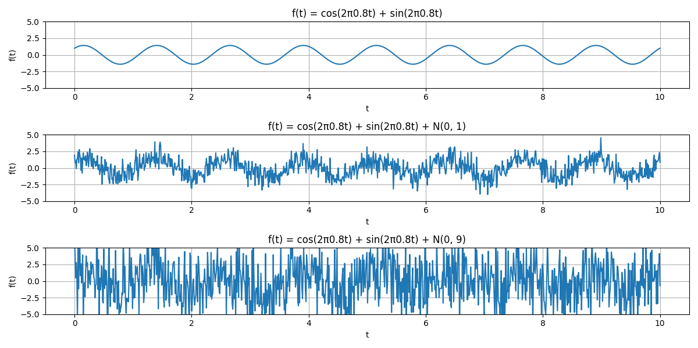
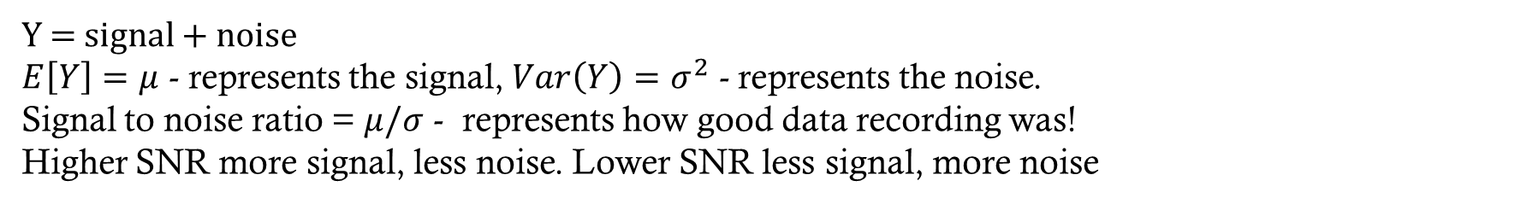
Signal and noise
Y = signal + noise
$E\left[Y\right]=μ$ - represents the signal, $Var\left(Y\right)=σ^{2}$ - represents the noise.
Signal to noise ratio = $μ/σ$ - represents how good data recording was!
Higher SNR more signal, less noise. Lower SNR less signal, more noise

Slide 6
Time series expression
Using all these components we can thus write time series as
$$Y(t)=y_{0}+rt+acos(ω_{0}t)+bsin(ω_{0}t)+ou_{k}(t)+ε(t)$$
$y_{0}=$ intercept
$r$ = rate
$a$ and $b$ are signal coefficients
$ω_{0}$ is frequency of signal
$o$ is the offset starting from $t_{k}$
$u_{k}$ Heaviside step function
$ε\left(t\right)$ is the noise

Slide 7
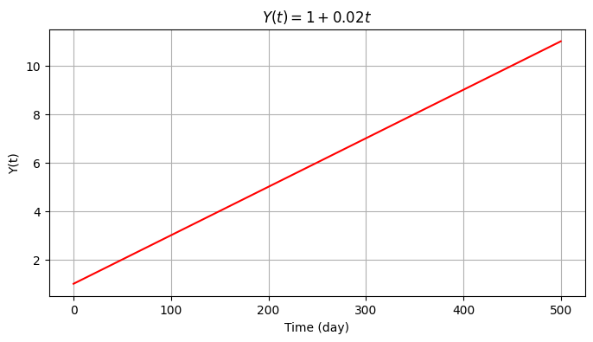
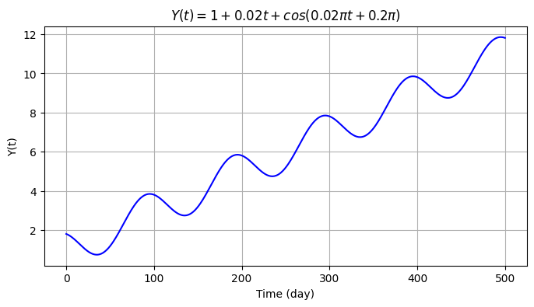
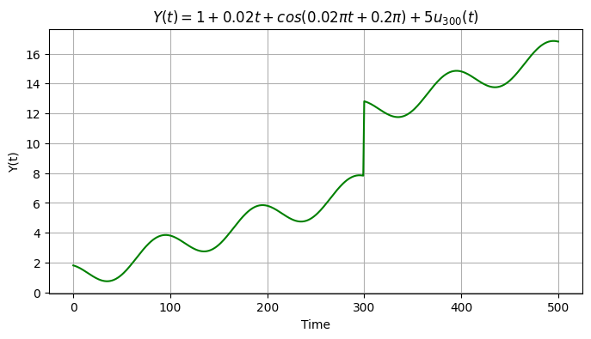
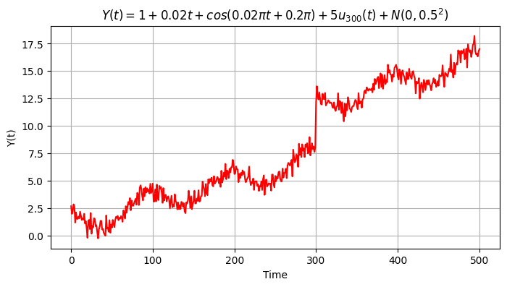
Example

Slide 8
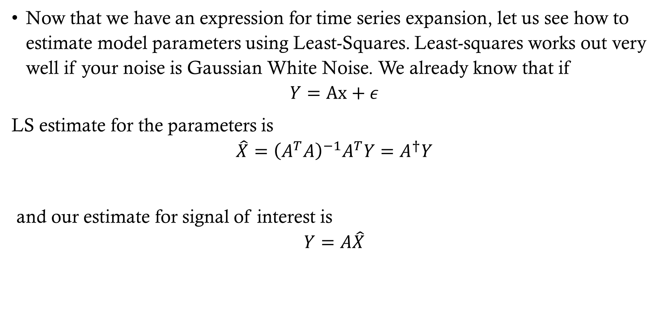
Model estimation
Now that we have an expression for time series expansion, let us see how to estimate model parameters using Least-Squares. Least-squares works out very well if your noise is Gaussian White Noise. We already know that if
$$Y=Ax+ε$$
LS estimate for the parameters is
$$\hat{X}={\left(A^{T}A\right)}^{−1}A^{T}Y=A^{†}Y$$
and our estimate for signal of interest is
$$Y=A\hat{X}$$

Slide 9
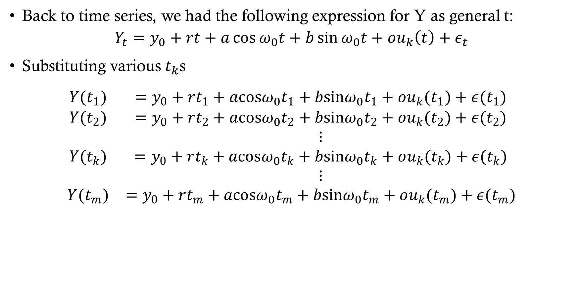
LS of time series
Back to time series, we had the following expression for Y as general t:
$$Y_{t}=y_{0}+rt+a\cos{ω_{0}t}+b\sin{ω_{0}t}+ou_{k}\left(t\right)+ε_{t}$$
Substituting various $t_{k}$s
$$\begin{aligned}\begin{matrix}Y(t_{1}) & =y_{0}+rt_{1}+acosω_{0}t_{1}+bsinω_{0}t_{1}+ou_{k}(t_{1})+ε(t_{1}) \\ Y(t_{2}) & =y_{0}+rt_{2}+acosω_{0}t_{2}+bsinω_{0}t_{2}+ou_{k}(t_{2})+ε(t_{2}) \\ & ⋮ \\ Y(t_{k}) & =y_{0}+rt_{k}+acosω_{0}t_{k}+bsinω_{0}t_{k}+ou_{k}(t_{k})+ε(t_{k}) \\ & ⋮ \\ Y(t_{m}) & =y_{0}+rt_{m}+acosω_{0}t_{m}+bsinω_{0}t_{m}+ou_{k}(t_{m})+ε(t_{m})\end{matrix}\end{aligned}$$

Slide 10
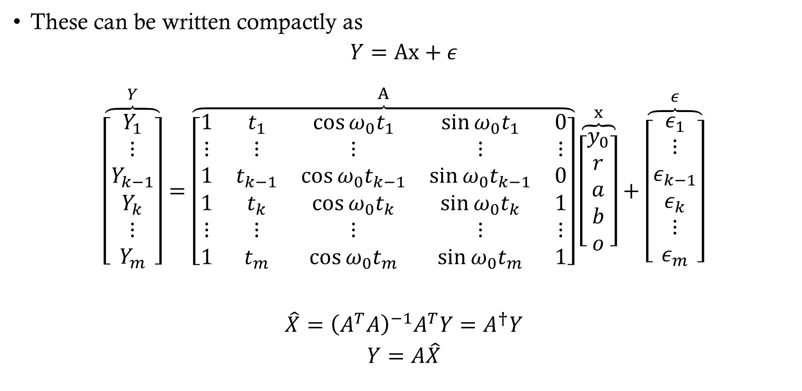
LS of time series
These can be written compactly as
$$Y=Ax+ε$$
$$\begin{matrix}\overset{Y}{\overbrace{\left[\begin{matrix}Y_{1} \\ ⋮ \\ Y_{k−1} \\ Y_{k} \\ ⋮ \\ Y_{m}\end{matrix}\right]}}=\overset{A}{\overbrace{\left[\begin{matrix}1 & t_{1} & \cos{ω_{0}t_{1}} & \sin{ω_{0}t_{1}} & 0 \\ ⋮ & ⋮ & ⋮ & ⋮ & ⋮ \\ 1 & t_{k−1} & \cos{ω_{0}t_{k−1}} & \sin{ω_{0}t_{k−1}} & 0 \\ 1 & t_{k} & \cos{ω_{0}t_{k}} & \sin{ω_{0}t_{k}} & 1 \\ ⋮ & ⋮ & ⋮ & ⋮ & ⋮ \\ 1 & t_{m} & \cos{ω_{0}t_{m}} & \sin{ω_{0}t_{m}} & 1\end{matrix}\right]}}\overset{x}{\overbrace{\left[\begin{matrix}y_{0} \\ r \\ a \\ b \\ o\end{matrix}\right]}}+\overset{ε}{\overbrace{\left[\begin{matrix}ε_{1} \\ ⋮ \\ ε_{k−1} \\ ε_{k} \\ ⋮ \\ ε_{m}\end{matrix}\right]}}\end{matrix}$$
$$\hat{X}={\left(A^{T}A\right)}^{−1}A^{T}Y=A^{†}Y$$
$$Y=A\hat{X}$$

Slide 11
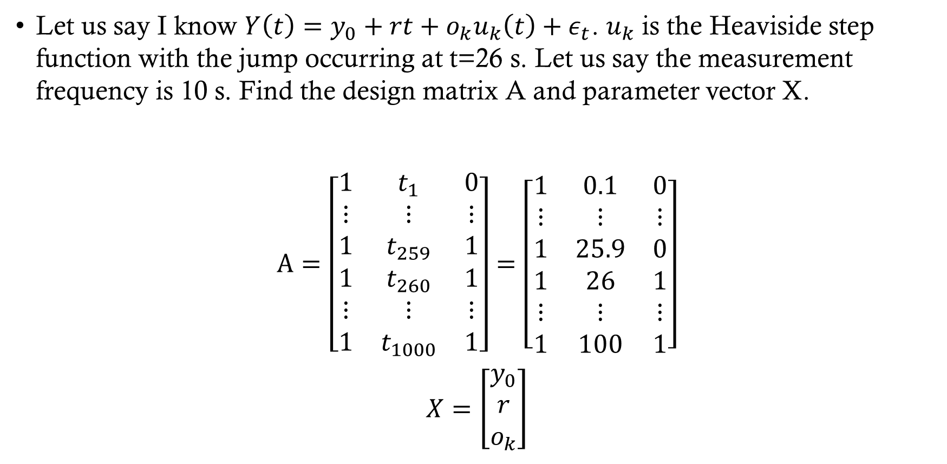
Example
Let us say I know $Y\left(t\right)=y_{0}+rt+o_{k}u_{k}\left(t\right)+ε_{t}$. $u_{k}$ is the Heaviside step function with the jump occurring at t=26 s. Let us say the measurement frequency is 10 s. Find the design matrix A and parameter vector X.
$$\begin{aligned}A=\left[\begin{matrix}1 & t_{1} & 0 \\ ⋮ & ⋮ & ⋮ \\ 1 & t_{259} & 1 \\ 1 & t_{260} & 1 \\ ⋮ & ⋮ & ⋮ \\ 1 & t_{1000} & 1\end{matrix}\right]=\left[\begin{matrix}1 & 0.1 & 0 \\ ⋮ & ⋮ & ⋮ \\ 1 & 25.9 & 0 \\ 1 & 26 & 1 \\ ⋮ & ⋮ & ⋮ \\ 1 & 100 & 1\end{matrix}\right]\end{aligned}$$
$$X=\left[\begin{aligned}y_{0} \\ r \\ o_{k}\end{aligned}\right]$$

Slide 12
Blue of time series
Back to time series if we don’t have $Σ_{y}≠σ^{2}I$, we need a new approach. We had the following expression for Y as general t:
$$Y_{t}=y_{0}+rt+a\cos{ω_{0}t}+b\sin{ω_{0}t}+ou_{k}\left(t\right)+ε_{t}$$
Substituting various $t_{k}$s
$$\begin{aligned}\begin{matrix}Y(t_{1}) & =y_{0}+rt_{1}+acosω_{0}t_{1}+bsinω_{0}t_{1}+ou_{k}(t_{1})+ε(t_{1}) \\ Y(t_{2}) & =y_{0}+rt_{2}+acosω_{0}t_{2}+bsinω_{0}t_{2}+ou_{k}(t_{2})+ε(t_{2}) \\ & ⋮ \\ Y(t_{k}) & =y_{0}+rt_{k}+acosω_{0}t_{k}+bsinω_{0}t_{k}+ou_{k}(t_{k})+ε(t_{k}) \\ & ⋮ \\ Y(t_{m}) & =y_{0}+rt_{m}+acosω_{0}t_{m}+bsinω_{0}t_{m}+ou_{k}(t_{m})+ε(t_{m})\end{matrix}\end{aligned}$$

Slide 13
Blue of time series
These can be written compactly as
$$Y=Ax+ε$$
$$\begin{matrix}\overset{Y}{\overbrace{\left[\begin{matrix}Y_{1} \\ ⋮ \\ Y_{k−1} \\ Y_{k} \\ ⋮ \\ Y_{m}\end{matrix}\right]}}=\overset{A}{\overbrace{\left[\begin{matrix}1 & t_{1} & \cos{ω_{0}t_{1}} & \sin{ω_{0}t_{1}} & 0 \\ ⋮ & ⋮ & ⋮ & ⋮ & ⋮ \\ 1 & t_{k−1} & \cos{ω_{0}t_{k−1}} & \sin{ω_{0}t_{k−1}} & 0 \\ 1 & t_{k} & \cos{ω_{0}t_{k}} & \sin{ω_{0}t_{k}} & 1 \\ ⋮ & ⋮ & ⋮ & ⋮ & ⋮ \\ 1 & t_{m} & \cos{ω_{0}t_{m}} & \sin{ω_{0}t_{m}} & 1\end{matrix}\right]}}\overset{x}{\overbrace{\left[\begin{matrix}y_{0} \\ r \\ a \\ b \\ o\end{matrix}\right]}}+\overset{ε}{\overbrace{\left[\begin{matrix}ε_{1} \\ ⋮ \\ ε_{k−1} \\ ε_{k} \\ ⋮ \\ ε_{m}\end{matrix}\right]}}\end{matrix}$$
$$\begin{matrix}Σ_{Y}=\left[\begin{matrix}σ_{1}^{2} & σ_{12} & … & σ_{1m} \\ σ_{21} & σ_{2}^{2} & & \\ ⋮ & ⋮ & ⋱ & \\ σ_{m1} & σ_{m2} & … & σ_{m}^{2}\end{matrix}\right]\end{matrix}$$

Slide 14
Blue of time series
Assuming $Σ_{Y}$ is known, BLUE can be estimated as
$$\begin{matrix}\hat{X}=\left[\begin{matrix}\hat{y_{0}} \\ \hat{r} \\ \hat{a} \\ \hat{b} \\ \hat{o}\end{matrix}\right], Σ_{\hat{X}}=\left[\begin{matrix}σ_{{\hat{y}}_{0}}^{2} & σ_{{\hat{y}}_{0}\hat{r}} & σ_{{\hat{y}}_{0}\hat{a}} & σ_{{\hat{y}}_{0}\hat{b}} & σ_{\hat{y_{0}}\hat{o}} \\ σ_{\hat{r}{\hat{y}}_{0}} & σ_{\hat{r}}^{2} & σ_{\hat{r}\hat{a}} & σ_{\hat{r}\hat{b}} & σ_{\hat{r}\hat{o}} \\ σ_{\hat{a}\hat{y_{0}}} & σ_{\hat{a}\hat{r}} & σ_{\hat{a}}^{2} & σ_{\hat{a}\hat{b}} & σ_{\hat{a}\hat{o}} \\ σ_{\hat{b}\hat{y_{0}}} & σ_{\hat{b}\hat{r}} & σ_{\hat{b}\hat{a}} & σ_{\hat{b}}^{2} & σ_{\hat{b}\hat{o}} \\ σ_{\hat{o}\hat{y_{0}}} & σ_{\hat{o}\hat{r}} & σ_{\hat{o}\hat{a}} & σ_{\hat{o}\hat{b}} & σ_{\hat{o}}^{2}\end{matrix}\right]\end{matrix}$$
where
$$\hat{X}=(A^{T}Σ_{Y}^{−1}A)^{−1}A^{T}Σ_{Y}^{−1}Y, Σ_{\hat{X}}=(A^{T}Σ_{Y}^{−1}A)^{−1}$$
Now $ω_{0}$ might not be known beforehand. In which case, we can first determine the parameters only for rate and offsets, remove them from time series. Then, using frequency decomposition we can determine $ω_{0}$

Slide 15
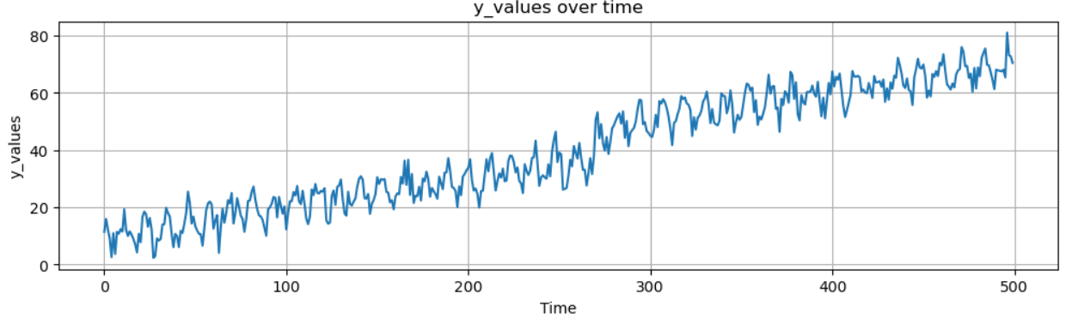
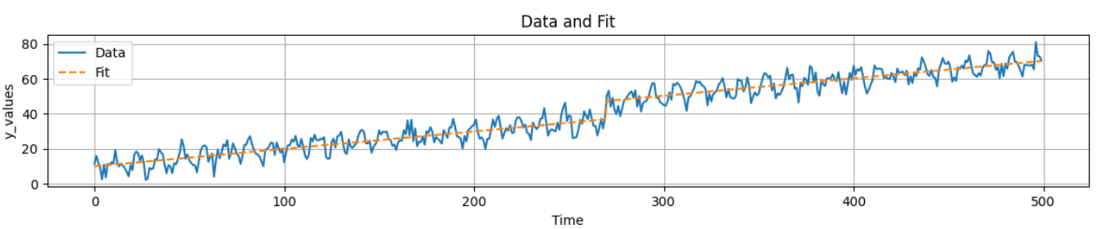
example

Slide 16
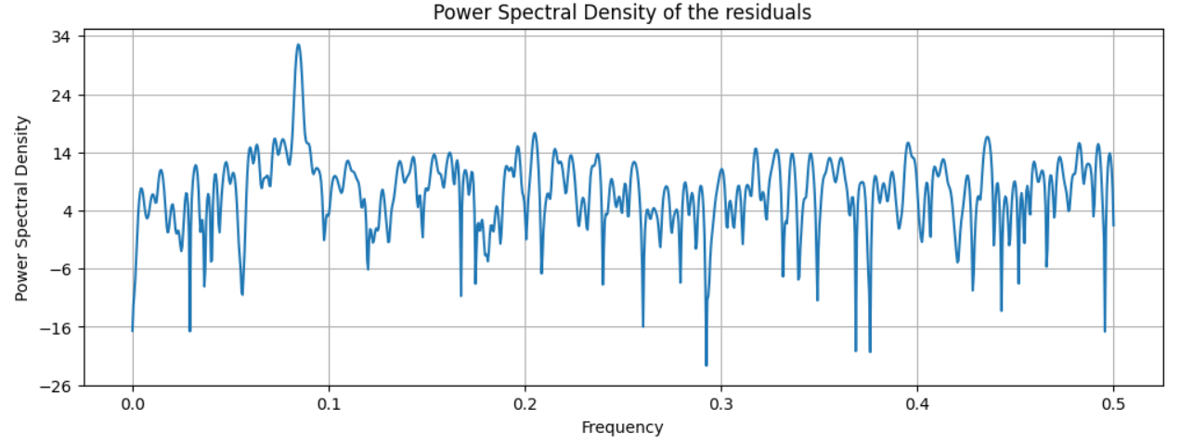
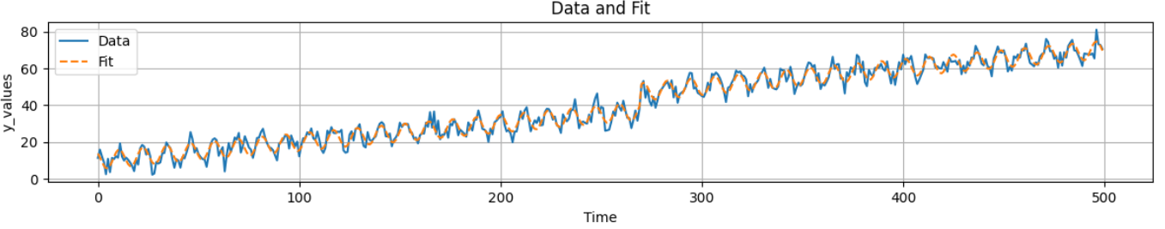
example

