Slide 1


CV5100: Modelling, Uncertainty and Data for Engineers
MODULE 1: Signal processing, lecture 1: Fourier series

Slide 2


What is Signal?
A signal, as a function of one or more variables, may be defined as an observable change in a quantifiable entity*
For instance,
  Disp(t)
    Quantifiable entity? => Yes
    Observable change as a function of some variable? => Yes
If the independent variable is time, signal = time series
$$Disp$$
$$t$$
* - Pragnan Chakravorty, "What Is a Signal? [Lecture Notes]," IEEE Signal Processing Magazine, vol. 35, no. 5, pp. 175-177, Sept. 2018. doi: 10.1109/MSP.2018.2832195
Notes:
Non-signal examples: A constant value that does not change with time or any variable (e.g., a temperature sensor always reading 25°C with no variation) is not a signal, because there is no observable change to quantify.
A mathematical function or variable that is not observable or measurable in any way (e.g., an abstract variable in an equation with no physical or measurable meaning) does not constitute a signal.
The absence of any measurable entity or phenomenon (e.g., silence in an environment with no detectable sound, or a sensor outputting zero with nothing happening) is not a signal, as there is no observable change to detect.

Slide 3
Motivation
Dynamic loads -> Dynamic response -> Signals
Understanding signal processing -> extract valuable information from raw data that would otherwise be invisible!
Applications?
  Experimental data analysis
  System identification -> Structural health monitoring, Non-destructive testing
  Vibration theory

Slide 4
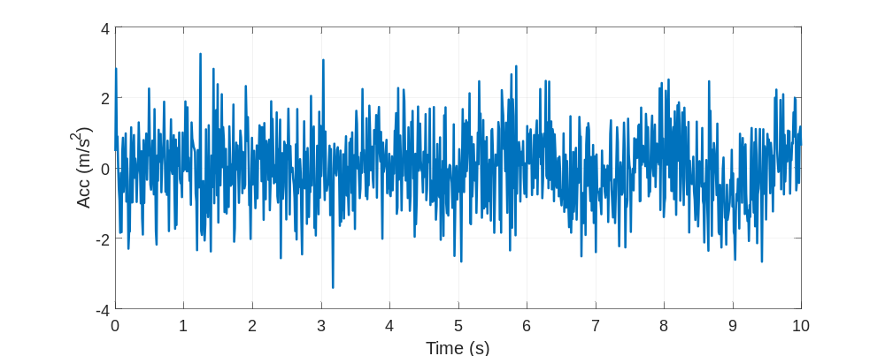
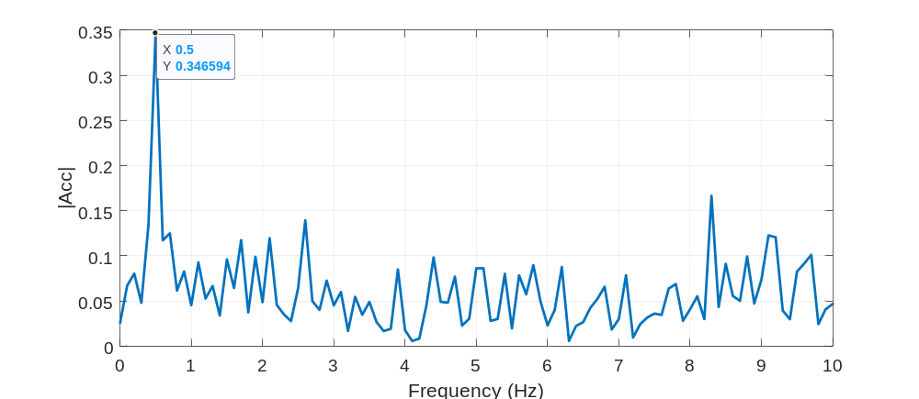
Motivation: illustration
For instance, SDOF with k= 100 kN/m, m = 10000 kg. What is the natural frequency?
Did you record the data correctly? Did everything go correctly?
Signal processing

Slide 5




frequency domain
Time-series =>difficult to interpret
Frequency domain: Instead of tracking a signal’s value at each moment (the time domain), the frequency domain shows how much of the signal is made up of different frequencies
Time domain v/s frequency domain: two different viewpoints of the same phenomenon, just different representations
$$x(t)$$
$$X(f)$$
$$t$$
$$F$$

Slide 6
Why frequency domain?
Frequency domain offers:
  Easy interpretation due to sparsity
  Simpler mathematical operations
Time-domain
Frequency-domain
Problem
transform
solve
transform
Solution

Slide 7
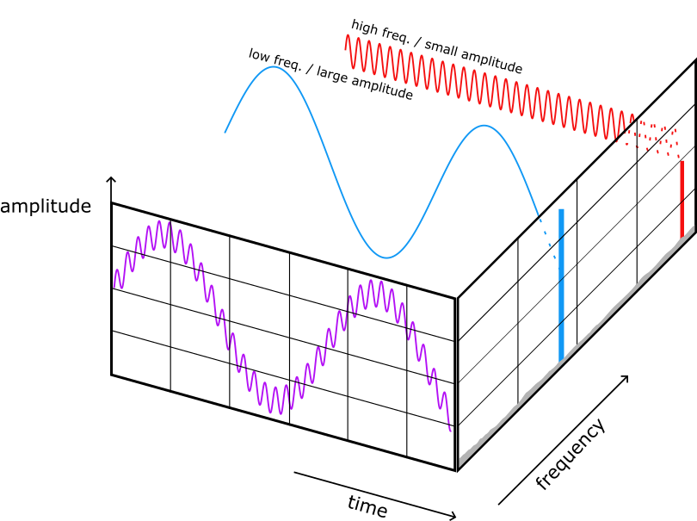
frequency domain
The goal of this chapter is to be able to identify and analyze frequency components in a signal
Image credits: https://mude.citg.tudelft.nl/2024/book/_images/fft_illustration.png

Slide 8






Fourier series
Periodic signals: A signal that repeats itself exactly after a fixed interval of time
Periodic signals examples?
  Unbalanced rotating machinery in building
  Rotating propeller at stern of the ship
Nonperiodic signals: A signal that does not repeat itself over regular intervals of time
Nonperiodic signals examples?
  Bomb blast pressure on the building
  Earthquake ground motion
$$x(t)$$
$$x(t)$$
$$t$$
$$t+T_{0}$$
$$t$$
$$t$$

Slide 9
Fourier series
Periodic signals: A signal that repeats itself exactly after a fixed interval of time
Periodic signals examples?
  Unbalanced rotating machinery in building
  Rotating propeller at stern of the ship
Nonperiodic signals: A signal that does not repeat itself over regular intervals of time
Nonperiodic signals examples?
  Bomb blast pressure on the building
  Earthquake ground motion
$$x(t)$$
$$x(t)$$
$$t$$
$$t$$

Slide 10
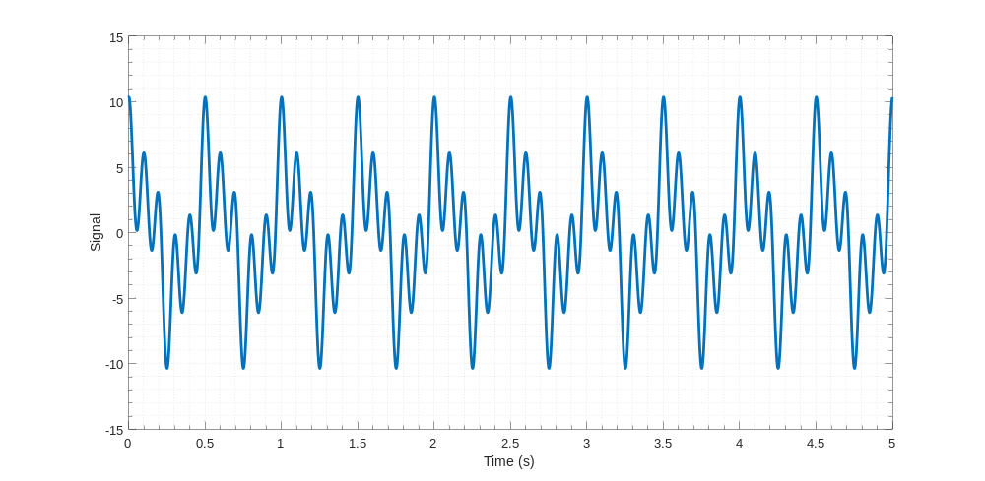
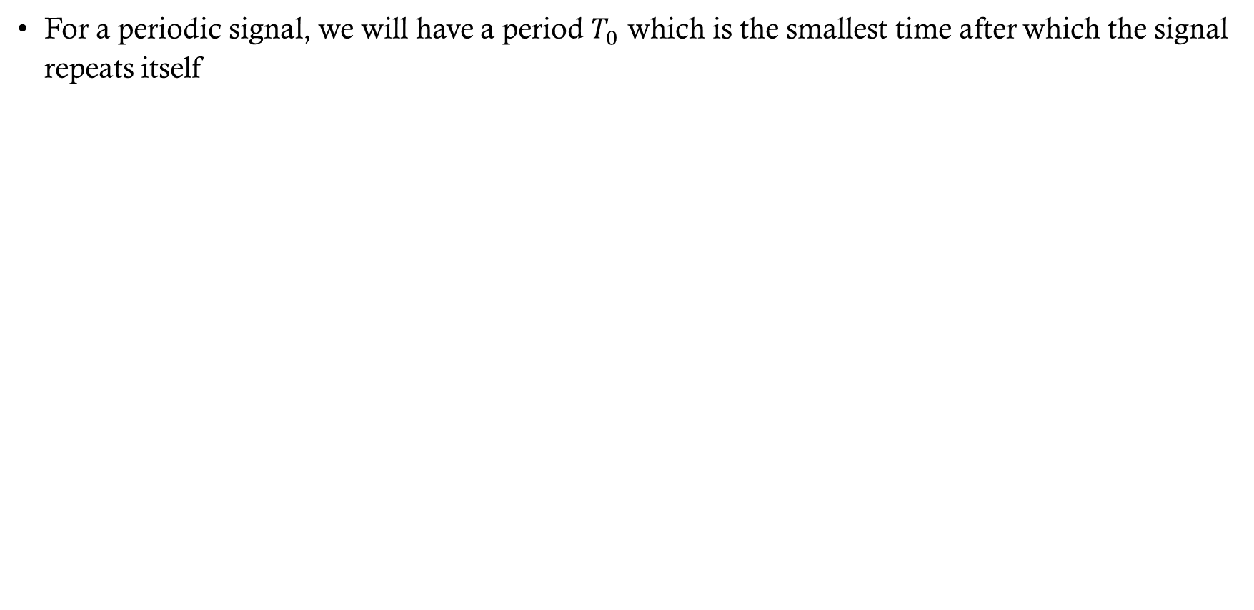
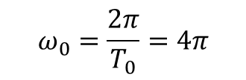

Fourier series
For a periodic signal, we will have a period $T_{0}$ which is the smallest time after which the signal repeats itself
Period, $T_{0}$ = 0.5 s
$$ω_{0}=\frac{2π}{T_{0}}=4π$$

Slide 11
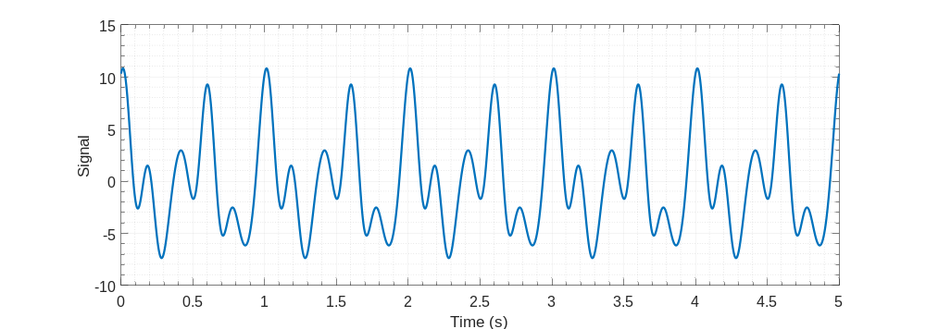
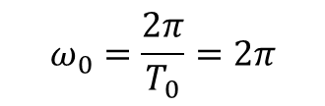

Fourier series
For a periodic signal, we will have a period $T_{0}$ which is the smallest time after which the signal repeats itself
Period, $T_{0}$ = 1 s
$$ω_{0}=\frac{2π}{T_{0}}=2π$$

Slide 12
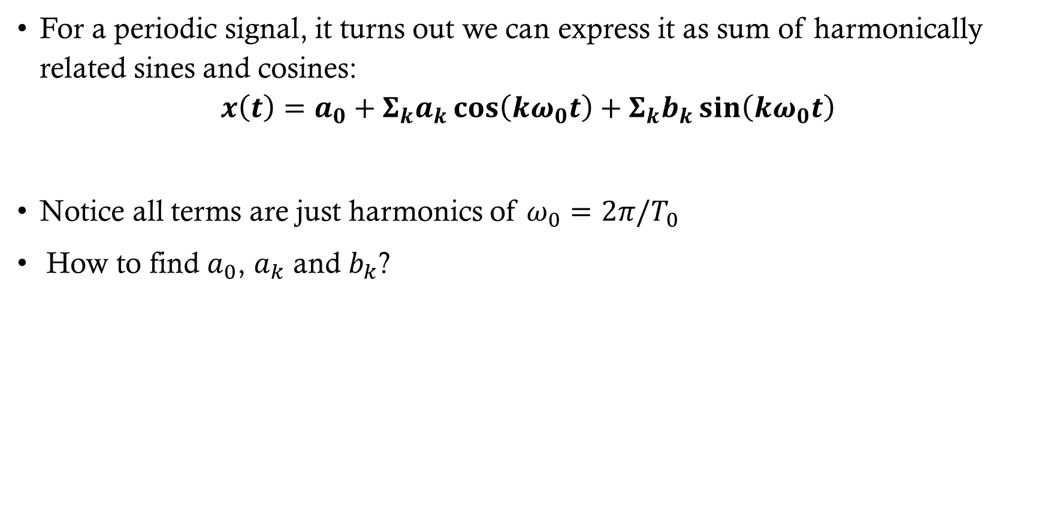
Fourier series
For a periodic signal, it turns out we can express it as sum of harmonically related sines and cosines:
$$x\left(t\right)=a_{0}+Σ_{k}a_{k}\cos\left(kω_{0}t\right)+Σ_{k}b_{k}\sin\left(kω_{0}t\right)$$
Notice all terms are just harmonics of $ω_{0}=2π/T_{0}$
How to find $a_{0}$, $a_{k}$ and $b_{k}$?

Slide 13
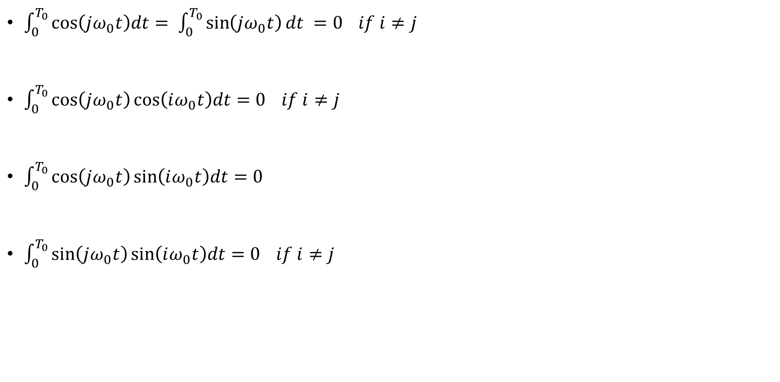
Some useful results
$\int_{0}^{T_{0}}{\cos\left(jω_{0}t\right)dt= \int_{0}^{T_{0}}{\sin\left(jω_{0}t\right)dt} =0 if i≠j}$
$\int_{0}^{T_{0}}{\cos\left(jω_{0}t\right)\cos\left(iω_{0}t\right)dt=0 if i≠j}$
$\int_{0}^{T_{0}}{\cos\left(jω_{0}t\right)\sin\left(iω_{0}t\right)dt=0}$
$\int_{0}^{T_{0}}{\sin\left(jω_{0}t\right)\sin\left(iω_{0}t\right)dt=0 if i≠j}$

Slide 14
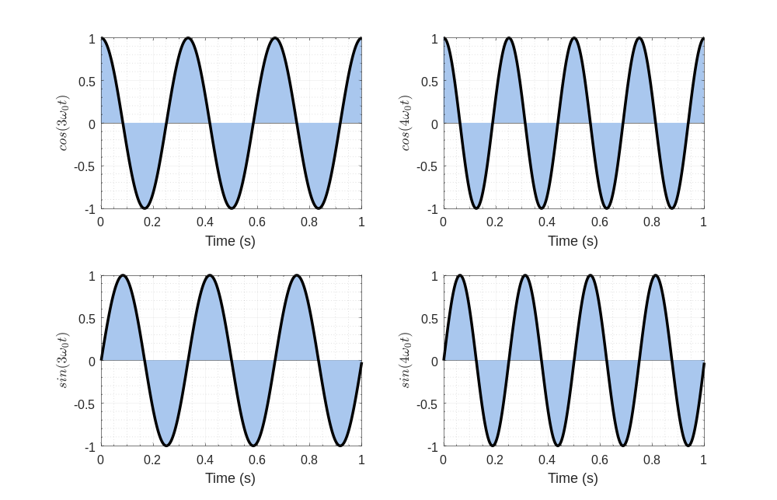
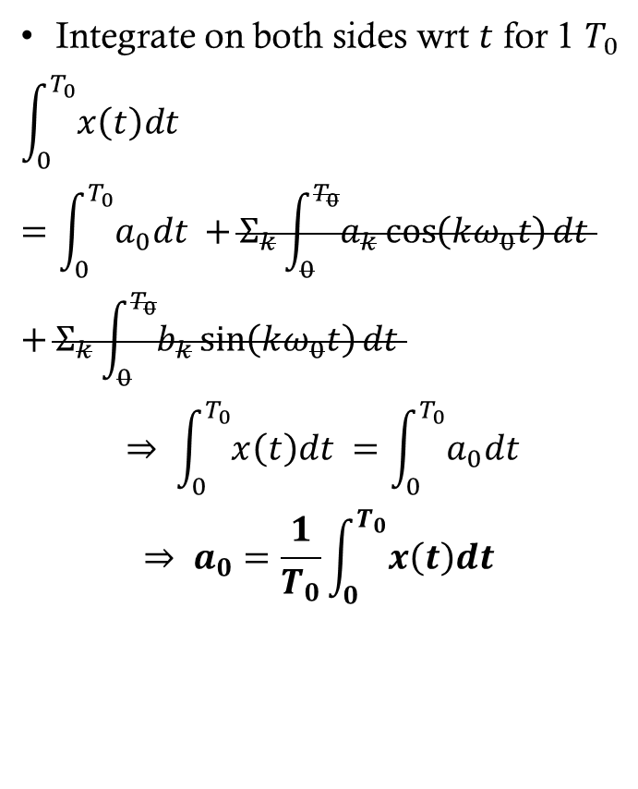
Fourier series
Integrate on both sides wrt $t$ for 1 $T_{0}$
$$\int_{0}^{T_{0}}{x\left(t\right)dt }=\int_{0}^{T_{0}}{a_{0}dt }+Σ_{k}\int_{0}^{T_{0}}{a_{k}\cos\left(kω_{0}t\right)dt }+Σ_{k}\int_{0}^{T_{0}}{b_{k}\sin\left(kω_{0}t\right)dt }$$
$$⇒ \int_{0}^{T_{0}}{x\left(t\right)dt }=\int_{0}^{T_{0}}{a_{0}dt }$$
$$⇒ a_{0}=\frac{1}{T_{0}}\int_{0}^{T_{0}}{x\left(t\right)dt }$$

Slide 15
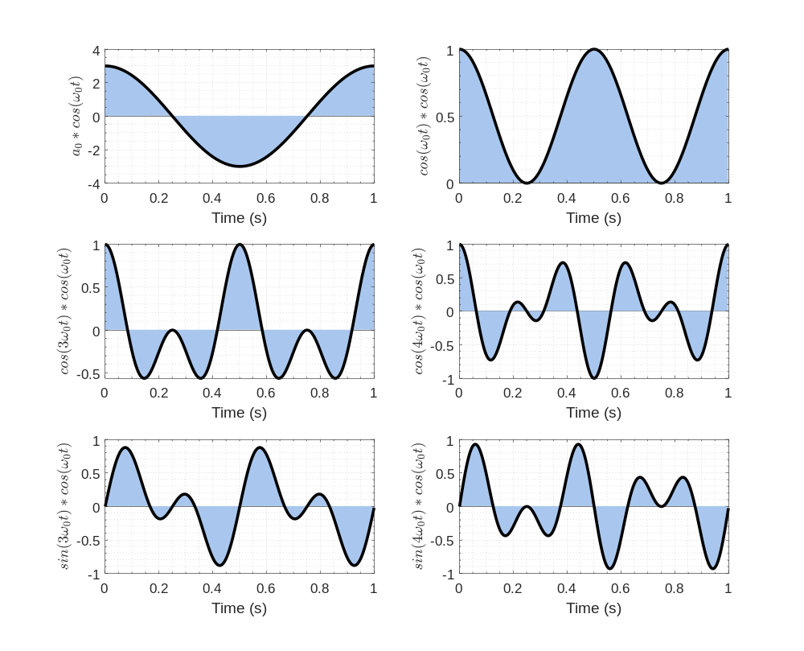
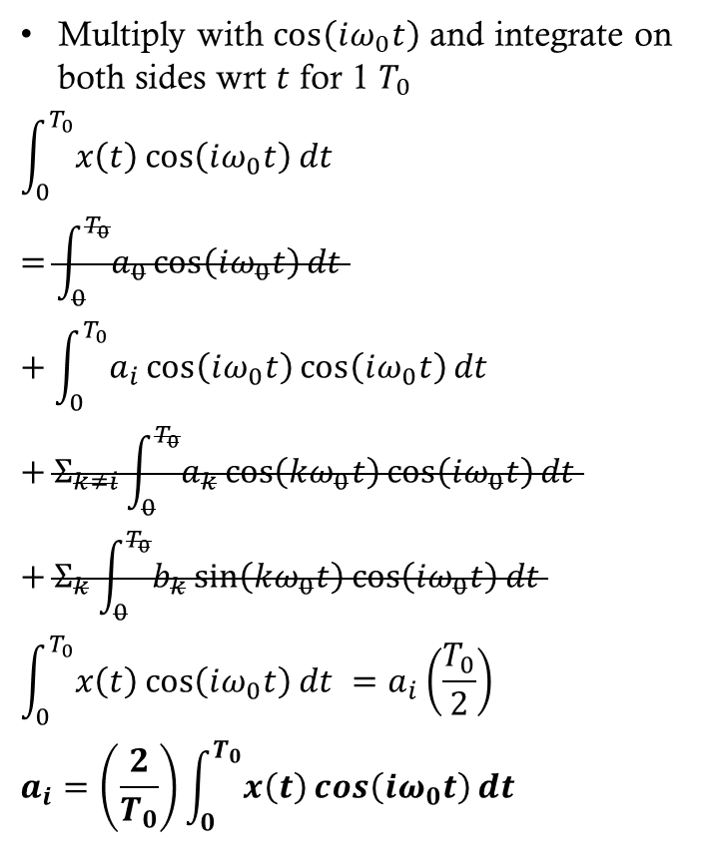
Fourier series
Multiply with $\cos\left(iω_{0}t\right)$ and integrate on both sides wrt $t$ for 1 $T_{0}$
$$\int_{0}^{T_{0}}{x\left(t\right)\cos\left(iω_{0}t\right)dt }=\int_{0}^{T_{0}}{a_{0}\cos\left(iω_{0}t\right)dt }+\int_{0}^{T_{0}}{a_{i}\cos\left(iω_{0}t\right)\cos\left(iω_{0}t\right)dt }+Σ_{k≠i}\int_{0}^{T_{0}}{a_{k}\cos\left(kω_{0}t\right)\cos\left(iω_{0}t\right)dt }+Σ_{k}\int_{0}^{T_{0}}{b_{k}\sin\left(kω_{0}t\right)\cos\left(iω_{0}t\right)dt }$$
$$\int_{0}^{T_{0}}{x\left(t\right)\cos\left(iω_{0}t\right)dt }=a_{i}\left(\frac{T_{0}}{2}\right)$$
$$a_{i}=\left(\frac{2}{T_{0}}\right)\int_{0}^{T_{0}}{x\left(t\right)\cos\left(iω_{0}t\right)dt }$$

Slide 16
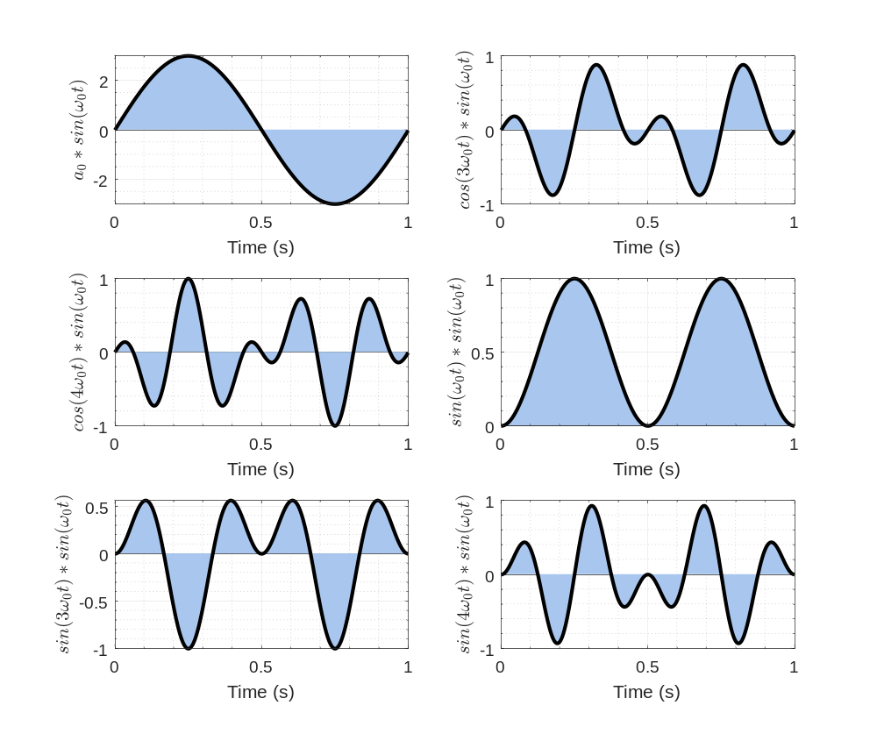
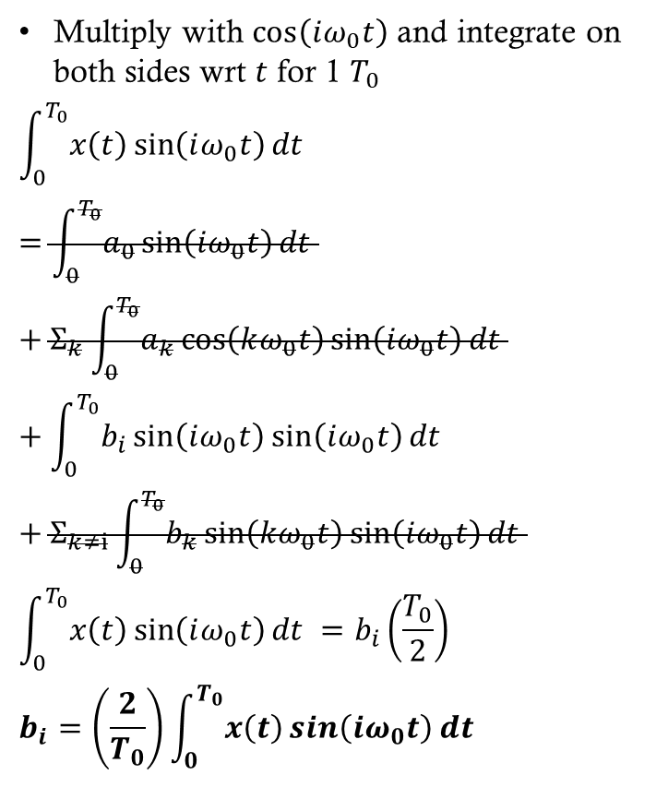
Fourier series
Multiply with $\cos\left(iω_{0}t\right)$ and integrate on both sides wrt $t$ for 1 $T_{0}$
$$\int_{0}^{T_{0}}{x\left(t\right)\sin\left(iω_{0}t\right)dt }=\int_{0}^{T_{0}}{a_{0}\sin\left(iω_{0}t\right)dt }+Σ_{k}\int_{0}^{T_{0}}{a_{k}\cos\left(kω_{0}t\right)\sin\left(iω_{0}t\right)dt }+\int_{0}^{T_{0}}{b_{i}\sin\left(iω_{0}t\right)\sin\left(iω_{0}t\right)dt }+Σ_{k≠i}\int_{0}^{T_{0}}{b_{k}\sin\left(kω_{0}t\right)\sin\left(iω_{0}t\right)dt }$$
$$\int_{0}^{T_{0}}{x\left(t\right)\sin\left(iω_{0}t\right)dt }=b_{i}\left(\frac{T_{0}}{2}\right)$$
$$b_{i}=\left(\frac{2}{T_{0}}\right)\int_{0}^{T_{0}}{x\left(t\right)\sin\left(iω_{0}t\right)dt }$$

Slide 17
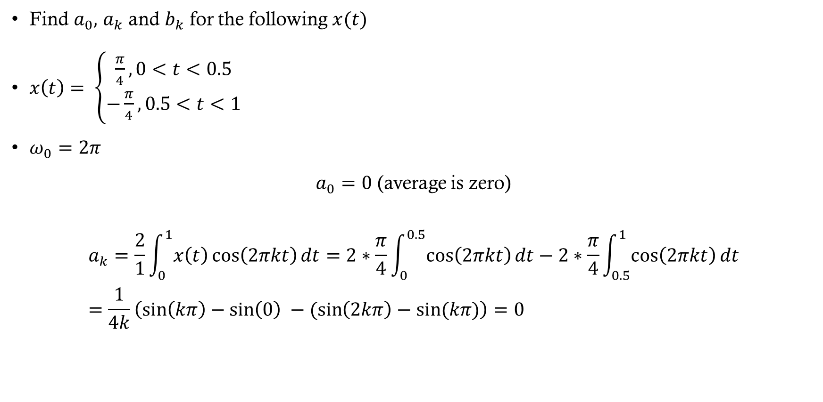
Square wave example
Find $a_{0},$ $a_{k}$ and $b_{k}$ for the following $x(t)$
$x\left(t\right)= \left\{\begin{aligned}\frac{π}{4}, 0<t<0.5 \\ −\frac{π}{4}, 0.5<t<1\end{aligned}\right.$
$ω_{0}=2π$
$a_{0}=0$ (average is zero)
$$a_{k}=\frac{2}{1}\int_{0}^{1}{x\left(t\right)\cos\left(2πkt\right)dt}=2∗\frac{π}{4}\int_{0}^{0.5}{\cos\left(2πkt\right)dt}−2∗\frac{π}{4}\int_{0.5}^{1}{\cos\left(2πkt\right)dt}=\frac{1}{4k}\left(\sin\left(kπ\right)−\sin\left(0\right) −(\sin\left(2kπ\right)−sin⁡(kπ)\right)=0$$

Slide 18
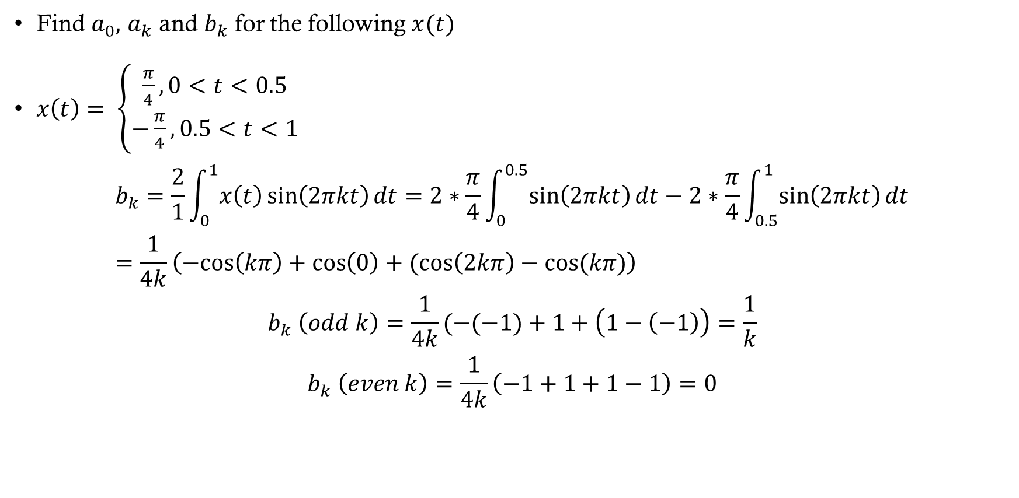
Square wave example
Find $a_{0},$ $a_{k}$ and $b_{k}$ for the following $x(t)$
$x\left(t\right)= \left\{\begin{aligned}\frac{π}{4}, 0<t<0.5 \\ −\frac{π}{4}, 0.5<t<1\end{aligned}\right.$
$$b_{k}=\frac{2}{1}\int_{0}^{1}{x\left(t\right)\sin\left(2πkt\right)dt}=2∗\frac{π}{4}\int_{0}^{0.5}{\sin\left(2πkt\right)dt}−2∗\frac{π}{4}\int_{0.5}^{1}{\sin\left(2πkt\right)dt}=\frac{1}{4k}\left(−cos\left(kπ\right)+\cos\left(0\right)+(\cos\left(2kπ\right)−cos⁡(kπ)\right)$$
$$b_{k} \left(odd k\right)=\frac{1}{4k}(−(−1)+1+\left(1−\left(−1\right)\right)=\frac{1}{k}$$
$$b_{k} \left(even k\right)=\frac{1}{4k}\left(−1+1+1−1\right)=0$$

Slide 19
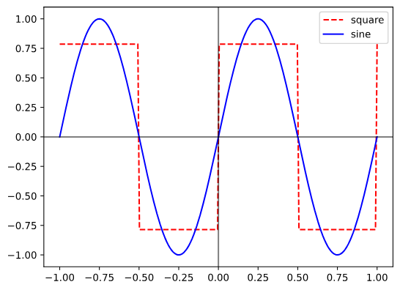
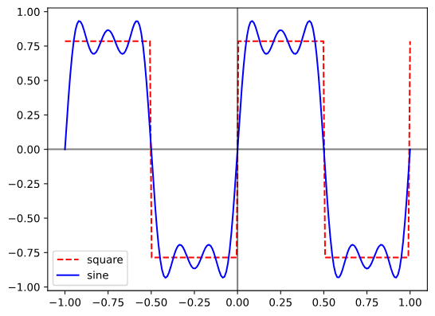
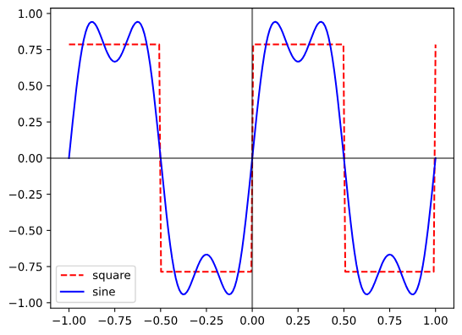
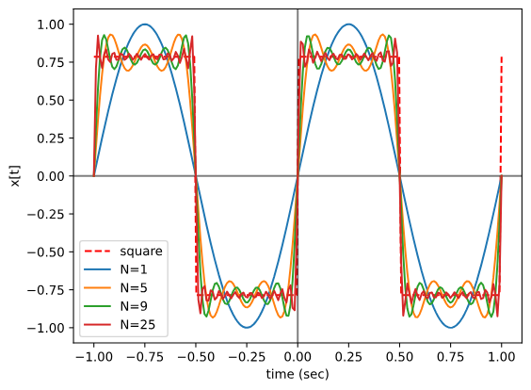
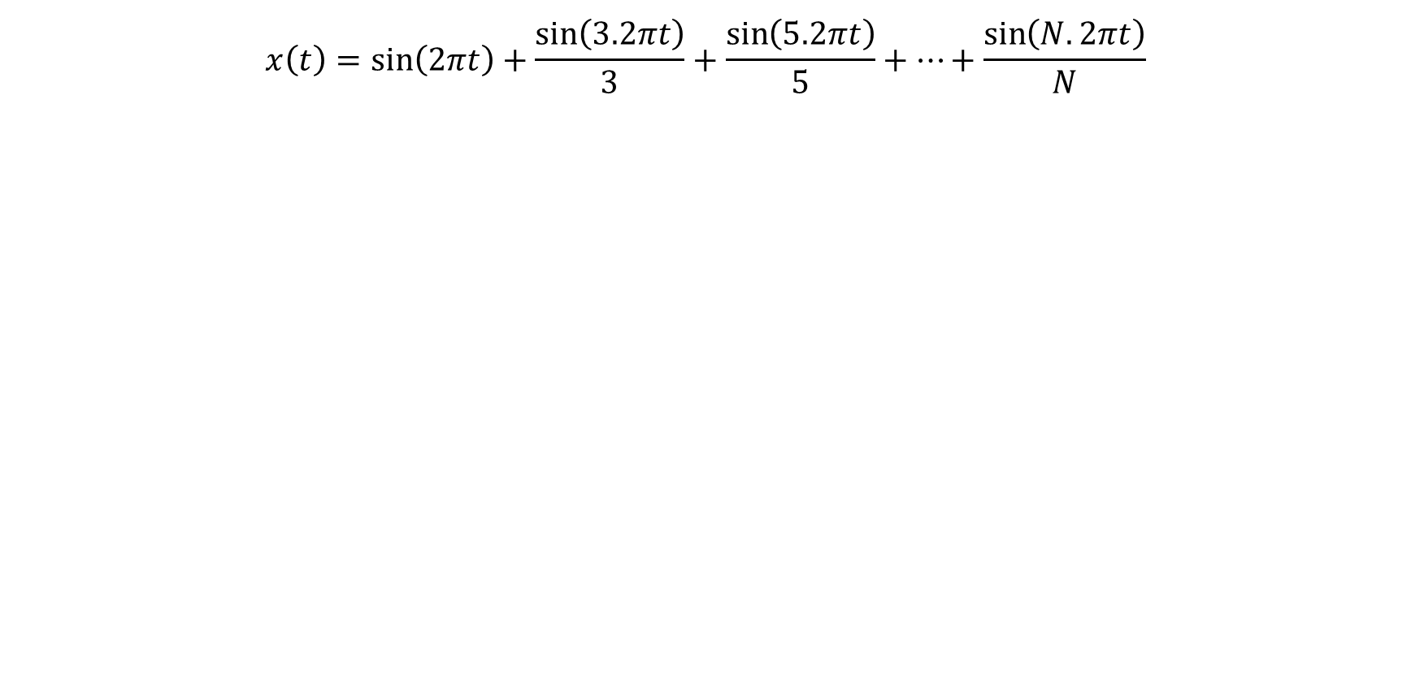
Square wave example
$$x\left(t\right)=\sin\left(2πt\right)+\frac{\sin\left(3.2πt\right)}{3}+\frac{\sin\left(5.2πt\right)}{5}+…+\frac{\sin\left(N.2πt\right)}{N}$$

Slide 20
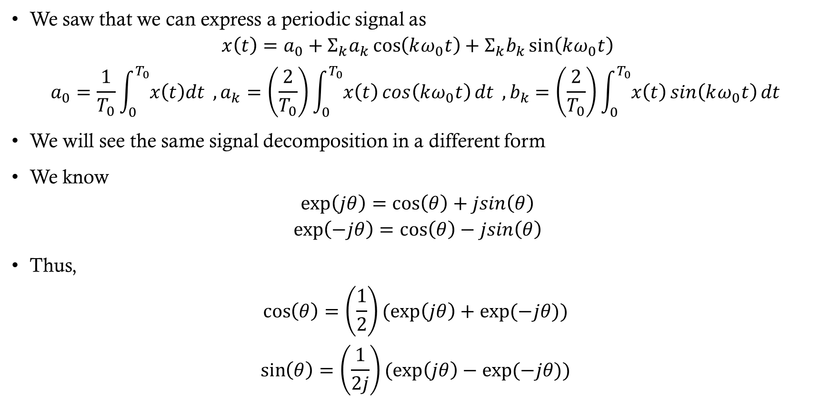
Complex fourier series
We saw that we can express a periodic signal as
$$x\left(t\right)=a_{0}+Σ_{k}a_{k}\cos\left(kω_{0}t\right)+Σ_{k}b_{k}\sin\left(kω_{0}t\right)$$
$$a_{0}=\frac{1}{T_{0}}\int_{0}^{T_{0}}{x\left(t\right)dt }, a_{k}=\left(\frac{2}{T_{0}}\right)\int_{0}^{T_{0}}{x\left(t\right)\cos\left(kω_{0}t\right)dt }, b_{k}=\left(\frac{2}{T_{0}}\right)\int_{0}^{T_{0}}{x\left(t\right)\sin\left(kω_{0}t\right)dt }$$
We will see the same signal decomposition in a different form
We know
$$\exp\left(jθ\right)=\cos\left(θ\right)+jsin\left(θ\right)$$
$$\exp\left(−jθ\right)=\cos\left(θ\right)−jsin\left(θ\right)$$
Thus,
$$\cos\left(θ\right)=\left(\frac{1}{2}\right)(exp\left(jθ\right)+exp⁡(−jθ))$$
$$\sin\left(θ\right)=\left(\frac{1}{2j}\right)(exp\left(jθ\right)−exp⁡(−jθ))$$

Slide 21
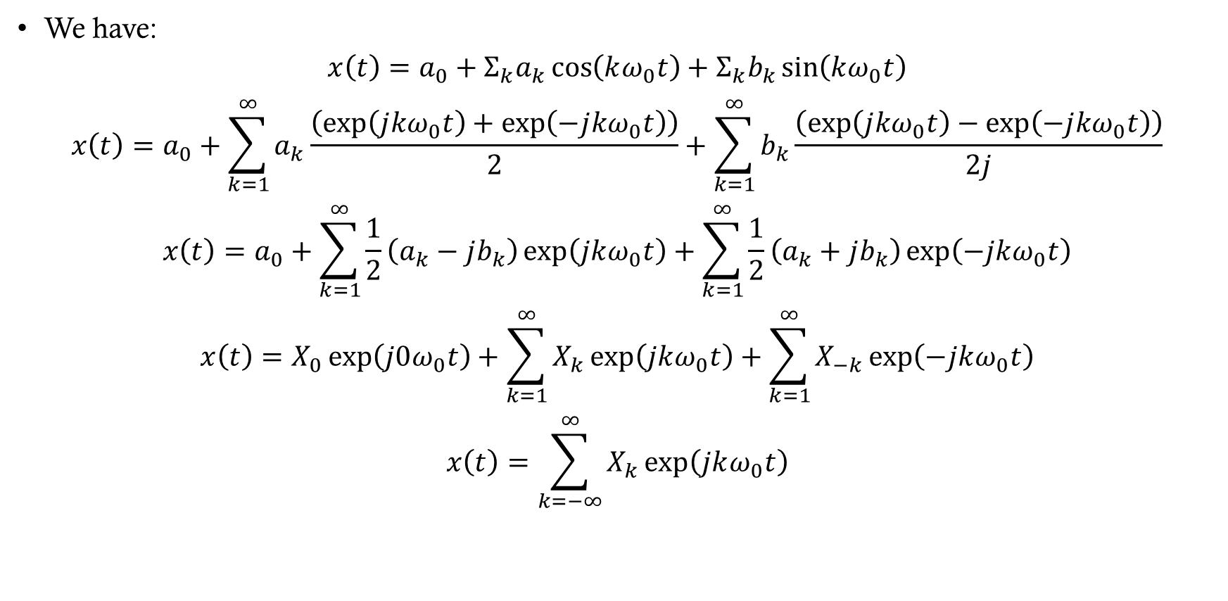
Complex fourier series
We have:
$$x\left(t\right)=a_{0}+Σ_{k}a_{k}\cos\left(kω_{0}t\right)+Σ_{k}b_{k}\sin\left(kω_{0}t\right)$$
$$x\left(t\right)=a_{0}+\sum_{k=1}^{∞}{a_{k}\frac{\left(\exp\left(j{kω}_{0}t\right)+\exp\left(−j{kω}_{0}t\right)\right)}{2}}+\sum_{k=1}^{∞}{b_{k}\frac{\left(\exp\left(j{kω}_{0}t\right)−\exp\left(−j{kω}_{0}t\right)\right)}{2j}}$$
$$x\left(t\right)=a_{0}+\sum_{k=1}^{∞}{\frac{1}{2}\left(a_{k}−jb_{k}\right)\exp\left(jkω_{0}t\right)}+\sum_{k=1}^{∞}{\frac{1}{2}\left(a_{k}+jb_{k}\right)\exp\left(−jkω_{0}t\right)}$$
$$x\left(t\right)=X_{0}\exp\left(j0ω_{0}t\right)+\sum_{k=1}^{∞}{X_{k}\exp\left(jkω_{0}t\right)}+\sum_{k=1}^{∞}{X_{−k}\exp\left(−jkω_{0}t\right)}$$
$$x\left(t\right)=\sum_{k=−∞}^{∞}{X_{k}\exp\left(jkω_{0}t\right)}$$

Slide 22
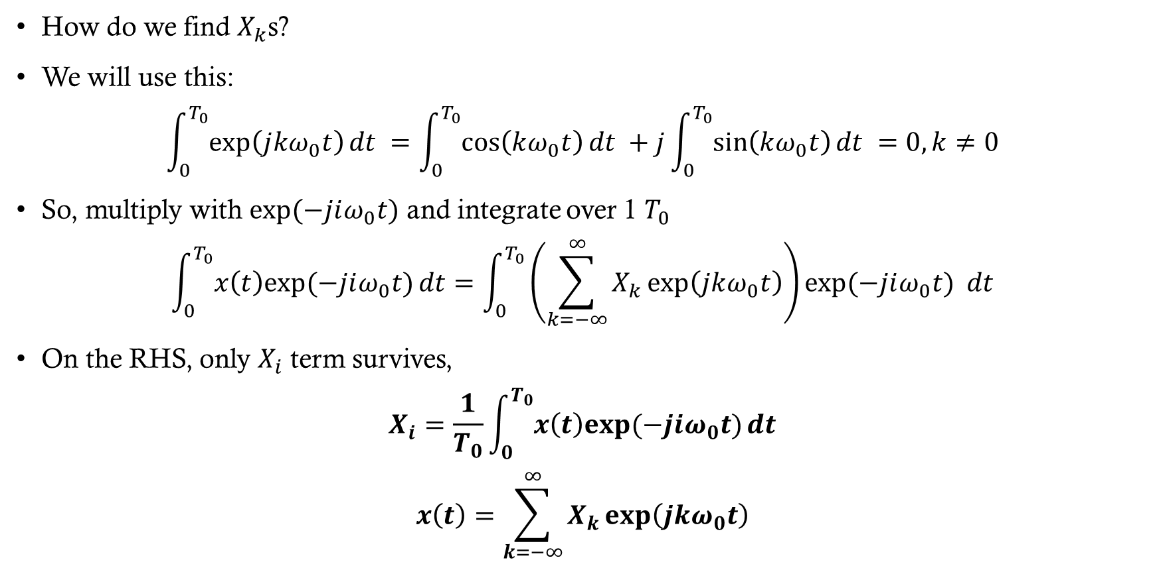
Complex fourier series
How do we find $X_{k}$s?
We will use this:
$$\int_{0}^{T_{0}}{\exp\left(j{kω}_{0}t\right)dt }=\int_{0}^{T_{0}}{\cos\left(kω_{0}t\right)dt }+j\int_{0}^{T_{0}}{\sin\left(kω_{0}t\right)dt }=0, k≠0$$
So, multiply with $exp⁡(−jiω_{0}t)$ and integrate over 1 $T_{0}$
$$\int_{0}^{T_{0}}{x\left(t\right)exp⁡(−jiω_{0}t)}dt=\int_{0}^{T_{0}}{\left(\sum_{k=−∞}^{∞}{X_{k}\exp\left(jkω_{0}t\right)}\right)exp⁡(−jiω_{0}t) }dt$$
On the RHS, only $X_{i}$ term survives,
$$X_{i}=\frac{1}{T_{0}}\int_{0}^{T_{0}}{x\left(t\right)exp⁡(−jiω_{0}t)}dt$$
$$x\left(t\right)=\sum_{k=−∞}^{∞}{X_{k}\exp\left(jkω_{0}t\right)}$$

Slide 23
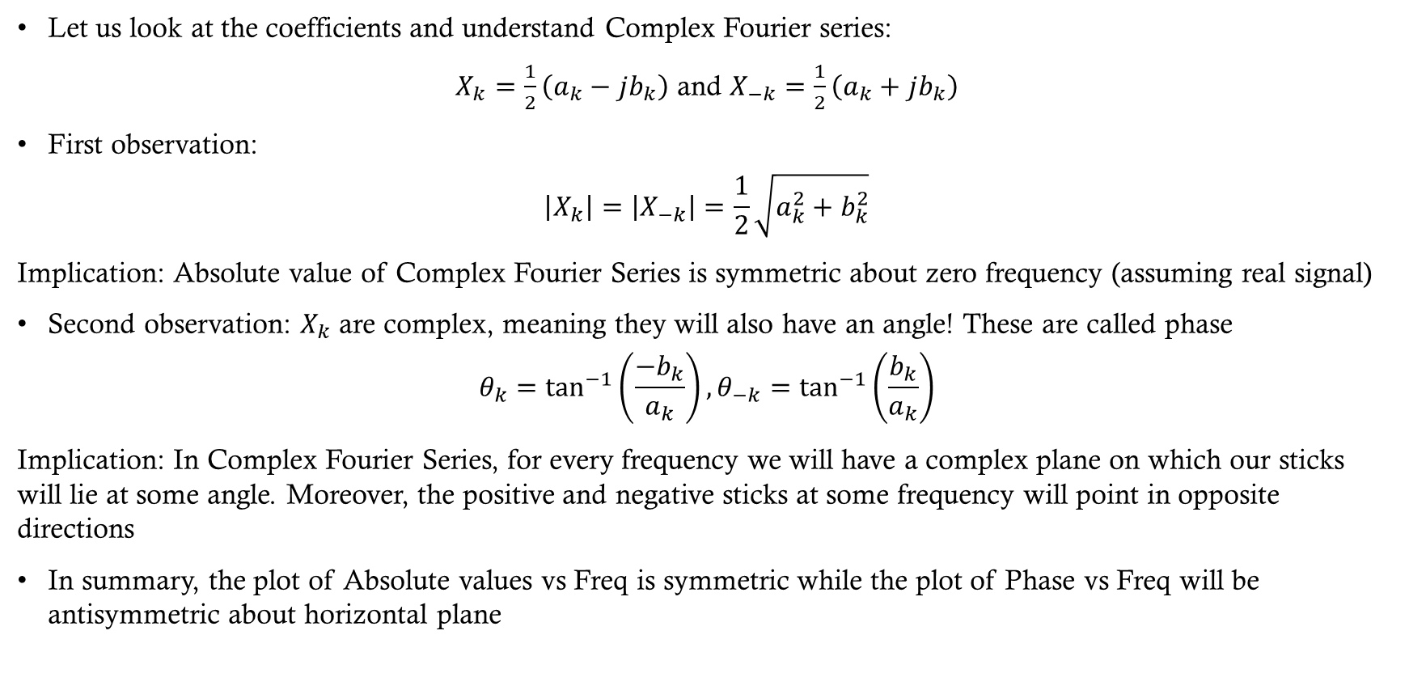
Complex fourier series
Let us look at the coefficients and understand Complex Fourier series:
$X_{k}=\frac{1}{2}\left(a_{k}−jb_{k}\right)$ and $X_{−k}=\frac{1}{2}\left(a_{k}+jb_{k}\right)$
First observation:
$$\left|X_{k}\right|=\left|X_{−k}\right|=\frac{1}{2}\sqrt{a_{k}^{2}+b_{k}^{2}}$$
Implication: Absolute value of Complex Fourier Series is symmetric about zero frequency (assuming real signal)
Second observation: $X_{k}$ are complex, meaning they will also have an angle! These are called phase
$$θ_{k}=\tan^{−1}\left(\frac{−b_{k}}{a_{k}}\right),θ_{−k}=\tan^{−1}\left(\frac{b_{k}}{a_{k}}\right)$$
Implication: In Complex Fourier Series, for every frequency we will have a complex plane on which our sticks will lie at some angle. Moreover, the positive and negative sticks at some frequency will point in opposite directions
In summary, the plot of Absolute values vs Freq is symmetric while the plot of Phase vs Freq will be antisymmetric about horizontal plane

Slide 24


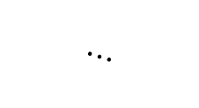
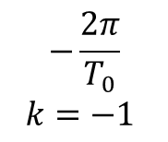

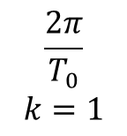

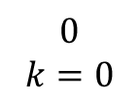
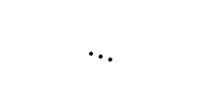




Complex fourier series
Im part
Im part
$$⋯$$
Real part
$${−θ}_{k}$$
Im part
$$−\frac{2π}{T_{0}}$$
$$k=−1$$
$$X_{0}$$
$$\left|X_{1}\right|$$
Real part
$$X_{1}$$
$$X_{−1}$$
$$0$$
$$k=0$$
$$\left|X_{1}\right|$$
Real part
$$θ_{k}$$
$$\frac{2π}{T_{0}}$$
$$k=1$$
$$⋯$$
$$Frequency$$

Slide 25
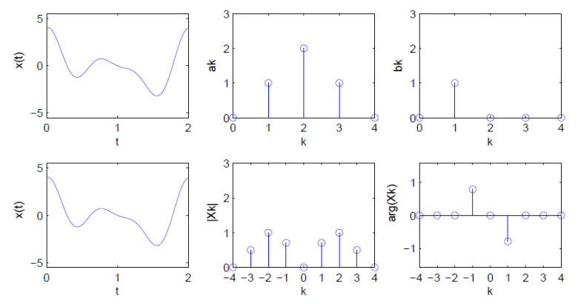
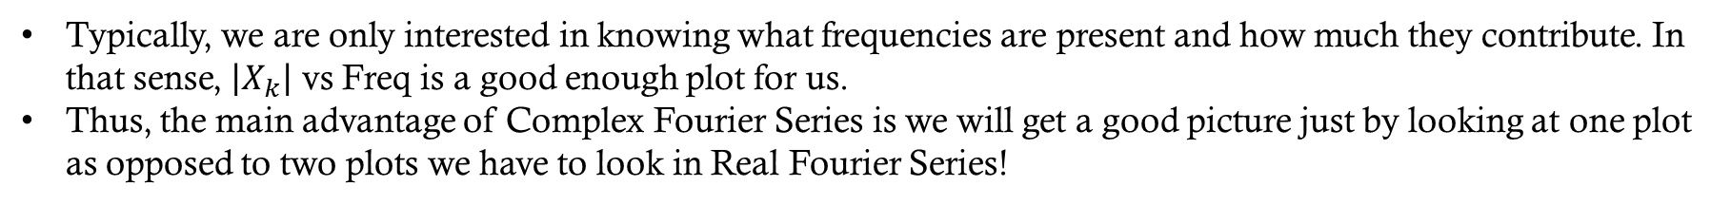
Real vs complex Fourier series
Typically, we are only interested in knowing what frequencies are present and how much they contribute. In that sense, $\left|X_{k}\right|$ vs Freq is a good enough plot for us.
Thus, the main advantage of Complex Fourier Series is we will get a good picture just by looking at one plot as opposed to two plots we have to look in Real Fourier Series!

Slide 26



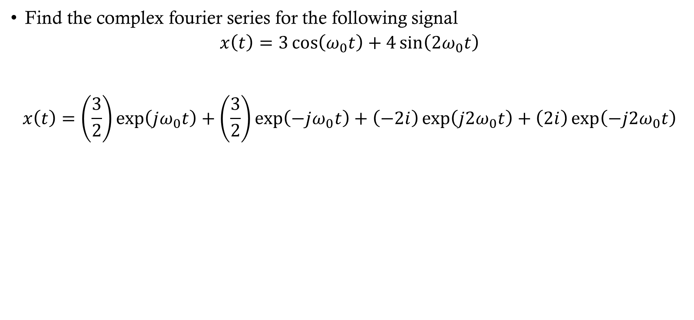



Complex fourier series example
Find the complex fourier series for the following signal
$$x\left(t\right)=3\cos\left(ω_{0}t\right)+4\sin\left({2ω}_{0}t\right)$$
$$x\left(t\right)=\left(\frac{3}{2}\right)\exp\left(jω_{0}t\right)+\left(\frac{3}{2}\right)\exp\left(−jω_{0}t\right)+\left(−2i\right)\exp\left(j2ω_{0}t\right)+\left(2i\right)\exp\left(−j2ω_{0}t\right)$$
$$|X_{k}|$$
$$k=−2$$
$$k=−1$$
$$k=0$$
$$k=1$$
$$k=2$$

