Slide 1
CV5100 – MUDE Modeling, Uncertainty, and Data for Engineers Ch5 – Optimization
Course instructors:
Prof. Phanisri Pradeep Pratapa
Prof. Prakash Singh Badal
Prof. Sudheendra Herkal
Department of Civil Engineering
Indian Institute of Technology Madras
3 September 2025

Slide 2
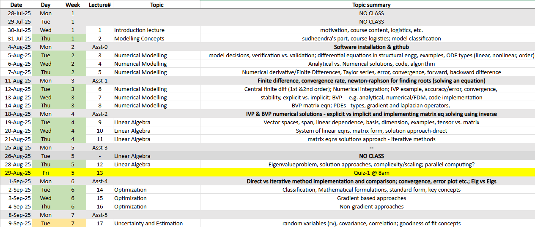
Numerical Modelling, Linear Algebra, Optimization

Slide 3
Outline
Optimization classification
Unconstrained vs. Constrained Optimization
Necessary & Sufficient Conditions
Gradient vs. Non-Gradient methods
Genetic Algorithm

Slide 4
Non-gradient methods
Genetic Algorithms (GA)
Simulated Annealing
Particle Swarm Optimization
Random Search
Neural Networks
Etc.
Notes:
Need for computers…

Slide 5
Genetic Algorithm
“Survival of the fittest”
Notes:
Need for computers…

