Slide 1


CV5100: Modelling, Uncertainty and Data for Engineers
MODULE 2: TIME SERIES ANALYSIS: ML, lecture 3: Modeling and estimation

Slide 2
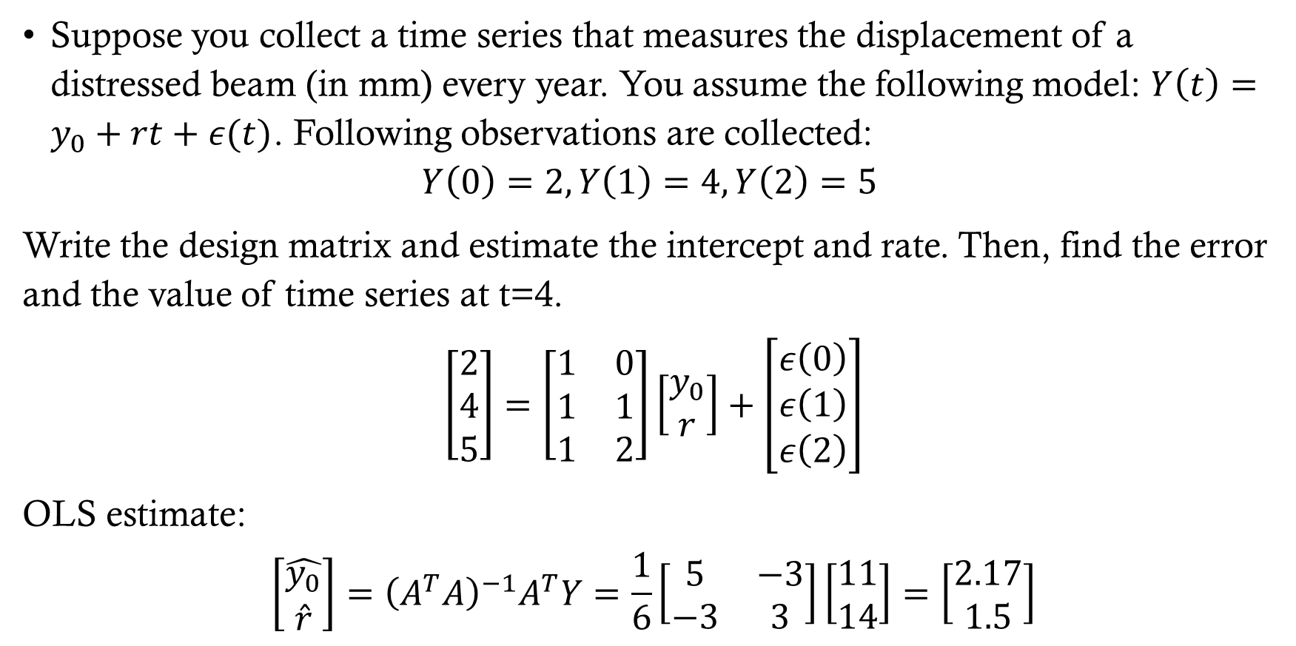
EXAMPLE
Suppose you collect a time series that measures the displacement of a distressed beam (in mm) every year. You assume the following model: $Y\left(t\right)=y_{0}+rt+ε(t)$. Following observations are collected:
$$Y\left(0\right)=2, Y\left(1\right)=4, Y\left(2\right)=5$$
Write the design matrix and estimate the intercept and rate. Then, find the error and the value of time series at t=4.
$$\left[\begin{matrix}2 \\ 4 \\ 5\end{matrix}\right]=\left[\begin{matrix}1 & 0 \\ 1 & 1 \\ 1 & 2\end{matrix}\right]\left[\begin{matrix}y_{0} \\ r\end{matrix}\right]+\left[\begin{matrix}ε\left(0\right) \\ ε\left(1\right) \\ ε\left(2\right)\end{matrix}\right]$$
OLS estimate:
$$\left[\begin{matrix}\hat{y_{0}} \\ \hat{r}\end{matrix}\right]={\left(A^{T}A\right)}^{−1}A^{T}Y=\frac{1}{6}\left[\begin{matrix}5 & −3 \\ −3 & 3\end{matrix}\right]\left[\begin{matrix}11 \\ 14\end{matrix}\right]=\left[\begin{matrix}2.17 \\ 1.5\end{matrix}\right]$$

Slide 3
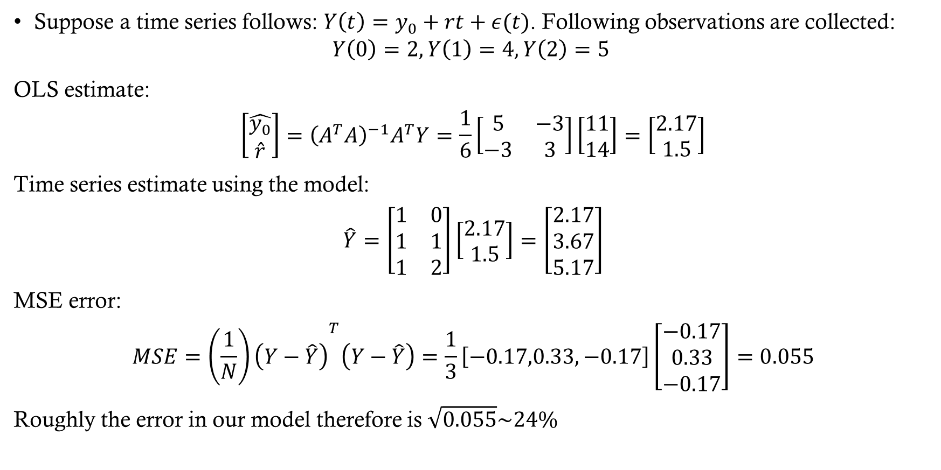
EXAMPLE
Suppose a time series follows: $Y\left(t\right)=y_{0}+rt+ε(t)$. Following observations are collected:
$$Y\left(0\right)=2, Y\left(1\right)=4, Y\left(2\right)=5$$
OLS estimate:
$$\left[\begin{matrix}\hat{y_{0}} \\ \hat{r}\end{matrix}\right]={\left(A^{T}A\right)}^{−1}A^{T}Y=\frac{1}{6}\left[\begin{matrix}5 & −3 \\ −3 & 3\end{matrix}\right]\left[\begin{matrix}11 \\ 14\end{matrix}\right]=\left[\begin{matrix}2.17 \\ 1.5\end{matrix}\right]$$
Time series estimate using the model:
$$\hat{Y}=\left[\begin{matrix}1 & 0 \\ 1 & 1 \\ 1 & 2\end{matrix}\right]\left[\begin{matrix}2.17 \\ 1.5\end{matrix}\right]=\left[\begin{matrix}2.17 \\ 3.67 \\ 5.17\end{matrix}\right]$$
MSE error:
$$MSE={\left(\frac{1}{N}\right)\left(Y−\hat{Y}\right)}^{T}\left(Y−\hat{Y}\right)=\frac{1}{3}\left[−0.17,0.33,−0.17\right]\left[\begin{matrix}−0.17 \\ 0.33 \\ −0.17\end{matrix}\right]=0.055$$
Roughly the error in our model therefore is $\sqrt{0.055}\sim 24\%$

Slide 4
Blue of time series
Back to time series if we don’t have $Σ_{y}≠σ^{2}I$, we need a new approach. We had the following expression for Y as general t:
$$Y_{t}=y_{0}+rt+a\cos{ω_{0}t}+b\sin{ω_{0}t}+ou_{k}\left(t\right)+ε_{t}$$
Substituting various $t_{k}$s
$$\begin{aligned}\begin{matrix}Y(t_{1}) & =y_{0}+rt_{1}+acosω_{0}t_{1}+bsinω_{0}t_{1}+ou_{k}(t_{1})+ε(t_{1}) \\ Y(t_{2}) & =y_{0}+rt_{2}+acosω_{0}t_{2}+bsinω_{0}t_{2}+ou_{k}(t_{2})+ε(t_{2}) \\ & ⋮ \\ Y(t_{k}) & =y_{0}+rt_{k}+acosω_{0}t_{k}+bsinω_{0}t_{k}+ou_{k}(t_{k})+ε(t_{k}) \\ & ⋮ \\ Y(t_{m}) & =y_{0}+rt_{m}+acosω_{0}t_{m}+bsinω_{0}t_{m}+ou_{k}(t_{m})+ε(t_{m})\end{matrix}\end{aligned}$$

Slide 5
Blue of time series
These can be written compactly as
$$Y=Ax+ε$$
$$\begin{matrix}\overset{Y}{\overbrace{\left[\begin{matrix}Y_{1} \\ ⋮ \\ Y_{k−1} \\ Y_{k} \\ ⋮ \\ Y_{m}\end{matrix}\right]}}=\overset{A}{\overbrace{\left[\begin{matrix}1 & t_{1} & \cos{ω_{0}t_{1}} & \sin{ω_{0}t_{1}} & 0 \\ ⋮ & ⋮ & ⋮ & ⋮ & ⋮ \\ 1 & t_{k−1} & \cos{ω_{0}t_{k−1}} & \sin{ω_{0}t_{k−1}} & 0 \\ 1 & t_{k} & \cos{ω_{0}t_{k}} & \sin{ω_{0}t_{k}} & 1 \\ ⋮ & ⋮ & ⋮ & ⋮ & ⋮ \\ 1 & t_{m} & \cos{ω_{0}t_{m}} & \sin{ω_{0}t_{m}} & 1\end{matrix}\right]}}\overset{x}{\overbrace{\left[\begin{matrix}y_{0} \\ r \\ a \\ b \\ o\end{matrix}\right]}}+\overset{ε}{\overbrace{\left[\begin{matrix}ε_{1} \\ ⋮ \\ ε_{k−1} \\ ε_{k} \\ ⋮ \\ ε_{m}\end{matrix}\right]}}\end{matrix}$$
$$\begin{matrix}Σ_{Y}=\left[\begin{matrix}σ_{1}^{2} & σ_{12} & … & σ_{1m} \\ σ_{21} & σ_{2}^{2} & & \\ ⋮ & ⋮ & ⋱ & \\ σ_{m1} & σ_{m2} & … & σ_{m}^{2}\end{matrix}\right]\end{matrix}$$

Slide 6
Blue of time series
Assuming $Σ_{Y}$ is known, BLUE can be estimated as
$$\begin{matrix}\hat{X}=\left[\begin{matrix}\hat{y_{0}} \\ \hat{r} \\ \hat{a} \\ \hat{b} \\ \hat{o}\end{matrix}\right], Σ_{\hat{X}}=\left[\begin{matrix}σ_{{\hat{y}}_{0}}^{2} & σ_{{\hat{y}}_{0}\hat{r}} & σ_{{\hat{y}}_{0}\hat{a}} & σ_{{\hat{y}}_{0}\hat{b}} & σ_{\hat{y_{0}}\hat{o}} \\ σ_{\hat{r}{\hat{y}}_{0}} & σ_{\hat{r}}^{2} & σ_{\hat{r}\hat{a}} & σ_{\hat{r}\hat{b}} & σ_{\hat{r}\hat{o}} \\ σ_{\hat{a}\hat{y_{0}}} & σ_{\hat{a}\hat{r}} & σ_{\hat{a}}^{2} & σ_{\hat{a}\hat{b}} & σ_{\hat{a}\hat{o}} \\ σ_{\hat{b}\hat{y_{0}}} & σ_{\hat{b}\hat{r}} & σ_{\hat{b}\hat{a}} & σ_{\hat{b}}^{2} & σ_{\hat{b}\hat{o}} \\ σ_{\hat{o}\hat{y_{0}}} & σ_{\hat{o}\hat{r}} & σ_{\hat{o}\hat{a}} & σ_{\hat{o}\hat{b}} & σ_{\hat{o}}^{2}\end{matrix}\right]\end{matrix}$$
where
$$\hat{X}=(A^{T}Σ_{Y}^{−1}A)^{−1}A^{T}Σ_{Y}^{−1}Y, Σ_{\hat{X}}=(A^{T}Σ_{Y}^{−1}A)^{−1}$$
Now $ω_{0}$ might not be known beforehand. In which case, we can first determine the parameters only for rate and offsets, remove them from time series. Then, using frequency decomposition we can determine $ω_{0}$

Slide 7
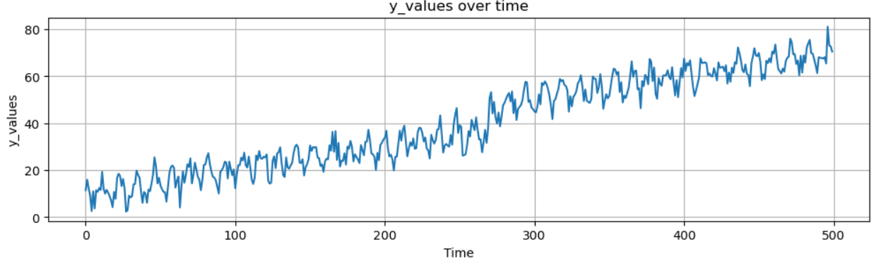
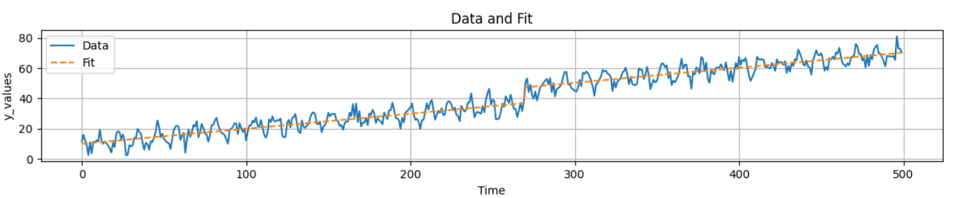
example

Slide 8
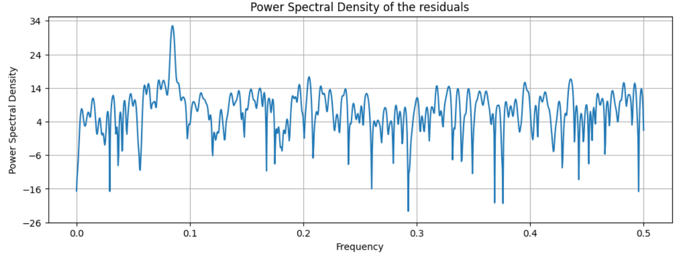
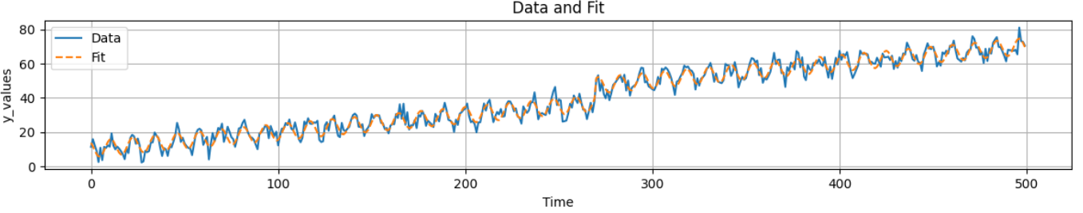
example

