Slide 1


CV5100: Modelling, Uncertainty and Data for Engineers
MODULE 3: MACHINE LEARNING, lecture 2: Linear regression as ML

Slide 2

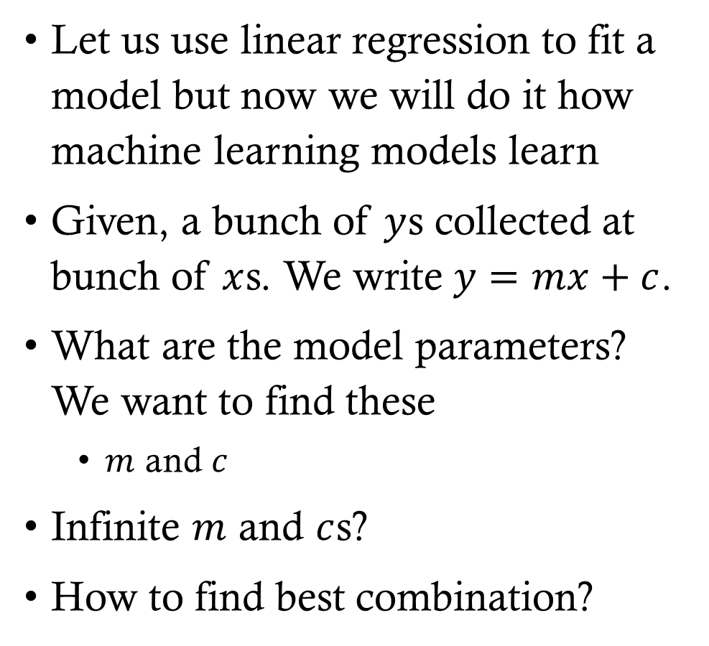

Linear regression from machine learning perspective
Let us use linear regression to fit a model but now we will do it how machine learning models learn
Given, a bunch of $y$s collected at bunch of $x$s. We write $y=mx+c$.
What are the model parameters? We want to find these
  $m$ and $c$
Infinite $m$ and $c$s?
How to find best combination?
$$y$$
$$x$$

Slide 3





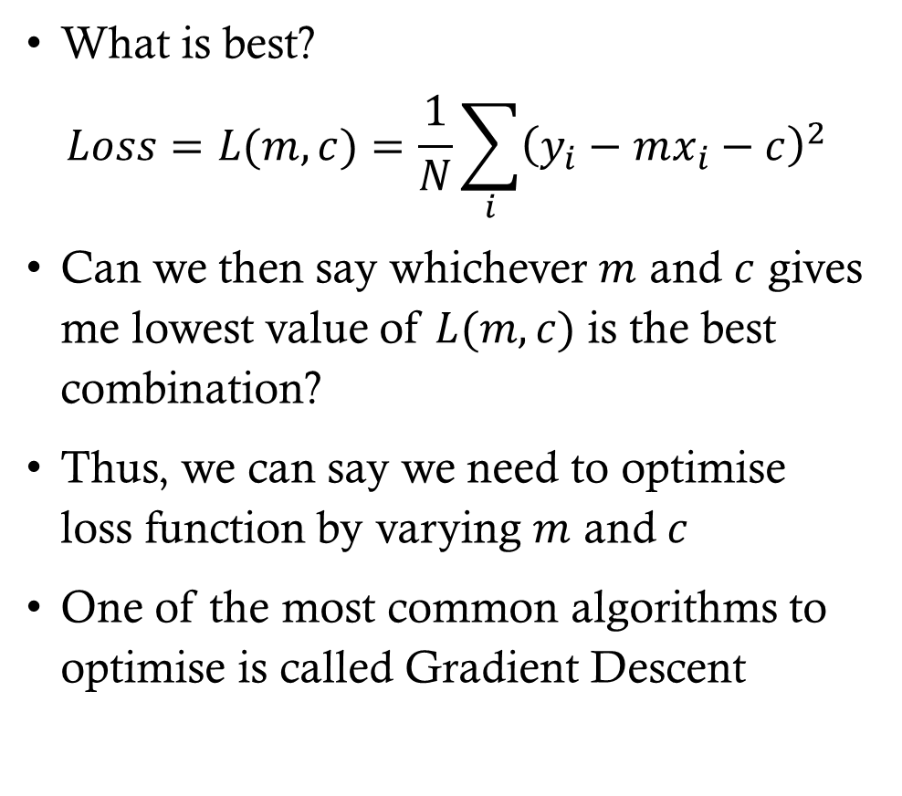






Linear regression from machine learning perspective
What is best?
$$Loss=L(m,c)=\frac{1}{N}\sum_{i}{{\left(y_{i}−mx_{i}−c\right)}^{2}}$$
Can we then say whichever $m$ and $c$ gives me lowest value of $L(m,c)$ is the best combination?
Thus, we can say we need to optimise loss function by varying $m$ and $c$
One of the most common algorithms to optimise is called Gradient Descent
$$y$$
$${\left(y_{8}−mx_{8}−c\right)}^{2}$$
$${\left(y_{7}−mx_{7}−c\right)}^{2}$$
$${\left(y_{6}−mx_{6}−c\right)}^{2}$$
$$y=mx+c$$
$${\left(y_{5}−mx_{5}−c\right)}^{2}$$
$${\left(y_{2}−mx_{2}−c\right)}^{2}$$
$${\left(y_{4}−mx_{4}−c\right)}^{2}$$
$${\left(y_{3}−mx_{3}−c\right)}^{2}$$
$${\left(y_{1}−mx_{1}−c\right)}^{2}$$
$$x$$

Slide 4
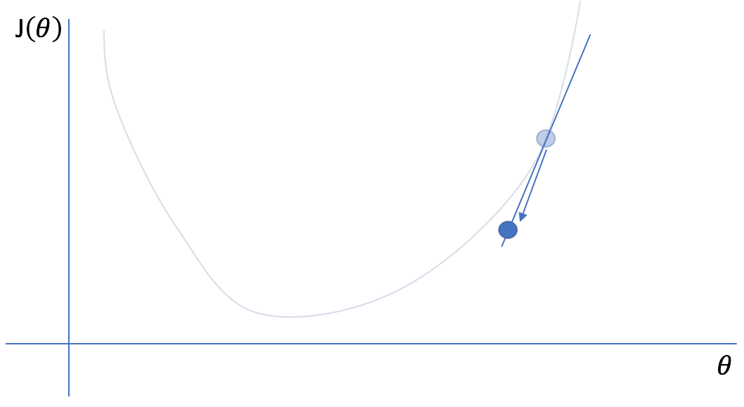
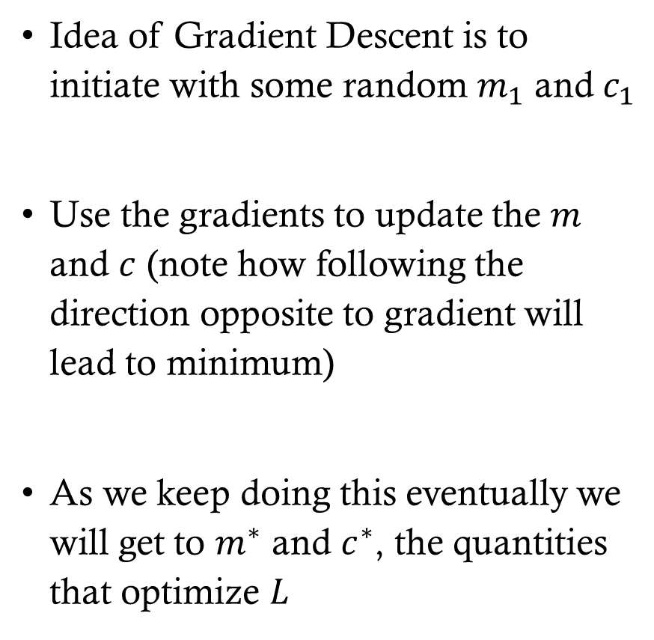


Gradient descent
Idea of Gradient Descent is to initiate with some random $m_{1}$ and $c_{1}$
Use the gradients to update the $m$ and $c$ (note how following the direction opposite to gradient will lead to minimum)
As we keep doing this eventually we will get to $m^{∗}$ and $c^{∗}$, the quantities that optimize $L$
$$L\left(θ\right)$$
$$θ^{∗}$$
https://www.jeremyjordan.me/gradient-descent/

Slide 5
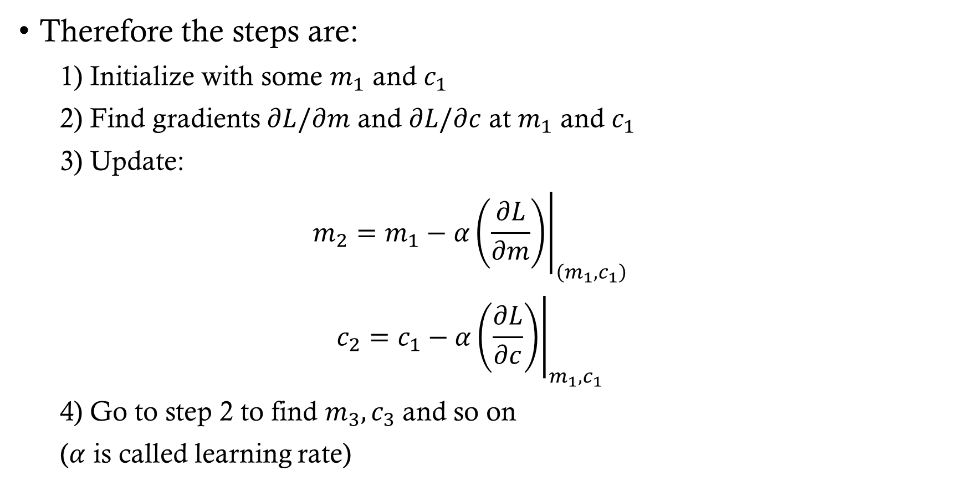
Gradient descent
Therefore the steps are:
  1) Initialize with some $m_{1}$ and $c_{1}$
  2) Find gradients $∂L/∂m$ and $∂L/∂c$ at $m_{1}$ and $c_{1}$
  3) Update:
  $$m_{2}=m_{1}−α{\left.\left(\frac{∂L}{∂m}\right)\right|}_{\left(m_{1},c_{1}\right)}$$
  $$c_{2}=c_{1}−α{\left.\left(\frac{∂L}{∂c}\right)\right|}_{m_{1},c_{1}}$$
  4) Go to step 2 to find $m_{3},c_{3}$ and so on
  ($α$ is called learning rate)

Slide 6
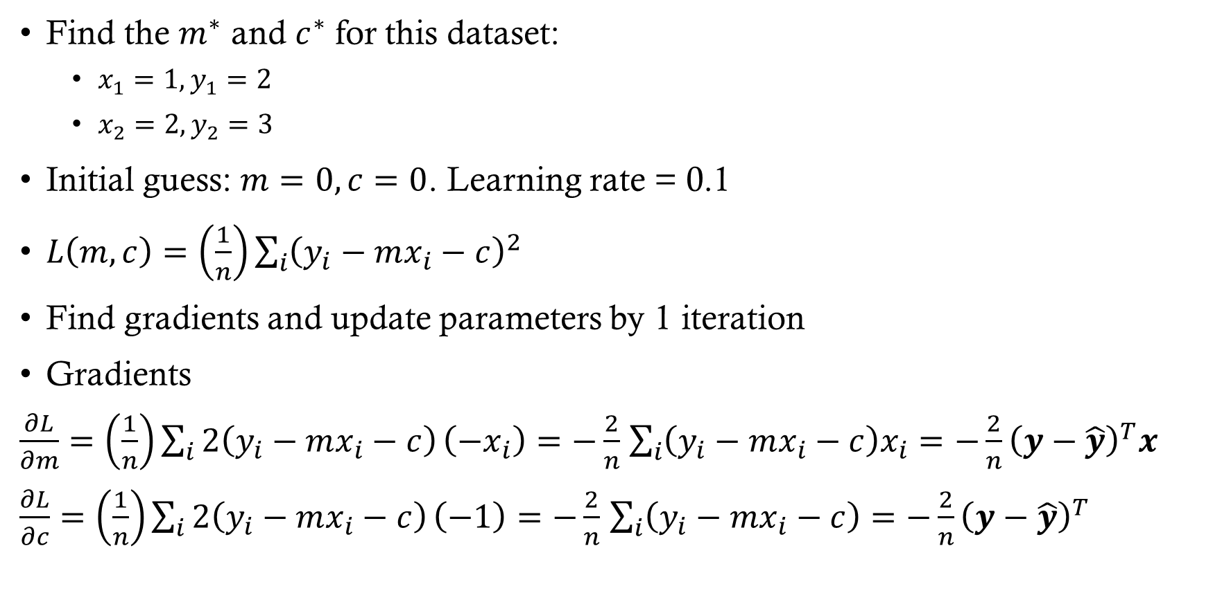
Gradient descent: Example
Find the $m^{∗}$ and $c^{∗}$ for this dataset:
  $x_{1}=1, y_{1}=2$
  $x_{2}=2, y_{2}=3$
Initial guess: $m=0, c=0$. Learning rate = 0.1
$L\left(m,c\right)=\left(\frac{1}{n}\right)\sum_{i}{{\left(y_{i}−mx_{i}−c\right)}^{2}}$
Find gradients and update parameters by 1 iteration
Gradients
$\frac{∂L}{∂m}=\left(\frac{1}{n}\right)\sum_{i}{2\left(y_{i}−mx_{i}−c\right)}\left(−x_{i}\right)=−\frac{2}{n}$ $\sum_{i}{\left(y_{i}−mx_{i}−c\right)x_{i}}=−\frac{2}{n}{\left(y−\hat{y}\right)}^{T}x$
$\frac{∂L}{∂c}=\left(\frac{1}{n}\right)\sum_{i}{2\left(y_{i}−mx_{i}−c\right)}\left(−1\right)=−\frac{2}{n}$ $\sum_{i}{\left(y_{i}−mx_{i}−c\right)}=−\frac{2}{n}{\left(y−\hat{y}\right)}^{T}$

Slide 7
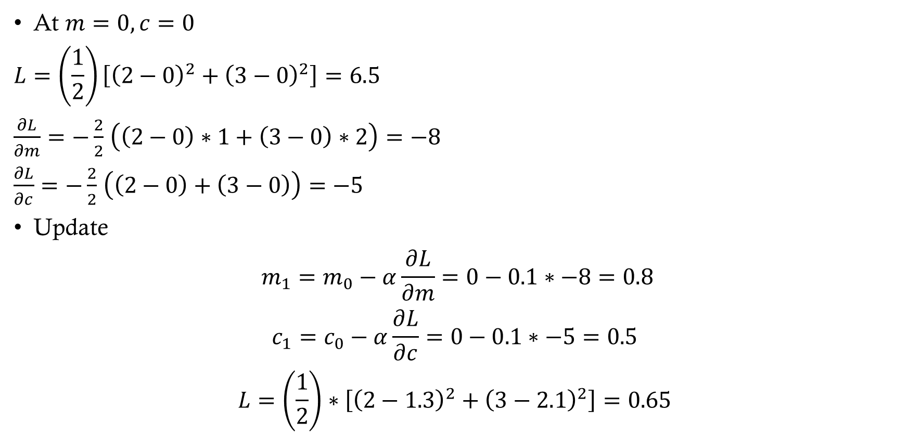
Gradient descent: Example
At $m=0, c=0$
$$L=\left(\frac{1}{2}\right)\left[{\left(2−0\right)}^{2}+{\left(3−0\right)}^{2}\right]=6.5$$
$\frac{∂L}{∂m}=−\frac{2}{2}$ $\left(\left(2−0\right)∗1+\left(3−0\right)∗2\right)=−8$
$\frac{∂L}{∂c}=−\frac{2}{2}$ $\left(\left(2−0\right)+\left(3−0\right)\right)=−5$
Update
$$m_{1}=m_{0}−α\frac{∂L}{∂m}=0−0.1∗−8=0.8$$
$$c_{1}=c_{0}−α\frac{∂L}{∂c}=0−0.1∗−5=0.5$$
$$L=\left(\frac{1}{2}\right)∗\left[{\left(2−1.3\right)}^{2}+{\left(3−2.1\right)}^{2}\right]=0.65$$

Slide 8
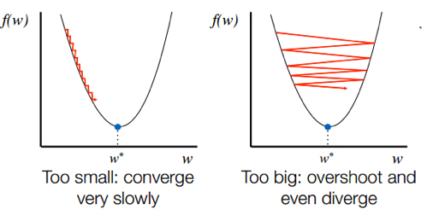
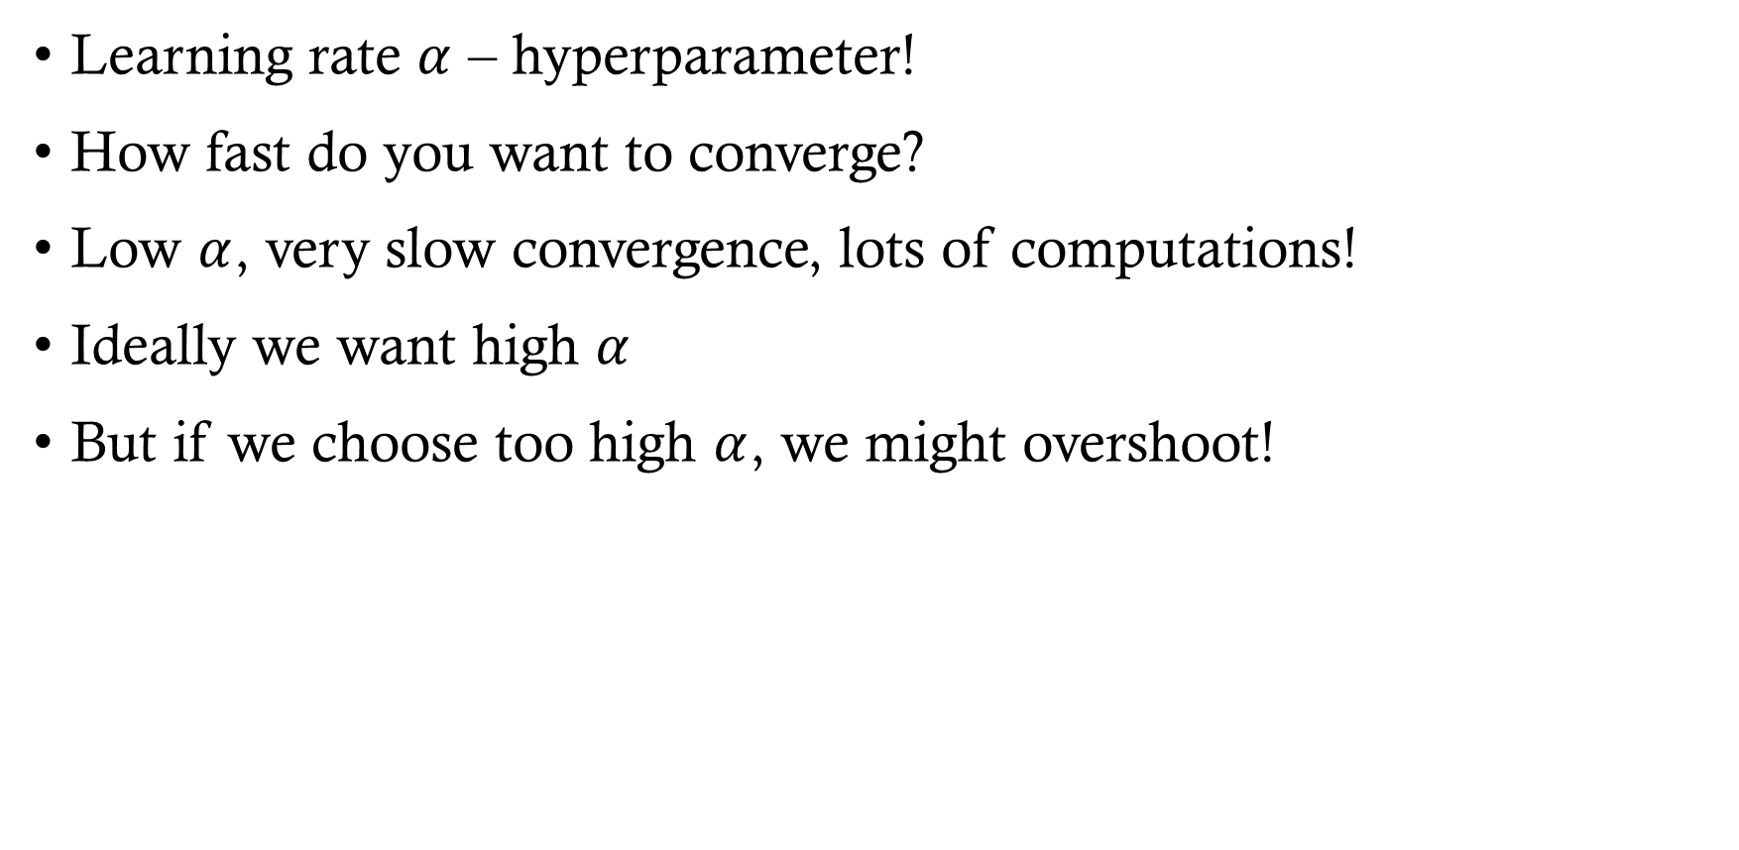
Gradient descent
Learning rate $α$ – hyperparameter!
How fast do you want to converge?
Low $α$, very slow convergence, lots of computations!
Ideally we want high $α$
But if we choose too high $α$, we might overshoot!
https://neptune.ai/blog/deep-learning-optimization-algorithms

Slide 9
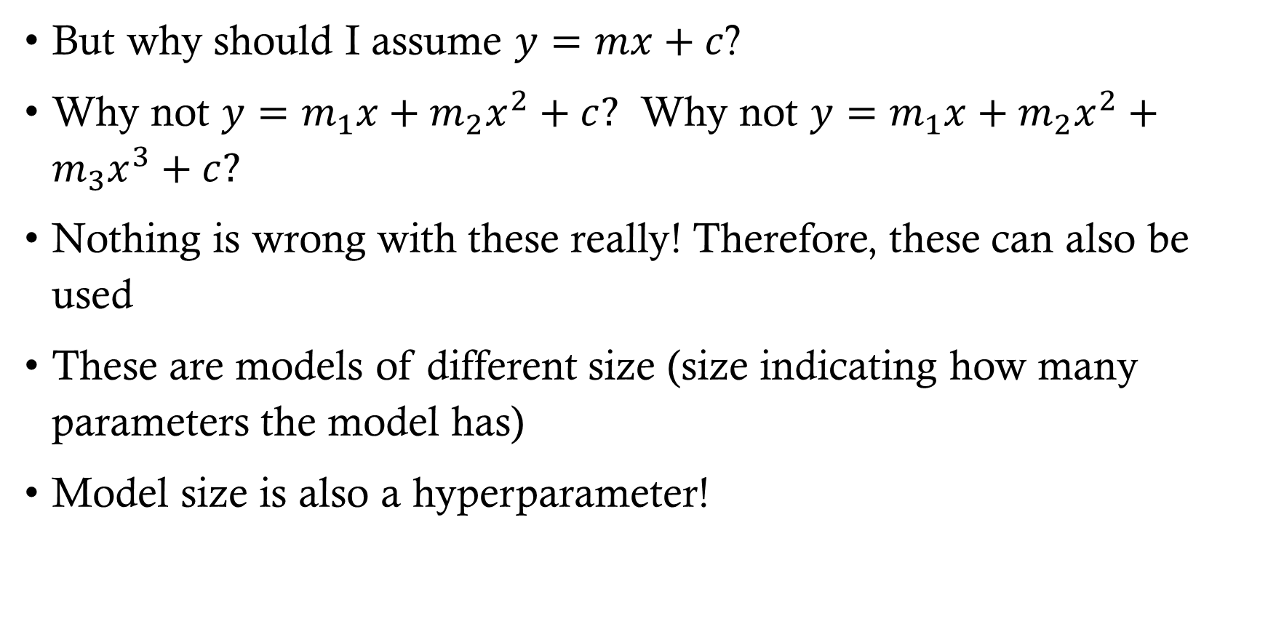
Model size
But why should I assume $y=mx+c$?
Why not $y=m_{1}x+m_{2}x^{2}+c?$ Why not $y=m_{1}x+m_{2}x^{2}+m_{3}x^{3}+c?$
Nothing is wrong with these really! Therefore, these can also be used
These are models of different size (size indicating how many parameters the model has)
Model size is also a hyperparameter!

Slide 10
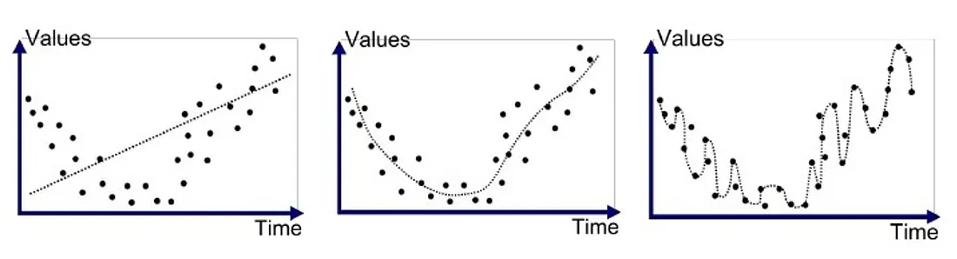



Model size
Price
Price
Price
Sq. Ft.
Sq. Ft.
Sq. Ft.
$$y=mx+c$$
$$y=m_{1}x+m_{2}x^{2}+c$$
$$y=m_{1}x+m_{2}x^{2}+m_{3}x^{3}+c$$
Underfitting: Not capturing the full trend. If we use this model for large Sq. Ft. we will predict much higher price
Correct fit: We are capturing all the trends adequately!
Overfitting: We are fitting way too well! We are fitting noise also. If we use this model for prediction we would end making vastly different prediction every time due to noise
MATLAB Code

Slide 11
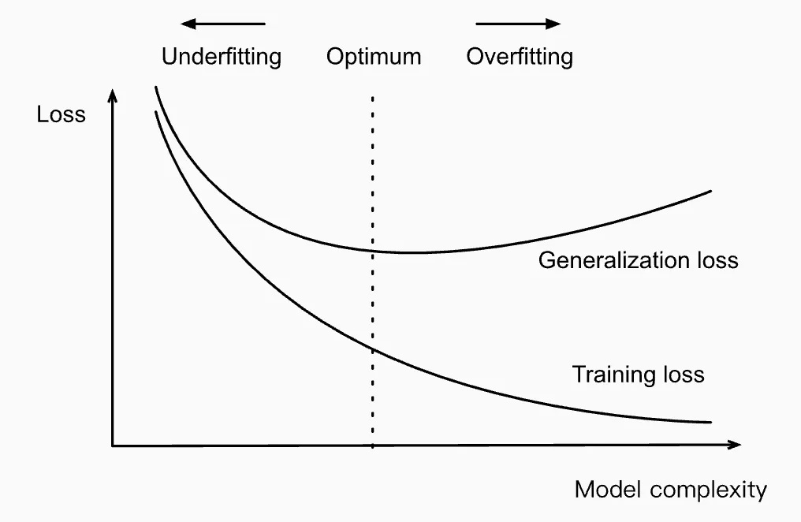
Underfitting vs overfitting
Underfitting:
  Will always incur some minimum error because we have not given model enough flexibility
  The parameters will not change much with varying data. Things will not blow up
Overfitting:
  The parameters will change significantly with varying data. Things can blow up
Bias Variance Tradeoff: Bias means expressibility. If I want to fit a linear function to quadratic dataset, there is always some fixed error I will see. However, if I want to fit a quartic function to linear dataset, there is chance of overfitting! High bias, low variance but low bias, high variance!

Slide 12
Validation
As we saw model size, learning rate all of these also influence the final model we trained
Therefore, it is good to make informed choices. This is where we will use validation set
In practice, we do the following:
  Split the dataset: Training, validation, testing
  Train multiple models by varying hyperparameters
  Select the hyperparameters with lowest validation error
Degree (Model Complexity) | Learning Rate | Train Error | Validation Error
1 (linear) | Low (0.01) | High | High
1 | Medium (0.1) | Medium | Medium
1 | High (1.0) | Diverges / oscillates | Diverges
2 (quadratic) | Low (0.01) | Medium | Medium-Low
2 | Medium (0.1) | Low | Lower
2 | High (1.0) | Jumps around | High
8 (overfit model) | Low (0.01) | Very Low | High
8 | Medium (0.1) | Very Low | Very High
8 | High (1.0) | Blows up | Blows up

Slide 13
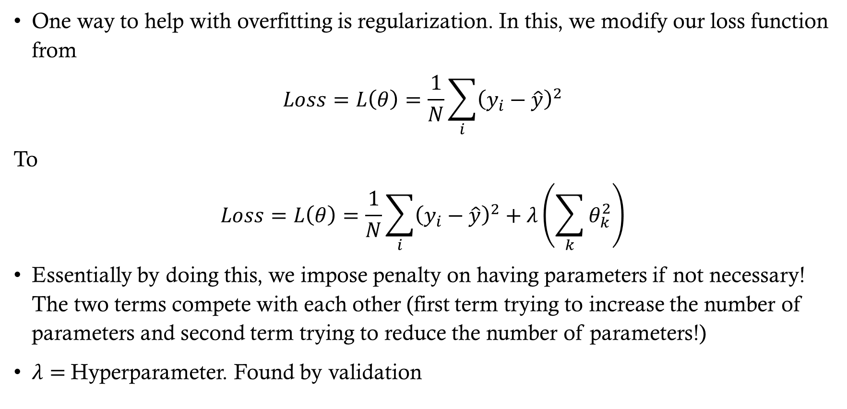
regularization
One way to help with overfitting is regularization. In this, we modify our loss function from
$$Loss=L\left(θ\right)=\frac{1}{N}\sum_{i}{{\left(y_{i}−\hat{y}\right)}^{2}}$$
To
$$Loss=L\left(θ\right)=\frac{1}{N}\sum_{i}{{\left(y_{i}−\hat{y}\right)}^{2}}+λ\left(\sum_{k}{θ_{k}^{2}}\right)$$
Essentially by doing this, we impose penalty on having parameters if not necessary! The two terms compete with each other (first term trying to increase the number of parameters and second term trying to reduce the number of parameters!)
$λ=$Hyperparameter. Found by validation

Slide 14
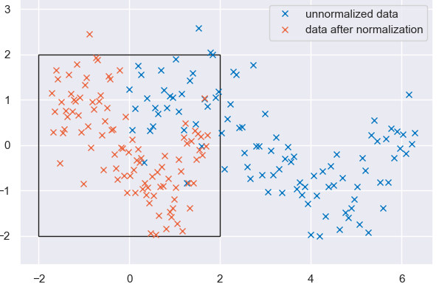
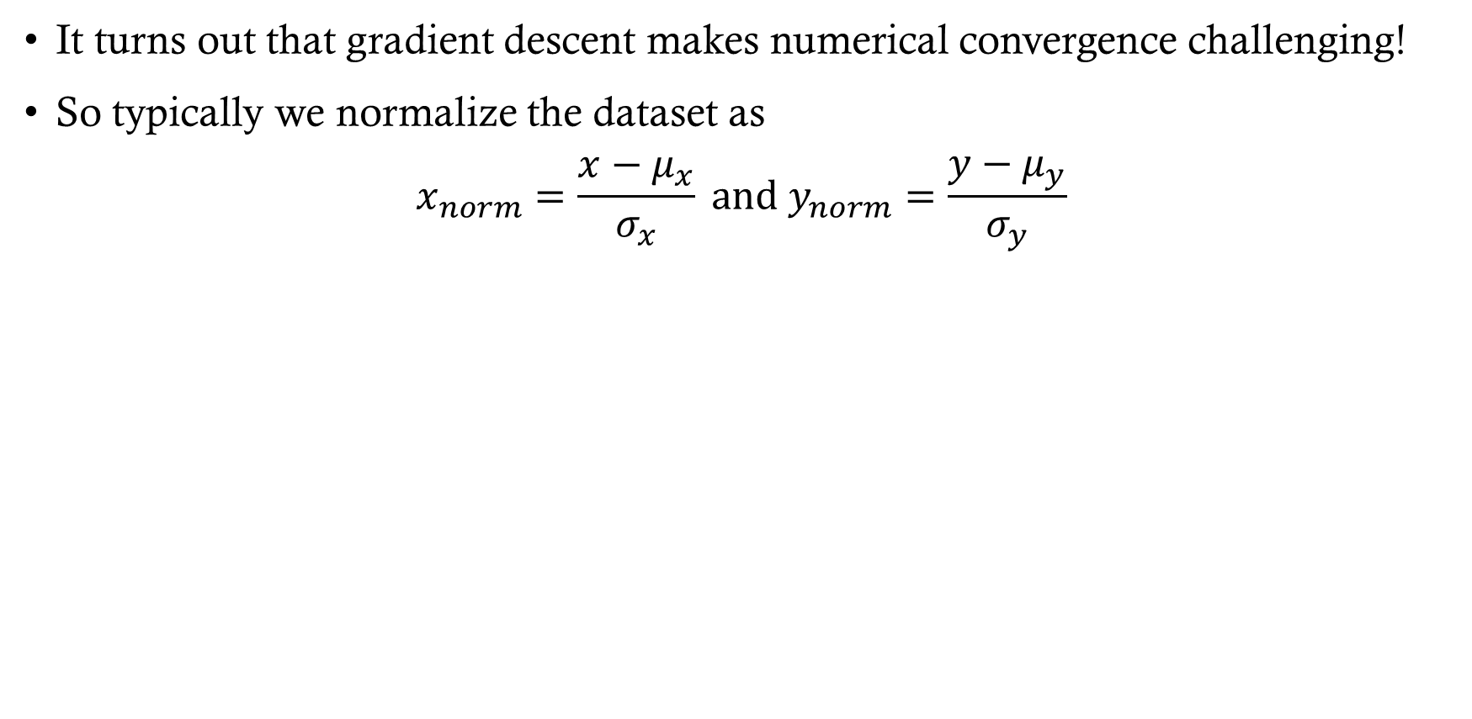
Data normalization
It turns out that gradient descent makes numerical convergence challenging!
So typically we normalize the dataset as
$$x_{norm}=\frac{x−μ_{x}}{σ_{x}} and y_{norm}=\frac{y−μ_{y}}{σ_{y}}$$

