Slide 1


CV5100: Modelling, Uncertainty and Data for Engineers
MODULE 3: MACHINE LEARNING, lecture 3-4:Linear regression & KNN

Slide 2
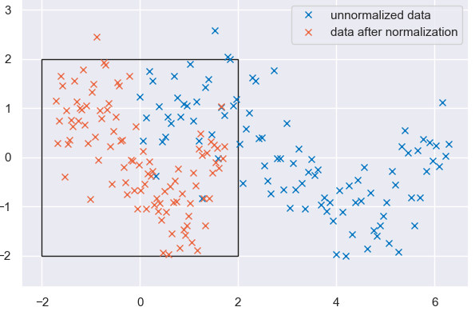
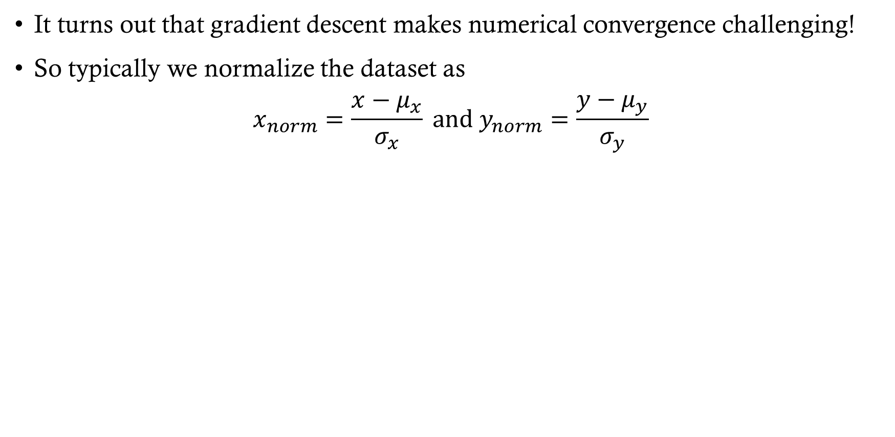
Data normalization
It turns out that gradient descent makes numerical convergence challenging!
So typically we normalize the dataset as
$$x_{norm}=\frac{x−μ_{x}}{σ_{x}} and y_{norm}=\frac{y−μ_{y}}{σ_{y}}$$

Slide 3
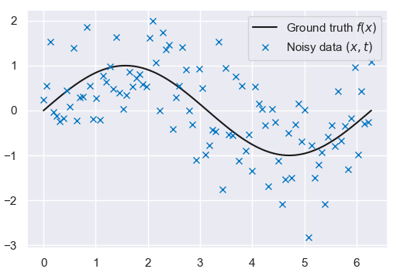
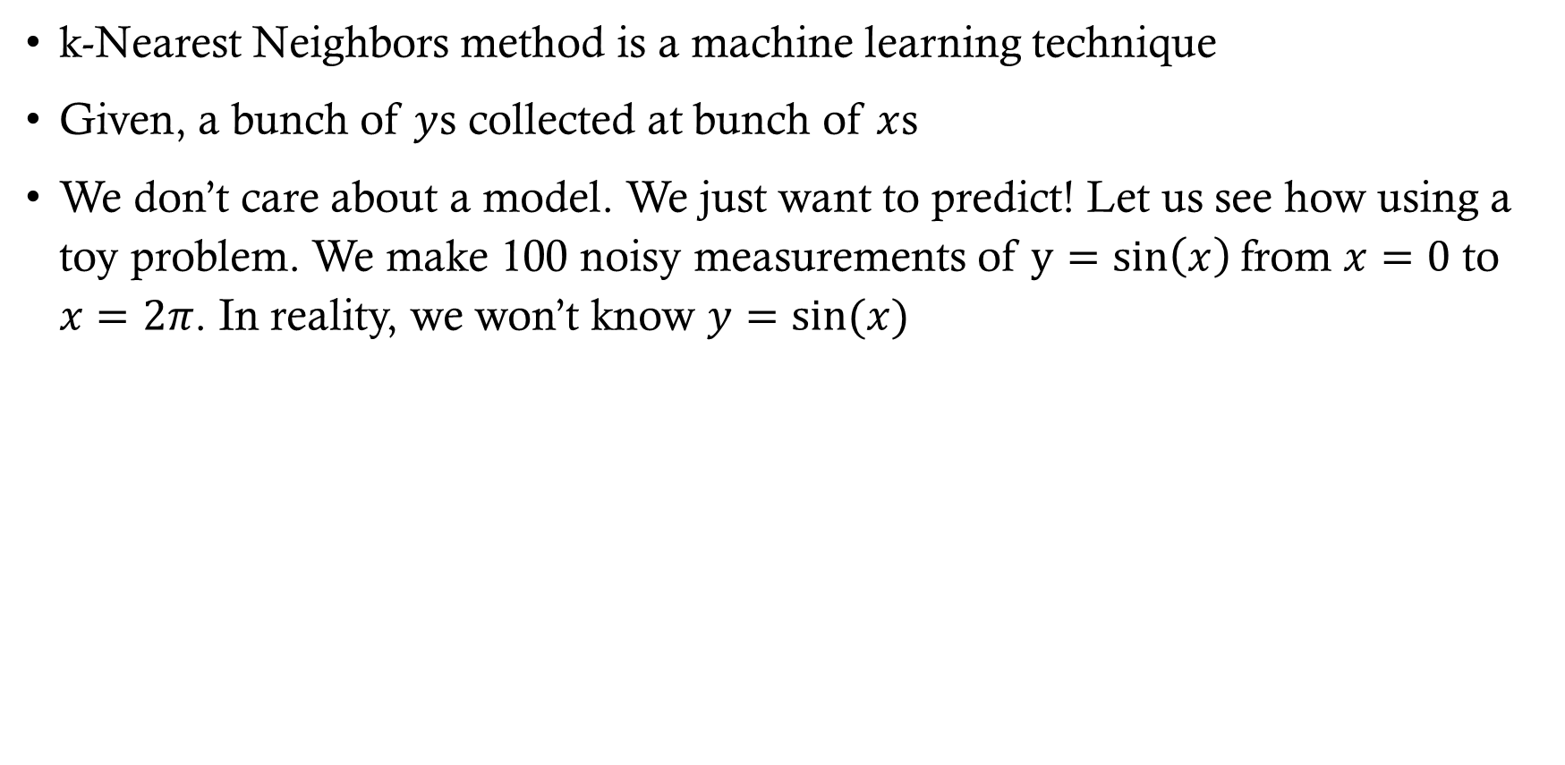


K-nearest neighbors
k-Nearest Neighbors method is a machine learning technique
Given, a bunch of $y$s collected at bunch of $x$s
We don’t care about a model. We just want to predict! Let us see how using a toy problem. We make 100 noisy measurements of $y=sin\left(x\right)$from $x=0$ to $x=2π$. In reality, we won’t know $y=sin⁡(x)$
Ground truth
Noisy data (x,y)
$$y$$
$$x$$

Slide 4
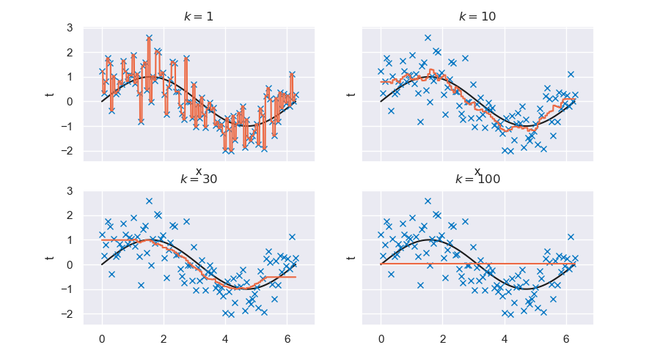
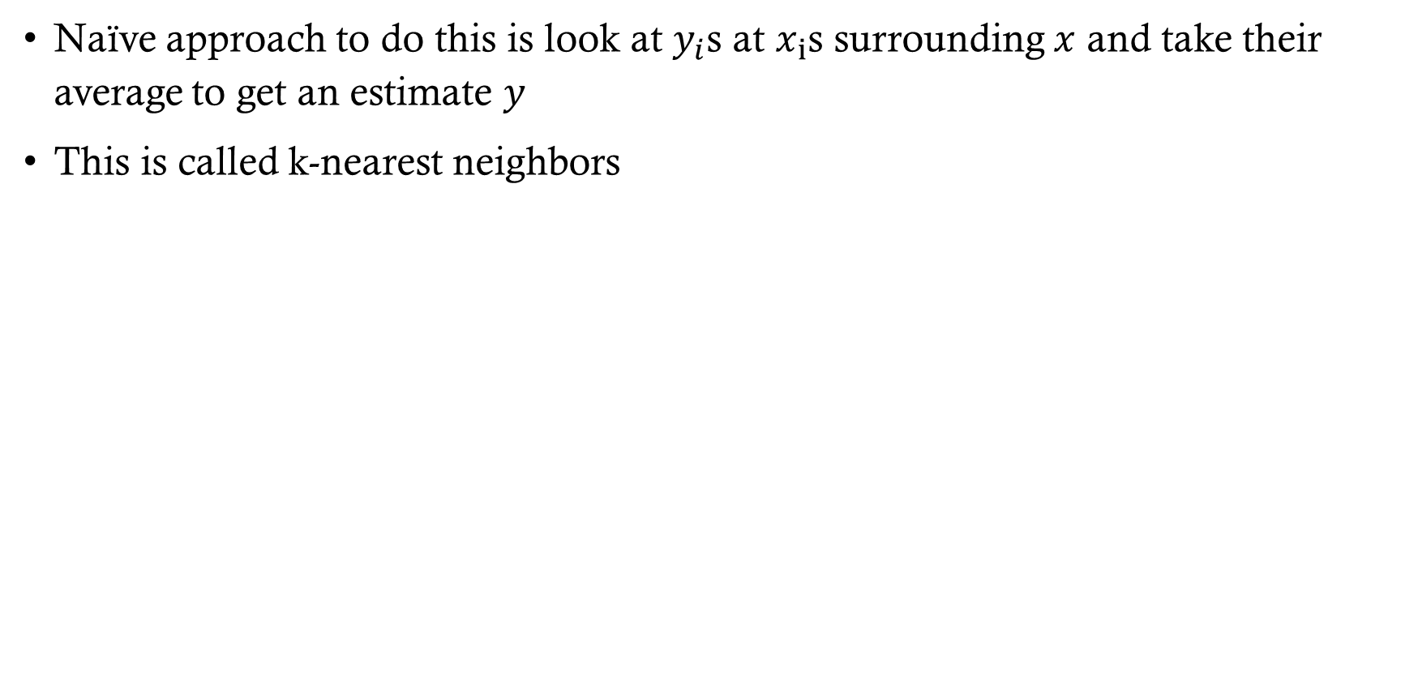
K-nearest neighbors
Naïve approach to do this is look at $y_{i}$s at $x_{i}$s surrounding $x$ and take their average to get an estimate $y$
This is called k-nearest neighbors
y
y
y
y

Slide 5
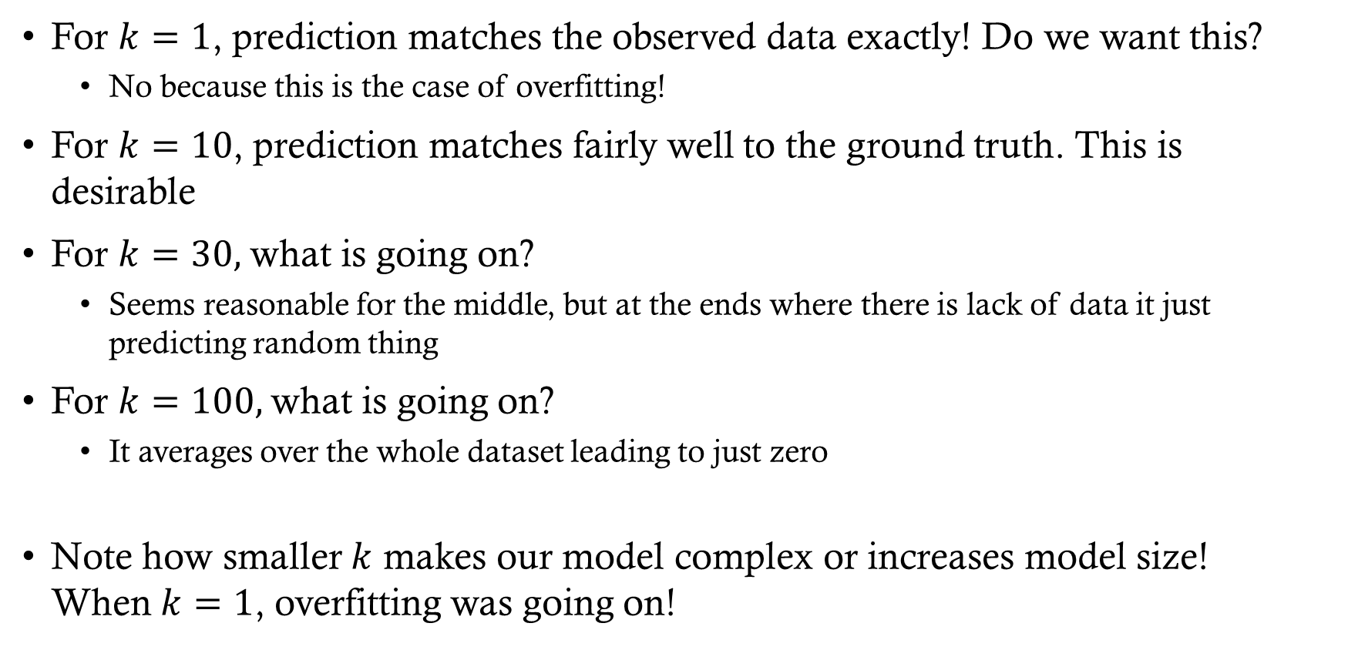
K-nearest neighbors
For $k=1$, prediction matches the observed data exactly! Do we want this?
  No because this is the case of overfitting!
For $k=10$, prediction matches fairly well to the ground truth. This is desirable
For $k=30,$ what is going on?
  Seems reasonable for the middle, but at the ends where there is lack of data it just predicting random thing
For $k=100,$what is going on?
  It averages over the whole dataset leading to just zero
Note how smaller $k$ makes our model complex or increases model size! When$k=1$, overfitting was going on!

Slide 6
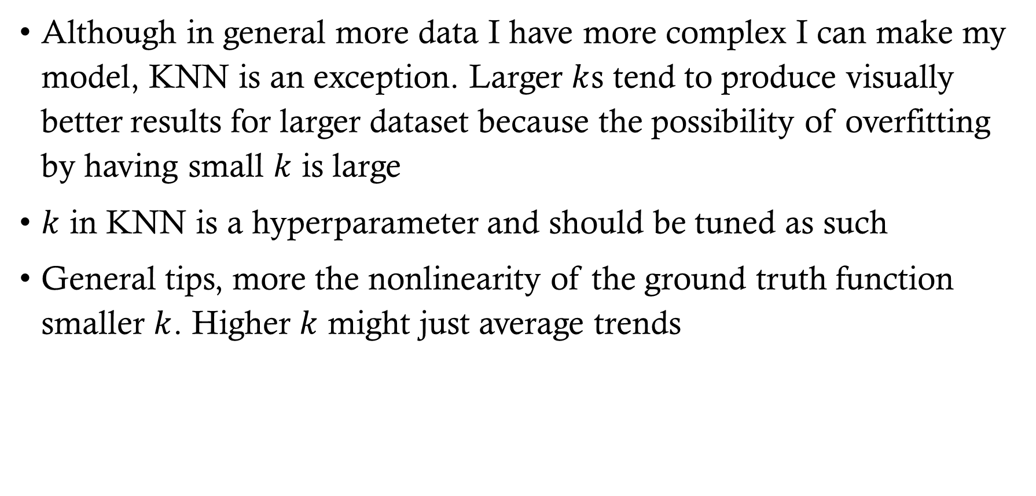
K-nearest neighbor tips and tricks
Although in general more data I have more complex I can make my model, KNN is an exception. Larger $k$s tend to produce visually better results for larger dataset because the possibility of overfitting by having small $k$ is large
$k$ in KNN is a hyperparameter and should be tuned as such
General tips, more the nonlinearity of the ground truth function smaller $k$. Higher $k$ might just average trends

