Slide 1
Verdikt
AI Multi-Agent Web Application & API Security Testing Platform
Manual-assessment-quality penetration testing, at automated speed

Slide 2
AGENDA
What we'll cover
• The problem: why manual pentesting doesn't scale, and why traditional DAST isn't trusted
• Design principles: multi-agent architecture, Confirmed-Only Findings
• System architecture & the 31-node scanning engine
• Confirmed-Only Findings pipeline — how false positives are engineered out
• Pluggable AI provider layer — bring your own LLM, including in-house/internal models
• Vulnerability coverage, attack chains, and reporting
• VGS integration, enterprise hardening, data handling & security, and deployment
• By the numbers, and an honest look at spec vs. reality
• Testing discipline & what's next
Verdikt
2

Slide 3
THE PROBLEM
Manual pentesting doesn't scale.
Automated scanning isn't trusted.
• A competent manual pentester takes days per application — demand for testing far outpaces supply
• Traditional DAST scanners scale, but are notorious for high false-positive rates
• Shallow coverage of business logic and access-control issues — the findings that matter most
• Reports nobody can act on without re-verifying every line by hand
Goal: scan a mid-size app (50–150 endpoints, one auth role, one workflow) and produce a report with ZERO false positives and manual-assessment-equivalent depth, in under a day, for under $20 of LLM spend.
Verdikt
3

Slide 4
DESIGN PRINCIPLES
Three ideas the whole system follows from
1. Multi-Agent, Not One Big Prompt
2. Confirmed-Only Findings
3. Smart Scan (partial)
31 narrow, purpose-built detection agents each own one vulnerability class, run as parallel nodes in a LangGraph DAG, and use the cheapest technique that reliably confirms that class.
Nothing becomes a Finding on a hunch. Deterministic probe → LLM triage → deterministic re-execution → adversarial validation, or it becomes a human-reviewed candidate.
A deterministic tech-stack fingerprint is computed and shown in every report — but today it gates only one check (SSTI). Broader cost-saving routing is a known next step, not shipped.
Verdikt
4

Slide 5
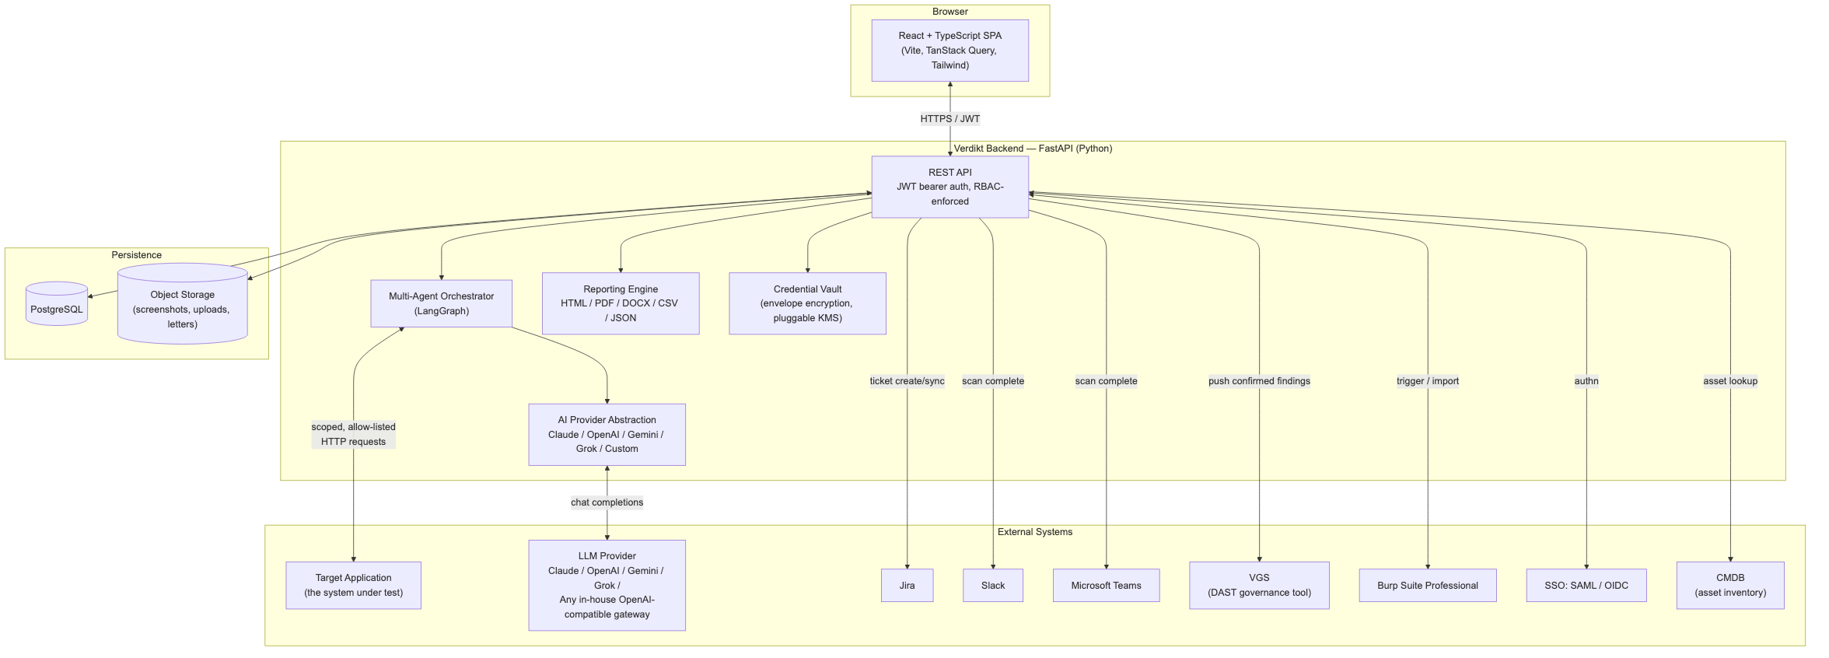
ARCHITECTURE
System Architecture
React/TypeScript frontend, FastAPI backend, pluggable AI/storage/KMS layers, and a wide enterprise-integration surface.
Verdikt
5

Slide 6
APP INFO
What it's built with
• Frontend — Vite + React + TypeScript + TanStack Query + React Router + Tailwind CSS
• Backend — Python 3.11+, FastAPI, SQLAlchemy 2.0 (async), Alembic, served via uv
• Database — PostgreSQL (dialect-agnostic ORM; test suite runs on ephemeral SQLite)
• AI layer — LangGraph 31-node multi-agent scan DAG; pluggable Claude/OpenAI/Gemini/Grok/custom-endpoint providers, with automatic per-task model tiering applied invisibly underneath
• Browser automation — Playwright (Chromium) for real execution proofs and login-macro recording, streamed live via a Docker-hosted VNC stack
• Deployment & integrations — Docker Compose end to end; Jira/Slack/Teams/Outlook/Burp/CMDB/VGS/SSO integrations, plus a standalone browser extension for native setups
Verdikt
6

Slide 7
MULTI-AGENT SCANNING ENGINE
35 detection agents in the scan graph
Injection
SQLi, OS command injection, SSTI, path traversal, NoSQLi, CSV/formula injection
XSS
Reflected, DOM-based, stored — with real browser execution proof
Access & Auth
Access control, auth bypass, OAuth redirect validation, session invalidation, weak password policy
Business Logic
IDOR, race conditions, workflow bypass, mass assignment
Request Integrity
CSRF, CORS, host header, request smuggling, cache poisoning
Client & Framework
Clickjacking, prototype pollution, GraphQL, WebSocket security, known-vulnerable JS components
Data Handling
XXE, insecure deserialization, file upload incl. polyglot bypass
Network
SSRF with real out-of-band callback proof
Config & Disclosure
Security headers, HSTS, cookie flags, version disclosure
Verdikt
7

Slide 8
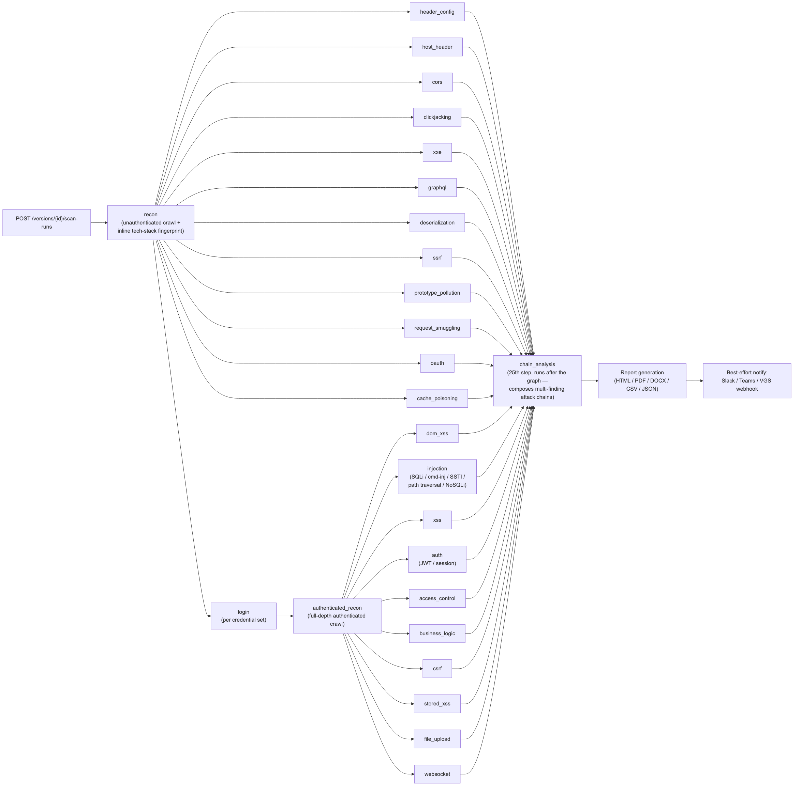
MULTI-AGENT PIPELINE
Scan Lifecycle
The real, verified 31-node graph — zero conditional edges, every node always runs. chain_analysis is a 32nd step that runs after the graph completes.
Verdikt
8

Slide 9
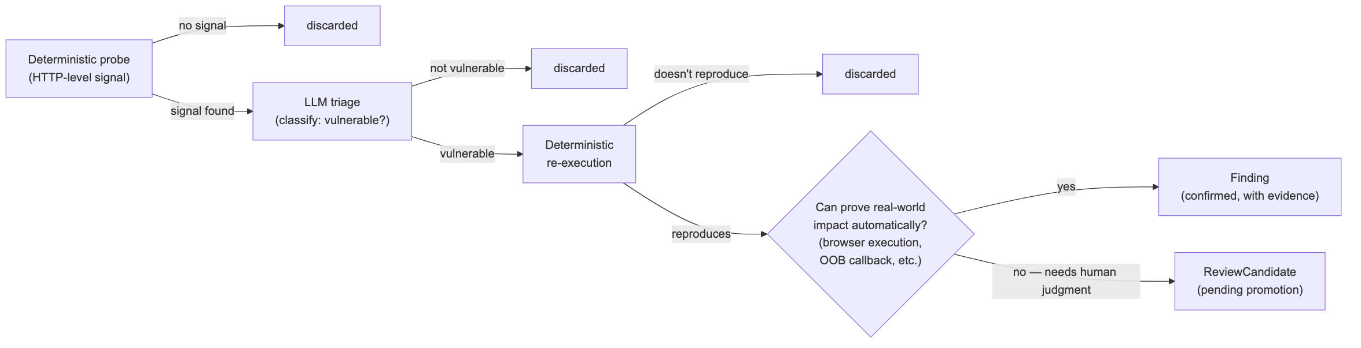
QUALITY BAR
Confirmed-Only Findings
A candidate must survive deterministic re-execution and adversarial LLM validation before it becomes a Finding — or it becomes a human-reviewed candidate.
Verdikt
9

Slide 10
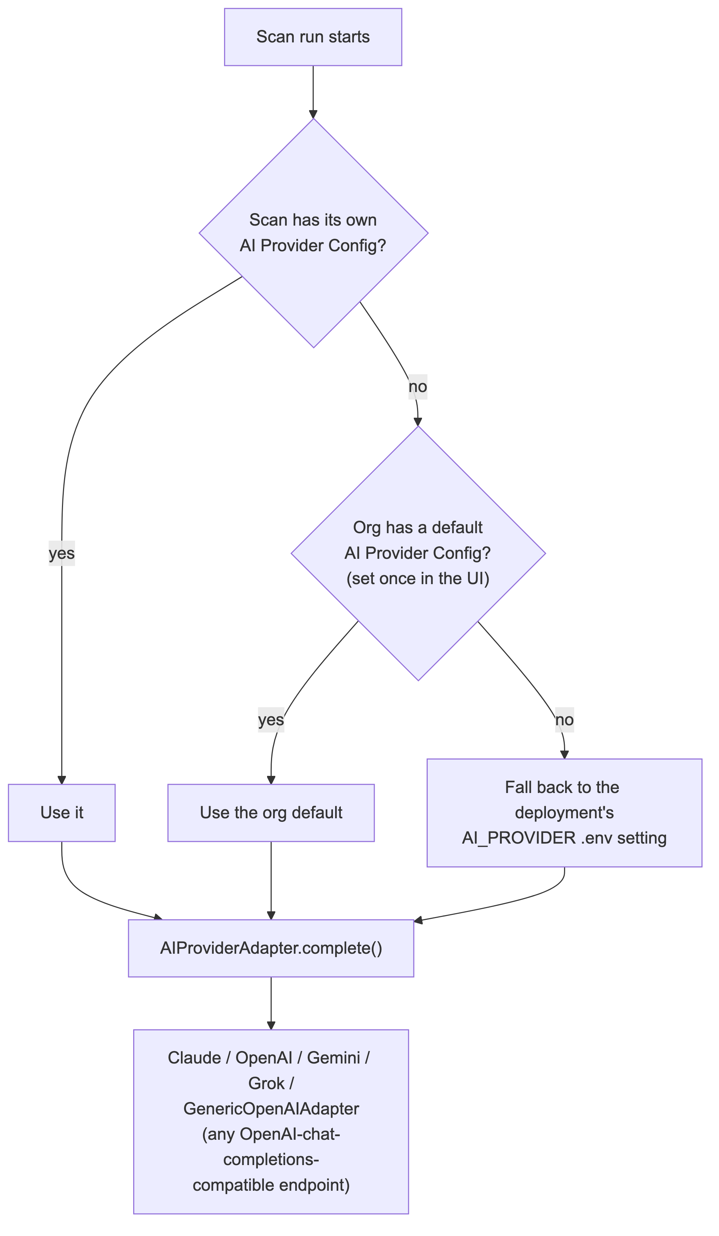
AI PROVIDER ABSTRACTION
Bring Your Own LLM
Claude, OpenAI, Gemini, Grok, or any in-house OpenAI-compatible model — configured once in the UI. The backend automatically substitutes a cheaper or stronger same-family model for a handful of specific tasks, invisibly. A $2.00/scan hard cost cap is enforced underneath.
Verdikt
10

Slide 11
COVERAGE
OWASP Top 10 (2025) + PortSwigger Web Security Academy
• Injection — SQL, OS command, SSTI, NoSQL, path traversal, CSV/formula injection
• Broken access control — IDOR, privilege escalation, missing function-level checks
• Cryptographic & session failures — token entropy, cookie attribute hygiene, session not invalidated on logout, weak password policy acceptance
• Cross-site scripting — reflected / DOM / stored, real browser execution proof
• Security misconfiguration — headers, plaintext HTTP, version disclosure
• SSRF — real out-of-band callback verified
• Authentication failures — auth bypass, OAuth redirect-URI validation
• Software & data integrity — insecure deserialization, prototype pollution, known-vulnerable client-side components (checked against OSV.dev)
• XXE, GraphQL introspection/DoS surface
• File upload — dangerous extensions + image-polyglot bypass technique
• CSRF, CORS, clickjacking — with real browser-confirmed framability
• HTTP request smuggling & cache poisoning/deception
• WebSocket security, business logic (race conditions, workflow, mass assignment)
• LLM / Chatbot Pentest — OWASP LLM Top 10 2026 + Agentic Top 10 2026: prompt injection, hidden-context extraction, improper output handling, excessive agency, unexpected code execution
• API-specific & CSP — deprecated API version data exposure, open redirect, JSONP-callback CSP bypass
Verdikt
11

Slide 12
BEYOND SINGLE FINDINGS
Attack chains, retest & rescan
• Attack Chain Analysis
‣ Runs after every other agent completes, looking for standalone findings that compose into a more severe, realistic attack path (e.g. reflected XSS + missing CSRF token → account takeover)
‣ Goes through the same adversarial-validation discipline as individual findings — no rubber-stamping
• Rescan
‣ Full re-run, diffed against the prior scan: new findings, still_open, and fixed — human decisions like risk_accepted are never silently overridden
• Retest
‣ Targeted, single-finding re-verification — "we just deployed a fix, did it work" — without paying for a full scan
Verdikt
12

Slide 13
REPORTING
One dataset, every audience
• HTML, PDF, DOCX, CSV, and JSON exports — all generated from the same underlying Finding records
• Finding grouping — shared check types collapse into one section with full evidence for a representative sample, preventing runaway report length (one real scan: 291 findings, not 629 pages)
• LLM-generated executive summary for non-technical stakeholders — generated once, cached
• Org branding — logo and primary color on every generated report
• A native, ported VGS report-builder workflow for teams that want manual curation
Verdikt
13

Slide 14
VGS INTEGRATION
Three complementary modes
Decoupled Webhook Push
• On scan completion, Verdikt POSTs findings to VGS's ingestion webhook
• Tagged source: ai-multi-agent
• VGS stays system of record for governance/remediation
• Best-effort: a broken webhook never fails the scan
Native Report-Builder
• VGS's manual workflow, ported into Verdikt as its own workspace
• Vulnerability Picker: confirmed findings, auto-seeded and tracked
• Delete or edit severity; "Load from PortSwigger" one-click pull
• Generate Report: same DOCX shape as the original VGS tool
Per-Scan-Run Export
• One-click report.vgs.docx export scoped to a single scan run
• Transient — not persisted or tracked like the workspace mode
• For a quick handoff when a full workspace isn't needed
• Same VGS-shaped DOCX output as the other two modes
Verdikt
14

Slide 15
ENTERPRISE HARDENING
Built for real organizations, not just demos
• RBAC — real DB-backed role_permissions table across 19 resource types; new roles are data changes
• SSO — SAML and OIDC, per-org, with configurable default role assignment
• Ticketing & notifications — Jira, Slack, Microsoft Teams, Outlook, plus a conversational Teams bot
• CMDB integration — generic, configurable REST client for any vendor's asset inventory
• API keys — long-lived, revocable tokens for CI/automation clients
• Audit log — every state-changing action recorded with actor, action, resource, metadata
• Cost governor — a per-scan-run cap on estimated LLM spend, enforced automatically
Verdikt
15

Slide 16
DATA HANDLING & SECURITY
What leaves your infrastructure, and what doesn't
• Multi-tenant isolation — every org_id-scoped resource chain (Project → Version → ScanRun → Finding) is enforced at the query layer, not just the UI
• Scope enforcement — ScopedHttpClient blocks any request outside a Version's declared scope; a scan can't wander off or exfiltrate to unauthorized infrastructure
• Credential encryption — every stored secret envelope-encrypted via KMS before touching the database; plaintext never logged or echoed back
• The one real third-party data flow — AI-assisted triage sends truncated request/response snippets to whichever LLM provider is configured for that scan
• Close it off entirely — point the AI provider at a self-hosted/on-prem endpoint, or run with no AI provider at all; deterministic checks (most of the catalog) still produce real, confirmed findings
• Evidence storage — screenshots and captured traffic go to local disk or S3, under the deploying organization's own infrastructure
• No telemetry — no analytics/telemetry SDK of any kind anywhere in the codebase
Verdikt
16

Slide 17
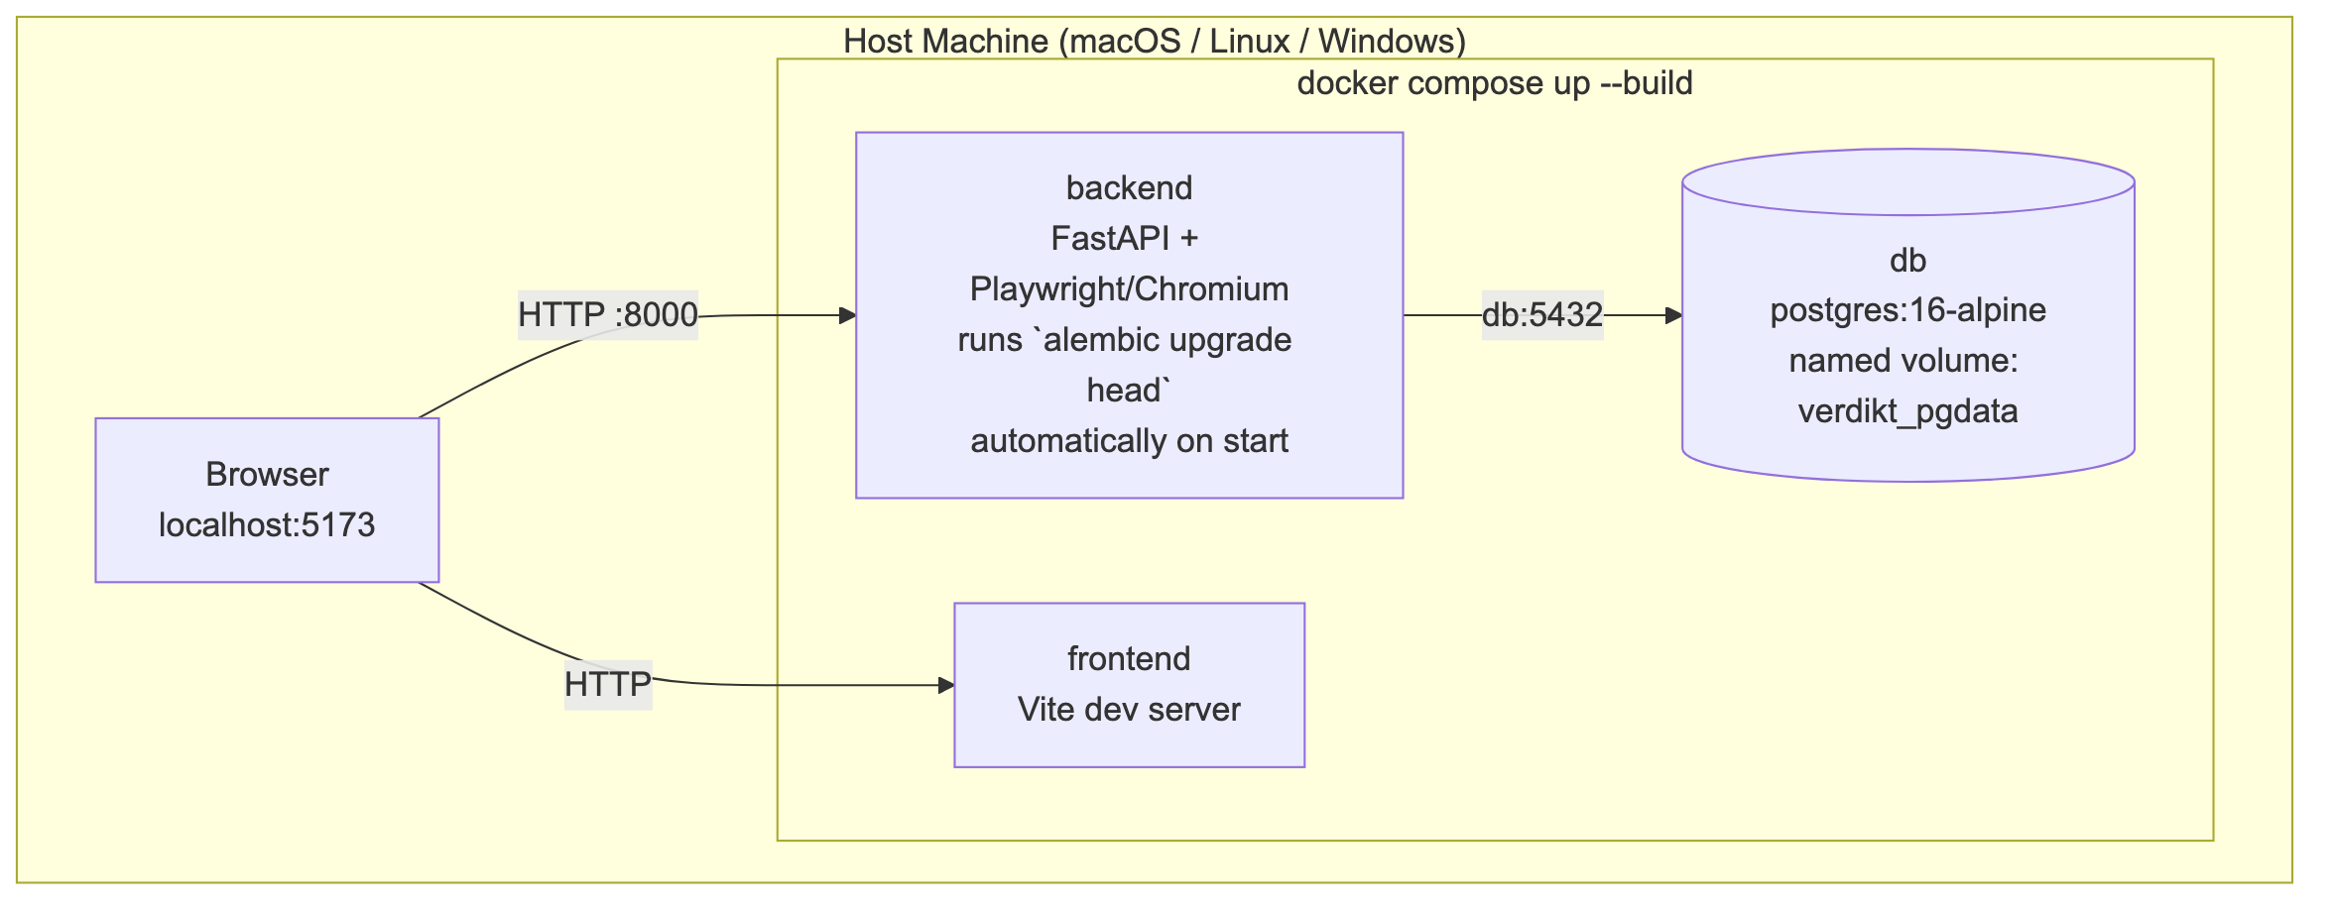
CROSS-PLATFORM, ONE COMMAND
Deployment
docker compose up — verified end-to-end on a fresh environment; migrations run automatically; works identically on macOS, Linux, and Windows.
Verdikt
17

Slide 18
BY THE NUMBERS
The codebase, counted — not estimated
57
agent files
(35 wired into the scan graph)
32
API route modules
36
persisted data models
10
external integrations
47
static check IDs
across 22 YAML catalogs
39
Alembic migrations
21×4
RBAC resources × actions
721
tests across 126 files
Verified by direct code inspection and by running the test collector — not estimated.
Verdikt
18

Slide 19
AN HONEST LOOK
Spec vs. reality
Built less than originally specified
• Pre-scan authorization gate — built, then fully removed
• Human-in-the-loop approval checkpoints — not built
• Smart Scan graph-level routing — only one narrow case (SSTI)
• Orchestration engine — LangGraph, not Temporal.io (the spec's primary recommendation)
• Depth slider (Quick/Standard/Deep) — not built
• Cross-credential-set result caching — not built
Built beyond what was specified
• VGS integration — spec asked for webhook push only; shipped three modes (webhook, native workspace, per-scan-run export)
• Image-polyglot file-upload bypass technique
• "Load from PortSwigger" scraper integration
• UI-only, per-org default AI provider configuration
• A genuine conversational Microsoft Teams bot
• Two independent login-macro recorders, four checks ported from a sibling DAST project, and (2nd attempt) automatic, zero-config per-task model tiering
Verdikt
19

Slide 20
QUALITY
Testing discipline
• 667 tests across 119 files, confirmed via pytest --collect-only — real fixtures over mocks: local HTTP servers, a real headless browser, real cryptographic round-trips
• Live-validated against OWASP Juice Shop and a real DVWA instance across all four security levels
• DVWA "Impossible" correctly produces zero injection/XSS findings; "Medium" correctly yields confirmed SQLi and command injection through the full pipeline
• Every bug fix in this system's history was root-caused against a real, running target — not inferred from a stack trace alone
Verdikt
20

Slide 21
ROADMAP
What's next
• Build out Smart Scan's graph-level routing — use the fingerprint to actually skip irrelevant node scheduling, not just display it
• A depth/intensity profile (Quick / Standard / Deep) as a scan-trigger option
• Extend automatic model tiering to Gemini once its 3.x naming stabilizes past the October 2026 retirement of the 2.5 line
• A more sophisticated file-upload bypass technique, chaining into a standalone RCE proof
• Configurable human-in-the-loop approval checkpoints for the most invasive check categories
• ASI02 Tool Misuse's malicious-argument-to-a-real-tool-call half — deferred pending tool/function-manifest introspection to design against
• Indirect prompt injection via RAG-corpus poisoning for the Chatbot Pentest capability — deferred pending a safe, generic way to plant content into a target's retrieval corpus
Verdikt
21

Slide 22
COMMON QUESTIONS
FAQ
• How does crawling work? — A Playwright-driven crawler discovers pages/forms/API calls within scope; uploaded traffic (HAR/Burp/Zest) supplements live crawling, it doesn't replace it.
• How are vulnerabilities found, and what does AI actually do? — Deterministic HTTP-level probes run first; AI only triages results and helps craft context-aware payloads. AI never single-handedly confirms a finding.
• How is this different from WebInspect or Checkmarx? — Those are single-pass deterministic scanners; Verdikt pairs the same deterministic probing with LLM-assisted triage and adversarial validation, so only confirmed findings reach a report.
• If I upload traffic, does it still crawl the live site? — Yes — uploaded traffic and live crawling both run and combine into one scope.
• What's the architecture, and why AI if scans are deterministic? — A 31-node LangGraph DAG per scan: deterministic probe → AI triage → deterministic re-execution → adversarial AI validation. AI expands and interprets; it never decides alone.
• Can Verdikt test a chatbot or LLM-backed app? — Yes — configure a ChatbotTarget and it's checked for prompt injection, hidden-context extraction, improper output handling, excessive agency, and code execution, the same conversational text-in/text-out safety envelope as every other AI-judged check.
• Can I save a custom auth header on a credential? — Yes — extra_headers forces a static header (e.g. X-API-Key) onto every request for that credential, layered on top of any login type including a recorded macro, not just bearer tokens.
Verdikt
22

Slide 23
A SECOND EXECUTION MODE
AI-Driven Autonomous Pentest
• Sits alongside the 35-node deterministic DAG — doesn't replace it
• A real LLM decides turn by turn what to investigate, with genuine shell tool-calling (curl, nmap, sqlmap, nikto, ffuf)
• Runs inside an isolated, network-restricted sandbox — Docker socket lives in a separate sidecar, never the main backend
• iptables egress allow-list, live-verified to block a raw nmap SYN scan even when the model is explicitly told to try
• Every finding requires real request/response evidence — the same “never guess a finding into existence” discipline as every deterministic check
Built directly in response to user feedback:
“I wanted AI to perform a pentest, not a deterministic scan.”
Verdikt
24

Slide 24
LIVE RESULTS
Real Findings, and an Honest Reliability Finding
SQL injection auth bypass + IDOR
demo.testfire.net
Critical
Reflected XSS, screenshot-verified
demo.testfire.net
High
Blind SQLi + command injection (bypassing filters)
DVWA — 24-session sweep
Critical
Honest finding: the dominant cause of a missed vulnerability wasn't investigation quality
A 24-session DVWA sweep found most zero-finding sessions never even reached the vulnerability — they lost a fragile, multi-step CSRF-token login sequence. The identified fix: pre-authenticate the sandbox using the existing, already-proven credential/login mechanism before the model's turn budget starts.
Verdikt
25

Slide 25
Thank you
Questions & discussion

