Slide 1
SOCIAL NETWORK ANALYSIS
Influence Maximization
and Early Discussion
Detection
A Hacker News case study using CELF
Mudigonda Himanshu
Name: __________________
Name: __________________
CB.SC.U4CSE23040
Roll no.: _____________________
Roll no.: _____________________
01
Notes:
Introduce the team. The two teammate name and roll-number fields are intentionally editable placeholders. Explain that the project compares influence maximization with early discussion detection using a Hacker News reply network.

Slide 2
The selection problem
Which small group of users gives us the most useful coverage?
SPREAD INFORMATION
OBSERVE DISCUSSIONS
Influence seeds
Detection sensors
Choose users from whom a message
could reach the most people.
Choose users whose participation
reveals important discussions early.
CELF selects a complementary set by the value of each additional user.
02
Notes:
A seed starts a simulated cascade. A sensor is a user we monitor in the recorded discussions. The application contribution is formulating sensor selection around early detection, rather than simply watching individually active users. CELF is an existing lazy implementation of greedy selection, not a new algorithm invented in this project.

Slide 3
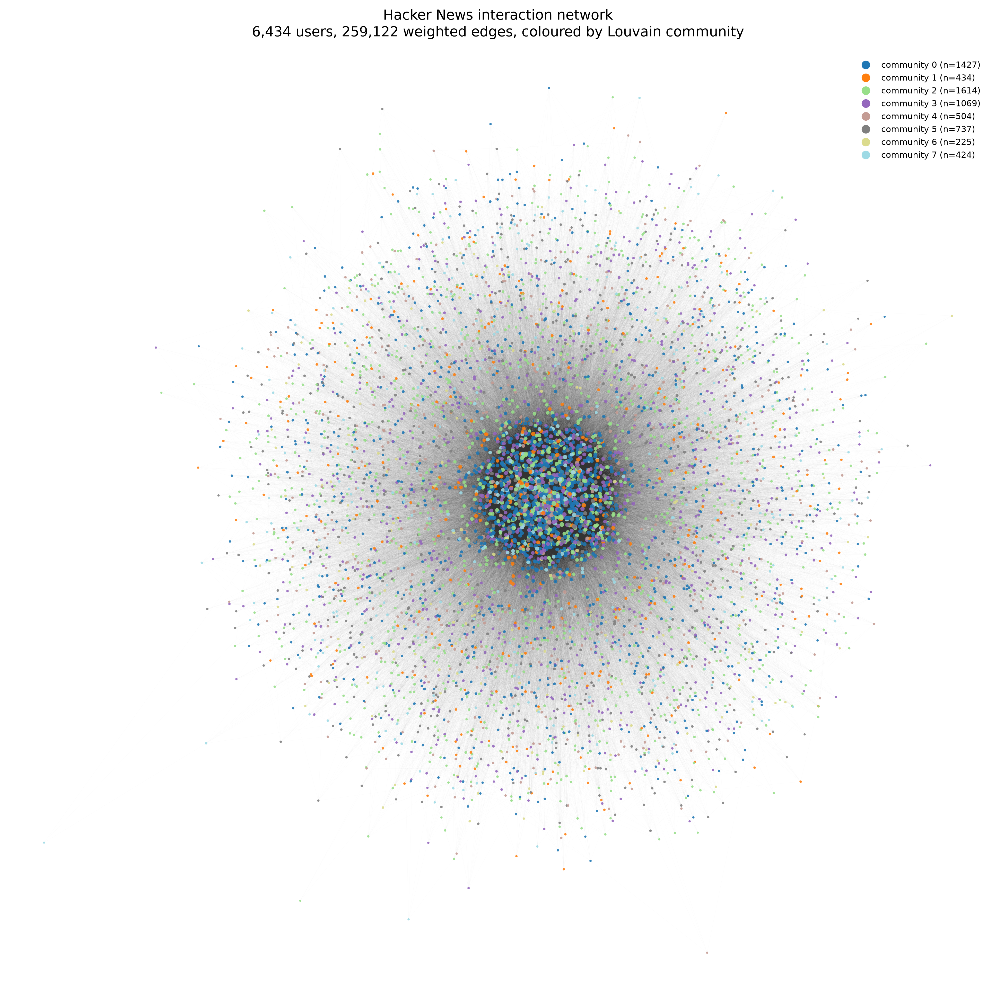
The Hacker News reply network
Observed replies provide both a graph and discussion timestamps
6,434
users
259,122
directed weighted edges
312,913
retained reply records
Parent author to replier. Edge weight counts replies.
03
Notes:
Source: data/hn_interactions_v3_CLEAN.csv, data/gephi_edges.csv, figures/fig_network_full.png. Observation range: 6 September 2025 to 6 September 2026, approximately one year. The supplied image uses the saved Gephi community partition. It does not show the newly computed canonical partition. The dataset is a filtered retained sample, not every Hacker News interaction.

Slide 4
Our approach
A discussion counts as significant at 10 distinct retained repliers
01
Build the benchmark
3,418 significant observed discussions
02
Measure first arrivals
Time each user’s earliest retained reply
03
Select a sensor set
Reward new coverage and earlier detection
04
Compare at the same budget
CELF, Top-reach and random selection
04
Notes:
Sources: section3a_detection.ipynb, final.ipynb, PROJECT_COMPLETION.ipynb. Historical headline selection used the 500 users with highest outbreak participation as candidates. An individual discussion contributes according to the earliest selected sensor. The corrected continuation uses max(0,1-delay/H), with zero for absence or arrivals after the horizon. The historical implementation did not clip late rewards, so do not attribute the monotone guarantee to that original implementation. Headline results on slides 8–13 are historical in-sample comparisons.

Slide 5
How CELF chooses the next user
Cost-Effective Lazy Forward selection
Candidate | Alone | Extra coverage after A
A | 100 discussions | Already selected
B | 90 discussions | 10 new discussions
C | 60 discussions | 60 new discussions
Choose A, then C
C adds more new coverage
than B after A is selected.
CELF keeps old gains as upper bounds and refreshes only candidates that could still win.
Illustrative coverage example. The actual detection score also rewards earlier arrival.
05
Notes:
This table is an explanatory example, not project measurements. Greedy recomputes every remaining candidate’s marginal gain each round. CELF stores gains, examines the highest bound, refreshes stale gains and accepts a candidate once its score is current and still highest. Diminishing returns makes old gains valid upper bounds for a monotone submodular objective. The original notebook used a sorted list. The corrected completion implements a stamped heap priority queue.

Slide 6
Algorithms and comparison methods
CELF is the main selector. Other methods test its value
Method | Role in this project
CELF / ordinary greedy | Select by marginal gain / verify lazy selection
Independent Cascade + RIS | Simulate spread / approximate influence selection
Top-reach + random | Discussion activity baseline / chance baseline
Centrality rankings | Degree, PageRank, betweenness, eigenvector, closeness, k-core
Louvain | Community analysis and network visualization
A propagation model simulates spread. A selection algorithm chooses users.
06
Notes:
Sources: influence_maximization_HN.ipynb, section2b_ris_sketch.ipynb, section3a_detection.ipynb, PROJECT_COMPLETION.ipynb. The historical main influence experiment compared degree, PageRank, betweenness, eigenvector, k-core and random. The continuation adds consistently defined outward closeness. RIS uses reverse-reachable sets for influence selection, not the historical detector. Louvain describes graph communities and does not directly select sensors.

Slide 7
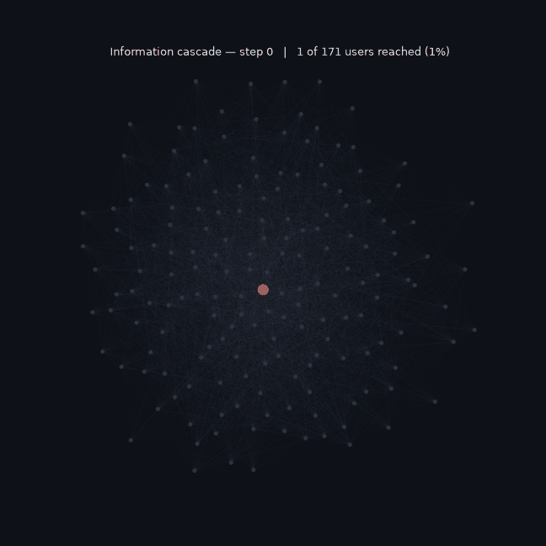
A simulated information cascade
How information can move outward from a seed
1
A seed becomes active
2
Newly active users try
to activate their neighbors
3
The cascade stops when
no new users activate
Illustration only: 171-user subgraph with amplified probabilities
07
Notes:
Source: figures/3_cascade_animation.gif and visualisation_suite.ipynb. This original eight-frame GIF is illustrative, using a 171-node filtered subgraph and doubled propagation probabilities. It is not the experiment used to produce the quantitative spread results. Run in PowerPoint Slide Show mode to display animation where supported. Independent Cascade gives each active node one activation attempt per inactive neighbor. The main historical model used min(1/in-degree(target),0.5).

Slide 8
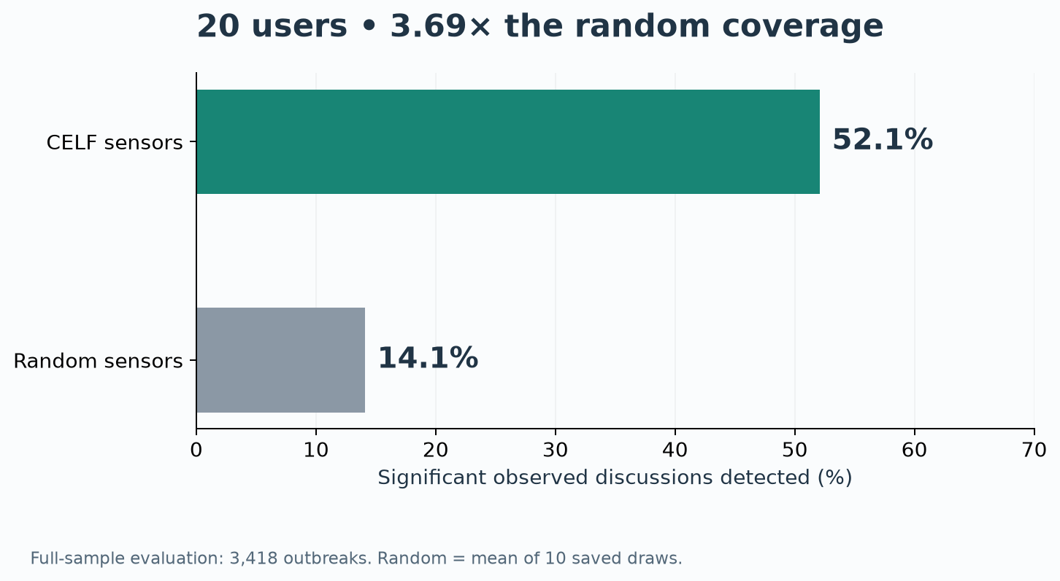
Finding 1: 52.1% coverage with 20 sensors
3.69× the saved random baseline
08
Notes:
Sources: final.ipynb, final_assets/verified_numbers.json, data/detection_results.csv. CELF detects 1,781 of 3,418 significant discussions. Random coverage 14.1106% is a saved mean over 10 random draws. These are historical in-sample results on retained discussions. Do not describe them as prospective coverage of every Hacker News discussion.

Slide 9
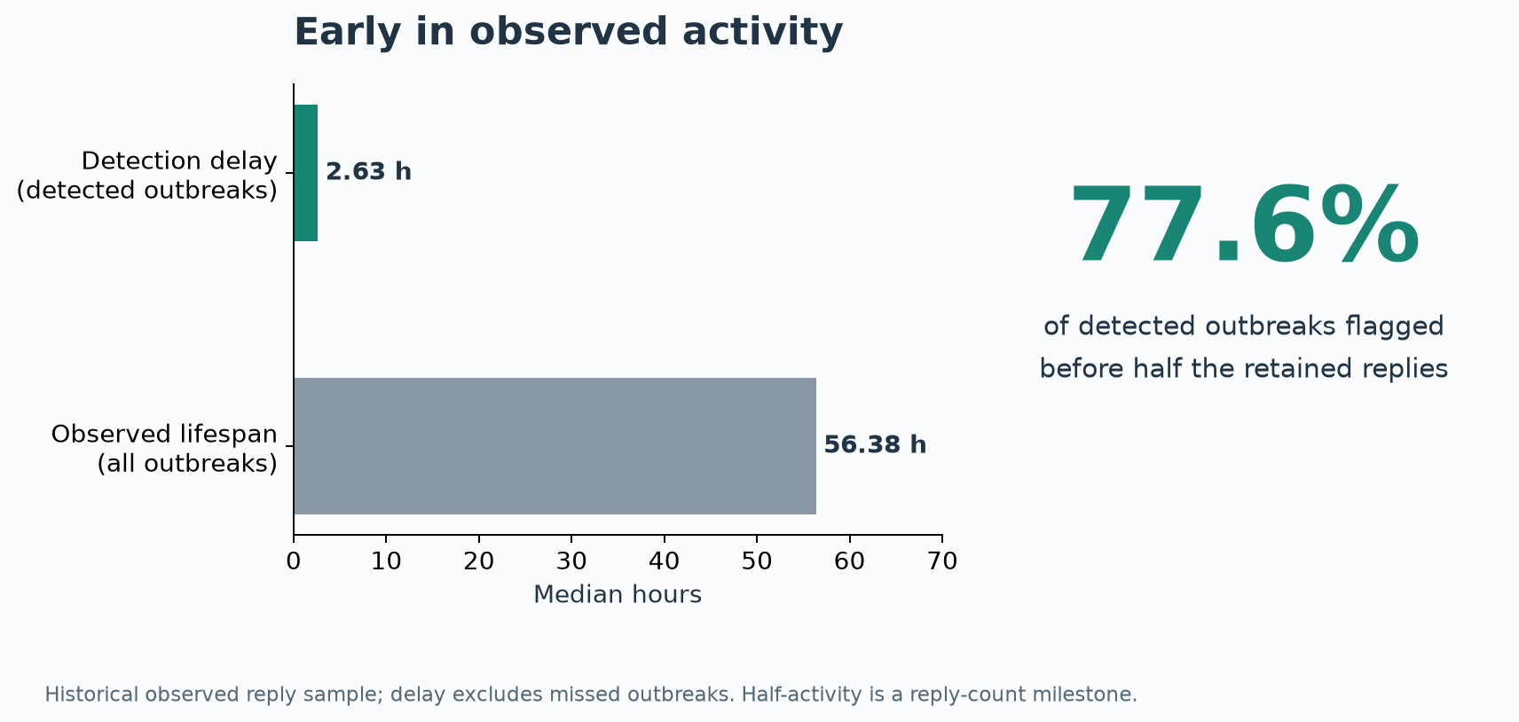
Detection arrived early in observed activity
Median delay: 2.63 hours. Median discussion lifespan: 56.38 hours
09
Notes:
Sources: final.ipynb and data/detection_summary.json. Delay is conditional on detection. Lifespan is the median across all significant observed discussions. Of detected outbreaks, 77.6% were detected before half the retained replies occurred. Half-activity does not mean half elapsed duration or the peak. Explain those denominators briefly if asked.

Slide 10
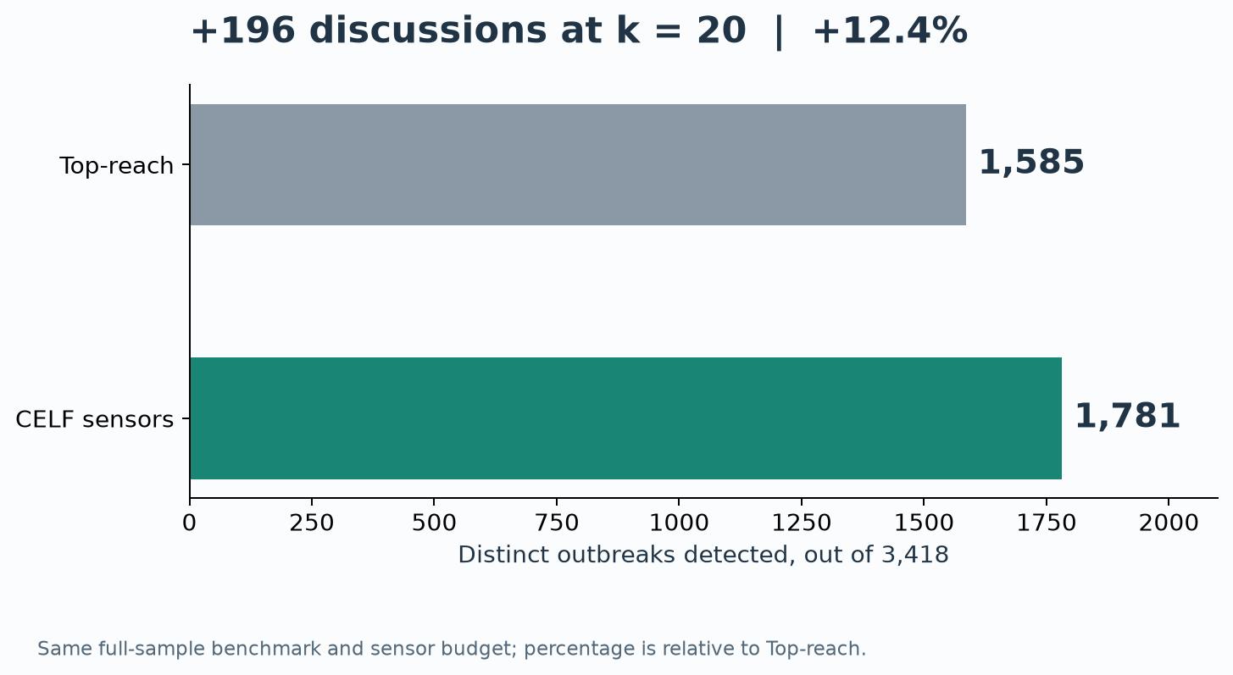
Finding 2: 196 additional discussions
12.4% relative improvement over Top-reach at k = 20
10
Notes:
Sources: data/detection_results.csv and final.ipynb. CELF covers 1,781 versus 1,585 for Top-reach. Relative gain is (1781-1585)/1585=12.3659%. Absolute recall gain is 5.734 percentage points. Top-reach ranks users by the number of significant discussions they participate in, not total comment volume. Historical in-sample comparison.

Slide 11
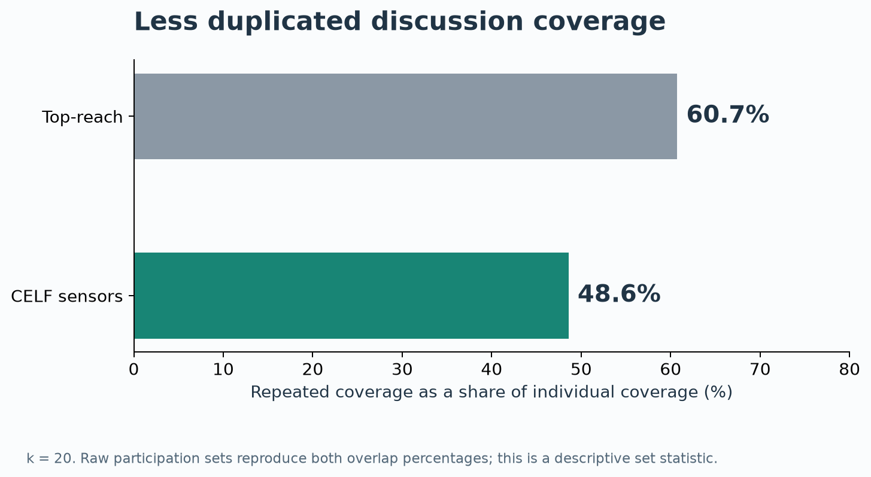
The selected sensors duplicated less coverage
Overlap fell from 60.7% to 48.6%
11
Notes:
Source: final.ipynb reconstructs participation from raw interactions. Repeated coverage = 1 - unique covered discussions / sum of individual sensor coverage. CELF: 1-1781/3465=48.6003%. Top-reach: 1-1585/4038=60.7479%. This descriptive result is consistent with complementary selection, not a separate causal proof.

Slide 12
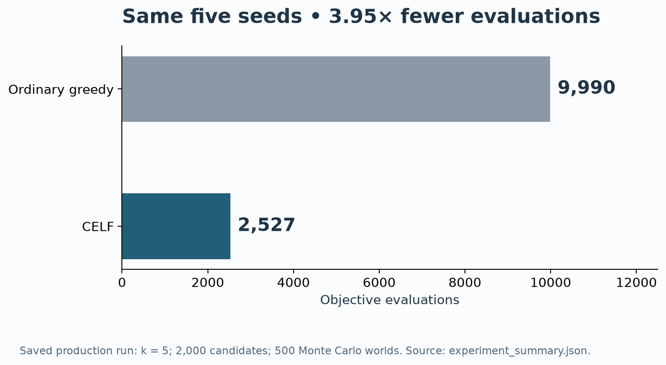
Finding 3: the same greedy selection, less work
3.95× fewer objective evaluations in the saved k = 5 experiment
CELF matched greedy on this instance. The result does not prove global optimality.
12
Notes:
Source: experiment_summary.json and influence_maximization_HN.ipynb. Greedy evaluated 9,990 candidates and CELF 2,527, a 3.9533 ratio. Saved run: k=5, pool=2,000, 500 Monte Carlo worlds. Agreement is with ordinary greedy, not exhaustive search. It does not prove global optimality or mathematically prove the theorem. Greedy’s 1-1/e bound requires a normalized monotone submodular objective; CELF preserves greedy selection under valid lazy bounds. Corrected fixed-world tests and clipped detection objective are in PROJECT_COMPLETION.ipynb. References: Leskovec et al. (2007), https://www.cs.cmu.edu/~guestrin/Publications/KDD2007/kdd2007.pdf; Kempe et al. (2003), https://www.cs.cornell.edu/home/kleinber/kdd03-inf.pdf.

Slide 13
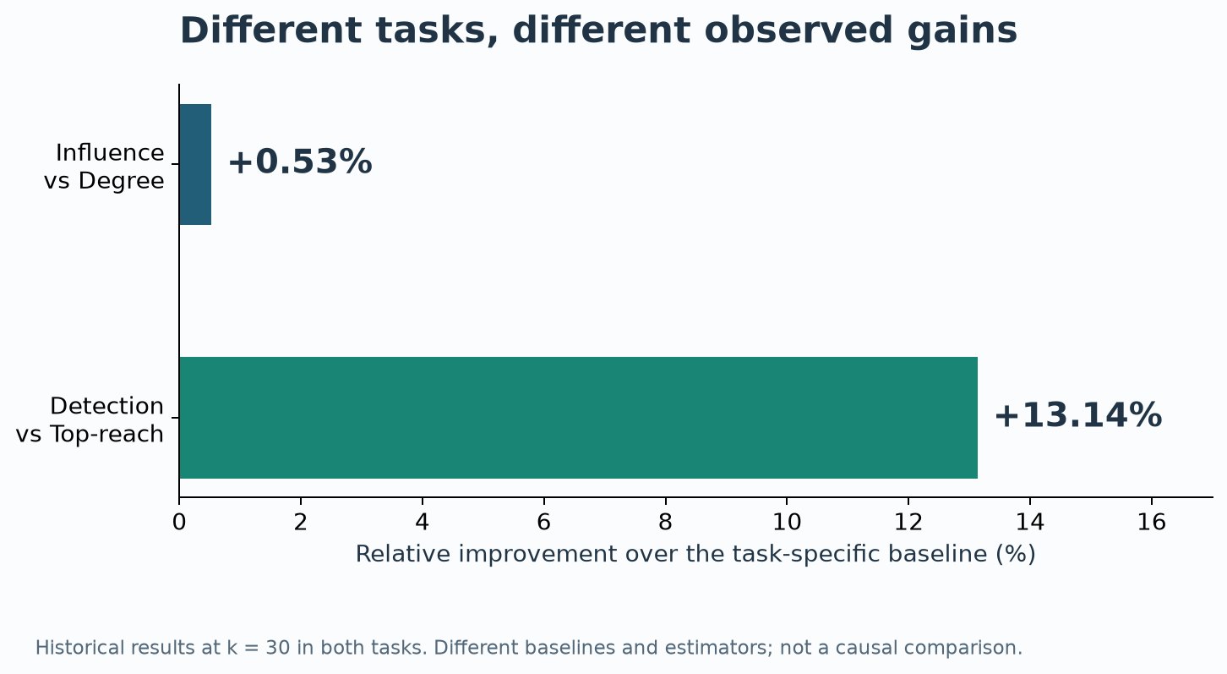
Finding 4: value varied across the two tasks
At k = 30, the historical gains were +0.53% and +13.1%
13
Notes:
Sources: im_results.csv and data/detection_results.csv, both at k=30. Influence: 1519.934 versus Degree 1511.984, +0.5258%. Detection: CELF 61.2346% versus Top-reach 54.1252%, +13.134%. Different candidate pools, baselines and estimators prevent causal attribution solely to changing the objective. This supports an application comparison, not an assertion of new mathematical theory.

Slide 14
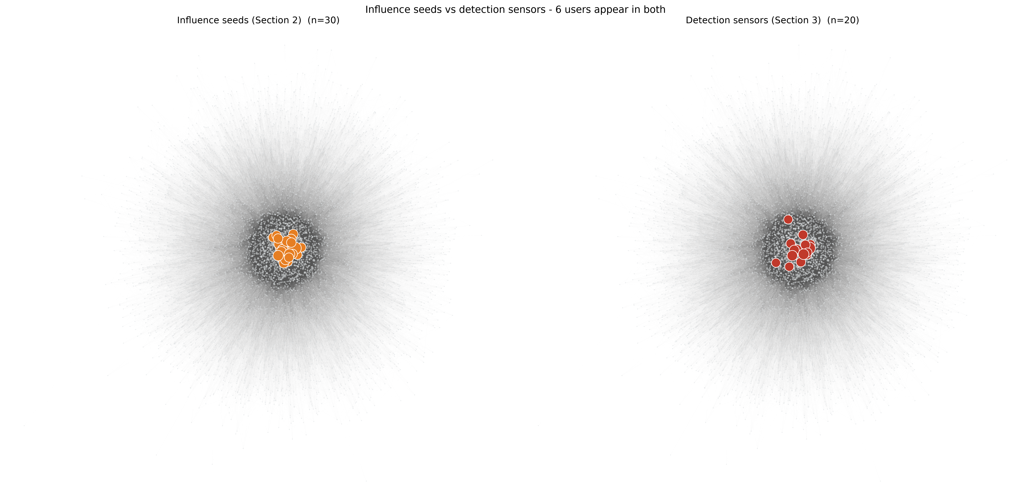
Influence seeds and detection sensors differ
The objective changes which users the optimizer selects
30 influence seeds
20 detection sensors
14
Notes:
Source: figures/fig_network_seeds_vs_sensors.png. Historical saved seed and sensor sets: 30 influence seeds, 20 detection sensors, six shared users. Budgets differ, so this is an illustrative membership comparison, not a controlled overlap test. The network layout does not prove that a particular location causes successful detection.

Slide 15
Validation across time
The historical detection advantage did not persist in the later test period
20 sensors
988 test outbreaks
Selection uses training
data only. The later
period tests generalization.
The four headline findings describe the original retrospective experiment.
15
Notes:
Source: completion_outputs/test_detection_results.csv and chronological_splits.csv. CELF detects 265/988=26.8219%, Top-reach 451/988=45.6478%. Training contains 1,382 outbreaks, validation 847, test 988. Purge 258 discussions crossing temporal boundaries. Corrected horizon derived from training: 36.18 hours. Original historical selection and scoring share the same data. The continuation also changes the clipped objective and eligible population, so do not interpret the raw 52.1 to 26.8 change as a pure causal estimate of leakage. Results do not establish future superiority.

Slide 16
What this case study demonstrates
Four measured findings, with a clear boundary on generalization
52.1%
coverage from 20 monitored users
+196
discussions over the activity baseline
3.95×
fewer evaluations for the same greedy seeds
0.53% / 13.1%
different gains across influence and detection
Historical results motivate the application. Temporal validation defines its limits.
16
Notes:
Closing explanation: We model early discussion detection as a set-selection problem. CELF efficiently chooses users who add new early coverage. Its retrospective benefit depends on the task and period. The project contributes a case study and evaluation, not a new CELF algorithm or proof of its theorem. Primary methodological references: Kempe, Kleinberg and Tardos (2003), https://www.cs.cornell.edu/home/kleinber/kdd03-inf.pdf; Leskovec et al. (2007), https://www.cs.cmu.edu/~guestrin/Publications/KDD2007/kdd2007.pdf; Borgs et al. (2014), https://www.microsoft.com/en-us/research/publication/maximizing-social-influence-nearly-optimal-time/. Ask for questions.

