Slide 1
CodeChef Annual Report “Professionals Do It with Certification”

Slide 2
Introduction
The Application is designed to help the Codechef coder community to get certified yearly.
Every year newbies join the codechef community, so they can catch up fast by starting at the same level as everybody every year.
This application will motivate the existing inactive members of the community to resume their participation and compete.
The CodeChef certifications substantiating performance will be a boost to the resume for the ones seeking jobs.
The application returns a yearly rankings of users based on Codechef monthly Long Challenge. Through this ranklist, certificates can be distributed to the participants based on their performance.

Slide 3
Instructions – Run App
Trigger the user interface – CodeChef Annual Report
There are 2 buttons and 1 dropdown.
Select a year from the drop down to view the Rankings of that year
If the list is not populated then click on “Fetch Data” button to populate the data for the selected year.[2012-present time period supported]
“Sort” button is provided to view the rankings based on both Total score and Average Score for that particular year.
Note:- As Code chef API has a Rate limit of 30 calls per 5 mins for some APIs, “Fetch data” will have to be triggered after every 5 minutes to get the updated table.

Slide 4
Function Descriptions
There are two functions or REST APIs hosted in Alibaba Cloud’s Elastic Compute Service(ECS) instance :
GET /fetchReports : Taking year as a parameter, the function fetches the records from the CodeChef API GET /rankings/{contestCode} , after which it cumulates the scores of all the participated users and stores the yearly scores in Alibaba Cloud ApsaraDb for RDS (mySQL).
GET /reports : This endpoint fetches the accumulated scores of users for a particular given year from Alibaba Cloud’s ApsaraDb for RDS instance. It returns the reports based on the sorting parameter as well(total score and average score).
The concept of yearly reports can be integrated with Codechef’s User Rating system to achieve more accurate reports. In this case only Long Challenges have been considered. LunchTime and CookOff challenges can also be considered once codechef user rating system comes into picture.

Slide 5
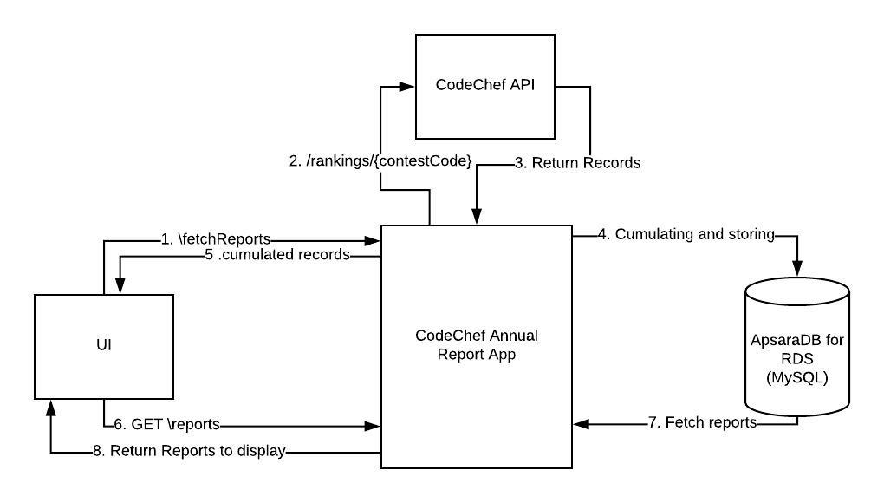
Architecture

Slide 6
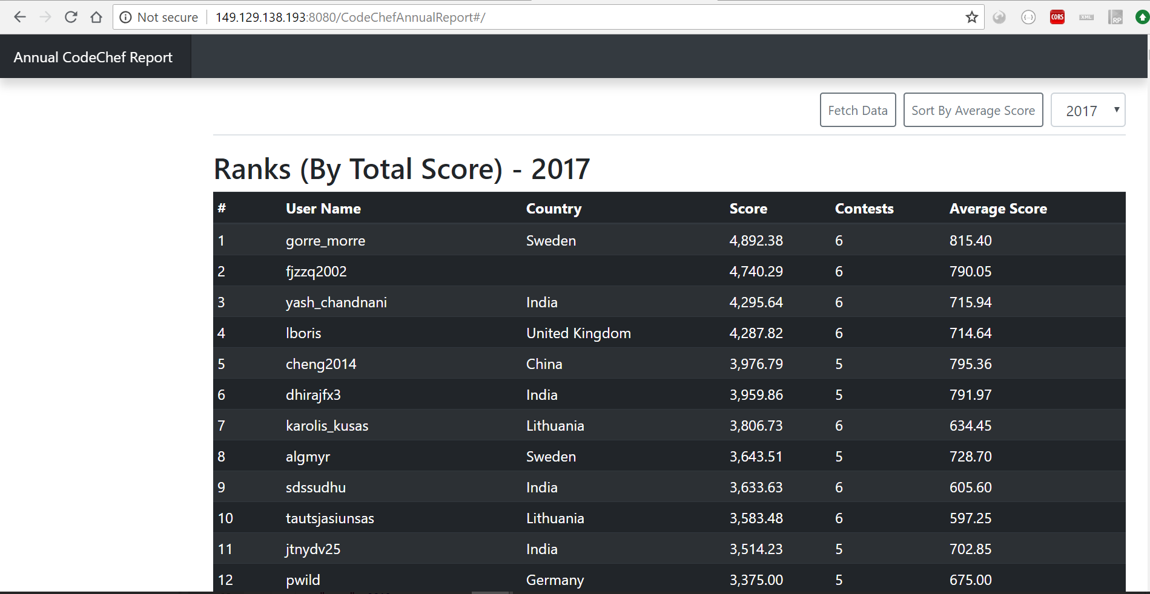
Screenshots - I

Slide 7
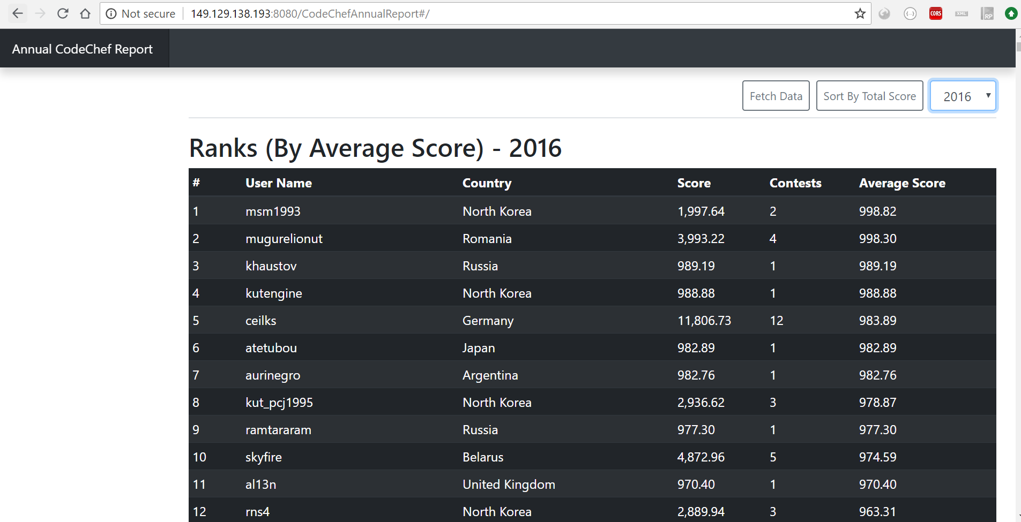
Screenshots - II

Slide 8
What Alibaba Cloud services have you used to develop and host the app? What are these services used for?
Alibaba Cloud Services used:
ApsaraDb for RDS (Database Engine - MySQL 5.7) : This database instance is used to store the cumulative reports of each user on a yearly basis. This instance is then used to fetch the accumulated reports and display in UI.
Elastic Compute Service (OS Ubuntu 16.04 64-bit) : This linux instance is used to host both the RESTful Web Services(using SpringBoot) and Angular application on an installed Apache Tomcat Server.

Slide 9
What do you think was the biggest advantage of developing and hosting your app with cloud computing services?
At the time of development , we just had to connect to the ApsaraDb for RDS instance without any installation or configuration of database locally.
Hence it was easier to test locally, how the application will behave while running in cloud.
Hosting application on cloud was similar to running application locally but in that case on virtual machine through ECS instance. Hence making the URL publicly accessible.

Slide 10
Learnings
It was interesting to gain knowledge on Alibaba Cloud offerings.
Being a Windows OS user, it was a good learning on how to configure and deploy applications in Linux (Ubuntu OS).
Being a backend developer, gained some knowledge on how to develop Angular applications.
Learned how to use remote connection tool – PuTTY
CodeChef APIs offerings.

Slide 11
What difficulties did you face while making the app?
Rate limit of Codechef API calls - Each call returns max of approximate 25 records. Hence it is a bit difficult to accumulate all the data.
It is not possible to have data at one go as there is a 5 min gap between certain number of calls.

