Slide 1

MiTH
Mudit Gupta

Slide 2
Objective
Problem Statement
To predict whether water point is
Functional
Non - functional

Slide 3
Approach
Scheme_name has the most no. of missing values, remove it(if possible).
Organization_surveyed has one value in whole, drop it.
Gps_height has some negative values.
table(sign(train$Gps_height))
2.6 for test (% of -ve values for the whole data)
2.6 for train (% of -ve values for the whole data)
Should we remove or should we keep? Decision making
Keep it (refer it to this link negative altitude )

Slide 4
Approach
They are separated from both the train and test and can be analysed later.
Population column has outliers in train dataset. (can remove them)
Above 4000 have been considered as outliers
They are separated from both the train and test and can be analysed later.
Gps_height, population have lots of 0 values present in whole(distribution check).
Organization funding has 2 types of entries with lorg and Org.
Company_installed and organization_funding are to really taken care of, visualize
Values where NA’s are to be placed are na.strings = c(' ','','Unknown','NA','-','NA ',' NA’)
0’s in Gps_height and payment are to be observed carefully

Slide 5
Approach
Gps_height, water_quality and quality_group are to be observed
Gps_height, water_quality and quality_group v/s quantity_group
Quantity and quantity group are similar
Gps_height v/s source, is there any relationship
Source and source type are almost similar
Source type has modified values of Source
For ex
Machine dbh -> borehole
River -> river/lake
Find more such values and drop one column after modification
Gps_height source_type and source_class, any relation?

Slide 6
Approach
Waterpoint_type and waterpoint_type group are similar or not
Drop id column from train and test
remove observations from population_above_4000_train from train_labels as well
organization_funding and company_installed cannot have 0 values and are considered to be NA
Amount_of_water has 0’s
Amount_of_water is to be categorized on a different scale
Above 10k to be categorized as 2
Between 3k and 9k to be categorized as 1
Less than 3k to be categorized as 0 Not required

Slide 7
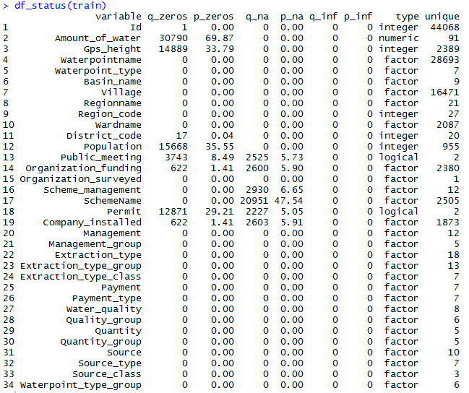
EXPLORATORY DATA ANALYSIS:
Summary data
Train

Slide 8
EXPLORATORY DATA ANALYSIS:
Summary data
Train

Slide 9
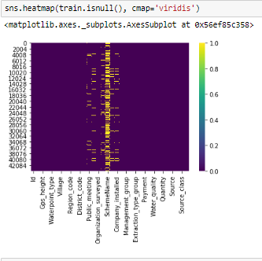
EXPLORATORY DATA ANALYSIS:
Remove features:
SchemeName

Slide 10
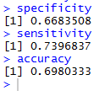
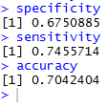
Naïve Bayes Model
Train
Validation

Slide 11
THANK YOU

