Slide 1

CARNOT RESEARCH Pvt Ltd, IIT Delhi
IILM UNIVERSITY, GN
INTERNSHIP
PRESENTATION
ON-PREMISE RAG AND AGENTIC SOLUTIONS
Presented by MUDIT AGRAWAL
B.Tech CSE(AI/ML) | 2026-27 | 4CSE1 | CS-2341718

Slide 2




INTERNSHIP AT GLANCE
ORGANISATION
ROLE
Duration
Focus
AI & ML Intern
End-to-End On-Premise RAG and Agentic AI workflows
Carnot Research Pvt Ltd - An IITD incubated startup
June 01 2026 to August 31 2026

Slide 3
ORGANISATION PROFILE
Carnot Research Pvt Ltd
Founded by IIT Delhi researchers, Carnot Research Pvt. Ltd. is a deep-tech company specializing in production-grade Generative AI, Computer Vision, and NLP. Carnot builds 100% on-premise, cloud-independent AI systems that ensure full data sovereignty for mission-critical environments. These research-driven solutions operate securely in air-gapped infrastructures without external data exposure. Serving defense, government, and critical enterprise sectors, Carnot is CMMI Level 3 and ISO 27001 certified, and trusted by the NSG, IIT Delhi, and BCG.

Slide 4
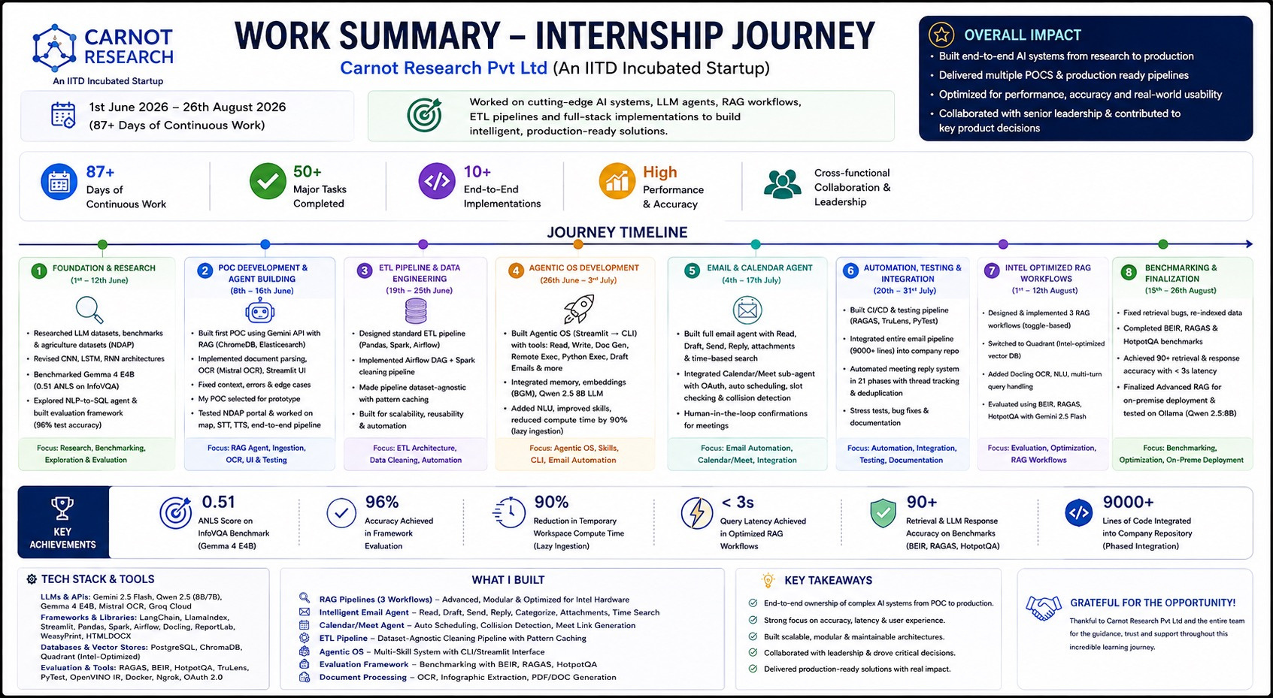
MY WORK AT CARNOT

Slide 5
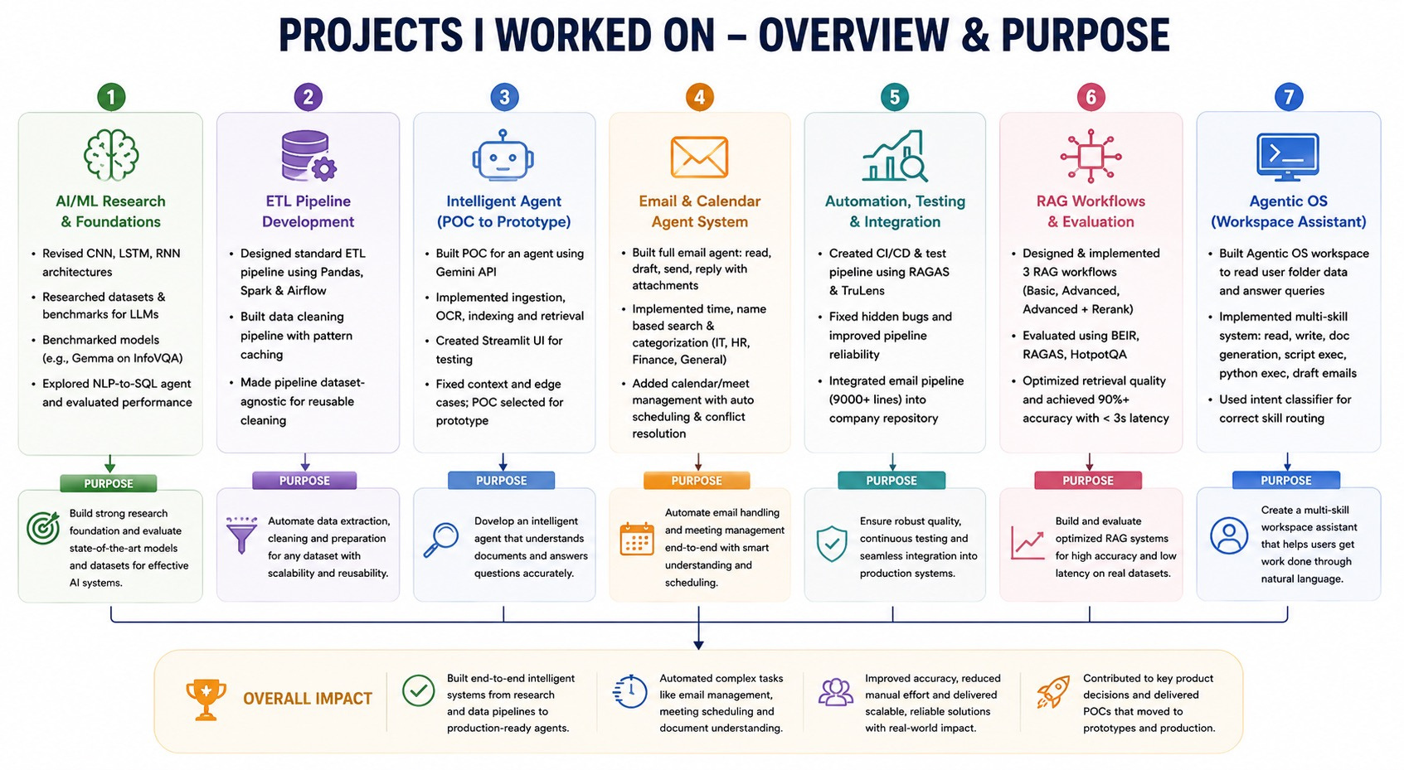

Slide 6
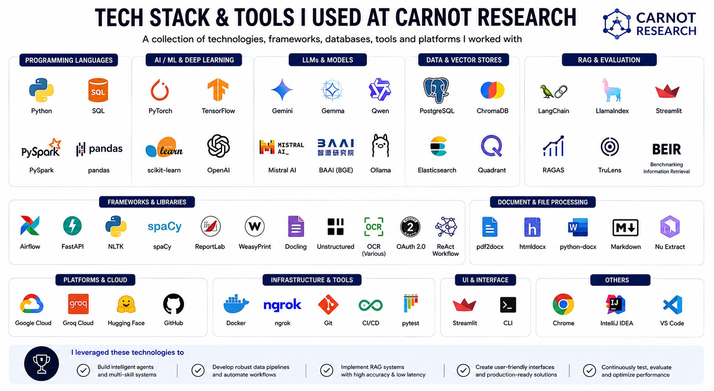
TECH STACK I USED AT CARNOT

Slide 7
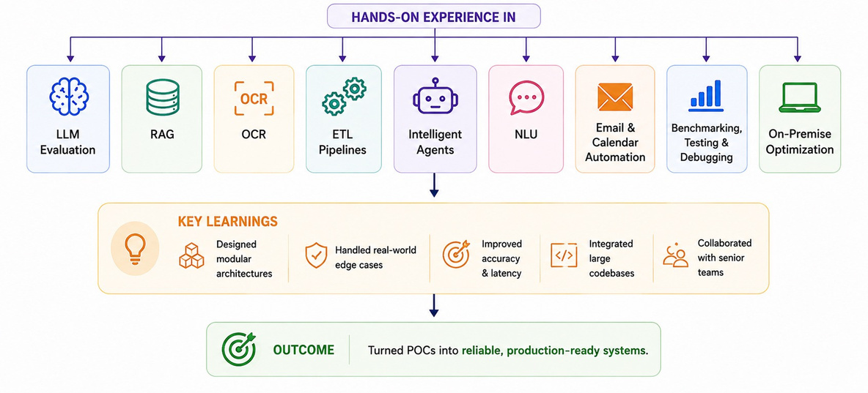
WHAT I LEARNED
During my time at Carnot Research, I learned how to take AI systems from research and experimentation to production. I gained hands-on experience in LLM evaluation, RAG, OCR, ETL pipelines, intelligent agents, NLU, email and calendar automation, benchmarking, testing, debugging, and on-premise optimization. I learned to design modular architectures, handle real-world edge cases, improve accuracy and latency, integrate large codebases, and collaborate with senior teams to turn POCs into reliable, production-ready systems.

Slide 8
THANK YOU

