Slide 1
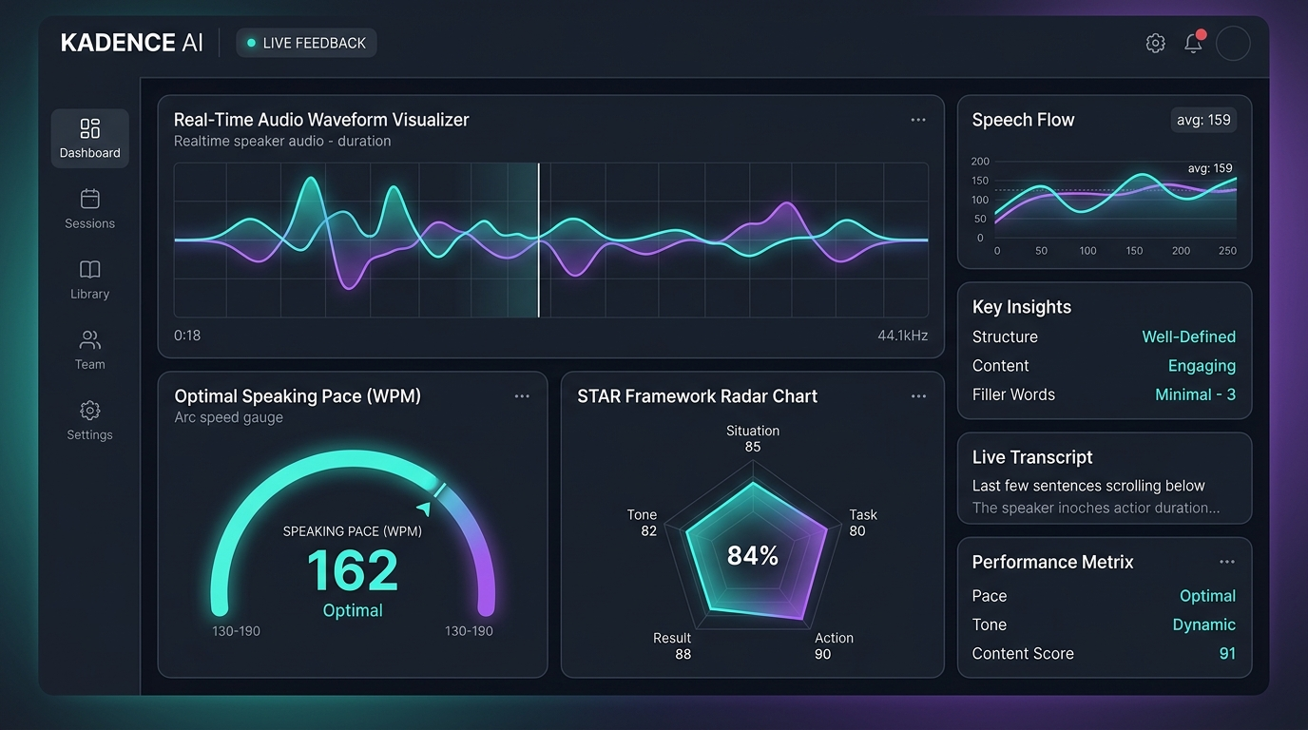
⚡ KADENCE AI
How to Stop Sounding Like a Nervous Potato in Technical Interviews 🥔✨
The Real-Time Vocal Telemetry Shield that Banishes "Um", "Like", & Panic Silences Forever.
🚨 47 Filler Words / Min
🏎️ 220 WPM Panic Speed
👻 Ghost Result Syndrome
🪄 1-Click Executive STAR
Notes:
Welcome everyone! Today we present KADENCE AI, the ultimate voice telemetry engine.

Slide 2
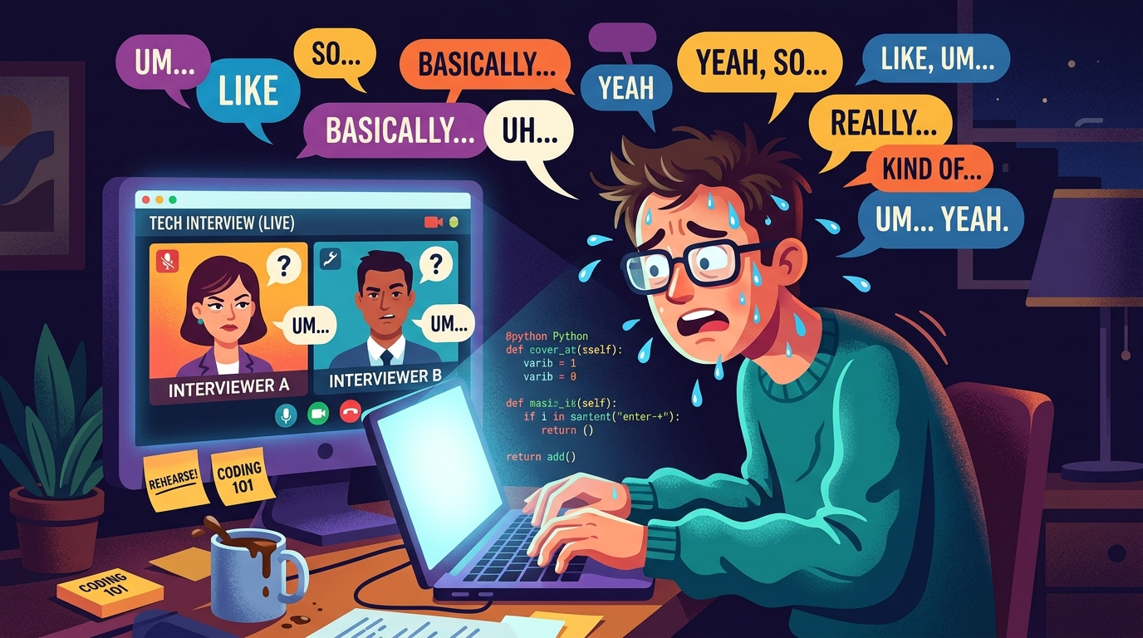
KADENCE AI | PROBLEM DIAGNOSIS
Expectation vs. Reality: The Interview Meltdown 🤡
🫠 What Happens 30 Seconds into Live Interview
• "Um, so... basically... like... you know..." 🔁
• Brain reboots like Windows 95 mid-sentence 💻
• Speaking at 210 WPM like Eminem speed-rapping 🎤
• Forgot the Result entirely & ended with "...and yeah" 💀
• Panic sweating while interviewers stare blankly 😳

Slide 3
KADENCE AI | THE HALL OF SHAME 🏆
Meet the 4 Villains Exterminated by KADENCE AI
🧟
🏎️
🦥
👻
The Filler Fiend
The Speed Demon
The Sloth Pauser
The Ghost Result
Averages 18 "um"s and 24 "like"s per minute. Dilutes authority by 90%.
Speaks at 220 WPM without breathing. Listener needs CPR.
4-second awkward silences between sentences while brain reboots.
Tells a 5-minute story... forgets to mention what actually happened.

Slide 4
KADENCE AI | CORE PLATFORM
KADENCE AI: Real-Time Vocal Telemetry & Visual Analytics
🎙️ Live Audio Waveform
Real-time Web Audio API canvas visualizer to monitor voice energy.
⚡ WPM Speed Arc Gauge
Keeps pace in optimal 120–160 WPM green zone. Red = Slow down!
🎯 Filler Word Engine
Detects "um", "like", "basically" with red transcript pill markers.
📊 STAR Radar Analysis
Evaluates Situation, Task, Action, & Result completeness live.

Slide 5
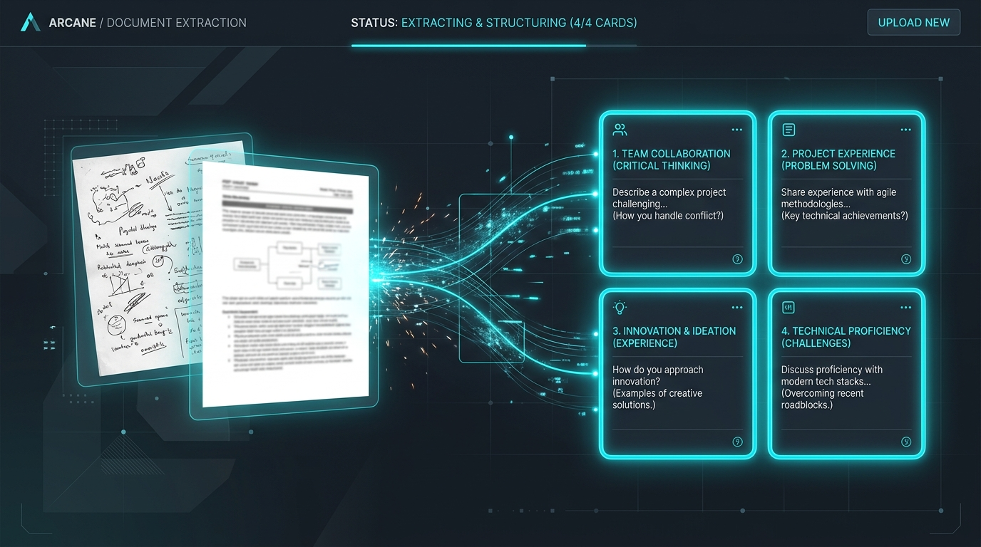
KADENCE AI | SMART QUESTION GENERATION 🧠⚡
Notes-to-Questions: Drop Messy Docs -> Get FAANG Questions
📁 Step 1: Dump Messy Notes
Drag & drop .txt, .md, or .pdf project notes.
🤖 Step 2: Concept Sniffer
Extracts technical buzzwords, terms, & milestones.
🔥 Step 3: Grill Generator
Spits out 5-8 hyper-specific STAR questions.
🚀 Step 4: 1-Click Practice
Click any card & start live vocal practice.

Slide 6
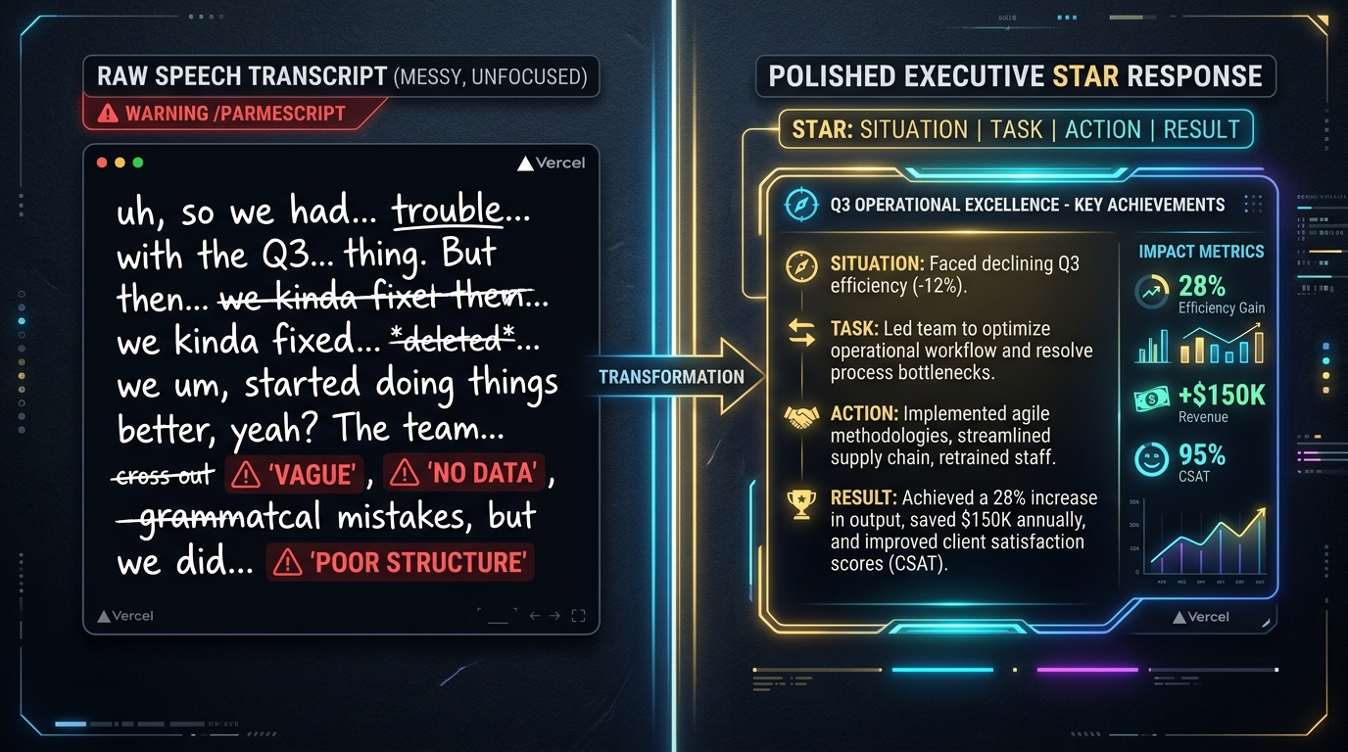
KADENCE AI | AI REWRITE ENGINE 🪄✨
The "How to Say It Better" Executive STAR Transformer

Slide 7
KADENCE AI | MEASURABLE IMPACT 📈
Why KADENCE AI Will Make You Unstoppable
0%
-85%
100%
10x
Awkward Silence
Filler Word Count
Quantified Impact
Offer Rate Boost
No more blanking mid-interview
Say goodbye to "um" and "like"
Every story has a real Result
Confidence is 90% of the battle

Slide 8
🎉 GO FORTH & GET HIRED!
KADENCE AI is ready to supercharge your vocal confidence.
Any Questions? (Or are you too busy counting your "ums" right now? 😉)
🚀 Try KADENCE AI Now

