Slide 1
EEOB 563 Final Project
Investigation of the Evolution of MutS Protein Family in Animals
Mudith Ekanayake
04/29/2021

Slide 2
DNA Repair Pathways and MMR
There are 5 major DNA repair pathways.
mismatch repair (MMR)
base excision repair (BER)
nucleotide excision repair (NER)
homologous recombination (HR)
non-homologous end joining (NHEJ)
Mismatch repair (MMR) is critical for maintaining genome stability.

Slide 3
Importance of MutS
MutS is incorporated in detecting mismatches in the sequences.
There are many homologs of MutS including MutS1, MutS2 in bacteria and MSH 1 to 6 in eukaryotes.
MSH 2-6 will be selected for the analysis along with few reference sequences including mitochondrial MutS (mtMutS) from Octocorals (Dendronephthya gigantea).

Slide 4
Many theories about the evolution of MutS protein
Octocoral mitochondrial MutS does not have a eukaryotic origin.
Eukaryotic MSH proteins have originated from a HGT event between bacteria and eukaryotes.

Slide 5
Methods
Retrieving Data
Public Databases/NCBI
Aligning the Sequences
MAFFT
Curating/Cleaning the Alignments
TrimAl
Model Selection
SMS
Phylogenetic Reconstruction
RAxML-NG
Visualization
FigTree/itol

Slide 6
Results
LG+G+I+F was the best model for all the 5 MSH datasets.
RAxML-NG estimated maximum likelihood values and tree topologies for the best tree found.
All the viral sequences were clustered in one single clade including Dendronephthya gigantea mtMutS.
All the eukaryotic MSH2 proteins were incorporated in a clade with metagenome samples as well as bacteria.
MutS homolog reference sequences from Saccharomyces cerevisiae, Nematostella, and human were clustered together as expected.

Slide 7
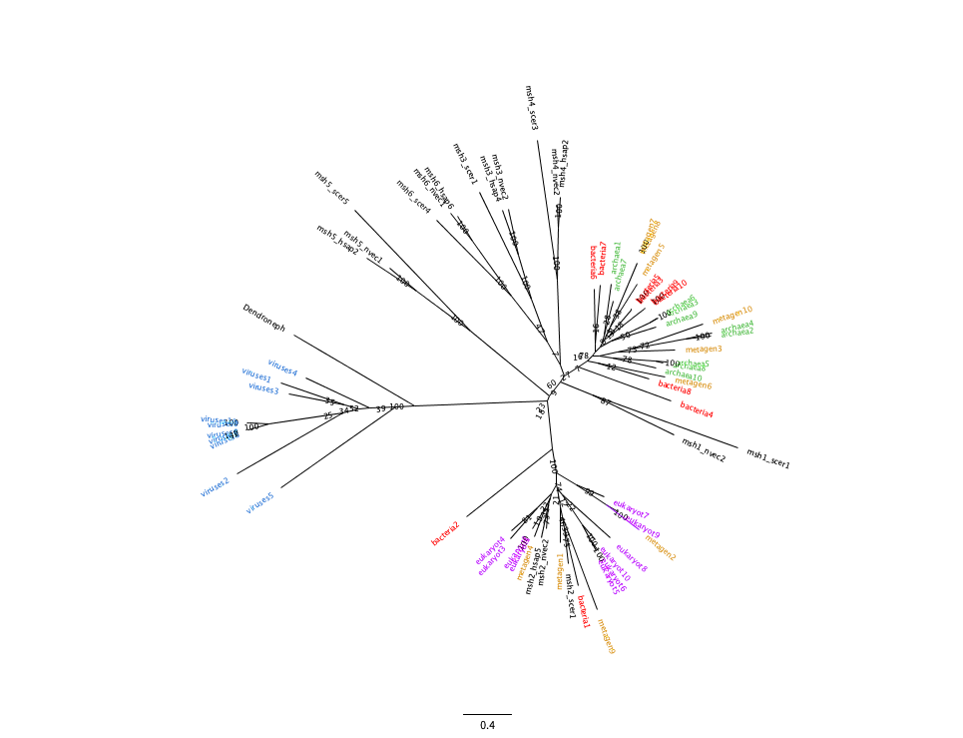
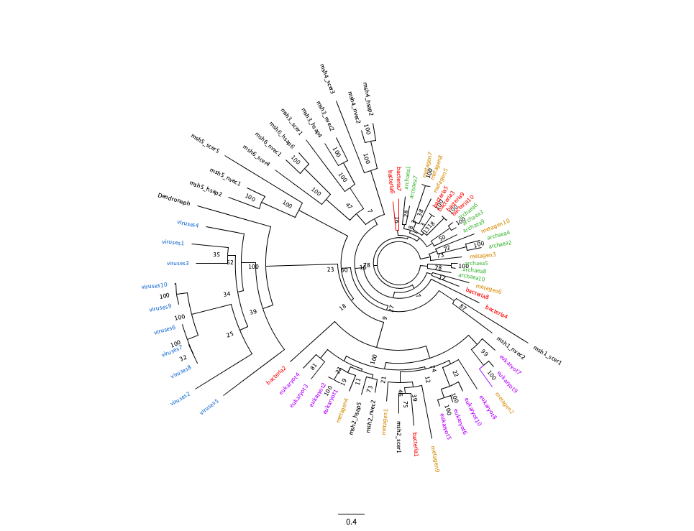
MSH2

Slide 8
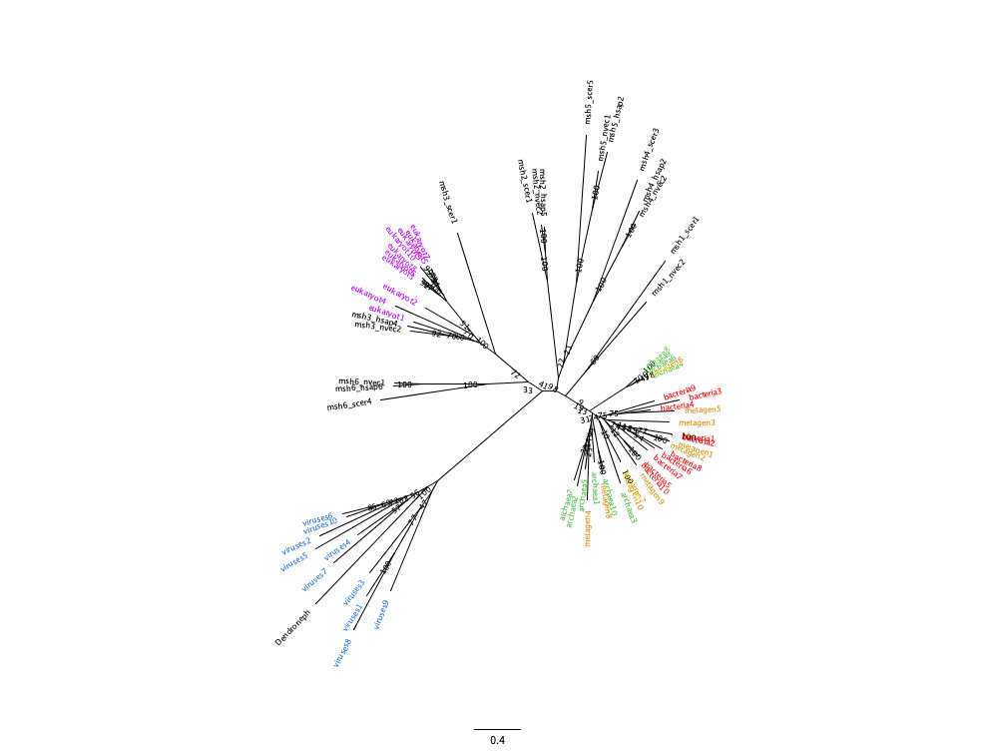
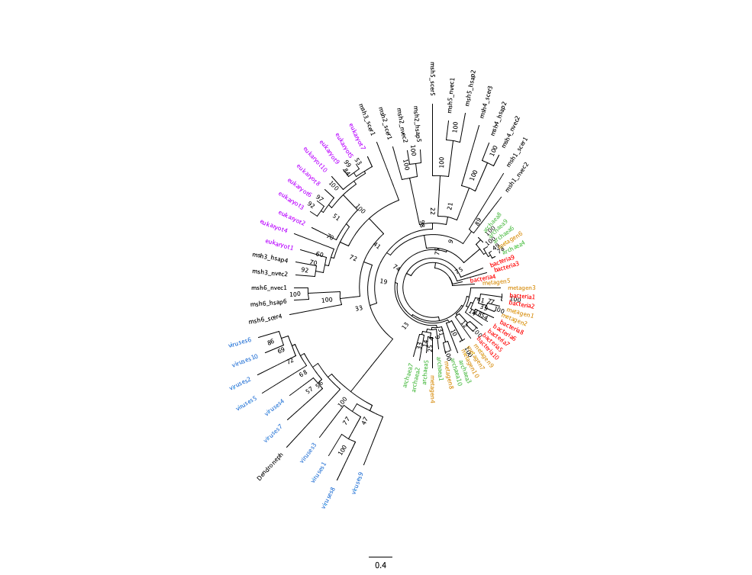
MSH3

Slide 9
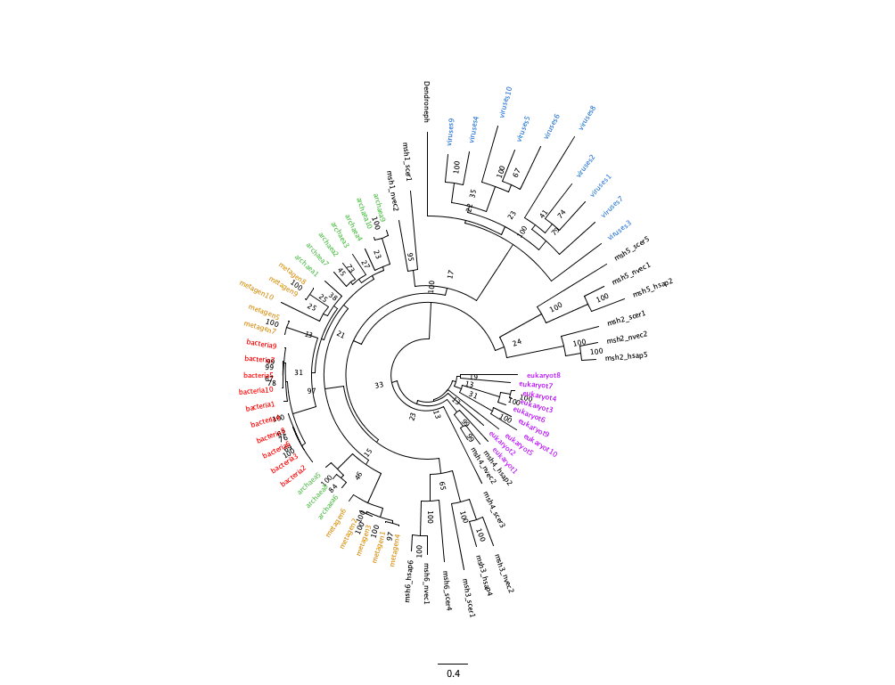
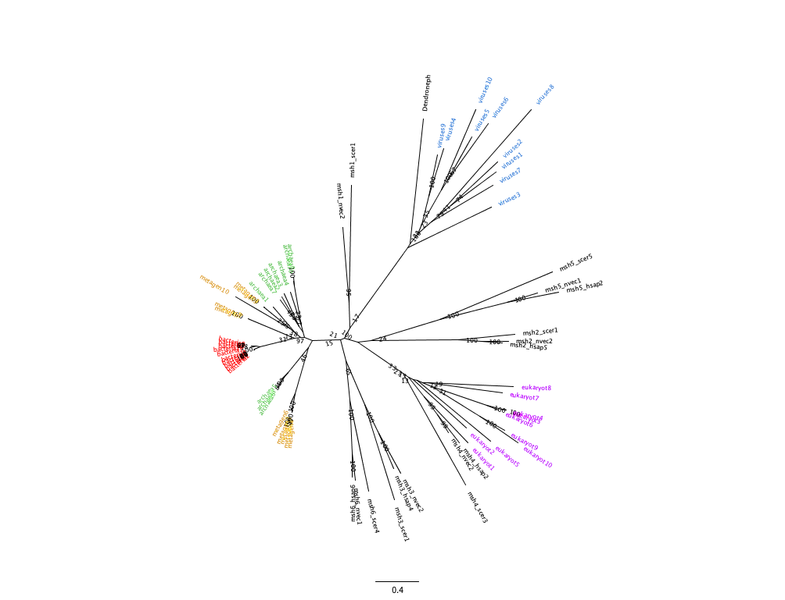
MSH4

Slide 10
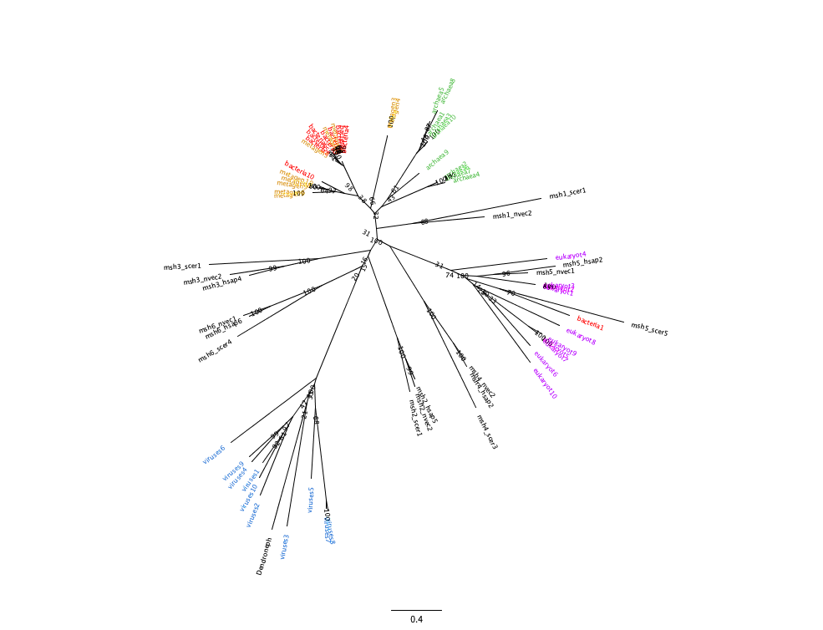
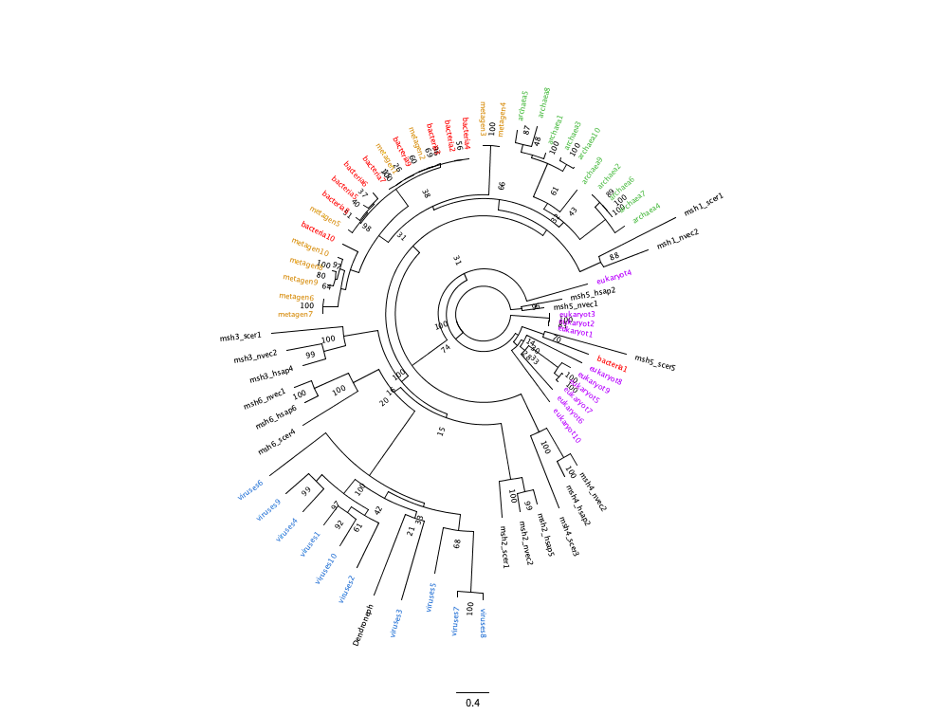
MSH5

Slide 11
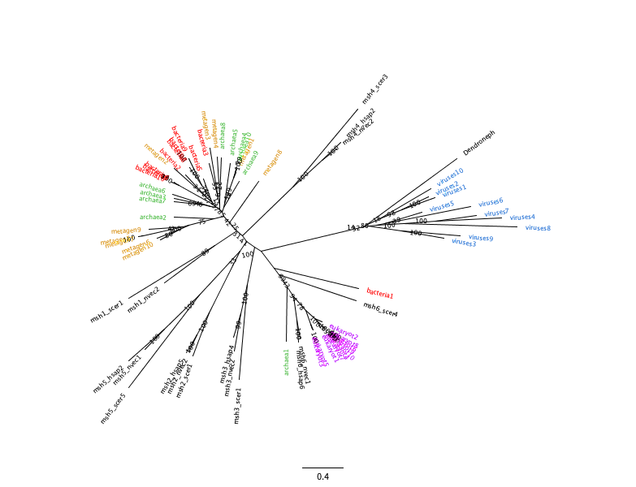
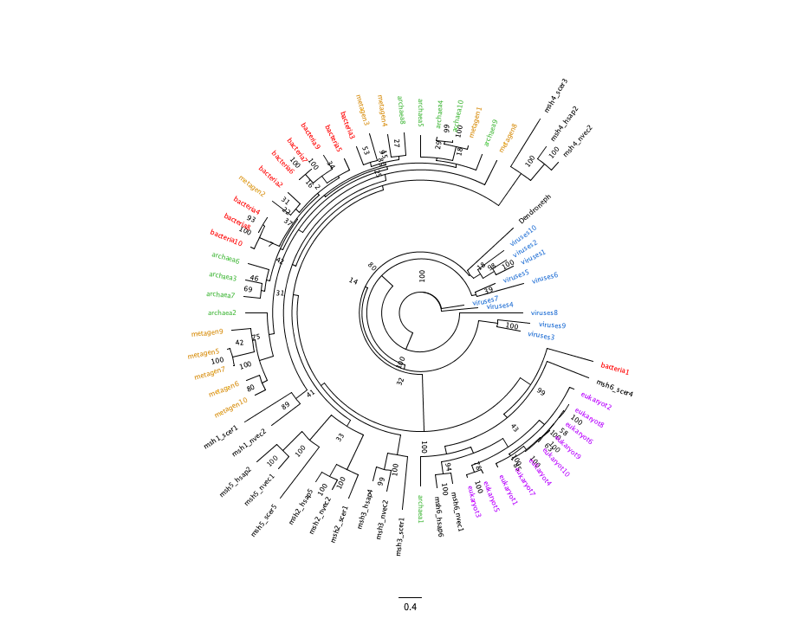
MSH6

Slide 12
Discussion
All the constructed phylogenies cluster viral sequences and mtMutS of Dendronephthya gigantea together indicating that mtMutS does not belong to the MSH family and also it does not have a eukaryotic origin.
Some evidence for the hypothesis that octocoral mtMutS has originated due to a horizontal gene transfer (HGT) event from a large DNA virus.
There are prokaryotic MutS sequences which are more closely related to eukaryotic MSH2 than eukaryotic MSH2 related to other species.
It Can be an evidence for horizontal gene transfer event between bacteria and eukaryotic genomes.
Further studies are required to confirm these theories.

Slide 13
THANK YOU!

