Slide 1
Battle of Neighborhood's
Discovering INDIA’s Best City

Slide 2
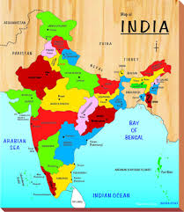
Introduction
Indian cuisine consists of a wide variety of regional and traditional cuisines native to the Indian subcontinent. Given the range of diversity in soil type, climate, culture, ethnic groups, and occupations, these cuisines vary substantially from each other and use locally available spices, herbs, vegetables, and fruits. Indian food is also heavily influenced by religion, in particular Hindu, cultural choices and traditions. The cuisine is also influenced by centuries of Islamic rule, particularly the Mughal rule. Samosas and pilafs can be regarded as examples.

Slide 3
Business Understanding
Restaurants
”A restaurant or an eatery, is a business which prepares and
serves food and drinks to customers in exchange for money. Meals are generally served
and eaten on the premises, but many restaurants also offer take-out and food delivery
services. Restaurants vary greatly in appearance and offerings, including a wide variety
of cuisines and service models ranging from inexpensive fast food
restaurants and cafeterias, to mid-priced family restaurants, to high-priced luxury
If a business like a restaurant offers such variety of alternatives, is highly recommended a
thorough study before any investment is made. It’s important to understand the
population characteristics of the target city, as well as their preferences

Slide 4
India population and cities
India is the second most populated country in the world with nearly a fifth of the world's population. According to the 2017 revision of the World Population Prospects, the population stood at 1,324,171,354.
During 1975–2010 the population doubled to 1.2 billion. The Indian population reached the billion mark in 1998. India is projected to be the world's most populous country by 2024, surpassing the population of China. It is expected to become the first political entity in history to be home to more than 1.5 billion people by 2030, and its population is set to reach 1.7 billion by 2050. Its population growth rate is 1.13%, ranking 112th in the world in 2017.

Slide 5
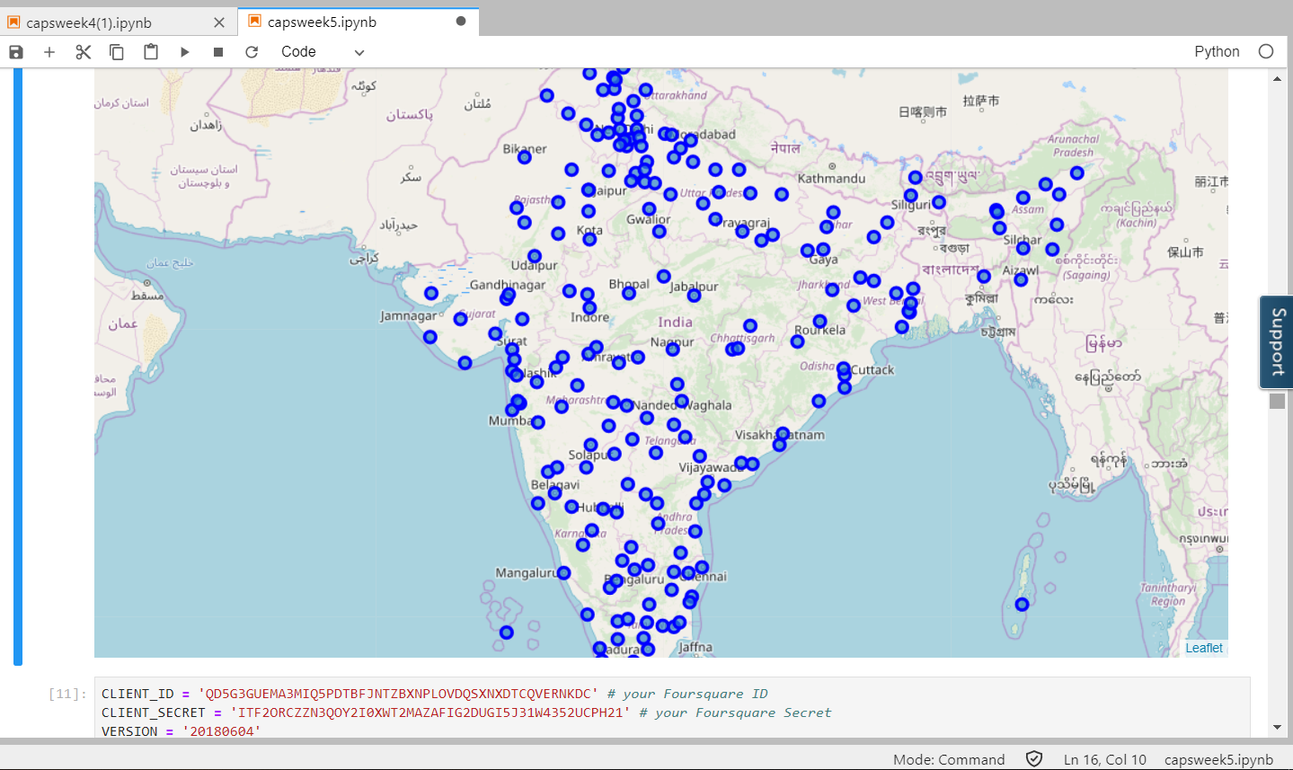
Map of major cities used in project

Slide 6
Analytic Approach
To solve this problem first we need to setup some benchmarks for the City to be eligible for Business. After getting the desired results of the City, we need to find the Locality in that City.
For discovering the City following benchmarks must meet
Nightlife
Services
Transport
Residence
Universities
Food
Entertainment
Travel

Slide 7
Methodology
Using numpy and panda Library and csv file containing information about Cities of INDIA by Population and are scraped into Pandas Dataframe.
Dataframe contained data about Cities, Coordinates, Area and Population Density. Than Dataframe was Cleaned and Processed according to requirement of the problem to be solved. Proper benchmarks were set to obtain the best results.
The List of Venues in a City were obtained using Foursquare API and the city with maximum weight according to the Model is selected.

Slide 8
Results
Based on analysis we have done the results we obtain are – The plot shows the final location predicted by the Machine Learning Model –
For opening the Shopping mall/hotel
The Best city in India – Pune
The best locality in Pune– Deccan gymkhana

Slide 9
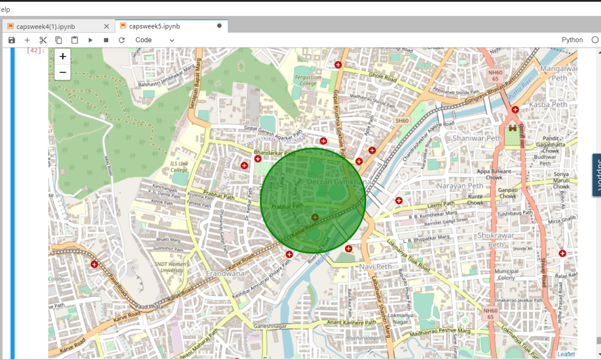
RESULT

