Slide 1
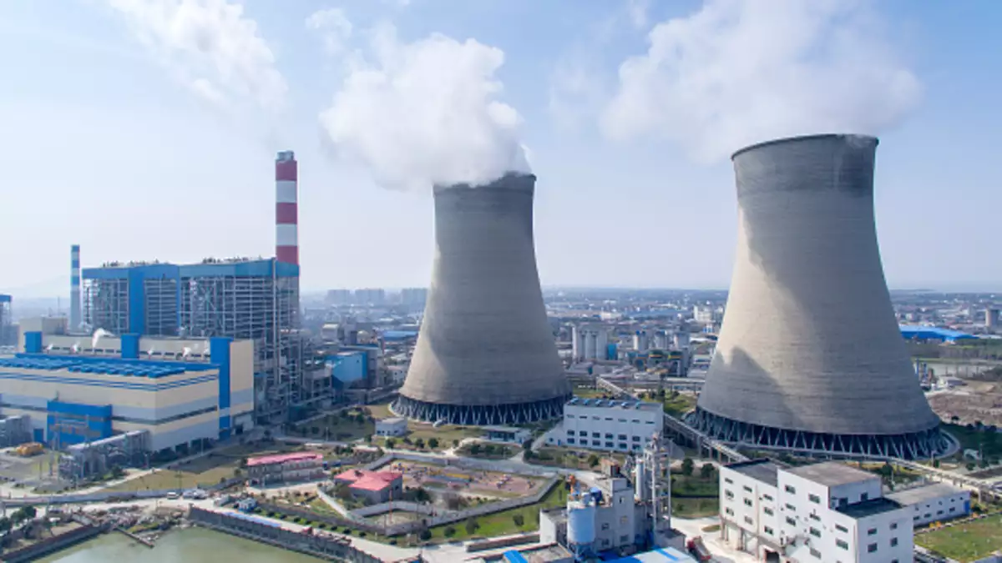
Power Plant Thermal Efficiency Improvement

Slide 2



In the mentorship of: Ankur Bhattacharjee , Praveen Vijayvargiya
Presented By:
MUDIT SRIVASTAVA
SIDDHARTHA JEJURKAR
2018A3PS0430G
2018A3PS0617G

Slide 3

CONTENTS
Introduction
Schematic Diagram
Power Plant Cycles
Rankine Cycle
Efficiency
Project Overview
References

Slide 4
Introduction
In Thermal power plants, the heat energy obtained from combustion of solid fuel (mostly coal) is used to convert water into steam, this steam is at high pressure and temperature.
This steam is used to rotate the turbine blade while turbine shaft is connected to the generator. The generator converts the kinetic energy into electrical energy.
As a matter of fact,
Thermal Power Plants constitute 75.43% of the total installed captive and non-captive power generation in India.

Slide 5
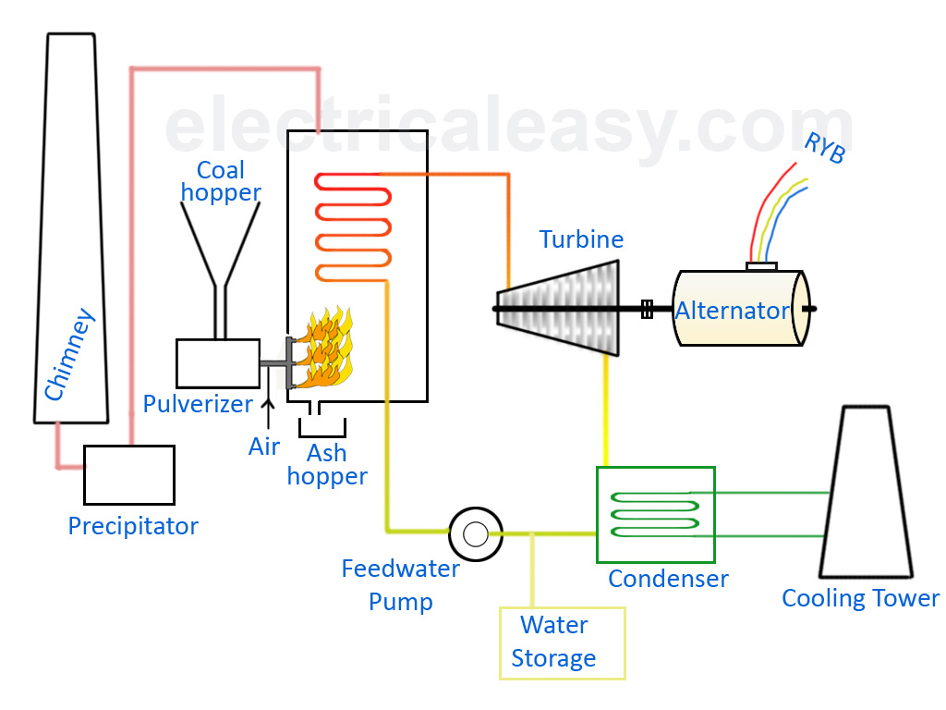
Schematic diagram of a Thermal Power Plant

Slide 6
Power Plant Cycles
A thermodynamic cycle is a series of operations, involving a heat source, a heat receiver, a machine and working substance.
Types of Power Plant Cycles:
Vapour Power Cycles
Rankine Cycle
Reheat Cycle
Regenerative cycle
Binary Vapour Cycle
Gas Power Cycles
Otto Cycle
Diesel Cycle
Dual Combustion Cycle
Gas Turbine Cycle

Slide 7
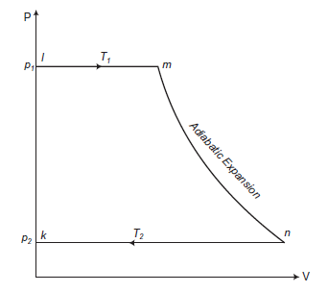
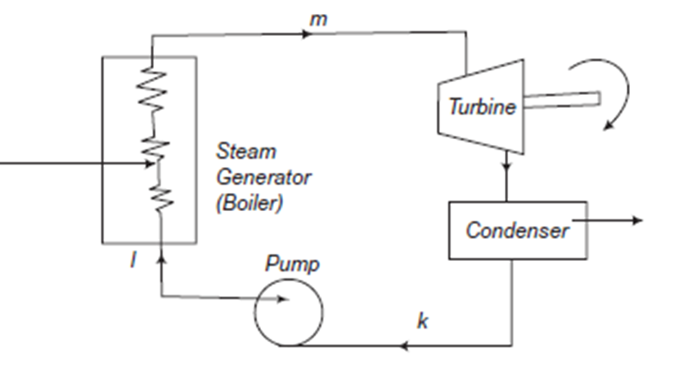
Rankine Cycle
Rankine cycle is the theoretical vapor-liquid cycle on which steam power plant works. In a vapor cycle if the working fluid in a vapor cycle passes through various components of the power plant without irreversibility and frictional pressure drop, then the cycle is called as Ideal Rankine Cycle.

Slide 8
The Efficiency of Rankine Cycle can be increased by the following methods:
Lowering the condenser Pressure
Superheating the steam to high temperatures
Increasing the Boiler Pressure
Rankine Cycle is modified into two types of cycles:
Reheat Cycle
The purpose of a reheating cycle is to remove the moisture carried by the steam at the final stages of the expansion process.
Regenerative Cycle
After emerging from the condenser (possibly as a subcooled liquid) the working fluid is heated by steam tapped from the hot portion of the cycle.

Slide 9
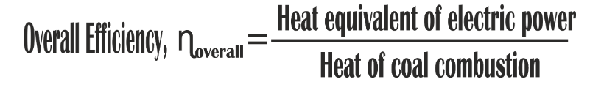
Efficiency of thermal power plants
Major factors affecting overall efficiency of power plants :
Boiler efficiency
Cycle efficiency
Turbine efficiency
Generator efficiency

Slide 10
The overall efficiency of thermal power plants is quite low, generally about 40%. A few steps to increase efficiency are:
Steam from boiler is further heated to produce dry superheated steam since energy output is directly related to the pressure and temperature of steam entering the turbine.
Pressurizing and heating low pressure steam is quite difficult and negatively affects efficiency. Instead low pressure steam is cooled down to liquid form in the condenser which is much easier to pressurize.

Slide 11
Project overview
Our project is targeted towards the performance improvement of Vikram Cement Works Power plant. Two major goals of this project are :
Improving thermal efficiency
Reducing auxiliary consumption
Based on provided workplan, first week covered the basics and operation of thermal power plants. We learned about the entire process of power generation and what factors affected the overall efficiency of power plants.
Following this the industry mentor provided us with a performance improvement report which identified various opportunities for improving performance and efficiency of the UTCL Vikram Cement Works Power plant.

Slide 12
Current week’s assignment includes studying about Automatic Process Controllers(APC) and analyzing the performance report.
We are required to submit a study report by the end of this week that compiles all important topics we have covered so far
Fundamentals of Thermal power plant
Power generation technology
Analysis of performance improvement opportunities for Vikram Cement works Power plant
Basics of an Automatic Process Controller(APC)

Slide 13
References
https://www.electrical4u.com/thermal-power-generation-plant-or-thermal-power-station/
http://www.thermodyneboilers.com/components-working-thermal-power-plant/#:~:text=How%20does%20Thermal%20Power%20Plant%20work%3F,is%20connected%20to%20the%20generator
https://www.electrical4u.com/rankine-cycle/
https://www.youtube.com/watch?v=IdPTuwKEfmA&t=208s

Slide 14
Thank you

