Slide 1
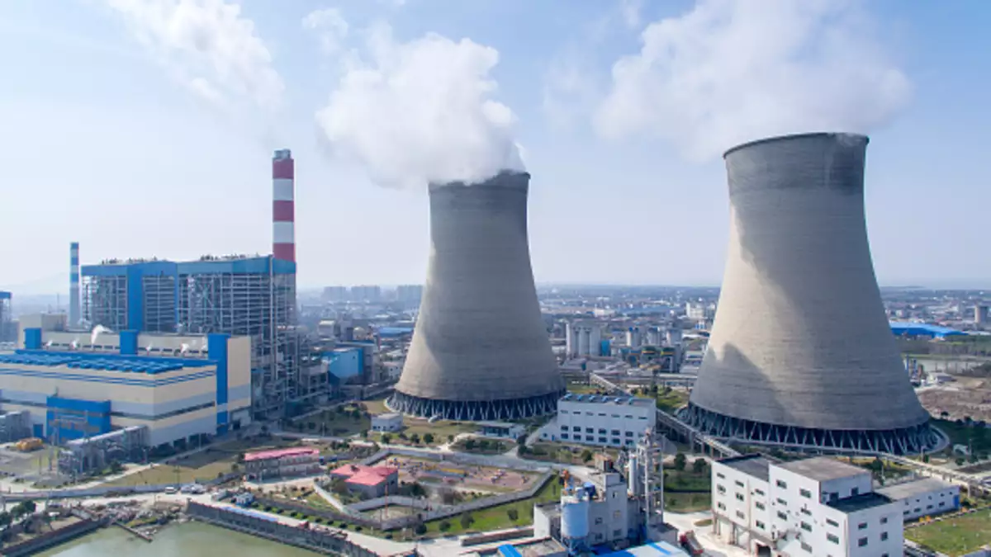
Power Plant Thermal Efficiency Improvement

Slide 2



In the mentorship of: Ankur Bhattacharjee , Praveen Vijayvargiya
Presented By:
MUDIT SRIVASTAVA
SIDDHARTHA JEJURKAR
2018A3PS0430G
2018A3PS0617G

Slide 3

CONTENTS
Introduction
MidSem Overview
Latest technologies in TPP
Automatic Process Control(APC)
Auxillary reduction of Power Consumption
Project Overview
References

Slide 4
MidSem Overview
In Thermal power plants, the heat energy obtained from combustion of solid fuel (mostly coal) is used to convert water into steam, this steam is at high pressure and temperature.
This steam is used to rotate the turbine blade while turbine shaft is connected to the generator. The generator converts the kinetic energy into electrical energy
A thermodynamic cycle is a series of operations, involving a heat source, a heat receiver, a machine and working substance.
Rankine cycle is the theoretical vapor-liquid cycle on which steam power plant works

Slide 5
Rankine Cycle is modified into two types of cycles:
Reheat Cycle
Regenerative Cycle
Major factors affecting overall efficiency of power plants :
Boiler efficiency
Cycle efficiency
Turbine efficiency
Generator efficiency
The overall efficiency of thermal power plants is quite low, generally about 40%.

Slide 6
Latest Tech in TPP
Thermal power plants contribute the highest level of emissions among the power generation sources, causing air quality and other environmental concerns.
Thermal Power is the main source of electricity generation in India. It stands at 230.6 GW out of which 198.5 is from coal alone
New standards in TPP
Overcome these issues

Slide 7
Some of the latest technologies around the world that are being implemented are:
AdvX™ Heat Recovery Technology
recover and utilize additional heat from flue gas
AdvX™ Stack Gas Reheat
AdvX™ Upgrade solutions
Ultra super critical (USC) conditioning
conventional thermal power plants
Hirono No. 5 Thermal Power Station of Tokyo Electric Power Company
Most sophisticated coal-fired TPP

Slide 8
Digitalization Technology
Continuous combustion tuning with artificial intelligence
Turbine operational optimization in real time using a combination of first principle analytics and machine learning
Predictive maintenance to avoid unplanned downtime using machine learning
Reducing stresses during variation on load to avoid failures and reduce maintenance needs
Remote monitoring for visibility and analysis
Oxyfuels

Slide 9
Thank you

