Slide 1
Power Plant Cycles
A thermodynamic cycle is a series of operations, involving a heat source, a heat receiver, a machine and working substance.
Types of Power Plant Cycles:
Vapour Power Cycles
Rankine Cycle
Reheat Cycle
Regenerative cycle
Binary Vapour Cycle
Gas Power Cycles
Otto Cycle
Diesel Cycle
Dual Combustion Cycle
Gas Turbine Cycle

Slide 2
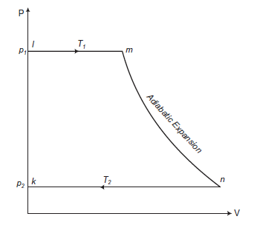
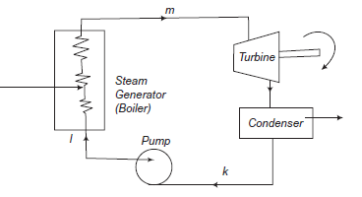
Rankine Cycle
Rankine cycle is the theoretical vapor-liquid cycle on which steam power plant works. In a vapor cycle if the working fluid in a vapor cycle passes through various components of the power plant without irreversibility and frictional pressure drop, then the cycle is called as Ideal Rankine Cycle.

Slide 3
The Efficiency of Rankine Cycle can be increased by the following methods:
Lowering the condenser Pressure
Superheating the steam to high temperatures
Increasing the Boiler Pressure
Rankine Cycle is modified into two types of cycles:
Reheat Cycle
The purpose of a reheating cycle is to remove the moisture carried by the steam at the final stages of the expansion process.
Regenerative Cycle
After emerging from the condenser (possibly as a subcooled liquid) the working fluid is heated by steam tapped from the hot portion of the cycle.

