Slide 1

Driver Pass System Presentation
By: Austin Niwa
Notes:
This is my presentation for the systems of the driver pass app. The app was made to help students practice for their drivers tests, schedule and take tests with instructors to help aid in passing the real driving test, and keep up to date with dmv regulations in each state.

Slide 2

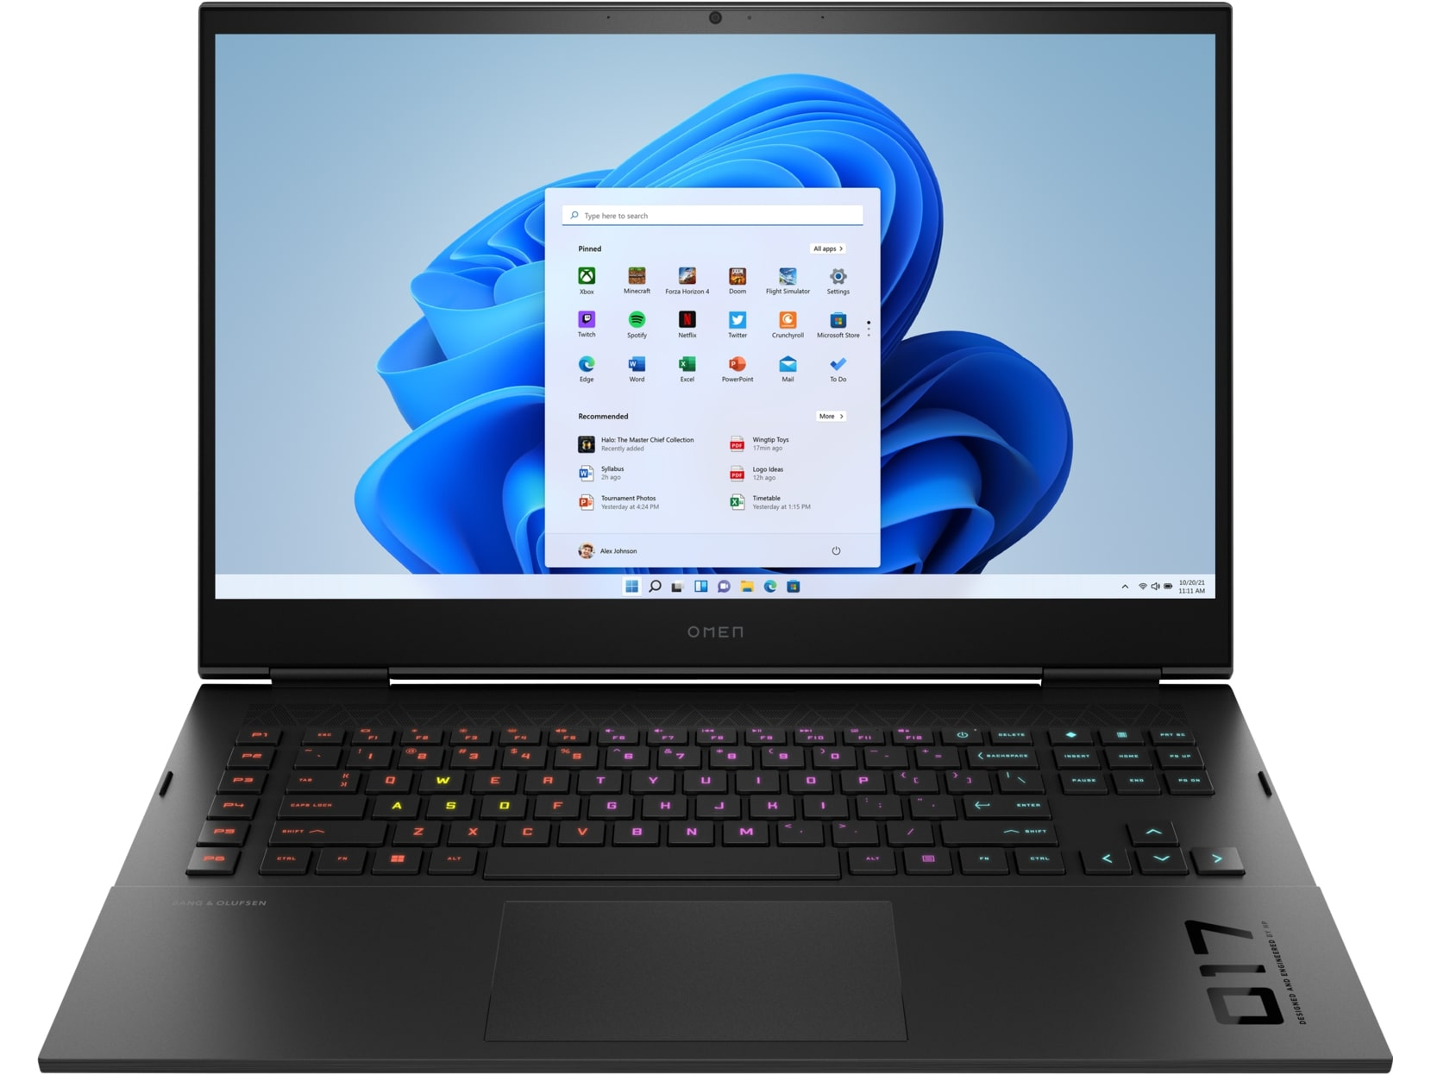
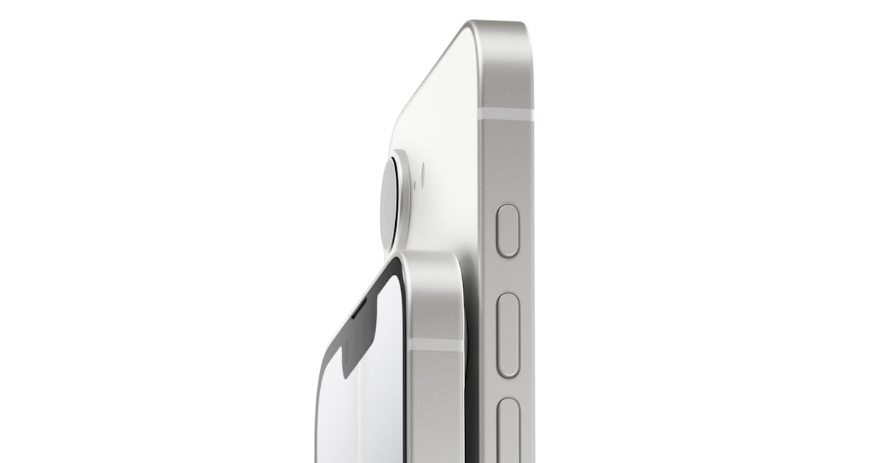
System Requirements
Cloud Based Systems such as AWS
Backed up to cloud
Usable online and offline
On the Windows, macOS, Android, and iOS operating systems
Notes:
DriverPass is a small company that likely would not be able to afford it's own servers nor expand them as necessary so using a cloud based system such as AWS or amazon web services would be the best option. This also allows them to back up their data to the cloud and have amazon manage their security as far as the servers go which will take much of the problems off of their shoulders. The app also needs to be able to be used offline as well as online so that students can study in places where there is not good internet but still want to use their phones to do so. The app also must be able to be used on the Windows, macOS, Android and iOS systems since those operating systems will cover most people that would use the app.

Slide 3
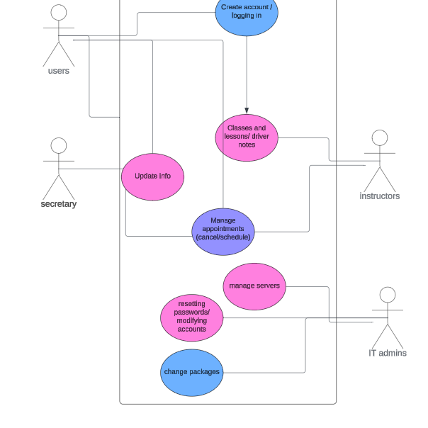
Use Case Diagram
Users and instructors need to be able to make accounts and manage appointments to make changes.
IT admins should be able to reset passwords in case theyre forgotten
Secretary, instructors, and users should be able to update info in case they move or need to change their payment information.
Notes:
This shows the general permissions for the DriverPass site based on what the Users,Secretary ,Instructors, and IT admins need perms to do. Users and instructors should be able to create accounts and log in so they can access classes, lessons and, drivers notes. They should also be able to manage appointments through scheduling and cancelling. The IT admins need to be able to manage the servers, reset passwords and change accounts in case someone has forgotten their info or needs them to change it. They should also be able to modify packages to add or remove them from the app.

Slide 4
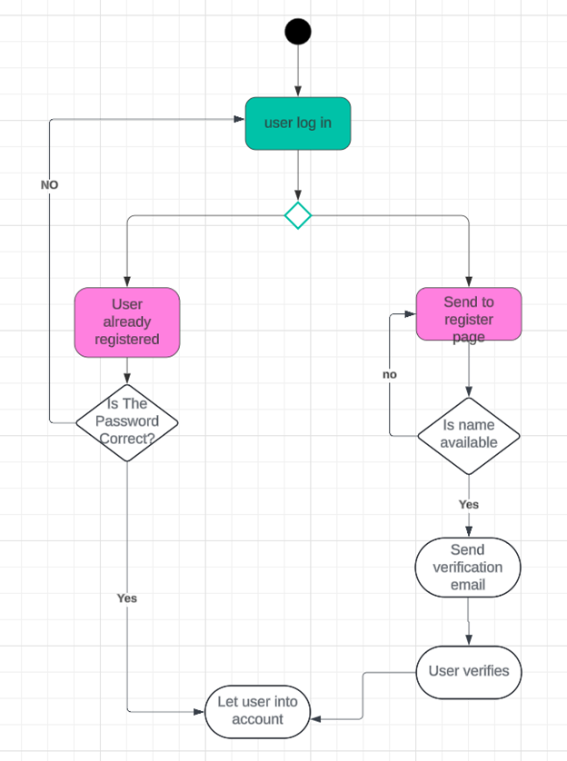
UML Activity Diagram
This is the process of a user logging into the driverpass app.
Notes:
This is the process of a user logging into the driver pass app. You can see that when they log in it checks to see if they are registered. If they are then it checks to see if the password is correct. If it is the app lets them into their account and if not then they are brought back to the log in screen. If they are not registered then it checks to see if their name is available. If it is then it says the name is taken. If it is not then it will send the user a verification email that the user then opens and goes back to the site which will let them into the app to access lessons.

Slide 5

SECURITY
Security is taken care of by Amazon Web Services
It should also be supplemented with regular meetings to discuss the latest phishing attempts and viruses so that there is less room for user error. After all the most likely cause of a hack is through user error.
Notes:
DriverPass should utilize Amazon Web Services for most of their security features as this takes a lot of the weight of having the servers be secure off their shoulders along with allowing them to expand them if they so wish. They should also supplement these with regular meeting so discuss the latest viruses and cyber attacks on companies and users along with any possible phishing attempts that might come their way. This way they can lower the chance of there being any user error since user error is the most likely cause of a cyber attack.

Slide 6
System Limitations
Has to be able to be used on MacOS, Windows, Android, and iOS devices
Need to have offline capabilities
Has to be able to be run on old phones with ineffective hardware
Needs to be updated as the DMV updates requirements
Needs to be done by May 10th
The budget our client can afford
Notes:
The system limitations for an app such as this would be that it neds to be run on all devices a user would typically use such as MacOS, Windows, Android, and iOS devices and it needs to be able to be used offline as well as offline according to the client. Since it needs to be run on android and iOS it needs to be able to be run on older phones as well so it has to be somewhat optimized for that as users may not have access to newer phones that can run apps well. The app needs to be updated when the DMV updates their requirements for tests so clients know what to expect when they go to take the test for real. We also only have about 5 months to make the app as we have from jan 11th to may 10th which is a heavy deadline to work on an app for and get features out that are required to have in. We also need to be able to restrain ourselves to our clients budget as going over could result in adverse effects like the client going bankrupt or worse.

