Slide 1
Diagramme Masterthesis

Slide 2
Experiment Protocol
Data privacy statement
KSS
Every 10 Minutes
Auditory Oddball Paradigm
Drive
General Questionaire
After 40 Minutes
Setup Devices
KSS
Reaction Game
Test Drive
Auditory Oddball Paradigm
Phase 1
Phase 2
Phase 3

Slide 3




Fatigue Detection system complete setup
Driver Cabin
Computer
Camera
Validation
EEG
Video
DS
DS Data
ECG
Signal Processing
Machine Learning
Result
KSS
Ground Truth
Auditory Oddball task
Reaction Game

Slide 4
Setup- Experiment – Schematic
Driver Cabin
Computer
Subject
Driving Simulator (DS)
Video
DS Data
ECG
EEG

Slide 5
Experiment Data Results Overview
Subject | Pre-P300 | Reaction Game | Driving |  |  |  | Post-P300
Further use? | EEG Data | EEG Data | EEG Data | Video Data | DS Data | Pulse Data | EEG Data
Subject 1
Subject 2
Subject 3
Subject 4
Subject 5
Subject 6
Subject 7
Subject 8
Subject 9
Subject 10
Subject 11
Subject 12
Subject 13

Slide 6
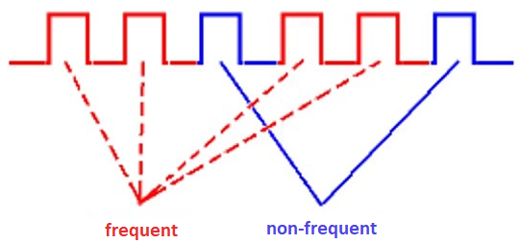

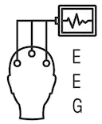
Auditory Oddball paradigm / P300 Test
Checken ob es wirklich sinn macht den Test zu machen!!
Oddball Source: https://i.ytimg.com/vi/ZJ-YB0YIdmM/maxresdefault.jpg
EEG Image: https://image.shutterstock.com/image-vector/electroencephalography-vector-line-icon-brain-260nw-1164871897.jpg
Oddball Paradigm 80% frequent Stimuli
20% non-frequent Stimuli
Eyes open
Eyes closed
30 Seconds
30 Seconds
4 Minutes
Measuring EEG

Slide 7
Reaction Game
AimLab (free on Steam, originally designed for improving Aim Skills)
Offers Data and Feedback after each training
Possible to create different tasks, to create a sequence of e.g.
Make the reaction game a bit more fun/interesting
Offer Mouse with different sensivity levels
Labelled awake EEG Data
Test Round
Game 1
Strafetrack
Game 2
Ninjashot
Game 3
Snipershot
Game 4
Decisionshot
Game 5
Capacity
1 Minute
1 Minute
1 Minute
1 Minute
1 Minute
1 Minute
Measuring EEG

Slide 8
Ground Truth
Semi-supervsied Learning
EEG Recording
Reaction Game
Driving
Labelled awake and non-awake Data
Labelled awake Data
Unlabelled Data
EEG Recording
Reaction Game
Driving
Driving
Last 5 Minutes
Labelled awake Data
Unlabelled Data
Labelled non-wake Data

Slide 9
Ground Truth

Slide 10
Processing Pipeline - 1
Read CSV File
Convert Data
Epoch series (EEG Data) : pd.Series
Frequency Features : pd.Dataframe
Channel Name List : List[str]
CSV Filepath : str
Yaml Config : Dict
Filter Signals
Pre-Process Signal
Feature Extraction

Slide 11
Processing Pipeline – 2 (Detailed)
Pre-Process Signal
Filter Signals
Create Epochs
Extract Features
Convert Data
Bandpass Filter
Convert Data into a 3D numpy Array
Extract Frequency Features
Load Data
Convert Index to Timestamp
Read CSV File
Bandstop Filter
Delete Faulty Epochs
Extract Entropy Features
Extract Signals
Replace Outliers
Normalize Data
Replace NaN’s with Zero

Slide 12
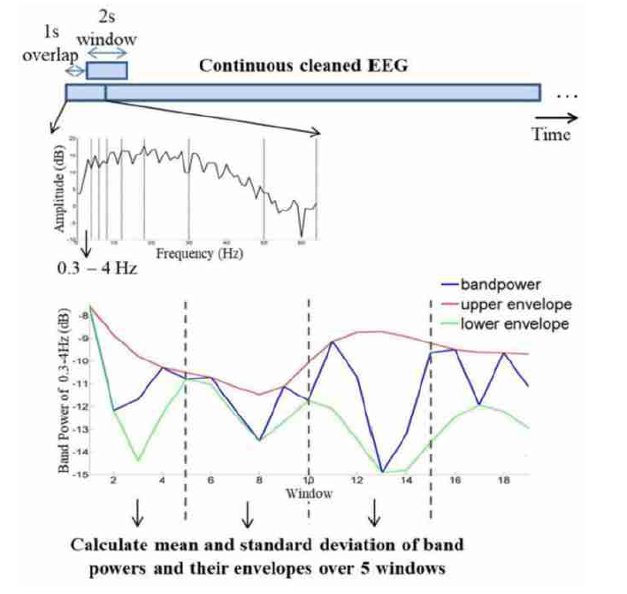
Frequency Feature Extraction
Calculate Relative Frequency Bands
Calculate Bandpower (with lower and upper Evenelope
Create Mean and Std of X Epochs of each Band and each Bandpower
Convert Result to Pandas Dataframe

Slide 13
Create Machine Learning Data

Slide 14
Machine Learning Process
Machine Learning
Create Train / Test / Validation Data
60 % Training Data
20 % Test Data
20 % Validation Data
Time Domain
TBD
Frequency Domain
Frequency Bands
Alpha, Beta, …
Absolute Bandpower
Average Bandpower
Alpha Spindels
…
Feature Extraction
Class Balancing:
Synthetic Minority Oversampling Technique (SMOTE)
Feature Selection:
Correlation-based Feature Subset Selection (CFSS)
Class Balancing & Feature Selection
Support Vector Machine
K-nearest Neighbour
Neural Network
… (maybe more)
Train Classifier
Evaluate Classifier
K-fold cross validation
Leave-one-subject-out cross validation

Slide 15
Evaluation

Slide 16
Time Windowing
2s
1s
Overlap
EEG Signal
Epoch 2
Epoch 1
Epoch 3
…
Time

Slide 17
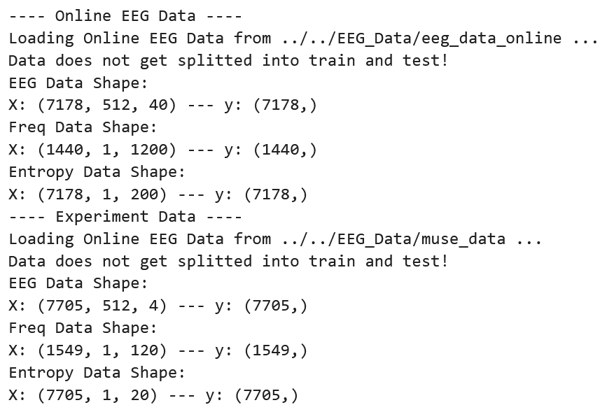
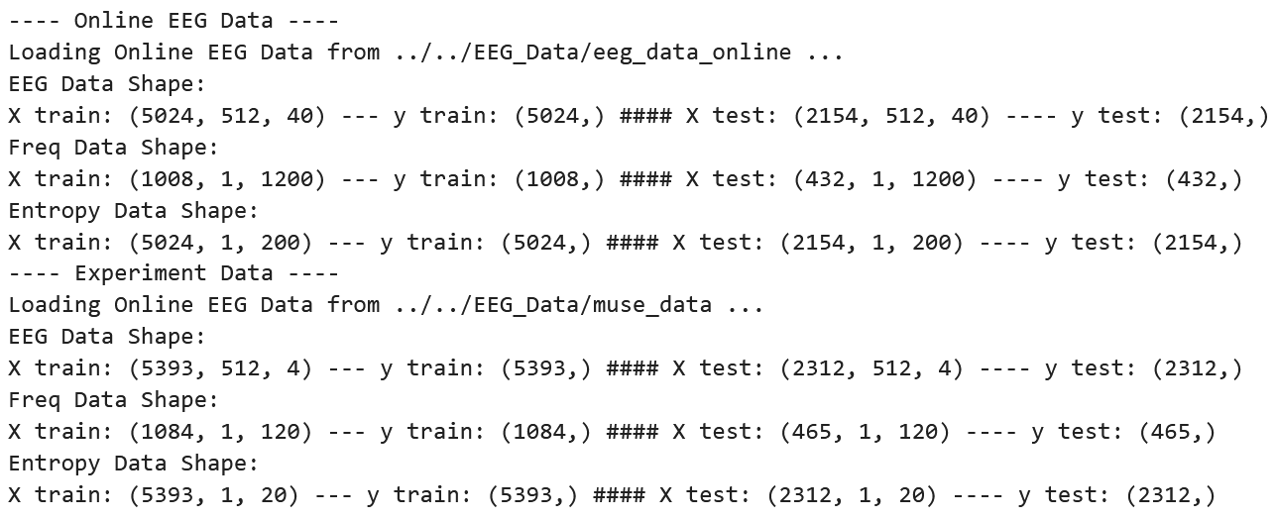
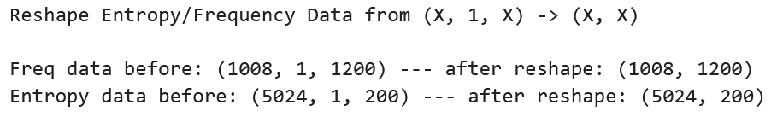
Data shape

Slide 18
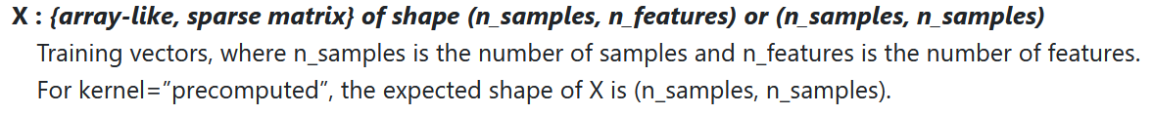
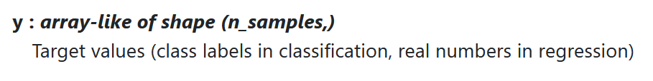
Data shape

Slide 19
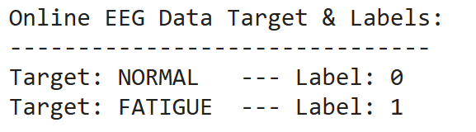
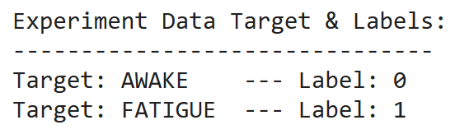
Classification

Slide 20
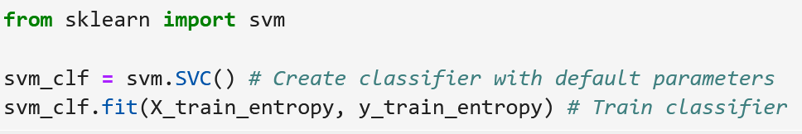
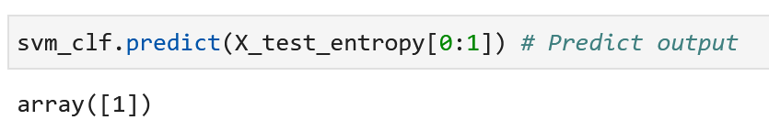
Train Classifier

Slide 21
Classifier Results
Dataset | Best F1 Score | Best Accuracy | Worst F1 Score | Worst Accuracy
Frequency online data | AdaBoost – 66% | KNN – 67% | RF – 53% | SVM & MLP – 58%
Entropy online data | SVM – 76% | SVM - 77% | KNN – 59% | DT - 56%
Frequency experiment data | SVM – 78% | SVM – 78% | DT – 67% | DT – 69%
Entropy experiment data | GBM – 65% | RF – 66% | DT – 58% | DT – 59%

