Slide 1

SMART GOVERNMENT · NIDit · LONELY STONE
CIVICPATH AI
AI-guided public service procedures
Guidance citizens trust. Applications officers can process.
STARTING WITH BIRTH REGISTRATION
Live demo
ai-guided-public-service-procedures.vercel.app
National Institute for Digital Technologies and Digital Transformation
01

Slide 2
THE PROBLEM
The failure happens before submission.
Citizens enter the process without certainty—and discover mistakes only after an official reviews the file.
01
02
03
What do I prepare?
Did I fill it in correctly?
Who can answer now?
Documents, forms, office, order of steps—information is fragmented and hard to interpret.
Missing fields and conflicts surface late—after time has already been spent submitting or traveling.
Too many repeat questions, too few officers—and citizens make avoidable in-person trips.
CivicPath AI · Smart Government
02

Slide 3
THE SOLUTION
One guided flow turns uncertainty into action.
A citizen describes the need once. CivicPath AI clarifies, prepares, and checks—inside the portal they already use.
1
2
3
4
Speak or type
Clarify
Prepare
Check
Describe the situation in everyday language.
AI asks the next best question and detects applicable cases.
Receive a case-aware checklist, steps, examples, and legal basis.
Catch missing fields and conflicts before submission.
No new app. No new portal. Embedded where citizens already are.
CivicPath AI · Smart Government
03

Slide 4
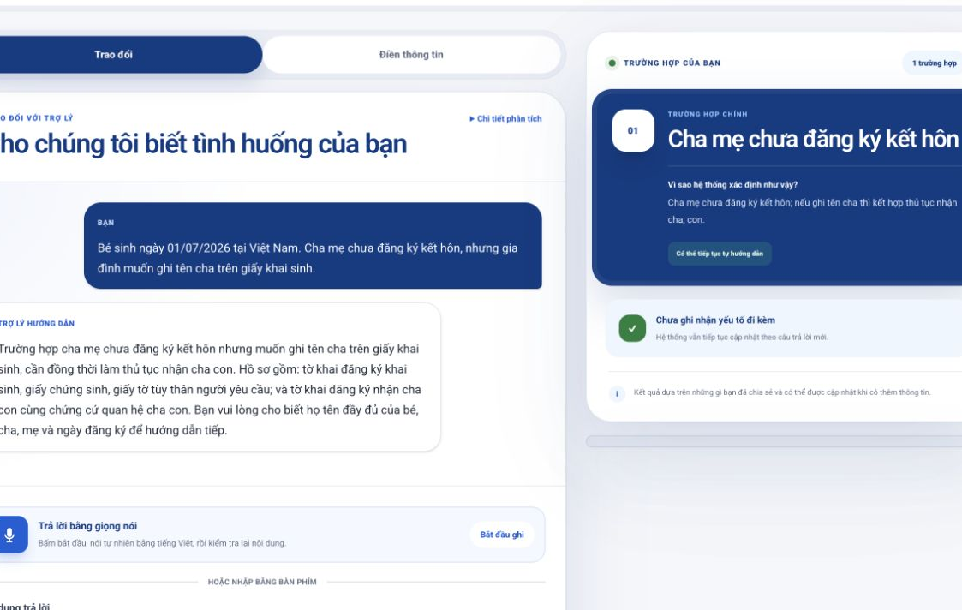
CAPABILITY 1
Guided intake makes the right procedure obvious.
Plain-language in. Case-aware guidance out.
VIETNAMESE VOICE + TEXT
Citizens speak naturally, review the transcript, and edit before sending.
MULTI-CASE CLASSIFICATION
One session can combine out-of-wedlock, overdue, foreign-element, and exceptional cases.
LIVE DEMO · 19 JUL 2026
CivicPath AI · Smart Government
04

Slide 5
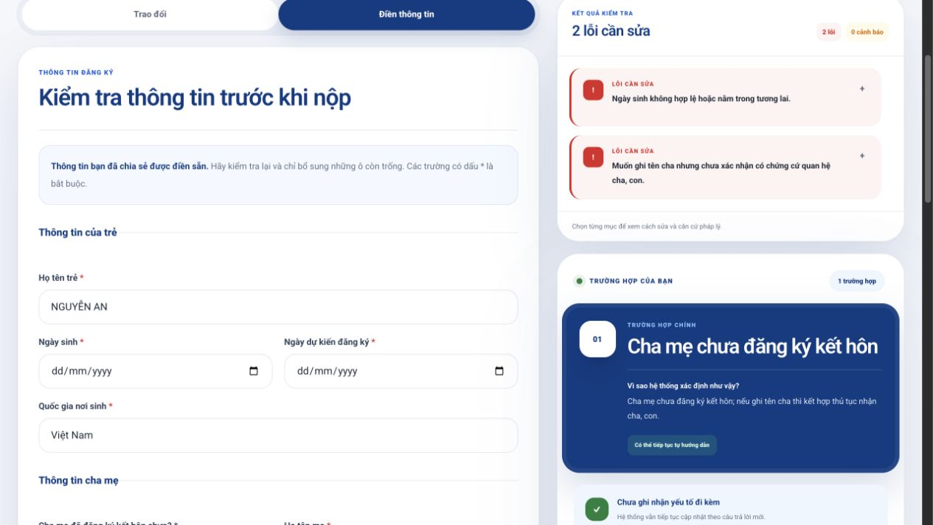
CAPABILITY 2
Pre-check catches what citizens and portals miss.
2
errors caught in the live demo
Mandatory errors come from deterministic rules. AI only adds clearly separated warnings for uncertain exceptions.
REQUIRED · CONDITIONAL · CROSS-FIELD
Each issue includes a suggested fix and traceable legal basis.
CivicPath AI · Smart Government
05

Slide 6
ACCURACY + SAFETY
Trust is engineered into the decision path.
AI interprets. Rules validate. Officers decide exceptions.
01 · AI LAYER
02 · RULE LAYER
03 · HUMAN LAYER
Understand the situation
Validate what matters
Handle exceptions
→
→
Extract facts, classify cases, and explain the next step in plain Vietnamese.
Versioned checklists, validation rules, documents, and legal references live in the backend.
Rare, conflicting, or uncertain cases are escalated for civil-status officer confirmation.
06 official National Public Service Portal links are exposed by the live /trust endpoint for direct verification.
CivicPath AI · Smart Government
06

Slide 7
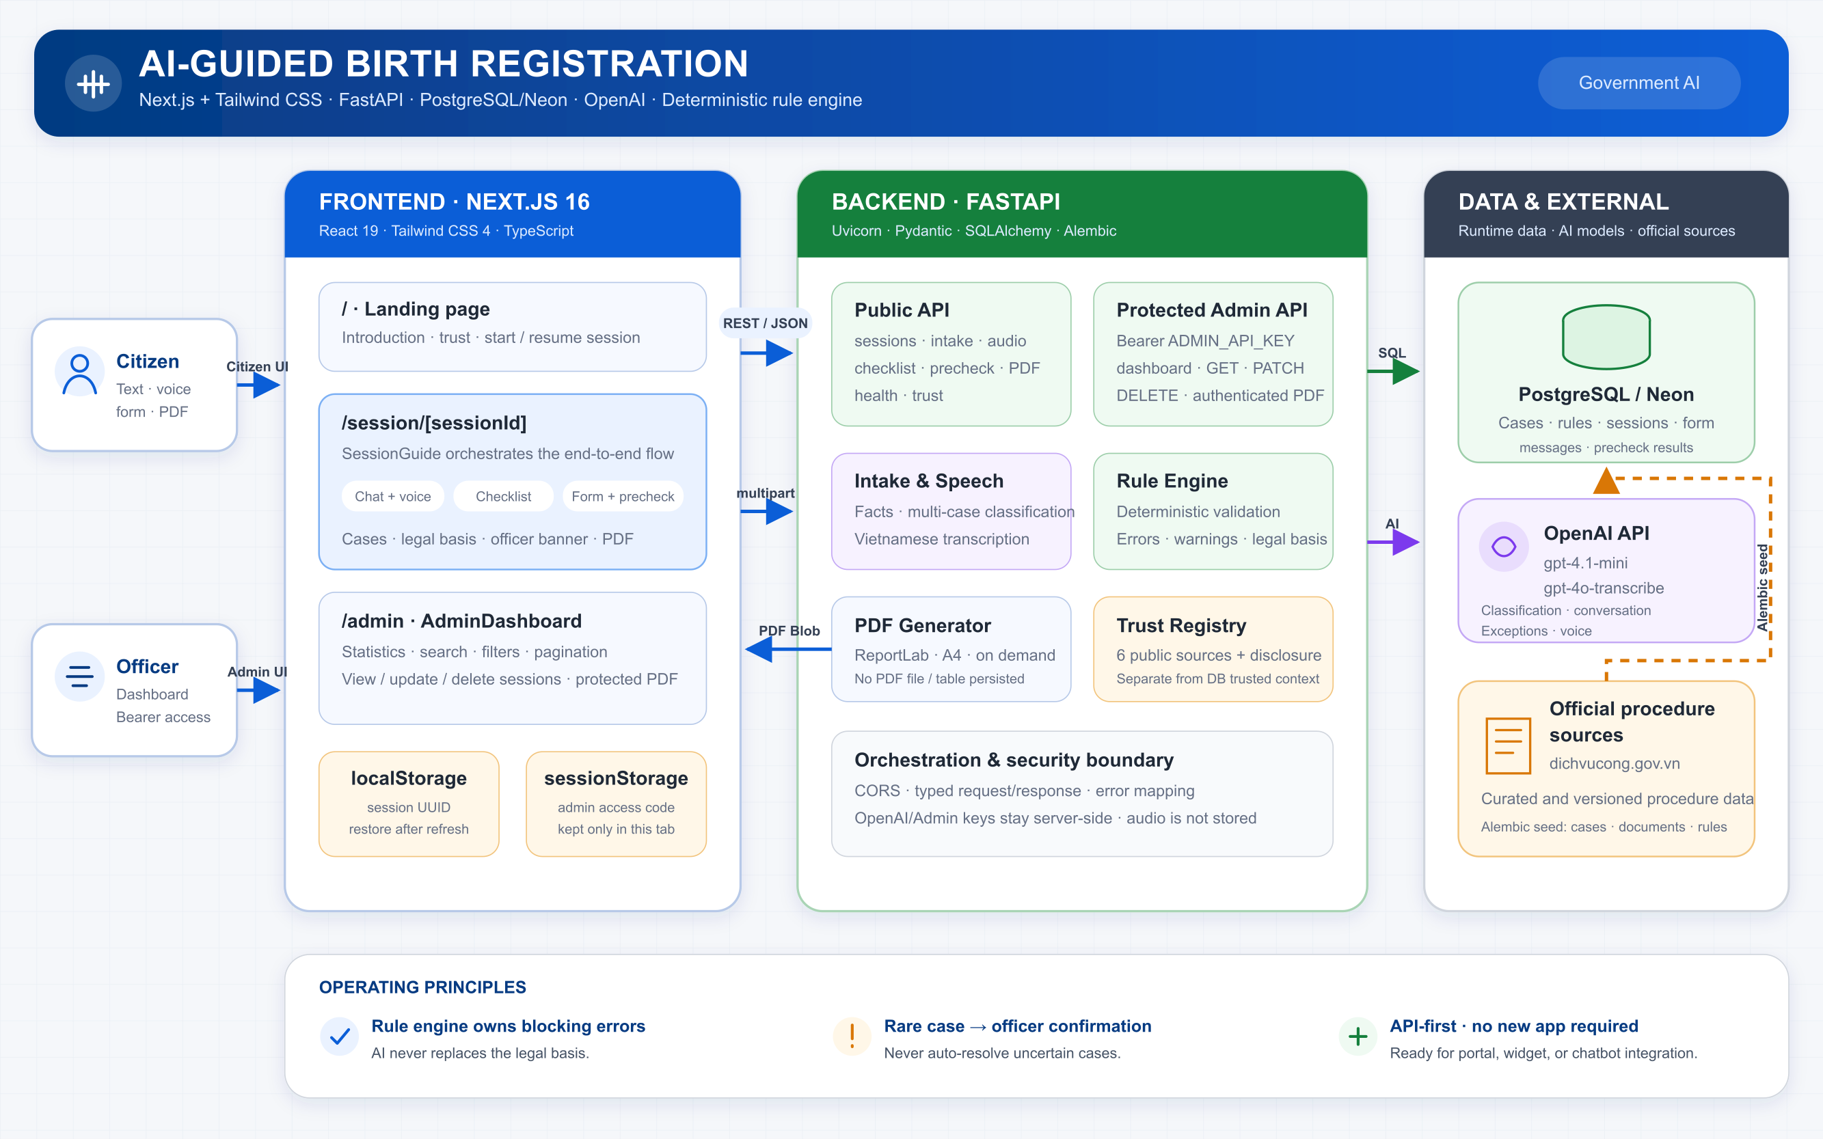
SYSTEM DESIGN
A production-shaped architecture, not a mockup.
CITIZEN + OFFICER UX
Next.js 16 · Tailwind CSS 4
TRUSTED SERVICE LAYER
FastAPI · SQLAlchemy · rule engine · PDF
EVIDENCE + AI
Neon Postgres · official sources · OpenAI API
MODELS
gpt-4.1-mini · classification + conversation gpt-4o-transcribe · Vietnamese speech
CivicPath AI · Smart Government
07

Slide 8
CAPABILITY 3
Built for current portals—not another app.
Embed the same trusted workflow through an API, widget, or chatbot while keeping data and AI keys server-side.
Drop-in integration
CORE API
POST
/sessions
POST
/intake/message
API
GET
/checklist/{session_id}
Portal widget
POST
/precheck
Chatbot
GET
/sessions/{id}/birth-registration.pdf
GET
/trust
One backend contract. Multiple citizen touchpoints.
CivicPath AI · Smart Government
08

Slide 9
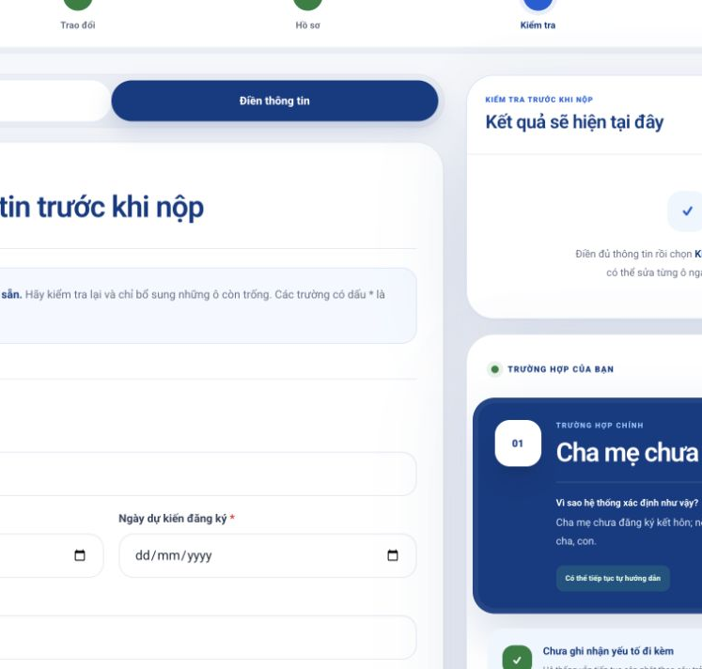
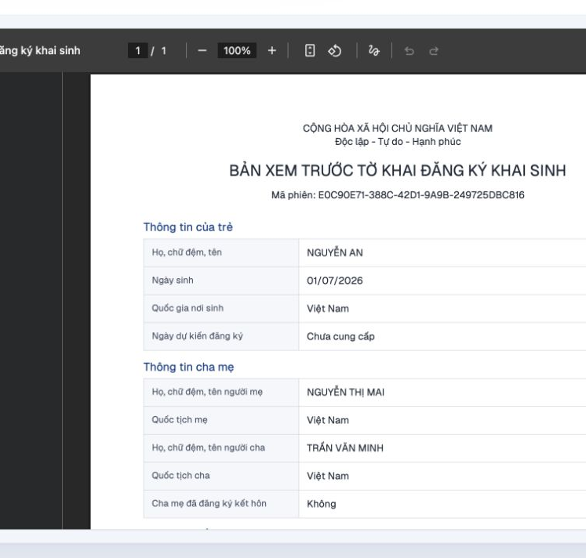
WORKING PRODUCT
Already live. Already end-to-end.
Public URL · real backend · real guidance · real pre-check · real PDF output
01 · UNDERSTAND
02 · PREPARE
03 · REVIEW
A clear, citizen-first entry point
Progressive form + case context
Generated PDF before submission
CivicPath AI · Smart Government
09

Slide 10
PILOT ROADMAP
A 90-day pilot can prove value safely.
Start narrow with birth registration, measure rigorously, and scale only after the evidence is strong.
WEEKS 0–2
WEEKS 3–6
WEEKS 7–12
Align
Integrate
Measure
01
02
03
Confirm local rules, source ownership, audit process, and pilot baseline.
Embed in one portal, onboard two pilot offices, and validate end-to-end operations.
Audit accuracy, citizen completion, preventable corrections, and officer workload.
PILOT PARTNERS
1 portal owner · 2 pilot offices · NIDit regulatory liaison
CivicPath AI · Smart Government
10

Slide 11
PROPOSED DECISION GATES
Pilot success is measurable.
These are targets for the 90-day pilot—not claimed production results.
≥95%
≥30%
≥25%
≥80%
Checklist alignment
Fewer preventable corrections
Fewer routine clarification contacts
Guided-flow completion
with current regulation in monthly expert audits
versus the pilot baseline
for questions covered by the guide
across mobile and desktop citizens
Scale only when accuracy and safety gates pass.
CivicPath AI · Smart Government
11

Slide 12

THE DECISION
Let every citizen arrive ready.
CIVICPATH AI
AI-guided public service procedures
Launch a 90-day birth-registration pilot and prove that accurate guidance can be both safer for government and simpler for citizens.
LIVE DEMO
ai-guided-public-service- procedures.vercel.app
01
Approve the pilot
02
Appoint a regulatory liaison
National Institute for Digital Technologies and Digital Transformation (NIDit)
03
Connect one portal and two offices
Lonely Stone · Smart Government
12

