Slide 1
Content-Based Recommender Systems
Based on properties of items
Similarity of items determined by measuring similarities of their properties

Slide 2
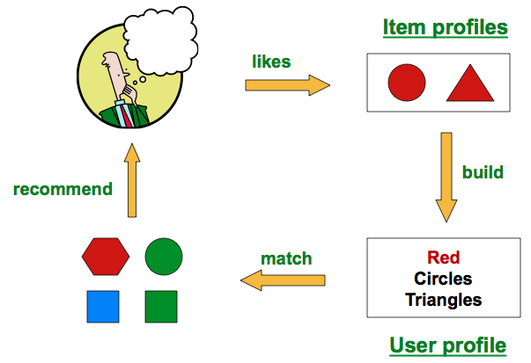
How does it work?
Mining of Massive Datasets (https://lagunita.stanford.edu/asset-v1:ComputerScience+MMDS+SelfPaced+type@asset+block@RecommenderSystems2_ContentBased.pdf)

Slide 3
1. Construct item profiles
Item-feature matrix:
Features – characteristics of items, can be boolean or numerical
Values – depend on the data type of features
Examples:
 | feature1 | feature2 | feature3 | …
item1
item2
…
Item | Features
movies | actors, directors, genre
documents (news articles, etc) | features extracted using TF.IDF or CountVectorizer
images | features generated by tagging

Slide 4
2. Construct user profiles
User-feature matrix
Features – same features used in the item-feature matrix
Values – again depend on the feature data type
How to obtain this data?
An example:
Suppose user watched 5 movies, 2 of which with actor A and 3 of which with actor B.
Feature A’s weight = 2/5 = 0.4
Feature B’s weight = 3/5 = 0.6
 | feature1 | feature2 | feature3 | …
user1
user2
…

Slide 5
Example
Items => movies
Values => numerical, describing degree of the feature in the movie (Note: this is not rating!!)
For the values below, -5 to +5:
 | blockbuster | family | famous actors
Finding Nemo | 5 | 5 | 2
Mission Impossible | 3 | -5 | 5
Jiro Dreams of Sushi | -4 | -5 | -5
Item Profile
User profile
User Jason | -3 | 2 | -2

Slide 6
3. Determine similarities
(between user and item vectors)
Cosine similarity
x
i
Θ
cos Θ = x • i ⁄ | x | | i |

Slide 7
Advantages of Content-Based System
No need for data on other users
Able to recommend to users with unique tastes
Able to recommend new and unpopular items (no first rater problem)
There are explanations for recommended items (content features that caused an item to be recommended
Mining of Massive Datasets

Slide 8
 | beer_abv | brewery_id | beer_style
beer1
beer2
beer3
…

Slide 9
Disadvantages of Content-Based System
Finding the appropriate features is hard
Oversimplification
Can’t give rise to incremental sales (sales that would not have happened otherwise)
Cold-start problem for new users
Mining of Massive Datasets

