Slide 1


JBOSS Drools – Rule Engine (5.3)
(JBOSS – BRMS)
Srinivas
06/08/2011
Confidential

Slide 2

Agenda
Introduction – Drools – JBOSS BRMS
Various available Rule engines in the market
Drools Architecture and Terminology
Various Code Examples
Migrate an existing Blaze application to Drools
Case Study – Compare Drools vs. Blaze
Pros and cons of each Implementation
Comparison of Drools 5.1/5.2/5.3
Confidential

Slide 3
Drools – JBOSS BRMS

Slide 4
JBOSS - Drools
Drools Expert (rule engine) - 4.0/5.1/5.2/5.3
Drools Guvnor
Drools Flow (process/workflow) – jBPM
Drools Fusion (complex event processing)
Drools Planner (automated planning)
Confidential

Slide 5
Various Rule Engines
Drools
Sweet Rules
Open Rules
Mandarax
Take
TermWare
JRuleEngine
JLisa
Prova Language
Open Lexicon
Zilonis
Hammurapi Rules
OpenL Tables
DTRules
Roolie
Blaze Advisor
JRules (IBM)
Quick Rules
Pega RULES
Catalyst
Logic Engine
irServer
CIA Server
Confidential

Slide 6
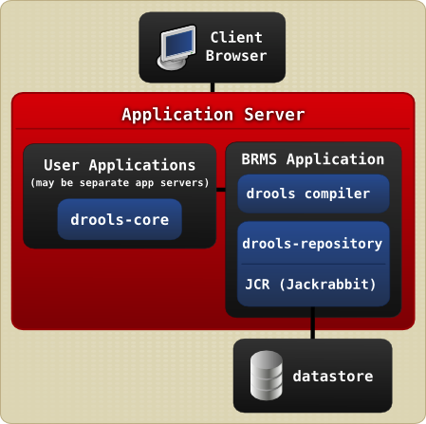
Drools Architecture
Confidential

Slide 7
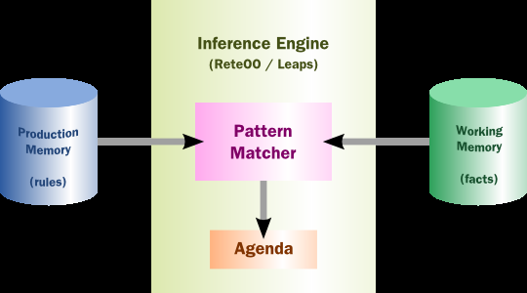
Drools Expert - High-level View of a Rule Engine
Forward Chaining
Backward Chaining
Confidential

Slide 8
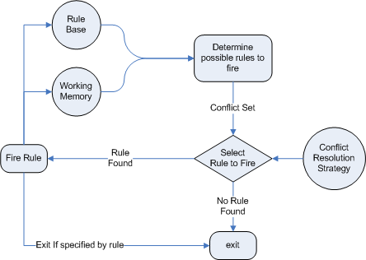
Drools Expert - High-level View of a Rule Engine
Drools - Forward Chaining
Confidential

Slide 9
Drools Terminology && keywords
package
imports
global
function
queries
rule
when
then
function
salience
forall
no-loop
init
action
attributes
in
exists
template
extend
declare
date-effective
date-expires
enabled
End, and
Confidential

Slide 10







Drools – Some Key Features
Cross Product
Knowledge Agent
Join
DSL
Change Set
Decision Tables
Confidential

Slide 11
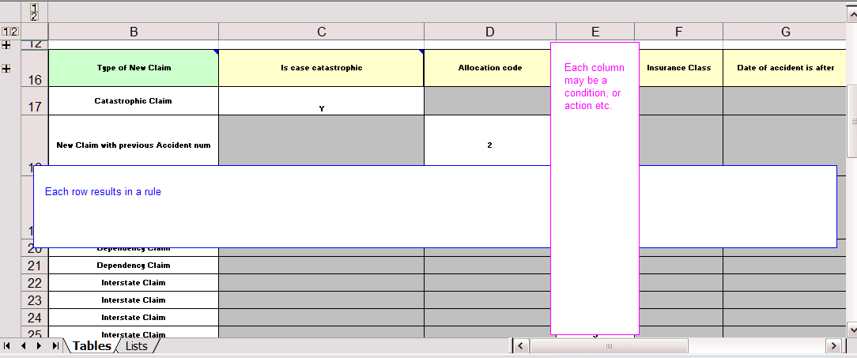
Using Spreadsheet Decision Tables
Confidential

Slide 12

Drools - Case Study
Confidential

Slide 13
Drools - Case Study
Event/Benefit Status Action Matrix using Blaze – Current Implementation
Event/Benefit Status Action Matrix using Drools
Code Demo
Compare the Drools Expert vs. Blaze Advisor
Pros and cons of each implementation
Analysis
Confidential

Slide 14
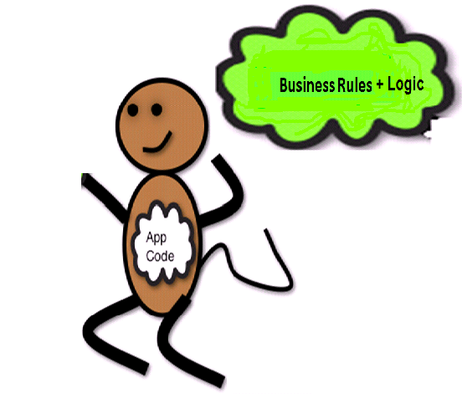

Rules Implementation - Do’s and Don'ts
Confidential

Slide 15

Rules Implementation – Do’s and Don'ts
Tightly coupled Java Code with Blaze Code
Crossing Thick Yellow Line
Too many Loop Back calls
Business logic in Blaze Rule engine functions
Migrating from one Rule engine to Another Rule Engine
Decision making in Rule engine than in Application - Invocation
Testing and Coding effort w.r.t. migration
Steep learning curve for newbie's
Confidential

Slide 16
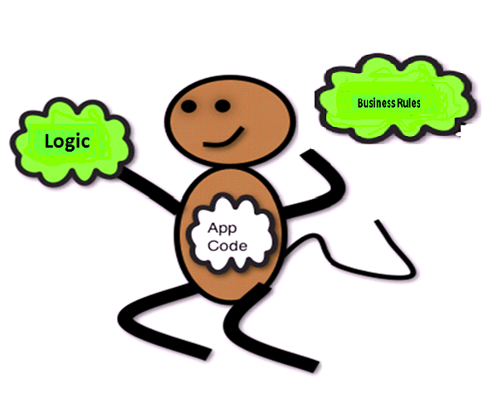

Rules Implementation - Do’s and Don'ts
Confidential

Slide 17

Case Study – Analysis – Drools
Simple Java based API to manage rules and decision tables
Syntax is close to Java, easy to learn and debug using eclipse
No licensing costs, frequent releases
Rule flow’s are not mandatory for simple scenarios
Various implementation solutions to maintain rules resources
Spread sheet, CSV based Decision tables
Can make changes to individual rule resource files
Easy to expose rule resource as a REST/SOAP/Spring service

Slide 18






Case Study – Drools Expert vs. Blaze
Licensing issues
Build and deployment issues
version control
Documentation setup/ease of use
Migration effort
IDE Plug-ins/Text Editor Support

Slide 19

Drools vs. Blaze
Confidential

Slide 20
Various Rule Engines
Drools
Sweet Rules
Open Rules
Mandarax
Take
TermWare
JRuleEngine
JLisa
Prova Language
Open Lexicon
Zilonis
Hammurapi Rules
OpenL Tables
DTRules
Roolie
Blaze Advisor
JRules (IBM)
Quick Rules
Pega RULES
Catalyst
Logic Engine
irServer
CIA Server

Slide 21


Case Study – Drools Expert vs. Blaze
Application Name | Item Measured | Blaze platform | Drools platform | Improvement
Benefit Status Matrix | Number Of classes Lines Of Code (Java Code) | 2 40 | 1 10 | 50% fewer classes 75% fewer lines of code
Benefit Status Matrix | Rules Repository size Lines Of Code In rule engine | 615 10 | 2 0 | 99% fewer repo files 100% fewer lines of code
 | Number Of config/XML files Lines of XML Code | 1 to 3 200 | 0 0 | 100% fewer xml files 200% fewer lines of XML code

Slide 22
Drools Expert vs. Blaze
 | Blaze Advisor | Drools Expert
UI to create rule resources | Available | Available as a separate deployment (Guvnor), but it is not mandatory.
Plug-ins for IDE and Support for Text Editors | Not available | Available
Spring Integration | Supports | Supports
Spread sheet, CSV based decision tables | Does not Support | Supports
Version Control for Individual Rule Resource (One decision table) | 1. Entire Repository 2. Very difficult to edit individual files | Supports
Boiler plate code | More | Less in 5.3 as compare to other versions

Slide 23
Drools Expert vs. Blaze
 | Blaze Advisor | Drools Expert
Ease of use | Medium | Simple and Easy, Java based syntax
Community and support | Active | Active
Support for multiple languages | Java and .NET | Java and .NET
Corporate backup | Fair Isaac | JBOSS
JDK versions support | Same Level | Same Level
Application Servers support | Same Level | Same Level

Slide 24
Drools Expert vs. Blaze
 | Blaze Advisor | Drools Expert
Exposing Rule resource as a SOA service | Supports | Supports
Support for Decision Tress | Supports | Not Supports, but can be implemented.
Build and Deployment Issues in Clustered environment | More | Less
Solutions available to manage Rules, RMA | Blaze RMA – API is used | Supports, Also have numerous solutions like POI API, File Upload etc.
Converting Rule Resource from one type to another - Example: Decision table to DRL | Blaze Advisor directly does not support | API available to convert Decision table to DRL file

Slide 25
Drools Expert vs. Blaze
 | Blaze Advisor | Drools Expert
Licensing Fee/Cost Savings | Starts at $20000 per developer seat, $40000 per deployment per CPU | Open Source

Slide 26
Technical/Non-Technical Benefits
Same level of service
Simplified API and Comfortable for Java Developers
Easy to learn and less boiler plate code
Maintainability and Manageability – Application Level
Cost Analysis
  Development cost
  Training cost/Special skill set consulting cost
  Short term and long term cost savings (nodes*cpu’s*price)
Reference Implementations in Wells Fargo – ILogs to Drools

Slide 27
Migration Strategy
End to End POC for each application to be migrated
Prioritize the application criticality
Identify Channel Secure, Build and Deployment issues if any
Calculate Cost savings for each application to be migrated
Application deployed in multiple nodes – /per CPU License
Simple applications first, followed by other applications
Not all applications in one release
Confidential

Slide 28
Comparison of Drools 5.1/5.2/5.3
Simplified API and less number of lines of code – 5.3
Less Boiler plate code
Migrating from 5.1 to 5.3 – Some code changes required in client side in 5.3
Confidential

Slide 29
Drools – Code Examples
Cross Product
Join
Change Set – XML Based configurations for rules
Spread Sheet Decision Tables – Supports XLS, CSV
Knowledge Agent – It provides automatic loading, caching and re-loading of resources and is configured from a properties files.
DSL – Domain Specific Language
  [when]Something is {colour}=Something(colour=="{colour}")
Confidential

Slide 30
References
http://java-source.net/open-source/rule-engines
http://www.infoworld.com/d/developer-world/ilog-jrules-65-brings-rules-soa-468?page=0,0
http://www.ncbi.nlm.nih.gov/pmc/articles/PMC1839377/ - Commercial
http://ea.homestead.wellsfargo.com/proj/bus/brm/Shared%20Documents/Current%20State%20Analysis/2011/HCFG-CSTS/BRM%20Current%20State%20Presentation%20-%20CSTS.ppt
http://blog.athico.com/2007/08/jboss-drools-vs-ilog-jrules.html
http://www.databorough.com/Visual-Guide-to-Business-Rules-Reuse.html
http://www.ibm.com/developerworks/library/ar-busrules2/?S_TACT=105AGX78amp%3B&S_CMP=HP
http://jeffsbox.net/pinged/2010/04/why-fat-monkeys-are-bad-or-why-rules-engines-rock/
Confidential

Slide 31

Confidential

