Slide 1
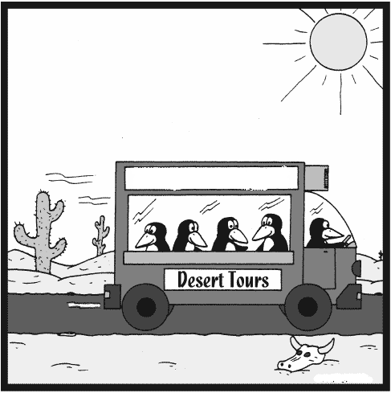
Enterprise Service Bus – ESB
Srinivasa Raju
03/02/2007
Suns
Enterprise service Bus

Slide 2

Agenda
ESB – Introduction
Why do we need an ESB ??
Integration topologies comparison
ESB Service Containers and Abstract End Points
Properties of an ESB
EAI/ESB – Design Patterns
Mule Architecture
Demo - Mule ESB on JBOSS
Notes:
ggjggg

Slide 3
Popular ESB Products
Java based ESB’s
  SUN - Java CAPS
  Bea - Aqualogic
  IBM - ESB
  TIBCO
  Mule - Open Source
  Apache - ServiceMix - Open Source ESB
  Sonic ESB
  JBOSS ESB (Acquired Rosetta ESB)
ESB.Net
  Microsoft BizTalk 2004
  www.esb.net.au
  http://www.neudesic.com/Main.aspx?SS=7&PE=75

Slide 4
Evolution of Enterprise Service Bus
XML
Y2K
JMS
Web services
Application Servers
E-Commerce Hubs
Internet Bubble Burst
Integration Brokers
Enterprise Service Bus
Message Oriented Middleware
New economics
Of Integration
1990 1996 1997 1998 1999 2000 2001 2002 2007
Adopted from Enterprise Service Bus – DAVID A. CHAPPELL

Slide 5
EAI Architectures

Slide 6
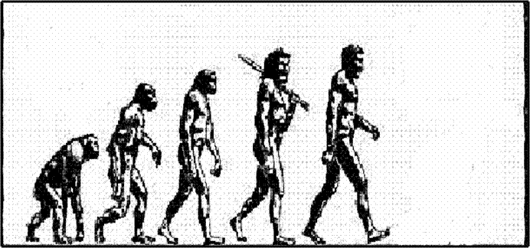
Evolution of EAI Architectures
Integration Brokers - HUB and Spoke (H&S)
(Early)
Point to Point Integrations
New economics
Of Integration
ESB – Enterprise Service Bus -
SOA based
SOA based Integrations
(Early)

Slide 7
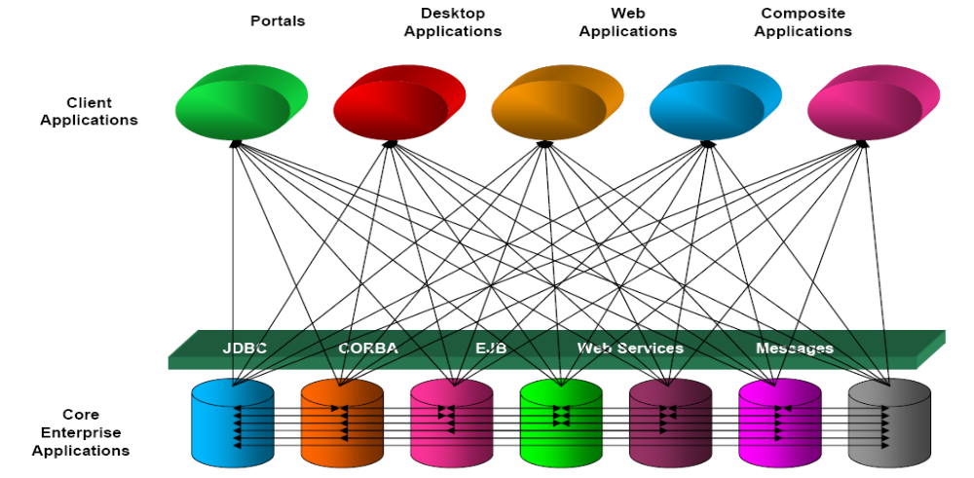
Point-to-Point Integrations
If one fails, they all fail
Min number of interfaces = n(n-1)/2
Single point of failure
Tightly coupled interfaces
N-squared problem

Slide 8
Integration Brokers - Hub and Spoke
Sales
Operations
SOAP in
Integration broker
Hub
Proprietary
Routing Rules
Transformation engines
Application Adapters
SOAP out
Web service
WS
WS
Web service
Legacy Order
Mgmt app..
JDBC
adapter
Custom
adaptor
CORBA
application
CRM application
Pkg.app
adapter
Pkg.app
adapter
ERP
J2EE app..
JCA
adapter
MOM
adapter
OLAP data
warehouse
TIBCO, seeBeyond (eGate, iCan, java CAPS), Bea - Aqua Logic, MS - BizTalk etc..
Number of interfaces = n
N square problem inside the central hub – Canonical data model.
Brokers are centralized, monolithic, Largely proprietary
Proprietary adapters

Slide 9
Hub and Spoke – Pros and Cons
In this topology, the number of edges is equal to the number of nodes, which means it grows linearly.
Examples: Message Broker, Airline Hubs and FedEx etc. etc.
It decouples sender and receiver by inserting an active mediator in the middle - the hub – commonly referred as Message Broker.
First of all, inserting a hub into the lines communication can cause additional overhead.
Each message now has to make two hops instead of one, with a potential routing decision in between. This is likely to increase the latency of a message flowing between participants.
  Example: An airline "hub" is going to make for a much longer journey than a direct flight.
The hub can also become a performance bottle neck since all messages have to travel though this hub.
We have to find a common data representation that suits every participant equally well – Canonical Data Model.

Slide 10
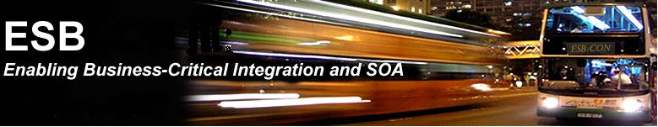
Introduction - What is ESB ??
Necessity is the mother of Invention …

Slide 11

Introduction - What is ESB ??
Gartner Inc Def of an ESB: It consists of following 4 things.
Message Oriented Middleware (MOM)
  Robust, reliable transport
  Efficient movement of data across abstract data channels
  End-to-end reliability
Web services
  Service Oriented Architecture (SOA)
  Abstract business services
Intelligent routing
  Message routing based on content and context
  Message routing based on business process rules
  Business process orchestration based on rule languages
XML transformation
  Based on XSLT and independently deployed service types
ESB = SOA + EDA

Slide 12
1. ESB - Messaging
Service A
Service B
Scalable
Avoids n*(n-1)/2 end points
Loose coupling
Message
Message
2. ESB - Transformation
Data format change
Data modification/enhancement
Message normalization
In case of XML use XSLT
Service A
Object
Transformer
Object
Service B
3. ESB - Routing
Aggregator service
split
5a
1
2
3
4
Content based
Rule based
XPath based
1
2
3
5
ESB
5b
1
2
3
4
join
Fanout/Splitter service

Slide 13
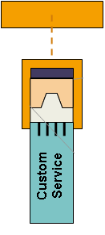
Generic ESB endpoint
Enterprise Service Bus
Connection to ESB (Virtual)
Service Container
Invocation and
management framework
Endpoint Interface
ESB End Point
methods

Slide 14
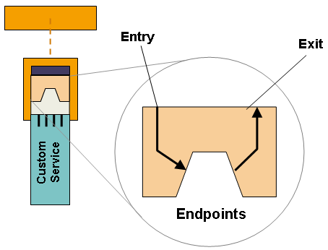
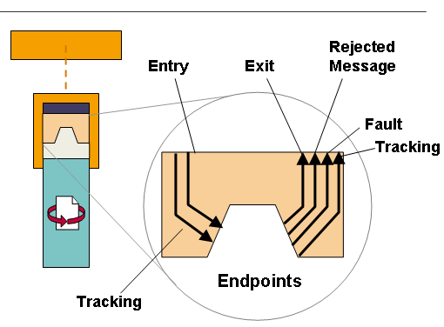
ESB Service Container and Abstract Endpoints

Slide 15



Good Bye Hub and Spoke., Hello ESB..
Content based
routing
XSLT
transformation
Application
Custom Service
ESB
Generic
Protocol
API
Custom
Application server
connections
Bridges
Adapters
Protocols and transports: http, vm, ftp, jdbc, smtp, POP, jms, etc…..

Slide 16


Content based
Routing
XSLT
Transformation
Legacy System or
Packaged app
Adapter
JCA
Service
containers
Service
containers
ESB service containers are specialized for integration services such as transformation, routing and application adapters
Service
Application
Custom Service

Slide 17
4a
1
2
3
1
2
3
5
Split
join
4b
1
2
3
Specialized Services
of the ESB - Multi-Itinerary
CBR pattern
Business Orchestration using BPEL and BPEL4WS
Content based
Router service
Aggregator
Service

Slide 18
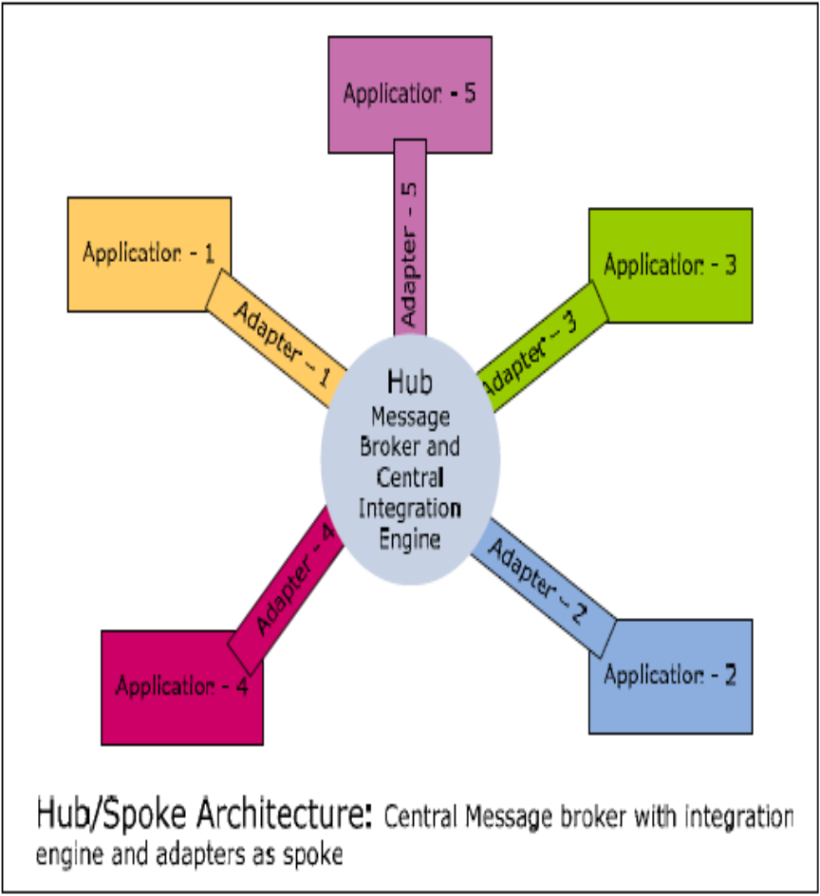
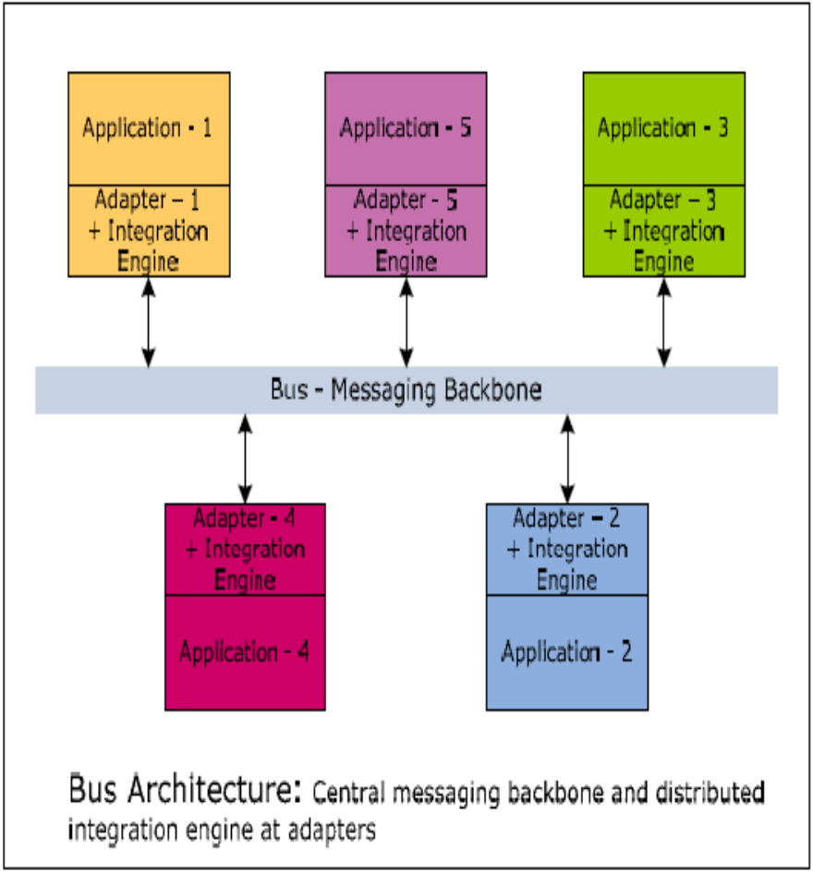
Hub and Spoke Vs. ESB

Slide 19
HUB and Spoke vs. ESB
The nature of traditional Hub and Spoke is centralized.
Traditional hub-and-spoke architecture is based on central operation and management.
EAI/hub-and-spoke solutions are generally based on proprietary standards.
Scalability: High if federated architecture is used otherwise limited by the hardware of box used to host Hub.
http://dotnet.sys-con.com/read/121831_2.htm
The nature of the ESB is distributed.
ESB architecture supports distributed operation and management.
An ESB is based on open standards.
The key difference is the capabilities in an ESB are themselves SOA-based, since they are spread out across the bus in a distributed fashion, and the capabilities are hosted in separately deployable service containers. This is a fundamental difference in architecture.
The distributed nature of the ESB Services allows for the selective deployment of integration broker functionality exactly where you need it, with no additional over bloating where it's not needed.
The ESB is more scalable than the hub-and-spoke architecture. Through the ability to deploy separate integration services, scaling up and scaling out becomes easier.

Slide 20
Hub and Spoke Vs. ESB
Central point for availing services like trasformation, routing and transaction management.
HUB (usually a message broker) is a monolithic piece of software.
Capabilities of the HUB cannot be used as pluggable components in another HUB.
Services provided by the HUB and the interfacing between these services is not standart based and is usually proprietary standards driven, leading to a risk of vendor locking.
The hub, being a monolithic piece of software can be used only in a 'all or nothing' mode.
Central point for availing services like trasformation, routing and transaction management.
ESB provided services are themselves distributed in the sense that different components come and play their role in providing the infrastructure services promised by the ESB.
Specific capabilities of an ESB can be plugged into other ESBs to allow the user to get the benefit of mix and match of services.
Standard based (JBI).
ESB user can choose which services need to installed and used and which services they want to leave per instance of the ESB.

Slide 21
Message Boxes in BizTalk Server
Adapter
Publisher
Flow Control and Routing
Message
Box
Message
Box
Transformation
Adapter
Subscriber
- Transformation / translation
- Routing
- Message combination or rules-based processing
- Business activity monitoring (BAM)
- Load balancing
- Message security

Slide 22
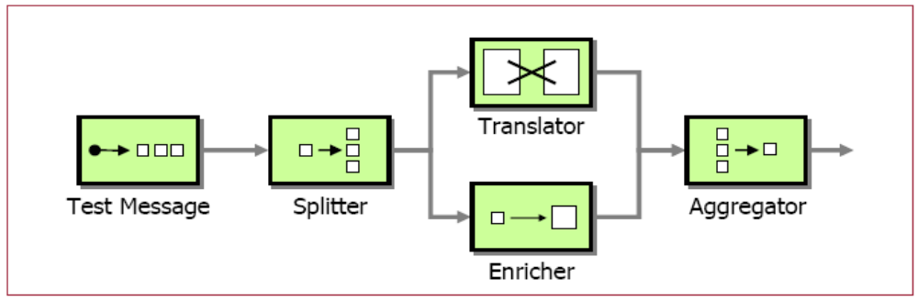
EAI Patterns

Slide 23
ESB/EAI Patterns
VETO – Validate, Enrich, Transform, Operate
VETRO - Validate, Enrich, Transform, Route, Operate
Simple
  Message Splitter
  Message Aggregator
  Publish Subscribe
Moderate
  Composed Message Processor
EAI Architecture Patterns
  Integration Adapter
  Integration Messenger
  Integration façade
  Integration Mediator
  Process Automator

Slide 24
ESB Integration Patterns - VETO
--------
XML
--------
--------
1
2
3
-------
-------
-------
4
XML Schema
Directory
cache
?
Distribution
Logistics
WSDL
Scripting
Validate
Enrich
Transform
Operate
The VETO pattern as independent services

Slide 25
ESB Integration Patterns – VETRO
ESB
--------
XML
--------
--------
1
2
3
4
-------
-------
-------
5
?
Distribution
Logistics
Validate Enrich Transform Route
Operate
The VETRO pattern includes a Route step, such as content based router

Slide 26
Splitter
Aggregator
A
C
A
B
C
B
Resequencer
Composed Message Processor

Slide 27
Routing Slip
Normalizer
Content Enricher
Content Filter

Slide 28
Integration Facade
Server
app1
Client
App A
Integration
facade
Server
app2
Process Controller
Client
App B
Server
app3
Activity
Service X
Activity
Service Y
App interaction model
App A
App B
App A
Integration
Messenger
App B
Process Automator Pattern
Integration Messenger Pattern

Slide 29

Mule – An Open Source ESB Tool

Slide 30
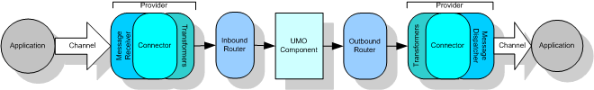


Mule - Introduction
An open source ESB/Network infrastructure
Mule Architecture
Router, Inbound Router, Connecter, Outbound Router, Transformer, UMO, Model
Ex: Inbound transformer
Ex: Outbound transformer

Slide 31
Example: Mule Configurations
<connector name="jmsConnector4" className="org.mule.providers.jms.JmsConnector">
<properties>
<property name="connectionFactoryJndiName" value="ConnectionFactory"/>
<property name="jndiInitialFactory" value="org.activemq.jndi.ActiveMQInitialContextFactory"/>
<property name="specification" value="1.1"/>
<map name="connectionFactoryProperties">
<property name="useEmbeddedBroker" value="true"/>
</map>
</properties>
</connector>
<endpoint-identifiers>
<endpoint-identifier name="InputQueue" value="jms://in.queue"/>
</endpoint-identifiers>
<transformers>
<transformer name="JMSMessageToObject" className="org.mule.providers.jms.transformers.JMSMessageToObject"/>
</transformers>
<model name="JmsSample">
<mule-descriptor name="JmsUMO" implementation="com.esb.demo.JmsService">
<inbound-router>
<endpoint address="InputQueue" connector="jmsConnector4"/>
</inbound-router>
</mule-descriptor>
</model>

Slide 32
Example: Mule – Axis and xFire web services
Axis Service:
<mule-descriptor name="axisService" implementation="com.esb.demo.AxisService">
<inbound-router>
<endpoint address="axis:http://localhost:18081/ws" transformers="httpToSoap"/>
</inbound-router>
</mule-descriptor>
Xfire Service:
<mule-descriptor name="xfireService" implementation="com.esb.demo.AxisService">
<inbound-router>
<endpoint address="xfire:http://localhost:18081/ws" transformers="httpToSoap"/>
</inbound-router>
</mule-descriptor>
Client:
MuleClient client = new MuleClient();
UMOMessage message = client.send("axis:http://localhost:18081/ws/axisService?method=getAddress", name, null);
String axisMessageOutput = (String) message.getPayload();

Slide 33
ESB and Spring(IoC)
IoC and Hollywood Principle:
  “Don’t call us, we’ll call you”. So you do not need our number.
Enterprise Service Bus adoption motto:
  “If you can’t bring the application to the bus, bring the bus to the application.”

Slide 34

Summary - ESB - Key benefits
ESB architecture supports distributed operation and management.
More configuration rather than integration coding.
Faster and cheaper accommodation of existing systems
Increased flexibility; easier to change as requirements change.
No central rules engine, no central broker.
Incremental changes can be applied with zero down-time; enterprise becomes "refactorable".
Standards based.
(JBI)
Scales from point solutions to enterprise-wide deployment (distributed bus).
The ESB is more scalable than the hub-and-spoke architecture.
ESB user can choose which services need to installed and used and which services they want to leave per instance of the ESB.

Slide 35
Summary - ESB - Key disadvantages
For effective implementation, requires a mature IT governance model
Extra translation layer when compared to regular messaging solutions
Enterprise Message Model is usually mandatory
Value of the ESB requires many disparate systems to collaborate on message standards.
Interoperability between ESB’s.
High Cost - i.e. Licenses, Consulting and Operations
It requires more hardware to run.
New skills needed to configure ESB.
It’s overused, over hyped, and confusing.
Rarely realizes ROI (Return on Investment) within first few projects; next few projects generally refine messages and services; the fifth project may begin to realize ROI

Slide 36
Top 10 reasons to like an ESB …
One more IT acronym makes a million
Look cool on your resume - don't forget to add SOA many, many times someone might Google you
Spend other people's money
Forget EAI mistakes and start over with ESB
Confuse business people so they will leave you alone
Justify the existence of a lot of software marketing people
Get lots of free lunches from software vendors
Avoid real work researching the pros and cons of to ESB or not to ESB
Play with technology versus solving business problems
Further irritate people that are bothered by the term ESB

Slide 37



ESB Demo – Mule 3.1 with JBoss 4.0.4.GA
Demo Examples:
  Transformation
  Routing
  REST based web services invocation and XSLT transformation
  Webservices: Axis and Xfire Implementations
  JMS Connector
  SMTP Connector
  Vm and JMS transports

Slide 38
Consuming Web Services in Oracle 10g
CREATE OR REPLACE FUNCTION get_stock_price (p_stock_code IN VARCHAR2)
RETURN NUMBER
AS
  l_service UTL_DBWS.service;
  l_call UTL_DBWS.call;
  l_result ANYDATA;
  l_wsdl_url VARCHAR2(1024);
  l_service_name VARCHAR2(200);
  l_operation_name VARCHAR2(200);
  l_input_params UTL_DBWS.anydata_list;
BEGIN
  l_wsdl_url := 'http://services.xmethods.net/soap/urn:xmethods-delayed-quotes.wsdl';
  l_service_name := 'StockQuoteService';
  l_operation_name := 'getQuote';
  l_service := UTL_DBWS.create_service (wsdl_document_location => URIFACTORY.getURI(l_wsdl_url),
  service_name => l_service_name);
  l_call := UTL_DBWS.create_call (service_handle => l_service, port_name => NULL, operation_name => l_operation_name);
  l_input_params(1) := ANYDATA.ConvertVarchar2(p_stock_code);
  l_result := UTL_DBWS.invoke (call_handle => l_call, input_params => l_input_params);
  UTL_DBWS.release_call (call_handle => l_call);
  UTL_DBWS.release_service (service_handle => l_service);
  RETURN ANYDATA.AccessNumber(l_result);
EXCEPTION
WHEN OTHERS THEN
RETURN NULL;
END;
SQL> SELECT get_stock_price('ORCL') FROM dual;
GET_STOCK_PRICE('ORCL')
------------------------------------------
12.47
SQL>

Slide 39

Resources to Study
http://en.wikipedia.org/wiki/Enterprise_service_bus
http://www.devx.com/Java/Article/28127/0/page/2
http://www.ftponline.com/special/esb2/
http://dotnet.sys-con.com/read/121831.htm
http://servicemix.blogspot.com/2006/07/hub-and-spoke-vs-esb.html
http://www.enterpriseintegrationpatterns.com
http://mule.mulesource.org/wiki/display/MULE/Home
Enterprise Service Bus – DAVID A. CHAPPELL

Slide 40
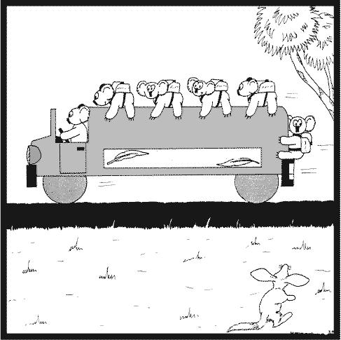
Service Bus
Thank You
Have a nice week end.

