Slide 1

WIL • XHAW5112
PAWSITIVE
PET ACADEMY
Website & mobile application
project presentation
Presented by: Donald Mudzani
A digital platform for pet-care learning and enquiries

Slide 2
01 • PROJECT CONTEXT
The client and the opportunity
Scenario 1: Pet Care & Training Academy
The client
The challenge
The digital response
Sarah Smith’s pet-care education and practical animal-training academy.
Pet owners and aspiring professionals may struggle to find accessible, organised information about care, training, nutrition and emergency care.
A website and mobile app that promote the academy, explain courses, estimate fees and help potential customers make enquiries.
Project objective
Make information easier to access and reduce friction between exploring a course and contacting the academy.
PAWSITIVE PET ACADEMY • WIL / XHAW5112
02

Slide 3
02 • USER-CENTRED DESIGN
Who are we designing for?
The interface should help different users reach useful information without unnecessary steps.
Pet owners & families
Pet-care workers
Future professionals
People who want to improve everyday pet care, safety and training knowledge.
Pet sitters, kennel staff and others who want to strengthen practical knowledge.
People interested in animal-related careers or starting pet-related businesses.
Core user need
Explore courses → understand costs → contact the academy
PAWSITIVE PET ACADEMY • WIL / XHAW5112
03

Slide 4
03 • DESIGN DECISIONS
Why this visual direction?
The design aims to feel caring and professional while keeping information easy to scan.
Deep Teal
Warm Cream
Golden Amber
Charcoal
#1F6F5C
#F7EFE3
#E8A33D
#2B2B2B
Trust, stability and a connection to nature.
A softer background that supports readability.
A warm accent for highlights and calls to action.
Strong contrast for readable text.
Design principles: consistent navigation • clear hierarchy • readable text • touch-friendly controls • responsive layouts
PAWSITIVE PET ACADEMY • WIL / XHAW5112
04

Slide 5

04 • IDENTITY & PLANNING
Logo and wireframe direction
The paw communicates the academy’s focus on animals and pet care. The simple circular treatment is intended to remain recognisable at different sizes.
PAWSITIVE PET ACADEMY • WIL / XHAW5112
05

Slide 6
05 • SOLUTION OVERVIEW
Two interfaces, one academy
The website and mobile app present the same course offering through different screen experiences.
Website
Mobile application
HTML, CSS and JavaScript
Published website for browsing information, viewing course details, calculating fees and submitting enquiries.
React Native with TypeScript and Expo
Mobile screens for exploring the academy, browsing courses, estimating fees and contacting the academy.
Development tools
Visual Studio Code • Android Studio Emulator • Git / GitHub • Figma
PAWSITIVE PET ACADEMY • WIL / XHAW5112
06

Slide 7
06 • COURSE CATALOGUE
Seven courses across two pathways
The same course catalogue is used to help visitors compare options.
Professional development • R1,500 each
Practical short courses • R750 each
Canine Obedience Training
Pet Grooming
Animal Behaviour
Pet Business Management
Puppy Care
Pet First Aid
Basic Dog Walking
PAWSITIVE PET ACADEMY • WIL / XHAW5112
07

Slide 8

07 • WEBSITE DEMONSTRATION
Website: from browsing to enquiry
WEBSITE SCREENSHOTS
1. Explore
Open the home page and course catalogue.
2. Calculate
Select courses and show the fee estimate.
3. Enquire
Complete the form and explain what happens after submission.
Published site: https://mudzani.github.io/pawsitive-Website/
PAWSITIVE PET ACADEMY • WIL / XHAW5112
08

Slide 9
08 • WEBSITE FUNCTIONALITY
How a website enquiry is handled
Visitor
Website
Cloudflare Worker
Apps Script
Google Sheets
Completes enquiry form
Validates and sends request
Handles the request and forwards it
Processes and records enquiry
Stores enquiry record
PAWSITIVE PET ACADEMY • WIL / XHAW5112
09

Slide 10
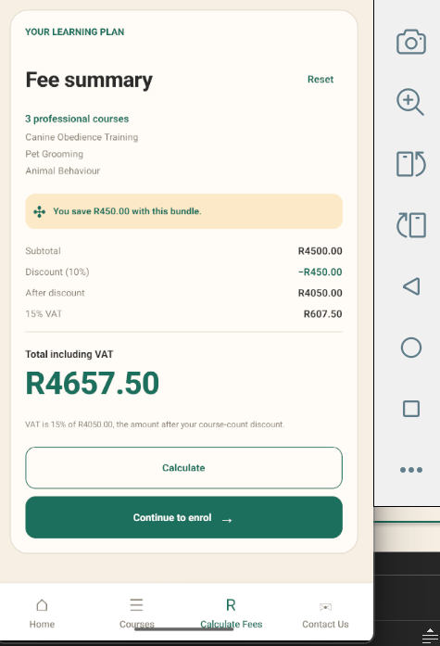
09 • MOBILE APPLICATION DEMONSTRATION
Mobile app: the same service on a phone
Home & About
Introduce the academy and help users understand its purpose.
Courses & Course Details
Browse the available courses and open an individual course.
Fees & Contact
Show the fee calculator and explain how a user contacts the academy.
Technology: React Native • TypeScript • Expo • Android Studio Emulator
PAWSITIVE PET ACADEMY • WIL / XHAW5112
10

Slide 11
10 • CONSISTENCY & USABILITY
A consistent experience across devices
The design language is shared, while each interface is adapted to its platform.
Visual consistency
Clear navigation
Useful feedback
Shared colours, logo, course names and tone.
Users can move between discovery, course information, fees and contact.
Forms and calculations should make the next step clear and understandable.
Show a real example on each platform.
PAWSITIVE PET ACADEMY • WIL / XHAW5112
11

Slide 12
11 • DEVELOPMENT & QUALITY
Implementation and quality checks
Mention only checks you can explain and demonstrate.
Website checks
Mobile checks
Dependency maintenance
Automated tests passed in the inspected archive. A live enquiry had previously been confirmed saved.
The inspected archive passed TypeScript and lint checks. You confirmed the updated app opens in the emulator.
Packages and React Native exports were updated in the newer local version. This is maintenance, not a new user-facing feature.
PAWSITIVE PET ACADEMY • WIL / XHAW5112
12

Slide 13
12 • REFLECTION
Challenges and what we learned
Dependency compatibility
Keeping packages and project exports aligned required updates and checking the app again in the emulator.
PAWSITIVE PET ACADEMY • WIL / XHAW5112
13

Slide 14

PAWSITIVE PET ACADEMY
A website and mobile app designed to make pet-care learning easier to explore.
Thank you
Figma: Wil-WireFrames • Website: mudzani.github.io/pawsitive-Website

