Slide 1

Masterarbeit Notizen
M.Sc. Simon Stock; M.Sc. Marco Stang
cand. el. Simon Müller
Innovative selbstlernende Gestensteuerung im Automotivbereich

Slide 2
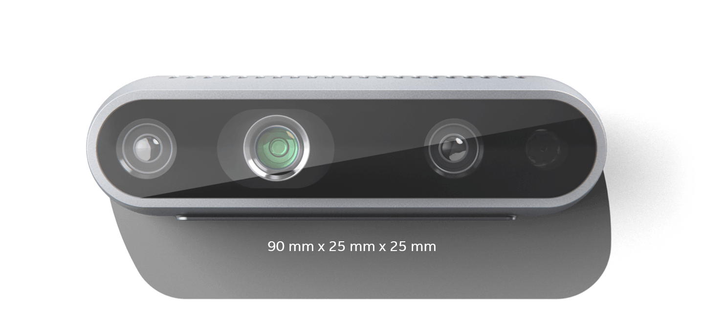
Intel Realsense D435
Working distances:
Min-Z: ~10cm
Max-Z: 10m
=> 30cm – 1m in car should be ok
Depth:
Res: 1280 x 720@90fps
FOV: 87°±3° x 58°±1° x 95°±3°
RGB:
Res: 1920x1080@30fps
FOV: 69.4° x 42.5° x 77° (+/- 3°)
=> Projection needed!*
Projection
* https://github.com/IntelRealSense/librealsense/tree/development/examples/align
https://github.com/IntelRealSense/librealsense/blob/master/wrappers/python/examples/align-depth2color.py

Slide 3
Two-step sequence
Input Frame
RGB
CNN
Intermediate representation
(„Skeleton“)
Gesture
Class
t
Input Frame
Depth
Lowpass
Classifier
LSTM?
KNN?
Siamese?
…
Input Frame
RGB
CNN
Intermediate representation
(„Skeleton“)
No gesture
t+n
Input Frame
Depth
Pose estimation
Gesture classification

Slide 4
Pose Estimation
 | Estimate Joint angles | Estimate Joint position
How | CNN | CNN
+ | Dimensional reduction Easily understandable representation | Dimensional reduction Semi-Automatic labeling with previous work Angles still calculatable
- | How to lable? Manual labeling almost impossible -> Synthetic data? | How do you label occluded joints?

Slide 5
Datasets Hand Pose Estimation
 | FHAD | BigHand 2.2m | cvpr15_MSRAHandGestureDB | FreiHAND | Imperial College London | NvGesture
+ | Skeleton annotations (joint locations) RGBD | Relatively large dataset Well curated because it was/is used in competition | Skeleton annotations (joint locations) |  |  | Relatively large Many subjects
- | Sensors + tape on hands make RGB images risky to work with |  | No RGB |  | No RGB Low contrast | No pose labels

Slide 6
Data augmentation (Núñez et al. 2018, S.84)
Various possibilities:
Scale
Shift
Time interpolation (Hard to do for images)
Noise

Slide 7
Challenge: execution time
Many networks take >30ms
Some even need preprocessing (hand segmentation)
Some use iterative refinement
→ Tradeoff betwen precision and speed

Slide 8
Challenge: Coordinate systems and camera models
Training data was recorded with different cameras → Camera intrinsics will vary between training/application
Most activation functions cut negative values → Normalization required
BUT: Gestures can contain every possible movement → Cropping/Normalization around fixed point of hand (e.g. palm as in [1]) not possible
[1] Malik, Jameel; Elhayek, Ahmed; Stricker, Didier (2018): Structure-Aware 3D Hand Pose Regression from a Single Depth Image. In: Patrick Bourdot, Sue Cobb, Victoria Interrante, Hirokazu kato und Didier Stricker (Hg.): Virtual reality and augmented reality. 15th EuroVR International Conference, EuroVR 2018, London, UK, October 22–23, 2018 : proceedings, Bd. 11162. Cham: Springer (Lecture Notes in Computer Science, 11162), S. 3–17.

Slide 9
Unified Datset Format
Skeleton Coordinates in CAMERA coordinates (apply extrinsics but not intrinsics!)
Allows to detect movement towards camera etc but does not depend on camera orientation
21 Joints
Skeleton joint order:
FHAD compatible: ["wrist", "tmcp", "imcp", "mmcp", "rmcp", "pmcp", "tpip", "tdip", "ttip", "ipip", "idip", "itip", "mpip", "mdip", "mtip", "rpip", "rdip", "rtip", "ppip", "pdip", "ptip"]
Depth image, 640x480
Tfrecords of img/skel pairs. Reduces epoch times by a factor of 10-20

Slide 10
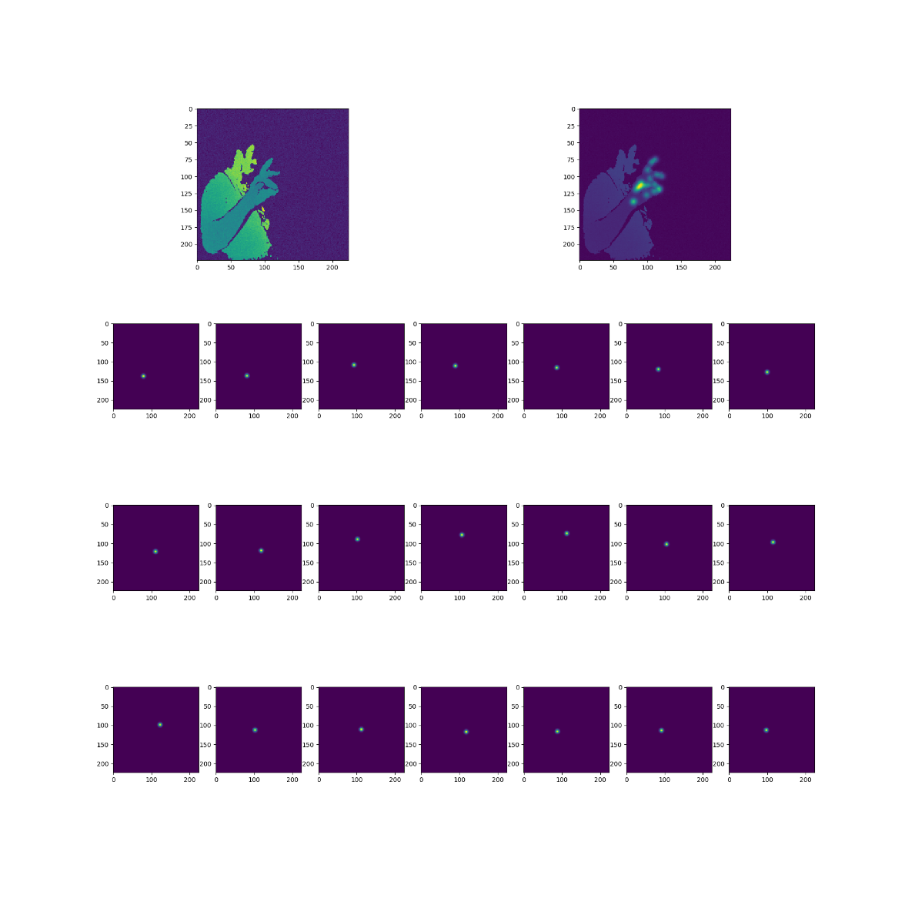
Pose estimation vis confidence maps
CNN generates 21 confidence maps / heat maps, representing gaussian distribution with maximum at joint location
2d joint locations can be retrieved via 2d argmax

Slide 11
CNN Architecture
Direct 3d regression
Confidence maps
Mobilenet V2
Mobilenet V2
Dense 2048
Upsample+Conv / Deconv
Dense 1024
Upsample+Conv / Deconv
(Pose prior Bottleneck < 3x21)
Upsample+Conv / Deconv
…
Output 3x21
Output 224x224x21

Slide 12
Challenge: One-Shot training
New data through data augmentation (Núñez et al. 2018, S.84)
K-Nearest Neighbours on blocks of pose data
Siamese networks
Compare input data with known classes
Output is similarity factor
→ Triple loss function!

Slide 13
GUI
_ □ x
Gesture 1
Gesture 2
Gesture 4
Settings
Samples
Name:
Gesture 3
G3 – Sample 1
G3 – Sample 2
G3 – Sample 3
G3 – Sample 4
Gesture 3
Action:
Mouse 1
▼
Start Control

Slide 14
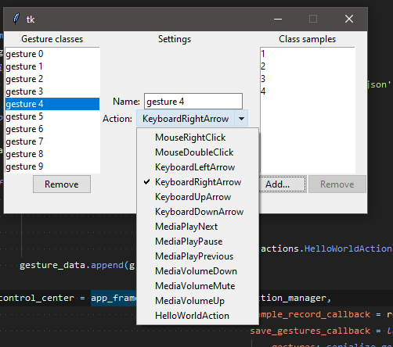
UI – Demo Interface

Slide 15
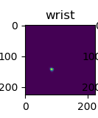
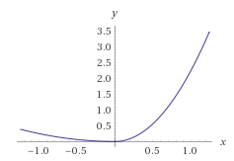
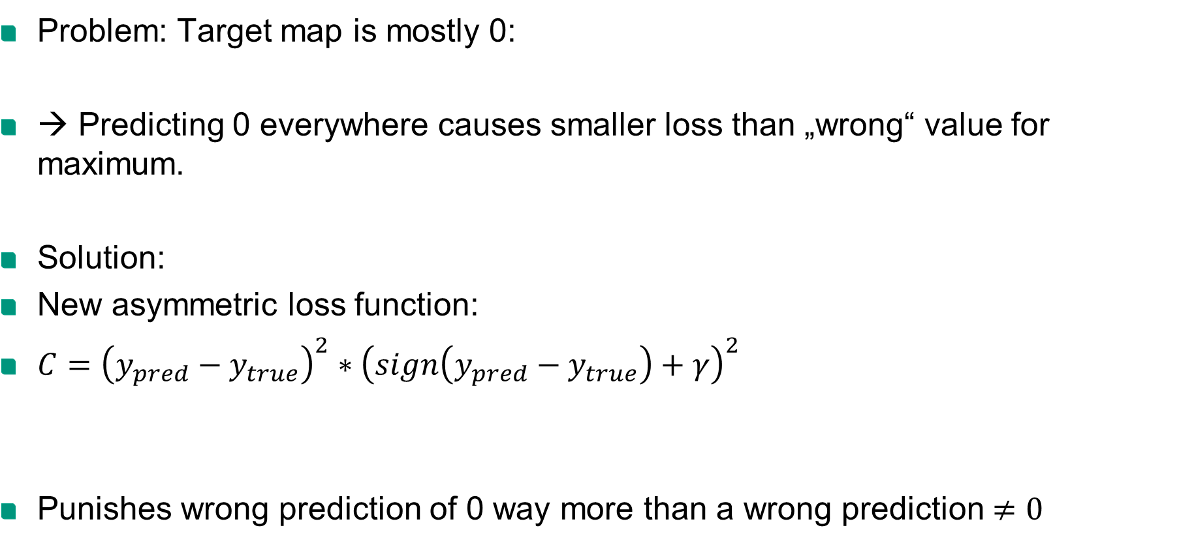
Training
Problem: Target map is mostly 0:
→ Predicting 0 everywhere causes smaller loss than „wrong“ value for maximum.
Solution:
New asymmetric loss function:
$C={\left(y_{pred}−y_{true}\right)}^{2}∗{\left(sign\left(y_{pred}−y_{true}\right)+γ\right)}^{2}$
Punishes wrong prediction of 0 way more than a wrong prediction $≠0$

Slide 16
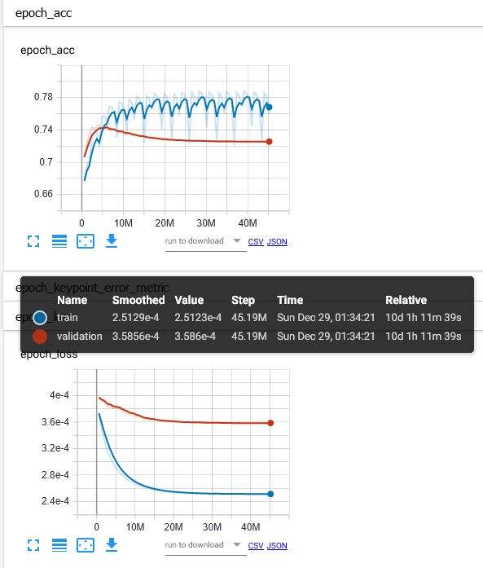
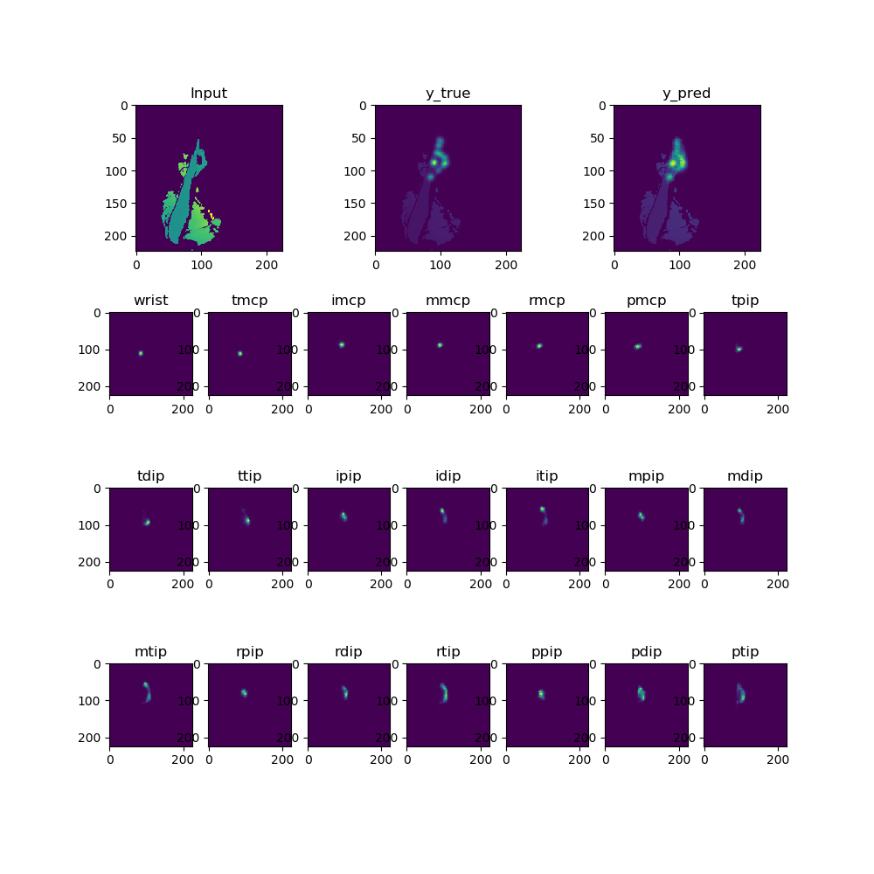
Training

Slide 17
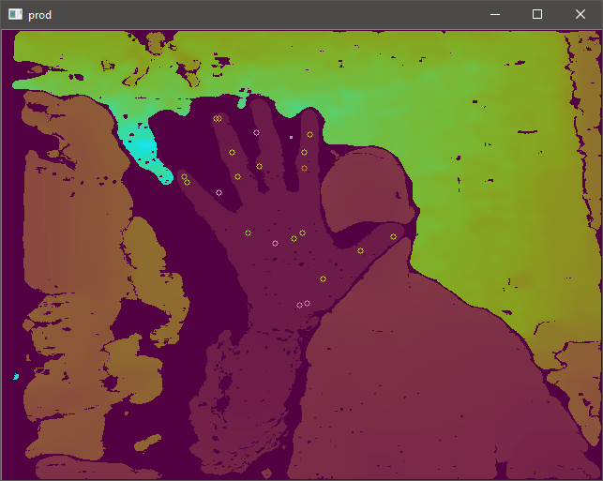
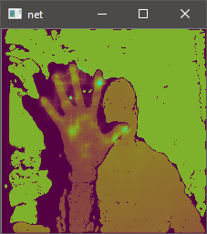
Training
Test-Result
Live result

Slide 18
Ideas for improvement
Low pass filter (reduce jitter caused by uncertainity)
Increase use of augmentation (esp. Rotation)
Reduce number of joints
Test impact of dropout/regularization

Slide 19
TOC
1 Introduction
2 Theoretical Basis
2.1 Human Machine Interfaces
2.1.1 History of Human machine interfaces
2.1.2 Tactile HMI
2.2 Computer Vision
2.2.1 The pinhole camera model
???
2.3 Neural Networks
2.3.1 Activation Functions
2.3.2 Convolutional Neural Networks (CNN)
2.3.3 Special Neural Network Architectures
2.4 Machine Learning
2.4.1 Types of machine learning
2.4.2 Nearest Neighbors
2.4.3 Learning Algorithms
2.4.4 One Shot Learning
2.5 Modeling the human hand
3 Related Work
3.1 Machine Learning
3.2 Computer Vision
3.2.1 Pose estimation
3.2.2 Gesture Classification
4 Conception and Requirements
4.1 Hardwar
4.2 Software
4.1 Datasets and Data Generation
5 Implementation
5.1 Hand pose estimation
5.1.1 Structural training
5.1.2 Training and Hyperparameter Tuning
5.2 Gesture Classification
5.3 Physical Construction
6 Evaluation
7 Conclusion and Outlook

Slide 20
Masterfolie (über: Ansicht – Master – Folienmaster)
Die Masterfolie wird genutzt, um grundlegende Elemente der Präsentation festzulegen und ggf. zu ändern.
Folgende Elemente können Sie in der Normalansicht individuell eintragen:
Inhaltsbereich:
Präsentationsüberschrift
Unterüberschrift
Fakultätsbezeichnung
Bildaustausch (graue Lasche am rechten Folienrand – zum leichteren Austausch)
Fußzeile (über: Ansicht – Kopf- und Fußzeile)

Slide 21
Folientitel: Arial 24pt fett 2-zeilig: Arial 20pt fett
Fließtext: Arial 24pt regular
Fußzeile: Arial 9pt regular
Seitenzahl: Arial 9pt fett
Aufzählungspunkte, falls nicht auf Folie vorhanden:
Format – Nummerierung- und Aufzählungszeichen – Bild – Importieren
Die Datei „kit-point.png“ auswählen
Größe: „70% vom Text“
Farben:
Sind bereits voreingestellt. Sie erhalten automatisch die KIT-Farbpalette

Slide 22
Generelle Hinweise
Das Foliendesign sollte nicht geändert werden
Wenn Sie aus einem anderen Office-Programm Texte kopieren, wird Powerpoint die Formatierungen beibehalten. Hier müssen Sie die Texte evtl. neu formatieren.
Grundlegende Elemente wie diese im grauen KIT-Rahmen, das KIT-Logo oder die Platzhalter sollten in der Position nicht verändert oder gelöscht werden.

Slide 23
Tipps zur Verwendung von Powerpoint
Seitenaufbau
Text und Grafiken: Diese Elemente sollten gezielt und zurückhaltend eingesetzt werden. Empfohlen werden zehn Worte pro Zeile und fünf Zeilen pro Folie.
Zahlen und Daten Effektive PowerPoint-Präsentationen enthalten wenig Zahlen: ausführliche Daten können Sie nach der Präsentation auf Handouts verteilen.

