Slide 1

DriverPass System Analysis
Maxwell Mueller
Notes:
[No speaker notes required for this slide.]

Slide 2

System Requirements
Non-Functional:
System must be compatible with modern browsers:
Edge
Chrome
Firefox
Opera
System must be compatible with mobile browsers:
Safari
Chrome for Android
Firefox for Android
Opera for Android
Functional:
The system shall provide a landing page to the user that displays relevant company information
The system shall allow a user or client to “log in” by filling out a secure form and validating the provided information against the database
The system shall display a dashboard of modules including Online Test Progress, Information, Driver Notes, Special Needs, Driver Photo, and Student Photo
The system shall link of the with the webpage that hosts the HTML for the desired module
Notes:
Functional requirements describe what the system should do, focusing on the specific behaviors or functions of the system. For DriverPass, some key functional requirements might include users, including students and instructors, should be able to create accounts, log in, and manage their profiles, authentication must be secure, supporting password encryption and potential multi-factor authentication, the system must allow students to take practice driving tests that mimic the format of official driving exams. Additionally, the system should track student progress over time, providing feedback and analytics on performance and the Instructors should be able to view and analyze student performance to tailor training sessions. It is also important to remember the non-functional requirements of the system and how they apply, as well. For example, the system should have minimal load times, with web pages loading within 2-3 seconds under normal conditions. The practice exam module must handle simultaneous sessions without performance degradation. Additionally, the system should be available across a variety of devices and browsers.

Slide 3
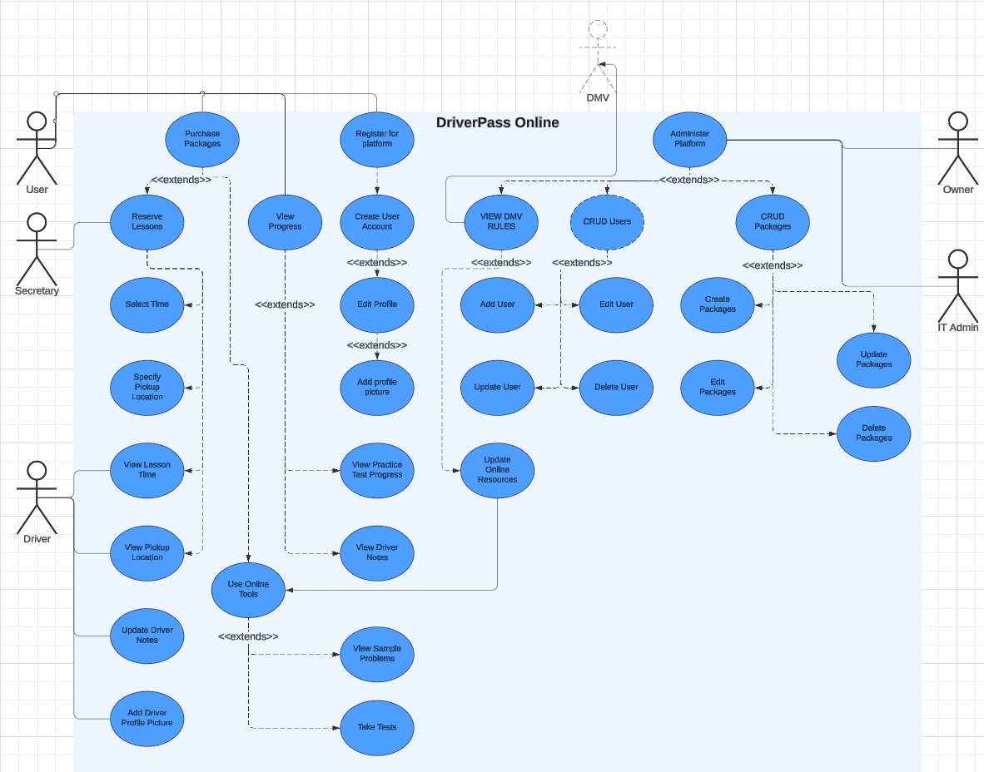
Use Case Diagram
[Insert your use case diagram here.]
Notes:
The system use case diagram starts with the Owner and IT Admin as they have all the modification tools necessary to CRUD users, the system, and packages. The Owner and IT Admin will administer the platform. This includes viewing DMV rules, creating users, creating packages, as well as editing or deleting previously created users or packages. The user will use the system by logging in and creating their user profile. From there, they can upload their profile picture, set a pickup location, take practice tests, and view their progress. Additionally, they will also be able to purchase packages and reserve lesson times. The secretary will be able to reserve lessons from people that come into the office in-person. Additionally, the secretary will be able to view reserved lessons by all users. Finally, the driver will be able to upload a profile picture, view user information like name and pick-up location, and update their notes on each individual user.

Slide 4
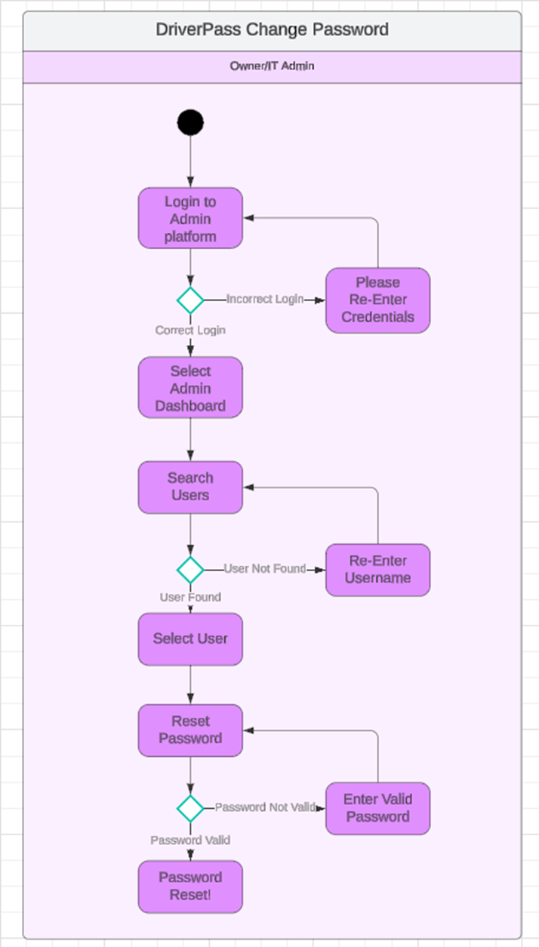
Activity Diagram
Notes:
The process depicted above is that of the Owner/IT Admin when they have to change a password for a user in the system. First, they must log into the system. If their password is input incorrectly, it will re-query them. If the password is correct, they will be able to select the “Admin Dashboard”. From there, they will select the “Search User” function which will all them to enter a username. If the username is incorrect, they will be re-queried. If them username is correct, they will be able to reset the password, if it is valid and follows domain policies.

Slide 5
Security
Username and password protected profile
Encapsulation of methods
Minimal access permissions
Notes:
Security is important in this system design as vital private information will be utilized and exchanged. This system will implement a username and password account system with a requirement that passwords are complex and include 1 symbol, 1 number, 1 uppercase letter, and have 10 characters. Additionally, emphasis was put on designing a system in a way that low-level accounts do not have access to modifying methods of other account types. For example, a simple User account is unable to view, read, write, modify, any account other than its own particular instance. The secretary, for example, will be able to reserve lessons and read and write user information but will not be able to reset user passwords or view practice test progress. Additionally, the Owner has permission elevation above the IT Admin so the IT Admin cannot CRUD Owner Accounts. Future updates will include the implementation of multi-factor authentication.

Slide 6
System Limitations
Time
Five-month deadline from inception to sign-off meeting
Technology
Based on the interview, DriverPass is a small company
System components must be optimized to handle the workload but also stay within the constraints of their budget
One server will handle the workload up until a certain point where it will then create outages
DriverPass has one IT employee to handle administrative tasks across the whole system
Notes:
The limitations in this system design are really going to occur as the system scales. Once DriverPass is handling millions of login instances, it will be impossible for one server at one site to keep up. This will provide an outage limitation, where the system will cause outages to some users as it can only serve so many. Additionally, it will cause a budget limitation as, if the company cannot afford to invest in infrastructure at that point, the system will completely fail. Additionally, the system will fail if there is not enough time put into the project at the beginning to really solidify business practices. We have 5 months from inception to the sign-off meeting. It is going to have to be all hands on deck in order to ensure proper system implementation.

