Slide 1
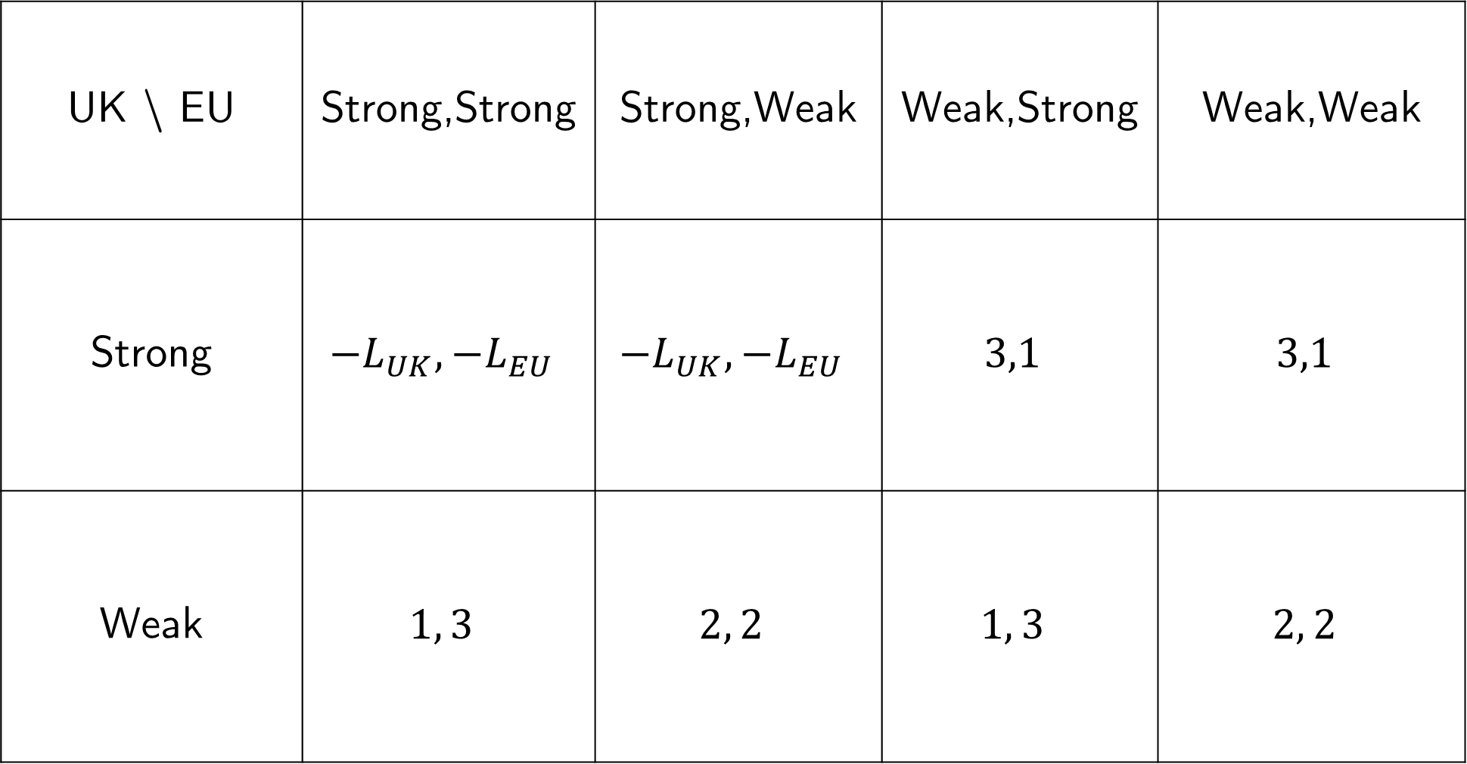
UK \ EU | Strong,Strong | Strong,Weak | Weak,Strong | Weak,Weak
Strong | $${−L}_{UK},{−L}_{EU}$$ | $${−L}_{UK},{−L}_{EU}$$ | $$3,1$$ | $$3,1$$
Weak | $$1, 3$$ | $$2, 2$$ | $$1, 3$$ | $$2, 2$$

Slide 2
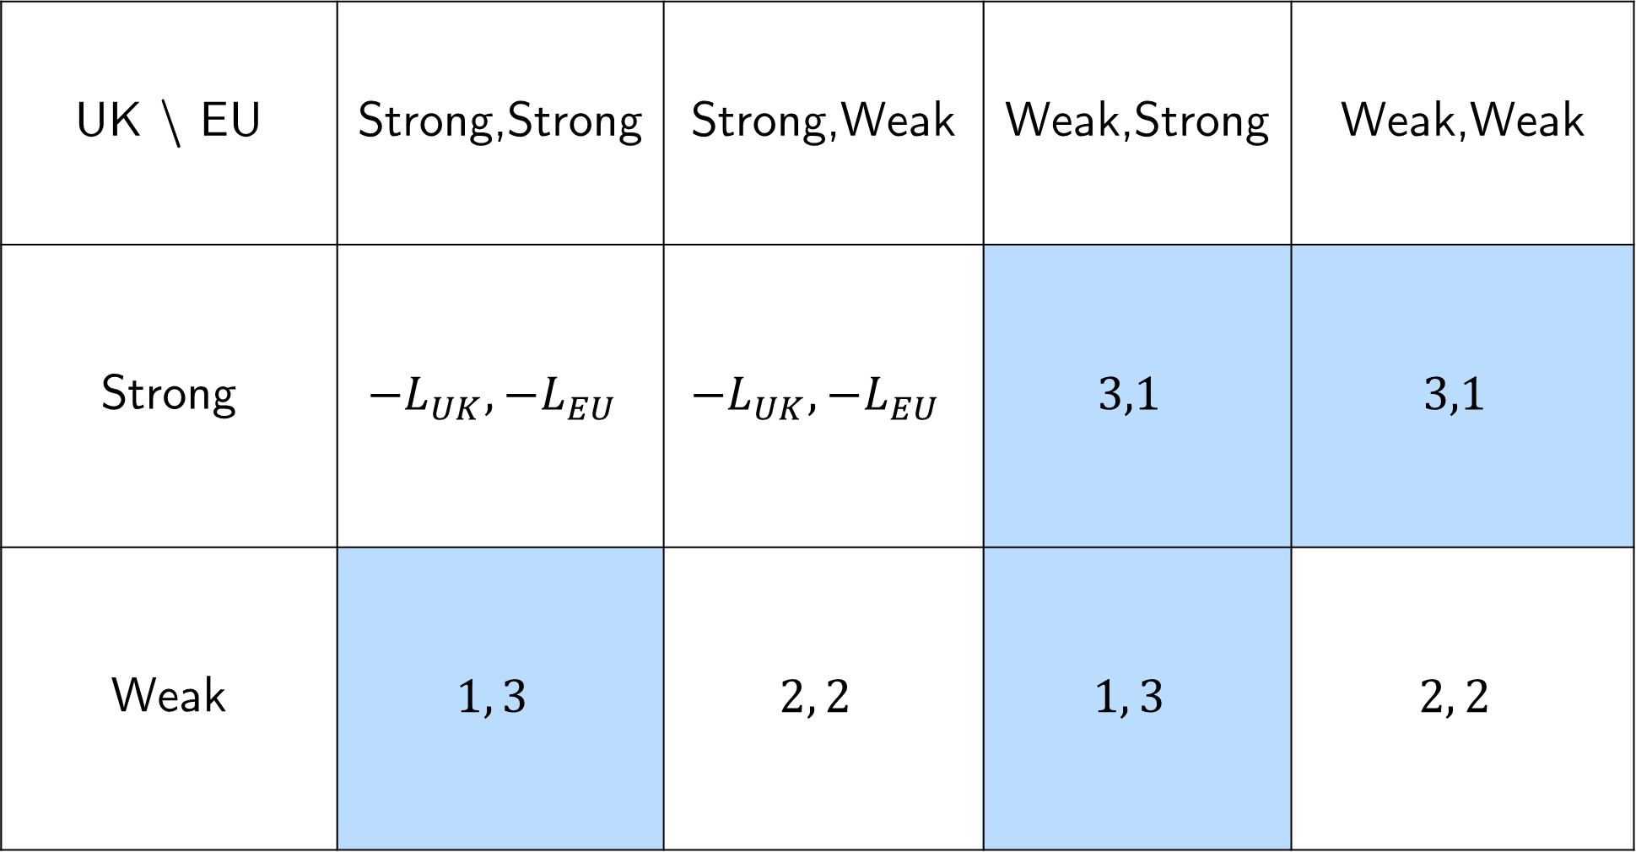
UK \ EU | Strong,Strong | Strong,Weak | Weak,Strong | Weak,Weak
Strong | $${−L}_{UK},{−L}_{EU}$$ | $${−L}_{UK},{−L}_{EU}$$ | $$3,1$$ | $$3,1$$
Weak | $$1, 3$$ | $$2, 2$$ | $$1, 3$$ | $$2, 2$$

