Slide 1
ARCHITECTURE & MATERIALS
Timber / Steel / Masonry
Structural Logic, Material Culture, and Environmental Performance
30-Slide Academic Presentation · Architecture & Structural Engineering
I. TIMBER (Slides 1–10)
II. STEEL (Slides 11–20)
III. MASONRY (Slides 21–30)
Prepared: June 2026

Slide 2

TIMBER
1 / 30
Timber as a Structural Material
Organic, Anisotropic, and Inherently Renewable
▪
Anisotropy and Grain Direction
Timber is an organic, orthotropic material. Mechanical strength varies with grain direction: parallel-to-grain tensile and compressive values far exceed perpendicular-to-grain values — a fundamental constraint governing every connection and panel detail (Allen & Iano, 2019).
▪
Strength-to-Weight Ratio
The specific strength (strength/density) of structural timber approaches mild steel, making it one of the most weight-efficient structural materials available for spans up to 30–40 m (Porteous & Kermani, 2013).
▪
Moisture and Dimensional Stability
Below fiber saturation (~30% MC), timber shrinks as it dries and swells as it gains moisture — exclusively perpendicular to grain. Poor moisture detailing causes splitting, fastener withdrawal, and long-term serviceability failure.
▪
Engineered Timber Products
CLT, glulam, and LVL overcome natural variability by cross-laminating or bonding fiber layers under factory conditions, producing dimensionally stable, large-format structural elements suitable for urban buildings at multi-storey scale.
▪
Carbon Sequestration
Trees absorb CO₂ during growth. When used in durable buildings, this biogenic carbon remains stored for the structure's service life, contributing to net carbon reduction in construction (Ramage et al., 2017).
◆ Timber's structural behavior is direction-dependent: efficient parallel to grain, vulnerable perpendicular to grain — every connection and detail must reflect this anisotropy.
Brock Commons Tallwood House, Vancouver (Acton Ostry Architects, 2016) Richard Gao / Wikimedia Commons | CC BY-SA 4.0
(Allen & Iano, 2019; Porteous & Kermani, 2013; Ramage et al., 2017)

Slide 3
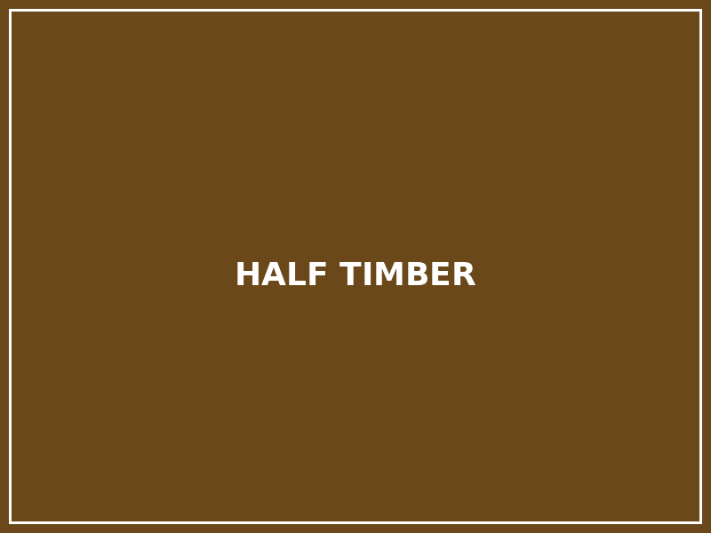
TIMBER
2 / 30
Historical Evolution of Timber Construction
From Vernacular Craft to Engineered Mass Timber
▪
Vernacular and Pre-industrial Timber
Post-and-beam, mortise-and-tenon, and scarf joints defined timber construction from prehistoric shelters through medieval Europe. Japanese and Scandinavian traditions developed highly refined structural systems without metal fasteners (Addis, 2007).
▪
Half-Timbering and Gothic Carpentry
Medieval half-timbering integrated exposed structural frames with infill panels. Gothic roof carpentry — tie beams, crown posts, hammer beams — pushed timber structural design to extraordinary formal and technical complexity.
▪
Industrial Sawmilling and Platform Framing
19th-century industrial sawmilling enabled standardized dimensional lumber, leading to balloon and platform framing in North America — lightweight, repetitive systems that remain the dominant low-rise residential structural approach globally.
▪
Development of Engineered Wood Products
Glulam (laminated glued lumber, developed 1900–1940s), LVL, PSL, and OSB restored timber relevance for longer spans and larger structures, enabling sports halls, school gymnasiums, and medium-span industrial buildings through the mid-20th century.
▪
21st-Century Mass Timber Revival
CLT (cross-laminated timber), pioneered in Austria in the 1990s, launched a mass timber movement that repositioned wood as a viable urban building material for multi-storey construction, driven by climate targets and prefabrication economics (Ramage et al., 2017).
◆ Timber's history is a series of technical revolutions: from craft joinery, to industrial framing, to engineered panels — each driven by new production technologies rather than material change.
Staple Inn, High Holborn, London — Tudor half-timbered frame construction Wikimedia Commons | CC BY-SA 3.0
(Addis, 2007; Ramage et al., 2017; Lehmann, 2012)

Slide 4
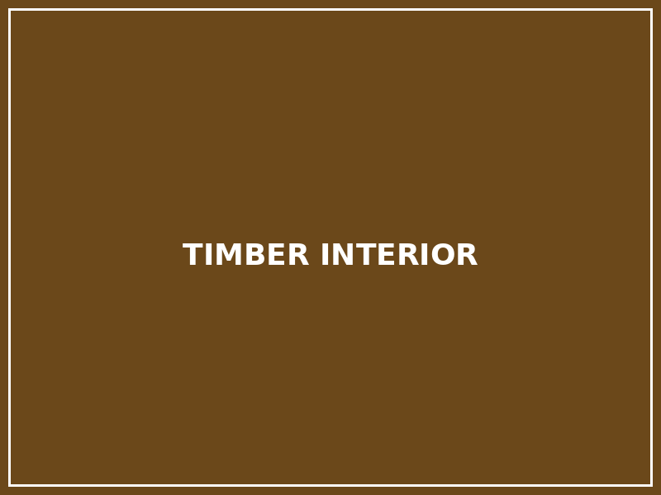
TIMBER
3 / 30
Material Properties: Anisotropy, Moisture, and Fire
Engineering Constraints Embedded in a Natural Material
▪
Orthotropic Mechanical Behavior
Timber has three principal grain directions — longitudinal, radial, and tangential — each with distinct strength and stiffness values. Structural design exploits longitudinal properties; perpendicular-to-grain loads must be strictly limited in all details.
▪
Moisture Equilibrium and Creep
Moisture content governs dimensional stability and long-term deflection. Creep under sustained loading is more significant in timber than in steel; CLT and glulam floor elements require explicit creep factors in deflection calculations (Porteous & Kermani, 2013).
▪
Fire Performance: Charring Rate
Mass timber chars at approximately 0.65 mm/min (species-dependent). The char layer thermally insulates the inner structural core, enabling load-bearing capacity to persist for calculable durations. Timber does not fail suddenly — it reduces capacity gradually.
▪
Sacrificial Char Design
Fire design of mass timber oversizes structural sections to provide a calculated char depth reserve. Connections — the most fire-vulnerable components — receive protection through timber encasement, intumescent coatings, or concealed steel plates.
▪
Biological Susceptibility
Sustained moisture above 18–20% promotes fungal decay; wood-boring insects attack inadequately protected timber in warm climates. Correct drainage, ventilation, vapor barriers, and species selection are the primary durability strategies.
◆ Timber burns predictably: the char layer protects the structural core for calculable time. Fire design is not a material limitation — it is a section-sizing and detailing discipline.
Glulam beam — glued laminated timber showing lamination layers Wikimedia Commons | CC BY-SA 3.0
(Porteous & Kermani, 2013; Buchanan & Levine, 1999)

Slide 5
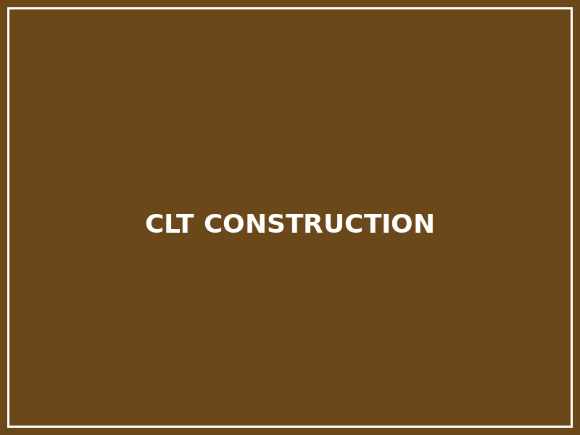
TIMBER
4 / 30
Timber Structural Systems and Load Paths
Post-and-Beam, CLT Panels, Glulam Arches, and Hybrid Systems
▪
Post-and-Beam and Timber Frame
Discrete glulam or LVL columns and beams form a structural grid. Loads travel from floor to beams to posts to foundations. Lateral stability requires bracing, shear walls, or rigid connections; the frame alone is usually insufficient for lateral loads.
▪
CLT Panel System
CLT panels act as structural floors, walls, and cores simultaneously. Cross-lamination creates two-way spanning capacity. Panel-to-panel connections via screws, lap joints, or proprietary hardware transfer both gravity and diaphragm forces to lateral-resistance elements (Allen & Iano, 2019).
▪
Glulam Arches and Long Spans
Curved glulam arches exploit timber's compressive efficiency to achieve clear spans of 30–80+ m in sports halls, bridges, and exhibition spaces. The three-pinned arch is the most common statically determinate configuration for long-span roof structures.
▪
Hybrid Timber Systems
Tall timber buildings almost universally use hybrid strategies: CLT or glulam for floors and secondary structure, concrete or steel cores for lateral stability, and composite deck details for vibration and fire performance (Smith & Frangi, 2014).
▪
Prefabrication Logic
Factory-fabricated CLT and glulam panels arrive on-site as dimensional components CNC-cut to precise tolerances. Typical erection rates in mass timber buildings: one structural floor per 2–5 working days, significantly faster than concrete.
◆ In CLT buildings, the floor–wall–core junction is the critical structural node: gravity load transfer, diaphragm continuity, and lateral stability all converge at this single detail.
Mass timber prefabricated construction — Brock Commons Tallwood House Richard Gao / Wikimedia Commons | CC BY-SA 4.0
(Allen & Iano, 2019; Smith & Frangi, 2014; Porteous & Kermani, 2013)

Slide 6
TIMBER
5 / 30
Timber Connections and Construction Logic
Joinery, Mechanical Fasteners, CNC Fabrication, and Moisture Protection
▪
Traditional vs. Mechanical Connections
Traditional mortise-and-tenon joinery relies on wood-to-wood bearing. Modern connections use high-strength timber screws, dowels, through-bolts, and concealed steel plates (Sherpa, Simpson, and custom connectors) — offering higher capacity and better performance under complex load combinations.
▪
Connection as Structural Governing Factor
In most timber buildings, connection capacity — not member section — governs the design. Notching, cross-grain stresses, and end-grain loading at joints must be calculated explicitly; connection failure is brittle and sudden (Porteous & Kermani, 2013).
▪
CNC Fabrication and Assembly Precision
CNC (Computer Numerical Control) timber processing enables submillimeter precision in cutting, drilling, and milling, making complex 3D joinery feasible at production scale. Pre-drilled elements arrive on-site ready for rapid bolted assembly.
▪
Moisture Protection at Connections
All connections must be designed to prevent moisture accumulation: exposed metal is vulnerable to corrosion; trapped moisture causes timber decay at connection zones. Design for draining, drying, and inspection access is essential for long-term durability.
▪
Assembly Sequence
Prefabricated CLT and glulam buildings require crane access and precise delivery sequencing; panels cannot be stacked interchangeably. The structural assembly sequence often determines the entire site logistics and construction program.
◆ In timber construction, the connection is the most technically critical element — it governs strength, fire behavior, moisture durability, and long-term serviceability simultaneously.
Brock Commons Tallwood House, Vancouver (Acton Ostry Architects, 2016) Richard Gao / Wikimedia Commons | CC BY-SA 4.0
(Porteous & Kermani, 2013; Allen & Iano, 2019)

Slide 7

TIMBER
6 / 30
Environmental Performance of Timber
Carbon Sequestration, Life-Cycle Assessment, and the Limits of Sustainability Claims
▪
Renewable and Carbon-Storing
Timber is the only major structural material that is biologically renewable. Trees absorb CO₂ during growth; when used in long-lived buildings, this carbon remains stored for the service life of the structure, contributing to net carbon reduction (Ramage et al., 2017).
▪
Embodied Carbon Comparison
LCA studies show that CLT construction can achieve significantly lower embodied carbon than equivalent concrete or steel structures — potentially net-negative in carbon terms for the structural frame — when certified timber and long service lives are assumed (De Wolf et al., 2017).
▪
Certified Forestry (FSC / PEFC)
Carbon benefits depend critically on responsible forest management. FSC and PEFC certification schemes verify that harvest rates are matched by regrowth, maintaining long-term forest carbon stocks. Uncertified timber supply chains can undermine all environmental claims.
▪
Prefabrication and Waste Reduction
Factory-fabricated mass timber systems generate significantly less construction waste than cast-in-place concrete. CNC cutting optimizes material use; off-cuts are often used for secondary components or biomass energy recovery.
▪
End-of-Life Strategy
Timber stored in landfill decomposes, releasing stored carbon. Structural reuse of timber elements, or cascade use (furniture, biomass), is necessary to close the material's carbon cycle and realize genuine life-cycle benefits (Buchanan & Levine, 1999).
◆ Timber is not automatically sustainable: only certified forestry, efficient production, long building life, and responsible end-of-life planning together realize the material's genuine environmental potential.
Managed forest — the renewable raw material basis of structural timber Library of Congress / Wikimedia Commons | Public Domain
(Ramage et al., 2017; De Wolf et al., 2017; Buchanan & Levine, 1999)

Slide 8

TIMBER
7 / 30
Case Study: Mjøstårnet, Brumunddal, Norway (2019)
Voll Arkitekter — 85.4 m, 18 Storeys — World's Tallest Timber Building
▪
Project Overview
Completed in 2019, Mjøstårnet reaches 85.4 m and contains mixed uses: hotel, apartments, offices, and a public indoor swimming pool. It is certified as the world's tallest timber building and demonstrates that tall timber is commercially, legally, and structurally viable (Voll Arkitekter, 2019).
▪
Structural System
Primary structure: glulam columns and diagonal X-bracing trusses visible on the façade, with CLT floor panels and shaft walls. The exposed glulam bracing system resolves lateral wind loads while serving as the building's primary architectural expression — structural logic made visible.
▪
Hybrid Strategy Above Floor 10
CLT floor decks are replaced by concrete slabs above the 10th floor to increase mass and reduce floor vibration response — a pragmatic hybrid decision driven by occupant comfort, not structural necessity (Kuzmanovska et al., 2018).
▪
Fire Strategy
Large-section glulam members provide inherent char protection; the building is fully sprinklered; fire separation is achieved through fire-rated CLT walls and protected stairwells. Norwegian code compliance for tall buildings was established through performance-based fire engineering analysis.
▪
Carbon and Prefabrication
Timber elements were sourced from Norwegian forests and prefabricated locally, minimizing transport carbon. Structural carbon footprint is substantially biogenic (stored) rather than fossil-based, making this one of the lowest-carbon tall building structures constructed to date.
◆ Mjøstårnet is not just a record-holder: it is a proof of concept that mass timber, hybrid structural strategies, and performance-based fire engineering can together produce viable tall urban buildings.
Mjøstårnet, Brumunddal, Norway (Voll Arkitekter, 2019) — 85.4 m, 18 storeys Statsbygg / Wikimedia Commons | CC BY 4.0
(Kuzmanovska et al., 2018; Voll Arkitekter, 2019; Ramage et al., 2017)

Slide 9
TIMBER
8 / 30
Case Study: Brock Commons & Tamedia Office Building
Prefabrication Speed vs. Structural Expression — Two Philosophies in Mass Timber
▪
Brock Commons: 18-Storey Student Residence
Brock Commons Tallwood House (Vancouver, 2016; Acton Ostry Architects) is an 18-storey, 53 m student residence at UBC, constructed with remarkable speed: the mass timber structure was erected at approximately one floor per day using prefabricated CLT and glulam elements (Acton Ostry Architects, 2016).
▪
Brock Commons: Structural Strategy
A concrete podium and two concrete cores provide lateral stability and fire egress. CLT floor panels span between glulam columns from floors 2 to 18. Structural concrete encasement of the base columns and concrete cores reflects a pragmatic hybrid approach prioritizing code compliance and construction speed over full timber expression.
▪
Tamedia: Joinery-Based Office Building
Tamedia Office Building (Zurich, 2013; Shigeru Ban Architects) uses a fully exposed, seven-storey timber structure with custom-engineered wood-to-wood connections free of metal fasteners — a contemporary interpretation of Japanese joinery at building scale.
▪
Tamedia: Structural Expression
Spruce columns and beams are connected by CNC-milled hardwood dowel joints, creating a system visible from every interior point. The exposed timber is simultaneously structure, finish, and spatial character — reducing material layers and expressing structural honesty throughout the building (Shigeru Ban Architects, 2013).
▪
Design Spectrum
Brock Commons and Tamedia represent opposite ends of a mass timber design spectrum: maximum construction efficiency vs. maximum structural expression. Both are technically successful; the appropriate choice depends on programme, budget, climate, and intent.
◆ Brock Commons proves that mass timber can be industrially fast; Tamedia proves it can be architecturally precise — the spectrum between them defines the range of contemporary timber practice.
Brock Commons Tallwood House, Vancouver (Acton Ostry Architects, 2016) Richard Gao / Wikimedia Commons | CC BY-SA 4.0
(Acton Ostry Architects, 2016; Shigeru Ban Architects, 2013; Lehmann, 2012)

Slide 10
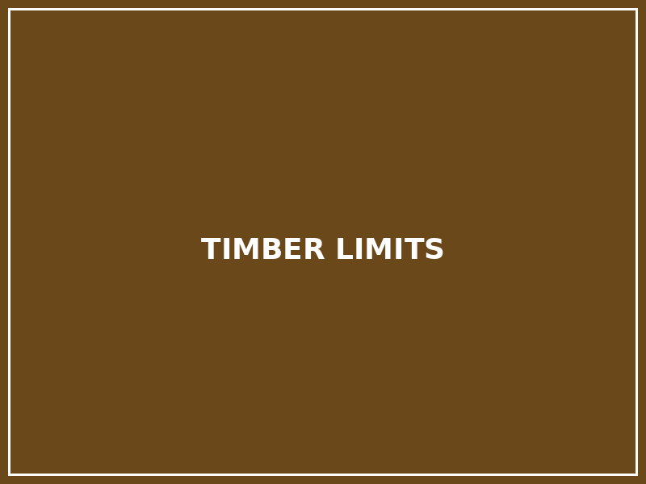
TIMBER
9 / 30
Limitations and Design Risks of Timber
Moisture, Decay, Acoustics, Vibration, and Regulatory Constraints
▪
Moisture and Biological Decay
Sustained moisture above 18–20% promotes fungal decay; wood-boring insects cause structurally significant damage without visible surface evidence. Poor detailing at roof connections, wall bases, and junction zones — where water can pond or migrate — is the dominant cause of long-term timber building failure (Allen & Iano, 2019).
▪
Acoustic Performance
CLT floor assemblies without adequate topping, floating screed, or resilient underlayer typically fail residential impact sound standards. Airborne sound transmission through CLT floors and walls also requires multi-layer assemblies with mass and decoupling, adding complexity and cost.
▪
Floor Vibration
Lightweight timber floors in spans exceeding 6–8 m can exhibit vibration at frequencies (4–8 Hz) that are perceptible and uncomfortable to occupants. Explicit vibration serviceability checks to national standards are mandatory for all longer-span timber floor designs.
▪
Creep and Long-Term Deflection
Under sustained loading, timber deflects more than initial elastic calculation suggests. Creep factors of 0.6–0.8 must be applied in Eurocode 5 deflection checks; unattended creep causes visible sag, cracking of finishes, and potential serviceability failure (Porteous & Kermani, 2013).
▪
Regulatory and Insurance Constraints
Building codes and insurance markets in many jurisdictions restrict timber building height and occupancy type more severely than concrete or steel. Performance-based fire engineering approval processes add time and cost to mass timber projects, particularly for first-of-type applications in new markets.
◆ Timber failure in buildings is rarely due to material inadequacy — it is almost always the result of moisture detailing error, acoustic under-design, or inadequate vibration engineering.
Glulam structural timber — precise fabrication and connection detailing are essential Wikimedia Commons | CC BY-SA 3.0
(Porteous & Kermani, 2013; Allen & Iano, 2019)

Slide 11
TIMBER
10 / 30
Timber Synthesis: Why Timber Matters Today
Carbon, Prefabrication, and the Architecture of Lightweight Structure
▪
Climate Imperative
Construction accounts for approximately 38% of global CO₂ emissions. Timber is the only widely available structural material that sequesters rather than emits carbon during production, making it strategically significant in any carbon-reduction construction pathway (Ramage et al., 2017).
▪
Proven Technical Viability
Mass timber has demonstrated structural viability from residential to 85-metre towers, in office, residential, educational, and cultural building types. Performance-based codes in Norway, Austria, and Canada have established clear precedents that other jurisdictions are progressively adopting.
▪
Prefabrication and Efficiency
CLT and glulam's factory fabrication reduces on-site construction time, workforce requirements, and waste generation. The DfMA (Design for Manufacture and Assembly) logic of mass timber aligns with industrialization trends in the construction sector.
▪
Biophilic and Occupant Benefits
Research consistently associates exposed timber interiors with measurable occupant wellbeing outcomes: reduced stress response, improved cognitive performance, and higher reported satisfaction — architectural qualities that reinforce the technical case for timber as a building material (Lehmann, 2012).
▪
The Disciplined Future
Timber's future requires engineering precision: moisture detailing, acoustic design, vibration analysis, certified supply chains, and end-of-life planning. It is neither a universal solution nor a nostalgic retreat — it is a technically rigorous material choice with genuine climate and architectural potential.
◆ Timber's future is not romantic — it is disciplined: precision detailing, verified LCA, and genuine carbon accounting are the only bases on which timber's environmental and structural claims stand.
Mjøstårnet, Brumunddal, Norway (Voll Arkitekter, 2019) — 85.4 m, 18 storeys Statsbygg / Wikimedia Commons | CC BY 4.0
(Ramage et al., 2017; Lehmann, 2012; Smith & Frangi, 2014)

Slide 12
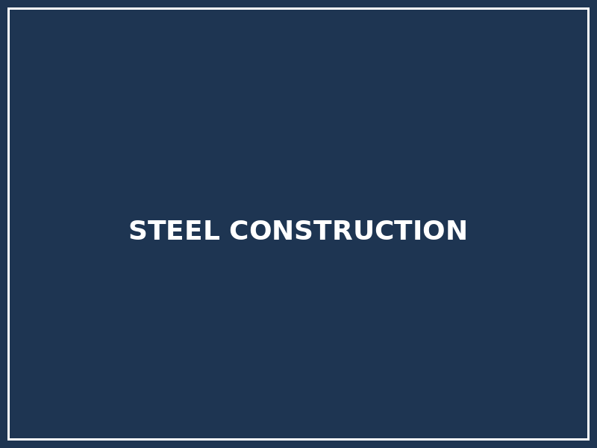
STEEL
11 / 30
Steel as a Structural Material
Industrial, Isotropic, High-Strength, and Ductile
▪
Isotropic and Homogeneous
Structural steel is an iron-carbon alloy produced through controlled industrial processes. Unlike timber, steel is isotropic: mechanical properties are equal in all directions, enabling precise calculation and standardized section production with highly reliable, predictable structural behavior (Lim, 2019).
▪
Tensile and Compressive Strength
Structural steel yield strength: 275 MPa (S275) to 355 MPa (S355) — approximately ten times the compressive strength of concrete and thirty times that of standard timber. This high strength allows slender sections to carry large loads, enabling long spans and high-rise structures with minimal material volume.
▪
Ductility and Seismic Performance
Steel's ductility — its ability to deform plastically before fracture — is its most critical seismic property. Ductile frames dissipate earthquake energy through controlled yielding, preventing sudden collapse and giving occupants time to evacuate (Allen & Iano, 2019).
▪
Precision and Standardization
Structural steel sections (I-beams, H-columns, channels, angles, hollow sections) are produced to millimeter tolerances in standard grades and dimensions worldwide. Standardization simplifies calculation, enables international procurement, and supports fast-track project delivery.
▪
Critical Vulnerabilities
Steel's performance limitations are well-defined: yield strength decreases by 50–70% above 550°C (fire); surfaces corrode without protection (wet environments); and thermal conductivity (~50 W/mK) creates significant heat bridges in building envelopes. All three require explicit design response.
◆ Steel's structural identity is defined by high tensile capacity, predictable ductility, and dimensional precision — but fire protection, corrosion control, and thermal bridging are non-negotiable engineering obligations.
Steel frame high-rise under construction — erection of structural steel skeleton Wikimedia Commons | CC BY-SA 4.0
(Lim, 2019; Allen & Iano, 2019)

Slide 13

STEEL
12 / 30
Historical Evolution: From Cast Iron to Modern Steel
Bessemer Process, Crystal Palace, Eiffel Tower, and the Birth of the High-Rise
▪
Cast Iron and Early Iron Structures
Cast iron (compressive, brittle) dominated 18th–early 19th century structural applications: columns, bridge arches, and mill building frames. Wrought iron provided improved tensile strength for beams and tension members. Both materials preceded modern structural steel but established the concept of metallic framing.
▪
Crystal Palace (1851): Industrial Prefabrication
Crystal Palace (Joseph Paxton) demonstrated prefabricated modular iron-and-glass construction: 83,000 sq m erected in approximately 9 months using standardized components — an unprecedented achievement of industrial production applied to architecture (Addis, 2007).
▪
Eiffel Tower (1889): Structural Expression
The Eiffel Tower's 7,300 tonnes of latticed iron were assembled from 18,038 individually calculated components. Gustave Eiffel's wind-loading calculations were among the first scientifically rigorous applications of structural analysis to a major building — making the tower as important as an engineering milestone as an architectural one (Billington, 1983).
▪
Bessemer Process and the Steel Frame
The Bessemer process (1856) massively reduced steel production costs. By the 1880s, standardized rolled steel sections replaced iron. The Home Insurance Building (Chicago, 1885; Jenney) first transferred building loads entirely through a metal frame, liberating the exterior wall from structural duty.
▪
Modern Steel Construction
20th-century steel construction evolved through standardized sections, high-strength bolts (replacing rivets), automatic welding, and computerized structural analysis, producing the global high-rise building stock that defines contemporary city skylines.
◆ The steel frame eliminated the load-bearing wall — freeing the façade, enabling flexible plans, and making modern tall buildings possible. This structural revolution of the 1880s fundamentally redefined architectural scale.
Crystal Palace, London (Joseph Paxton, 1851) — prefabricated iron-and-glass structure Dickinson Brothers / Wikimedia Commons | Public Domain
(Addis, 2007; Billington, 1983)

Slide 14
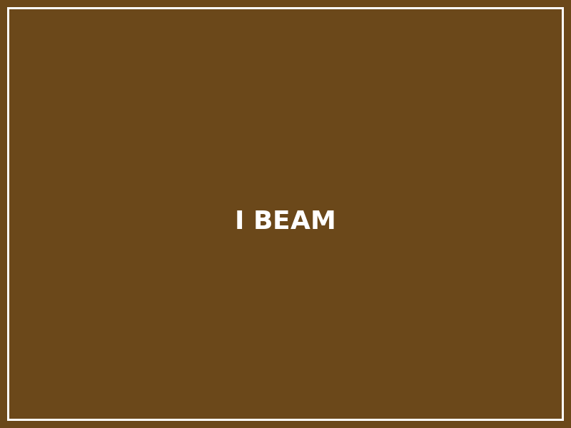
STEEL
13 / 30
Material Properties: Strength, Ductility, and Structural Behavior
Yield Strength, Modulus of Elasticity, Buckling, Fire, and Thermal Bridges
▪
Yield Strength and Plastic Behavior
At yield strength (fy), steel enters permanent plastic deformation before strain-hardening. Plastic design methods exploit this plateau, allowing redistribution of forces in statically indeterminate systems. Ultimate tensile strength (fu) exceeds fy by 20–30%, providing significant overstrength reserve.
▪
Elastic Modulus and Stiffness
Steel's modulus of elasticity (E ≈ 200–210 GPa) is approximately three times concrete and ten times structural timber. This high stiffness enables slender members with minimal deflection — but also means buckling (not yielding) often governs the design of columns and beams (Lim, 2019).
▪
Buckling as Governing Failure Mode
Slender steel columns fail by Euler buckling at stresses well below yield. Lateral-torsional buckling governs unrestrained steel beams under bending. Plate buckling governs thin-walled sections. All three require explicit calculation beyond material strength checks.
▪
Fire-Induced Strength Loss
At 300°C, steel retains ~80% of ambient yield strength. At 550°C, retention falls to ~30%. At 700°C, near-complete loss occurs. All structural steel in fire-risk zones requires fire protection — intumescent paint, board encasement, or concrete encasing — calibrated to the design fire scenario.
▪
Thermal Conductivity and Bridges
Steel's thermal conductivity (~50 W/mK) is 1,500× greater than mineral wool insulation. Connections between steel structural elements and building envelopes create significant thermal bridges unless detailed with thermal break systems, increasing energy loss and condensation risk.
◆ Steel is strong in tension — but fire protection and stability against buckling are not secondary concerns: they are primary structural design obligations that govern section selection in most practical applications.
Structural steel I-beam (W-section) — standard cross-section for beams and columns Wikimedia Commons | CC BY-SA 2.5
(Lim, 2019; Allen & Iano, 2019)

Slide 15

STEEL
14 / 30
Steel Structural Systems and Load Paths
Frames, Trusses, Space Frames, Cables, and Diagrids
▪
Moment-Resisting Frames
Rigid beam-column connections transfer both gravity and lateral loads through bending and shear in columns and beams. Moment frames are ductile under seismic loading and allow open, unbraced floor plans — essential for flexible office and mixed-use building typologies.
▪
Braced Frames
Diagonal steel bracing (K-brace, X-brace, eccentric brace) resists lateral loads primarily through axial forces, providing stiff lateral resistance with minimal material. Eccentric braced frames (EBF) add ductility through controlled link element yielding for seismic applications (Taranath, 2012).
▪
Trusses for Long Spans
Trusses resolve loads into axial tension and compression in individual members, achieving very long spans (20–100+ m) with minimal self-weight. Applications: roof structures, bridge decks, floor transfer structures, and stadium canopies.
▪
Space Frames and Cable Structures
Double-layer space frames span in two directions with uniform depth, suited for large column-free roof areas. Cable structures (stayed or suspended) exploit steel's tensile strength for ultra-long spans with minimal material volume, used in stadium roofs, bridges, and atrium structures.
▪
Diagrid Exoskeletons
Diagrid systems — diagonal external grid frames — transfer gravity and lateral loads simultaneously through inclined members, reducing or eliminating internal core requirements. The Hearst Tower (Foster+Partners, NYC) reduced steel tonnage by approximately 20% compared to a conventional braced frame.
◆ Steel's versatility lies in its ability to organize load paths into multiple structural languages: the same material can express tension (cable), compression (arch), bending (beam), or combined action (diagrid) with equal efficiency.
Centre Georges Pompidou, Paris (Piano & Rogers, 1977) — exposed steel and services Wikimedia Commons | CC BY-SA 3.0
(Taranath, 2012; Billington, 1983; Lim, 2019)

Slide 16
STEEL
15 / 30
Steel Connections and Assembly
Bolted Joints, Welded Connections, and Fabricated Precision
▪
Bolted Connections
High-strength friction-grip bolts (Grade 8.8 and 10.9) are the standard for site assembly. Bolted connections are quick to erect, visually inspectable, torque-verifiable, and demountable at end of life — making them the preferred choice for circular economy steel design strategies.
▪
Moment-Resisting Connections
Flush and extended end-plate connections with high-strength bolts achieve near-rigid moment transfer for wind and seismic frames. Full-strength moment connections require careful engineering of bolt pattern, plate thickness, and column stiffener requirements (Lim, 2019).
▪
Shop Welding vs. Site Welding
Factory welding achieves higher quality under controlled conditions (position, temperature, inspection) than field welding. Standard practice: shop-weld primary members; site-bolt connections. All structural welds require non-destructive testing (NDT) for critical elements.
▪
Base Plates and Anchor Bolts
Column base plates distribute column load to concrete foundations through bearing; anchor bolts resist combined tension, shear, and moment. Leveling nuts and non-shrink grout beneath the plate ensure full bearing contact and dimensional accuracy at the structure-foundation interface.
▪
Prefabrication and Erection Efficiency
Structural steel is virtually entirely fabricated off-site, delivered to dimensional tolerance, and assembled by crane in sequence. Modern fabrication shops use CNC plate cutting, robotic welding, and BIM-coordinated geometry to achieve complex three-dimensional structures with high accuracy and speed.
◆ Steel connection design is where structural mechanics, fire protection, corrosion resistance, fabrication economics, and circular reuse potential all converge — a good connection is simultaneously efficient in all five dimensions.
Centre Georges Pompidou, Paris (Piano & Rogers, 1977) — exposed steel and services Wikimedia Commons | CC BY-SA 3.0
(Lim, 2019; Allen & Iano, 2019)

Slide 17

STEEL
16 / 30
Case Study: Eiffel Tower & Crystal Palace
Metal Structure as Monumental Architecture and Industrial Prefabrication
▪
Crystal Palace: Modular Industrial Prefabrication
Crystal Palace (Paxton, 1851) demonstrated that prefabricated iron and glass could create 90,000 sq m of covered space in under nine months using standardized modules. The entire building was designed around a production logic rather than a compositional one — an architectural revolution as significant as its construction speed (Addis, 2007).
▪
Crystal Palace: Structural and Economic Innovation
All iron members were produced from standard patterns, reducing fabrication cost and enabling precise structural calculation of repetitive elements. The building was subsequently dismantled and re-erected at Sydenham — demonstrating demountability as a design intention, not an afterthought.
▪
Eiffel Tower: Wind Engineering Precedent
Eiffel's design was driven by quantitative wind load analysis at a time when such calculations were rare in architectural practice. The lattice cross-section minimizes wind resistance while maximizing structural stiffness — form following engineering logic directly (Billington, 1983).
▪
Eiffel Tower: Structure as Architecture
At 324 m, the Eiffel Tower remained the world's tallest structure for 41 years. The exposed iron lattice — initially controversial — became the defining image of industrial modernity, demonstrating that structural engineering, expressed honestly, can achieve monumental architectural significance.
▪
Maintenance and Long-Term Durability
The Eiffel Tower requires approximately 50–60 tonnes of paint applied every 7 years to prevent corrosion — a continuous maintenance commitment that underlines the real cost of exposed metal structures and the need to incorporate maintenance cycles into lifecycle planning from the outset.
◆ Crystal Palace and the Eiffel Tower demonstrate that structural engineering, expressed without concealment, can be the primary source of architectural meaning — the structural system IS the architecture.
Eiffel Tower, Paris (Gustave Eiffel, 1889) — 324 m iron lattice structure Benh LIEU SONG / Wikimedia Commons | CC BY-SA 3.0
(Addis, 2007; Billington, 1983)

Slide 18

STEEL
17 / 30
Case Study: Centre Pompidou & Seagram Building
High-Tech Expression vs. Miesian Restraint — Two Poles of Steel Architecture
▪
Centre Pompidou: Structural Inversion
Centre Pompidou (Piano & Rogers, 1977) relocated all structural, mechanical, and circulation elements to the exterior, leaving floor plates entirely unobstructed. Cast steel gerberette brackets carry floor loads outward; color-coded external pipes and ducts make the building's servicing infrastructure its dominant aesthetic element (Addis, 2007).
▪
Pompidou: Engineering Collaboration
The gerberette — a large cast steel cantilever element supporting 800 tonnes per floor — required intensive collaboration between architects Piano & Rogers and structural engineers Ove Arup & Partners, establishing a precedent for integrated technical design that remains influential today.
▪
Seagram Building: Concealed Structure, Expressed Logic
The Seagram Building (Mies van der Rohe, 1958) conceals its primary steel frame within fire-proofed concrete. The visible bronze I-section mullions on the curtain wall are non-structural — an applied expression of structural logic rather than the structure itself (Billington, 1983).
▪
Mies's Structural Philosophy
Mies accepted the contradiction between structural honesty and fire protection requirements, using applied ornamental steel to represent the structural grid that could not legally be exposed. This philosophical position — structural expression as architectural language, not literal exposure — remains a productive debate in contemporary architecture.
▪
Two Traditions
Pompidou (exposed, raw, industrial) and Seagram (restrained, refined, graphic) represent the two dominant traditions of steel architectural expression: honest engineering revelation vs. structural representation. Both are intellectually rigorous; both require deep material intelligence to execute convincingly.
◆ Steel in architecture has two legitimate traditions: honest structural exposure (Centre Pompidou) and structural representation through applied material (Seagram Building). Both require rigorous material intelligence.
Seagram Building, New York (Mies van der Rohe & Philip Johnson, 1958) Max Hermus / Wikimedia Commons | CC BY-SA 3.0
(Billington, 1983; Addis, 2007)

Slide 19

STEEL
18 / 30
Environmental Performance of Steel
High Embodied Carbon, Exceptional Recyclability, and the Circular Economy
▪
Embodied Carbon: Production Energy
Basic oxygen furnace (BOF) steel from virgin ore: approximately 1.6–2.8 t CO₂/t steel. Electric arc furnace (EAF) steel from recycled scrap: approximately 0.4–0.7 t CO₂/t steel — a factor of 4× improvement. Source material specification is therefore the single most impactful environmental choice in steel procurement (De Wolf et al., 2017).
▪
Recyclability: Highest of Any Structural Material
Global structural steel recycling rates exceed 85%. Steel can be recycled indefinitely without mechanical property degradation. Unlike concrete demolition waste (which downcycles to aggregate), steel retains full structural value through the recycling loop.
▪
Reuse vs. Recycling
Structural reuse — using a member in its original form in a new building — requires near-zero energy input and avoids all re-melting carbon. Bolted connections and standardized section dimensions make structural steel the most reusable major building material. Design for disassembly (DfD) strategies are increasingly incorporated into new projects.
▪
Longevity and Adaptability
Steel buildings that serve multiple uses over 100+ years amortize embodied carbon over extended service lives. Adaptive reuse of steel-framed buildings — warehouses converted to offices, factories to residential — demonstrates steel's long-term structural adaptability as a carbon-reduction strategy.
▪
Green Steel Pathway
Hydrogen-based direct reduction (H-DRI) and renewable-powered EAF processes offer a near-zero-carbon steel production pathway. Commercial green steel production is expanding; by 2040–2050, structural steel's embodied carbon profile could be fundamentally transformed.
◆ Steel's high upfront embodied carbon must be weighed against exceptional recyclability, reusability potential, structural durability, and the emerging trajectory toward green steel production.
Willis Tower (SOM, 1973), Chicago — bundled tube structural system, 442 m Daniel Schwen / Wikimedia Commons | CC BY-SA 4.0
(De Wolf et al., 2017; Allen & Iano, 2019)

Slide 20
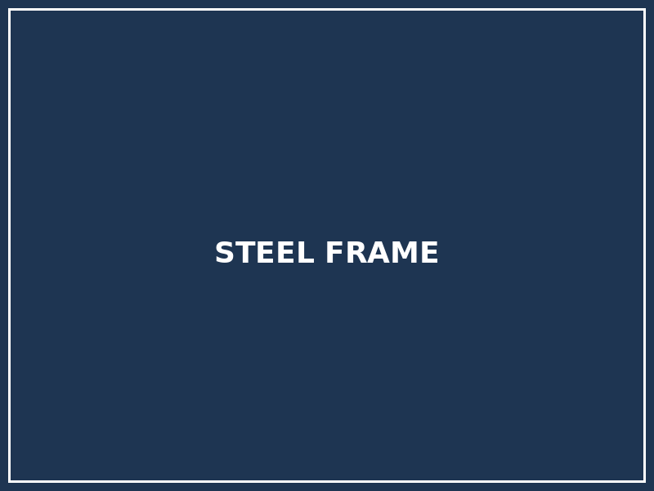
STEEL
19 / 30
Limitations and Failure Risks of Steel
Corrosion, Buckling, Fire, Fatigue, and Thermal Expansion
▪
Corrosion: The Primary Durability Risk
Steel corrodes through electrochemical oxidation in the presence of moisture, oxygen, chlorides, or pollutants. Coastal and industrial environments require high-performance coating systems with 5–15 year maintenance cycles. Undetected corrosion in inaccessible zones is a major long-term structural risk.
▪
Fire-Induced Structural Failure
At 550°C, structural steel retains only ~30% of ambient yield strength; at 700°C, near-complete capacity loss occurs. All steel in fire-risk areas requires protection calibrated to the design fire: intumescent paint, mineral spray, or board encasement. Fire protection is a structural engineering requirement, not a code formality (Lim, 2019).
▪
Stability: Buckling Failure Modes
Steel members fail by flexural buckling (columns), lateral-torsional buckling (beams), and local plate buckling (thin-walled sections) at loads below material yield strength. Slenderness governs design; restraint against lateral-torsional buckling must be provided at regular intervals for beams.
▪
Fatigue Under Cyclic Loading
Repetitive loading (bridges, cranes, wind, machinery) causes fatigue crack initiation and propagation at welds and stress concentrations. Welded connections have lower fatigue resistance than parent metal; fatigue life must be explicitly calculated for all dynamically loaded structural elements.
▪
Thermal Expansion and Movement
Steel expands at ~12 × 10⁻⁶ /°C — approximately 3× masonry and 8× concrete. Long steel structures (>50–60 m) require designed expansion joints. Connections to other materials must accommodate differential thermal movement to prevent stress concentration and joint failure.
◆ Steel's performance under fire, corrosion, and fatigue is entirely manageable — but only when protection and detailing strategies are fully integrated into the structural design, not added as afterthoughts.
Steel frame high-rise under construction — structural steel skeleton Wikimedia Commons | CC BY-SA 4.0
(Lim, 2019; Allen & Iano, 2019)

Slide 21
STEEL
20 / 30
Steel Synthesis: Precision, Span, and the Architecture of Modernity
From Industrial Frames to Sustainable, Demountable Structures
▪
Steel's Definitive Structural Role
Steel enables the spans (20–200+ m), heights (100–800+ m), and structural refinements that define contemporary architecture. The curtain wall tower, the long-span roof, and the cable-stayed bridge are all structurally dependent on steel's tensile capacity, ductility, and precision (Taranath, 2012).
▪
The Sustainability Challenge
High embodied carbon — 1.6–2.8 t CO₂/t steel for virgin production — is the material's primary environmental liability. Minimum material volume through structural optimization, maximum recycled content specification, and design for disassembly are the principal mitigation strategies available now.
▪
Hybrid Structural Solutions
Contemporary practice increasingly combines steel with timber, concrete, and glass — using each material only where its properties are most advantageous. Composite steel-concrete decks, steel-timber hybrid floors, and steel-CLT buildings reduce total material use while optimizing structural performance.
▪
Digital Fabrication and Form
Parametric structural design and robotic fabrication enable steel structures of unprecedented geometric complexity — branching columns, doubly curved trusses, and diagrid exoskeletons — without proportional cost increase, expanding steel's architectural vocabulary significantly.
▪
The Circular Steel Future
Design for disassembly using bolted connections and material passports, combined with green steel (H-DRI) production and high recycled content specification, provides a credible pathway toward dramatically reduced embodied carbon in steel construction by mid-century.
◆ Steel's future is not more steel — it is less, better-placed, longer-lived, and progressively lower-carbon: precision optimization, circular reuse, and green production working together.
Centre Georges Pompidou, Paris (Piano & Rogers, 1977) — exposed steel and services Wikimedia Commons | CC BY-SA 3.0
(De Wolf et al., 2017; Taranath, 2012; Allen & Iano, 2019)

Slide 22
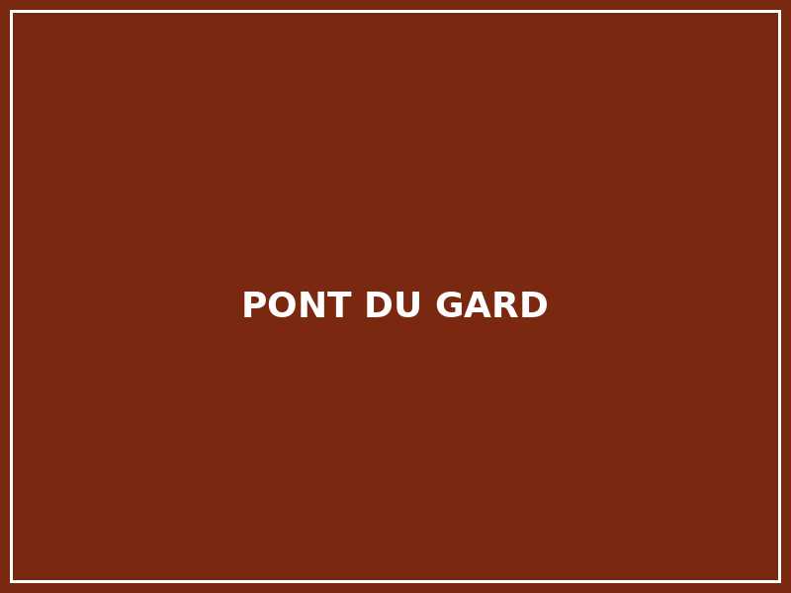
MASONRY
21 / 30
Masonry as a Structural Material
Mass, Compression, and the Architecture of Permanence
▪
Definition and Structural Logic
Masonry is a unit-based compressive system assembled from discrete elements — stone, brick, concrete masonry units (CMU), or adobe — bonded with mortar or dry-stacked. It is the oldest structural tradition in human building history, predating metal and engineered materials by millennia (Hendry et al., 2004).
▪
Compressive Strength, Tensile Weakness
Masonry units resist compression effectively (brick: 20–100 MPa; stone: 50–200 MPa) but have very low tensile capacity (typically 10–20% of compressive strength). This asymmetry shaped the entire history of masonry structural form — from the arch to the vault to the dome — as geometric strategies for eliminating tensile stress.
▪
Thermal Mass
Dense masonry (1,500–2,500 kg/m³) stores thermal energy at 840–1,000 J/kg·K, providing significant thermal mass. A 200 mm brick wall gives 8–12 hours of thermal lag, moderating interior temperatures in climates with large day-night variation — a passive energy-conservation strategy (Allen & Iano, 2019).
▪
Durability and Redundancy
Well-constructed masonry is among the most durable structural systems: Roman brickwork from 2,000 years ago remains structurally functional. The redundant, unit-based assembly means localized damage rarely causes global collapse — a resilience characteristic not shared by monolithic structural systems.
▪
Craft and Local Material
Masonry is historically a craft-based material: bricklaying quality directly affects structural performance. Clay brick, stone, and adobe are typically extracted and produced regionally, reducing transport carbon and strengthening the connection between building material and site geology.
◆ Masonry is compressive architecture: its entire structural vocabulary — arch, vault, buttress, dome — is a geometric solution to the fundamental challenge of spanning with materials that cannot resist tension.
Pont du Gard, France (1st century CE) — Roman stone arch masonry aqueduct Benh LIEU SONG / Wikimedia Commons | CC BY-SA 3.0
(Hendry et al., 2004; Heyman, 1995; Allen & Iano, 2019)

Slide 23
MASONRY
22 / 30
Historical Evolution of Masonry
Stone, Brick, Adobe, and Concrete Block — 10,000 Years of Building Tradition
▪
Prehistoric and Ancient Stone
Neolithic megalithic structures (Stonehenge, Carnac), Mycenaean Cyclopean walls, and Egyptian pyramid masonry demonstrate compressive structural logic at monumental scale. Stone selection, coursing, and mass — rather than mortar or reinforcement — provided structural integrity (Addis, 2007).
▪
Roman Masonry: Arch, Vault, and Concrete
Roman construction combined fired brick, opus reticulatum concrete facing, and pozzolanic lime concrete to build vaults, domes, and aqueducts of unprecedented scale. The Pantheon dome (43.3 m diameter, c. 125 CE) remains the world's largest unreinforced concrete dome (Lancaster, 2005).
▪
Byzantine and Islamic Masonry
Byzantine architecture refined the pendentive dome — transferring circular dome loads to square piers — enabling the Hagia Sophia's 31.3 m dome (537 CE). Islamic masonry combined structural brick, geometric tile, and muqarnas vaulting into integrated tectonic and decorative systems.
▪
Gothic Masonry: Structural Limits
Gothic cathedrals pushed load-bearing stone masonry to its material limits: pointed arches reduce lateral thrust; ribbed vaults concentrate loads on piers; flying buttresses externalize and resolve thrust, enabling thin nave walls and large clerestory windows (Heyman, 1995).
▪
Industrial Brick and Modern Masonry
Industrial brick production (19th century) enabled standardized modular construction at urban scale. The Monadnock Building (Chicago, 1891) reached 16 storeys with load-bearing brick walls — the practical upper limit. Modern masonry includes reinforced CMU, cavity wall systems, and brick façades on structural frames.
◆ The history of masonry is a history of geometric intelligence: each era found new forms — arch, vault, dome, buttress — that redirected tension into compression, expanding masonry's structural range without changing its material logic.
Pont du Gard, France (1st century CE) — Roman stone arch masonry aqueduct Benh LIEU SONG / Wikimedia Commons | CC BY-SA 3.0
(Heyman, 1995; Lancaster, 2005; Addis, 2007)

Slide 24

MASONRY
23 / 30
Material Properties: Compression, Thermal Mass, and Mortar
Compressive Strength, Brittleness, Moisture, and the Structural Role of the Mortar Joint
▪
Compressive Strength Variation
Masonry unit compressive strength varies widely: engineering brick 50–100 MPa; standard clay brick 20–50 MPa; CMU 17–35 MPa; adobe 1–5 MPa. Assembled masonry compressive strength (fk) is significantly lower than unit strength due to mortar joint behavior and stress concentration (Hendry et al., 2004).
▪
Tensile and Shear Weakness
Tensile bond strength of mortar-bonded masonry: typically 0.1–0.5 MPa — approximately 5–10% of compressive strength. Mortar-unit interfaces are the weakest tensile planes; flexural cracking, diagonal shear cracking, and sliding shear at bed joints are the dominant in-plane failure modes.
▪
Mortar Composition and Stiffness
Cement-rich mortars are stronger but stiffer, potentially concentrating stress and increasing cracking risk in older or flexible masonry. Lime-based mortars are weaker but flexible, redistributing stresses across more joints — preferred in conservation and heritage contexts where differential movement is expected (Morton, 2008).
▪
Moisture Movement
Fired clay bricks expand irreversibly after manufacture (moisture expansion). Concrete and autoclaved products (AAC, CMU) exhibit drying shrinkage. Both phenomena generate internal stresses requiring designed movement joints at regular intervals and at changes in wall direction or material.
▪
Thermal Mass Performance
Masonry's thermal storage capacity moderates diurnal temperature swings, reducing peak heating/cooling demand in appropriate climates. A 220 mm solid brick wall provides approximately 8–12 hours of thermal lag — a significant passive climate control benefit in hot-dry and Mediterranean climatic zones (Allen & Iano, 2019).
◆ Mortar is not passive bonding: it governs masonry deformability, crack resistance, and moisture tolerance. The wrong mortar in a repair can cause more damage than the original decay it replaced.
Brick masonry wall — close-up of mortar joints and stretcher bond pattern Wikimedia Commons | CC BY-SA 4.0
(Hendry et al., 2004; Morton, 2008; Allen & Iano, 2019)

Slide 25
MASONRY
24 / 30
Masonry Structural Systems and Load Paths
Bearing Walls, Arches, Vaults, Domes, and Buttresses
▪
Load-Bearing Walls
Masonry bearing walls carry gravity loads through continuous vertical compression from roof to floor to foundation. Wall slenderness ratio (height/thickness) and lateral support conditions govern stability; as height increases without intermediate lateral restraint, buckling governs over material strength (Heyman, 1995).
▪
The Arch: Fundamental Spanning Solution
An arch redirects vertical loads into diagonal compression forces that flow to the abutments. In an arch aligned with the thrust line under its design load, all material is in compression — zero tensile stress. The arch is the geometrically optimal spanning solution for a purely compressive material.
▪
Vault and Dome Geometry
The barrel vault extends the arch longitudinally; the groin vault intersects two barrel vaults at right angles. The dome extends the arch radially, creating three-dimensional compression that generates compressive hoop forces at the crown and potentially tensile hoop forces near the base — the historic cause of dome cracking addressed by iron tension rings (Lancaster, 2005).
▪
Buttresses and Thrust Resolution
Lateral thrust from arches and vaults must be resolved into ground-reaching compression. Massive buttresses absorb thrust through weight and cross-section; Gothic flying buttresses externalize and transmit thrust over the side aisles, enabling thinner nave walls and larger window openings.
▪
Reinforced Masonry
Steel reinforcement placed in grouted masonry cores (vertical) or bed joints (horizontal) fundamentally extends masonry's structural capability to resist bending, tension, and shear — particularly in seismic zones where unreinforced masonry is vulnerable (Hendry et al., 2004).
◆ The arch is not merely a historical form — it is the structurally correct solution for spanning with compressive materials. Every masonry arch built since antiquity obeys the same thrust-line logic.
Pont du Gard, France (1st century CE) — Roman stone arch masonry aqueduct Benh LIEU SONG / Wikimedia Commons | CC BY-SA 3.0
(Heyman, 1995; Lancaster, 2005; Hendry et al., 2004)

Slide 26
MASONRY
25 / 30
Masonry Bonds, Details, and Construction Logic
Bonding Patterns, Cavity Walls, DPC, and Contemporary Digital Fabrication
▪
Bonding Patterns and Structural Function
Brick bonding interlocks units so vertical joints never align continuously through more than one course. Running bond (stretcher bond) is most common; Flemish bond (alternating headers and stretchers) and English bond (alternating header and stretcher courses) create stronger cross-wall interlocking for structural load-bearing applications (Hendry et al., 2004).
▪
Cavity Wall Construction
Post-1940s standard practice separates the outer weathering leaf from the inner structural or thermal leaf with a 50–100 mm cavity, filled with insulation or left as a drained airspace. Wall ties connect the two leaves; thermal break wall ties are required to prevent conductivity-driven condensation.
▪
Damp-Proof Courses and Moisture Control
Horizontal DPC layers at wall base, above ground, and at sill and ledge positions prevent capillary moisture rise and lateral water penetration. DPC positions are structural weak points for differential movement; this zone requires careful detailing and regular inspection and maintenance.
▪
Lintels, Arches, and Opening Edges
Every opening in a masonry wall interrupts the compressive load path; lintels (steel, concrete, or stone) or arches must redistribute loads around openings. The structural behavior of masonry at opening edges — arching action in the masonry above — must be explicitly considered in design.
▪
Robotic and Digital Brick Fabrication
CNC and robotic bricklaying (BUGA Wood Pavilion, Eramus Bridge abutments, and academic prototypes) enable parametric brick patterns — angled, twisted, perforated — at precision impossible by hand, expanding masonry's architectural vocabulary while reducing skilled labor requirements.
◆ Bonding pattern is a structural decision: it determines crack propagation paths, lateral load distribution, and wall rigidity — not just surface texture or historical reference.
Brick masonry wall — close-up of mortar joints and stretcher bond pattern Wikimedia Commons | CC BY-SA 4.0
(Hendry et al., 2004; Allen & Iano, 2019)

Slide 27

MASONRY
26 / 30
Case Study: Pantheon & Hagia Sophia
Compressive Geometry and 2,000 Years of Structural Durability
▪
Pantheon: The World's Greatest Unreinforced Dome
The Pantheon (Rome, c. 125 CE) dome spans 43.3 m — still the world's largest unreinforced concrete dome nearly 2,000 years after construction. The dome is composed of Roman concrete (opus caementicium) with gradually lightened aggregate from base (heavy travertine) to crown (pumice) — a deliberate structural gradient reducing self-weight at maximum curvature (Lancaster, 2005).
▪
Pantheon: Structural Intelligence
The 8.2 m oculus, far from weakening the dome, reduces self-weight where compressive stresses are most critical. Brick arch relieving ribs within the concrete dome redirect concentrated loads to the drum walls. The building has survived with only cosmetic repair for nearly twenty centuries.
▪
Hagia Sophia: Dome on Pendentives
The Hagia Sophia (Istanbul, 537 CE; Anthemius of Tralles) achieves a 31.3 m dome on four pendentives — a spherical triangle geometry that transitions circular dome loads to square pier supports. Semi-domes to east and west buttress the main dome laterally while extending the spatial volume.
▪
Hagia Sophia: 1,500 Years of Structural Intervention
The building has required continuous structural maintenance: Ottoman external buttresses added after earthquake damage; iron tension rings embedded in the dome base; and ongoing monitoring of pier settlements, dome cracks, and material deterioration — a 1,500-year record of structural adaptation.
▪
Lessons for Contemporary Masonry
Both buildings demonstrate that compressive geometry is extraordinarily durable when correctly designed and maintained. They also demonstrate that maintenance is structural engineering: Hagia Sophia's survival depends as much on its Ottoman buttresses as on its original Byzantine geometry.
◆ The Pantheon and Hagia Sophia are not monuments to ancient mysticism — they are proofs of the power of compressive geometry. Correct structural form, with adequate material quality, can outlast civilizations.
Pantheon dome interior, Rome (c. 125 CE) — 43.3 m unreinforced concrete dome with oculus Dave Amos / Wikimedia Commons | CC BY-SA 2.5
(Lancaster, 2005; Heyman, 1995)

Slide 28

MASONRY
27 / 30
Case Study: Monadnock Building & Great Mosque of Djenné
Load-Bearing Masonry at Urban Scale and Adobe Masonry as Living Structure
▪
Monadnock Building: The Structural Limit
The Monadnock Building (Chicago, 1891; Burnham & Root / Holabird & Roche) reached 16 storeys with load-bearing brick walls 1.8 m thick at the base — the practical upper limit of unreinforced masonry for high-rise construction. Its completion in 1893 coincided with the widespread adoption of steel frames; it was the last major tall building designed with bearing masonry walls.
▪
Monadnock: Architecture from Structure
The deep window reveals created by 1.8 m walls, the slight battered base profile, and the projecting cornice all emerge directly from structural necessity — a case of authentic tectonic expression in which the building's architectural character is inseparable from its structural logic.
▪
Great Mosque of Djenné: Adobe and Community
The Great Mosque of Djenné (Mali, rebuilt 1906–1907) is the world's largest adobe (mud brick) structure and a UNESCO World Heritage site. The building is structurally maintained through an annual community repointing festival — a cultural practice in which structural maintenance is social ritual.
▪
Djenné: Climate-Responsive Adobe
Adobe's high thermal mass, low embodied energy, and local material sourcing make it one of the most climate-responsive structural systems in the hot-arid Sahelian climate. The mosque's massive walls moderate extreme diurnal temperature swings, maintaining interior comfort without mechanical systems.
▪
Comparative Insight
Monadnock and Djenné represent opposite ends of the masonry structural spectrum: industrial urban masonry at its structural maximum vs. earth architecture as community infrastructure. Both demonstrate that masonry's structural logic and cultural significance are inseparable.
◆ Masonry's structural character is inseparable from its social and cultural meaning: the Monadnock's thick walls are urban dignity; Djenné's mud walls are community practice. Structure and culture are the same material.
Great Mosque of Djenné, Mali (rebuilt 1907) — UNESCO World Heritage adobe masonry Ruud Zwart / Wikimedia Commons | CC BY-SA 3.0
(Addis, 2007; Heyman, 1995)

Slide 29

MASONRY
28 / 30
Environmental Performance of Masonry
Durability, Local Materials, Thermal Mass, and Life-Cycle Trade-offs
▪
Durability as the Primary Environmental Argument
Well-constructed masonry structures last 200–500+ years with appropriate maintenance. This extraordinary service life amortizes embodied carbon over time spans that no competing structural system reliably achieves, making longevity masonry's strongest life-cycle environmental argument (De Wolf et al., 2017).
▪
Local and Regional Material Sourcing
Clay brick, limestone, sandstone, and adobe are produced and sourced within regional material sheds, significantly reducing transport carbon compared to globally traded structural materials. Local quarrying connects building identity to site geology — a cultural and environmental benefit simultaneously.
▪
Brick Firing Energy
Clay brick firing at 900–1200°C generates approximately 200–300 kg CO₂/t brick — notably higher than concrete block or stabilized earth block. However, this production energy is a one-time investment amortized over centuries of service; in long-lived buildings, the per-year carbon cost becomes very low (Morton, 2008).
▪
Thermal Mass Operational Benefits
Masonry's thermal storage capacity reduces peak heating and cooling loads, lowering operational energy consumption over the building's entire service life. In Mediterranean, hot-dry, and cold-continental climates, passive thermal mass strategies can reduce cooling energy by 20–40% compared to lightweight construction.
▪
Circular Economy: Salvage and Reuse
Salvaged brick and stone have been reused for centuries — Roman bricks appear in medieval church walls throughout Europe. Contemporary urban salvage programs recover and resell structural masonry units for new construction, closing the material cycle with minimal energy expenditure.
◆ Masonry's environmental argument is temporal: its high firing energy is offset by multi-century durability, thermal mass operational benefits, local sourcing, and reuse potential that no other structural material consistently delivers.
Hagia Sophia, Istanbul (Anthemius of Tralles, 537 CE) — masonry dome on pendentives Wikimedia Commons | CC BY-SA 3.0
(De Wolf et al., 2017; Morton, 2008; Allen & Iano, 2019)

Slide 30
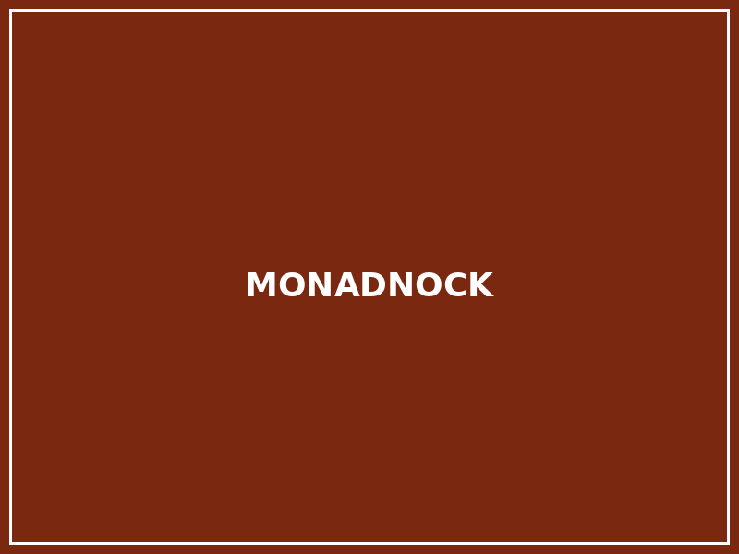
MASONRY
29 / 30
Limitations and Failure Risks of Masonry
Seismic Vulnerability, Tensile Weakness, Moisture, and Differential Settlement
▪
Seismic Vulnerability: The Critical Limitation
Unreinforced masonry (URM) lacks ductility and tensile capacity, making it catastrophically vulnerable to lateral earthquake forces. URM buildings have caused a disproportionate share of earthquake fatalities globally: Christchurch 2011, L'Aquila 2009, and repeated events in Turkey, Iran, and Nepal (Allen & Iano, 2019; Hendry et al., 2004).
▪
Out-of-Plane Wall Failure
Lateral acceleration exceeds masonry wall bending capacity, causing walls to fail out-of-plane — falling outward independently if not tied to floor diaphragms. Inadequate wall-to-floor connection is the most common cause of fatal masonry collapse in earthquakes. Retrofitting with ring beams, floor anchors, and wall ties addresses this mechanism.
▪
Differential Settlement and Cracking
Masonry is a rigid, low-deformability system: differential foundation settlement (from variable soil, shrinkable clay, or undermining) generates diagonal cracking in walls and lintels that may compromise structural load paths. Foundation investigation and, where necessary, underpinning are essential in variable soil conditions.
▪
Moisture Deterioration
Freeze-thaw cycling causes spalling of soft brick and stone; soluble salt crystallization (efflorescence, cryptoflorescence) exfoliates masonry surfaces and weakens mortar joints over time. Rising damp (capillary moisture) deteriorates base courses and internal plaster finishes. Correct DPC, drainage, and periodic repointing are essential.
▪
Inappropriate Repair
Repointing with cement-rich mortars harder than the parent masonry forces moisture movement stress into the brick face, causing spalling and long-term structural deterioration. Conservation repairs must use mortars of matched flexibility and permeability to the original masonry (Morton, 2008).
◆ Unreinforced masonry is the world's most seismically lethal building type: its mass and brittle tensile behavior are catastrophically incompatible with lateral earthquake loading. Retrofitting is essential in seismic zones.
Monadnock Building, Chicago (Burnham & Root, 1891) — 16-storey load-bearing brick masonry Wikimedia Commons | CC BY 2.0
(Hendry et al., 2004; Allen & Iano, 2019; Morton, 2008)

Slide 31
MASONRY
30 / 30
Final Synthesis: Timber, Steel, and Masonry Compared
Three Structural Languages, Three Material Identities, One Decision
▪
Timber: Light, Carbon-Storing, Prefabricated
Timber: light (300–700 kg/m³), carbon-sequestering, prefabricable, biophilic, anisotropic, moisture-sensitive, acoustically demanding. Optimal for: low-to-medium rise construction, hybrid systems, carbon-reduction strategies, buildings where warmth, lightness, and speed of construction are valued. (Ramage et al., 2017)
▪
Steel: Strong, Ductile, Long-Span
Steel: isotropic, high tensile strength (275–690 MPa), ductile, fire- and corrosion-vulnerable, highly recyclable, high embodied carbon. Optimal for: long spans, high-rise structures, infrastructure, seismic systems, and any application requiring high precision and tensile capacity. (Lim, 2019)
▪
Masonry: Massive, Durable, Compressive
Masonry: compressive (20–200 MPa), massive (1,500–2,500 kg/m³), thermally stable, locally sourced, seismically vulnerable, centuries-durable. Optimal for: low-to-medium-rise structures, heritage contexts, thermal mass strategies, façade systems, and environments where permanence and local identity matter. (Hendry et al., 2004)
▪
Hybrid and Combined Strategies
Contemporary best practice rarely chooses a single material for an entire building: CLT floors on steel cores, masonry façades on concrete frames, and glulam roofs on masonry bearing walls all exploit material complementarity. Hybrid construction is synthesis, not compromise — each material positioned where its properties best serve the structural system.
▪
Material Selection as Integrated Decision
Material choice simultaneously determines structural behavior, construction culture, environmental impact, and architectural expression. No material is universally superior; the architect's task is to select the structural language appropriate to the specific combination of structural problem, climate, culture, budget, and responsibility to future generations. (Allen & Iano, 2019)
◆ Material selection is not a technical preference — it is an architectural position. Timber, steel, and masonry each embody a structural logic, a cultural history, and a set of environmental consequences that cannot be separated.
Hagia Sophia, Istanbul (Anthemius of Tralles, 537 CE) — masonry dome on pendentives Wikimedia Commons | CC BY-SA 3.0
(Allen & Iano, 2019; Heyman, 1995; Ramage et al., 2017; De Wolf et al., 2017)

Slide 32
REFERENCES
Selected Academic and Authoritative Sources
[1] Allen, E., & Iano, J. (2019). Fundamentals of Building Construction: Materials and Methods (7th ed.). Hoboken, NJ: Wiley.
[9] Lancaster, L. C. (2005). Concrete Vaulted Construction in Imperial Rome. Cambridge: Cambridge University Press.
[2] Addis, W. (2007). Building: 3000 Years of Design, Engineering and Construction. London: Phaidon.
[10] Lehmann, S. (2012). Sustainable construction for urban infill development using engineered massive wood panel systems. Sustainability, 4(10), 2707–2742.
[3] Billington, D. P. (1983). The Tower and the Bridge: The New Art of Structural Engineering. New York: Basic Books.
[11] Lim, J. (2019). Structural Steel Design (5th ed.). Upper Saddle River, NJ: Pearson.
[4] Buchanan, A. H., & Levine, S. B. (1999). Wood-based building materials and atmospheric carbon emissions. Environmental Science & Policy, 2(6), 427–437.
[12] Morton, J. (2008). Seeing Structures Forum: Stone, Brick and Mortar. The Structural Engineer, 86(15), 13–20.
[5] De Wolf, C., Pomponi, F., & Moncaster, A. (2017). Measuring embodied carbon dioxide equivalent of buildings: A review and critique of current industry practice. Energy and Buildings, 140, 68–80.
[13] Porteous, J., & Kermani, A. (2013). Structural Timber Design to Eurocode 5 (2nd ed.). Oxford: Wiley-Blackwell.
[6] Hendry, A. W., Sinha, B. P., & Davies, S. R. (2004). Design of Masonry Structures (3rd ed.). London: E & FN Spon.
[14] Ramage, M. H., Burridge, H., Busse-Wicher, M., Fereday, G., Reynolds, T., Shah, D. U., … Scherman, O. A. (2017). The wood from the trees: The use of timber in construction. Renewable and Sustainable Energy Reviews, 68, 333–359.
[7] Heyman, J. (1995). The Stone Skeleton: Structural Engineering of Masonry Architecture. Cambridge: Cambridge University Press.
[15] Smith, I., & Frangi, A. (2014). Use of Timber in Tall Multi-Storey Buildings. Zurich: International Association for Bridge and Structural Engineering (IABSE).
[8] Kuzmanovska, I., Miltersen, A., & Kirkegaard, P. H. (2018). Tall timber buildings: Emerging typology challenges. Proceedings of the World Conference on Timber Engineering (WCTE 2018).
[16] Taranath, B. S. (2012). Structural Analysis and Design of Tall Buildings: Steel and Composite Construction. Boca Raton, FL: CRC Press.

