Slide 1
COLLATERAL PLEDGE AND RELEASE
Mohamed Mufazil Lebbai(13C56)
iNautix intern(201203)
May 05,2017

Slide 2


Introduction
Pledge
To lender the actual possession of assets and securities to banks in need of money
Release
To get back the pledged securities and assets from the bank by paying back the dept.
Mohamed Mufazil Lebbai M (13C56)

Slide 3
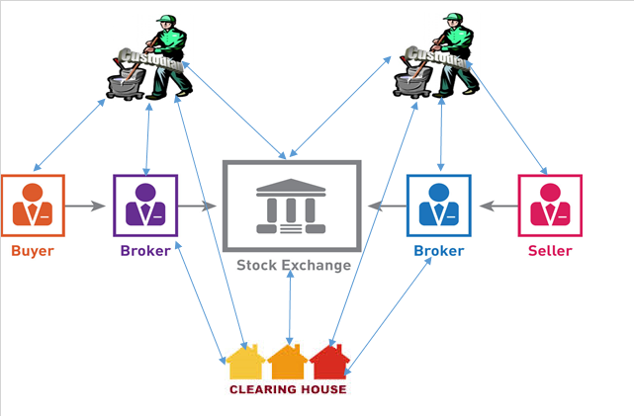
Continued.,
Clearing House
Acts as a backend between the seller and the buyer
Takes care of all the paper works
It takes t+2 days to complete the formalities
Mohamed Mufazil Lebbai M (13C56)

Slide 4
Problem Statement
Pledge a transfer of stocks against a debt
An agreement between the client and the bank.
Managing pledge and release process for a large amount of client is difficult.
Management of several systems to integrate made it more complex.
Mohamed Mufazil Lebbai M (13C56)

Slide 5
Objective
To build a system that will allow clients to initiate their pledging process using SPA(Single Page Application).
Clients can do it using Clearing House
Intermediate Broker Dealer(IBD) takes care of the clients request(pledge or release).
Mohamed Mufazil Lebbai M (13C56)

Slide 6
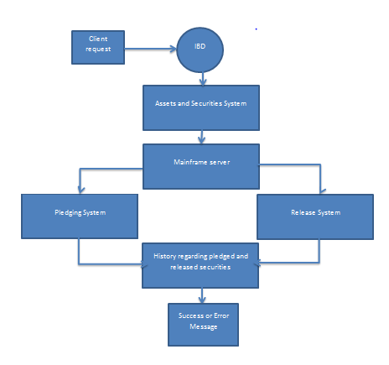
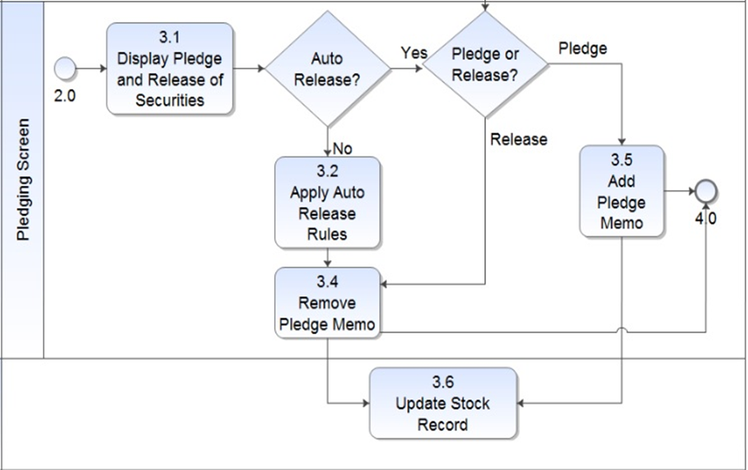
Methodologies
Existing Pledge Process
Proposed and Developed Process
Mohamed Mufazil Lebbai M (13C56)

Slide 7
Continued.,
Existing Pledge Process
Proposed and Developed Process
System 1- Assets and Securities
System 2- Mainframe Server
System 3- Pledging System
System 4- Releasing System
System 5- Containing history regarding pledge and release .
Client cannot access.
All the 5 systems have been integrated in a single page (SPA)
Client access is denied
If pledge cannot be done due to some reasons an error pop-up is thrown.
The pledged securities will be auto released for every 24 hrs.
Penalty will be fired if the client doesnt have enough money to pay the debts
Mohamed Mufazil Lebbai M (13C56)

Slide 8
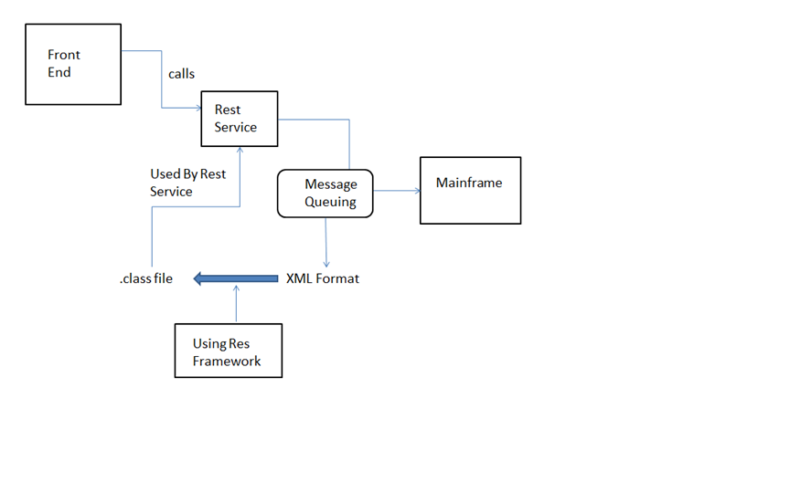
New process work flow
Mohamed Mufazil Lebbai M (13C56)

Slide 9
New process.,
Pledge
Pledge Success
Client Request for pledge
IBD chooses the Securities
Selection of bank
Pledge
Update the record
Mohamed Mufazil Lebbai M (13C56)

Slide 10
Continue.,
Release
Release Success
Client Request for pledge
IBD chooses the Securities
Selection of bank
Release
Update the record
Mohamed Mufazil Lebbai M (13C56)

Slide 11
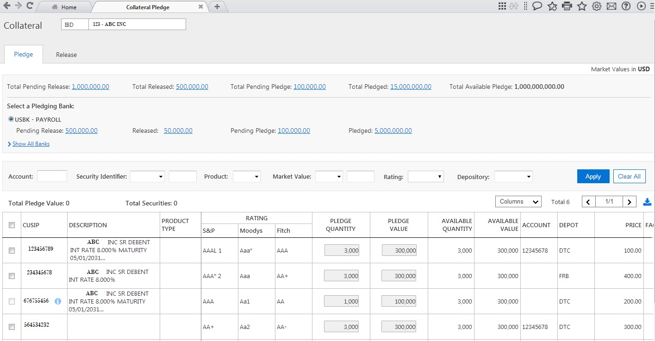
Result- Pledge
Mohamed Mufazil Lebbai M (13C56)

Slide 12
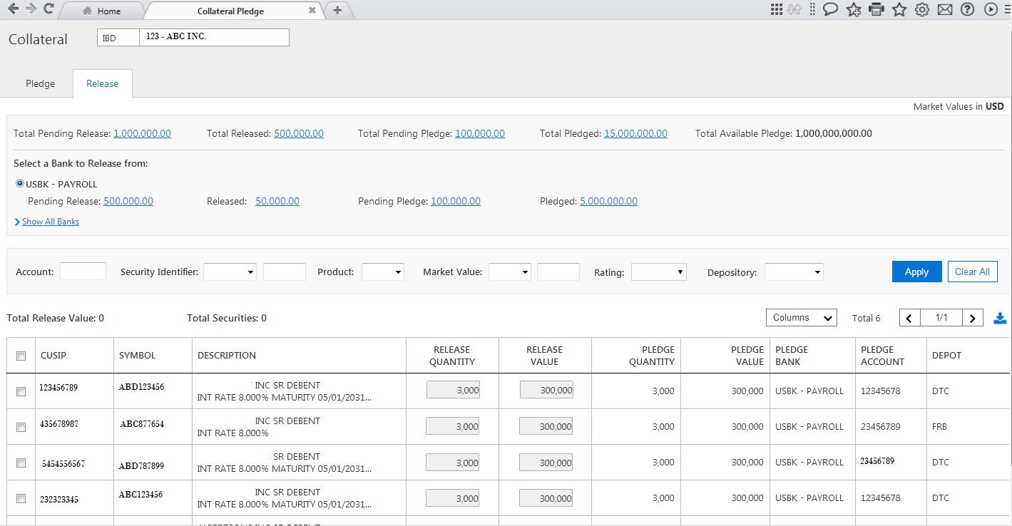
Result- Release
Mohamed Mufazil Lebbai M (13C56)

Slide 13
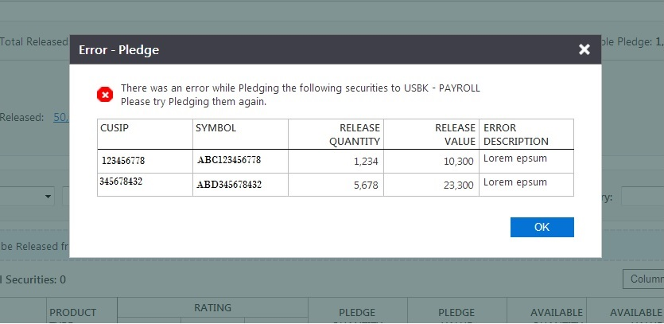
Result- Error
Mohamed Mufazil Lebbai M (13C56)

Slide 14
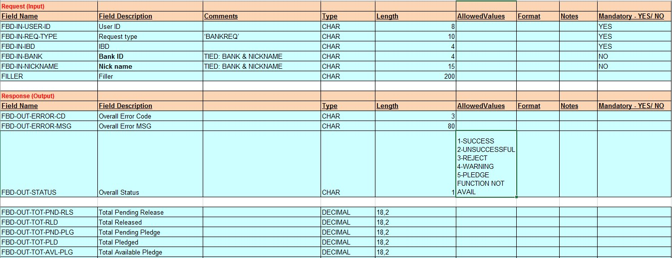
Technologies Used
Front End – Angular 2
Middle Ware – Messaging Queue
Back End - Mainframe
Mohamed Mufazil Lebbai M (13C56)

Slide 15
Conclusion
To ease out the user experience in dealing with the pledging and release process.
This application also displays all the security policies of the software and makes the user interface self-explanatory
This developed module responds to user queries in a fraction of time because of highly sophisticated technologies like Angular JS 2, Node JS .
The best part of the application software is that there is no external agent is required to perform clearing process,.
Mohamed Mufazil Lebbai M (13C56)

Slide 16
References
https://nexenwebcontentmanagement.bnymellon.net/pages/cms-home
https://inautixonline.inautix.com/
https://mysourcesocial.bnymellon.net/groups/campus-hire-induction-program/projects/team-da-vinci
https://www.google.co.in/search?q=netx360&oq=netx3&aqs=chrome.1.69i57j0l5.4238j0j4&sourceid=chrome&ie=UTF-8
https://www2.netx360.com/cgi/inet/loginpage.trn
https://www.pershing.com/netx360/
https://www.pershing.com/_global-assets/pdf/netx360-brochure
https://www.pershing.com/_global-assets/pdf/netx360-premium-content-brochure
Mohamed Mufazil Lebbai M (13C56)

Slide 17
Disclosure
BNY Mellon is the corporate brand of The Bank of New York Mellon Corporation and may be used as a generic term to reference the corporation as a whole and/or its various subsidiaries generally. Products and services may be provided under various brand names in various countries by duly authorized and regulated subsidiaries, affiliates, and joint ventures of The Bank of New York Mellon Corporation. Not all products and services are offered in all countries.
BNY Mellon will not be responsible for updating any information contained within this material and opinions and information contained herein are subject to change without notice.
BNY Mellon assumes no direct or consequential liability for any errors in or reliance upon this material. This material may not be reproduced or disseminated in any form without the express prior written permission of BNY Mellon.
©2017 The Bank of New York Mellon Corporation. All rights reserved.

Slide 18
Thank You
Mohamed Mufazil Lebbai M (13C56)

