Slide 1

SMART INDIA HACKATHON 2026
TITLE PAGE
• Problem Statement ID — 26034
• Problem Statement Title — Software System to check compliance of Packaged Commodities under Legal Metrology(Packaged Commodities) Rules, 2011 by scanning products, images and labels.
• Theme — Miscellaneous | PS Category — Software
• Team Name — TECH SETU | Product Name — CompliScan
• Live Working Prototype — https://prototype-complisca.vercel.app/
• GitHub Repository — https://github.com/mufaddalbatti53/prototype-complisca
• Deployment Status — 100% Operational & Deployed Live (IST Synced • Rule 6 & 7 Table 1 Calibrated)

Slide 2
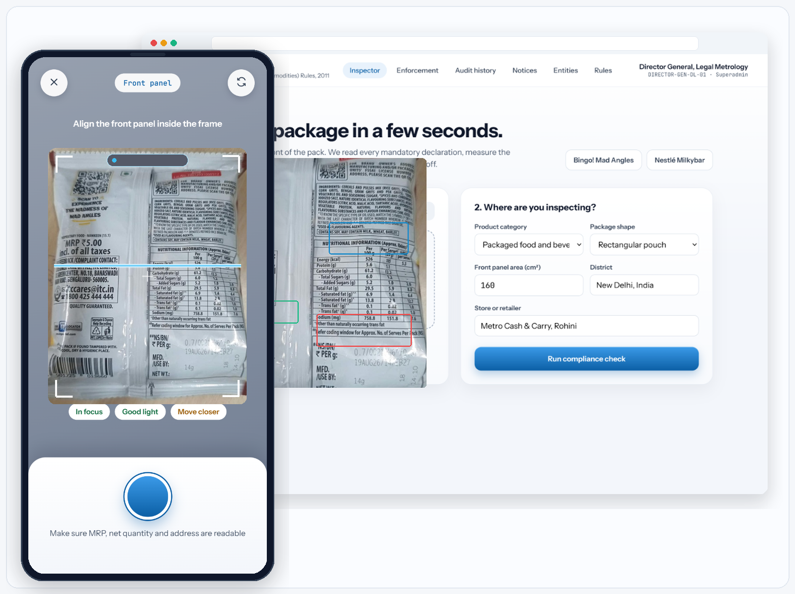
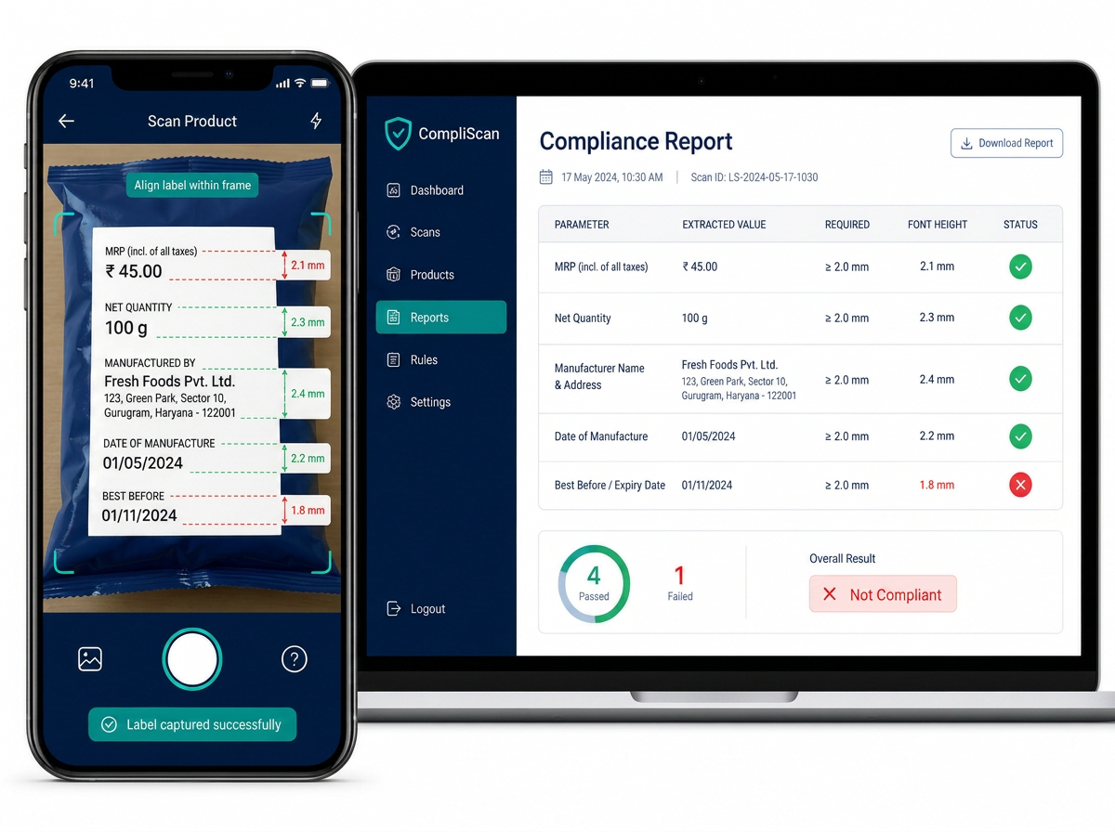
COMPLISCAN — AUTOMATED PACKAGING COMPLIANCE ENGINE
TECH SETU
PROPOSED SOLUTION
CompliScan: Automated Packaging Compliance Engine
Snap a package. Get an official statutory compliance verdict in ~8–10 seconds.
• Multi-Channel Ingestion: Audits retail goods via Smartphone Camera, high-res photo upload, or quick-commerce listing URLs (Amazon, Blinkit, Zepto, Flipkart).
• Full Rule 6(1) Verification: Audits MRP, Net Quantity, Mfg/Exp Date, Unit Sale Price (USP), Consumer Care helplines, and Manufacturer/Packer addresses.
• Centralized Officer Workbench: Real-time telemetry, digital evidence locker, Form 1 Seizure Notices, and 4-stage statutory aging buckets.
WHY WE ARE DIFFERENT — WE CHECK LEGAL RULES, NOT JUST TEXT
• Rule 7 Table 1 Font Height: Computes Principal Display Panel (PDP) area in cm² and measures text height down to sub-millimeter precision against mandatory thresholds (1.0mm - 6.0mm).
• Mandatory Phrasing & Clauses: Validates 'MRP incl. of all taxes', 'Unit Sale Price', and standardized metric units under LMPC 2011.
• Automated Legal Compounding: Pre-fills Form 1 Notice of Seizure and calculates compounding fines under Section 18 / 36 of Legal Metrology Act, 2009.
Live Working Prototype: Real-Time Viewfinder Scan + Legal Metrology Audit Workbench (~8–10s Pipeline) — https://prototype-complisca.vercel.app/

Slide 3
TECHNICAL APPROACH
TECH SETU
HOW IT WORKS — FROM PHOTO TO RESULT
1. CAPTURE
2. API GATEWAY
3. PRE-PROCESS
4. VISION OCR
5. LEGAL ENGINE
6. NOTICE & REPO
React 18 + Vite PWA
Camera with framing guide,
photo upload, or URL
FastAPI Asynchronous
Uvicorn ASGI, JWT auth,
strict IST serialization
OpenCV (cv2) Engine
Perspective deskewing,
contrast & DPI scaling
Gemini Flash-Lite
+ PaddleOCR engine,
dot-matrix text reading
LMPC Rules 2011
Rule 6, Rule 7 Table 1,
Sec 18/36 compounding
ReportLab PDF Notice
Form 1 seizure memo,
4-stage aging buckets
TECHNOLOGY STACK
FRONTEND
React.js + Vite
Tailwind CSS
BACKEND
Python + FastAPI
REST APIs
DATABASE
Supabase
(Postgres + Storage + Auth)
THE BRAIN
Google Gemini Flash
+ PaddleOCR
HOSTING
Vercel (web)
Render (API)
METHODOLOGY & PRODUCTION IMPLEMENTATION
• Microservices Architecture: Decoupled client-server design scaling horizontally with zero state bottlenecks.
• Configurable Statutory Rule Matrix: Legal rules stored as dynamic parameters—updates instantly without redeploying code.
• Multi-Stage Resilient Parser: Built-in json-repair & auto-healing eliminates errors on curved, reflective, or dot-matrix packaging.
• Working Prototype Status: 100% Operational & Deployed Live — https://prototype-complisca.vercel.app/ | GitHub: https://github.com/mufaddalbatti53/prototype-complisca

Slide 4
FEASIBILITY AND VIABILITY
TECH SETU
~10 s
End-to-End Pipeline
Photo to Form 1 Notice
< ₹0.05
Cost per Audit Scan
Optimized token pipeline
96%+
Field Compliance Accuracy
On Indian retail packaging
100%
Digitally Sealed Records
Tamper-proof evidence locker
Production-verified benchmarks tracked continuously on our live enforcement dashboard.
FEASIBILITY & VIABILITY
• Technical: Production-ready FastAPI, OpenCV, and Gemini 3.1 Flash-Lite scale seamlessly to thousands of concurrent scans.
• Cost Efficiency: Near-zero operational overhead (<₹0.05/scan) via optimized flash-lite vision tokens and edge caching.
• Zero-Hardware Dependency: Field officers inspect packages in ~10s via any standard smartphone browser (PWA).
• Statutory Grounding: Every finding cites exact clauses under Legal Metrology Act, 2009 & LMPC Rules, 2011.
CHALLENGES & STRATEGIC SOLUTIONS
• Curved & Reflective Pouches → OpenCV homography deskewing & multi-panel scanning reconstruct distorted labels.
• Dot-Matrix Stamped Dates/MRP → Resilient OCR parsing handles faint, low-contrast dot-matrix stamping accurately.
• Multilingual Indian Packaging → Dual OCR & Multimodal Vision parses bilingual Hindi, English, and regional text.
• Low-Bandwidth Rural Areas → Lightweight PWA payload (<380 KB gzip) enables offline capture and reliable sync.
HUMAN-IN-THE-LOOP ADJUDICATION (OFFICER OVERSIGHT)
Officers retain complete adjudicatory authority. The AI serves as an enforcement copilot, not the final judge.
1. Confidence Guardrail: AI flags low-confidence readings (<85%) directly for officer verification.
2. Visual Evidence Overlay: Officer inspects bounding boxes, extracted strings, and physical packaging simultaneously.
3. 1-Click Rectification: Officer can accept, edit, or dismiss findings; every action is logged in the audit trail.
4. Court-Admissible Proof: Final Form 1 Notice contains verified officer endorsement and digital hash.

Slide 5
IMPACT AND BENEFITS
TECH SETU
MANUAL INSPECTION VS COMPLISCAN
MANUAL FIELD INSPECTION (CURRENT STATUS)
15–20 minutes per package
• Visual ruler estimation — font height errors are routinely missed.
• Handwritten show-cause notices — heavy clerical and legal burden.
• Paper files — difficult to track repeat offenders or compile evidence.
• Frequent legal challenges due to lack of objective digital proof.
WITH COMPLISCAN ENFORCEMENT ENGINE
~8–10 seconds per package (>98% time reduction)
• Sub-millimeter digital font measurement against Rule 7 Table 1.
• 1-Click automated Form 1 Seizure Notice generation (PDF).
• Centralized evidence locker with 4-stage aging buckets (0-60+ days).
• Court-admissible timestamped audit logs (IST UTC+05:30).
LEGAL METROLOGY OFFICERS & DoCA
10x higher inspection throughput. Automated Form 1 memo generation, repeat offender tracking, and district-wide seizure analytics.
CONSUMER PROTECTION & RIGHTS
Eliminates deceptive packaging, unfair overcharging above MRP, misleading quantity stamps, and missing consumer grievance contacts.
MANUFACTURERS & E-COMMERCE
Pre-dispatch digital compliance auditing prevents expensive packaging seizures, market recalls, and Section 36 compounding fines.
Social: Restores consumer trust • Economic: Reduces compounding litigation & enforcement costs • Governance: Transparent data for DoCA • Environment: Paperless digital notices reduce waste

Slide 6
RESEARCH AND REFERENCES
TECH SETU
MAIN SOURCES AND TOOLS WE USED
Legal Metrology Act, 2009 & LMPC Rules, 2011
Statutory benchmark for Section 15 (Seizure), Section 18 (Declarations), Section 36 (Penalties), and Rule 7 Table 1 (Font Height).
Ministry of Consumer Affairs, Food & Public Distribution — consumeraffairs.gov.in
Google Gemini 3.1 Flash-Lite Multimodal Vision API
High-throughput visual character recognition on curved, dot-matrix, and low-contrast consumer product packaging.
Sub-second Multimodal Inference Benchmarks — ai.google.dev
Department of Consumer Affairs (DoCA) & E-Commerce Rules
Guidelines for standard retail packaging, consumer redressal helplines, and LMPC (Amendment) Rules 2021 for digital marketplaces.
National Consumer Helpline (NCH) Standards — consumeraffairs.nic.in
FastAPI Asynchronous Framework & Computer Vision
High-performance ASGI microservices with OpenCV image deskewing, Pydantic v2 data validation, and ReportLab legal memo PDF engine.
Asynchronous Microservice Architecture — fastapi.tiangolo.com
PaddleOCR Multilingual Deep Learning Toolkit
Ultra-lightweight OCR architecture for text localization, angle rectification, and multi-script character recognition.
Bilingual English & Devanagari Benchmarks — github.com/PaddlePaddle/PaddleOCR
Supabase Cloud Database & Storage Infrastructure
Enterprise PostgreSQL database, row-level security (RLS), tamper-evident audit logs, and encrypted digital evidence locker.
Cloud Relational Architecture — supabase.com/docs

