Slide 1
FEATURES OF STOCK MARKET PREDICTION
17BIT055

Slide 2
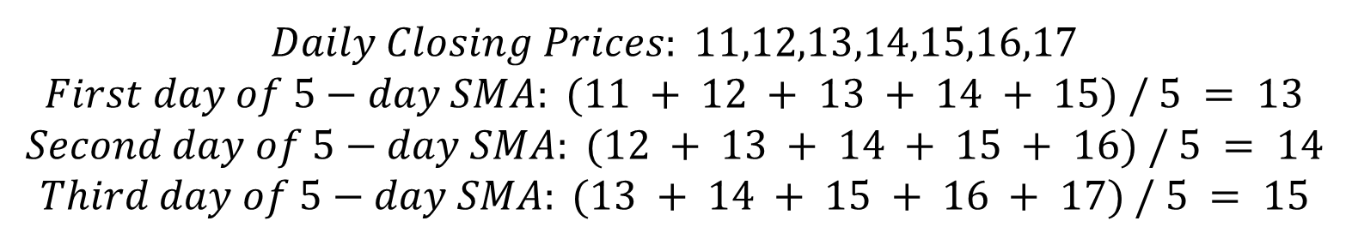
Simple Moving Average
$$Daily Closing Prices: 11,12,13,14,15,16,17$$
$$First day of 5−day SMA: (11 + 12 + 13 + 14 + 15) / 5 = 13$$
$$Second day of 5−day SMA: (12 + 13 + 14 + 15 + 16) / 5 = 14$$
$$Third day of 5−day SMA: (13 + 14 + 15 + 16 + 17) / 5 = 15$$

Slide 3
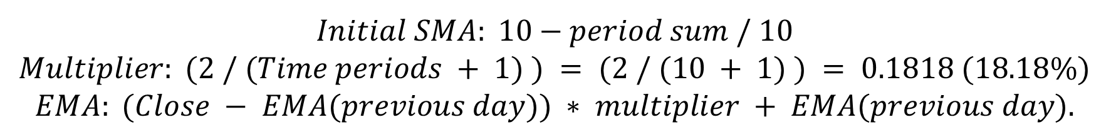
Exponential Moving Average
$$Initial SMA: 10−period sum / 10$$
$$Multiplier: (2 / (Time periods + 1) ) = (2 / (10 + 1) ) = 0.1818 (18.18\%)$$
$$EMA: (Close − EMA(previous day)) ∗ multiplier + EMA(previous day).$$

Slide 4
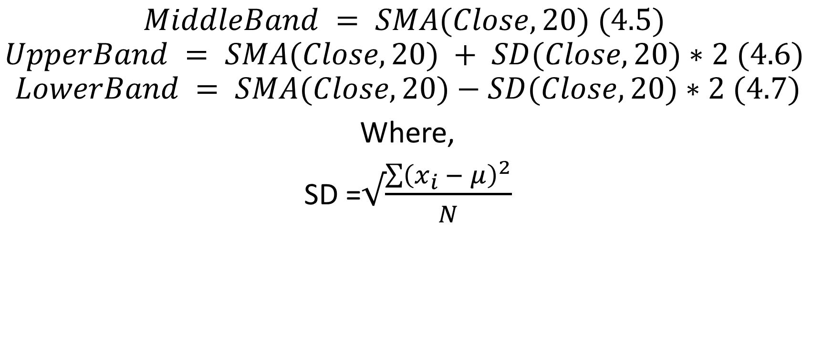
Bollinger Bands
$$MiddleBand = SMA(Close,20) (4.5)$$
$$UpperBand = SMA(Close,20) + SD(Close,20)∗2 (4.6)$$
$$LowerBand = SMA(Close,20)−SD(Close,20)∗2 (4.7)$$
Where,
SD =$√\frac{\sum{{\left(x_{i} − μ\right)}^{2}}}{N}$

Slide 5

Triple Exponential Moving Average
$$TEMA=3∗EMA −3∗EMA\left(EMA\right)+EMA(EMA(EMA))$$

Slide 6

%b
$$\%b= \frac{close−LowerBB}{UpperBB −LowerBB}$$

Slide 7

Moving Average Convergence/Divergence
$$MACDLine=EMA\left(Close,12\right)−EMA(Close,26)$$

Slide 8
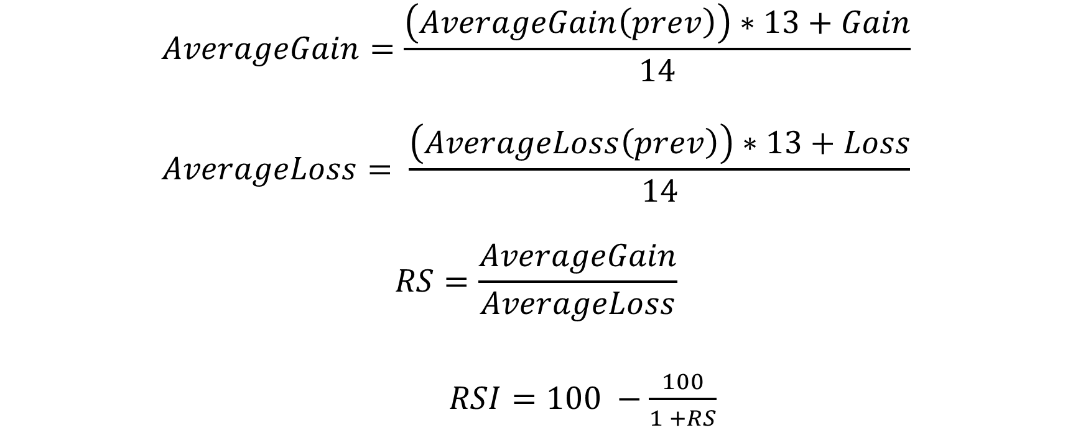
Relative Strength Index
$$AverageGain=\frac{\left(AverageGain\left(prev\right)\right)∗13+Gain}{14}$$
$$AverageLoss= \frac{\left(AverageLoss\left(prev\right)\right)∗13+Loss}{14}$$
$$RS=\frac{AverageGain}{AverageLoss}$$
$RSI=100 −\frac{100}{1 +RS}$

Slide 9
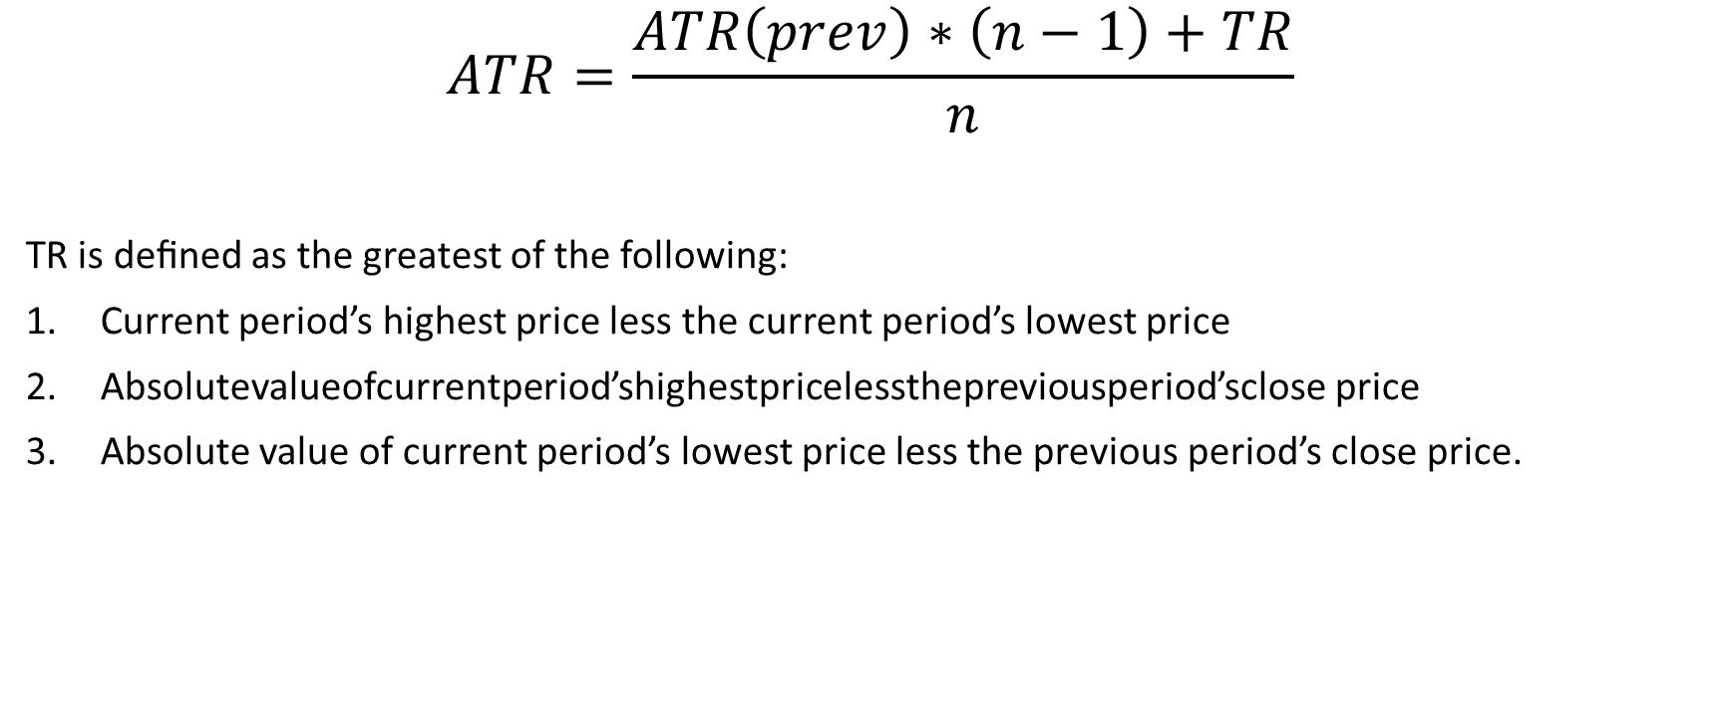
Average True Range
$$ATR=\frac{ATR\left(prev\right)∗\left(n−1\right)+TR}{n}$$
TR is deﬁned as the greatest of the following:
Current period’s highest price less the current period’s lowest price
Absolutevalueofcurrentperiod’shighestpricelessthepreviousperiod’sclose price
Absolute value of current period’s lowest price less the previous period’s close price.

Slide 10

Chandelier Exit
$$ChandelierExit\left(long\right)=Highest\left(Close,22\right)−ATR\left(33\right)∗3$$
$$ChandelierExit\left(short\right)=Lowest\left(Close,22\right)+ATR\left(33\right)∗3$$

Slide 11

Chande Momentum Oscillator
$CMO = ((upSum−downSum)/(upSum+float(downSum)))∗100$

Slide 12
Force Index
$$Force Index = (Close (current period) − Close (prior period)) ∗ Volume$$

Slide 13

Elder-ray
$$Bull Power = Daily High – EMA (of n−periods)$$
$$Bear Power = Daily Low – EMA (of n−periods)$$

Slide 14

Stochastic %k
$$\%k= \frac{close −LL(p)}{HH\left(p\right)−LL(p)}∗100$$

Slide 15

Stochastic %d
$$\%d=SMA(\%k , 3)$$

Slide 16
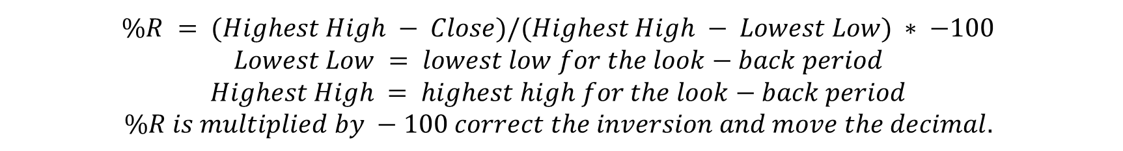
Williams %R
$$\%R = (Highest High − Close)/(Highest High − Lowest Low) ∗ −100$$
$$Lowest Low = lowest low for the look−back period$$
$$Highest High = highest high for the look−back period$$
$$\%R is multiplied by −100 correct the inversion and move the decimal.$$

Slide 17
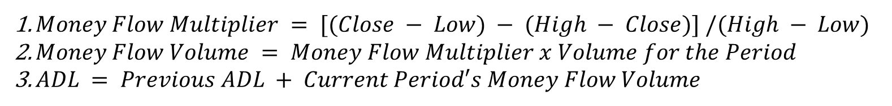
Accumulation Distribution Oscillation
$Money Flow Multiplier = [(Close − Low) − (High − Close)] /(High − Low)$
$Money Flow Volume = Money Flow Multiplier x Volume for the Period$
$ADL = Previous ADL + Current Period′s Money Flow Volume$

Slide 18
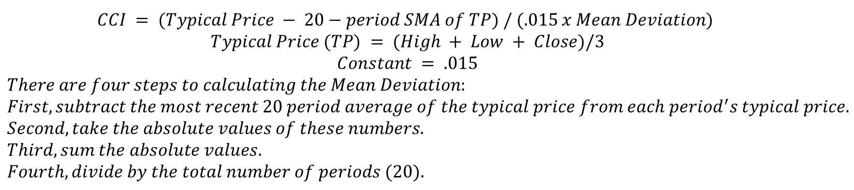
Commodity Channel Index
$$CCI = (Typical Price − 20−period SMA of TP) / (.015 x Mean Deviation)$$
$$Typical Price (TP) = (High + Low + Close)/3$$
$$Constant = .015$$
$$There are four steps to calculating the Mean Deviation:$$
$$First, subtract the most recent 20 period average of the typical price from each period^{′}s typical price.$$
$$Second, take the absolute values of these numbers.$$
$$Third, sum the absolute values.$$
$$Fourth, divide by the total number of periods (20).$$

