Slide 1
Project #543 Visualizing Spatio-Temporal Uncertainty in High-Density Data
Mustafa Bozyel
Senih Kırmaç
Ömer Mert Özel
Project #543

Slide 2
Problem & Motivation
Context + goal
Real-world spatio-temporal data is inherently uncertain (sensor noise, missingness, drift).
Standard dashboards often present values as deterministic, masking uncertainty.
Goal: visualize uncertainty to support safer, more informed decision-making.
Key challenge: communicate uncertainty in high-density data without visual overload.
*Example (to validate): on a city-scale GNSS trace, accuracy varies over time; a single line can hide drift, while uncertainty-aware encodings reveal low-confidence segments.*
Project #543 — Visualizing Spatio-Temporal Uncertainty
2/19

Slide 3
Related Works — Uncertainty Visualization Design Space
Literature
Padilla, Kay, and Hullman (2022): design space of uncertainty visualization techniques.
Distributional graphics (e.g., quantile dot plots, ensemble plots) vs. direct visual encodings.
For high-density spatio-temporal data: prefer density-aware encodings (opacity, blur, gradients) to reduce clutter.
MacEachren et al. (2012): visual semiotics—blur, transparency, fuzziness, and size effectively communicate uncertainty.
Project #543 — Visualizing Spatio-Temporal Uncertainty
3/19

Slide 4
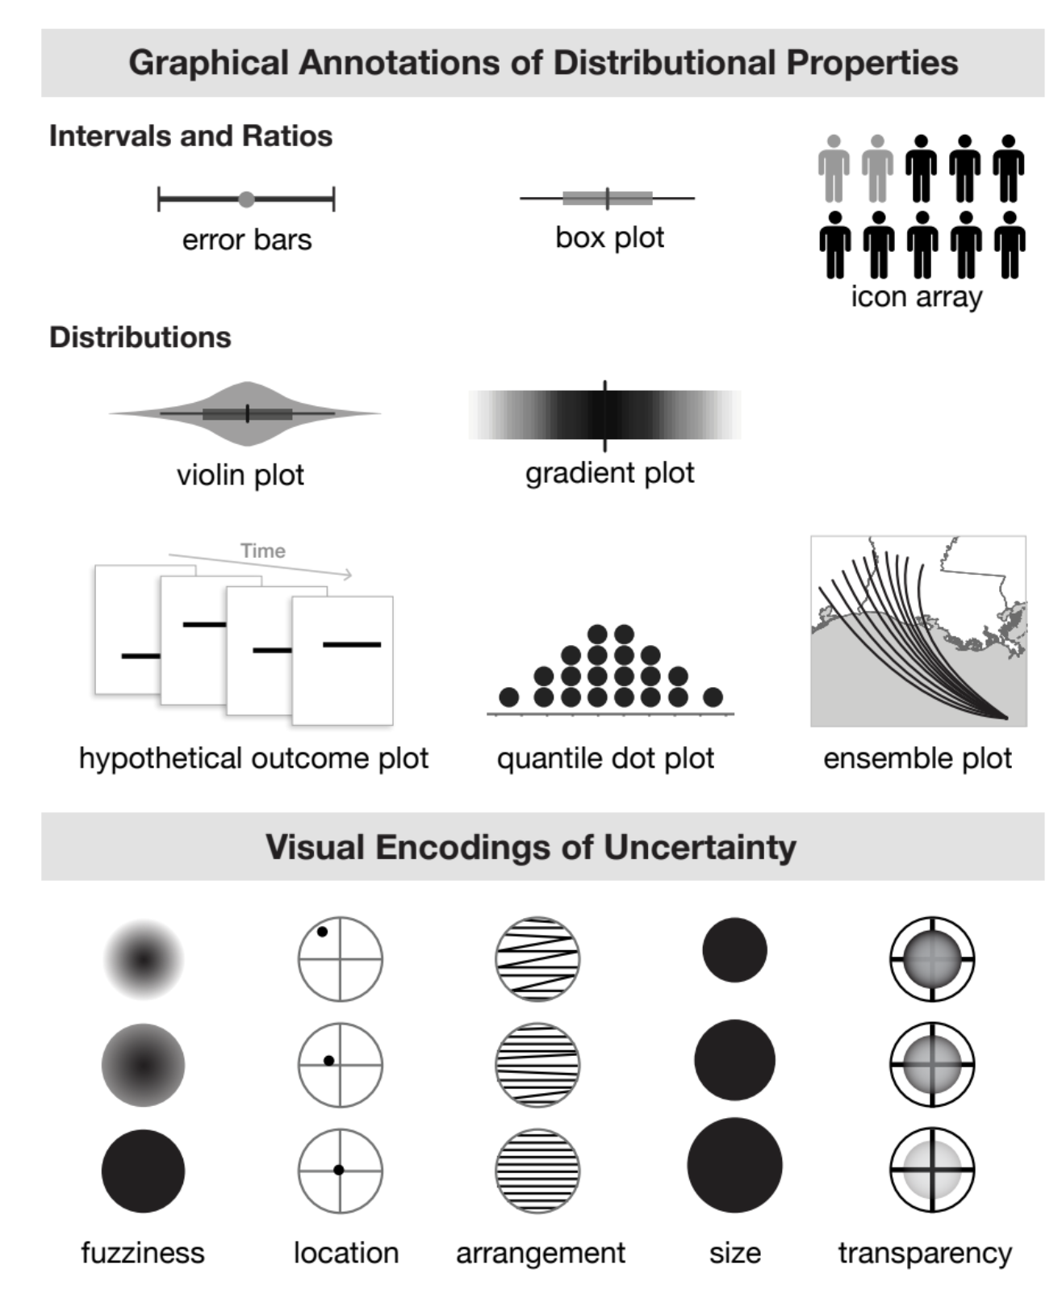
Related Works — Design Space (Padilla et al., 2022)
Literature
Uncertainty visualization techniques and encodings (overview figure).
Project #543 — Visualizing Spatio-Temporal Uncertainty
4/19

Slide 5
Related Works — Spatial Uncertainty & Decision-Oriented Views
Literature
McKenzie et al. (spatial uncertainty examples): uncertainty in map/mobile interfaces.
Common approach: positional uncertainty regions (e.g., circles), enriched with contextual cues.
Risk: hard boundaries can imply false certainty; continuous uncertainty should avoid rigid borders.
Liu et al. (2016): representative sampling / ensemble visualization for multiple possible outcomes.
Implication: uncertainty views must balance clarity, density, and user interpretation.
Project #543 — Visualizing Spatio-Temporal Uncertainty
5/19

Slide 6
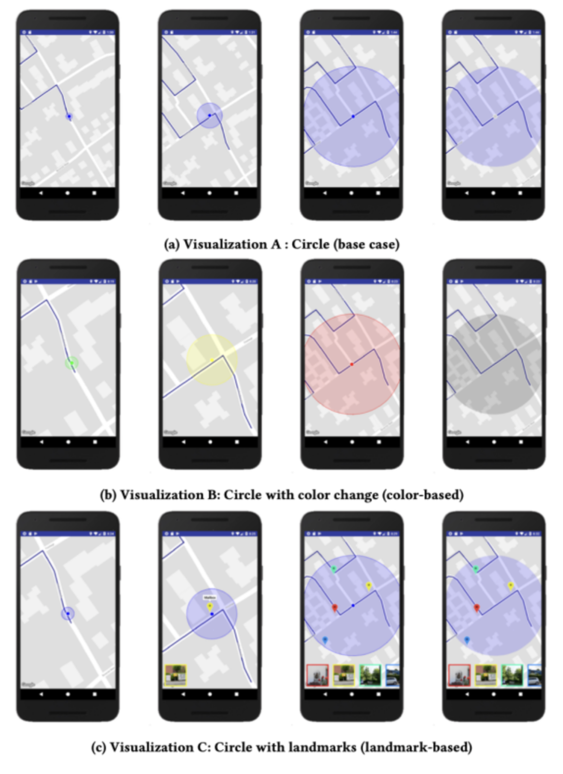
Related Works — Spatial Uncertainty Example
Literature
Example of spatial uncertainty depiction for decision-making contexts.
Project #543 — Visualizing Spatio-Temporal Uncertainty
6/19

Slide 7
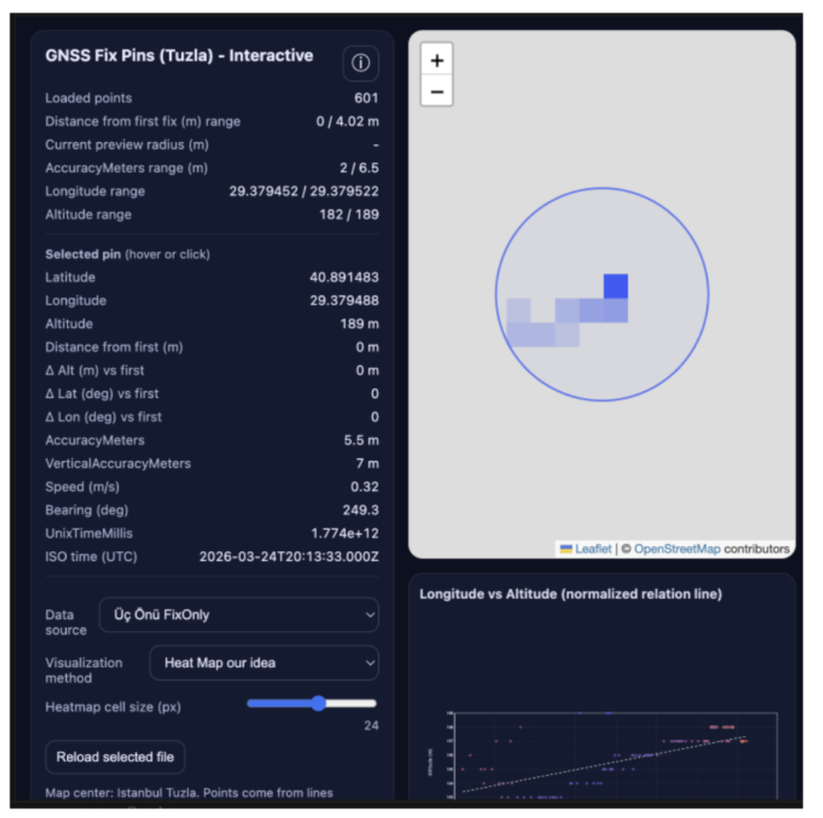
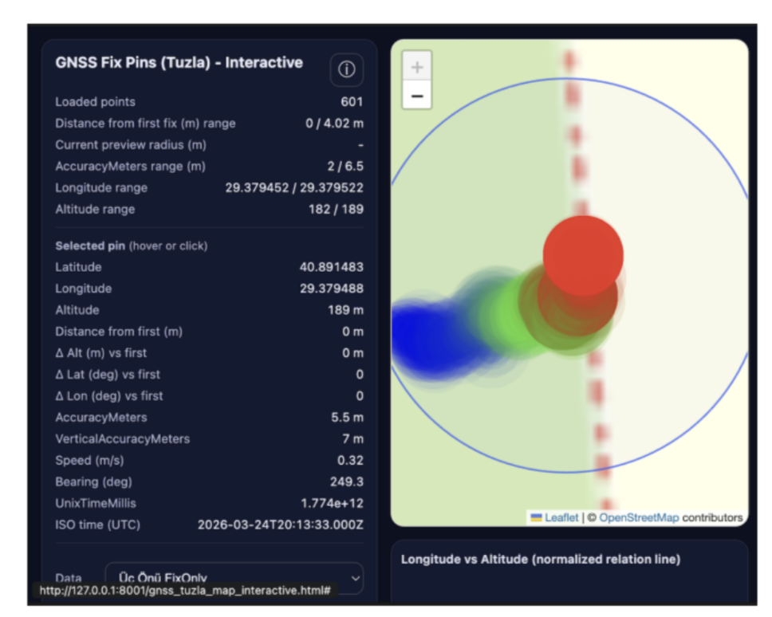
System Overview
Pipeline + prototype views
Raw Spatio-Temporal Data → Preprocessing & Cleaning → Uncertainty Estimation → Visual Encoding Layer → Interactive Dashboard → Decision Support
Raw Data: location + time + observed values
Preprocessing: cleaning, aggregation, temporal alignment
Uncertainty Estimation: confidence, variance, missingness, prediction error
Visual Encoding: opacity, blur, gradients, density-aware views
Dashboard: map, timeline, filters, interaction
Decision Support: identify reliable and uncertain regions
Dense raw point data (high density, overplotting risk).
Uncertainty-aware aggregated view (density/heatmap encoding).
Project #543 — Visualizing Spatio-Temporal Uncertainty
7/19

Slide 8
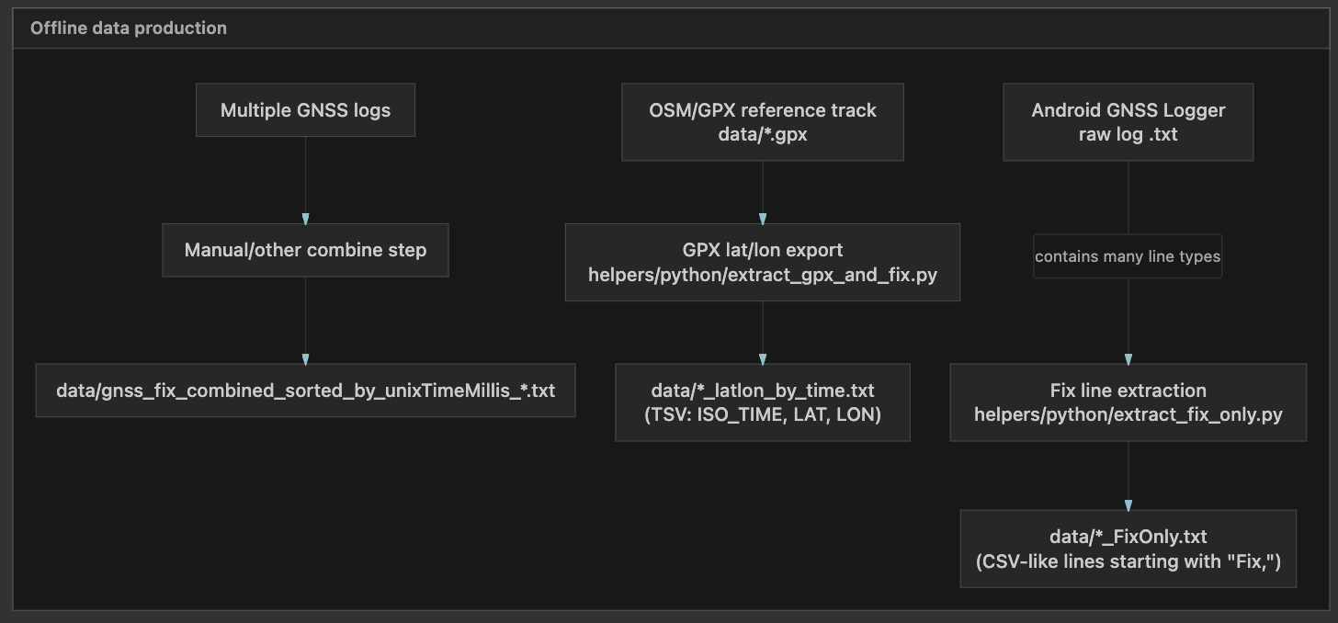
Data Flow Diagram — Data Insertion
Architecture
End-to-end ingestion flow: raw logs → parsing → storage/indexing.
Project #543 — Visualizing Spatio-Temporal Uncertainty
8/19

Slide 9
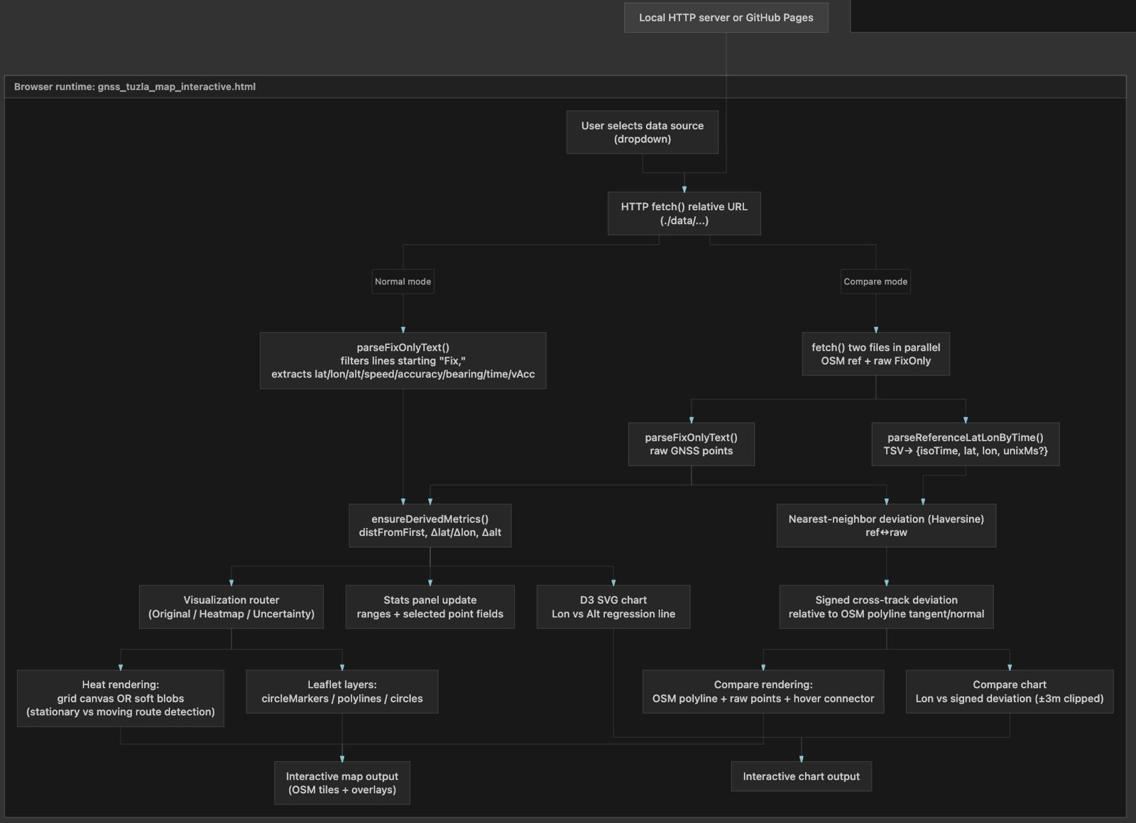
Data Flow Diagram — Operations / Interaction Workflow
Architecture
User operations: filtering, mode selection, comparison, and visual updates.
Project #543 — Visualizing Spatio-Temporal Uncertainty
9/19

Slide 10
Methodology — GNSS Fix Visualization (Leaflet + D3)
Implementation
Ingest Android GNSS Logger data; keep only “Fix,” rows → *_FixOnly.txt (CSV-like).
Optionally load OSM GPX reference exported as *_latlon_by_time.txt (TSV: ISO_TIME, LAT, LON).
Parse Fix fields (lat/lon/alt/speed/accuracy/bearing/UnixTimeMillis/VerticalAccuracyMeters) in a web app via fetch().
Compute derived metrics: Haversine distance-from-first, Δlat/Δlon, and Δalt.
Render multiple views: point map (color=distance, size=accuracy), heatmaps (grid/soft density; 30 m stationary threshold; hover window i±7), and uncertainty rings (radius=AccuracyMeters).
Compare mode: align GNSS vs OSM reference; compute nearest-neighbor deviation and signed cross-track deviation; show on map + D3 chart.
Tools/Tech: Leaflet, D3.js, JavaScript (fetch), and Python preprocessing utilities as needed.
Outputs: interactive map, linked chart (Lon vs Alt / Lon vs deviation), and summary stats panel.
Project #543 — Visualizing Spatio-Temporal Uncertainty
10/19

Slide 11
Validation & Testing — GNSS Fix Visualization (Leaflet + D3)
Quality
Test data / scenarios: stationary and walking traces; with/without OSM reference track; varying fix density and accuracy.
Input validation: accept only well-formed Fix lines (len ≥ 13); skip non-finite lat/lon/alt; treat missing fields as null.
Loading checks: relative URLs (./data/...) for GitHub Pages or local HTTP server; manual upload fallback verified.
Metric sanity: Haversine distance ranges and monotonic distance-from-first checks; validate Δlat/Δlon/Δalt against raw fields.
Visualization testing: Original / Heatmap (mono & BGR) / Uncertainty modes render without errors; 30 m moving threshold enforced; hover i±7 preview stable.
Compare-mode validation: nearest-neighbor and signed cross-track deviation consistent across hover and chart; chart clipping ±3 m applied correctly.
Acceptance criteria: no runtime errors; consistent stats panel ranges; map selection fields match chart values for the same fix index.
Project #543 — Visualizing Spatio-Temporal Uncertainty
11/19

Slide 12
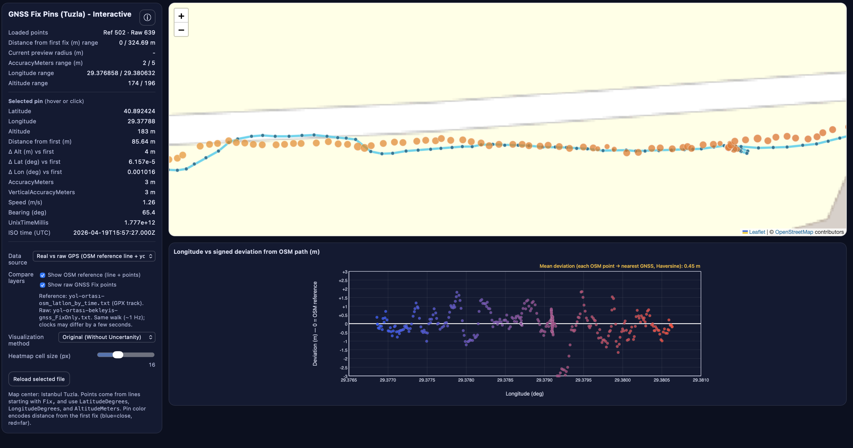
Demo — Reference vs Raw GNSS Comparison
Demo
Comparison of reference track vs raw GNSS; chart shows distance deviation (meters).
Project #543 — Visualizing Spatio-Temporal Uncertainty
12/19

Slide 13
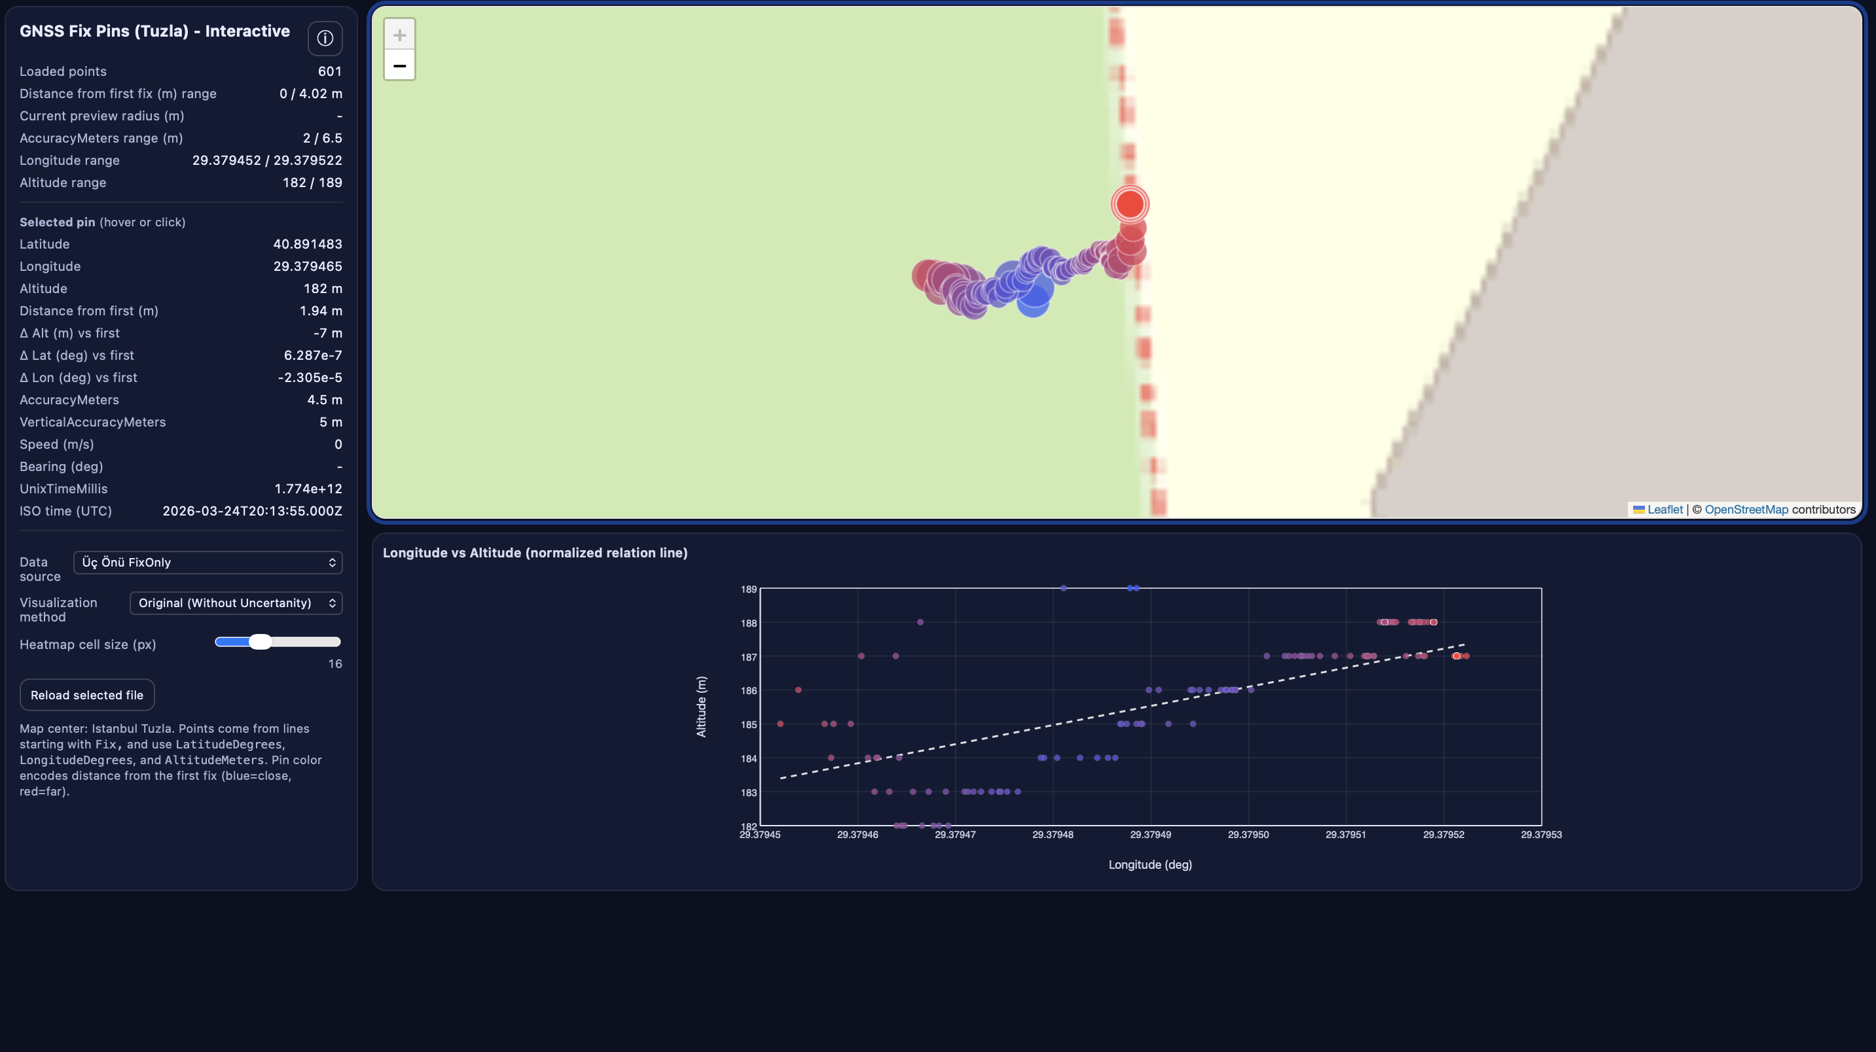
Demo — Deviations in Stationary Data
Demo
Observed drift/deviation patterns while device is stable.
Project #543 — Visualizing Spatio-Temporal Uncertainty
13/19

Slide 14
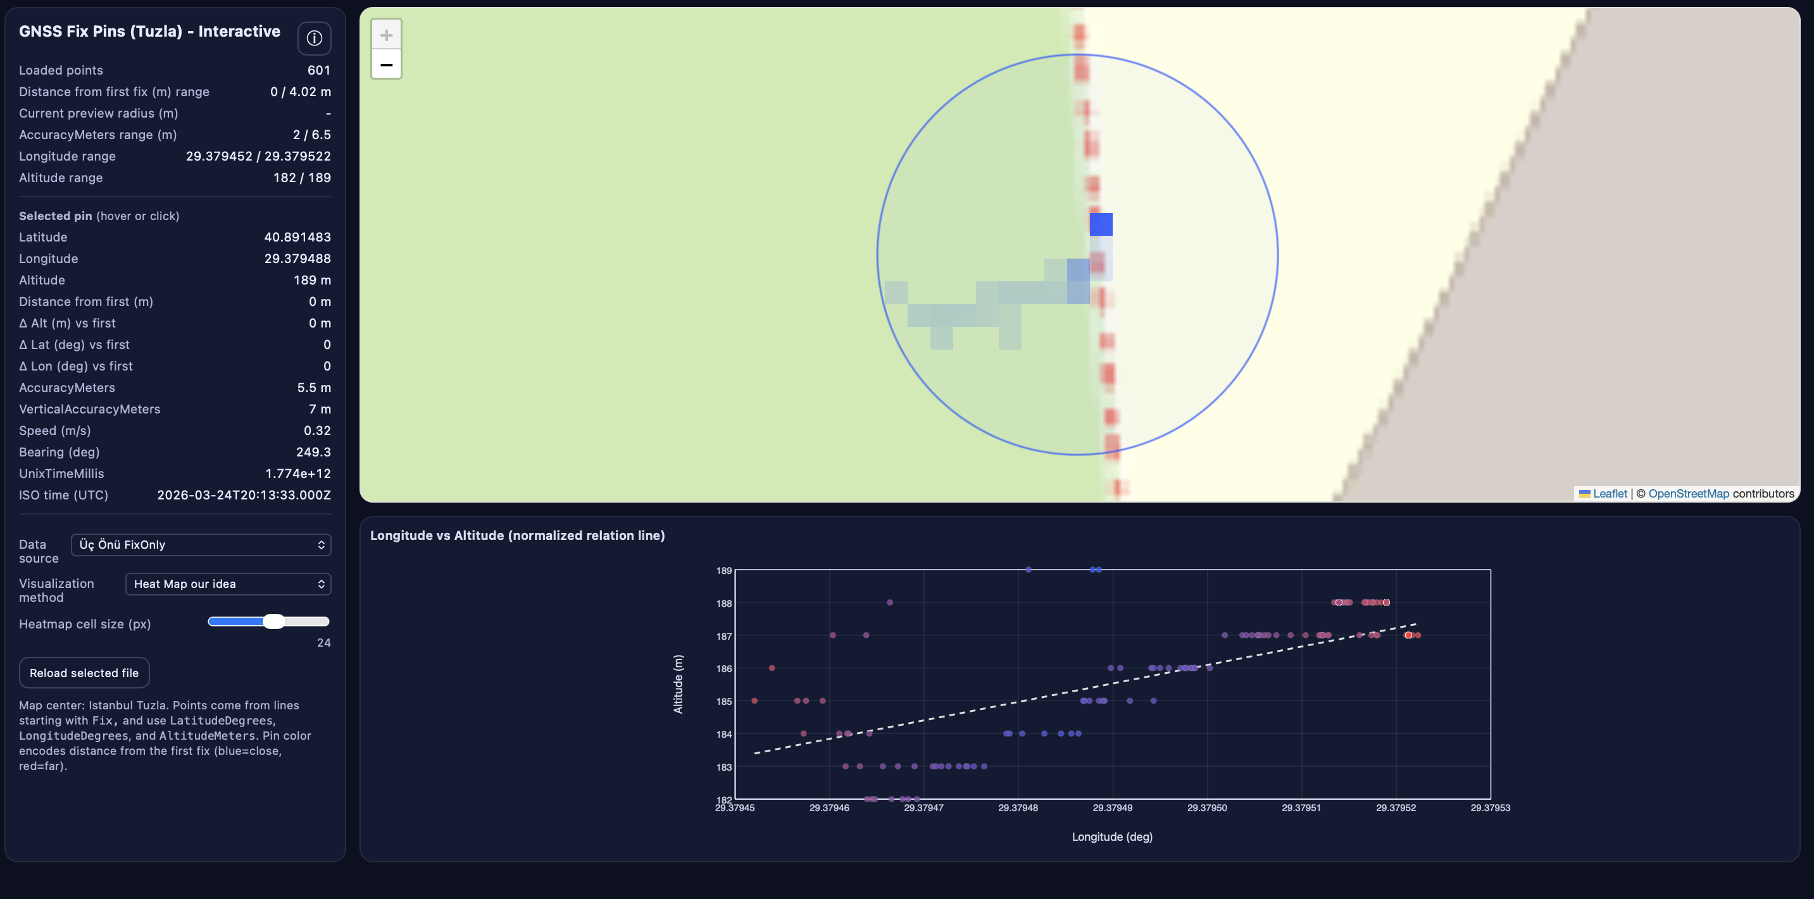
Demo — Uncertainty in Stationary Data (Density / Heatmap)
Demo
Density-based encoding for stationary uncertainty patterns.
Project #543 — Visualizing Spatio-Temporal Uncertainty
14/19

Slide 15
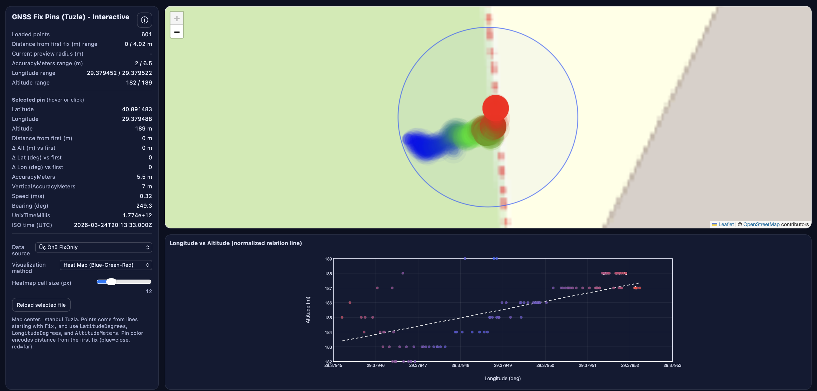
Demo — Uncertainty in Stationary Data (Heatmap)
Demo
Heatmap encoding for stationary uncertainty patterns.
Project #543 — Visualizing Spatio-Temporal Uncertainty
15/19

Slide 16
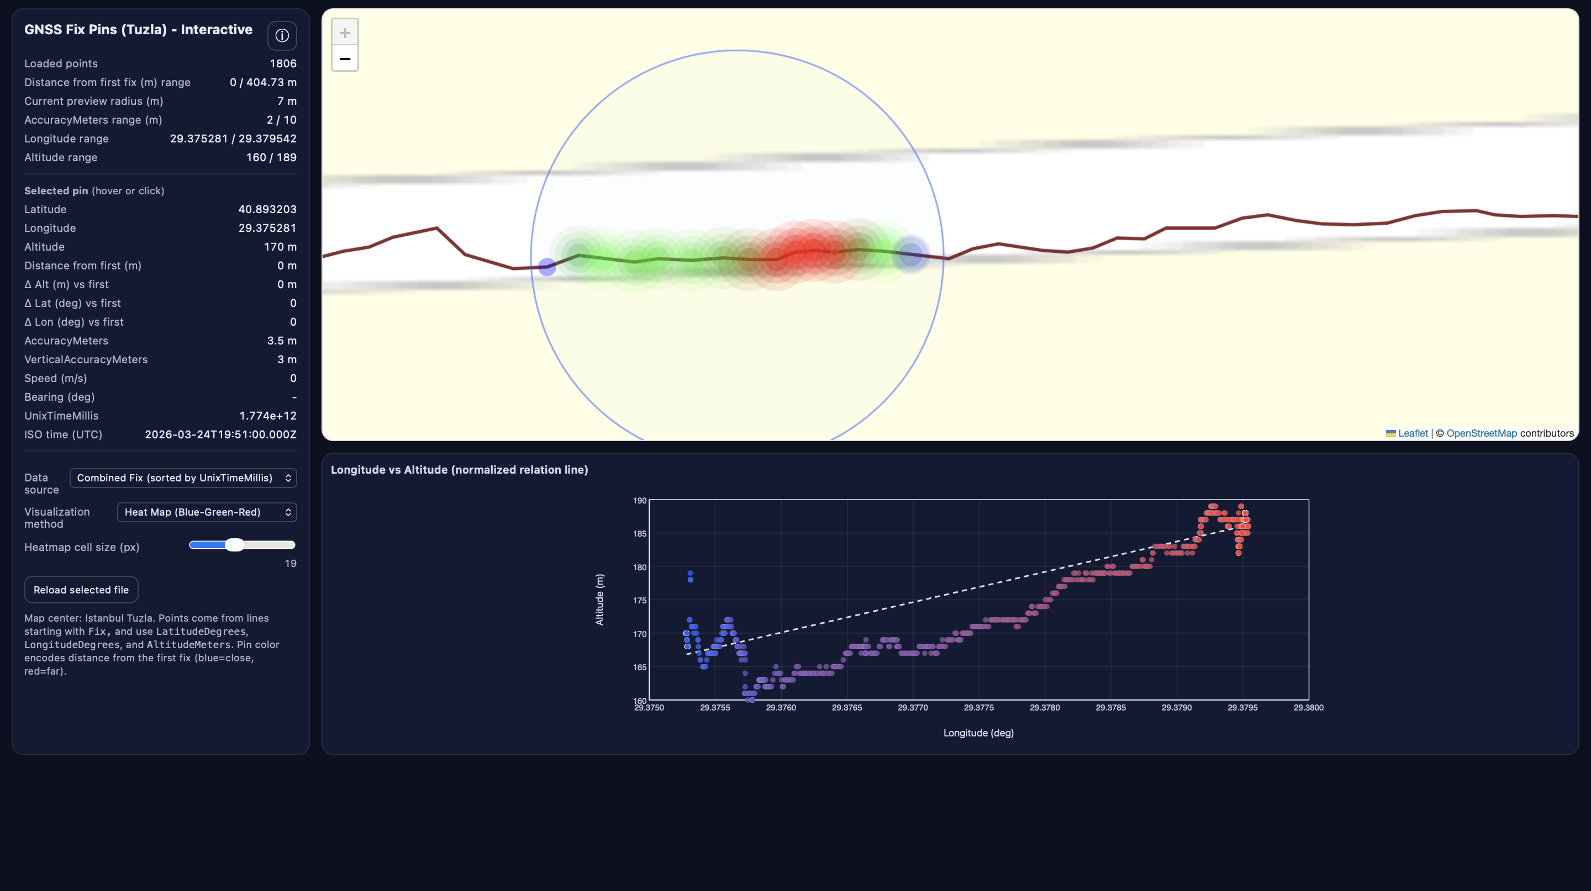
Demo — Walking Data
Demo
Behavior of density/heatmap uncertainty views on walking traces.
Project #543 — Visualizing Spatio-Temporal Uncertainty
16/19

Slide 17
Conclusion
Wrap-up
Built an interactive GNSS fix analysis tool (Leaflet map + D3 chart) for visual exploration.
Parsed and cleaned Android GNSS Logger Fix records; computed derived metrics (distance-from-first, deltas).
Provided multiple perspectives: point view, density/heatmaps, and uncertainty rings.
Enabled reference-based evaluation using OSM track comparison (nearest-neighbor + cross-track deviation).
Improved interpretability of accuracy, drift, and route-level behavior through linked interactions (hover/click).
Project #543 — Visualizing Spatio-Temporal Uncertainty
17/19

Slide 18
Future Work
Wrap-up
Large-scale validation on dense, high-frequency, long-duration datasets (city-scale, many tracks).
Performance: mitigate browser memory pressure and UI lag (many markers / heavy heat computations).
Visualization scaling: address overplotting, zoom-dependent density bias, and detail loss (clustering/tiling).
Data quality: handle time misalignment, outliers/multipath effects, and missing accuracy fields robustly.
Next steps: spatial indexing (grid/k-d tree), vector tiling, incremental/streamed loading, and outlier filtering.
Project #543 — Visualizing Spatio-Temporal Uncertainty
18/19

Slide 19
Thank you
Q&A
Thank you.
Project #543 — Visualizing Spatio-Temporal Uncertainty
19/19

